Slide 1
Disclosure of Medical Errors AND Risk Management

Slide 2
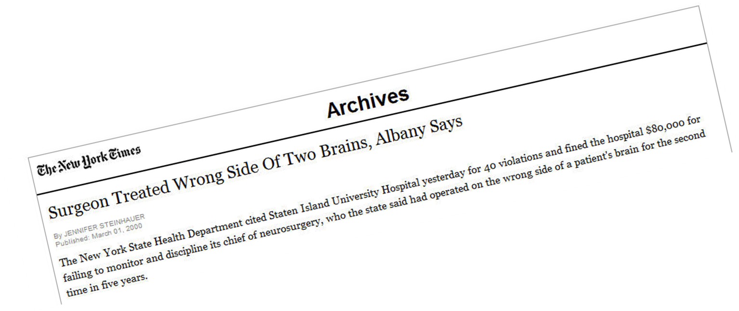
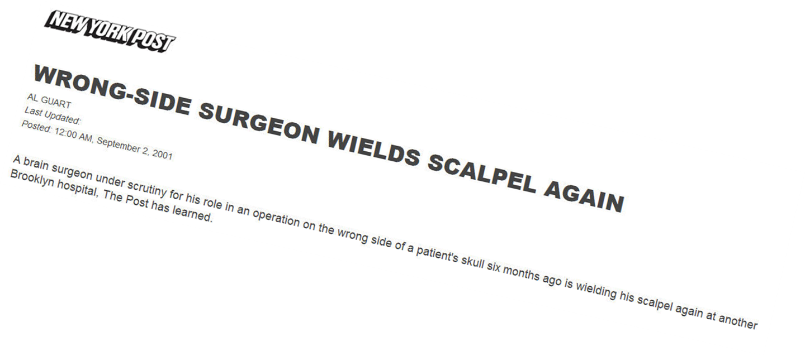

Slide 3
No one makes an error on purpose
Everyone makes mistakes every day
No one admits an error if you
punish them for it.

Slide 4
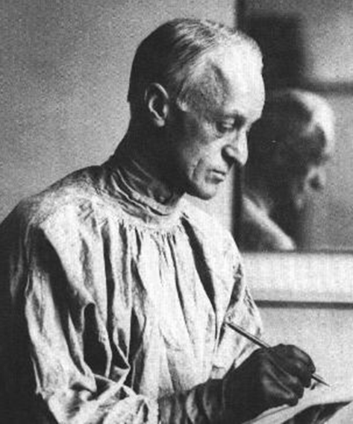
“Cushing openly acknowledged and described significant instances of human error, mistakes in judgment and technique, and equipment and supply oversights, regardless of whether these events affected patient outcome.”

Slide 5
Iceberg Model of Accidents and Errors

Slide 6
Institute of Medicine: “To Err is Human”
98,000 deaths/year
0.2-2% hospitalized patients experience major permanent injury or death secondary to medical care
Vast majority (90%) due to failed systems and procedures, not physician negligence
System flaws set good people up to fail

Slide 7
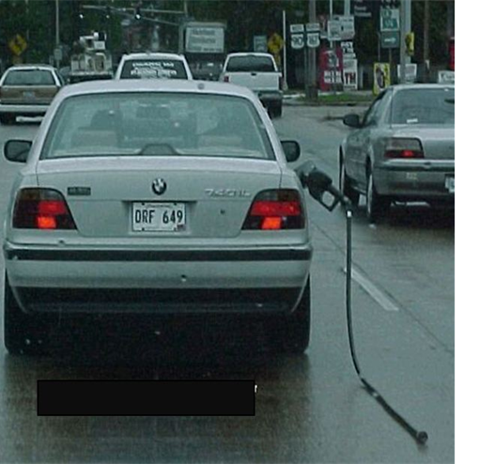
Humans Make Errors
Limited short term memory
Being late or in a hurry
Limited ability to multi-task
Fatigue
Stress
Interruptions
Environment
However most errors are systems related!
Interaction of multiple factors at different levels of a complex system

Slide 8
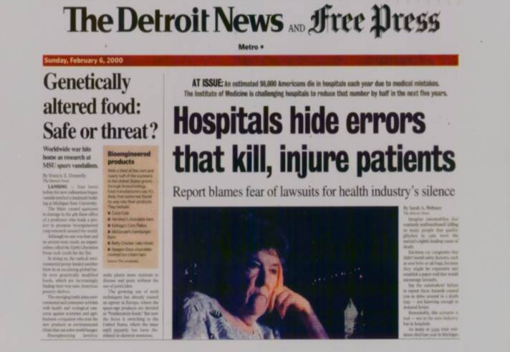
Adverse event: harm related to medical treatment or lack thereof and generally not caused by an error
Medical errors can have a subjective component
Patient’s perspective may be very different than physicians

Slide 9
NEJM 354:21, 2006
“Malpractice suits often result when an unexpected adverse outcome is met with a lack of empathy from physicians and a withholding of essential information”
Health care providers often do not disclose medical errors for fear of lawsuits

Slide 10
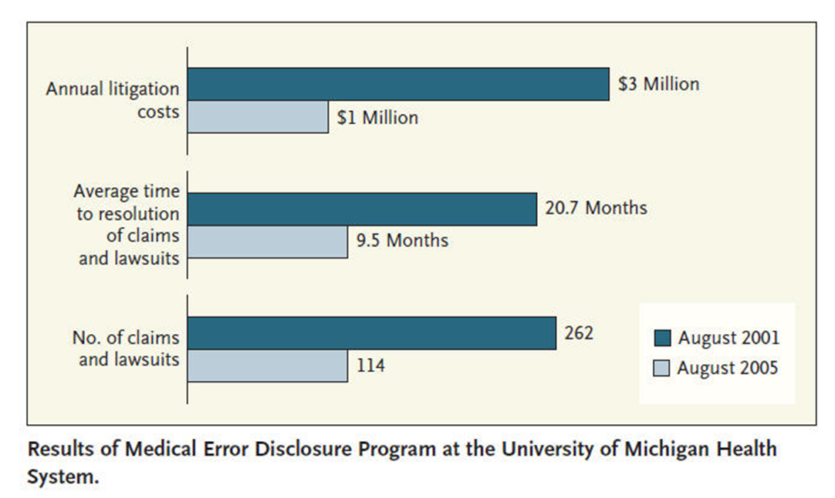
University of Michigan Health System
Medical Error Disclosure Program with Compensation resulted in fewer claims and lawsuits with lower litigation costs.

Slide 11
Disclosure of Adverse Events
National Patient Safety Foundation (2000)
“when a healthcare injury occurs, the patient and the family or representative is entitled to a prompt explanation of how the injury occurred and it’s short and long-term effects. When an error contributed to the injury, the patient and the family should receive a truthful and compassionate explanation about the error and the remedies available to the patient. They should be informed that the factors involved in the injury will be investigated so that steps can be taken to reduce the likelihood of similar injury to other patients.”

Slide 12
Disclosure of Adverse Events
Emotional effects for patient and physician make communication difficult
Communication failures may cause distrust of medical team
Communication should be prompt, compassionate and honest
Error disclosure may reduce a patient’s intention to file a lawsuit

Slide 13
What If…I Make a Mistake
Don’t panic, stay calm
Perform appropriate clinical action to stabilize situation – ask for help if needed
Contact senior residents and/or attending
Hospital risk management
In advance, plan what should be said to patient/family and by whom

Slide 14
Provide information on what happened
Provide apology and expressions of regret
Concern, caring, empathy
Patient’s value an acknowledgment of responsibility
Emphasize individual and system level changes so that recurrences are prevented for other patients

Slide 15
Summary
Disclosure now viewed as responsibility of healthcare team
Communication may be difficult but should be prompt and compassionate
Emphasize system and personal improvements to avoid similar event
Appropriate and timely disclosure may not increase malpractice lawsuit risk

