Slide 1
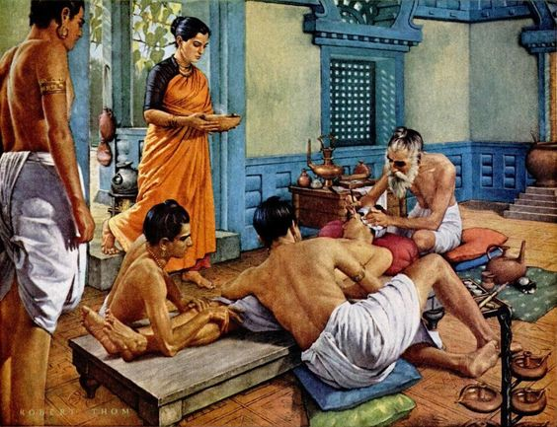
How To Teach Residents to Operate
Laligam N. Sekhar, MD, FACS, FAANS
Professor and Vice Chairman
Department of Neurological Surgery
University of Washington
Sushruta Performing Surgery Circa 1000 BCE

Slide 2
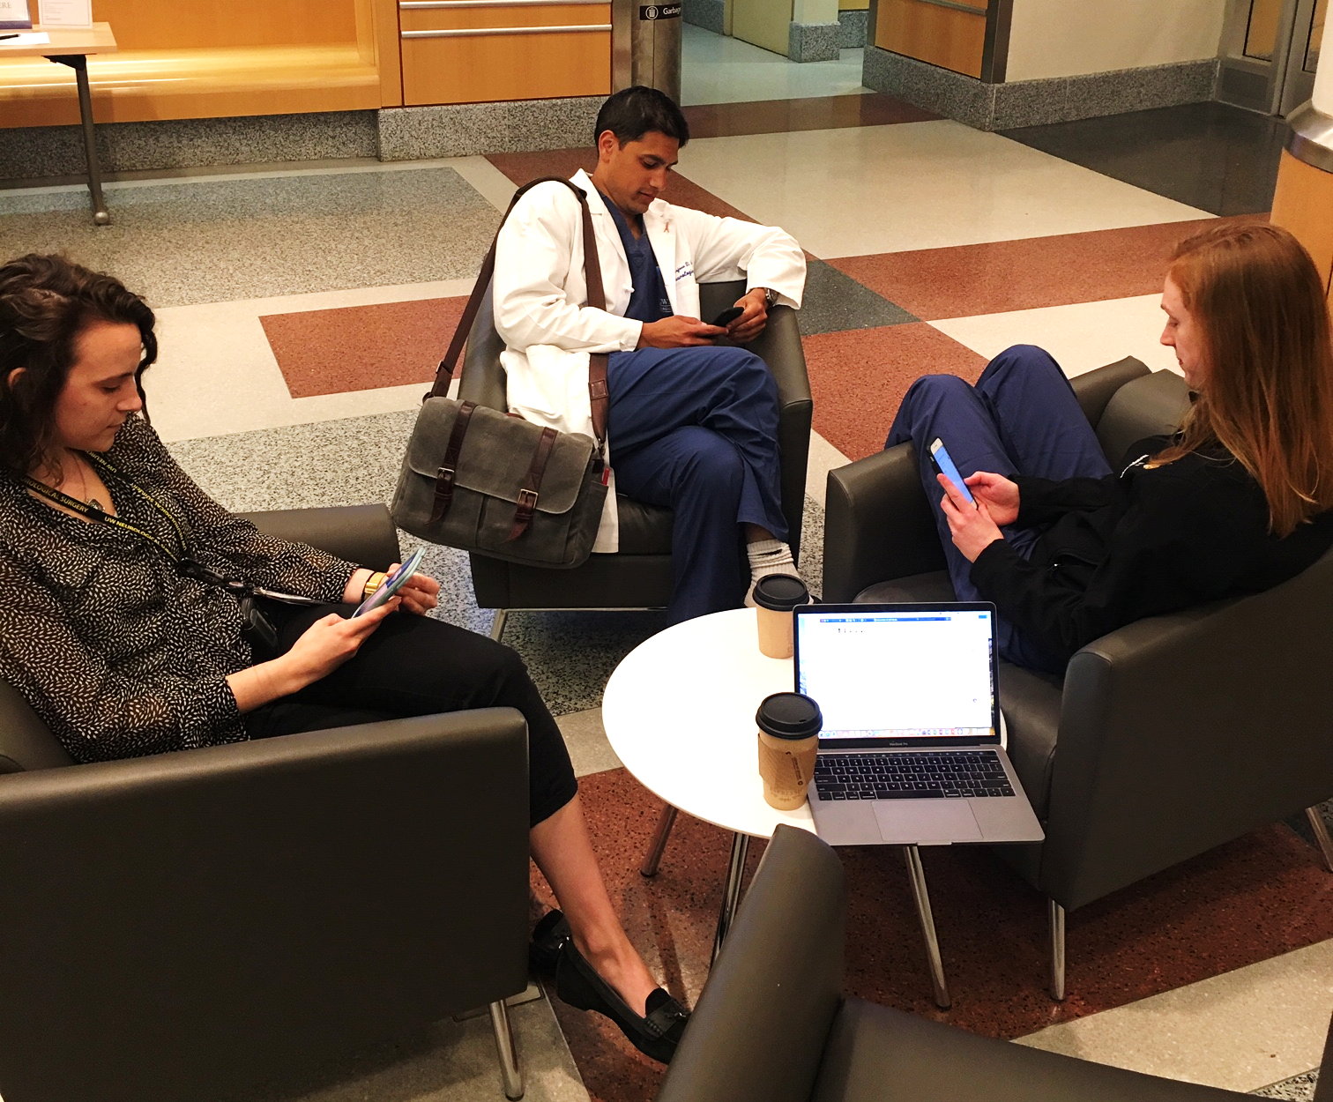
Challenges of Operative Teaching in 2019
Educational:
> Increasing and Changing Complexity and Variety of Procedures e.g. Endoscopic Surgery, Minimally Invasive Spine Surgery, Endovascular Surgery, etc.
> Residents are recruited out of Medical School, without assessment of Technical Skills, Endurance, and Reaction to Stress
> 80 Hour Work Week: ±
Millennial Generation:
> Shorter Attention Span; Less Motivation than 20 years ago??, More Focus on Social Sphere
Attending Surgeons:
> Greater Scrutiny By Hospitals: Outcomes of procedures, Time Taken for Operations, Length of Stay, etc.
> Patient Care vs. Resident Teaching: Ethical Dilemma
> Competitors in our cities may create some rumors about “resident surgery” if patients see them in second opinion
Patients :
> Often Ask: “Will You Do the Operation, Doctor, or some student?”
> May have researched the Internet, and have a lot of Information, or Misinformation

Slide 3
Methods of Teaching
“Show One, Do One, Teach One” William Halstead 1890 : Not Applicable Any More
The 4 Stage Zwisch Model (developed by Zwischenberger at the Univ. Kentucky)
1. Show and Tell: Surgeon Shows How to Do the Procedure
2. Smart Help: Surgeon becomes the Assistant, but leads the resident
3. Dumb Help: Follows the Resident’s lead; advises regarding technique refinement
4. No Help: Provides No Unsolicited Advice; Monitors Progress; Not applicable to Neurosurgical cases in the Present Day
DeRosa DA, Zwischenberger JB, et al. J Surg Educ. 70; 24-30, 2013

Slide 4
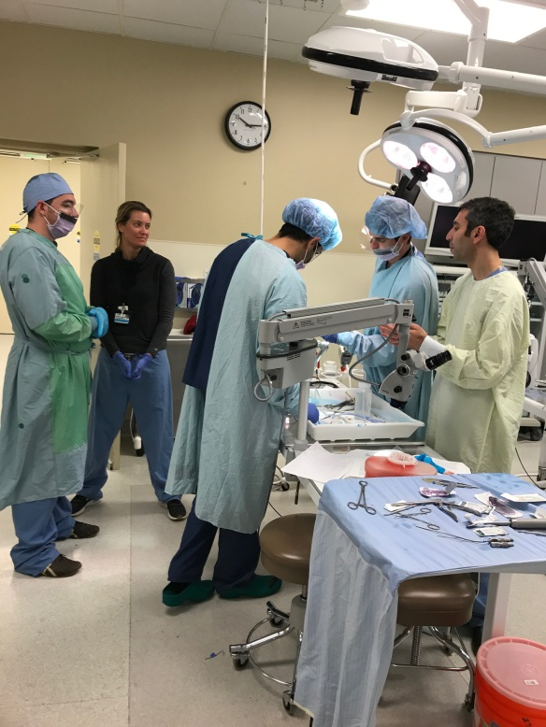
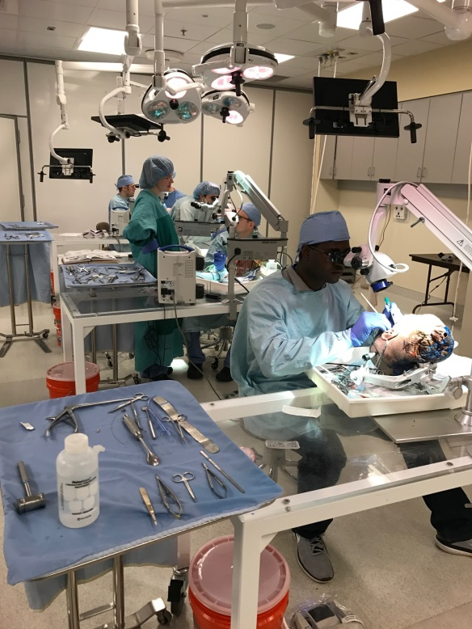
Skills Training In Cadavers
Boot Camp: Craniotomy, Ventriculostomy, etc. (Nationally Sponsored)
WISH Lab at the University of Washington- HMC
Extensive struggle by LNS, and RGE for 4 years
Constructed at An Approximate Cost of 4 Million Dollars
Industry Sponsorship of Equipment and Educational Courses
9 Operative Stations: For Prosection, and Dissection
Dedicated 1 day courses for Residents/ Fellows (7 -8 /year):
Skull Base; Vascular; Micro anastomosis; Brain Anatomy; Spinal Procedures; Minimally Invasive Spinal Surgery
Residents Paired According to Level of Training
Faculty Leadership, and Active Teaching
Visiting Professors
Focused on Skills Training of Residents, Improving the Safety for our Patients
Additional Dedicated Dissection Room for Neurosurgery Residents/ Fellows
Residents and Fellows Encouraged to Work there in their Own time to Perfect Surgical Skills
Self- Directed Training Before/ After Critical Operations

Slide 5
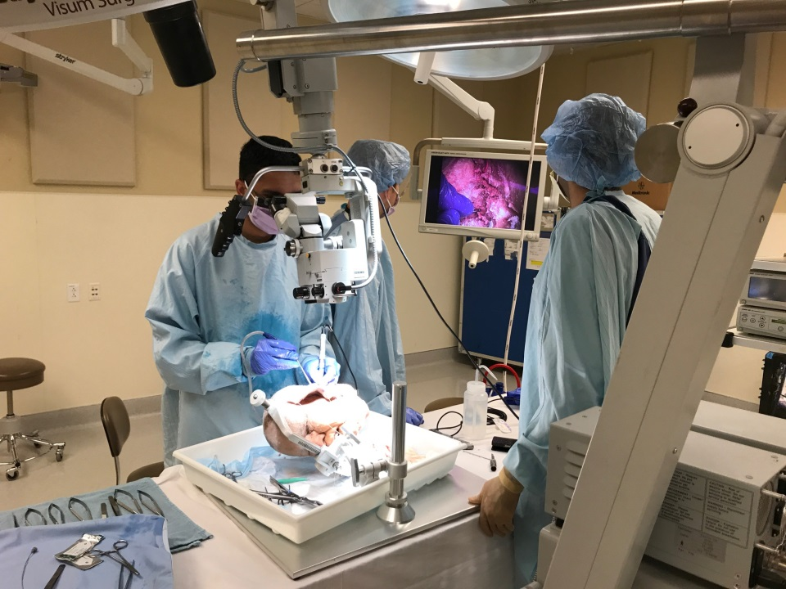
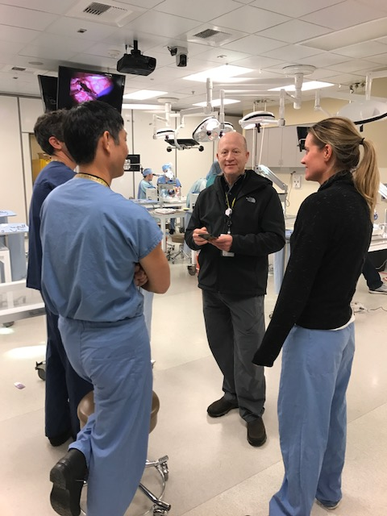
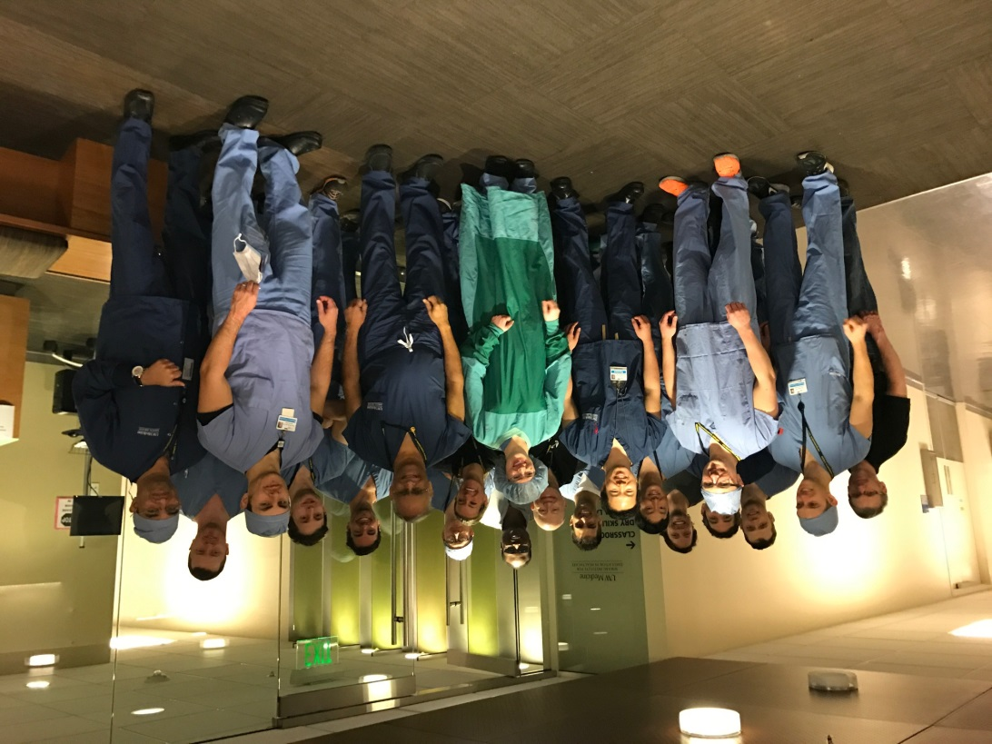
Dedicated Course Coordinator (AH)
Applies for Grants, plans fine details
Industry Sponsorship
Staff Support
Course Director; co-directors; faculty
Course Curriculum
Teaching, Evaluation on the spot
Attendance Required unless death,
marriage, or birth intervene

Slide 6
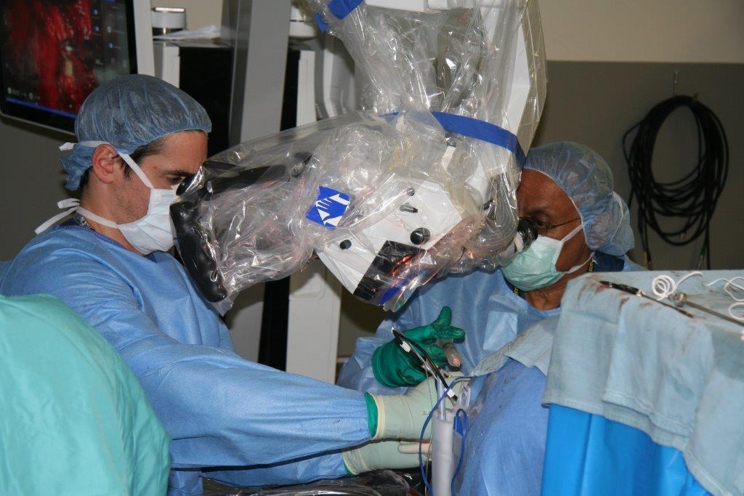
Operating Room : Teaching Surgeon
“Surgery is an Art More than a Science;
You must Master Anatomy to Master Surgery”
Evandro De Oliveira
Lead By Example
Emphasize Team Work
Treat Every One with Respect
Surgery is Not Just Science, But more of an Art
Respond to Crisis Situations with Calmness, Prayer, and Leadership
Patient Safety Supersedes Teaching
Your Residents, Fellows, and Students are your Legacy
Direct them to the Right Learning Materials
Some will be more talented than others
“Hunger to Learn” is important

Slide 7
Step- wise Teaching of Operations
Weekly Preoperative Conference (at each hospital)
Specific Case: Preoperative Discussion About Indications, Strategy, Technique
Resident Must Read up on Procedure, Reviews Videos, etc.
Have Pertinent Films Up, Participates in Preoperative Discussion with Anesthesia, Nursing, Monitoring, etc.
Patient Positioning
Opening the Wound
Steps in Procedure, Timed (e.g) Opening Sylvian Fissure, Exposure of Lesion Under the Microscope – Attending Supervises Directly or Indirectly
Critical Portions of Procedure e.g. Dissection and Clipping of Aneurysm – Attending Performs with Resident Help, or Guides the Resident
Closure Without Complications, Cosmetically Pleasing
Postoperative Debrief – (as needed)

Slide 8
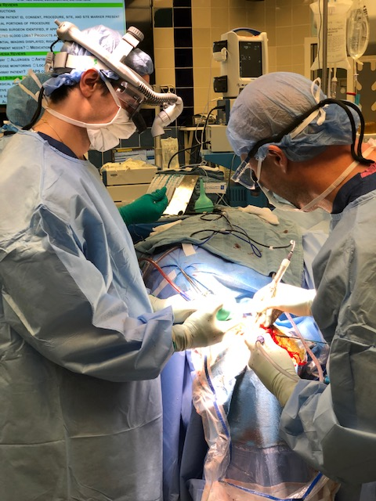
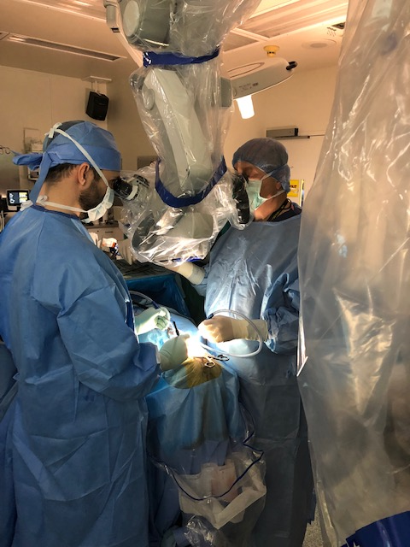
Role of Fellow/ Chief Resident/ Junior Resident/ Medical Student
Fellows and the Chief Resident Have a Significant Role in Teaching more junior Residents
Roles Must be defined Before the Operation, but can change
according to circumstances
Medical Students Have a Limited Role in Neurosurgical Operations
CV/SB Fellow Michael Moore and
Chief Resident Josh Abecassis
Dr. Ellenbogen and
Senior Resident
Lynne McGrath

Slide 9
Natural Talent vs. Practice in Learning
Some Residents are Over-performers, and some are Under-performers
But every one needs 10,000 hours of practice
Continuous Quality Improvement and Life-long Learning are needed
Every one’s performance can be affected by:
> Being in a Hurry
> Lack of Focus, distractions
> Loss of Sleep, Fatigue
> Disease of Any Kind
> Anger, Adverse Reaction to Stress
Residents Need to Be Educated About How to manage these factors

Slide 10
Remediation of the Underperforming Resident
Underperformance may be Due to a variety of factors: Lack of Knowledge; Poor preparation; Lack of manual skills; Essential Tremor; Poor attitude; Poor Learning skills, etc.
Should Be discussed amongst the Faculty Teachers
And With the Resident by the Program Director
Remediation May Consist of: Active efforts on the part of the Resident and Teachers ; More Self Study; Dedicated Time in the Skills Lab
Everyone can improve at least 2 levels with attention (on a scale of 1 to 10)
If correction is not possible, resident must be encouraged to pursue other Fields (Before the end of the 3rd Year)…

Slide 11
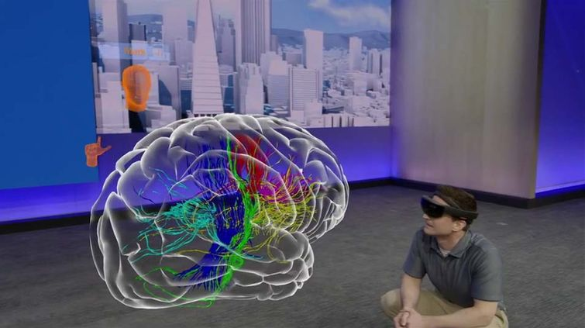
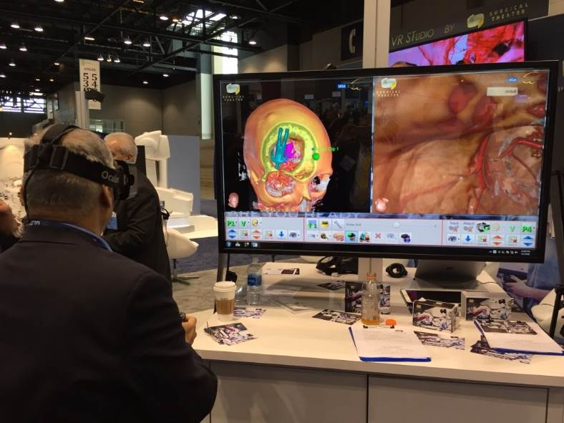
Some Other Methods of Learning
Holographic Models of Surgical Anatomy
Virtual Reality Simulations of Surgery
Review Videos of Resident Surgery and Evaluate Progression/ Errors
Resident edits Videos of Operations, Active Discussion at Conferences Focused on Techniques
Review Video Tapes of Operations by Surgical Maestros
Dedicated Rotation for cadaver/ laboratory based Dissections
Meditation to Improve Concentration/ Balance During Surgery
Maintain Physical Fitness
Get Adequate Sleep, Dedicate Time to Read at home
Discuss Problems with an Assigned Neurosurgical Mentor
& Clinical Psychologist

Slide 12
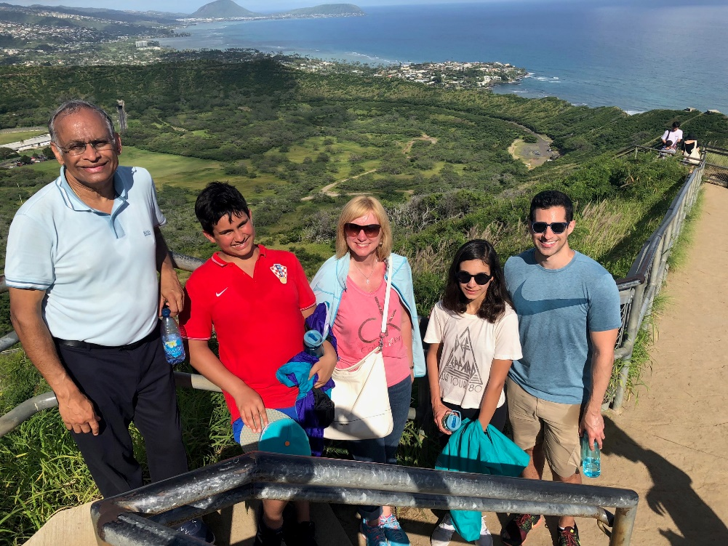
Thank You!

