Slide 1
Introduction to Neurosurgical Subspecialties: Trauma and Critical Care Neurosurgery
Brian L. Hoh, MD¹, Gregory J. Zipfel, MD² and Stacey Q. Wolfe, MD³
¹University of Florida, ²Washington University, Wake Forest Univeristy³

Slide 2
Trauma/Critical Care Neurosurgery
Trauma/critical care neurosurgeons treat patients with:
Traumatic brain injury
Closed head injury
Open head injury: gunshot wounds, knife wounds, projectiles
Spine fractures
Nontraumatic intracranial hemorrhage
Ischemic stroke
Manage critical care issues on neurosurgery patients
Direct a Neurocritical Care ICU

Slide 3
Trauma/Critical Care Neurosurgery
Medical and surgical management of patients with traumatic brain injury, spine fractures, and other acute neurosurgical care
Direct a Neurocritical Care ICU
Neurocritical care neurosurgeons
Neurocritical trained neurologists
Other neurocritical care-trained ICU physicians
Residents and medical students
Fellowship for trauma/critical care neurosurgeons is not required but some may opt for specialized training via fellowship

Slide 4
Case Illustration #1
25 yo male fell onto back of head while riding his bike
Initially brief loss of consciousness, then awoke. 3 hours later acutely lost consciousness.
Presents to ED with GCS 9 (E2,M5,V2)

Slide 5
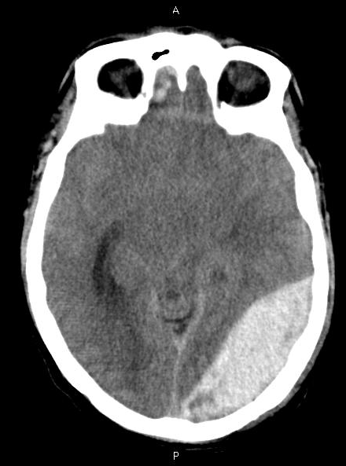
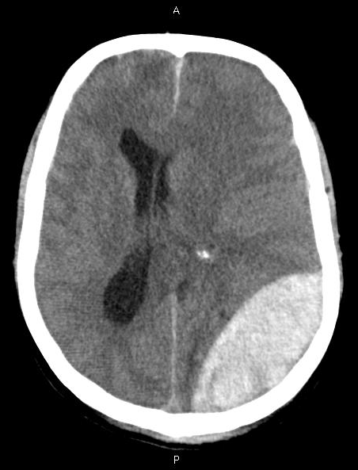
Case Illustration #1

Slide 6
Case Illustration #1
Emergent craniotomy for evacuation of epidural hematoma. Small laceration of transverse sinus noted.
Immediately regained consciousness. Discharged to home on POD#2.

Slide 7
EPIDURAL HEMATOMA
Etiology
Skull fracture with laceration of middle meningeal artery
Skull fracture with dural venous sinus laceration
High suspicion for early imaging
Lucent period prior to deterioration
Without associated injuries, 100% good outcome with prompt care
Any mortality is a system failure or delay in care
True neurosurgical emergency

Slide 8
Case Illustration #2
65 y/o male who fell backward off the back of a golf cart while drinking
On ASA for CAD
PE: Confused and combative, yelling
Opens eyes to voice
Follows commands all extremities

Slide 10
Epidural vs Subdural hematoma

Slide 11
SUBDURAL HEMATOMA
Associated with underlying brain injury
Worse prognosis
If asymptomatic, may watch if <1cm in diameter
Treatment
Acute- Hyperintense- craniotomy
Subacute- Isointense- bur holes
Chronic- Hypointense- SEPS (twist drill/suction)

Slide 12
Case Illustration #3
83 y/o man s/p drug eluting coronary stent
On Plavix and ASA
Tripped in the driveway 4 weeks ago (No LOC)
Now with HA and difficulty walking
PE: Awake with mild STM deficit
PERRLA, EOMI
5/5 all extremities, left drift

Slide 13
Chronic Subdural Hematoma

Slide 14
Case Illustration #4
24 y/o male fell off bike
Seizure at the scene
Normal neurologic exam
on arrival

Slide 15
Traumatic Subarachnoid Hemorrhage

Slide 16
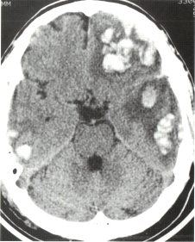
Case Illustration #5
45 y/o male pedestrian hit by car
+LOC
PE: PERRLA
Moaning
No eye opening
Withdrawing

Slide 17
TBI: Coup/Contrecoup

Slide 18
Contusions
Parenchymal damage from the bony ridges at base of the skull
Associated with edema
Worse prognosis
Potential for “blossoming”
Repeat CT within 4-6 hours

Slide 19
Diffuse Axonal Injury
Deceleration injury- usually MVA
Shear-strain forces on the axons during rotation/deceleration of head
Poor prognosis
35% of all TBI deaths
Most common cause of coma
and severe disability

Slide 20
Neurocritical Care: Treatment of Increased Intracranial Pressure
Positioning
Hyperventilation
Hypertonic therapy (steroids not useful except in tumor swelling)
CSF drainage
Decrease brain metabolism
Surgical decompression

Slide 21
Position Patient Correctly
Elevate head of bed to 30 degrees
Maintain head and neck in straight alignment
Prevent compression of jugular veins by circumferential endotracheal tape, trach ties or cervical collar
Minimize endotracheal suction and gagging

Slide 22
Hyperventilation
Mechanism: CO2 vasodilates, causing increased blood flow within the brain
If you blow off CO2, you decrease the blood volume of the brain
Maintain CO2 30-35 for <24 hrs to prevent ischemia
Never drop CO2 below 30

Slide 23
Hypertonic Therapy
Use osmotic gradient to pull fluid out of brain and into the vascular space, decreasing brain volume
Mannitol
Hypertonic saline
Never use hypotonic fluid, such as 1/2NS or D5W- this causes brain swelling and can cause death
Avoid Dextrose in fluids to decrease glutamate production

Slide 24
CSF drainage
Placement of an external ventriculostomy (EVD) to drain CSF and monitor ICP

Slide 25
Decrease Cerebral Metabolic Rate
Sedation (propofol or precedex for continual neurologic assessment)
Paralytics
Barbituate coma
Control Seizures, Fever, Restlessness, Pain
Normothermia
Hypothermia- literature still controversial

Slide 26
Conclusions
Trauma neurosurgery is one of the central components of a neurosurgical career
Trauma neurosurgery can be highly rewarding when a preterminal patient can be returned to a normal or near normal life
Neurocritical care of ICU patients is distinctly different from critical care management of other patient populations
In addition to cranial and spine trauma, stroke and intracranial hemorrhage are other large critical care populations

