Slide 1
CAST SNS Annual Meeting Seattle 21 May 2019
Arthur L Day, MD
Charles Branch, MD

Slide 2
Agenda
I. CAST Membership
II. CAST Fellowship Accreditation
NESAC/NCCTRAC Update
Form 2 and Guidelines
ACGME ADS/Form 3 Requirement
2 year activity rule
Fee schedule
Non Neurosurgery ACGME Associated CAST Fellowships
III. ABNS - CESAC
IV. Leadership Transition and Recognition

Slide 3
CAST after MAY 2019 SNS Meeting
CAST Members (3 yr. term, renewable x 1 – total 6 yrs.)
Nicholas Barbaro (Chair) 2019 functional
Sander Connolly 2019 CV
Cormac Maher 2017 pediatrics Charles Branch (Secretary) 2011 spine
Linda Liau 2018 tumor
Shelly Timmons 2014 trauma/NCC
Doug Kondziolka 2016 functional
Vince Traynelis 2018 spine
ABNS ad hoc – Kevin Cockroft 2018 NES
ABNS Secretary – Carl Heilman 2018 Ex-Officio
RRC - Griff Harsh 2018 Ex-Officio

Slide 4
CAST Accreditation of Programs (as of May 2019)
Programs: Approved
a. Cerebrovascular 11
b. Endovascular 47
c. Neuro Critical Care 27
d. Neurological Oncology 15
e. Peripheral Nerve 7 f. Pediatric 28
g. Stereotactic/Functional 25
h. Spine 44
TOTAL 204

Slide 5
CAST Program Accreditations 20-30 New/Renewal applications /yr Web application and review system outdated Increasing linkage top ACGME Program Data

Slide 6
CAST Program Accreditations Neuroendovascular Surgery (NES) (as of May 2019)

Slide 7
CAST Individual Certifications
NeuroEndovascular Surgery (NES) (as of April 2019)
Certificates:
Approved
a. Neurosurgeons 119
b. Neurologists 85
c. Radiologists 105
TOTAL 309
total after CAST approval at April AANS meeting

Slide 8
NESAC Membership
Name | Institution | Term Start | Term End
Brian Hoh, MD** | University of Florida-Gainesville | 2015 | 2020
Adnan Siddiqui, MD | SUNY Buffalo | 2015 | 2019
Howard Riina, MD | New York University | 2015 | 2018
Neurosurgery
JSCVS
Adam Arthur | University of Tennessee | 2019 | 2022
Name | Institution | Term Start | Term End
Tudor Jovin, MD** | University of Pittsburgh | 2015 | 2020
Sam Zaidat, MD | Medical College of Wisconsin | 2015 | 2019
Italo Linfante, MD | Miami, FL | 2015 | 2018
Neurology
SVIN
Johanna T. Fifi | Mount Sinai | 2019 | 2022
Name | Institution | Term Start | Term End
Philip Meyers, MD** | Columbia University | 2015 | 2020
Colin Derdeyn, MD | Washington University at St. Louis | 2015 | 2019
Aquilla Turk, MD | Medical University of South Carolina | 2015 | 2018
** denotes signing member of NESAC formation document, finalized Jan 2015
Radiology
SNIS
David Fiorella | Stoneybrook | 2019 | 2022

Slide 9
CAST Program Accreditations NeuroCritical Care (as of April 2019)

Slide 10
CAST Individual Certifications
NeuroCritical Care(NCC) (as of April 2019)
Certificates: Approved
a. Neurosurgeons 43
b. Neurologists 45
c. Pulmonologist 19
d. Anesthesiologist 13
e. Neurointensivist – 9
Emergency Medicine
f. Pediatrician 2
TOTAL 131
Total after CAST approval at April AANS meeting

Slide 11
NCCTRAC Membership
NeuroCritical Care/NeuroTrauma
Name | Institution | Start Date | Term End
Shelly D. Timmons, MD | Penn State Hershey/Neurosurgery | Original
Robert E. Harbaugh, MD | Penn State Hershey/Neurosurgery | Original
Alex B. Valadka, MD | Virginia Commonwealth University | Original
Richard Rodgers, MD | Indiana University | New
Thomas Bleck , MD | Rush University Medical Center | New
Jaime Ullman, MD | Mount Sinai | New
Cheryl Chang – Advisor/Liaison | UCNS | New

Slide 12
New CAST Fellowship Requirements
Post Chief Resident year (NCC and NES exceptions)
Form 2 (Specialty Specific) submission with new/renewal applications
Form 3 (Individual Activity) submission annually for CAST Diploma of Fellowship completion
ADS submission annually

Slide 13
CAST Fellowship Accreditation: Data/Form Requirements
Initial application and renewal
Form 1: institutional case report – general. Includes all cases done by sponsoring institution residency training program (due at time of initial application or renewal)
Form 2: institutional case report – subspecialty. Includes all pertinent subspecialty cases done by sponsoring institution residency training program (due at time of initial application or renewal)
Annual
Form 3: individual case report form – training. Validates the experience of the individual during the fellowship (updated to CAST annually)
ACGME ADS: annual fellowship update
(updated and submitted to CAST through ACGME annually)

Slide 14
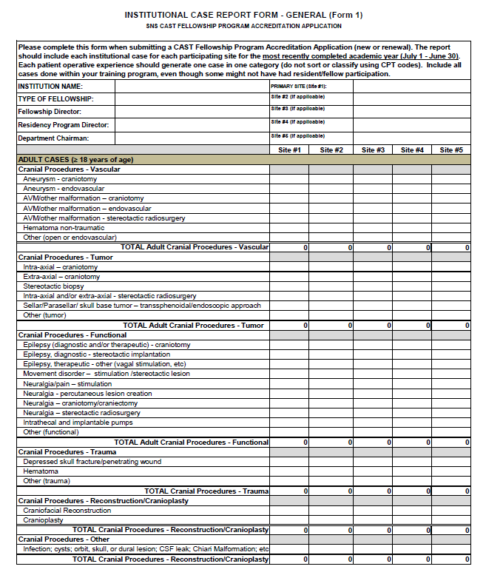
Form 1:
INSTITUTIONAL
CASE REPORT
– GENERAL
all cases done by institution
sponsoring training program
same for all sub-specialties
does program have enough
cases to justify a fellowship?

Slide 15
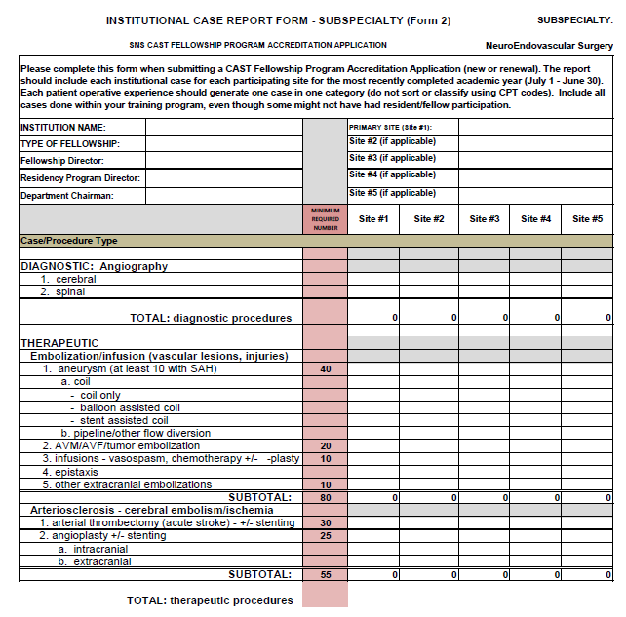
Form 2:
INSTITUTIONAL
CASE REPORT
– SUBSPECIALTY
all pertinent cases done by
institution sponsoring
training program
defined by subspecialty FRC
different for each subpecialty
(sample from neuroendovascular surgery)
does program have enough
subspecialty cases to justify
a fellowship?

Slide 16
Form 2: Institutional Case Minimums for Neurosurgical Oncology

Slide 17
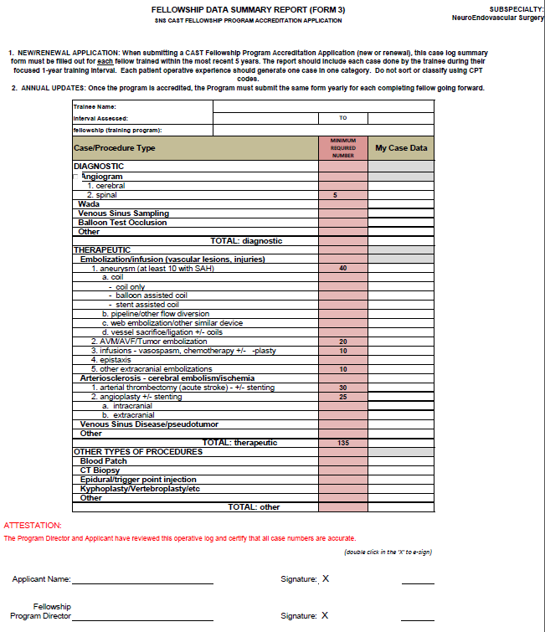
Form 3:
INDIVIDUAL
CASE REPORT
– TRAINING
all cases done by fellow
during fellowship
defined by subspecialty FRC
different for each subspecialty
(minimal case number requirements)
(sample from neuroendovascular surgery)
validates the fellowship
experience

Slide 18
Form 3: Individual Fellow Case Minimums for Neurosurgical Oncology

Slide 19
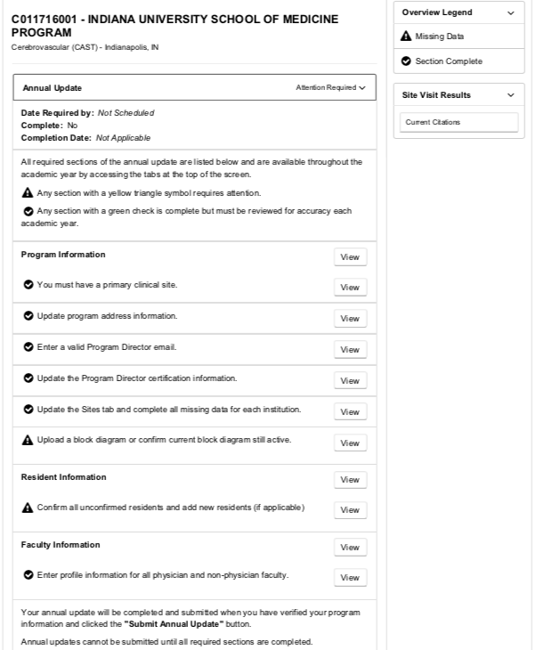
ACGME ADS:
Annual submission through ACGME site
all CAST accredited fellowships must be linked to ACGME approved residency program
In the current form, the fellow will be substituted for the term resident
Faculty CV/Scholarly activity will not be required for ADS
Block diagram submission is required for ADS and initial application
Sample ADS courtesy of Indiana University CV Fellowship

Slide 20
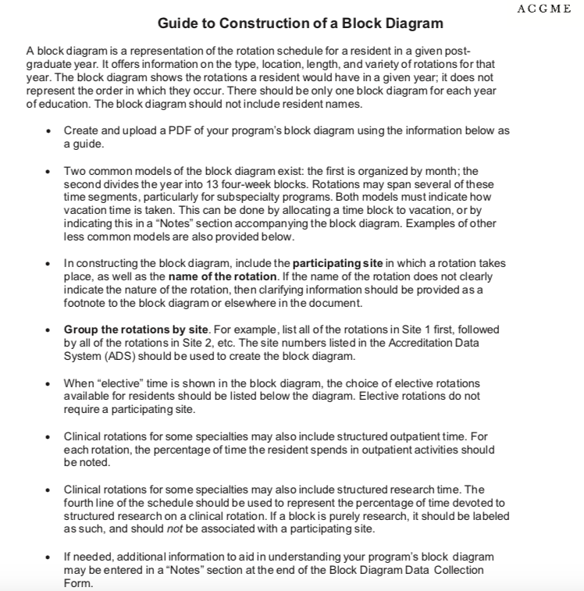
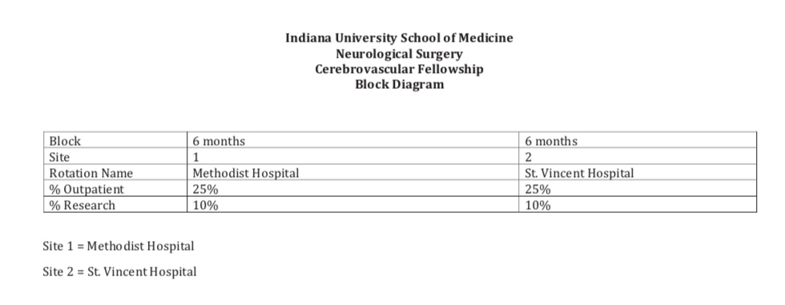
ADS Block Diagram
Illustrates planned fellowship experience at sponsoring training program
Sample ADS courtesy of Indiana University CV Fellowship

Slide 21
CAST Program Accreditation Considering a “two year” activity rule
2 year limit on non-receipt of an ADS indicating fellowship status
no fellow activity or
failure to submit Form 3 for each graduating fellow
citation issued
no Fellow/Form3 in the subsequent year
CAST Accreditation withdrawn
new application needed for reinstatement

Slide 22
ACCREDITATION
2019 CAST FEE STRUCTURE
CAST Function application fee type Revenue Expense
Accreditation new program $3,000 ----
(5-year cycles)
renewal $2,000 ----
ACGME/ADS $1,000

Slide 23
CAST Accredited Fellowships in programs without ACGME Neurosurgery

Slide 24
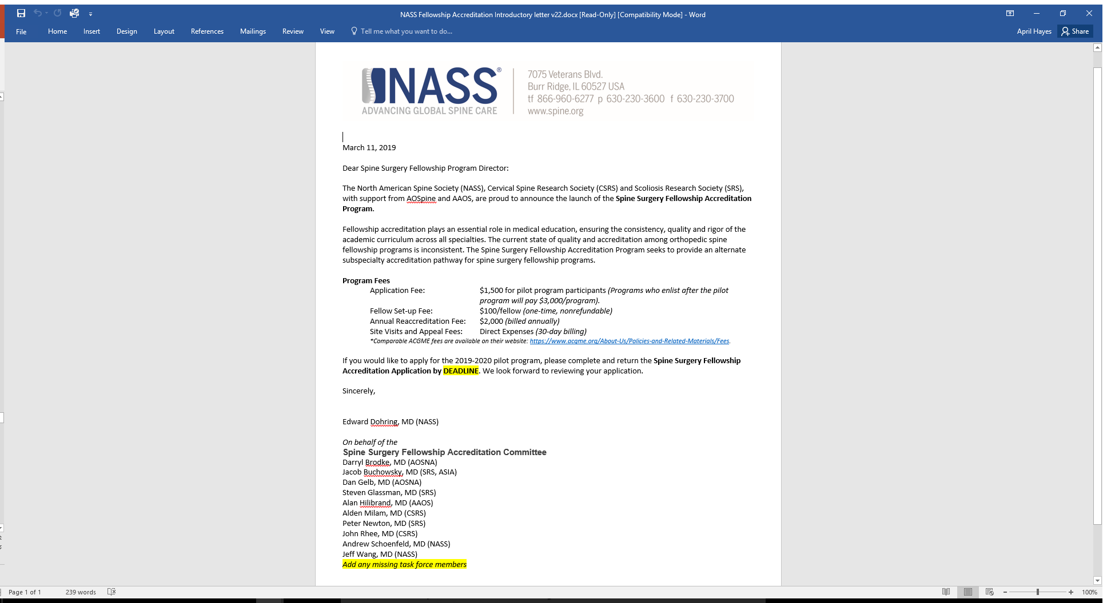

Slide 25
2019 CAST FEE STRUCTURE CERTIFICATION/TRAINING ACKNOWLEDGMENT
CAST FUNCTION FEE TYPE REVENUE
Individual recognition Practice Track $500
Co-recognition ACKNOWLEDGMENT $500
of training completion

Slide 26
Individual Certification NES/NCC – ABNS Interactions
CAST Certificate to RFP
NESAC CESAC

Slide 27
CAST Individual Certifications
NeuroEndovascular Surgery (NES) (as of April 2019)
specialty # approved
a. Neurosurgeons 119
b. Neurologists 85
c. Radiologists 105
TOTAL 309

Slide 28
RFP CNS Neuroendovascular Surgery
This purpose of this document is to detail the organizational construct, training, accrediting, and credentialing requirements for the Recognized Focused Practice (RFP) in CNS Neuroendovascular Surgery. This RFP is co-sponsored by the American Board of Neurological Surgery, American Board of Radiology, and the American Board of Psychiatry and Neurology.. The ABNS will serve as the managing ABMS board. This RFP has been approved by the ABMS and has the goal of recognizing candidates who have successfully completed standardized neuroendovascular training and practice criteria, thereby elevating and advancing patient care for the public good.
Organizational Structure:
There will be two committees, NESAC (Neuro-Endovascular Surgery Advisory Committee) and CESAC (Credentialing Endovascular Surgery Advisory Committee),that will work collaboratively in the work of fellowship accreditation (NESAC) and fellow credentialing (CESAC). Once established, they will work independently to accomplish their charges. Membership of each committee will consist of equal numbers of representatives from neurological surgery, neuroradiology, and neurology. The chair of NESAC will be selected by SNS-CAST. The CESAC Chair may be from any of the 3 disciplines, and CESAC will consist of equal representation of the 3 parent organizations. The chairs will be responsible for providing timely reports back to the parent organizations and for coordinating the timing of and agenda for meetings between the parent organizations and the committee members. NESAC and CESAC will be self-governed with the oversight and approval of their parent organizations.
Fellowship Accreditation: NESAC
Accreditation of fellowships will be done by NESAC under the authority of the Society of Neurological Surgeons through its Committee for Advanced Subspecialty Training (CAST). This committee will establish fellowship educational and training requirements based on agreed upon criteria which will include procedural case volumes available for training fellows, faculty experience, facilities, academic environment, and institutional/departmental support. The NESAC committee will use these criteria to approve fellowship applications from all specialties.
Fellow Credentialing: CESAC
Credentialing of fellows trained in CAST (NESAC) accredited and ACGME fellowships will be done by a committee termed CESAC. This committee will consist of all NESAC members as well as appointees from the ABNS, ABPN, and ABR, with an equal number of experts from all three specialties. CESAC is charged with: 1) writing the cognitive exam (ABNS will refer to this exam as the RFP Endovascular exam), 2) writing an annual adaptive learning tool module to be given in conjunction with member board continuous certification exercises, 3) determining the details of the required practice data submission (both initial and annual) and the metrics by which that data is approved or denied, and 4) recommending approval for initial RFP in CNS Neuroendovascular Surgery by their respective Boards. Although the ABNS will serve as the managing board, RFP Certificates will be issued and maintained by the appropriate ABMS member Board.

Slide 31
CAST Individual Certifications
NeuroCritical Care(NCC) (as of April 2019)
specialty: # approved
a. Neurosurgeons 43
b. Neurologists 45
c. Pulmonologists 19
d. Anesthesiologists 13
e. Neurointensivists – 9
Emergency Medicine f. Pediatricians 2
TOTAL 131

Slide 32
Leadership Transition and Recognition
Steve Giannotta and Kathy Guzman –USC
CAST Secretary and Fellowship Counseling Team
Shannon Gignac – SNS Office
CAST Administration and ‘one armed paper hanger’
Art Day – Outgoing Chair
Nick Barbaro – Incoming Chair

Slide 33
Forecast A statement of what is judged likely to happen in the future, especially in connection with a particular situation. In our season change, I am confident the ForeCAST is good!

