Slide 1
SNS CoRE Report May 21st, 2019
Richard W. Byrne, MD
CoRE Committee
Society of Neurological Surgeons

Slide 2
CoRE Subcommittees
Resident Courses: Greg Zipfel
Portal Editorial: Nick Bambakidis, Fred Barker
Milestones (with ACGME): Nate Selden
Web: Sepi Amin-Hanjani
Tool Kit: Randy Jensen

Slide 3
Portal Editorial Bambakidis, Sagher
Partnering with CNS education committee (Bambakidis chair) and AANS (Fred Barker) to link education materials
AANS education committee reports detail strong and weak points in the Matrix
Plans pending MOU update

Slide 4
Milestones Group
ACGME suggested sub-competencies tailored to neurosurgical education, including research.
Fewer elements, cleaner progression of traceable progress compared to Milestones 1.0
Sub-competencies arranged in a developmental progression of specific behaviors.
Fellowship/early practice attributes are included in every case at level 5.

Slide 5
Web Subcommittee
Chair: Sepi Amin-Hanjani
Web site redesign
Choosing a new vendor
PD Toolkit re-design- Randy Jensen, MD, PhD

Slide 6
SNS Resident Course Update May 21st, 2019
Gregory J. Zipfel, MD

Slide 7
Resident Course Subcommittee
Rich Byrne
Dan Barrow
Bernard Bendok
Deborah L. Benzil
Joseph Ciacci
Aaron Cohen-Gadol
E. Sander Connolly
William T. Couldwell
Aclan Dogen
Bruce Ehni
Richard Ellenbogen
Isabella Germano
M. Sean Grady
Michael Haglund
Carl Heilman
Michael Kaplitt
Alexander Khalessi
Paul Larson
David Limbrick
Thomas Origitano
Ali Ozturk
Vikram C. Prabhu
Gustav Pradilla
Ganesh Rao
Scott Shapiro
Philip Stieg
Chris Winfree
Julian Wu
Greg Zipfel (Chair)

Slide 8
SNS Resident Course Portfolio
Intern Boot Camp
SNS
PGY1
PGY2
PGY5-7
Senior Resident Course
Junior Resident Course

Slide 9
Intern Boot Camp (PGY1)

Slide 10
Intern Boot Camp
Goal
Help transition medical students into NSG interns
Format
“Flipped classroom”
Pre-course study
Interactive small group sessions
Skills / simulation stations

Slide 11
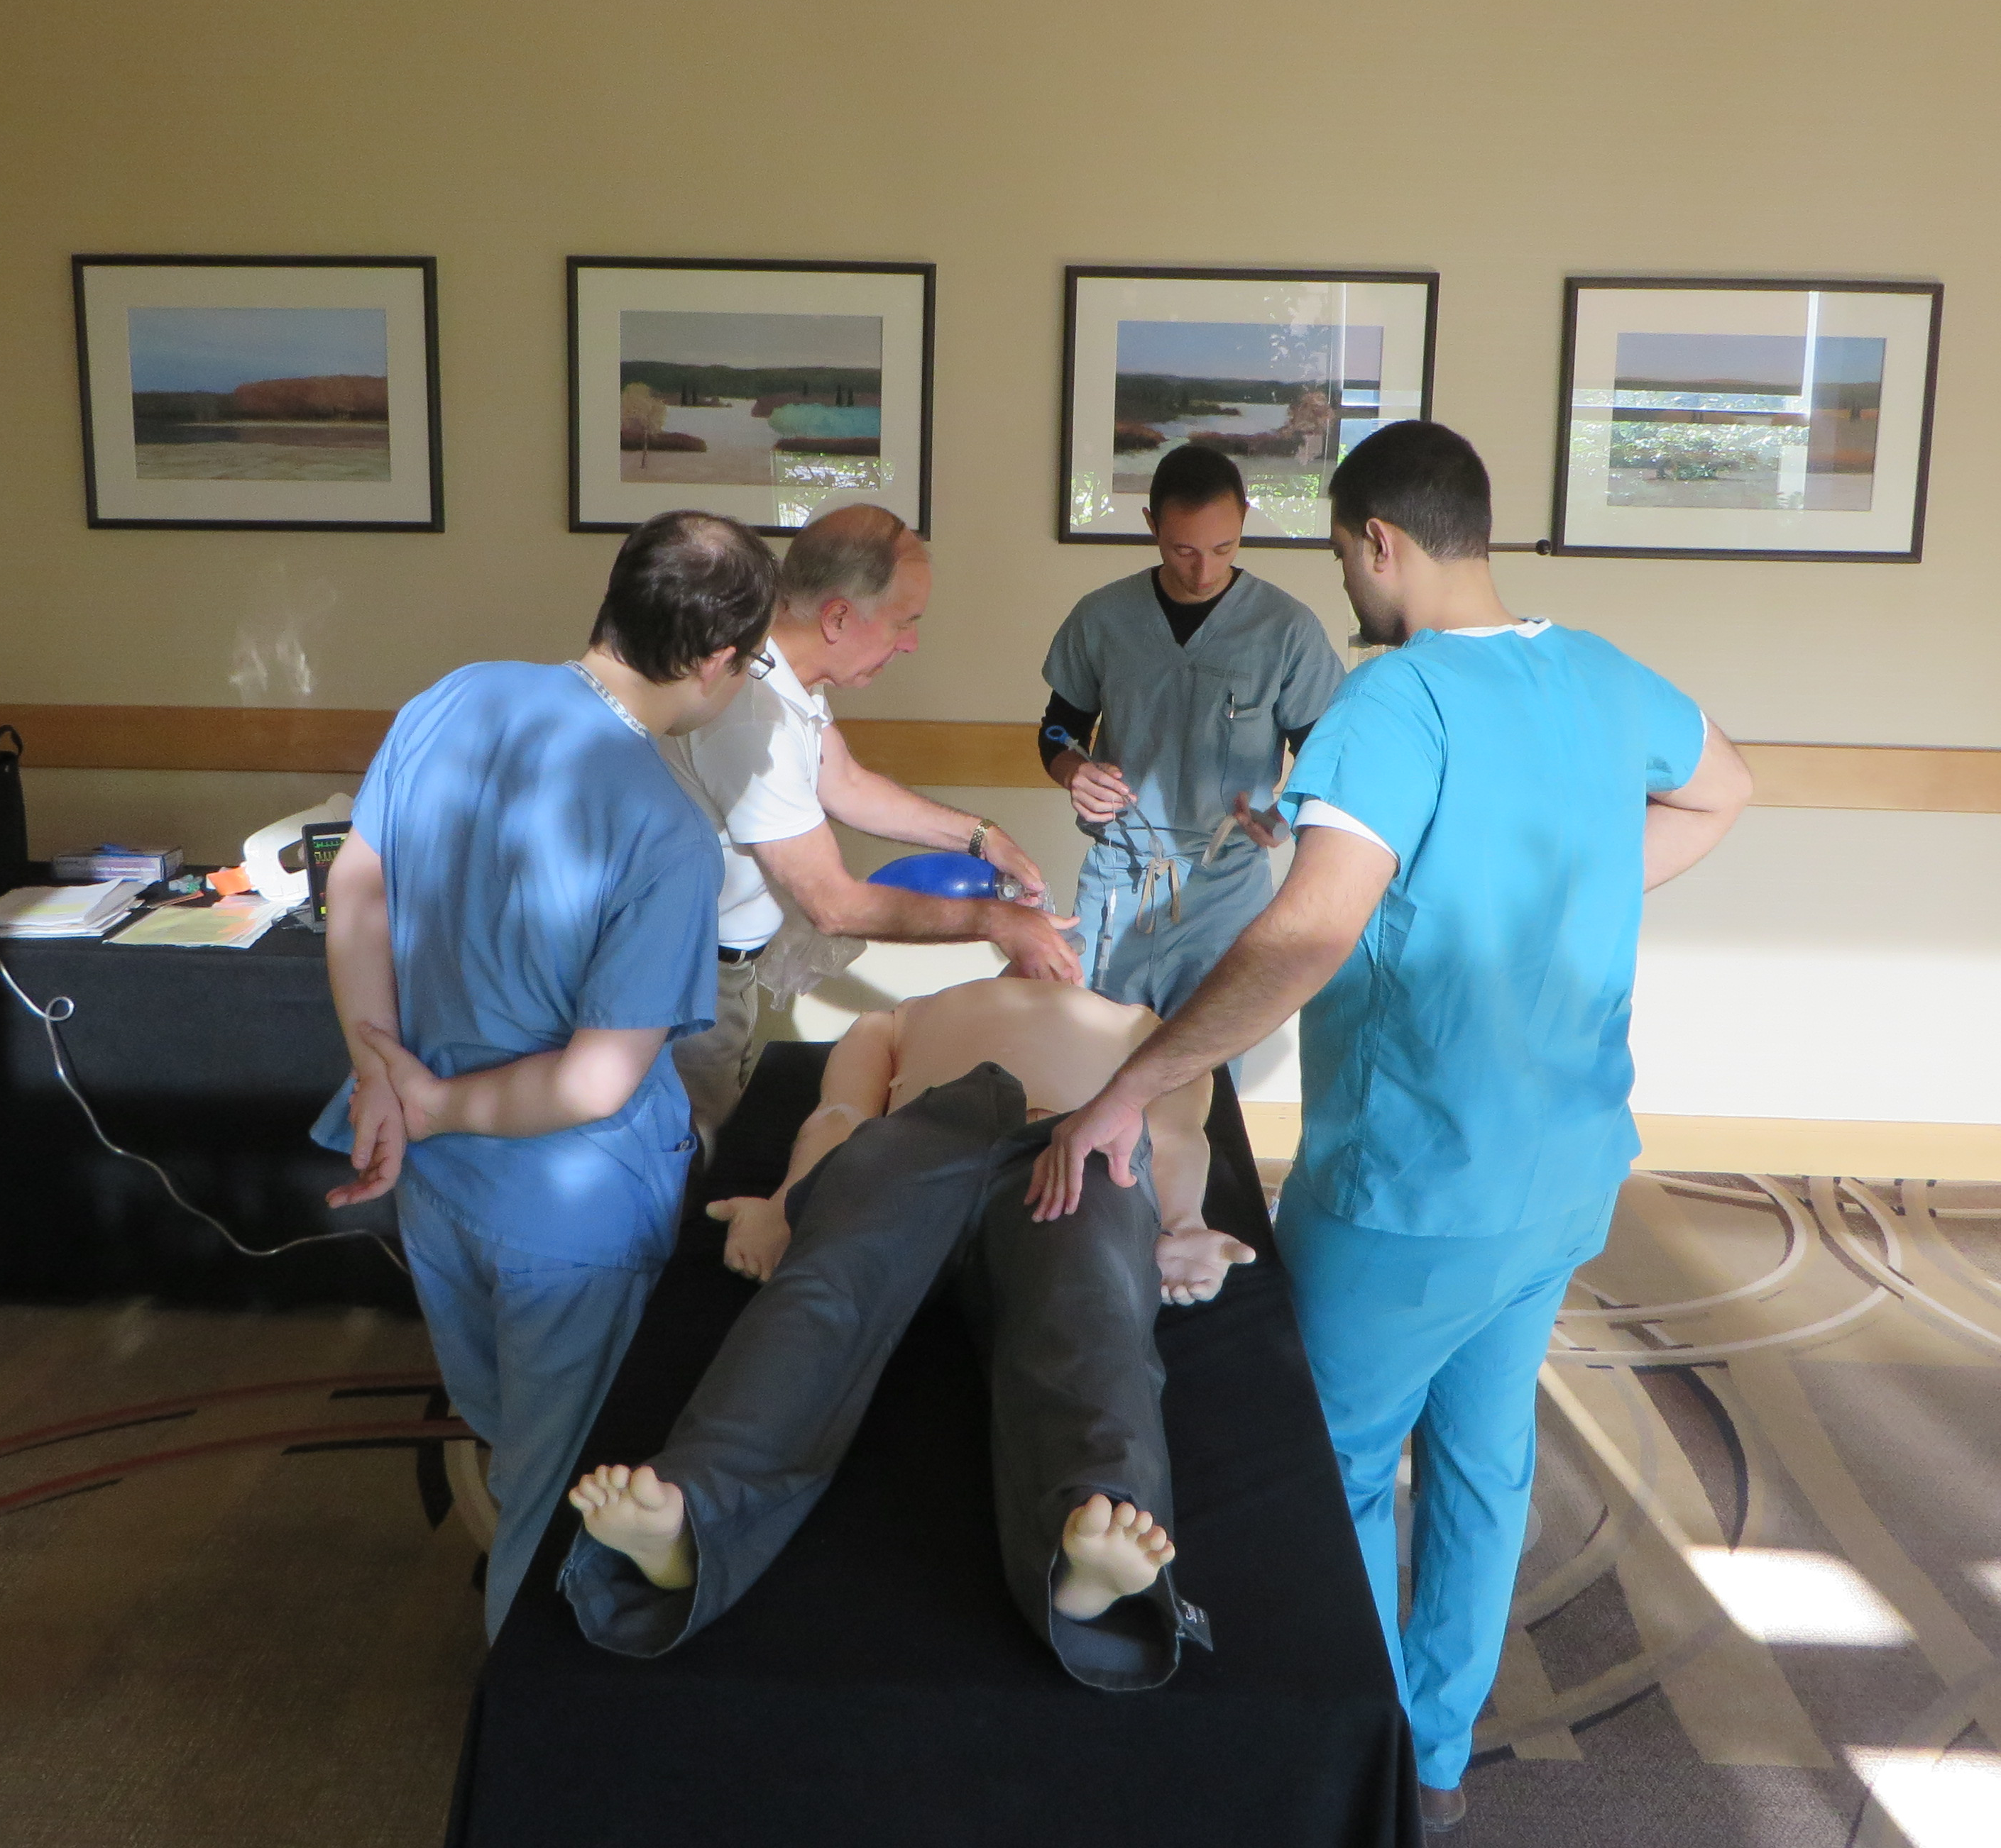
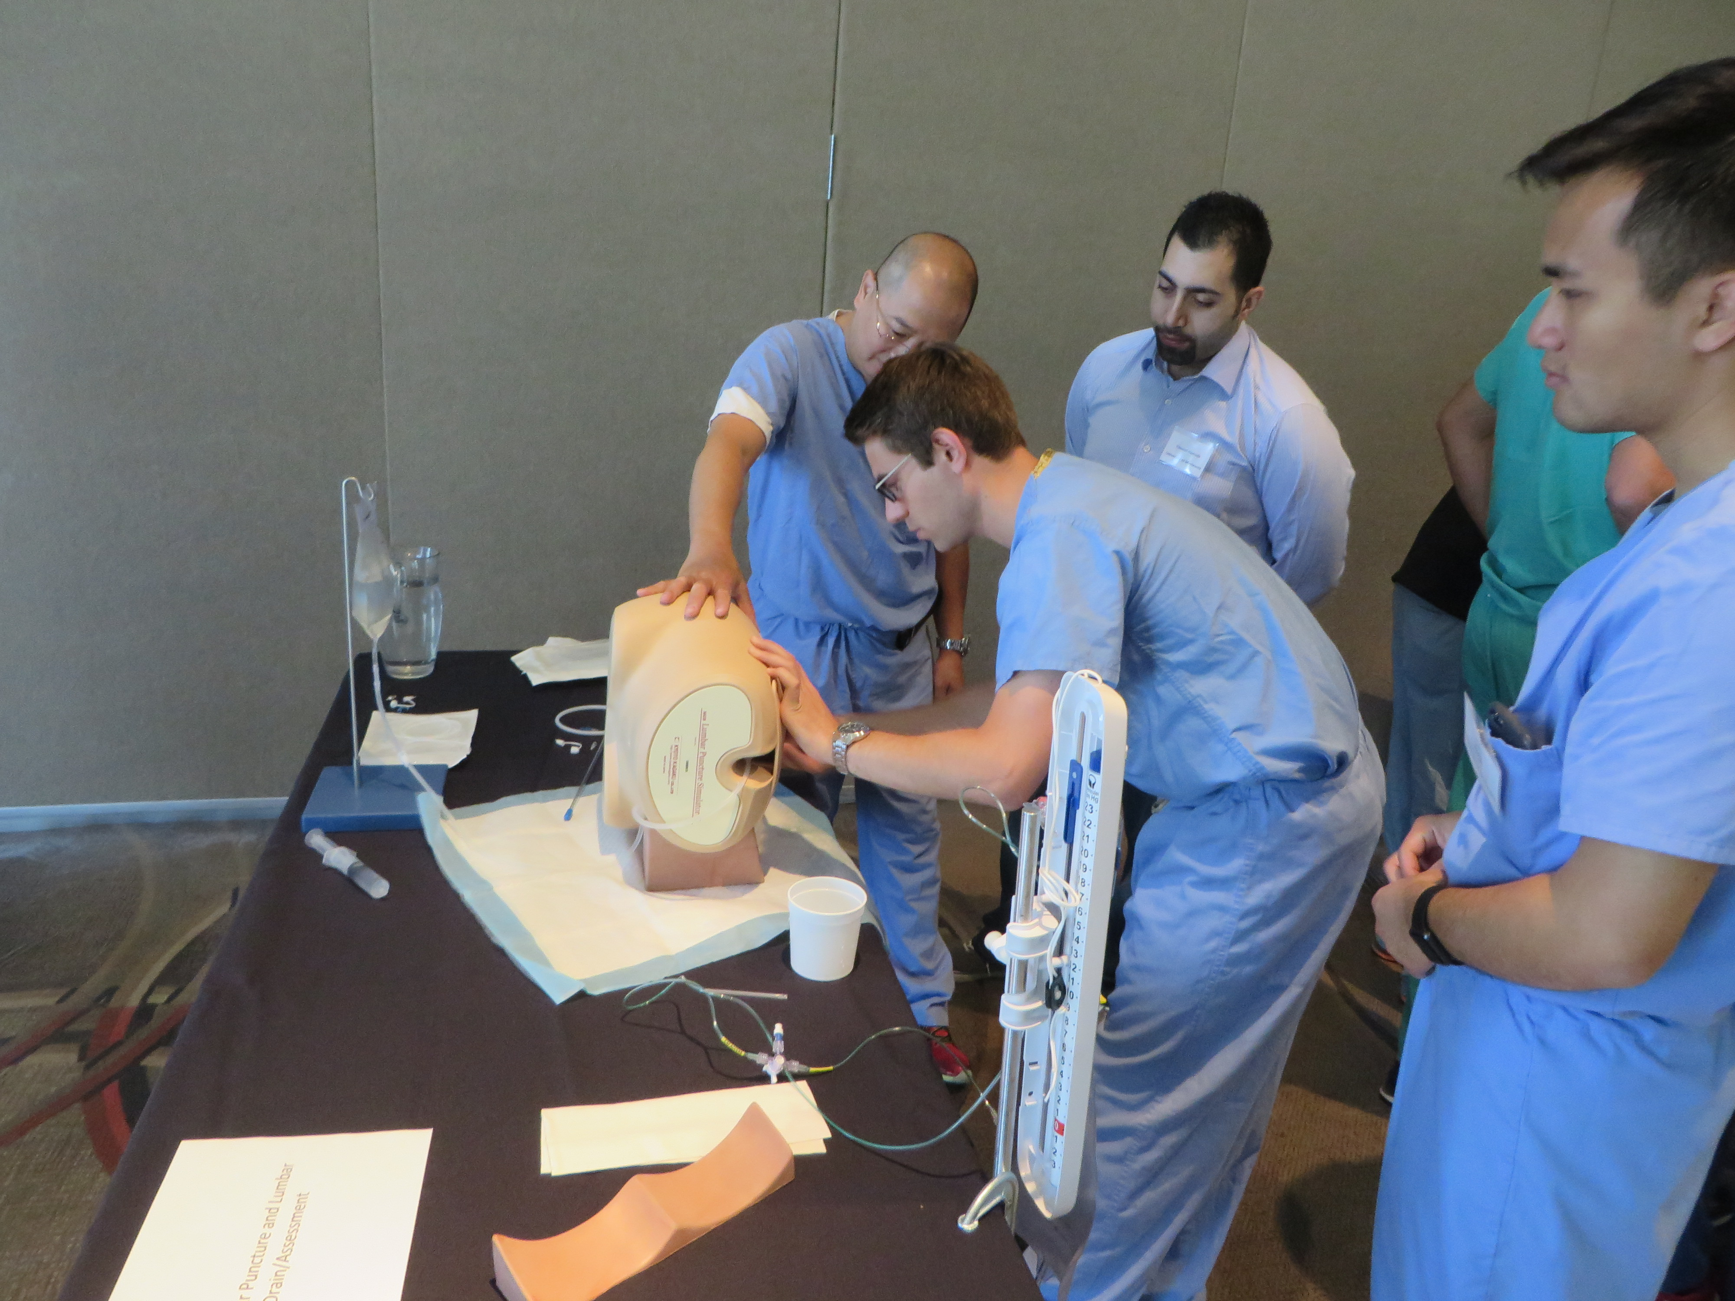

Slide 12
Intern Boot Camp National Director: Julian Wu
July 12-13, 2019
Portland, OR; Directors: J. Ciporen / F.P.K. Hsu / A. Lee
Houston, TX; Directors: J. Weinberg / J. White
July 19-20, 2019
Boston, MA; Directors: J. Wu / C. Heilman
Chicago, IL; Directors: R. Byrne / T. Origitano
July 26-27, 2019
Atlanta, GA; Directors: G. Pradilla / D. Barrow
Philadelphia, PA; Directors: A. Ozturk / S. Grady

Slide 13
Intern Boot Camp
2019
No major changes
Near-universal participation across sites
2018 – 232 attended
2019 – 234 enrolled
Continued very high evaluations
Very strong industry support

Slide 14
Intern Boot Camp
Primary Industry Sponsor

Slide 15
Junior Resident Course (PGY2)

Slide 16
Junior Resident Course
Goal
Help transition interns into NSG junior residents
Format
“Flipped classroom”
Pre-course study
Simulation-based training
Professionalism, leadership, communication

Slide 17
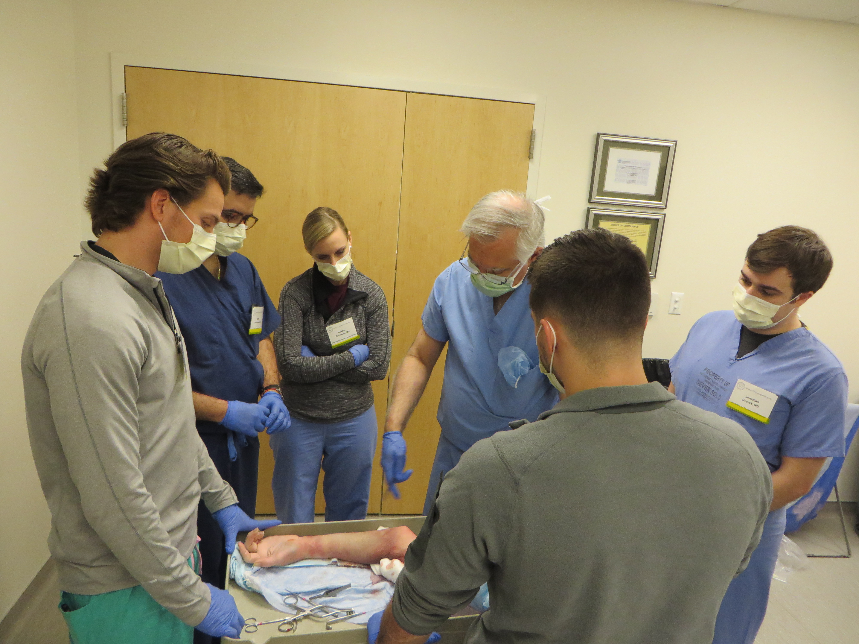
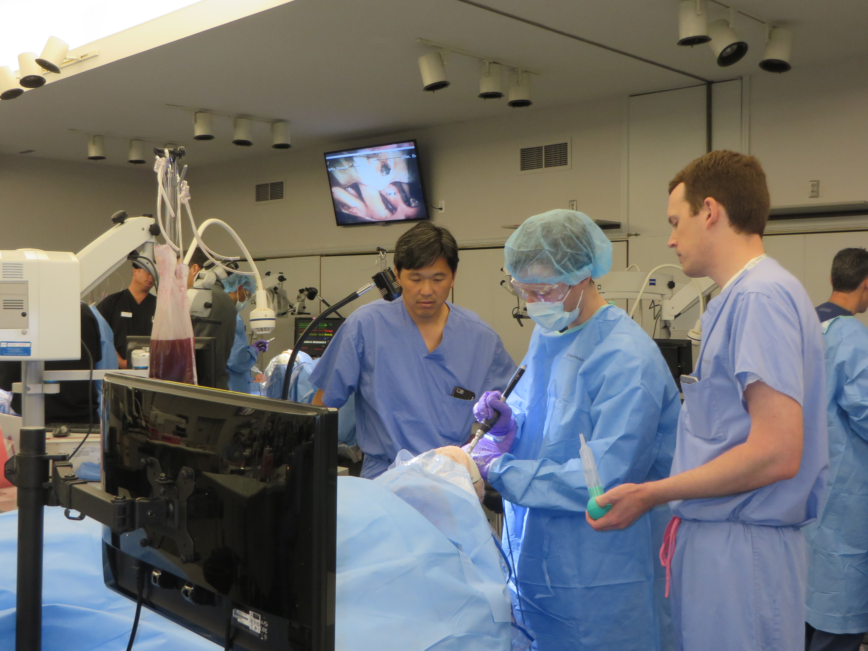
Junior Resident Course
Upper Extremity Prosection Intraoperative Catastrophe
Management

Slide 18
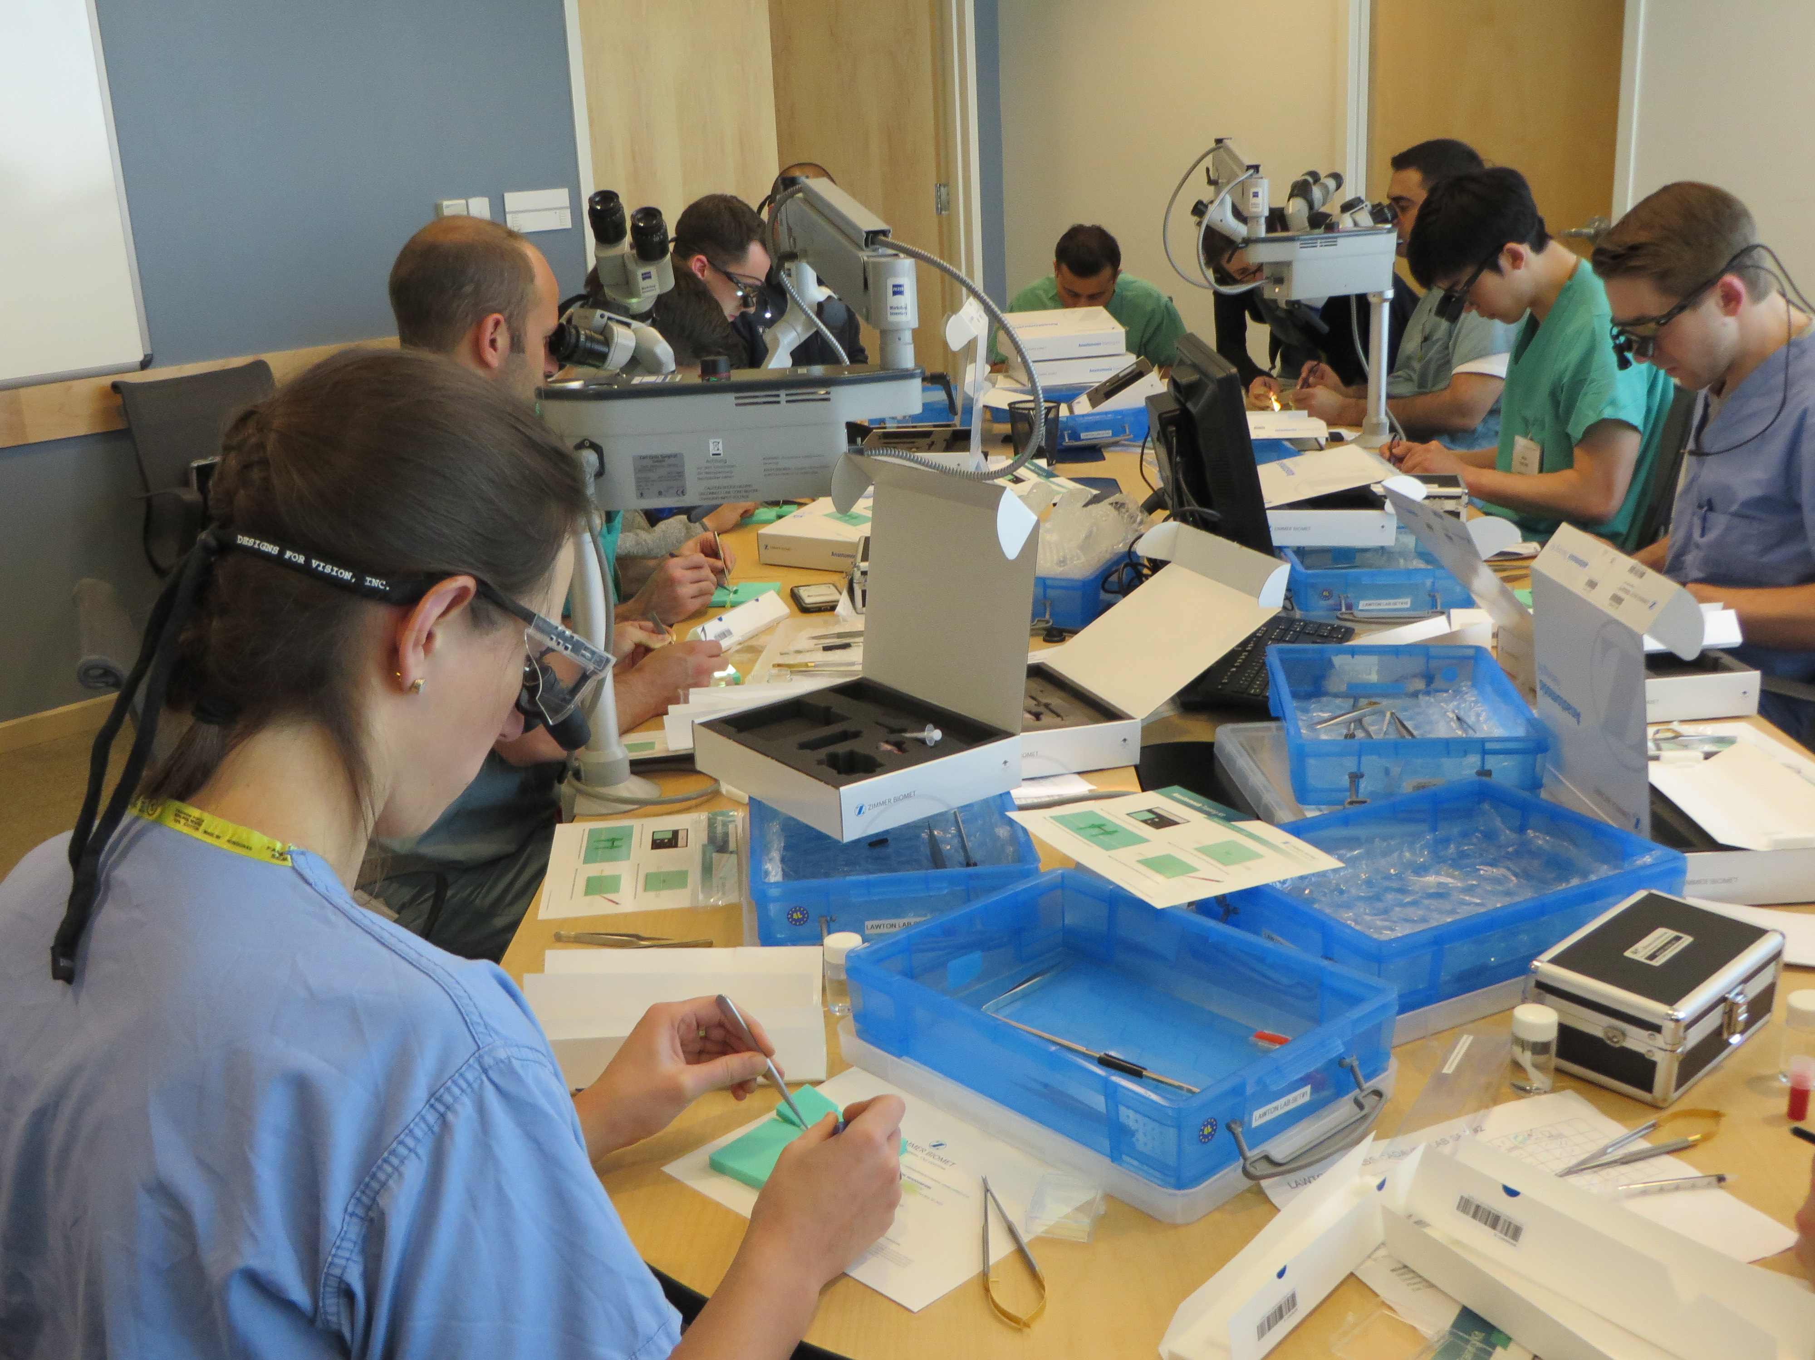
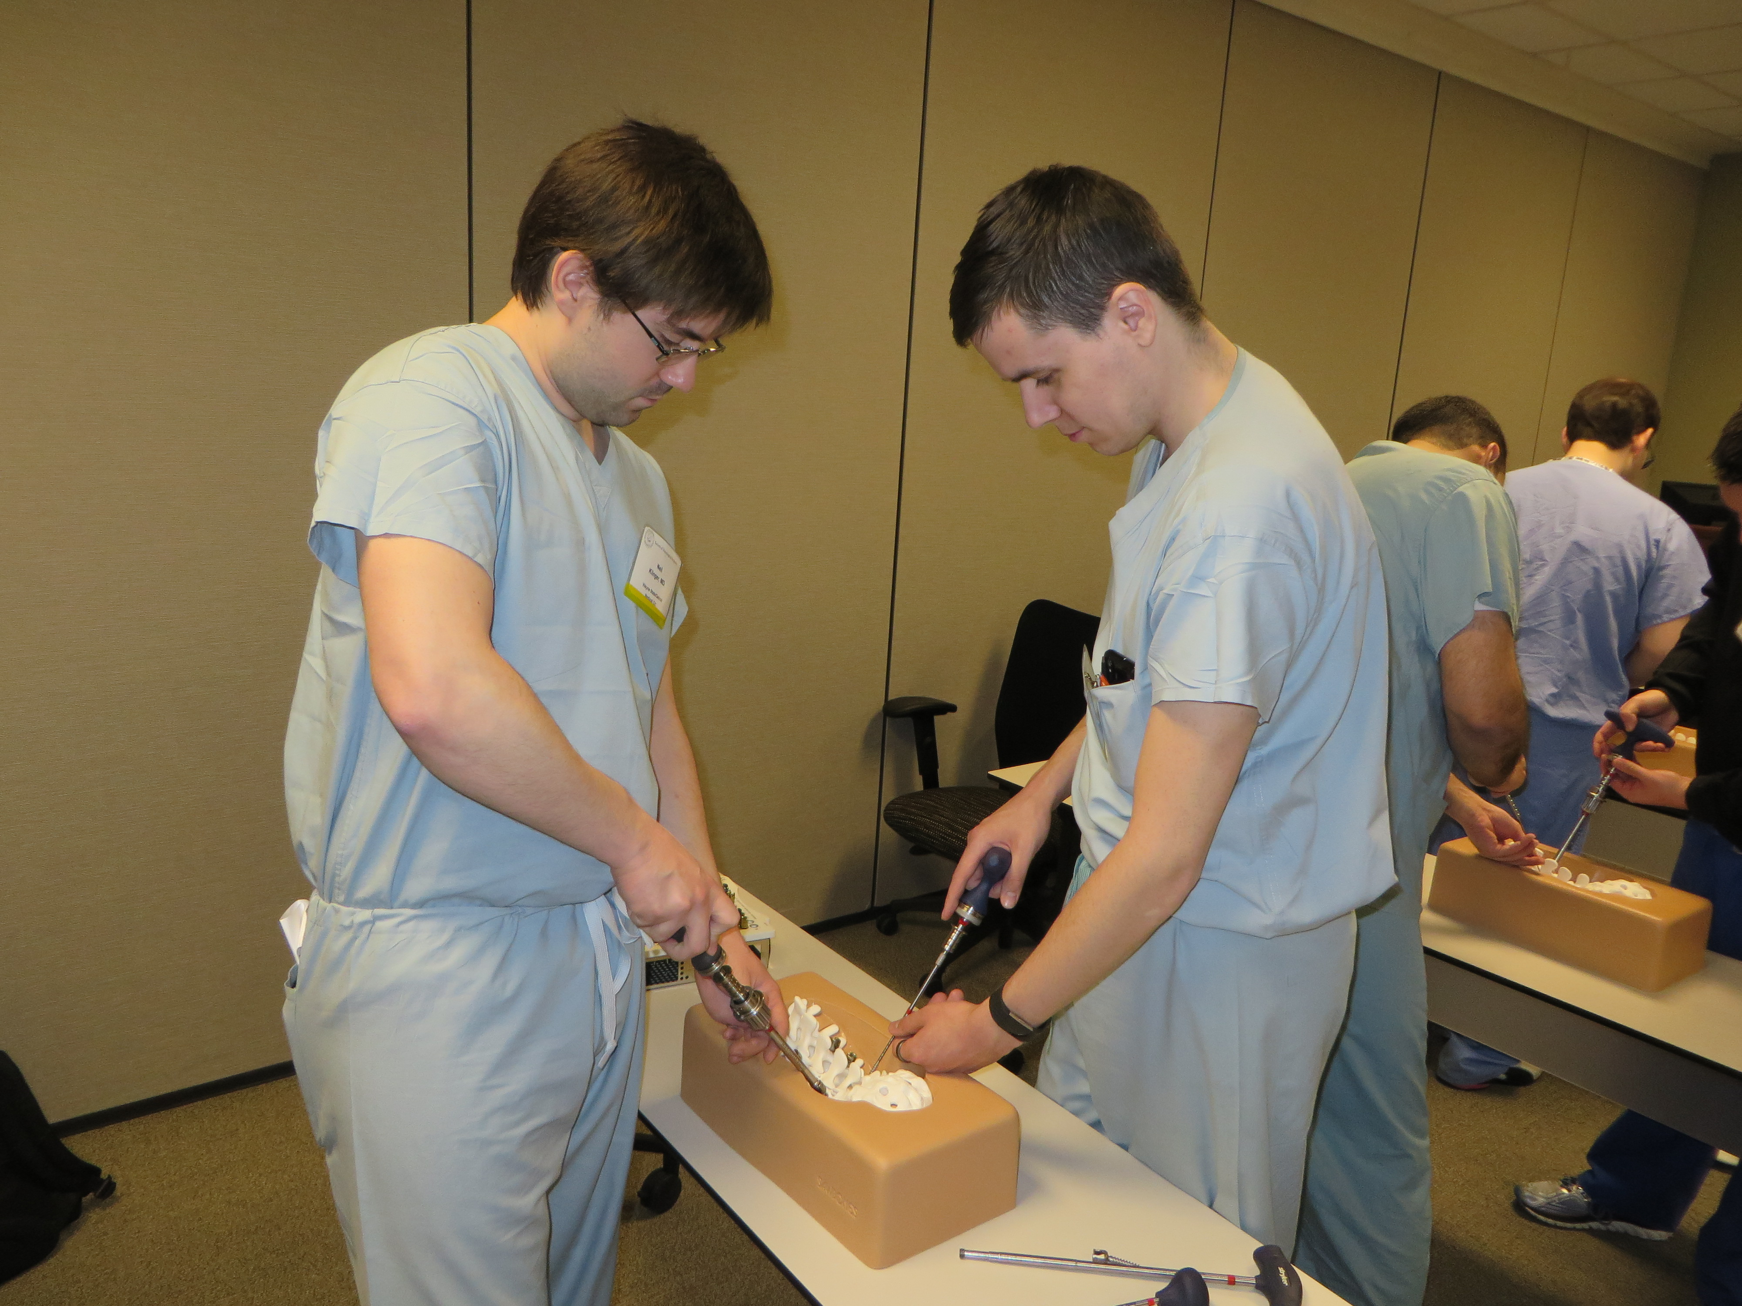
Junior Resident Course
Vessel Anastomosis
Spine Basics

Slide 19
Junior Resident Course National Director: Scott Shapiro
April 4-5, 2019
UC San Diego; Directors: A. Khalessi / J. Ciacci
April 24-25, 2019
IU Indianapolis; Directors: S. Shapiro / D. Limbrick
May 30-31, 2019
Weill-Cornell NY; Director: M. Kaplitt / C. Hadjipanayis

Slide 20
Junior Resident Course
2019
Attendance is up
206 in 2019 vs. 198 in 2018
East Coast and Midwest > West Coast
Evaluations remain very strong
Expansion of spine simulations well-received
Occipital-cervical and lumbar
Industry support relatively strong

Slide 21
Junior Resident Courses
Primary Industry Sponsors

Slide 22
Senior Resident Course (PGY5-7)

Slide 23
Senior Resident Course
2019 – Major Changes
New Focus
Socioeconomic issues only
New Leadership
Deb Benzil / Chris Winfree
New format
½ day course
Pre-course online modules
Small group discussions

Slide 24
Senior Resident Course
Three Focus Areas
Getting the Right Job and Building a Career
Medicolegal and Ethics Considerations
Personal Finance

Slide 25
Senior Resident Course
Course Faculty
Deb Benzil
Chris Winfree
Jim Bean
Joe Cheng
William Couldwell
Amir Dehdashti
Stan Pelofsky
John Ratliff
Judy Rosman
Martina Stippler
Luis Tumialan
Robert Whitmore
Richard Wohns

Slide 26
Senior Resident Course April 13, 2019 at AANS

Slide 27
Senior Resident Course April 13, 2019 at AANS
Initial Impressions
Very strong interest (53 paid registrants)
Engaged and diverse faculty (13 faculty)
Very high post-course evaluations

Slide 28
Course Financials

Slide 29
2018 Course Revenues
PGY1
Sponsorship $269,818
Registration $0
PGY2
Sponsorship $258,607
Registration $36,465
PGY3
Registration Collected / retained by AANS
Total $564,890

Slide 30
2018 Course Revenues
PGY1
Revenue: $269,818
Expense: $256,382
Passed Back: $13,436
PGY2
Revenue: $258,607
Expense: $237,933
Passed Back: $20,674

Slide 31
2019 Course Revenues
PGY1
Continued strong support from primary sponsor (Stryker)

Slide 32
2019 Course Revenues
PGY2
Year-to-year financial pressures remain
Two grant budgets reduced by industry partners
Plan
Engage additional sponsors for 2020
Especially in areas of spine
Evaluate finances at current courses
Lessons from recent East Coast RFP
Consider registration fees for Intern Boot Camp

Slide 33
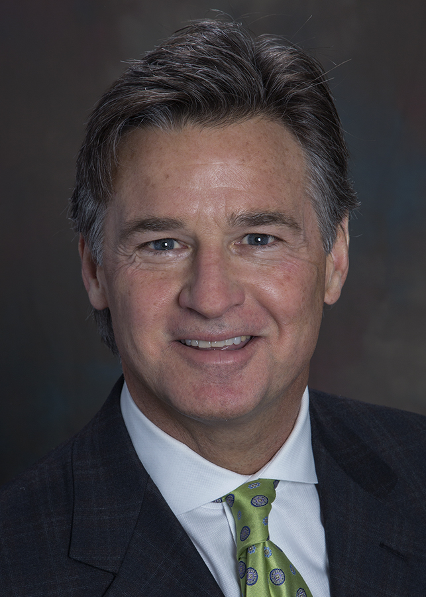
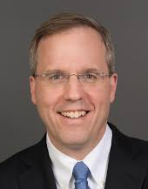
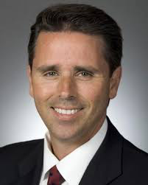
Thank-you!
Special thanks to…
All Course Faculty
All Program Directors / Coordinators
My WashU Staff – Sophie Church / Gretchen Blow / Michelle Ernst
Joni Shulman, SNS Resident Course Administrator

