Slide 1
Surgical Anatomy of the Spine

Slide 2
Cervical Spine
7 Vertebrae
Lordotic Curve
Facets in Axial Plane
2 Special Vertebrae

Slide 3
Cervical Spine
Atlas/C1
Ring shaped, anterior/posterior arches
Anterior ring articulates with dens of axis /C2
Transverse foramen (vertebral arteries)
Lateral masses lie anterior and medial
Form joints with condyles and axis (C2)

Slide 4
Cervical Spine
Axis /C2
Elongated dens articulates with anterior ring of C1
Superior facet articulates with C1
Inferior facet articulates with C3
Transverse foramen
(vertebral arteries)
Pars interarticularis
versus the pedicles
- Screw placement

Slide 5
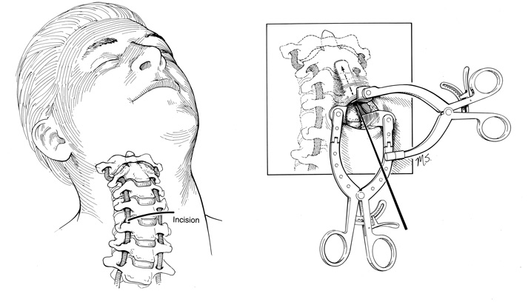
Cervical Spine
Odontoid screws

Slide 6
Cervical Spine

Slide 7
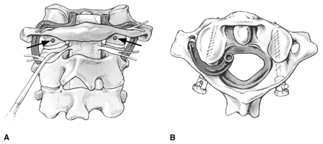
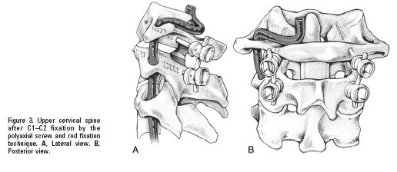
C1 lateral mass screw and C2 pedicle screw(Harms)
Avoid vertebral artery laterally and superiorly
Avoidance of C2 nerve root (may be sacrificed)
Robust venous plexus

Slide 8
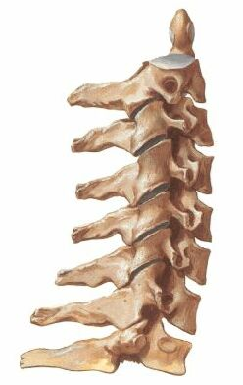
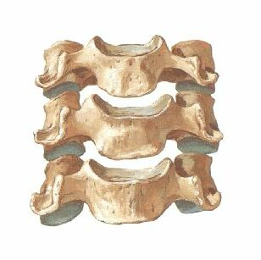
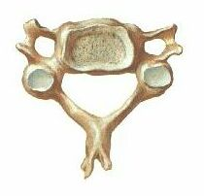
Subaxial Cervical Spine

Slide 9
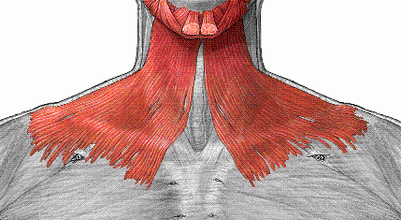
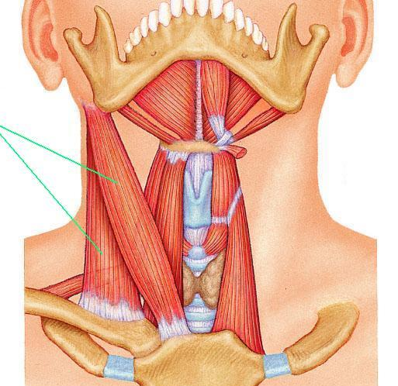
Anterior Anatomy of Cervical Spine
Anterior musculature
Platysma
Sternocleidomastoid
Longus colli

Slide 10
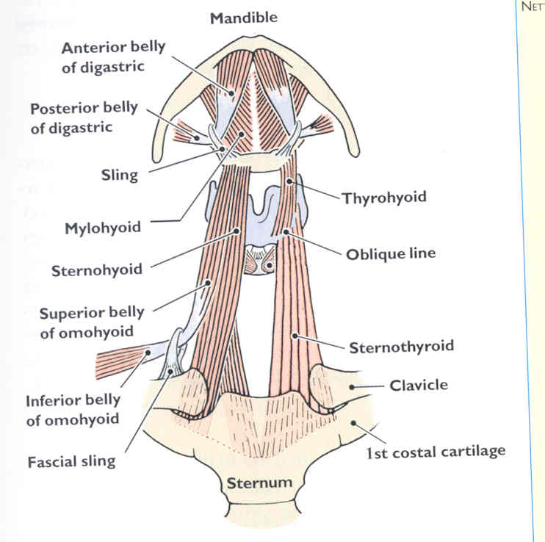
Anterior Anatomy of Cervical Spine
Anterior musculature
Strap muscles (Infrahyoid)
Sternohyoid
Omohyoid
Thyrohyoid
Sternothyroid
Strap muscles (Suprahyoid)
Digastric
Mylohyoid

Slide 11
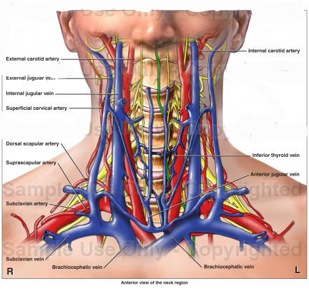
Anterior Anatomy of Cervical Spine
Important Vessels
External jugular
Superficial to SCM
Internal jugular (IJ)
Deep to SCM
Sits lateral to carotid
Common carotid
Deep to SCM
Sits medial to IJ

Slide 12
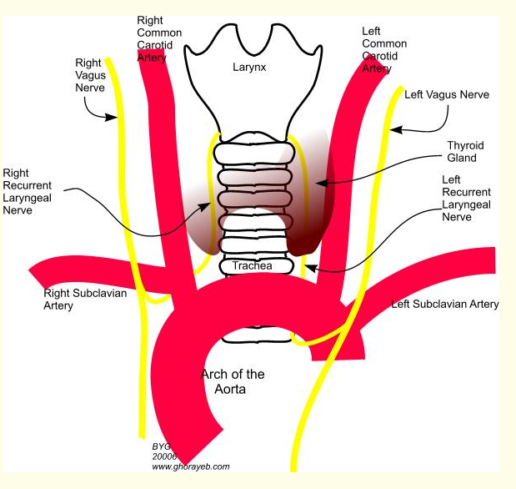
Anterior Anatomy of Cervical Spine
Important nerves
Vagus nerve
Posterior in sheath
Branches of vagus
Recurrent laryngeal
Lower on left side

Slide 13
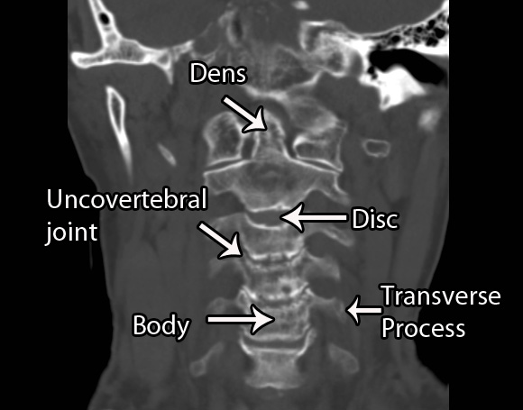
Anterior Anatomy of Cervical Spine
Bony Anatomy
Vertebral body
Uncinate processes
Uncovertebral joint
Lateral margin for discectomy
Transverse processes
Anterior tubercle
Posterior tubercle
Groove for nerve

Slide 14
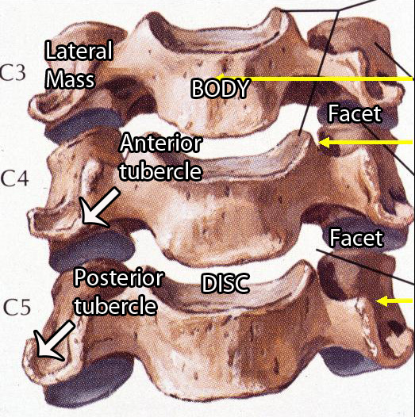
Anterior Anatomy of Cervical Spine

Slide 15
Patient Positioning and Preparation
Soft roll under the C-spine
Normal lordotic curve is re-established when feasible
Patients head may be placed under traction
Notes:
The patient is placed in the supine position, the neck is supported, and slightly hyper-extended.

Slide 16
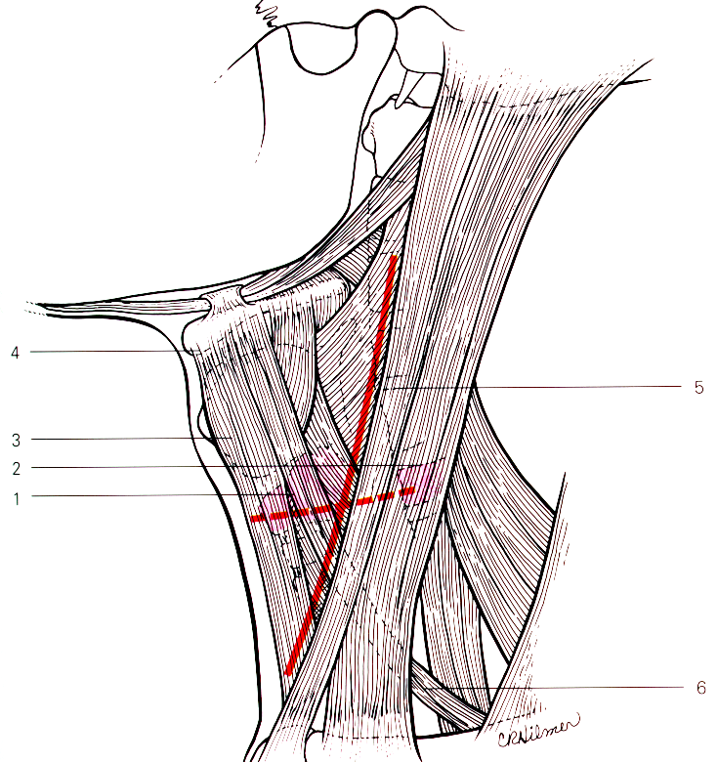
Anterior Anatomy of Cervical Spine

Slide 17
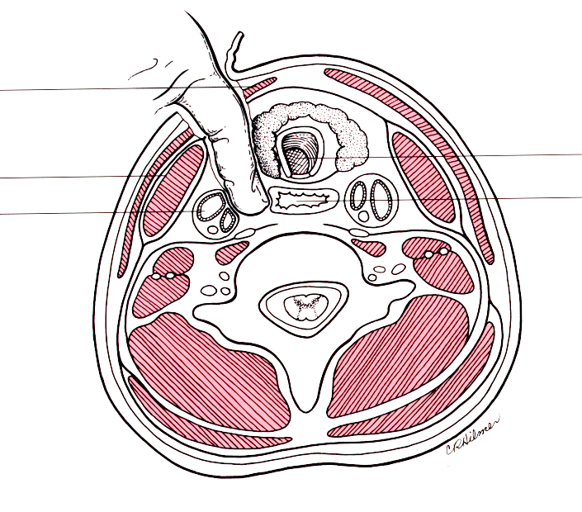
Exposure and Dissection Plane

Slide 18
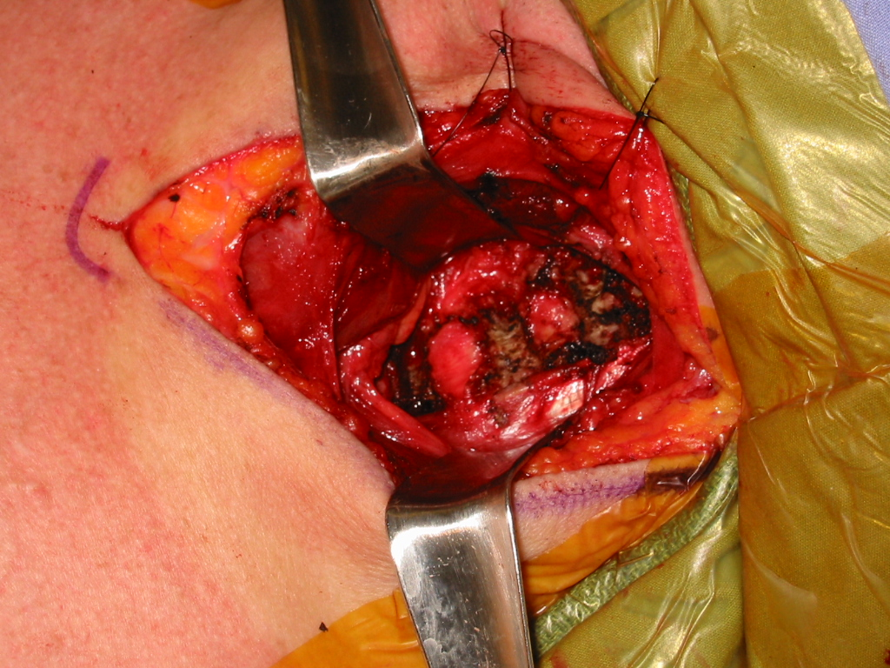
Surgical Approaches
Anterior
Notes:
Verify that the image is from a skeletally mature patient.
Footnote where image was taken/borrowed from.

Slide 19
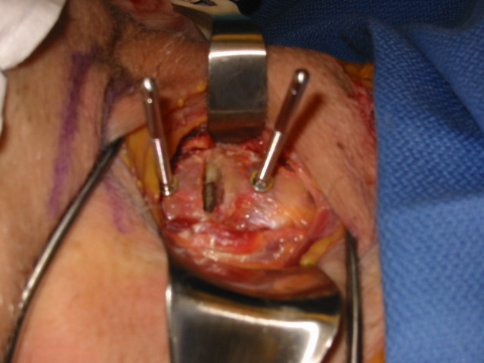
Surgical Approaches
Anterior
Notes:
Verify that the image is from a skeletally mature patient.
Footnote where image was taken/borrowed from.

Slide 20
Anterior Discectomy

Slide 21
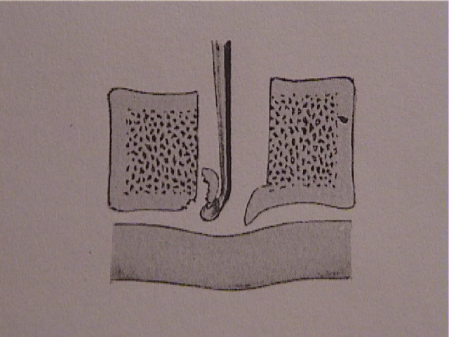
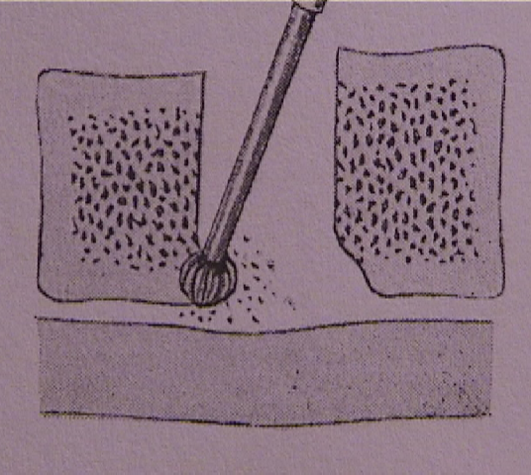
Decompression - Removal of the Posterior Osteophytes
Notes:
The osteophytes may be removed the a curette or a drill, and should be removed before the ligament is removed.

Slide 22
Posterior Anatomy of Cervical Spine
Posterior musculature (superficial to deep)
Trapezius
Splenius capitis
Semispinalis capitis
Semispinalis cervicis
Rectus capitis posterior
Minor and major
Obliquus capitis

Slide 23
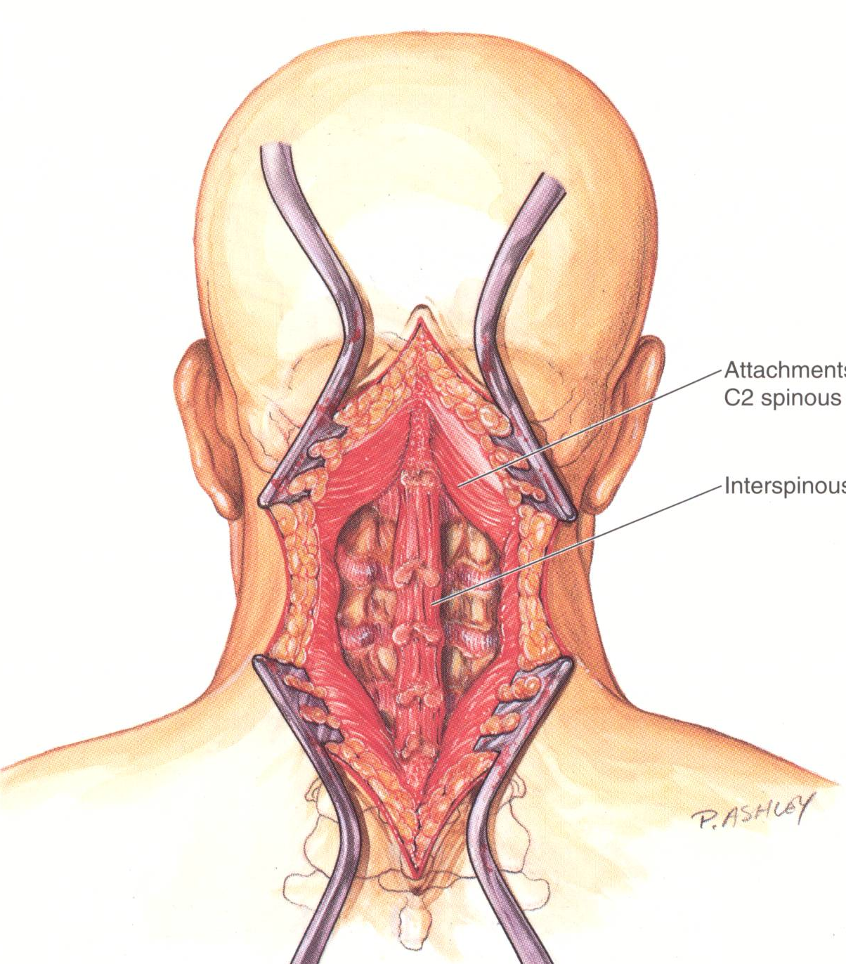
Exposure of Posterior Cervical Spine

Slide 24
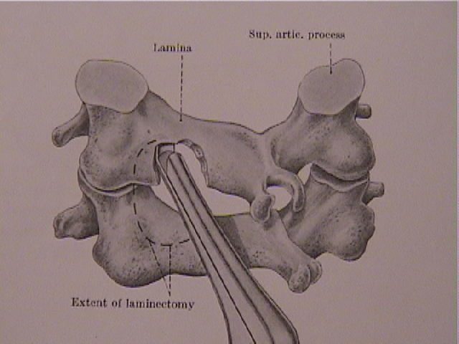
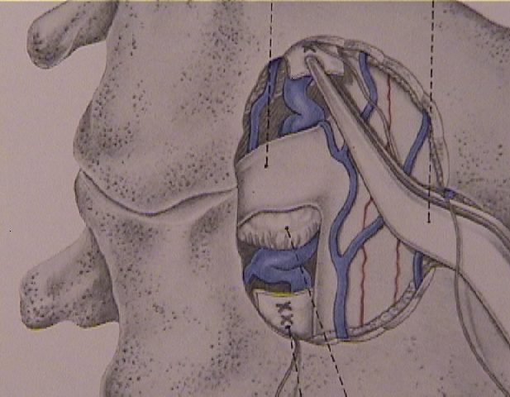
Posterior Cervical Lamino-foramenotomy

Slide 25
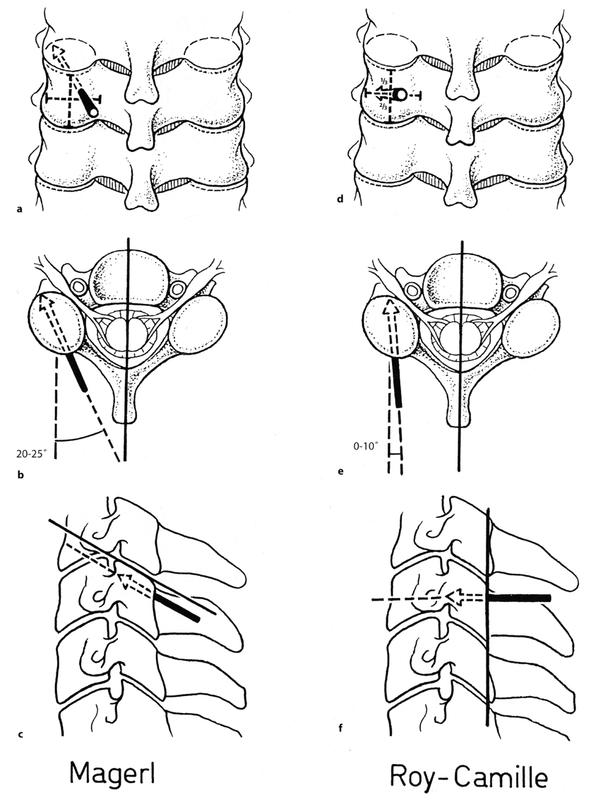
Instrumentation Landmarks of the Posterior Subaxial Cervical Spine

Slide 26
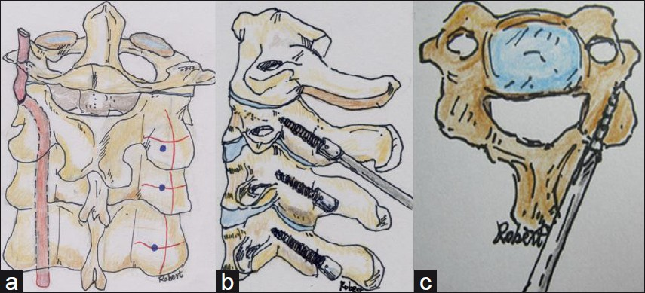
Posterior Anatomy of Cervical Spine
Schematic drawing of lateral mass screws

Slide 27
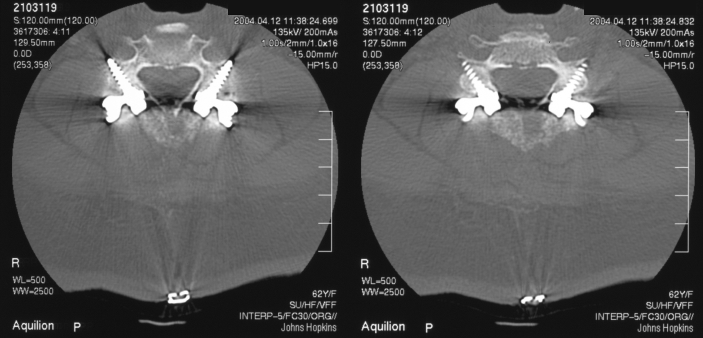
Lateral Mass Screws

Slide 28
Thoracic Spine
12 Vertebrae
Kyphotic Curve
Ribs Attached
Minimally Mobile
Facets in Coronal Plane

Slide 29
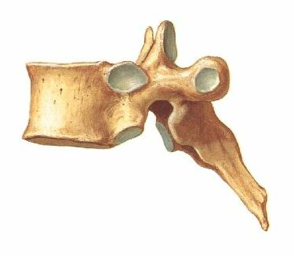
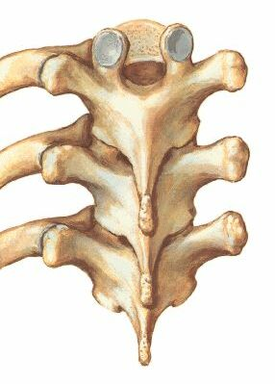
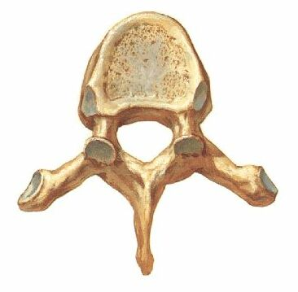

Slide 30
Surgical Approaches
Posterior - Laminectomy (all levels)
Posterolateral
Transpedicular (all levels)
Costotransversectomy (thoracic)
Lateral
Lateral extracavitary (thoracic)
Anterolateral
Posterolateral thoracotomy (thoracic)
Retroperitoneal (L2 - L4)
Thoracoabdominal (T11-L1)
Anterior
Median sternotomy (T1 - T3)
Transperitoneal (L5 - S1)

Slide 31
Anterolateral Thoracic (same for lumbar)
Lateral decutitus, bean bag
Flex down leg at knee for stability
Pad knees with pillow
Axillary roll
Arms at 90 degrees
+/- bend in table (opens up T/L junction)
Left side up to avoid liver and vena cava
Good for retroperitoneal approach

Slide 32
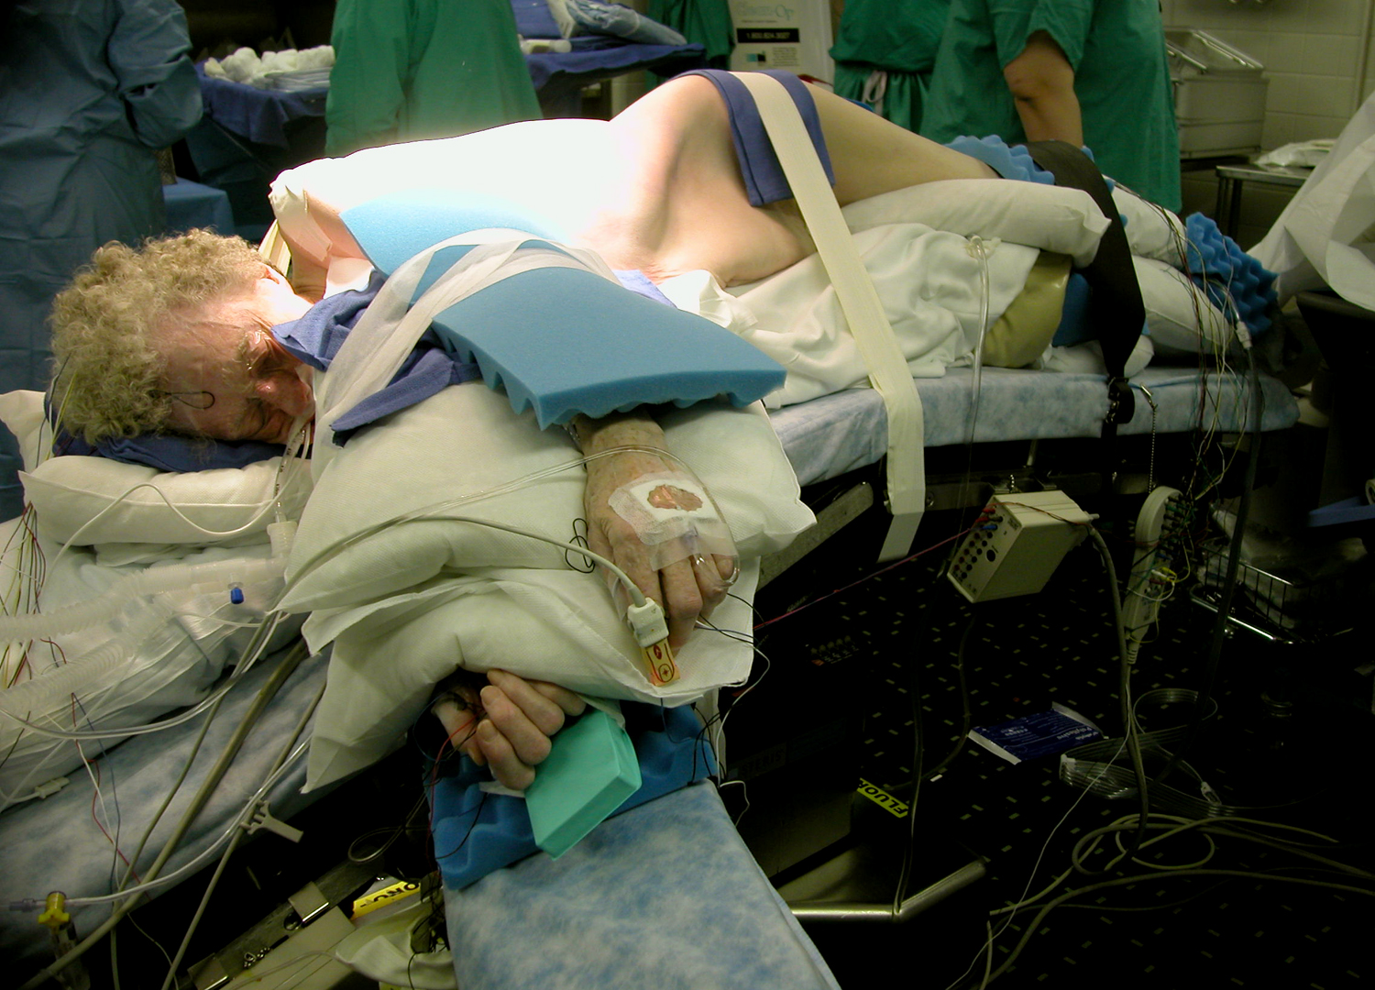

Slide 33
Exposure

Slide 34
Exposure

Slide 35
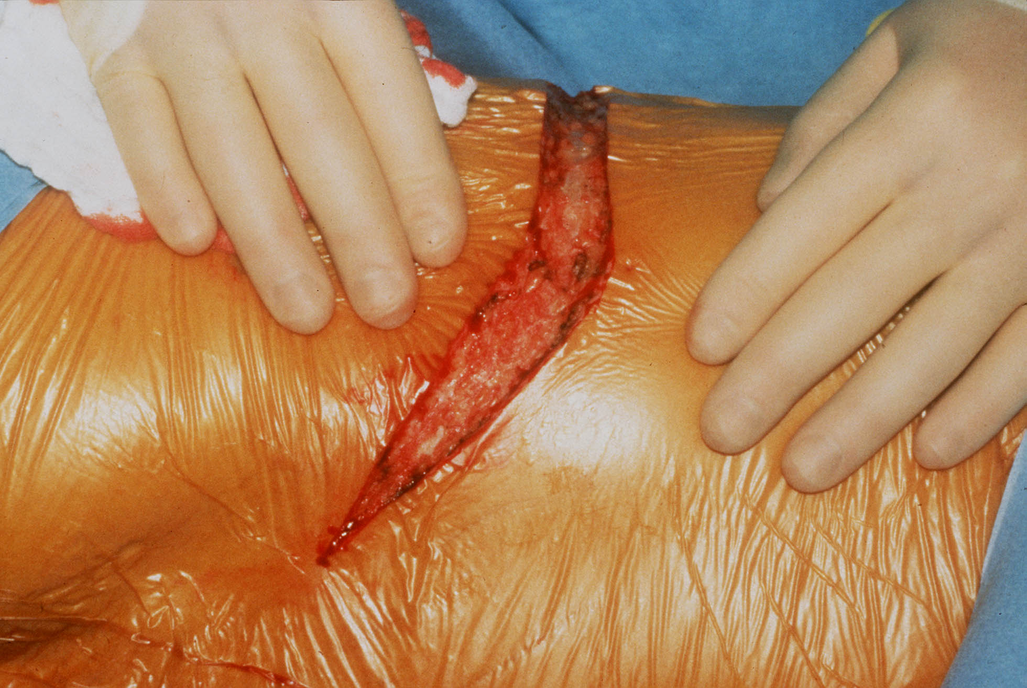

Slide 36
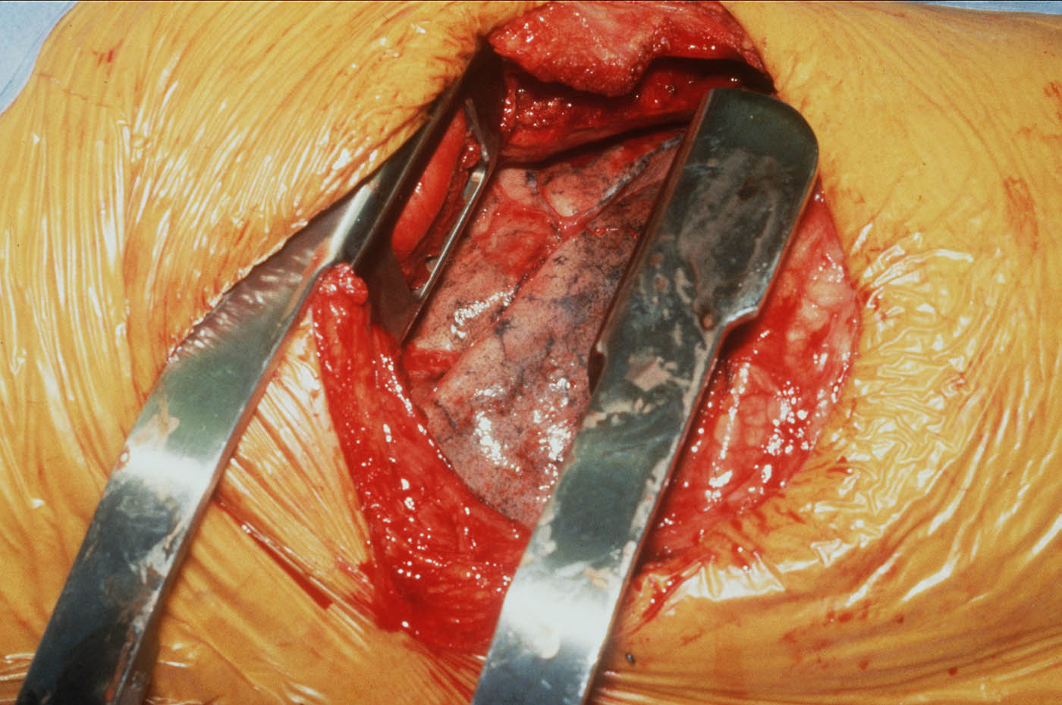

Slide 37
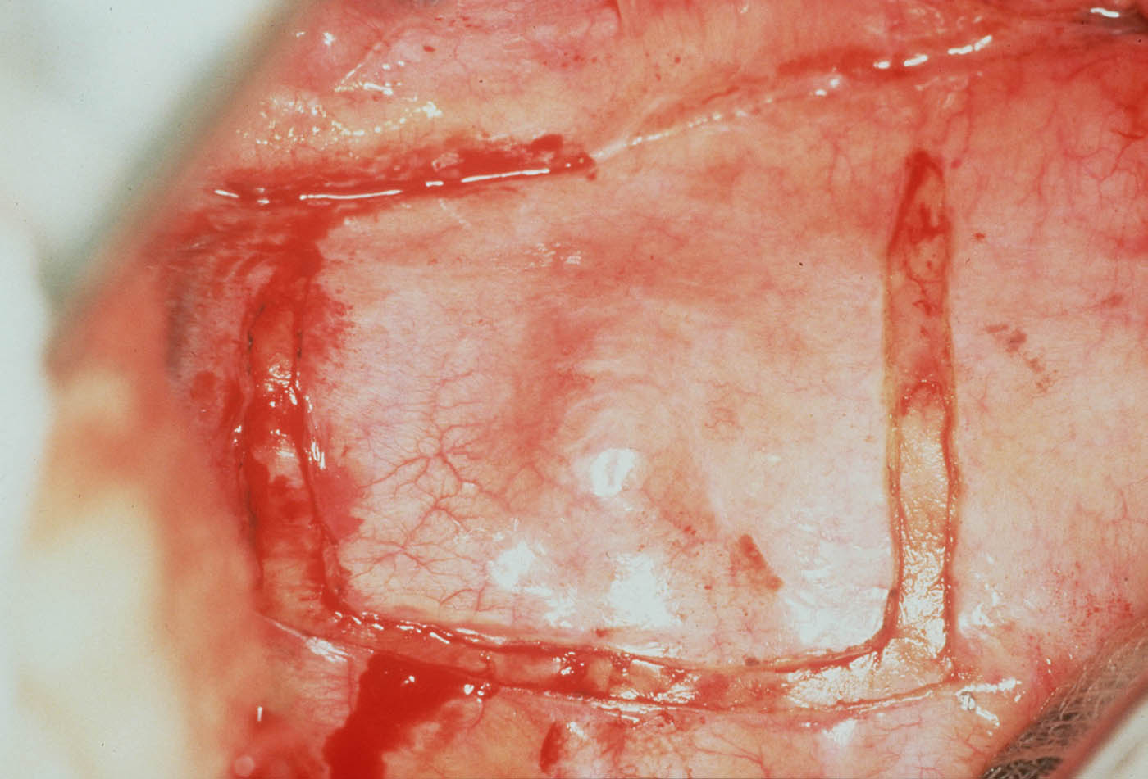

Slide 38
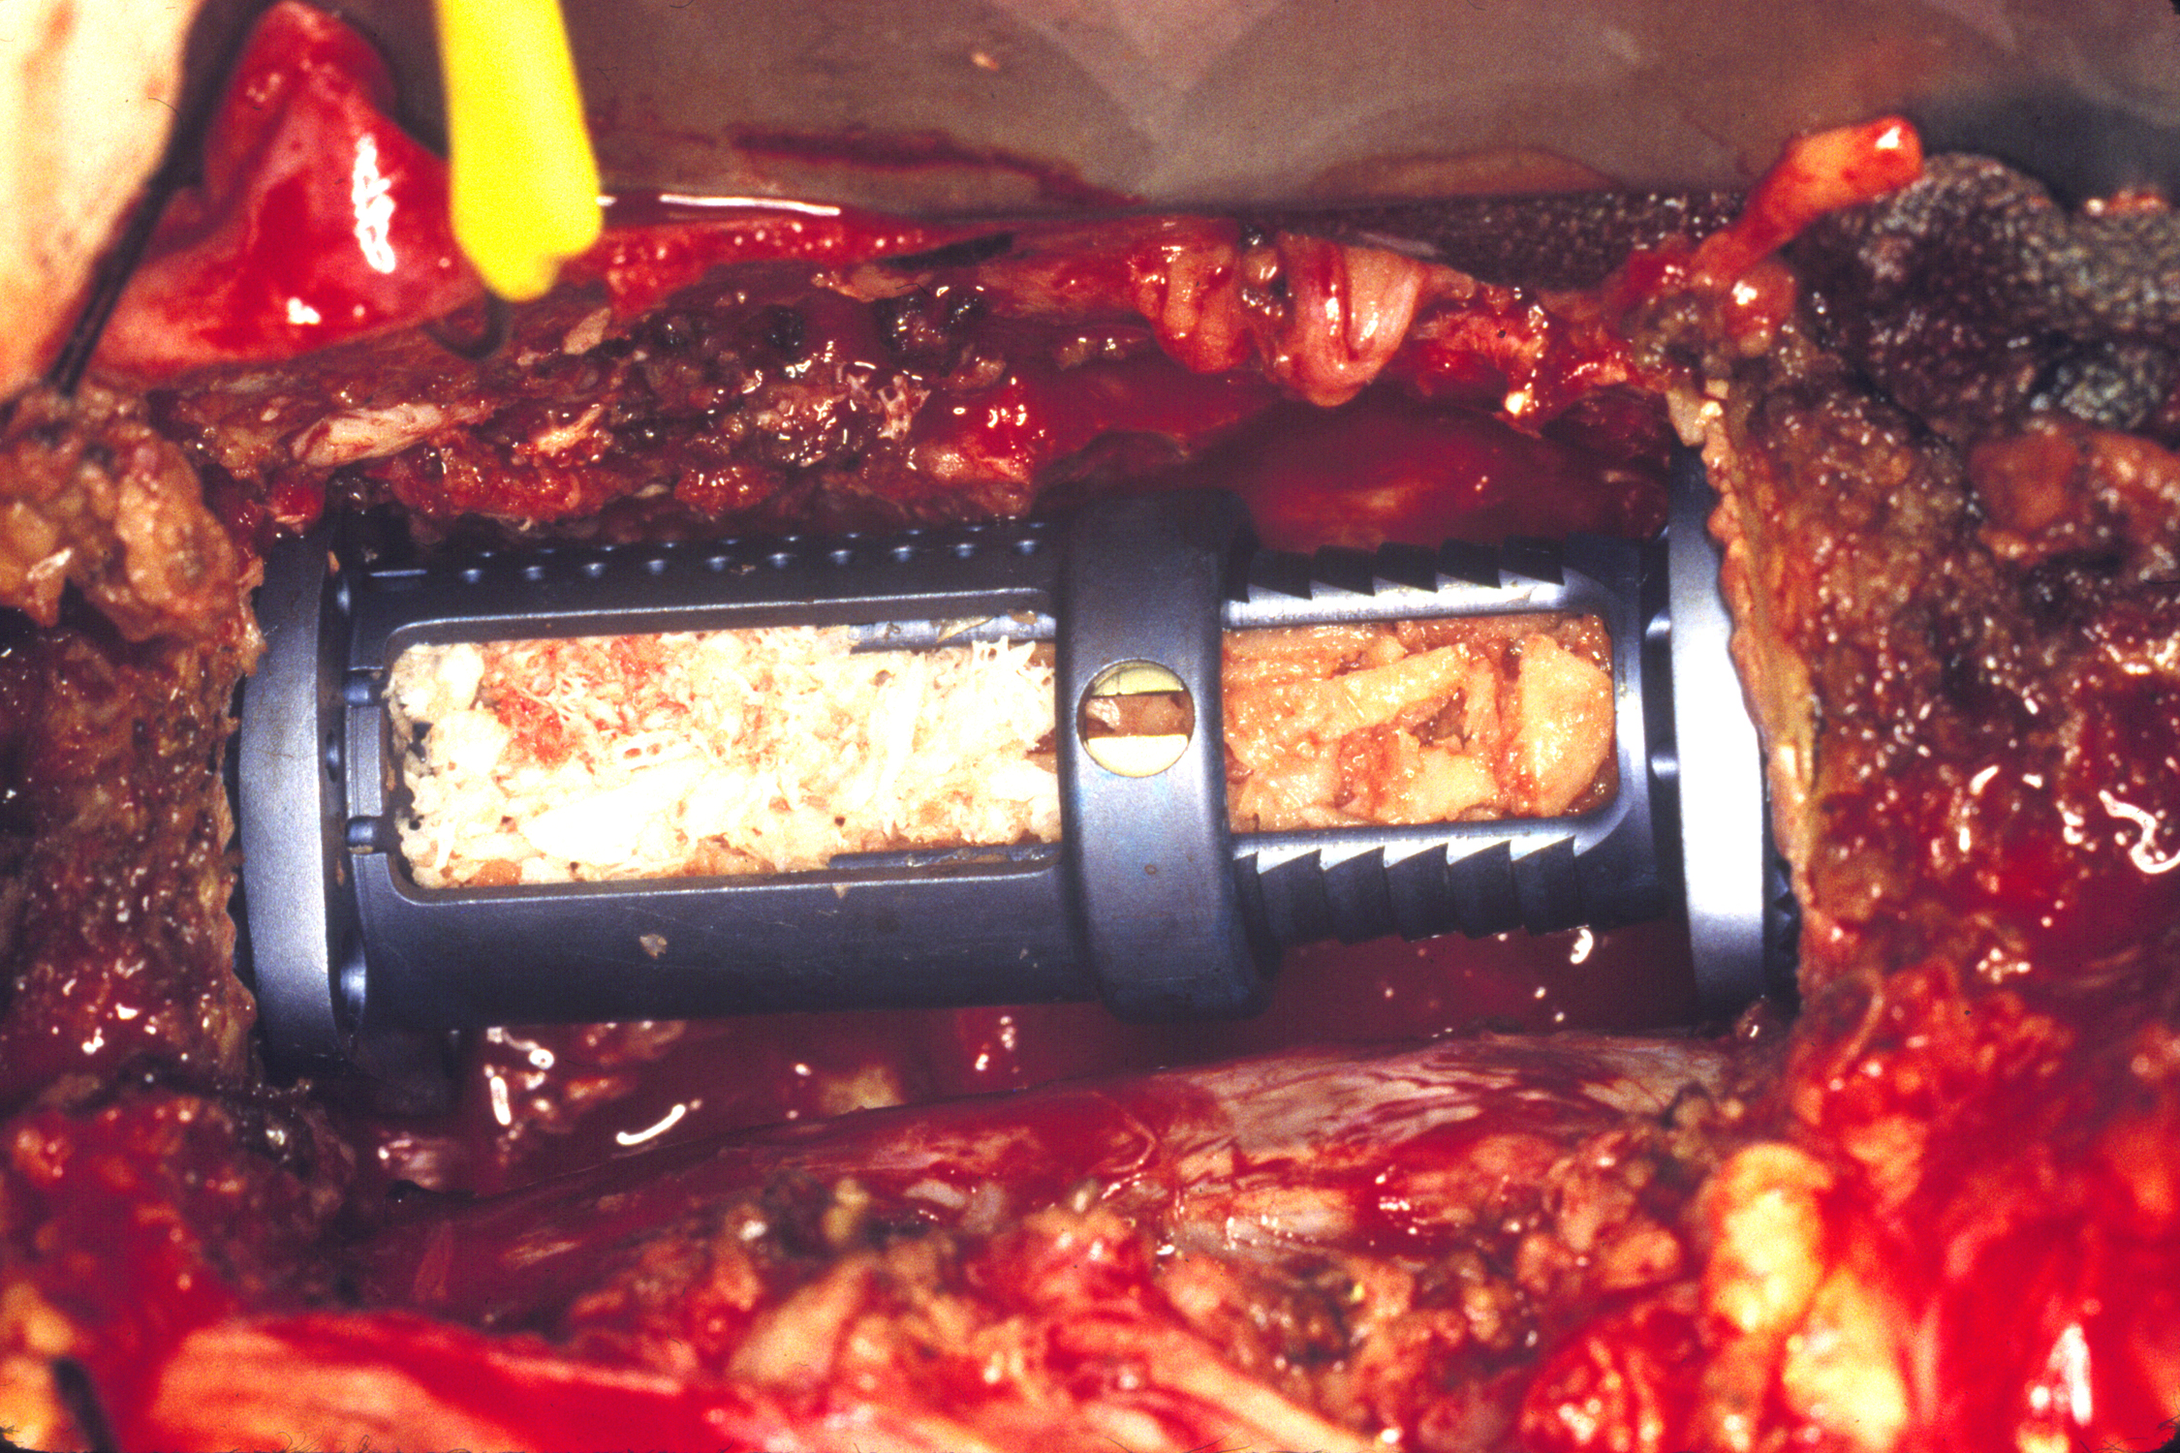

Slide 39
Anterior Surgical Approaches
Access to T1 from Anterior Cervical approach in rare cases
T2-4 via Transclavicular, Transmanubrial, T2-6 Trans-sternal/trans-thoracic
High morbidity due to anatomical structures

Slide 40
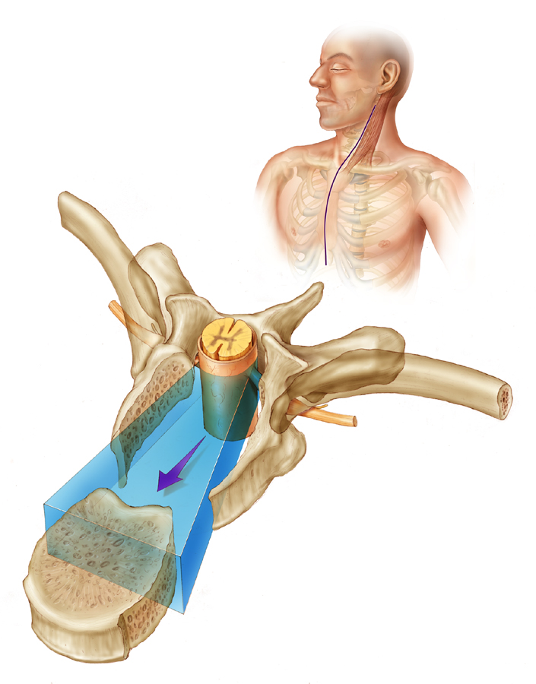

Slide 41
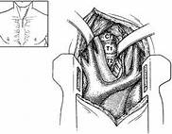
Anterior Surgical Approaches

Slide 42
Posterior Approaches
Midline posterior approaches allow for a variety of procedures
Transpedicular
Costotransversectomy
Posterolateral
Lateral extracavitary
Transforaminal

Slide 43
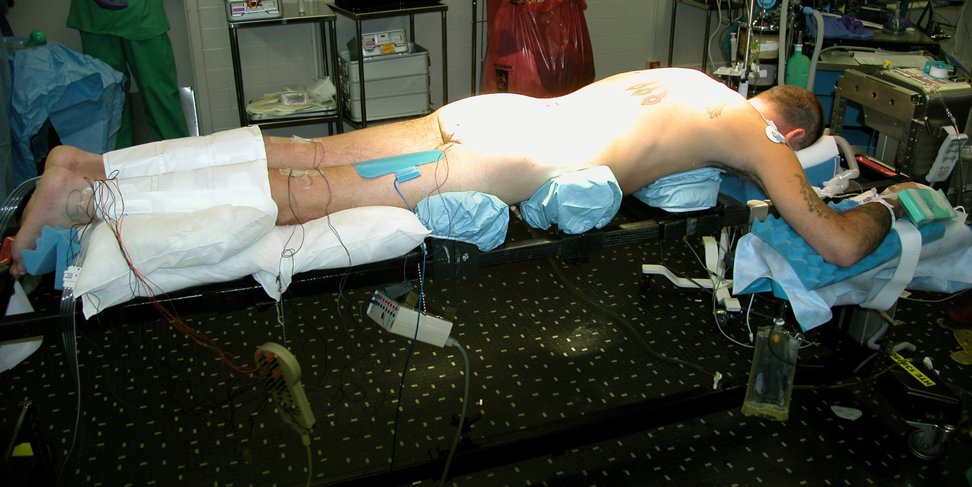

Slide 44
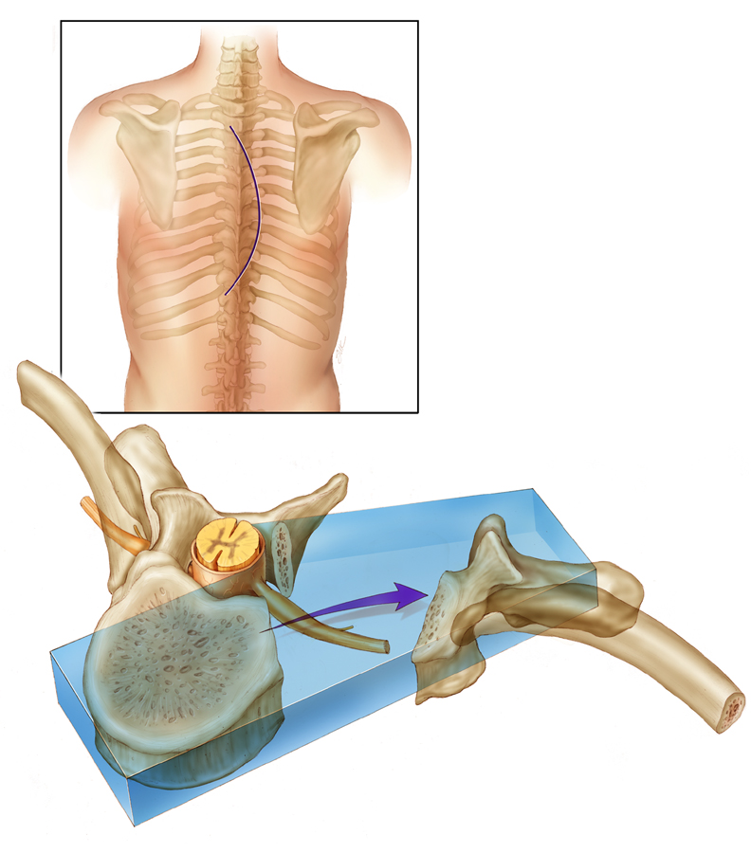

Slide 45
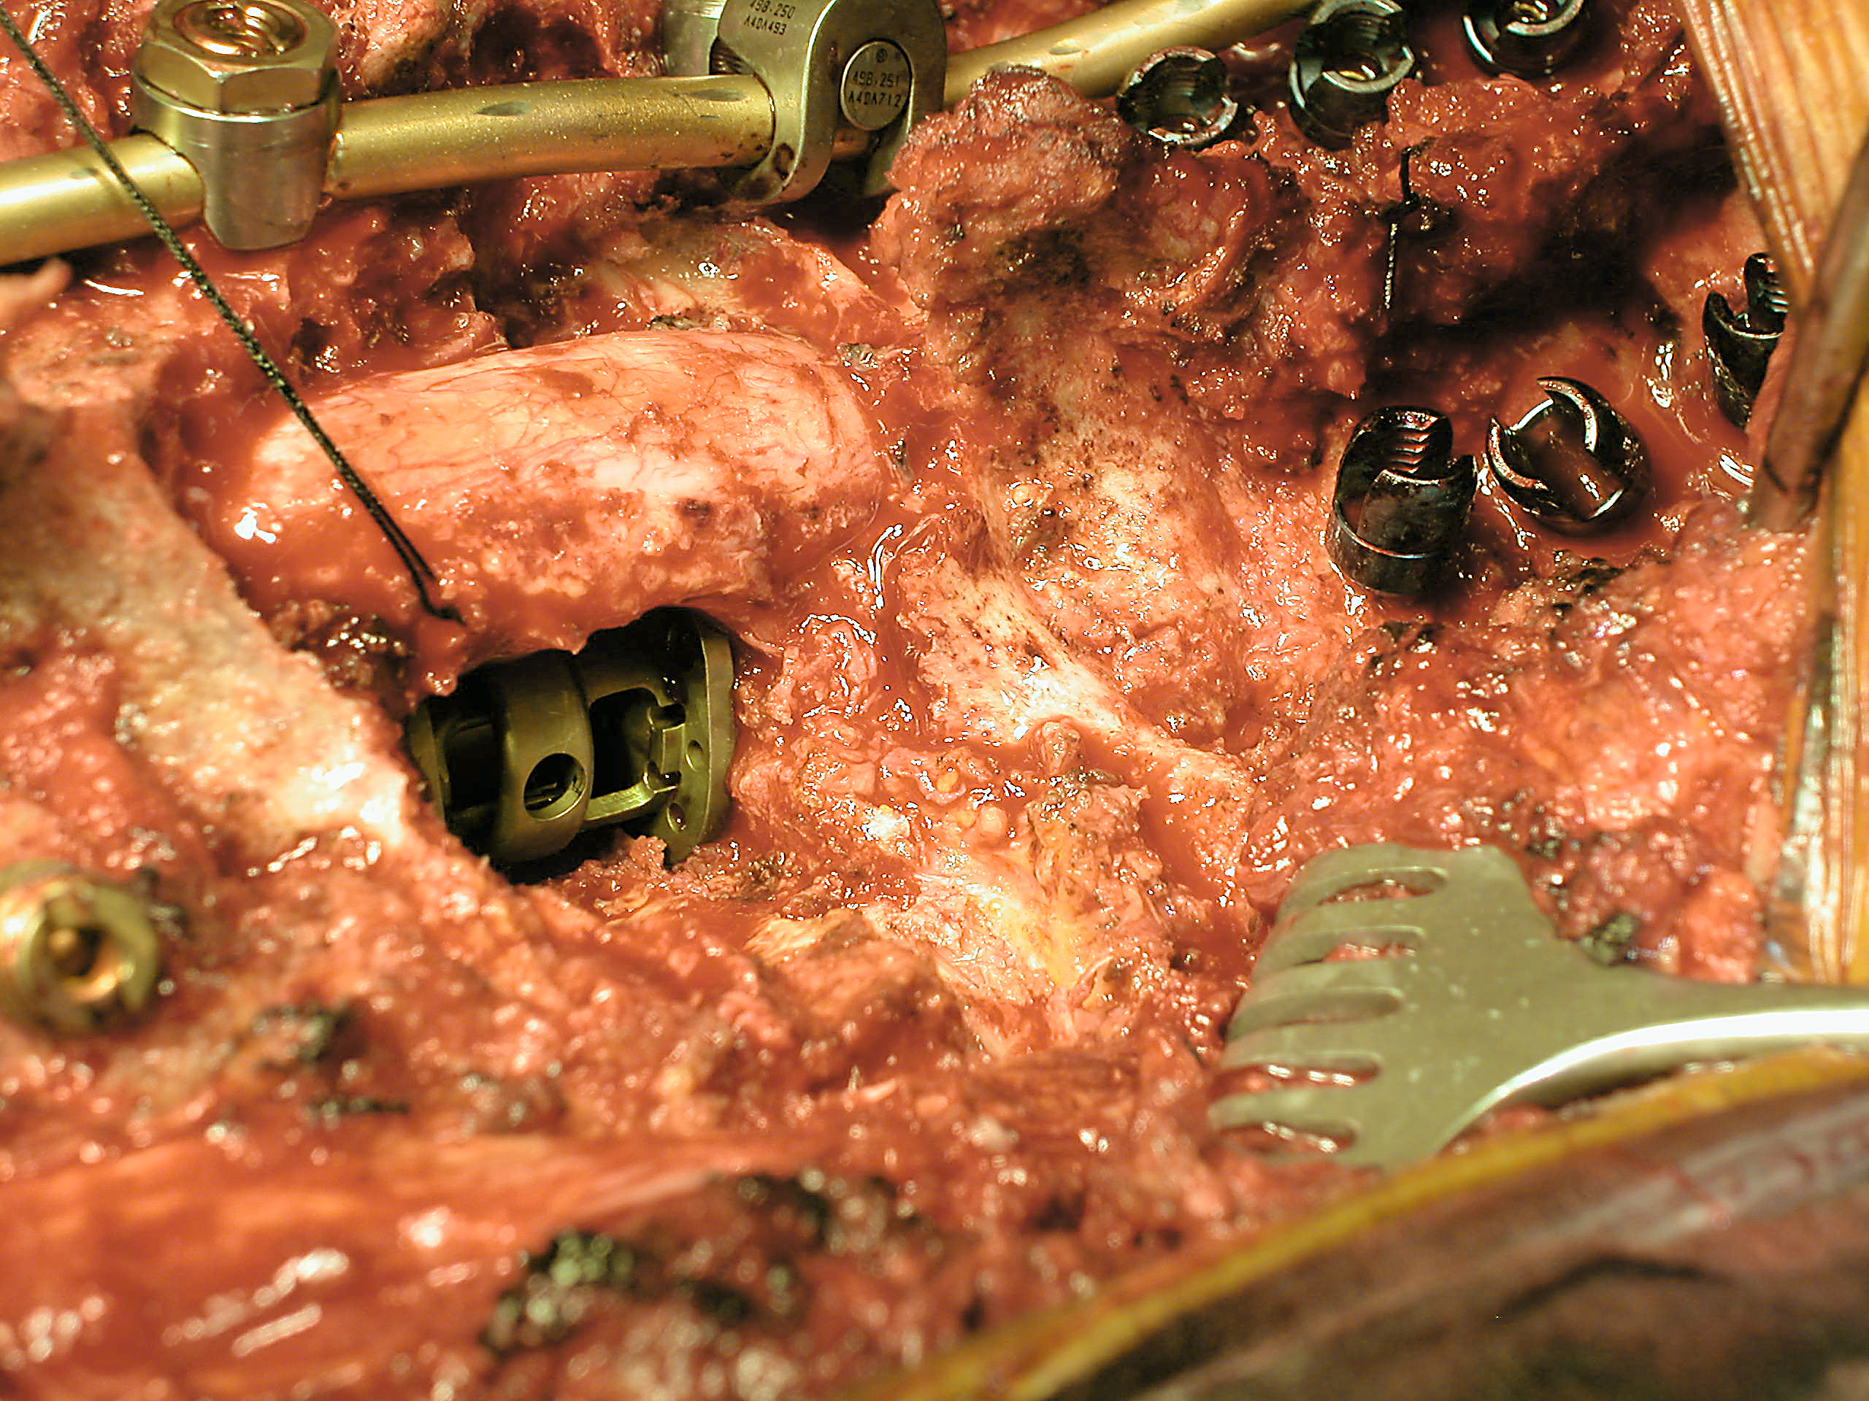

Slide 46
4 mo followup

Slide 47
Thoracic Pedicle Screw Anatomy
Identify Transverse process ridge
Identify lateral 1/3 of facet joint
3-4mm pineapple burr for start hole

Slide 48
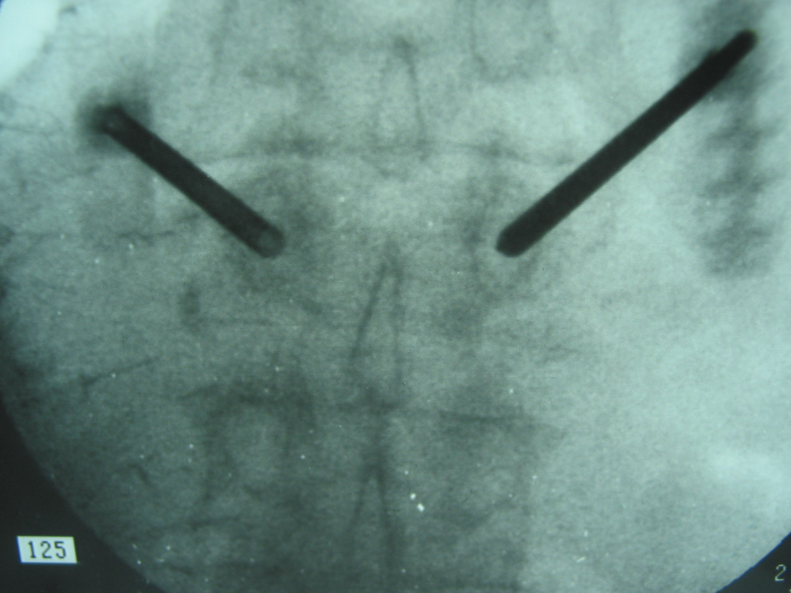
Thoracic Pedicle Screw Anatomy
Thoracic facet joint
Pedicle
Transverse process

Slide 49
Thoracic Pedicle Screw Anatomy
Remove all soft tissue
Expose key anatomy
Remove facet capsule
Locate TP and lamina
Remove inferior facet

Slide 50
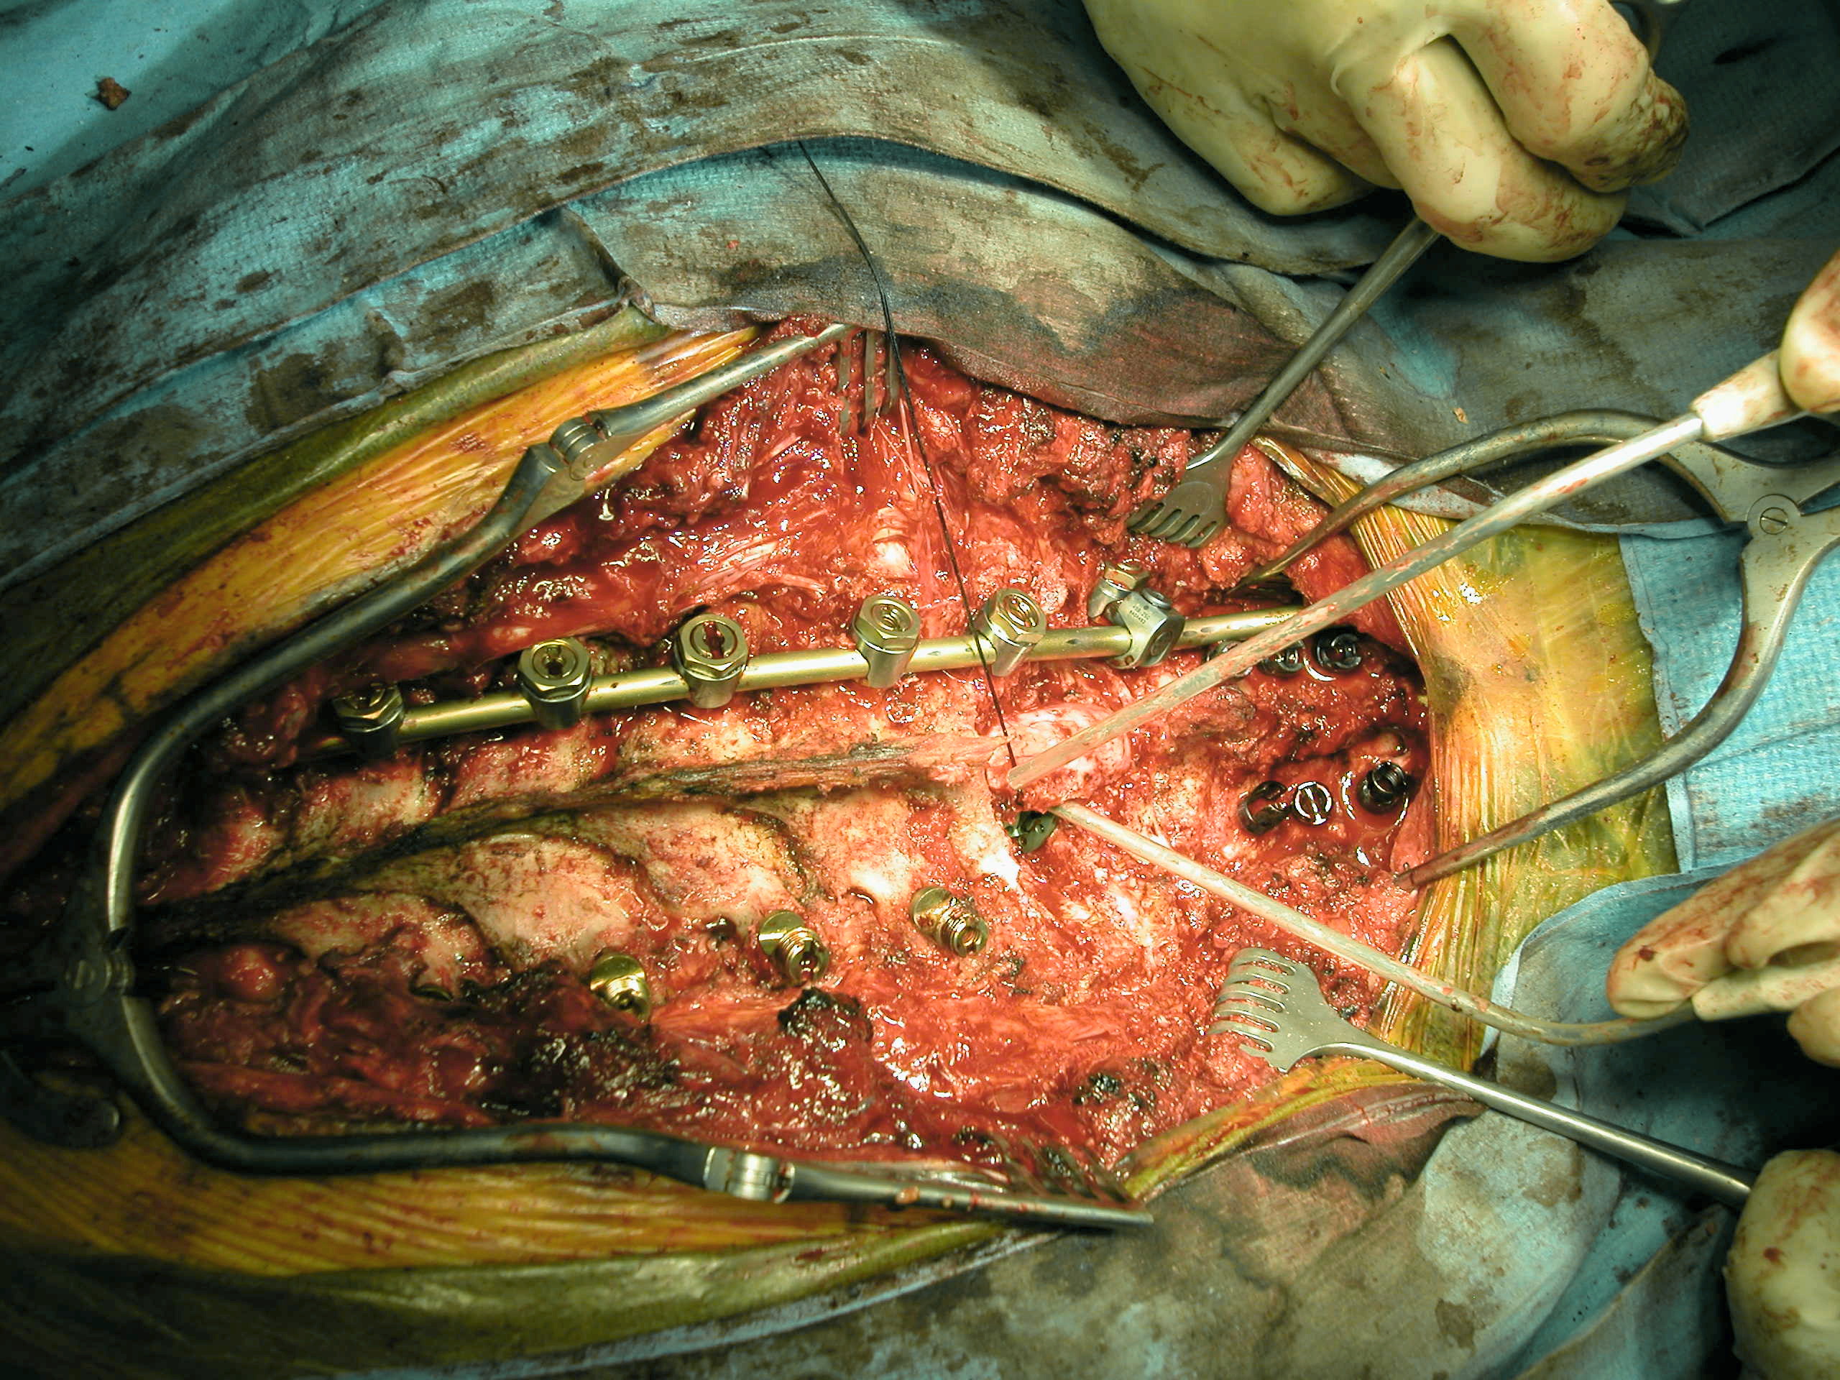

Slide 51
Lumbar Spine
5 Vertebrae
Lordotic Curve
Facets in Sagittal Plane

Slide 52
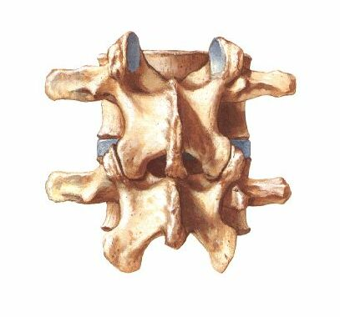
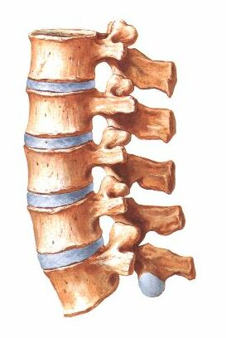
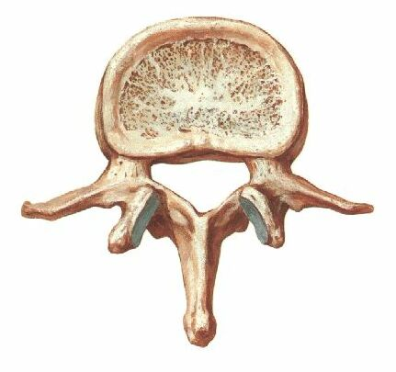

Slide 53
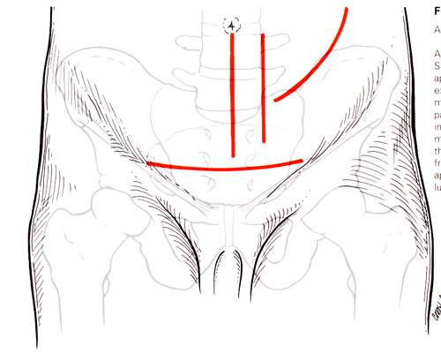
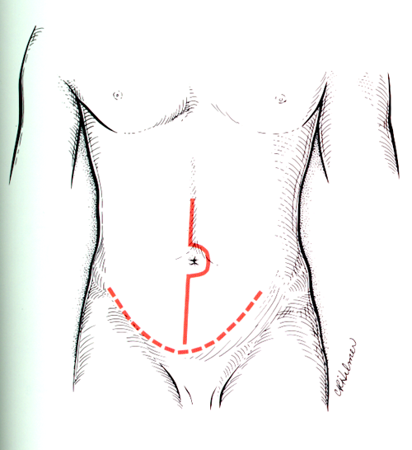
Anterior Approach

Slide 54
Landmarks

Slide 55
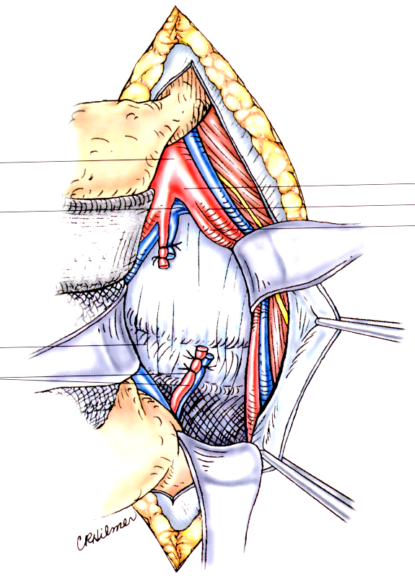
Exposure

Slide 56
Exposure

Slide 58
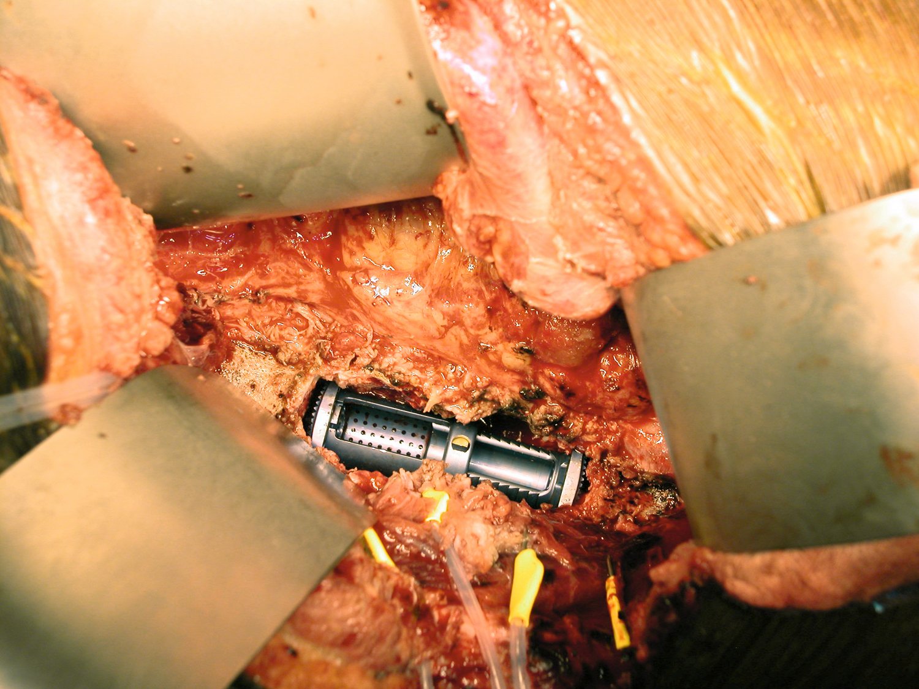
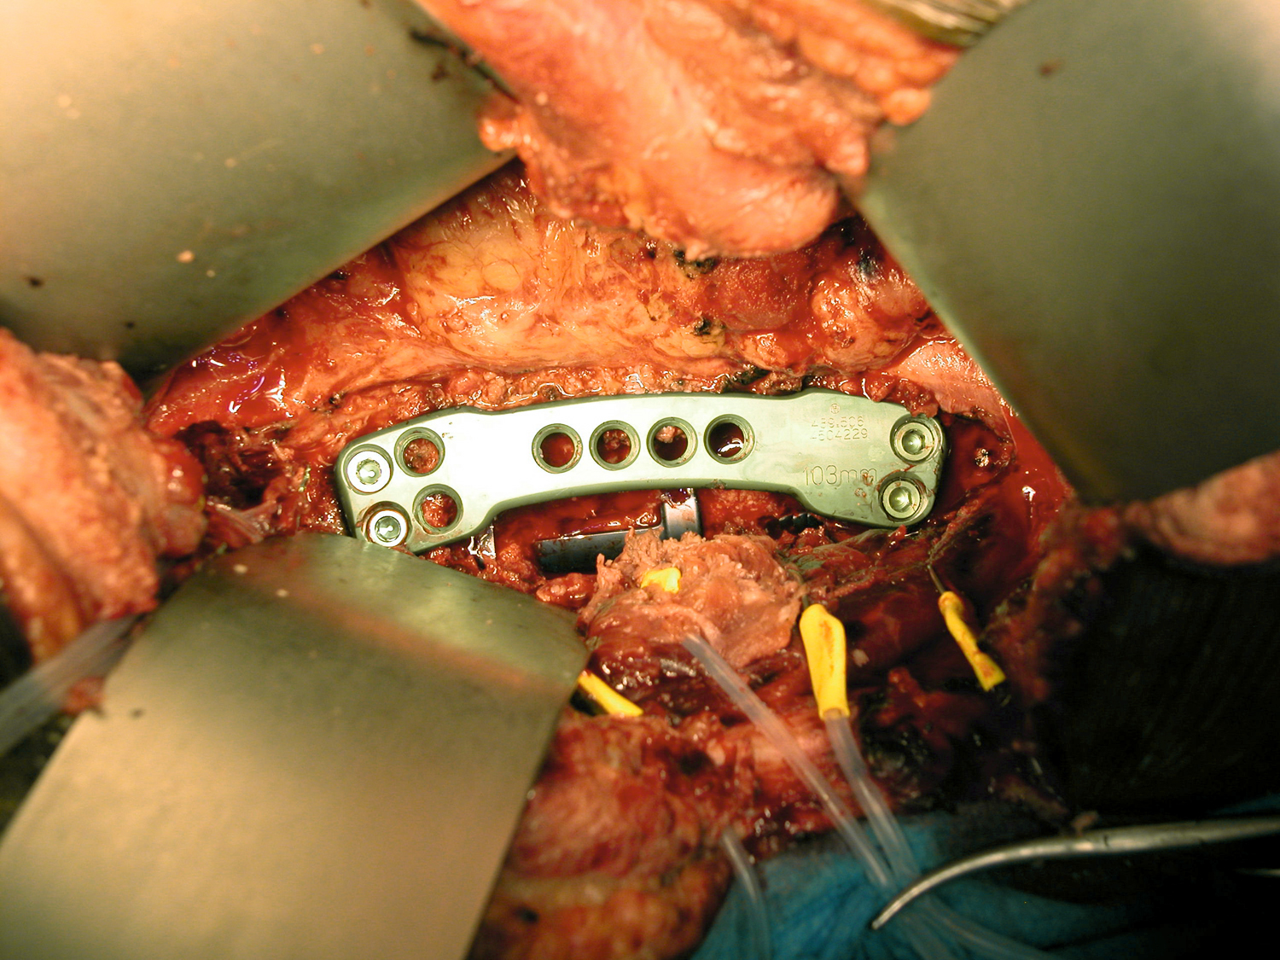
Anterior Lumbar

Slide 59
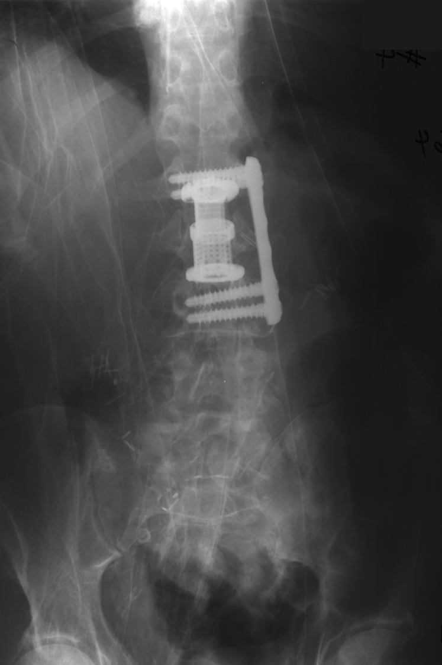
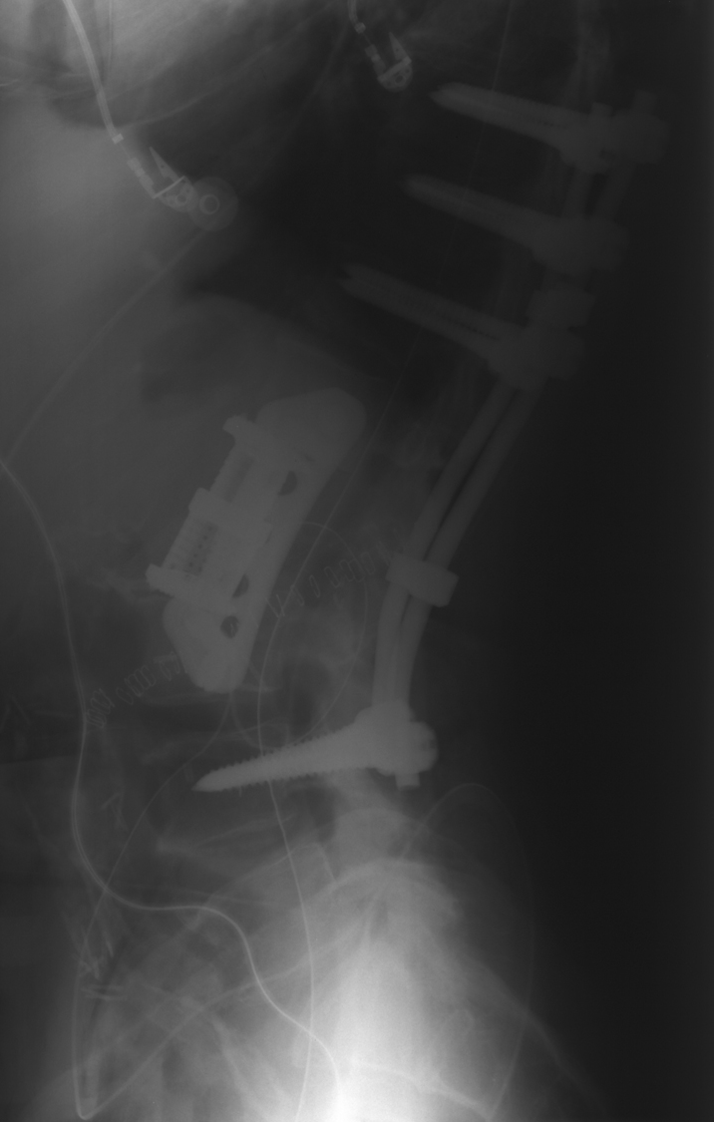
Anterior Lumbar

Slide 60
Posterior Approach

Slide 61
Exposure

Slide 62
Instrumentation Landmarks

Slide 63
Pedicle screw placement

