Slide 1

Handoffs
SNS Resident Training Course

Slide 2
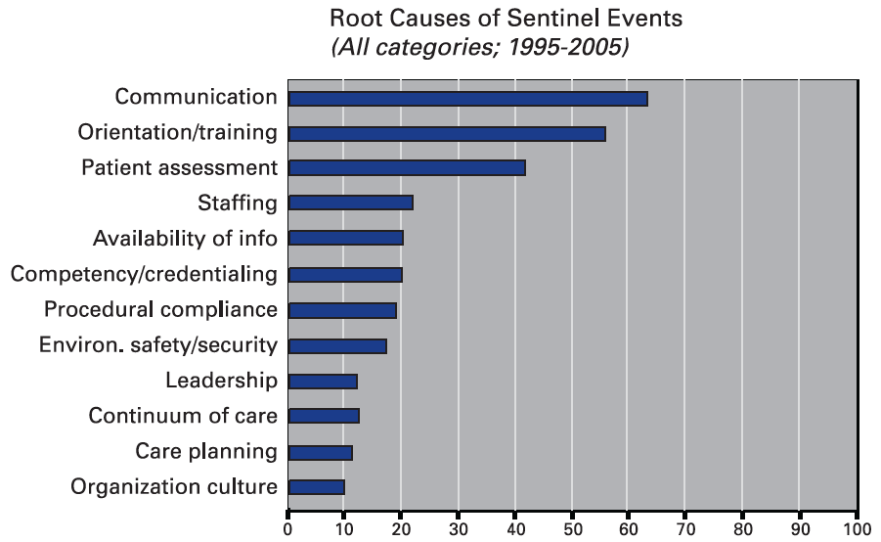
The Need for Safer Transitions of Care
Medical errors result in ~98,000 deaths/year in the U.S.
Communication errors cited in nearly 65% of sentinel events
  Sentinel event = preventable adverse events that result in serious injury or death
Joint Commission’s
Annual Report on Quality
and Safety 2007

Slide 3
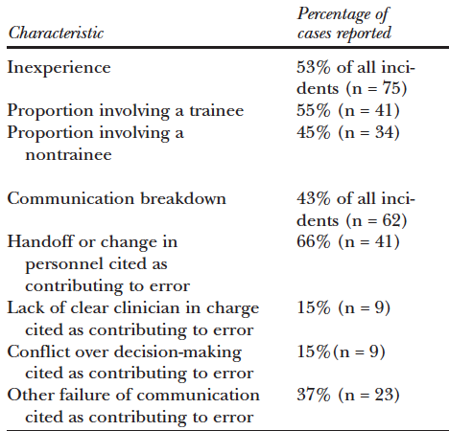
The Need for Safer Transitions of Care
43% or surgical adverse events attributed to communication errors
Handoff error or clinician shift change implicated in 66% of these
Gawande et al.
Surgery 133:614-21
2003

Slide 4
Handoffs and Their Importance
Handoff: definitions
  Verbal and written communications between healthcare professionals as they transition between work shifts
  Transfer of primary responsibility of patient care to another person
Cross-coverage is an independent predictor of potentially preventable adverse events
Burton MC et al. J Hosp Med 5:547-52, 2010
Van Eaton et al. J Am Coll Surg 200:538-45, 2005

Slide 5
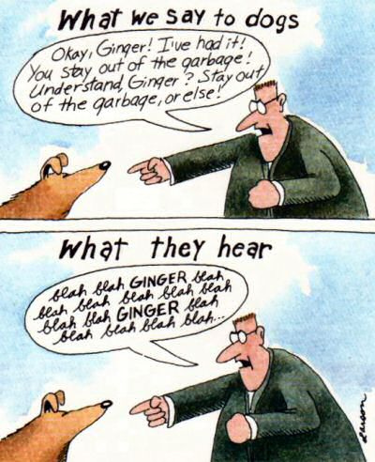
Modifiable Factors in Deficient Handoffs
Background noise or activity
Disorganized communication
Too much/too little information
Failure to communicate high-risk status
Incomplete transition of responsibility
Hierarchical barriers
  Junior residents reluctant to hand work off to seniors
Mismatch of information conveyed
  Differing levels of resident experience/seniority
  Differing expectations by provider type
Communication Breakdown
  Speaker: overestimates how well the message is understood
  Listener: failure to listen
Pham JC et al. Ann Rev Med 63:447-63, 2012

Slide 6
Emphasis: Transition of Responsibility
After finishing a case in the evening, an attending comes to round in the ICU and asks the night float about a CT on a patient that s/he is covering.
“I’m sorry, that’s not my patient” is not acceptable!
Handoffs transfer professional responsibility of patients in addition to informational content.

Slide 7
Improving Handoffs: Why Now?
The rate of preventable adverse events remains unacceptably high
  Conventional, non-standardized handoffs anticipated only 42% of overnight adverse events on surgical patients
Implementation of duty hours restrictions
  Number of handoffs increased 40% after in implementation in 2003
  Average of 15 handovers during a 5-day hospitalization since 2011
  Cultural change in healthcare that emphasizes shifts
Increasing involvement of non-physician providers
Scoglietti VC et al. Am Surg 76:682-6, 2010
Vidyarthi AF et al. J Hosp Med 1:257-266, 2006
Biller CK et al. J Surg Res 135:275-81, 2006
Babu MA et al. PLoS ONE 7:e41810, 2012

Slide 8

Transitions of Care:
From ACGME Common Program Requirements VI.B
Programs must design clinical assignments to minimize the number of transitions in patient care.
Sponsoring institutions and programs must ensure and monitor effective, structured hand-over processes to facilitate both continuity of care and patient safety.
Programs must ensure that residents are competent in communicating with team members in the hand-over process.

Slide 9

Handoffs in Other Fields:
Key Elements
Face to face transfer of information
Limited interruptions, quiet environment
Structured format to decrease omissions
Written summary with checklist
Accurate and up-to-date information
Specific contingency plans
Unambiguous transfer of responsibility
Both sender and receiver may ask questions
“Read-back” to increase memory and familiarity
Standardize the handoff!!

Slide 10
Data to Convey in Handoffs
Written Sign-out List | Verbal Exchange
Name/MRN | Describe each patient
Sex/Age | Identify active problems with current management and ongoing plan for each problem
Location
Attending | Pending studies/tests
Code Status/Sick | Review tasks being signed out
Dx | Planned admissions
Operation(s) and date(s) | Expected communications up the chain of command
Focused PMH
Focused Meds
Tubes/Drains/Lines
Active Issues
Things to Do
Chain of Command
Antonoff MB et al. Am J Surg 2012 Sep 6. [Epub ahead of print]

Slide 11
Sample Template for Handoffs:
“SBAR”
Originally developed in the U.S. military, adapted for healthcare
Most commonly cited handoff tool
Endorsed by the WHO
S | Situation | Patient ID, covering MD and contact info, present illness, procedure details
B | Background | Diagnosis, code status, PMHx, surgical Hx, Meds, Allergies, VS, lab results, significant events during hospital stay, pertinent exam findings
A | Assessment | Specific needs and concerns, cardiovascular stability, surgical complications, relevant cultural factors
R | Recommendation | Treatment plan, discharge plan, preoperative assessment complete or not, etc.
Time is allowed for dialog and questions at the end.
Riesenberg LA et al. Am J Med Qual 24:196–204, 2009

Slide 12
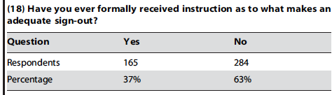
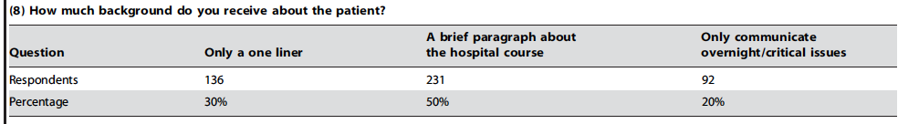
Handoffs in Neurosurgery
Specific challenges in neurosurgery handoffs
  Severity and acuity of illness
  Risks associated with lumbar and external ventricular drains
  Management of elevated ICP
  Indications for surgery vs conservative management
  Importance of serial neurological exams
  Many others
Significant opportunity for improvements in neurosurgery handoffs
  Babu et al. PLoS ONE, 2012
  Survey of 449/795 residents
  98 programs

Slide 13
Sample Template for NSG Handoffs:
The “SAAFE” Checklist
S | Sick patients | Relevant information pertaining to the sickest patients on service with a plan for clinical deterioration.
A | After Surgery | Summary of all recent post-op patients, who are vulnerable to early complications.
A | Admissions | Recent and expected admissions with treatment plans.
F | Follow closely | Patients with neurological conditions known to have a natural history of clinical deterioration.
E | Essential run-through | A complete run-through of the patient list, highlighting diagnosis, pertinent history, course in hospital, active issues and outstanding tasks.
Fallah A et al. World Neurosurg 2012 Jan 16 [Epub ahead of print]

Slide 14
Tools for Use in Handoffs
Presently, >25 mnemonics exist for use as handoff tools
  May not be “one size fits all”
  Jorm et al. Med J Aust, 2009 asserts that the best handoff tool is created through “flexible standardization” and contains:
  Minimum core clinical content
  Customization based on local/institutional needs
  Specialty-specific content

Slide 15
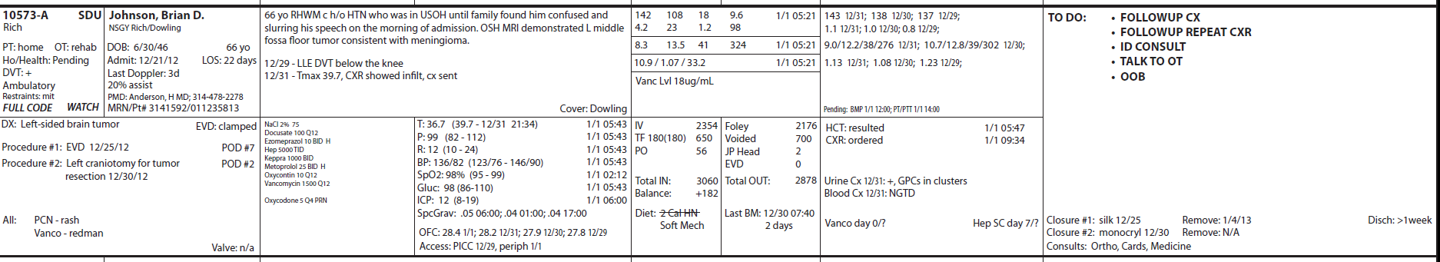
Sample Handoff Form from Washington University
Electronic Form:
Rounding List:
(Data auto-populates from EMR)

Slide 16
Summary
Transfer content and professional responsibility
Communication strategies
  Face-to-face
  Prioritize time on the sickest patients
  Ask questions
  “Read-back” to increase memory
Verbal content with specific contingency plans
Comprehensive, updated written content
Tasks to be completed
Standardize the handoff format!

