Slide 1
Burnout
Fredric B. Meyer, M.D.
Executive Dean, Mayo Clinic College of Medicine and Science
Dean, Mayo Clinic Alix School of Medicine

Slide 2
H Freudenberger 1974 ”staff burnout” as a state of exhaustion in the workplace theat leads to negative behaviorial traits C Maslach 1981 Emotional exhaustion Depersonalization decreased accomplishments

Slide 3
Emotional exhaustion (9)
Depersonalization Cynicism (5)
Decreased accomplishments (8)
BURNOUT

Slide 4
Burnout in Physicians vs. U.S. Workers
Shanafelt, West, Sinsky, Trockel, tutty, Satele, Carlasare, Dyrbye. Mayo Clin Proc In press
ePub https://doi.org/10.1016/j.mayocp.2018.10.023
Notes:
2011, 2014, 2017 surveys of US physicians along with a probability-based sample of US workers
Burnout (as measured by 2 items from the Maslach Burnout Inventory) improved between 2014 and 2017 among physicians, but physicians remain at higher risk for burnout than other US workers (persists on MV analysis controlling for work hours and other factors)

Slide 5
Common Signs/Symptoms of Burnout
Emotional withdrawal:
Cynicism
Broken relationships
Irritable behavior, workplace conflict
Diminished interest in department affairs
Insomnia
Apathy
Alcohol, substance abuse
Anxiety, Depression
Job dissatisfaction – transfer, early retirement
Suicide
Physical exhaustion

Slide 6
Precipitants of Burnout
Excessive workload Lack of autonomy
Financial stressors
Excessive administrative bureaucracy Exclusion from important work decisions
Relationship, family stress
Work – life imbalance
Shanafelt 2003, 2005; Spickard 2002

Slide 7
Medical Students

Slide 8
Associated Factors in NS residents Attenollo et al JNS 129:1349-1363, 2018
National Survey 21% response 346/1643
81% satisfied with career choice
32% satisfied with work/life balance
66% would select their residency again
41% had given serious thought to quitting
Overall burnout rate 67%
Influencers- hostile faculty social stress inadequate OR experience
Mitigators- Good Mentorship

Slide 9
Associated Factors in NEUROSURGEONS McAbee et al JNS 123:161-173, 2015
National Survey 24% response 783/3247
80% satisfied with career choice
70% would select their career again
52% thought that their career would worsen
48% satisfied with work/life balance
40% had given serious thought to quitting
Overall burnout rate 57% Academic NS 48% Private practice 63%
Influencers- work/life balance future earnings/health care reform

Slide 10
Shanafelt, West, .., Dyrbye. Mayo Clin Proc In press
ePub https://doi.org/10.1016/j.mayocp.2018.10.023
Notes:
2017 (n=5445), 2014 (n=6880), 2011 (n = 7288)
Burnout is measured here using the full 22-item Maslach Burnout Inventory (gold standard)
Some specialties experienced minimal change in proportion w. burnout, , but most peaked in 2014.
The 2017 MV analysis: older age and being married associated with lower odds of burnout. Being a woman (OR 1.32) and working more hours associated with higher rates of burnout.
In comparison to IM subspecialty, ER doctors (OR 1.87) were at higher risk for burnout while general surgery subspecialty, neurosurgery, and pediatric subspecialty were at lower risk for burnout.

Slide 11
Death in Residency academic medicine 92:976-983, 2017
2000- 2014 ACGME programs
381,614 residents
324 deaths (men 220 women 104)
Neoplastic disease (breast cancer)
Suicide (? Burnout)
Accidents

Slide 12
Physician SUICIDE
400 physicians annually
2-3 x higher than general population
Risk factors: depression (odds ratio 7.0)
burnout (odds ratio 1.9)
severe medical errors (odds ratio 1.8)
work stress

Slide 13
Resiliency
The capacity to recover quickly from difficulties; toughness; the ability of a substance or object to spring back into shape; elasticity
Synonyms: toughness, tenacity, “grit”, adaptability, hardiness, endurance, vigor, adaptability
“The ability to recover from setbacks, adapt well to change, and keep going in the face of adversity“
How to increase physician resiliency??
(Evans, Harvard Business Review, Jan. 2015)

Slide 14
Interventions
Residents are not a work force, they are there to learn
Adverse and abusive learning environment
Work hours, Green space
Annual physical examinations
Exercise
Close mentorship
Program Director commitment
Program resources
Wellness programs

Slide 15
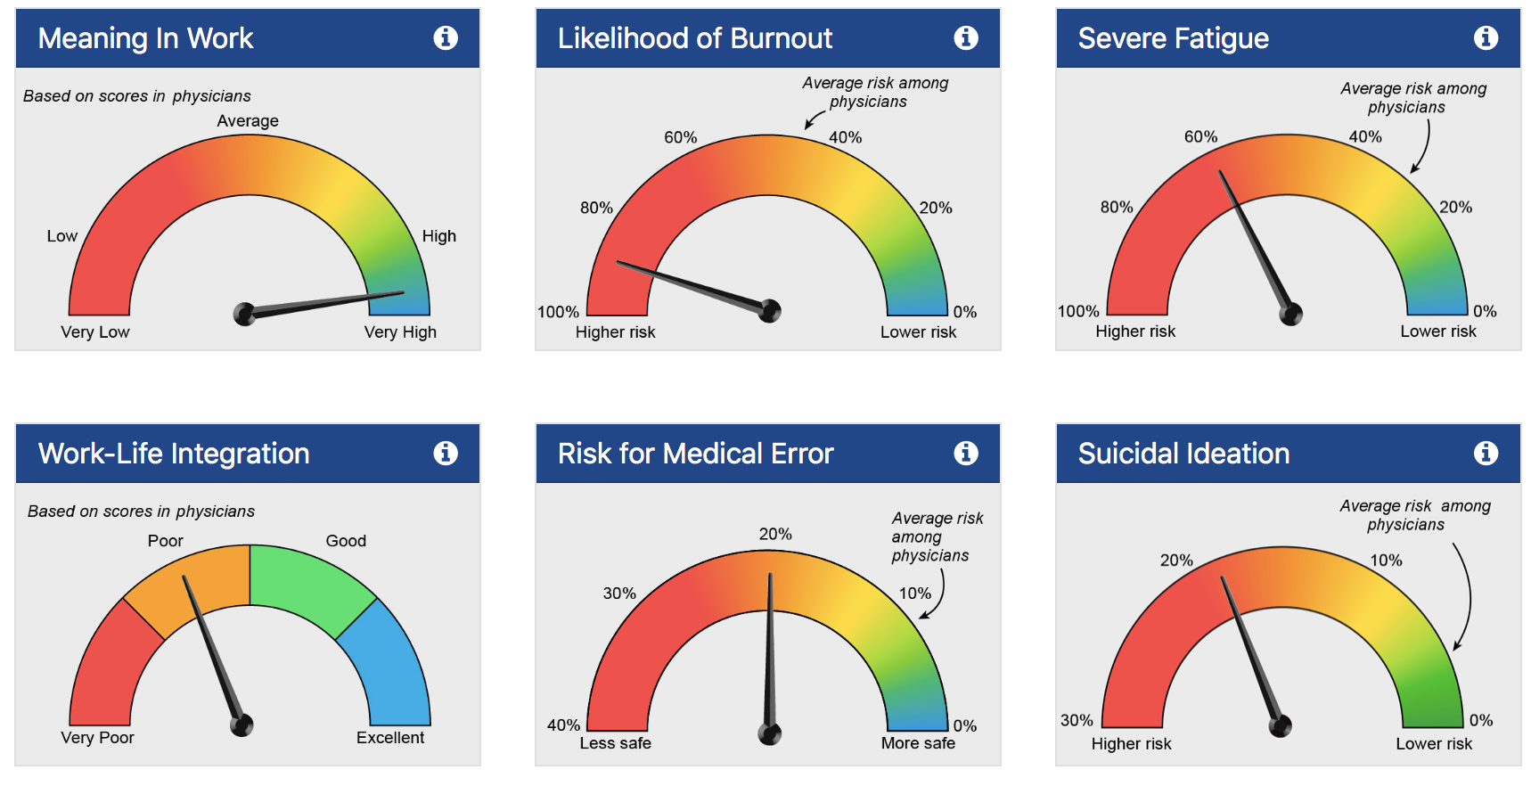

Slide 17
ARE You Burnt out!!!
TEXT
797979
Message EZWBI
Click on Link

