Slide 1
Principles of Neuronavigation: Frame and Frameless

Slide 2
History
“Stereotactic”: From Greek “stereos”=3-dimensional and Latin “tactus”=to touch
1908: Horsely and Clarke develop first apparatus for insertion of probes into the brain based upon Cartesian planes and bony landmarks; only used in primates
1947: Spiegel and Wycis report first human use of stereotactic device . Goal was to perform minimally-invasive psychosurgery but first use was movement disorders
1948: Leksell develops first arc-centered frame
1957: Talairach publishes first atlas based upon ventriculography and intracranial brain landmarks rather than bone landmarks
1986: Kelley develops frame-based system for eye-tracking of operative microscope
1986: Roberts develops frameless acoustic-based system for tracking operative microscope
1991: Bucholz develops the first prototype for frameless sonic navigation of tracking tools and instruments in human cranial surgery
Soon after incorporated optical digitizers to reduce inaccuracies from sound echoes

Slide 3
General Principles of Stereotaxy
Navigation is based upon targeting relative to known reference points
Fiducial :
From latin “fiducia” meaning trust
A point of reference that can be visualized on imaging and identified by the surgeon and/or software package
Accuracy of targeting is influenced by the number of fiducials around a target zone and the constancy of fiducials relative to the target
Frame-based stereotaxy: Fiducials are bars built into cage or box that sits on frame during imaging
Frameless stereotaxy: Fiducials are reference markers (stickers, bone screws) which are fixed directly to the patient prior to imaging

Slide 4
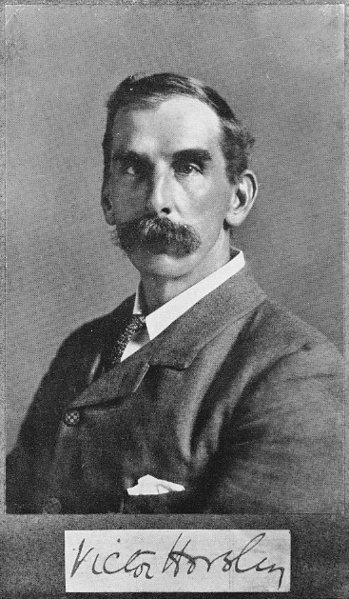
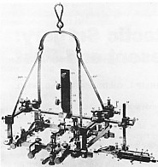
Co-registration is the fundamental principle of stereotaxy
1906 -- Horsley & Clarke (animal) stereotactic frame

Slide 5
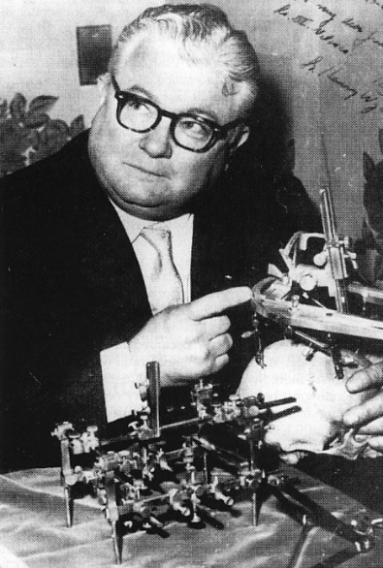
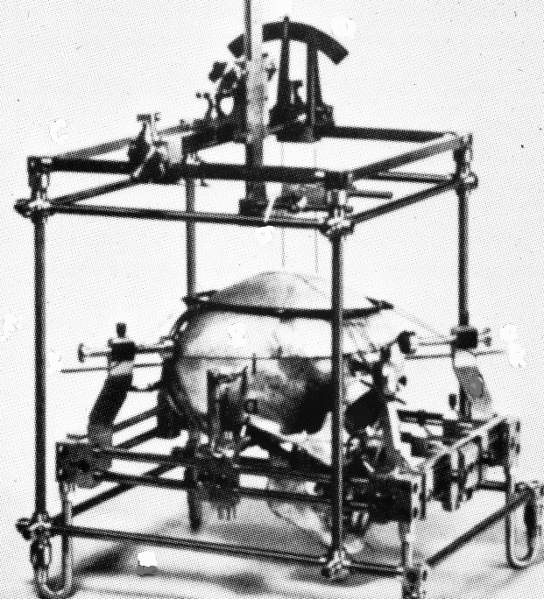
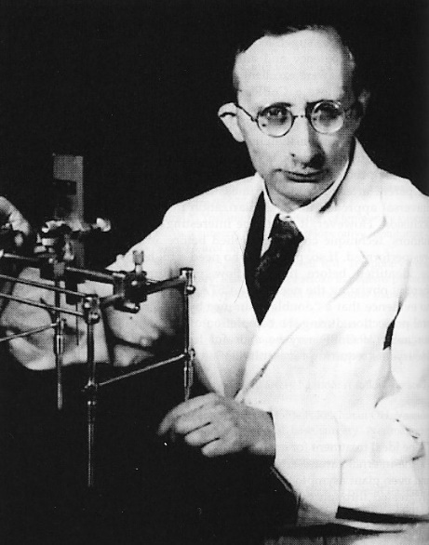
Co-registration is the fundamental principle of stereotaxy
1906 – Horsley & Clarke (animal) stereotactic frame
1947 – Spiegel & Wycis (human) stereotactic frame

Slide 6
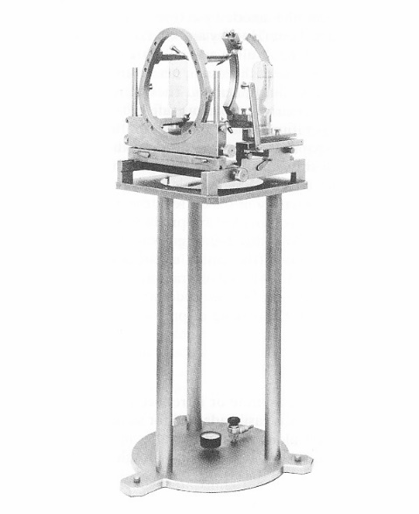
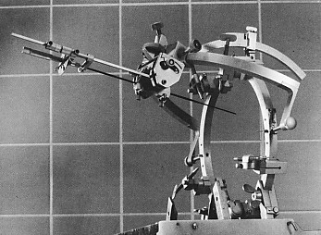
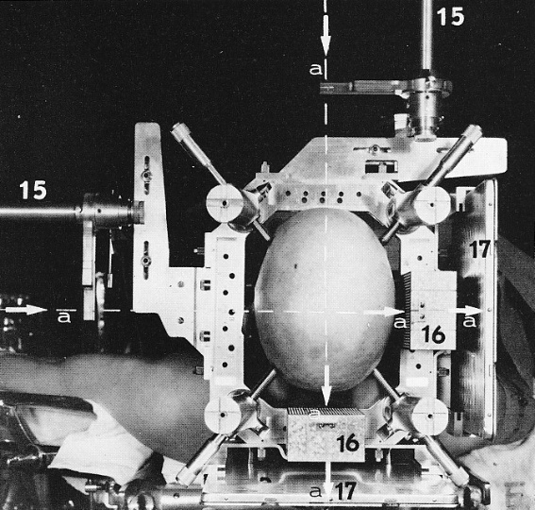
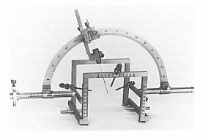
Co-registration is the fundamental principle of stereotaxy
1906 – Horsley & Clarke (animal) stereotactic frame
1947 – Spiegel & Wycis (human) stereotactic frame
1947-1980 – Proliferation of stereotactic frames

Slide 7
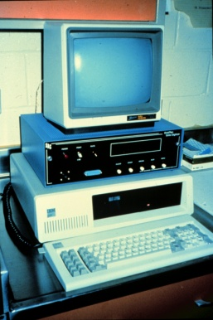
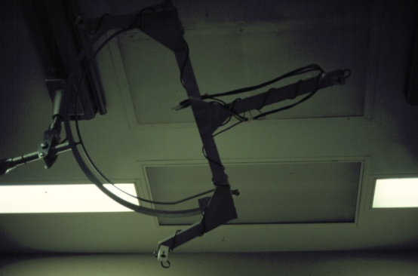
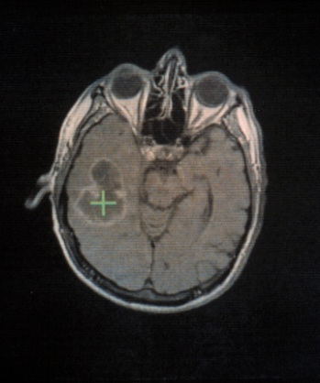
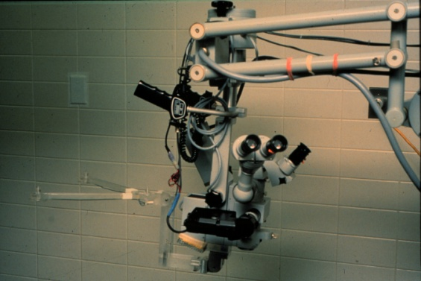
Co-registration is the fundamental principle of stereotaxy
1906 – Horsley & Clarke (animal) stereotactic frame
1947 – Spiegel & Wycis (human) stereotactic frame
1947-1980 – Proliferation of stereotactic frames
1980s – Computational resources enable “frameless” transformation-based stereotactic systems

Slide 8
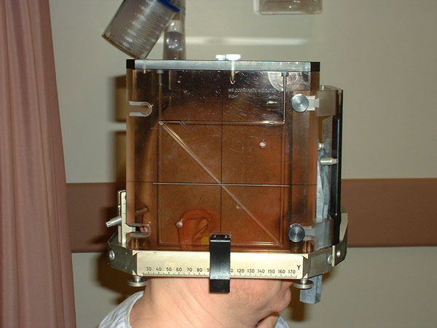
Considerations with Frame-Based Stereotaxy
Method of target localization
Indirect vs. direct
Imaging errors due to frame placement
Imaging errors due to distortion

Slide 9
Methods of Image-Based Target Localization
Indirect (Based upon position of AC-PC)
Standard coordinates
Leksell’s pallidotomy target is classic example
Adjusted map
Schaltenbrand-Wahren is most common
Average AC-PC distance is 23-27mm; greater than 30mm should raise accuracy concerns
Direct (Target visually chosen from scan)

Slide 10
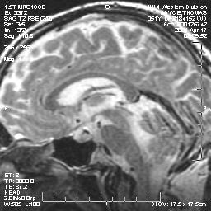
AC-PC: Sagittal T2 Localizer
PC
Colliculi
AC

Slide 11
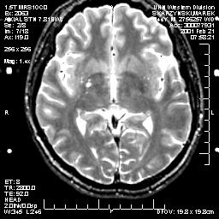
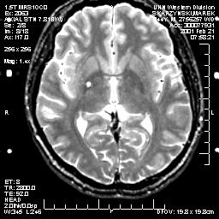
Axial T2 Measurement of AC-PC
AC
PC

Slide 12
Indirect Targeting: Fixed Coordinates
Thalamus (Vim)
1-7mm posterior
0-3mm superior
12-17mm lateral
GPi
2-3mm anterior
3-6mm inferior
18-22 mm lateral
STN
3-5mm posterior
5-6mm inferior
11-14mm lateral
(All points relative to midcommissural point)

Slide 13
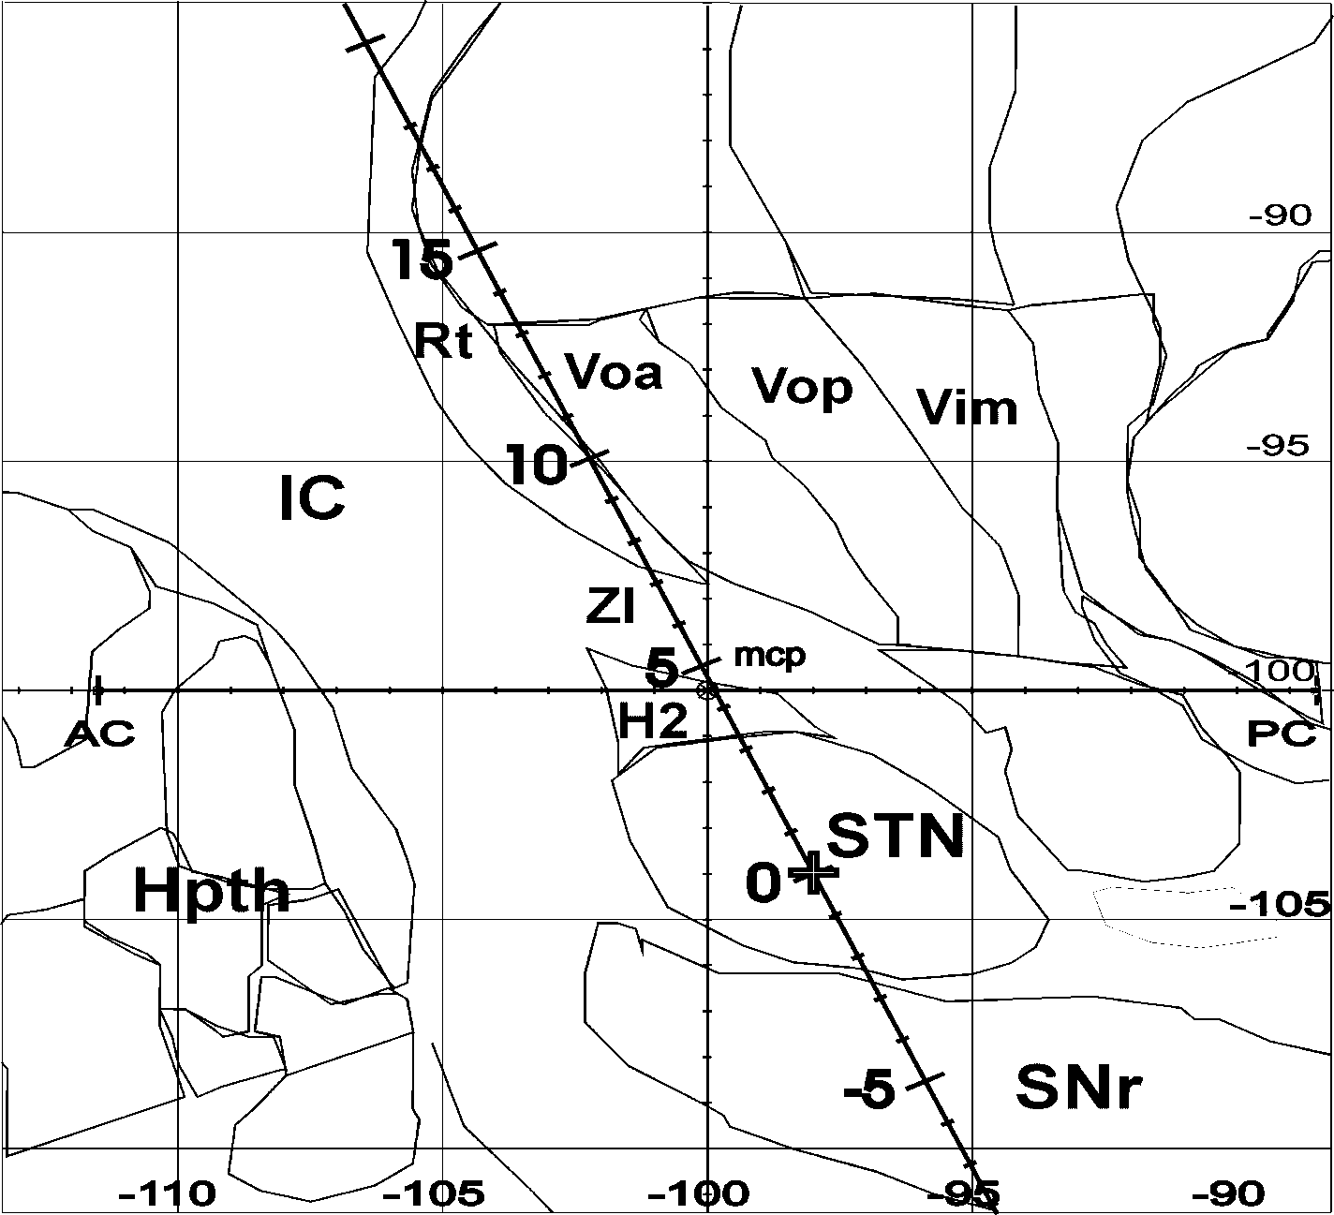
Indirect targeting: Adjusted Map

Slide 14
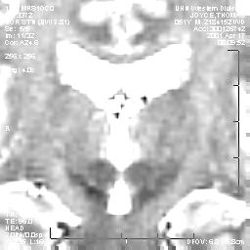
Direct targeting: STN

Slide 15
Sources of Error: MRI Image Distortion
Magnetic field inhomogeneities and non-linear magnetic field gradients cause distortion
Distortion often worst in coronal sections; measuring Leksell fiducials can determine distortion severity
Frame may introduce additional distortion
Measuring target distance from MCP on preop MRI can guide targeting from framed image
CT not subject to these distortions; CT/MRI fusion may minimize effects of distortion
Bandwidth can influence contrast
Lower bandwidth increases gray/white contrast to a point
Very low bandwidth can worsen distortion

Slide 16
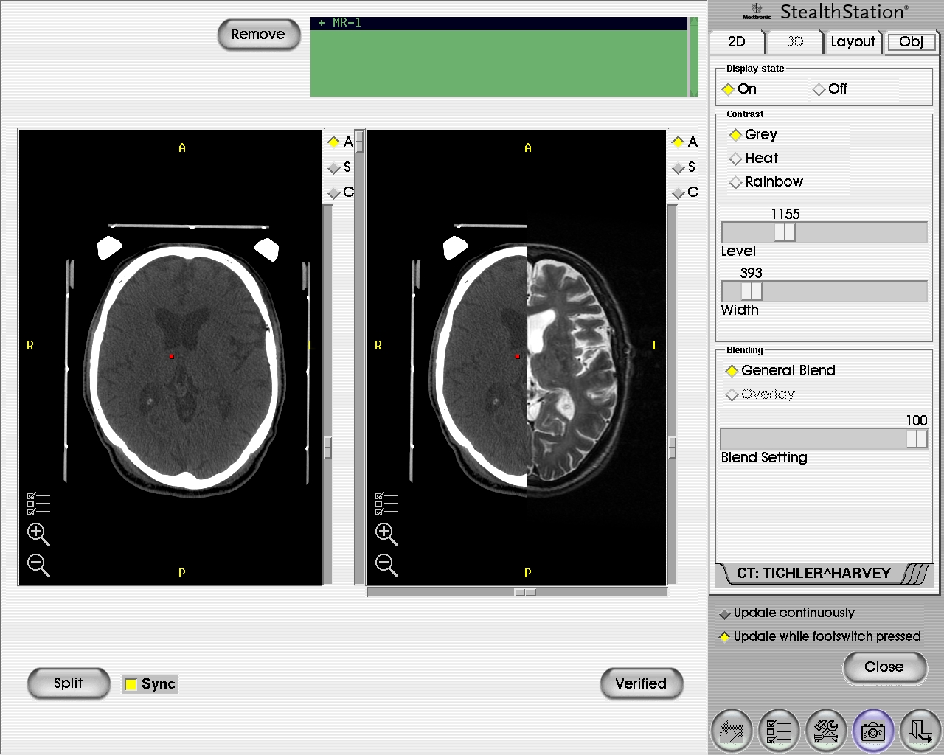
Image Fusion

Slide 17
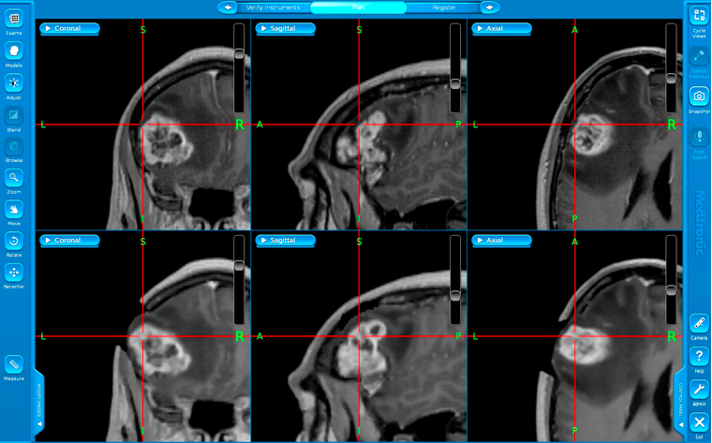
Eight Things Every Neurosurgery Resident Should Know about Frameless Image-Guidance

Slide 18
What is image-guided surgery and how does it work?
Image-guided surgery (neuronavigation, “frameless stereotaxy”) is an operative technique by which correlation between imaging studies and the operative field is provided.
This is accomplished by co-registration of imaging studies with the OR patient.

Slide 19
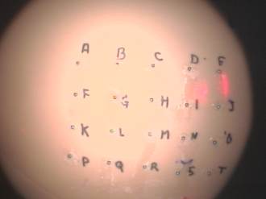
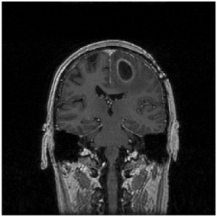
Matrix Expression
Image overlay, 2I
P_{2I} = ^{2I}T_{M} ^{M}T_{W} ^{W}T_{3I} P_{3I}
Polaris
^{2I}T_{M}
Microscope calibration
Microscope
frame, M
Head in the world space, W
Preop. 3D image, 3I
^{M}T_{W}
^{W}T_{3I}
Patient registration
Tracking patient and microscope
Notes:
The real power of computational stereotaxy lies in its ability to readily calculate the transformations between the various coordinate systems of imaging studies, operating rooms, microscopes, and just about anything else of interest.

Slide 20
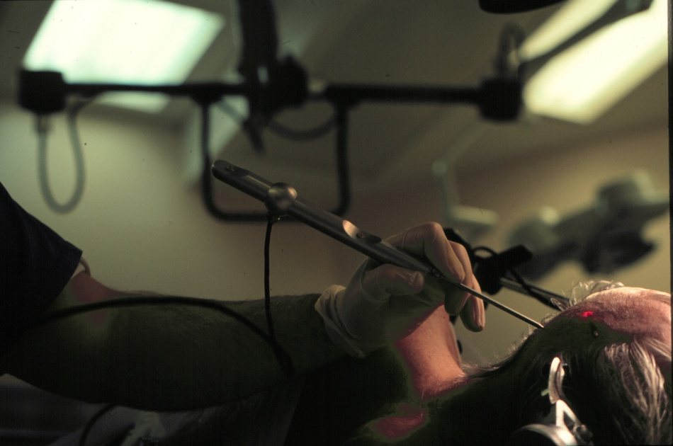
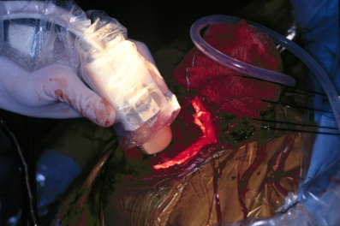
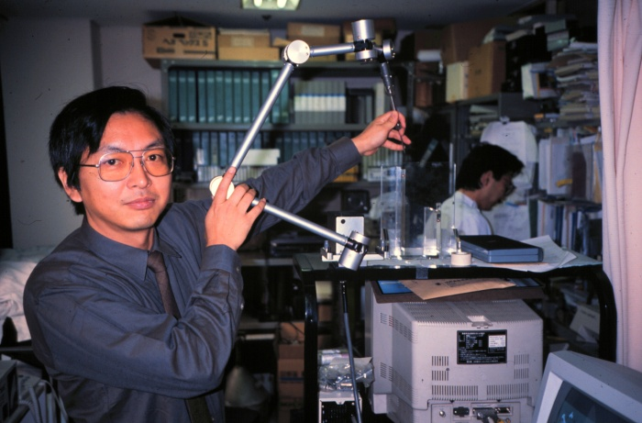
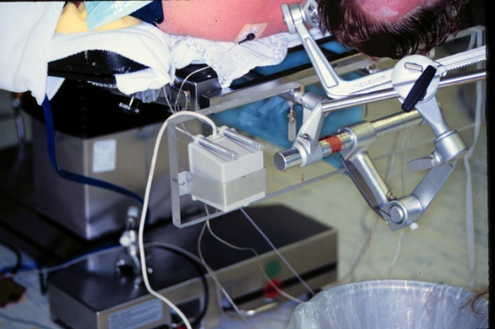
What equipment is involved?
Localization device (digitizer)
e.g., optical, electromagnetic, articulated arm
most systems today include a reference frame to enable OR table movement

Slide 21
What equipment is involved?
Localization device (digitizer)
e.g., optical, electromagnetic, articulated arm
Computer with registration algorithm

Slide 22
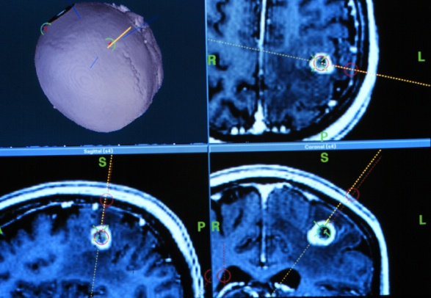
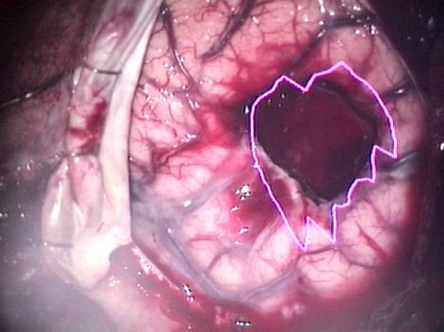
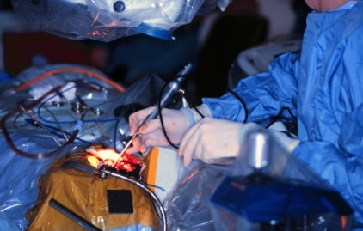
What equipment is involved?
Localization device (digitizer)
e.g., optical, electromagnetic, articulated arm
Computer with registration algorithm
Effector
e.g., pointer and monitor, microscope heads-up display

Slide 23
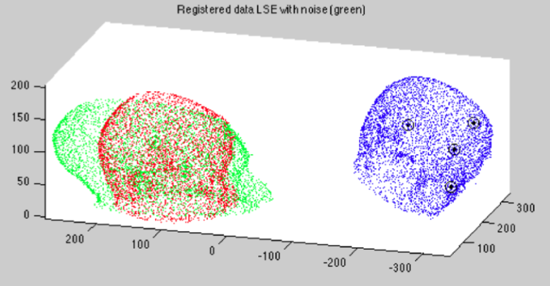
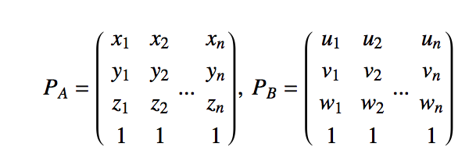
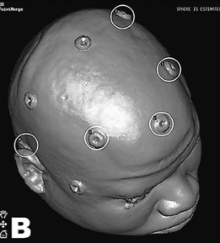
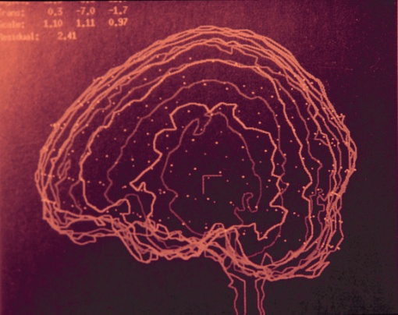
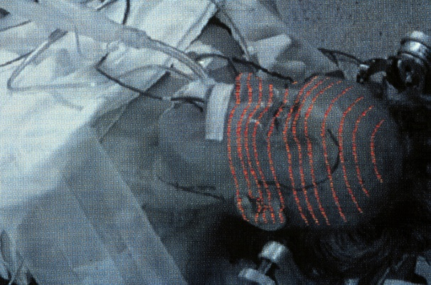
What types of co-registration strategies can be used?
Paired-point rigid transformation
Surface (contour) matching

Slide 24
Fiducial registration error (FRE)
Some important definitions…
the root- mean square distance between corresponding fiducial points after registration
Fitzpatrick & West, 2001

Slide 25
Fiducial localization error (FLE)
the error in locating the fiducial points
Fitzpatrick & West, 2001

Slide 26
Target registration error (TRE)
the distance between corresponding points other than the fiducial points after registration
This is what really matters!
Fitzpatrick & West, 2001

Slide 27
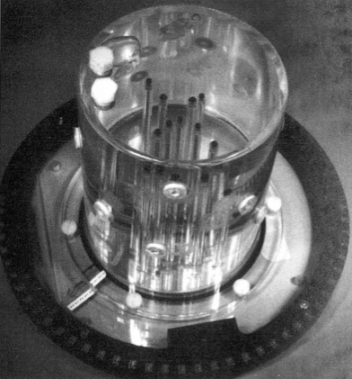
Accuracy in phantom testing
Benardete et al, 2001

Slide 28
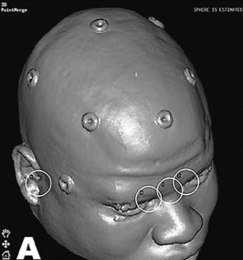
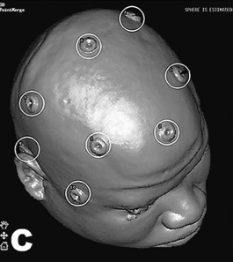
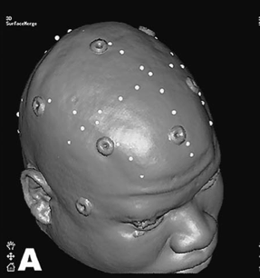
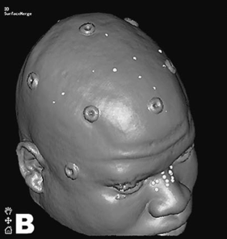
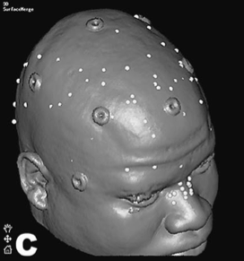
Clinical application accuracy (comparing seven registration methods)
Mascott et al, 2006

Slide 29
What are the sources of error?
Imaging data set
resolution
e.g., slice thickness, pixel/voxel size
spatial infidelity
e.g., magnetic field inhomogenieties in echo planar fMRI
imaging study fusion
e.g., CT–MRI, atlas–MRI

Slide 30
Dependence of stereotactic accuracy on image slice thickness
Maciunas et al, 1994
Notes:
This study was done for stereotactic frames but the principle is the same,
Importance points:
No frame is submillimetric
Clinically important is C.I. (range)
Slice thickness plays a major role

Slide 31
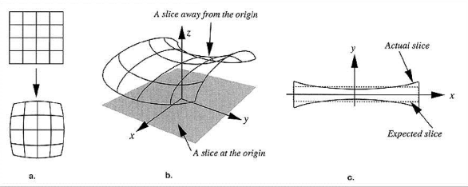
What are the sources of error?
Imaging data set
resolution
e.g., slice thickness, pixel/voxel size
spatial infidelity
e.g., magnetic field inhomogenieties in echo planar fMRI
Sumanaweera, 1994

Slide 32
What are the sources of error?
Imaging data set
resolution
e.g., slice thickness, pixel/voxel size
spatial infidelity
e.g., magnetic field inhomogenieties in echo planar fMRI
imaging study fusion
e.g., CT–MRI, atlas–MRI

Slide 33
What are the sources of error?
Imaging data set
Registration process (image–OR space)
axes orientation (handedness of coordinate system)
algorithm ambiguity
fiducial number, configuration, displacement, OR localization (surgeon & digitizer)

Slide 34
Number of fiducials and accuracy
Steinmeier et al, 2000
Fitzpatrick et al, 1998
Notes:
Phantom studies, empirical observation, and simulation studies have all shown increasing accuracy with increasing number of fiducials.

Slide 35
West et al, 2001
Notes:
FIGURE 2. A–H, views of a large square and large triangular fiducial configurations and their corresponding TRE profiles. Missing iso-error contours indicate that the TRE value was either consistently above or below that isocontour value for the entire displayed slice. A, left and right view; B, coronal view; C, sagittal view; D, axial view; E, left and right view; F, coronal view; G, sagittal view; H, axial view.

Slide 36
TRE has an approximate N^{-1/2} dependence
Fitzpatrick et al, 1998

Slide 37
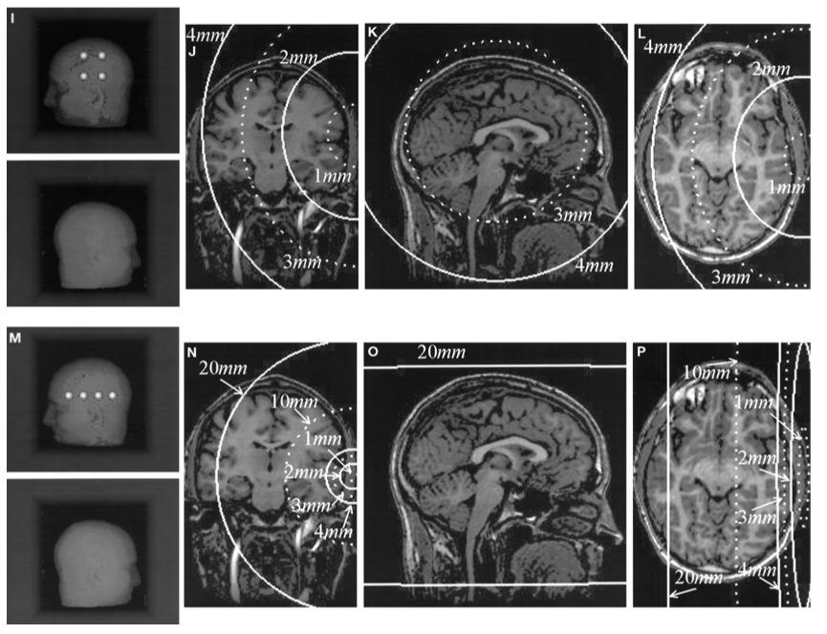
Error increases as the distance of the target from the fiducial centroid
West et al, 2001
Notes:
As the distance of the target from the fiducial centroid increases, the error increases, approaching dependence. The error also increases as the configuration of the fiducials becomes smaller.

Slide 38
FRE is not a reliable indicator of registration accuracy (!!)
FRE is independent of fiducial configuration
FRE is independent of bias errors (e.g., MRI gradient, digitizer camera malalignment, bent handheld probe)
Fitzpatrick et al, 1998

Slide 39
Tips regarding fiducials
Avoid linear fiducial configurations
Arrange fiducials so that the center of their configuration is close to the region of interest during surgery
Spread out the fiducials
Use as many fiducials as reasonably possible
Mark scalp at fiducial site
Avoid occipital region or distorted scalp
partially adapted from West et al, 2001

Slide 40
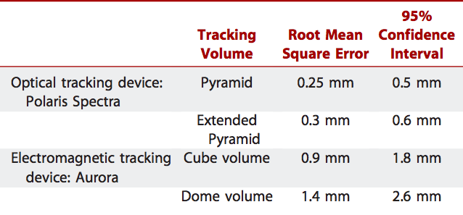
What are the sources of error?
Imaging data set
Registration process (image–OR space)
Digitizer performance
Wang & Song, 2011

Slide 41
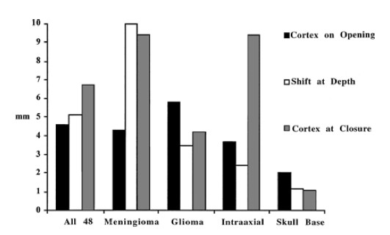
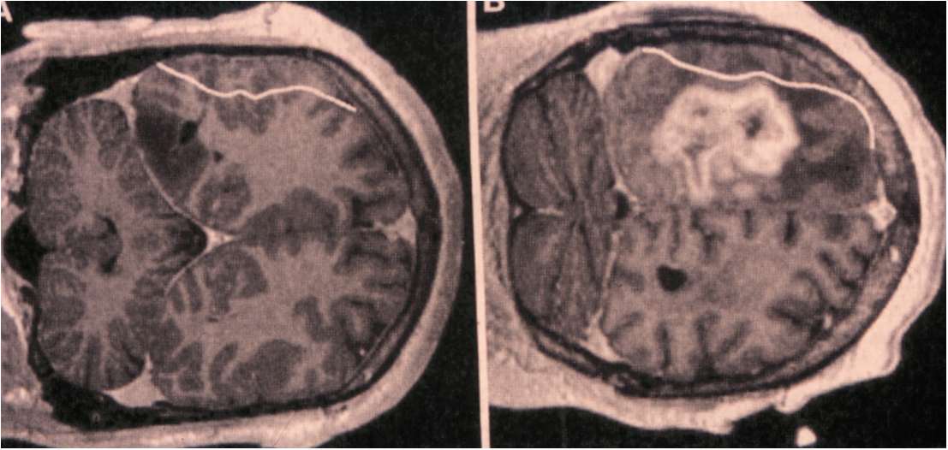
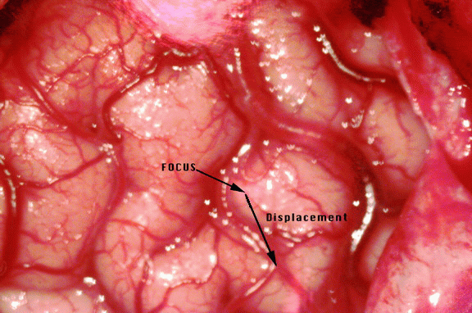
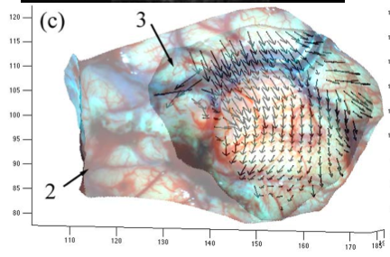
What are the sources of error?
Surgical field displacement or deformation
Dorward et al, 1998
Hill et al, 1998
Roberts et al, 1998
Ji et al, 2012
Notes:
Numerous studies showing displacements, often exceeding 10mm.

Slide 42
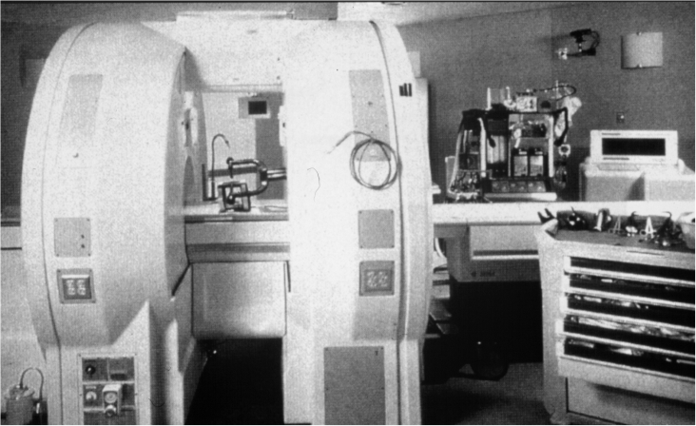
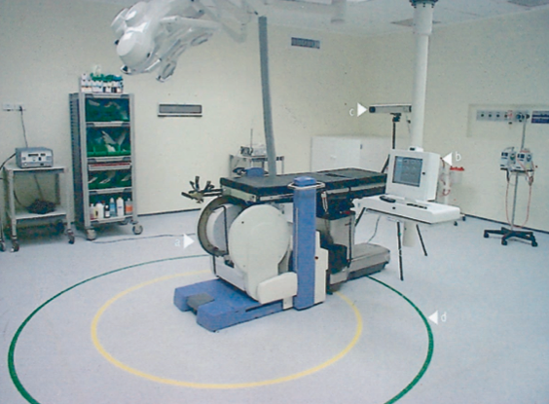
How does this relate to intraoperative MRI/CT?
Numerous implementations
Facilitated co-registration
Updated image data-set
Cost-benefit analyses pending

Slide 43
In what applications has image-guidance been important?
Tumor (biopsy, resection of glial and met tumor)
Epilepsy (structural & physiologic data, resection)
Functional (DBS)
Spine (instrumentation)
Radiosurgery (frameless technologies)
Cerebrovascular (?)
Other: ENT, Plastics, Ortho, General

Slide 44
What’s under development for image-guidance?
Automated registration
Ease of use
Updated imaging/registration
Increasing accuracy
Robotics
Extension of application to other
surgeries, other disciplines
Nathoo, 2005
Louw, 2004

