Slide 1
Introduction to Neurosurgical Subspecialties: Pediatric Neurosurgery
Brian L. Hoh, MD¹ and Gregory J. Zipfel, MD²
¹University of Florida, ²Washington University

Slide 2
Pediatric Neurosurgery
Pediatric neurosurgeons treat children with:
Brain tumors
Spina bifida / spinal dysraphism
Spasticity
Brachial plexus injury
Hydrocephalus
Epilepsy
Spinal deformities / tumors
Brain and spine trauma
Pediatric neurosurgery crosses the entire spectrum of neurosurgical subspecialties

Slide 3
Pediatric Neurosurgery
Fellowship for pediatric neurosurgery is typically required

Slide 4
Hydrocephalus
Causes:
Communicating
Idiopathic, post-hemorrhagic, post-infectious, congenital
Obstructive
Tumors, cysts, aqueductal stenosis, ventricular loculations

Slide 5
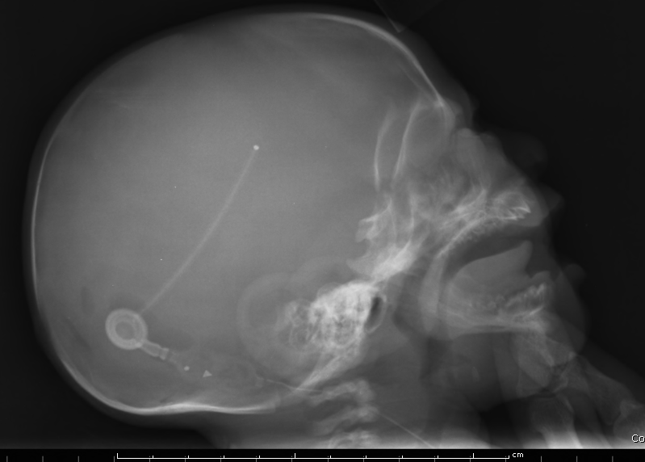
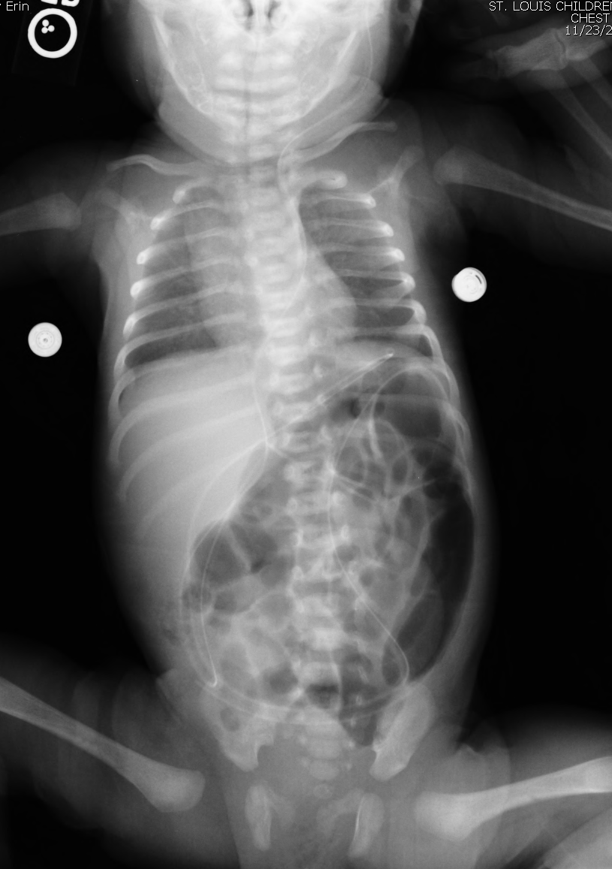
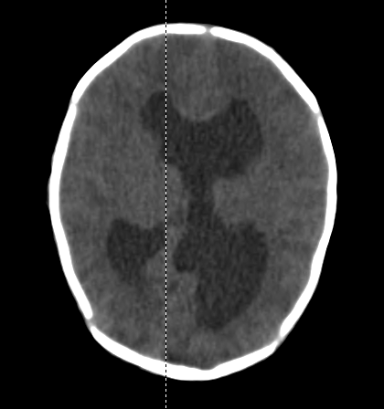
Hydrocephalus Treatment: Ventriculoperitoneal Shunt

Slide 6
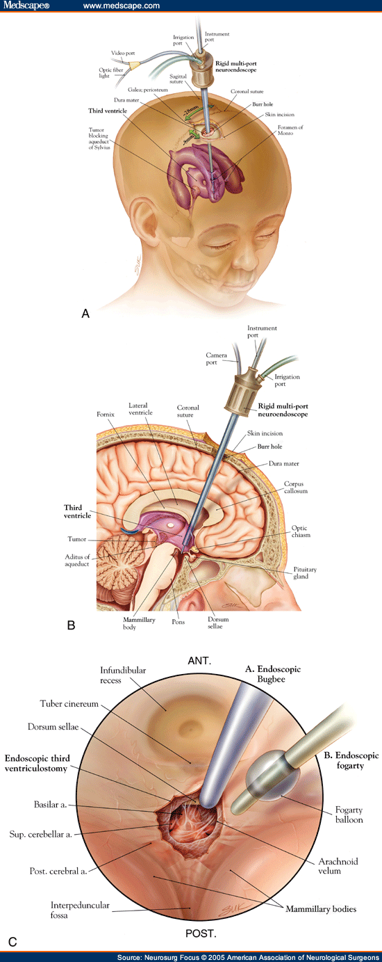
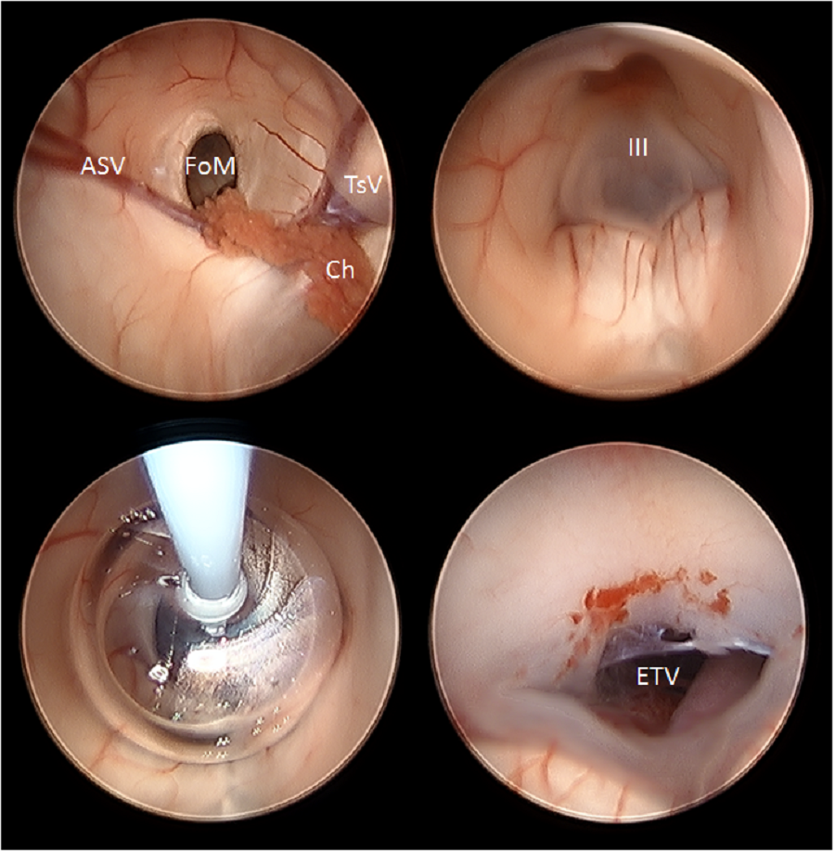
Hydrocephalus Treatment: Endoscopic Third Ventriculostomy (ETV) ETV

Slide 7
Brain tumor
Infratentorial (2/3)
Medulloblastoma -- malignant
Juvenile pilocytic astrocytoma (JPA) -- benign
Ependymoma – benign or malignant
Brainstem tumors – benign or malignant
Atypical teratoid rhabdoid tumor (ATRT) -- malignant
Supratentorial (1/3)
JPA
Ependymoma
Glioma/astrocytoma
Ganglioglioma, Dysembryoplastic NeuroEpithelial Tumor (DNET)
Craniopharyngioma
Many others

Slide 8
Brain Tumors--Astrocytoma
Pre-op Post-op

Slide 9
Brain Tumors--Ependymoma
Pre-op Post-op

Slide 10
Spina bifida/spinal dysraphism
Closed neural tube defects
Tethered spinal cord
fatty filum, dermal sinus tract, diastematomyelia, lipomyelomeningocele
Open neural tube defects
Myelomeningocele and variants (myelocystocele)
Associated with hydrocephalus, type II Chiari malformation, syringomyelia, urologic and orthopedic disorders

Slide 11
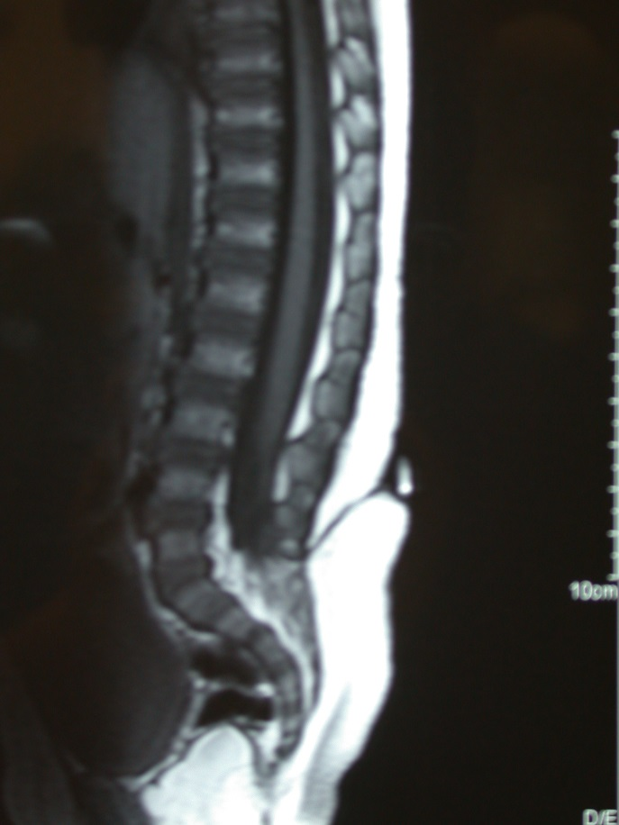
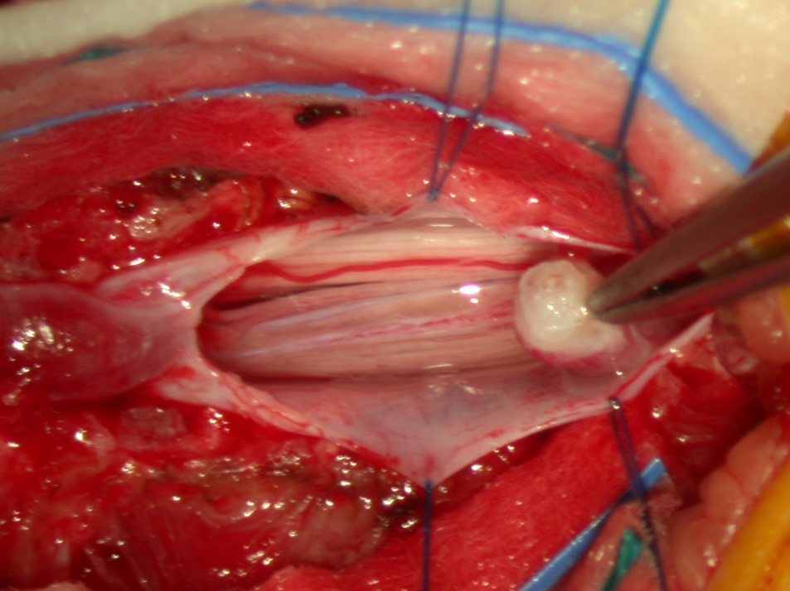
Dermal sinus tract with tethered cord

Slide 12
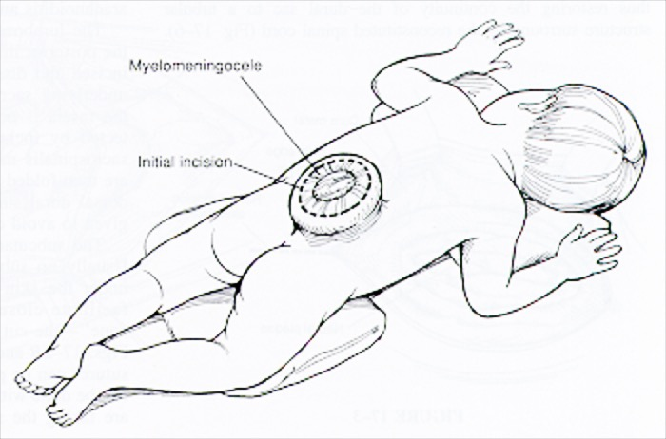
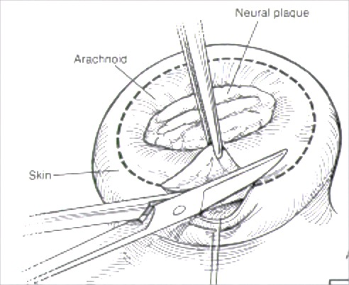
Myelomeningocele / NTD

Slide 13
Epilepsy Surgery
Epilepsy is predominantly a disease of the young
Majority of patients have seizure onset in childhood
Substrates include cortical dysplasia/neuronal migrational disorders, tuberous sclerosis, lesional/structural causes such as tumors, vascular lesions, trauma, stroke

Slide 14
Response to AEDs among children (AED = anti-epileptic drug)
60-70%
Seizure-Free
20-30%
Seizure-Free
5-10%
Seizure-Free
1st
AED
2nd
AED
3rd
AED
Stage I pre-surgical evaluation
EEG-video, MRI, PET, Neuropsychology
Epilepsy Surgery Conference

Slide 15
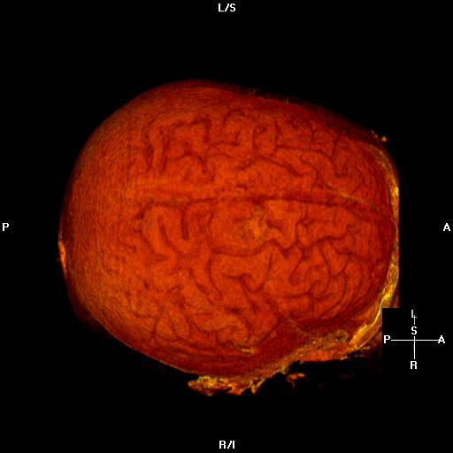
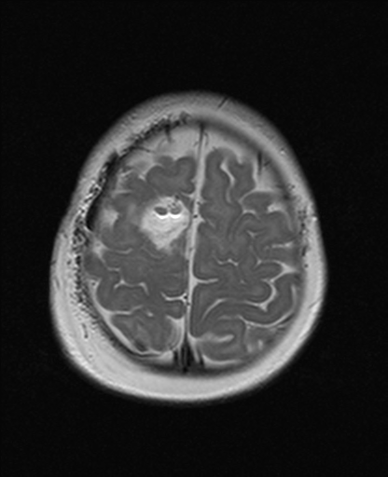
Lesionectomy 6 mo old with partial seizures
7788111
1/9/2004
F
F
Focal Cortical Dysplasia
Page: 1 of 4
,
A
,
A
7788111
1/9/2004
F
F
R
L
R
L
TE: 106
Z: 1
P
P

Slide 16
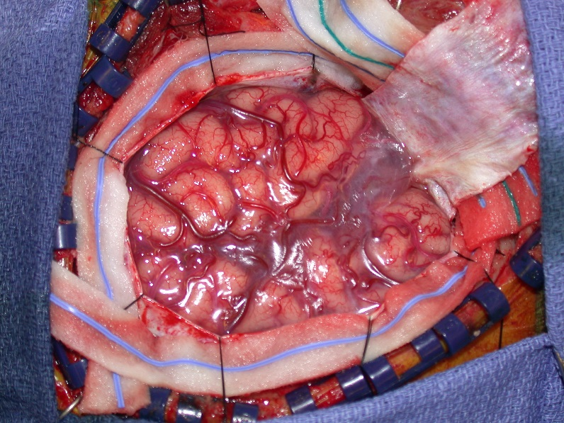
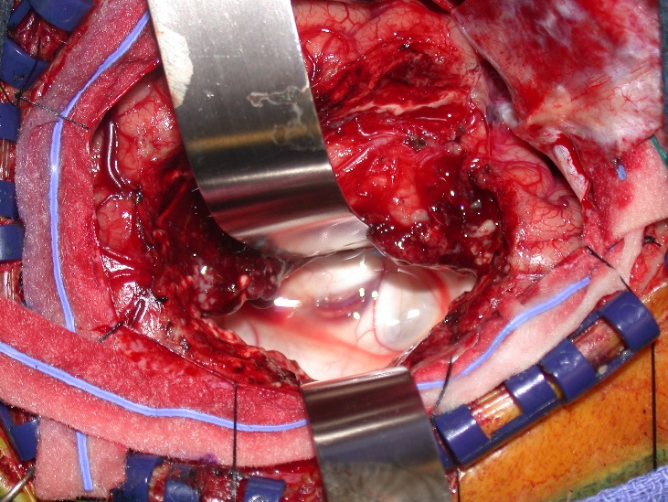
Peri-insular Hemispherotomy 7 year old with intractable seizures

Slide 17
Chiari malformation
Type I is most common
Herniation of hindbrain (cerebellar tonsils) into upper cervical canal
Usually asymptomatic
Associated with suboccipital post-tussive headache
Syringomyelia and scoliosis
Posterior decompression +/- duraplasty are main surgical options
Type II associated with myelomeningocele only

Slide 18
Suboccipital craniectomy / duroplasty for Type 1 Chiari with syrinx

Slide 19
Craniosynostosis
Affects 1:2500 children
Premature fusion of one or more cranial vault sutures
Sagittal most common, followed by metopic/coronal and then lamboid
Not to be confused with benign positional plagiocephaly
Surgical options include traditional open vault and facial reconstructions and minimally invasive endoscopic strip craniectomies with custom molding helmet therapy for children < 6 months of age

Slide 20
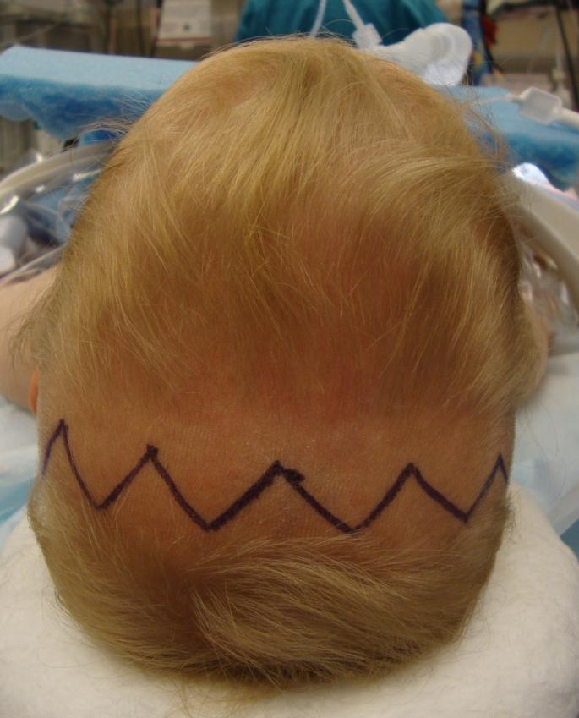
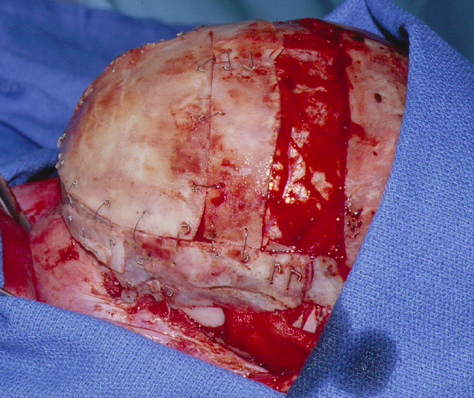
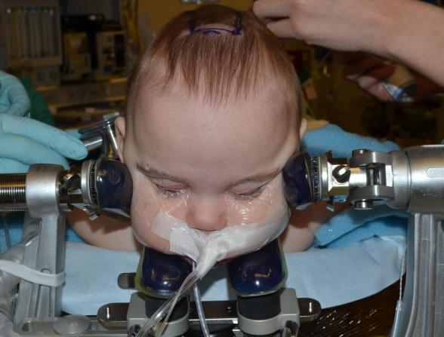
Craniosynostosis
Open Surgery
Endoscopic Surgery

Slide 21
Conclusions
Pediatric neurosurgeons do procedures that span the spectrum of neurosurgical operations
Even more than adult neurosurgery, pediatric neurosurgeons have ”families as patients”

