Slide 1
CNS leadership institute Principles and progress
Lola B. Chambless, MD, FAANS
Associate Professor, Residency Program Director
Vanderbilt University
CNS Member at Large

Slide 2
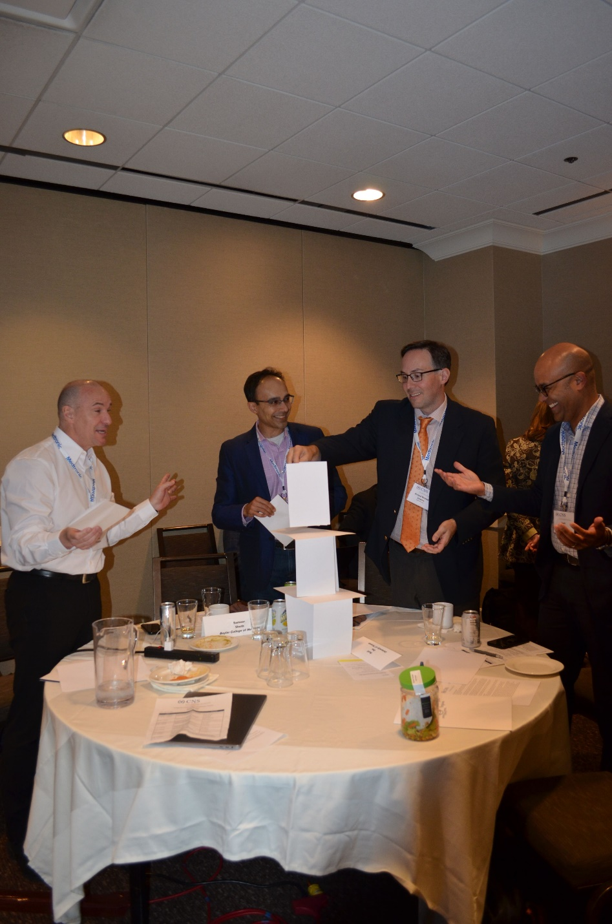
“None of us came out of the womb as Winston Churchill”
These skills are not innate
They are not taught in residency
Needed to identify and influence stakeholders to build programs

Slide 3
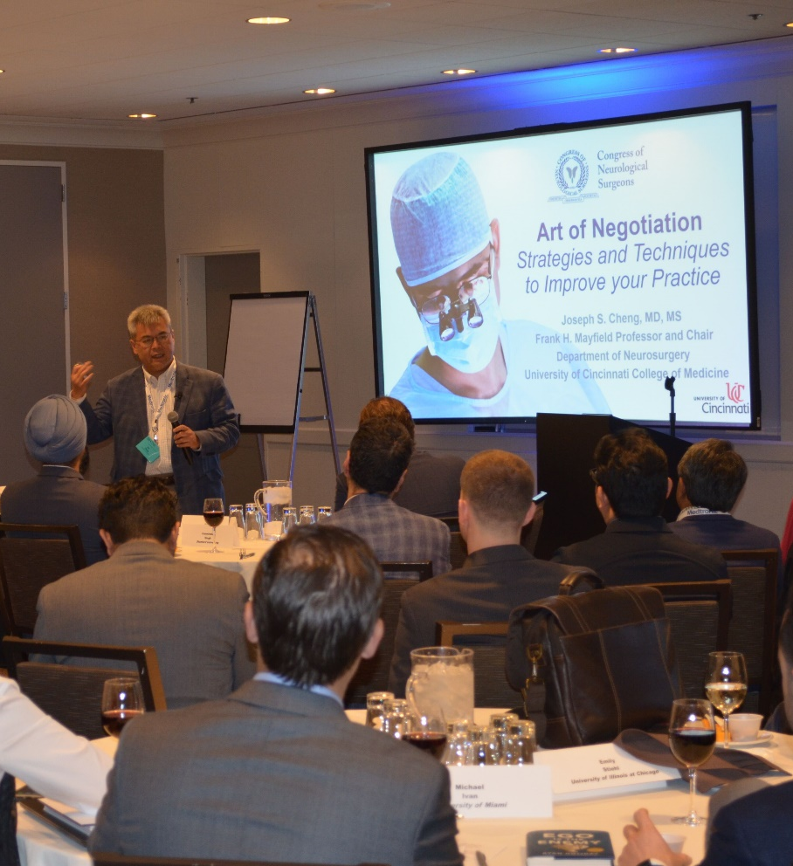
CNS LEADERSHIP INSTITUTE
Began with a pilot course in 2016
Developed in partnership with industry and business leaders
Uses problem-based learning
Has become a longitudinal training program where students become teachers

Slide 4
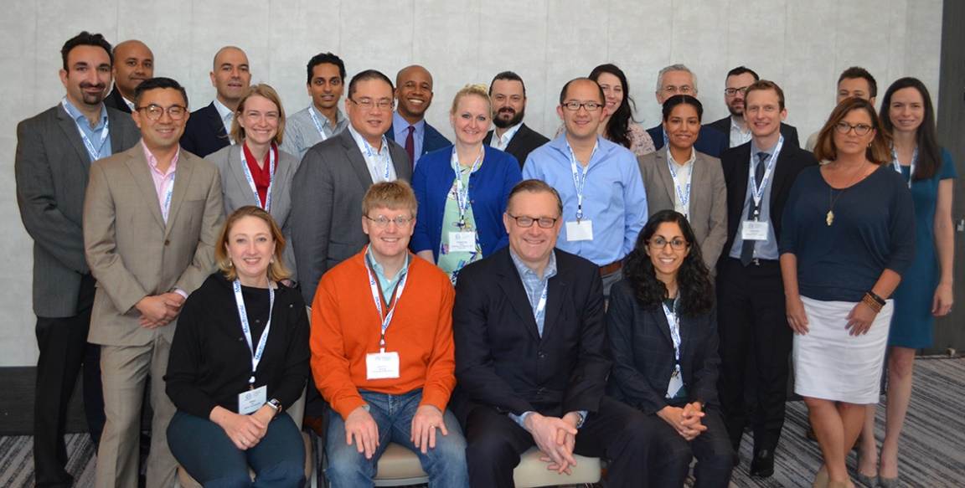
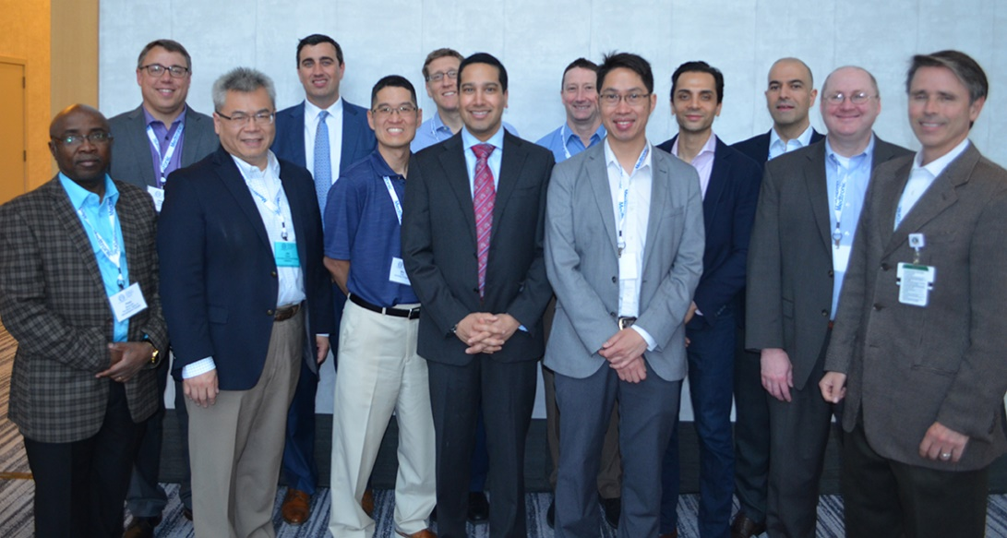
CNS Leadership Institute
Leadership in Healthcare
Vanguard leadership
1-5 years out of training
15 attendees
6-15 years out of training
10 attendees
2018 Cohorts

Slide 5
Topics
SCHEDULE
Weekend live course (May)
4 interactive webinars
Longitudinal mentorship for
personal project
Live report-out session (October)
Change Management
Kotter Model of Influence
Mentors vs. Coaches
Personal Branding
Optimizing Neurosurgical
Service Lines
Negotiation
Reimbursement Models
Health System Dynamics

Slide 6
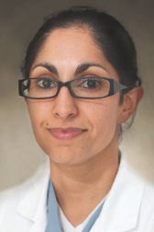
Case Study: Maryam Rahman, MD
How do we improve staff coverage for afternoon and evening cases?
Build influence, apply change management
Guidance from peers, faculty, new mentors
Returned as a mentor and reengaged
Developed a presence in organized neurosurgery
“The course launched a part of my career that was nonexistent before I arrived.”

Slide 7
Challenges: What next?
Curate useful resources
Engage local support
Ask fellows to return as mentors and eventually faculty
Develop series of courses to be taken sequentially with common themes of leadership development
Offer opportunities in organized neurosurgery

Slide 8
Challenges: role of complementary programs

Slide 9
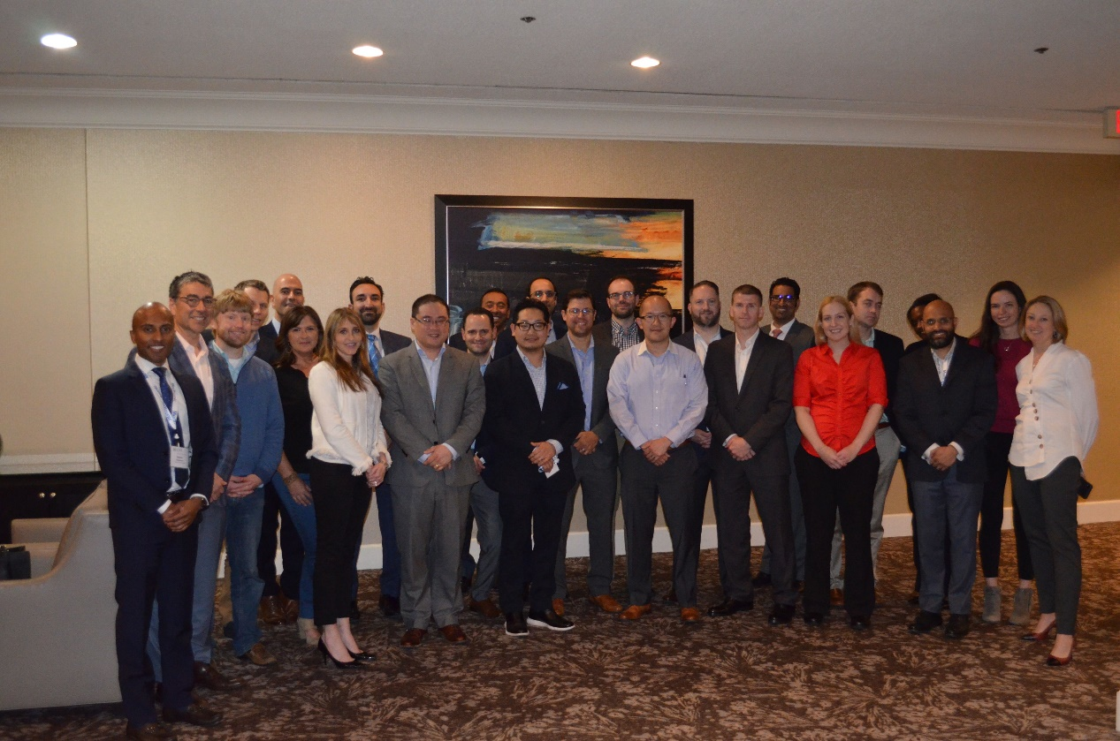
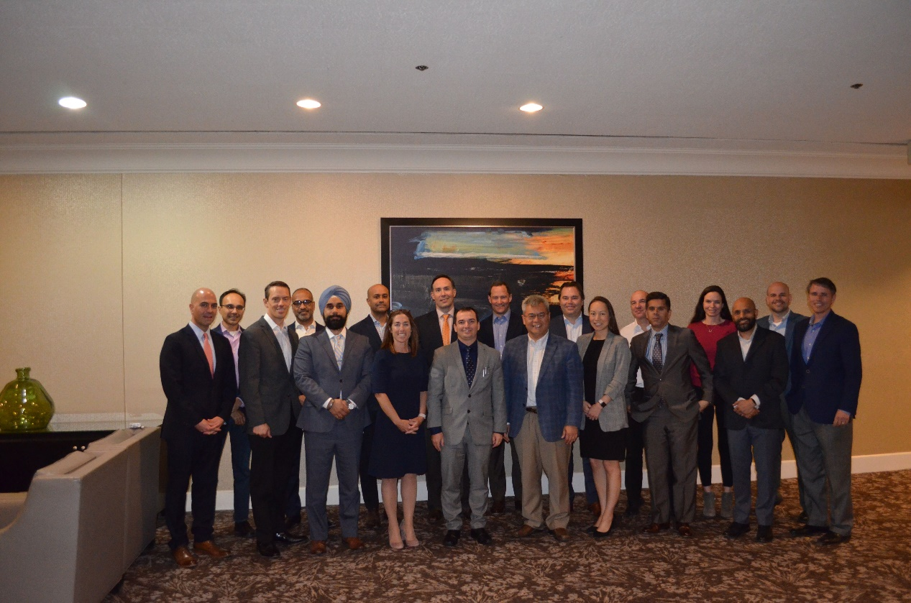
Challenges: universal vs specific
2019 Cohorts

Slide 10
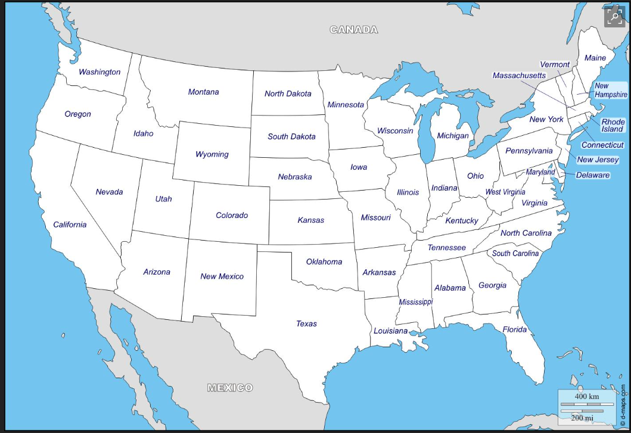
Physician and Hospital Leadership Development | July 2017 | Confidential, for Internal Use Only
10
Notes:
2016
13 Leadership Fellows selected and completed course
2017
30 applied, 13 Leadership Fellows selected and completed course
2018
19 applied for 1.0 and 12 Leadership Fellows selected
14 applied for 2.0 and 10 Leadership Fellows selected
Currently complimentary for attendees, supported 100% by
Medtronic.

Slide 11
CNS Leadership Fellows (2016)
Physician and Hospital Leadership Development | July 2017 | Confidential, for Internal Use Only
11
Notes:
2016
13 Leadership Fellows selected and completed course
2017
30 applied, 13 Leadership Fellows selected and completed course
2018
19 applied for 1.0 and 12 Leadership Fellows selected
14 applied for 2.0 and 10 Leadership Fellows selected
Currently complimentary for attendees, supported 100% by
Medtronic.

Slide 12
CNS Leadership Fellows (2016 - 2017)
Physician and Hospital Leadership Development | July 2017 | Confidential, for Internal Use Only
12
Notes:
2016
13 Leadership Fellows selected and completed course
2017
30 applied, 13 Leadership Fellows selected and completed course
2018
19 applied for 1.0 and 12 Leadership Fellows selected
14 applied for 2.0 and 10 Leadership Fellows selected
Currently complimentary for attendees, supported 100% by
Medtronic.

Slide 13
CNS Leadership Fellows (2016 - 2018)
Physician and Hospital Leadership Development | July 2017 | Confidential, for Internal Use Only
13
Notes:
2016
13 Leadership Fellows selected and completed course
2017
30 applied, 13 Leadership Fellows selected and completed course
2018
19 applied for 1.0 and 12 Leadership Fellows selected
14 applied for 2.0 and 10 Leadership Fellows selected
Currently complimentary for attendees, supported 100% by
Medtronic.

Slide 14
CNS Leadership Fellows (2016 - 2019)
Physician and Hospital Leadership Development | July 2017 | Confidential, for Internal Use Only
14
Notes:
2016
13 Leadership Fellows selected and completed course
2017
30 applied, 13 Leadership Fellows selected and completed course
2018
19 applied for 1.0 and 12 Leadership Fellows selected
14 applied for 2.0 and 10 Leadership Fellows selected
Currently complimentary for attendees, supported 100% by
Medtronic.

Slide 15
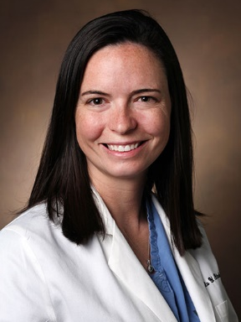
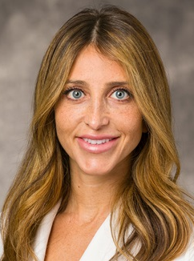
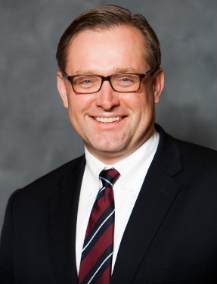
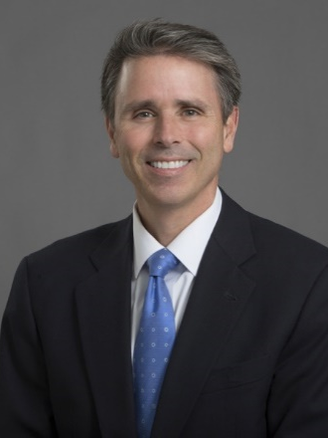
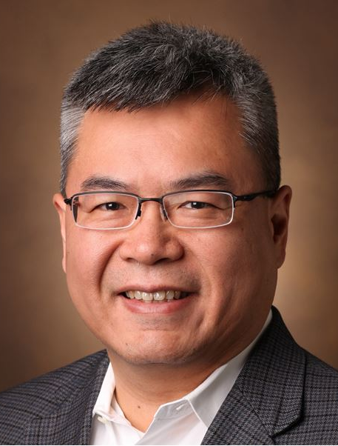
CNS Leadership Institute team
Dr. Brian Nahed
Co-Chair
Dr. Lola Chambless
Co-Chair
Dr. Jennifer Sweet
Vice-Chair
Dr. Alan Scarrow
Key Faculty Member
Dr. Richard Byrne
Key Faculty Member
Dr. Joe Cheng
Key Faculty Member
THANK YOU!

