Slide 1
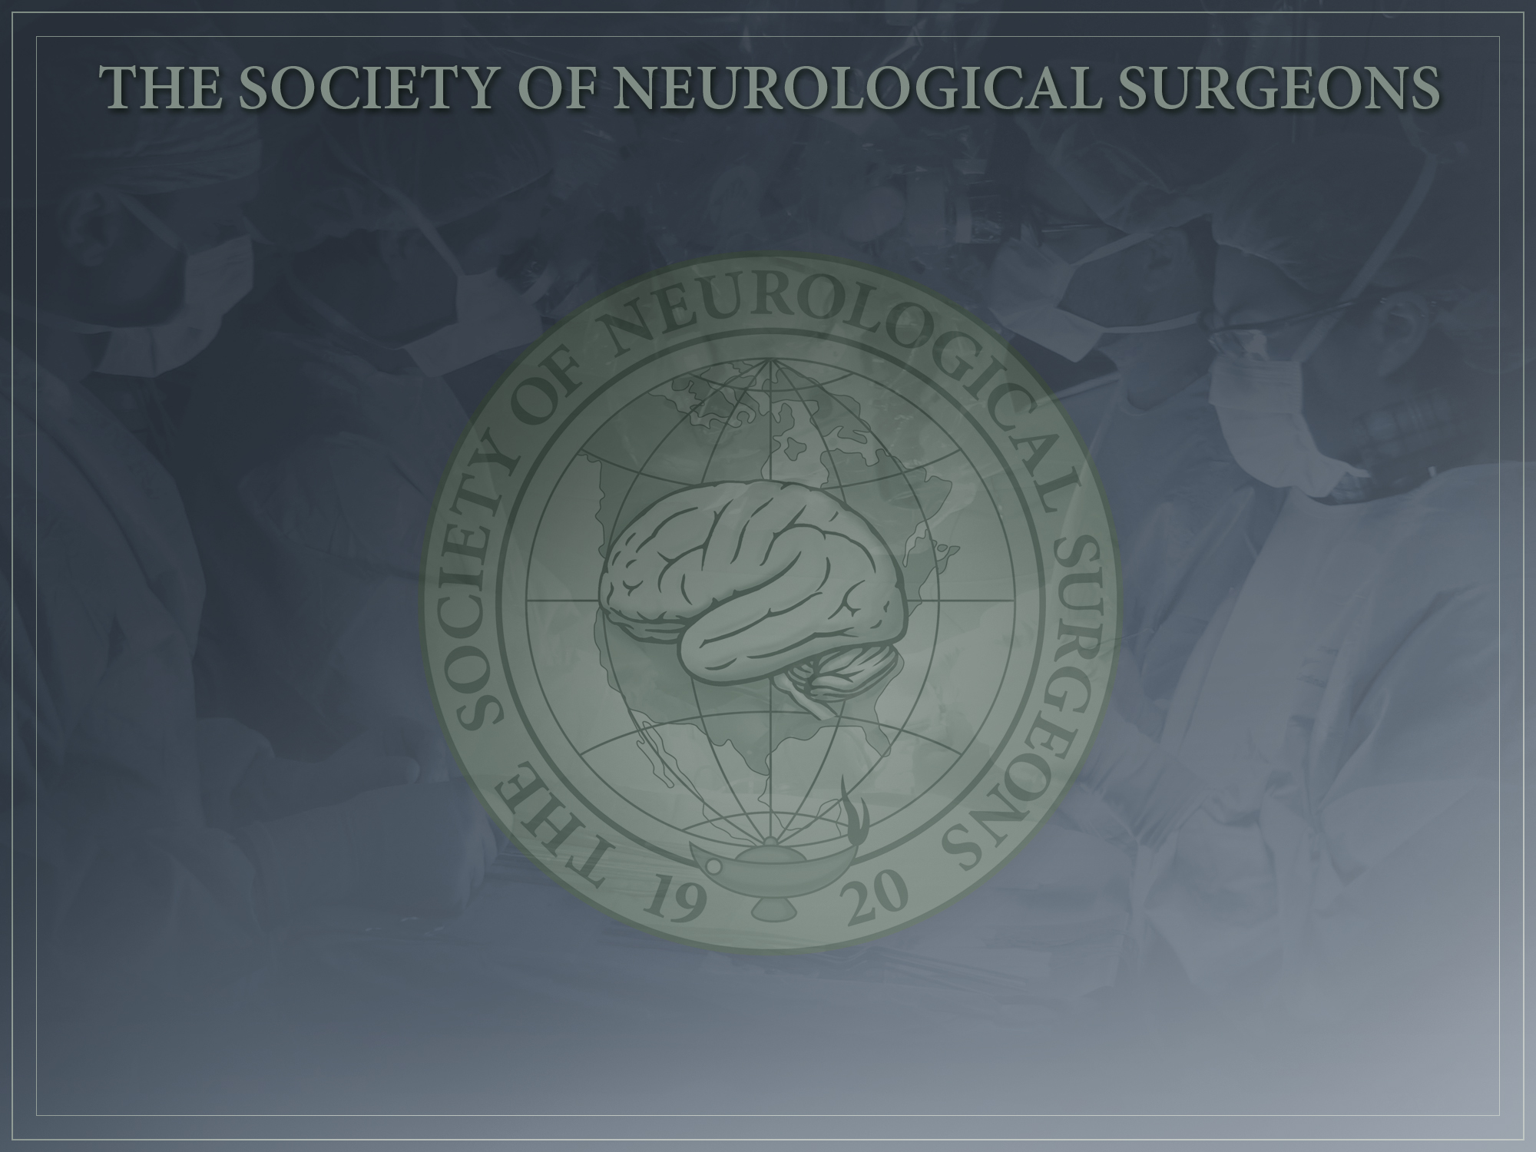
PGY1 Boot Camp Courses
Nathan R. Selden, MD, PhD
Campagna Chair of Pediatric Neurosurgery
Oregon Health & Science University

Slide 2
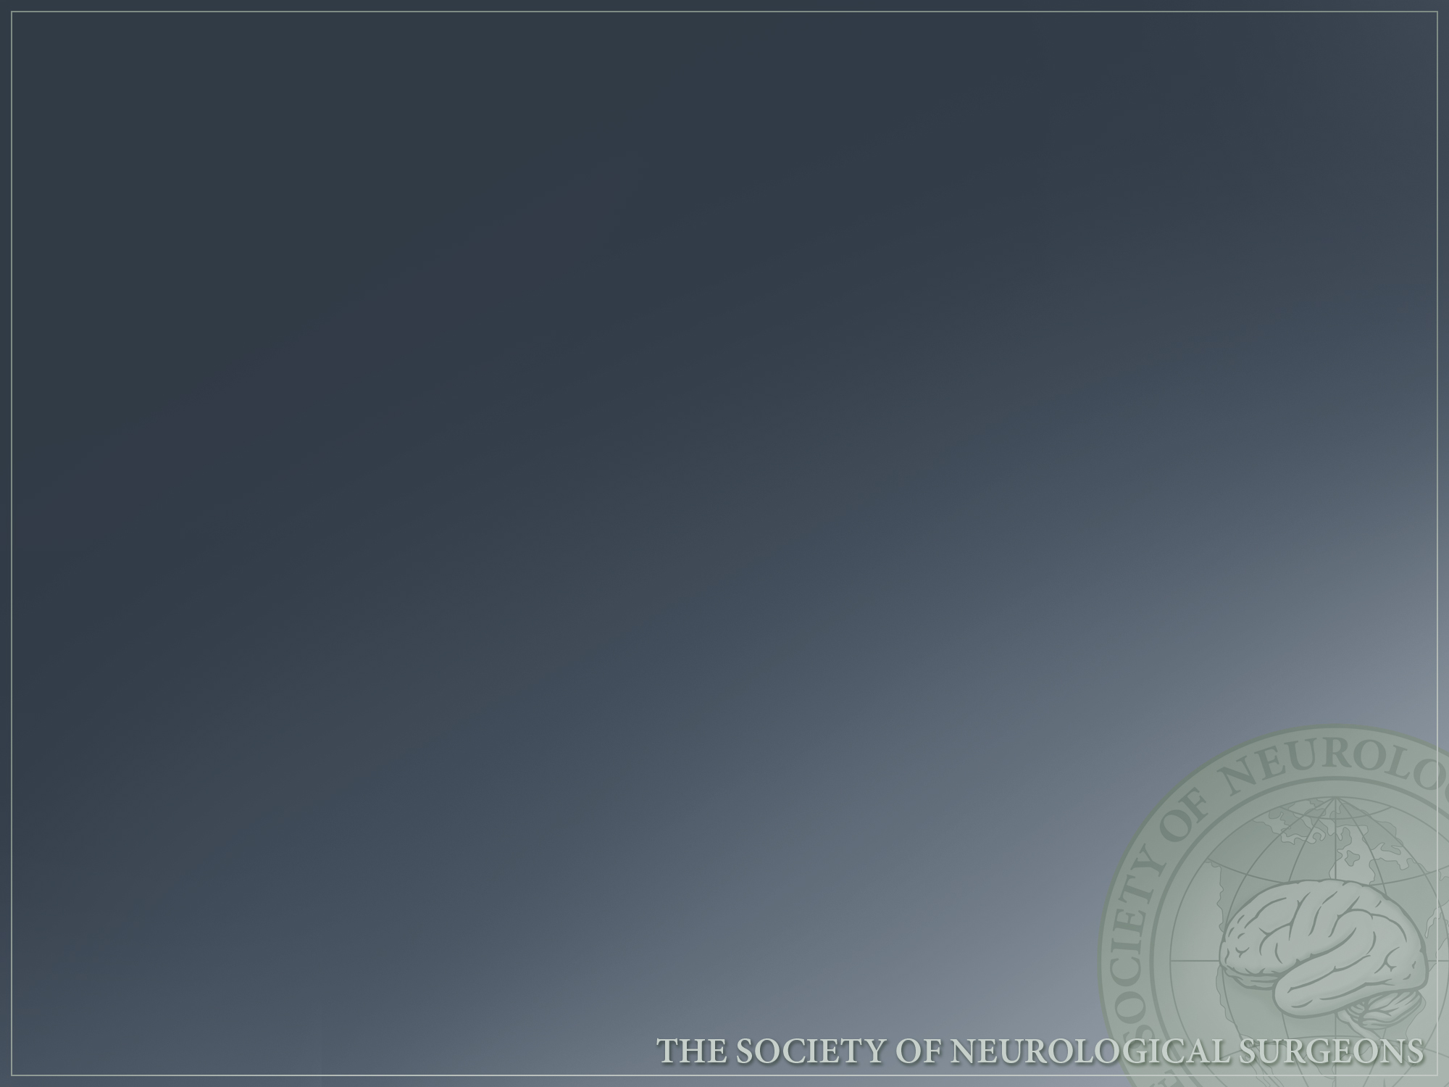
Disclosures
Dr. Selden has no financial relationship with any Boot Camp sponsor
He serves as Chair of the Committee on Resident Education (CoRE), Society of Neurological Surgeons
He serves as Chair, ACGME Neurosurgery Milestones Group

Slide 3
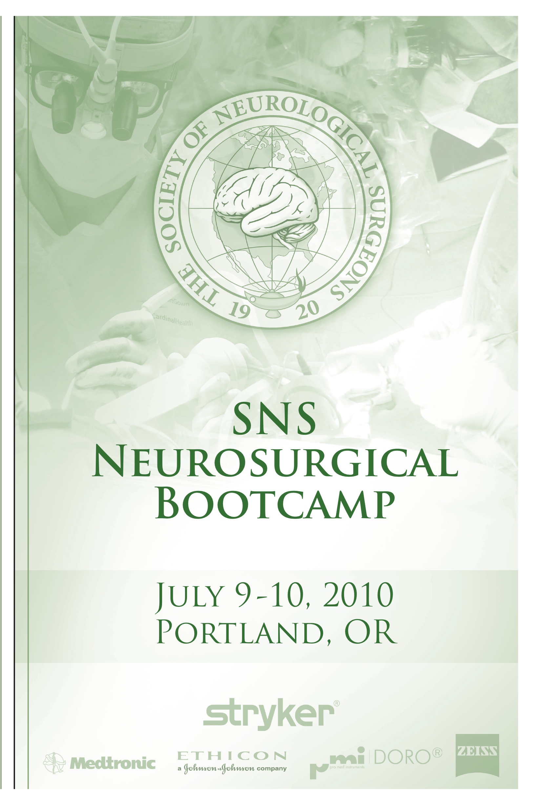
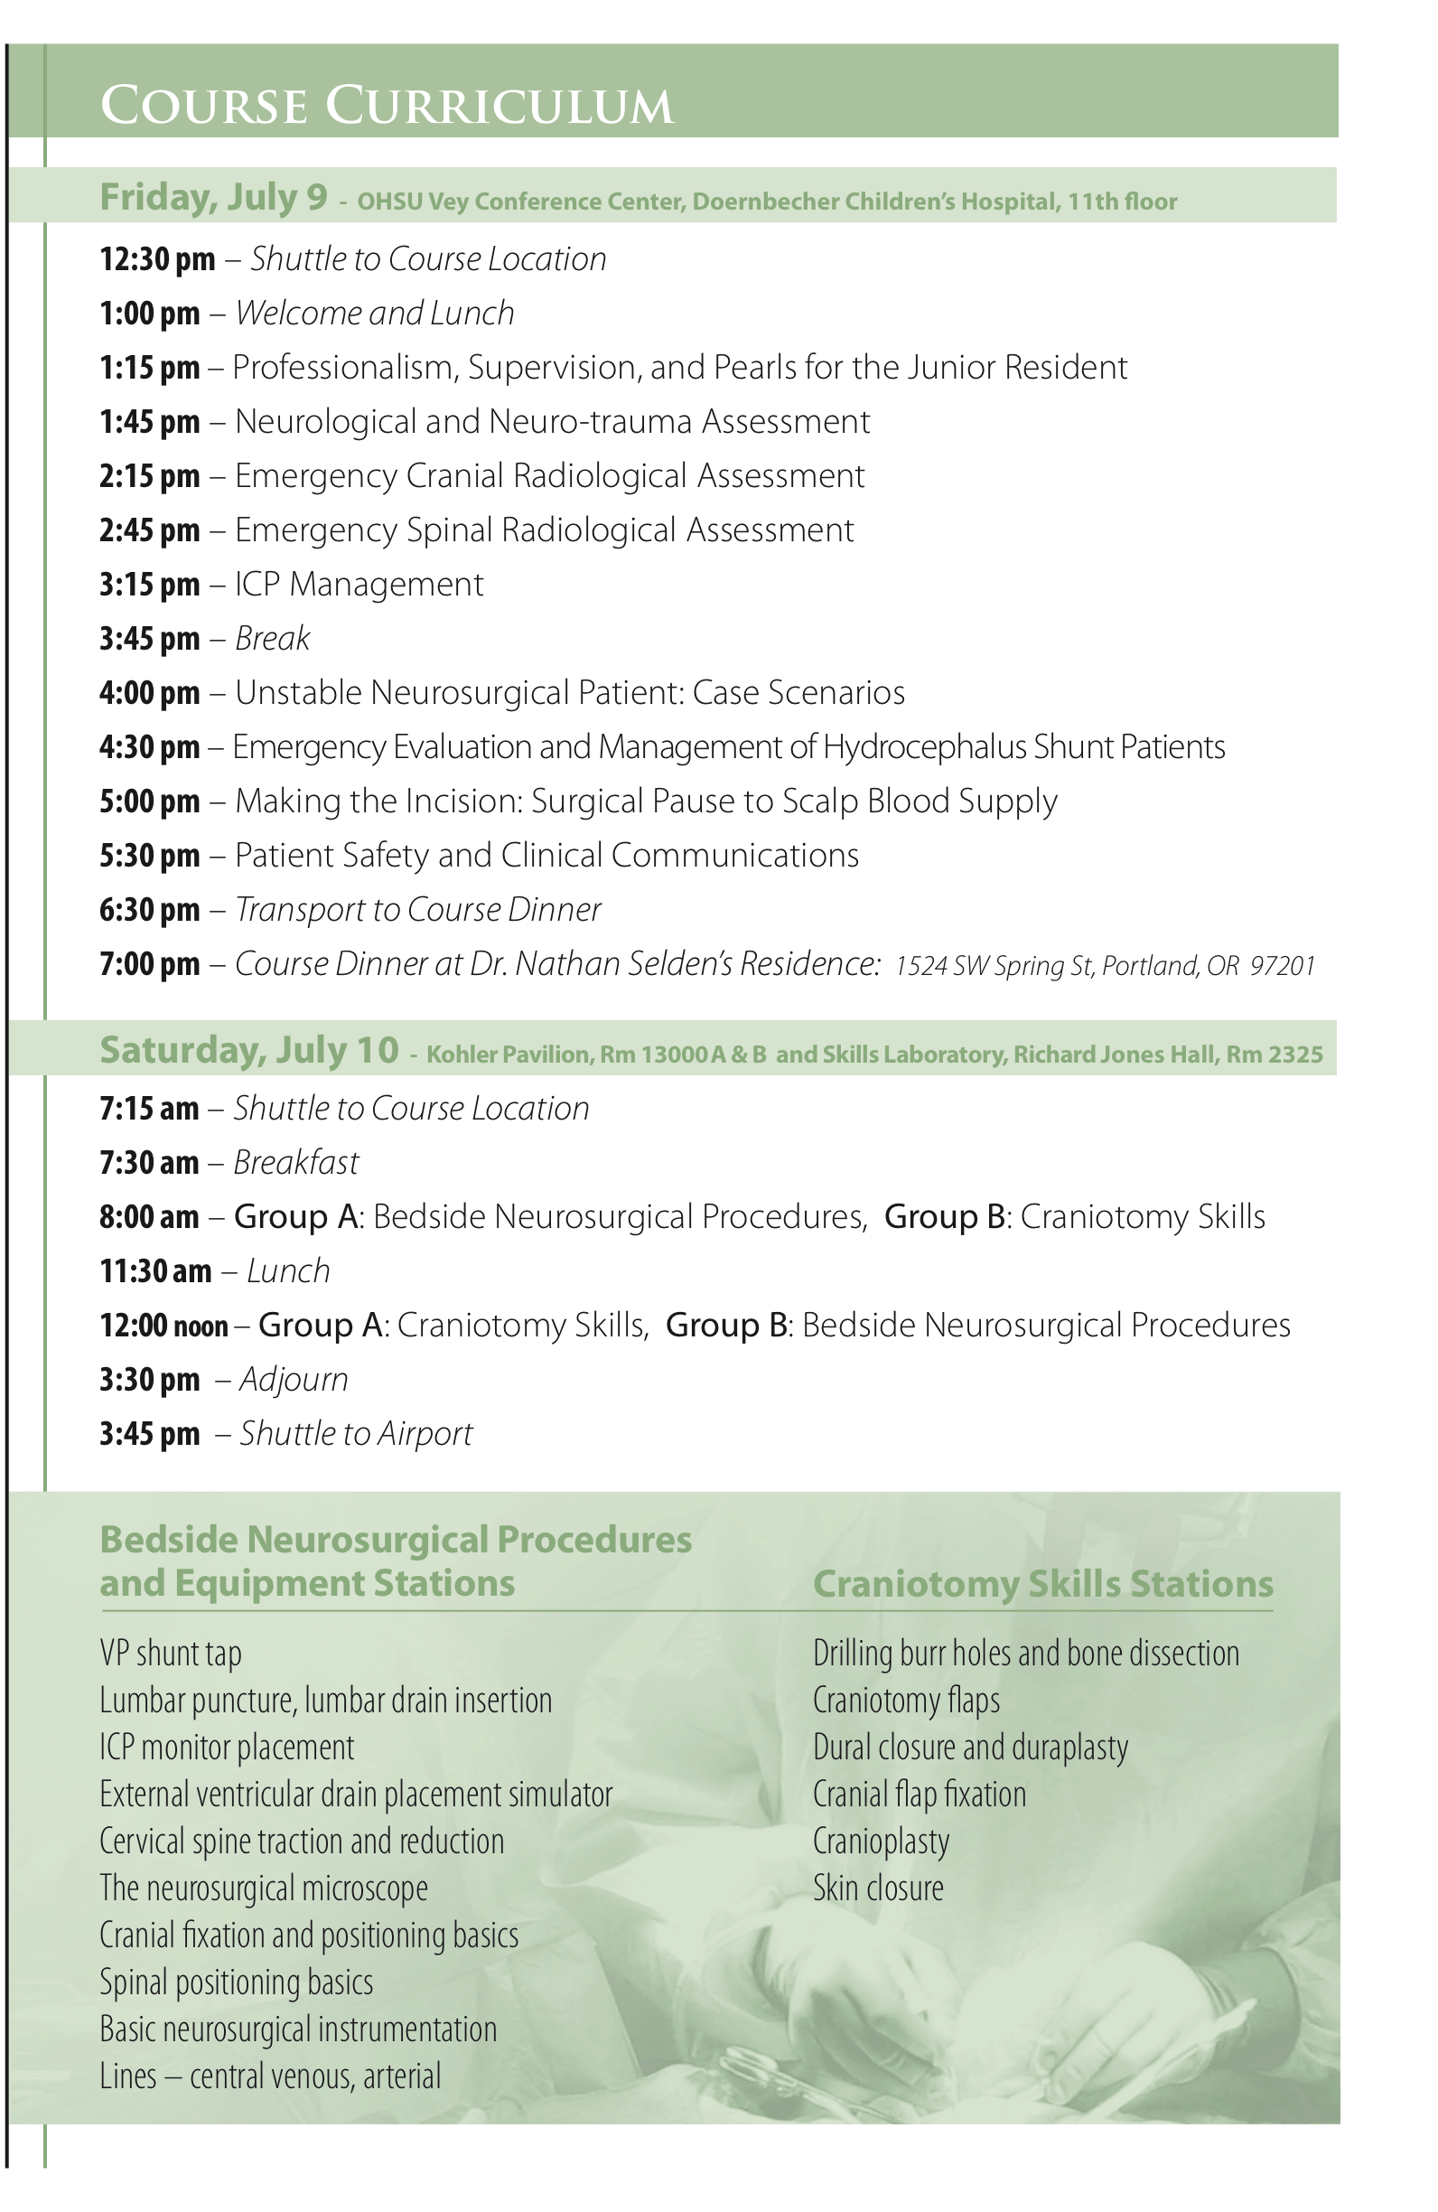
Outline
Update
Iterative improvements
Model based simulation for early learners
Coordination with ACGME

Slide 4
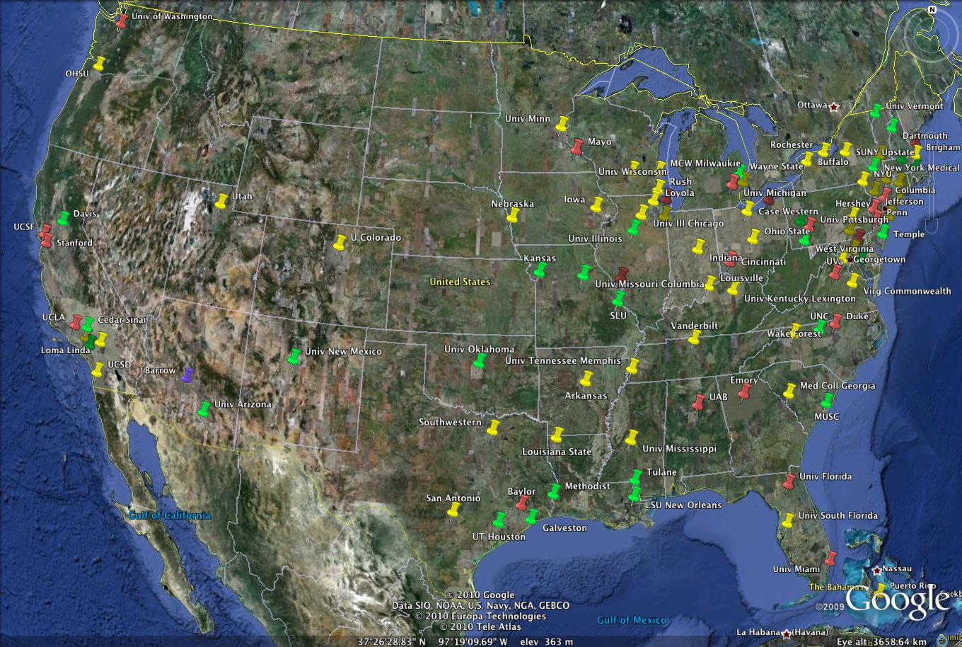
NEW ENGLAND
Programs: 18
Residents: 33
MIDWEST
Programs: 19
Residents: 38
WESTERN
Programs: 14
Residents: 29
MID ATLANTIC
Programs: 16
Residents: 34
SOUTHWEST
Programs: 16
Residents: 25
SOUTH
Programs: 16
Residents: 36

Slide 5
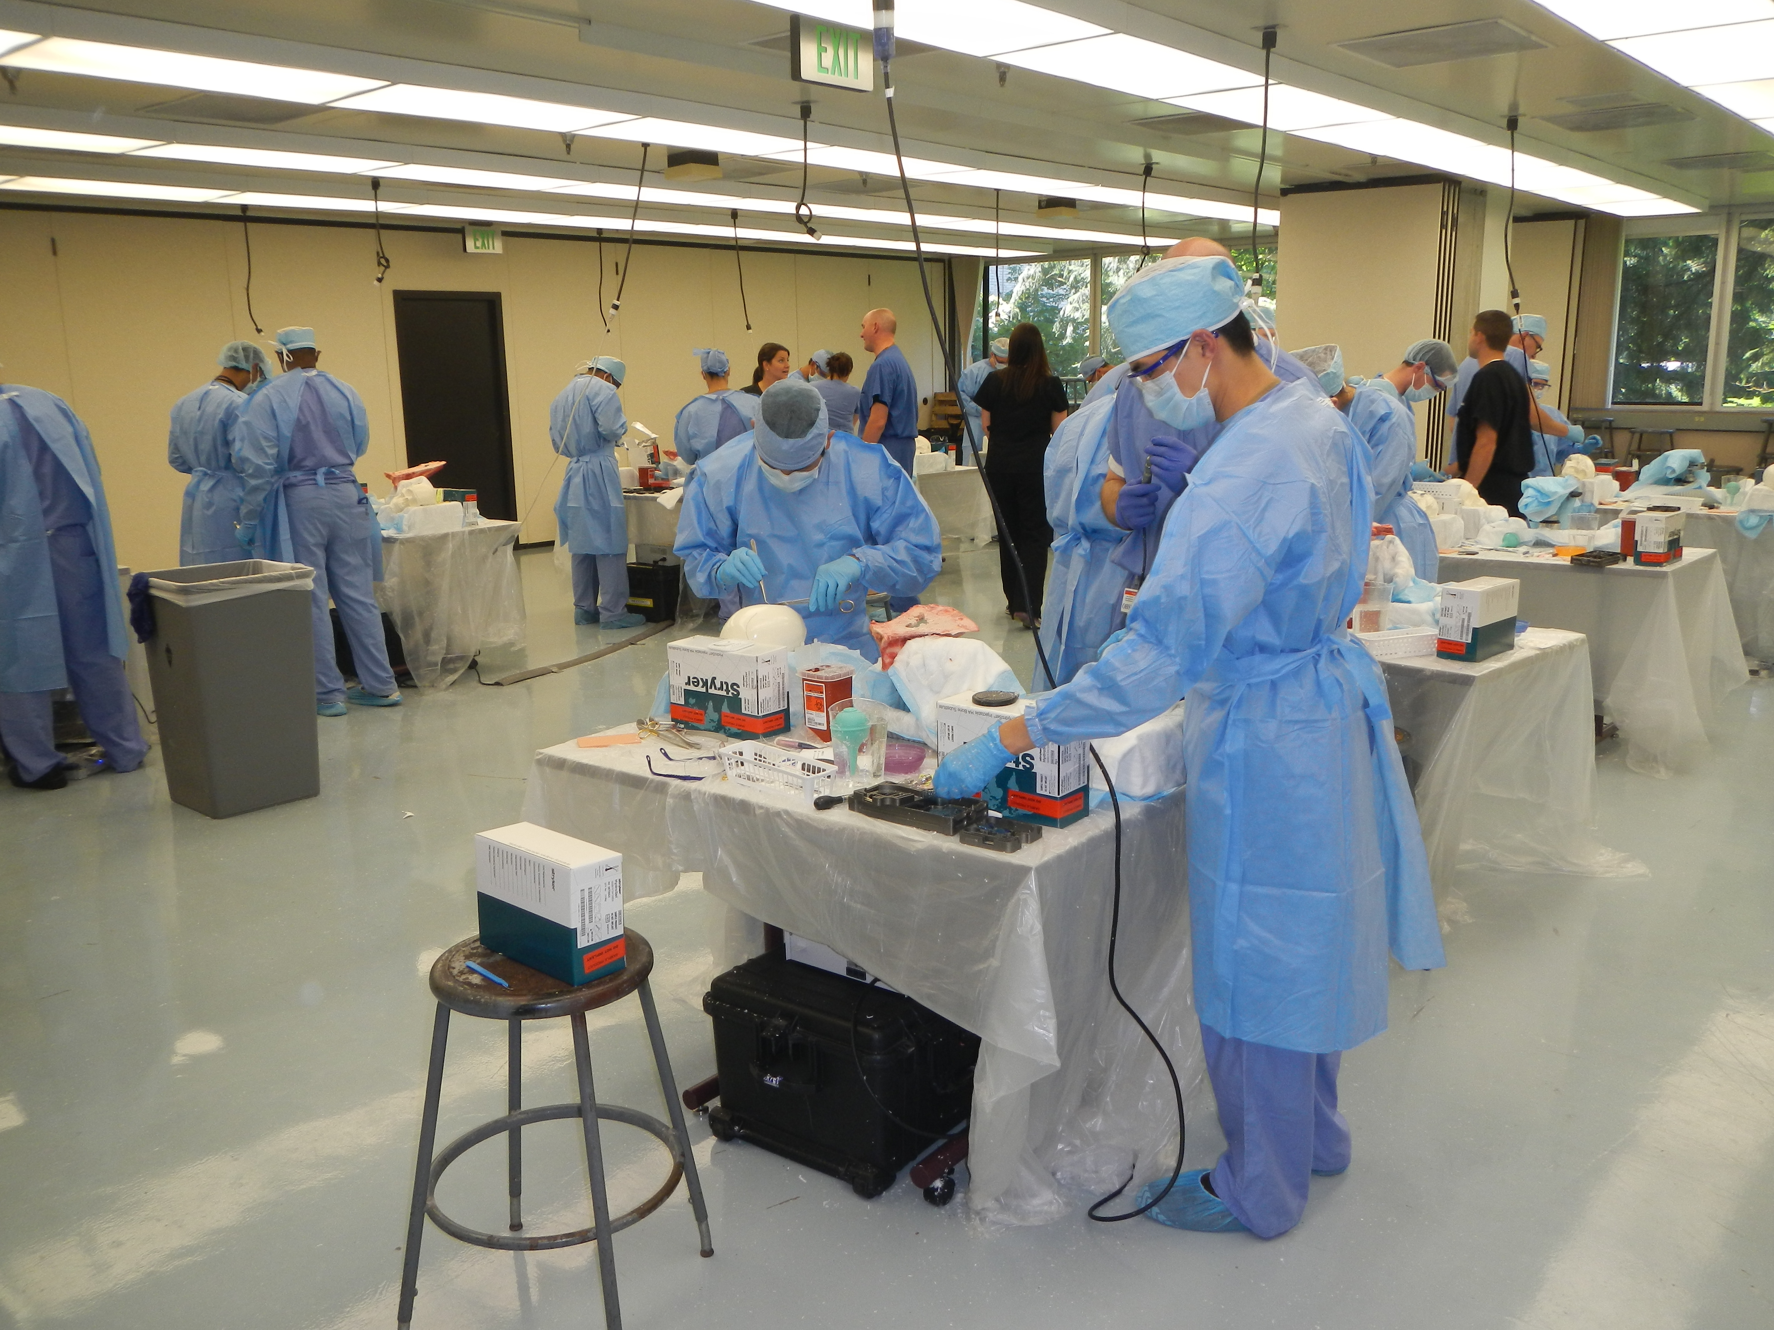
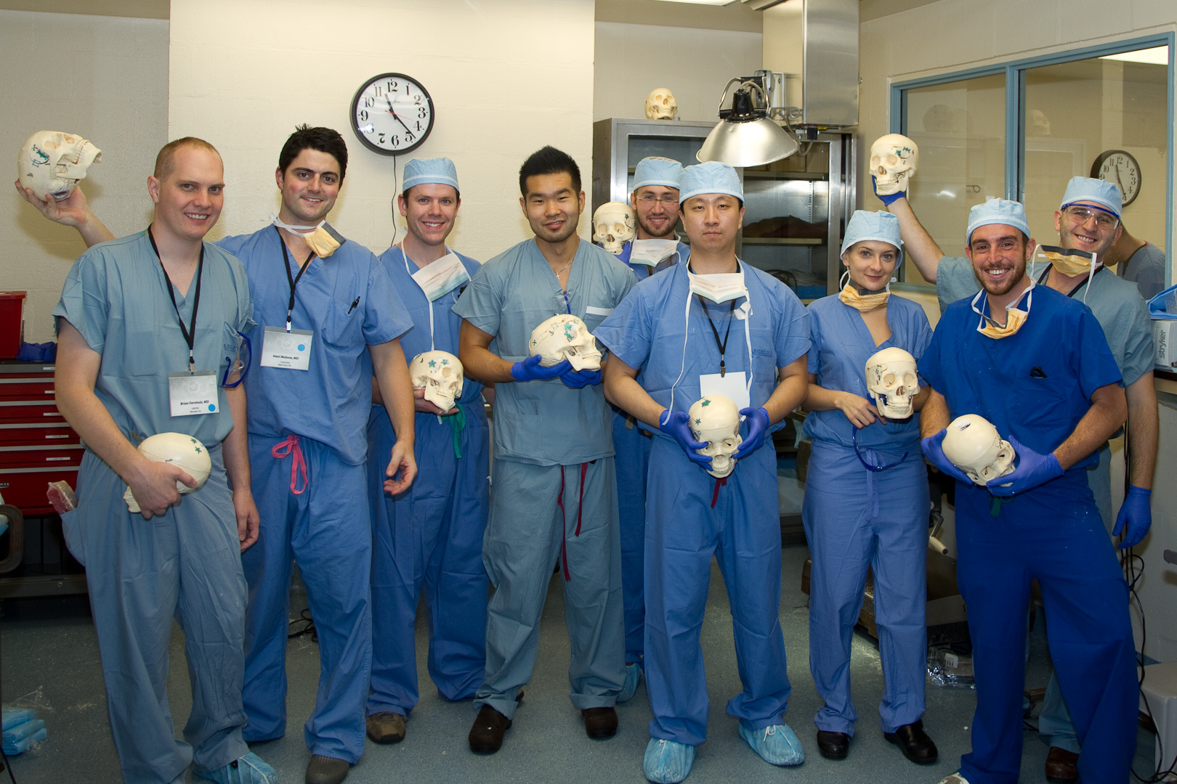
Attendance
2010
  95 programs (96%)
  186 residents (94%)
2011
  101 programs (100%)
  201 residents (100%)
2012
  101 programs (100%)
  206 residents (100%)
  89 registered faculty

Slide 6
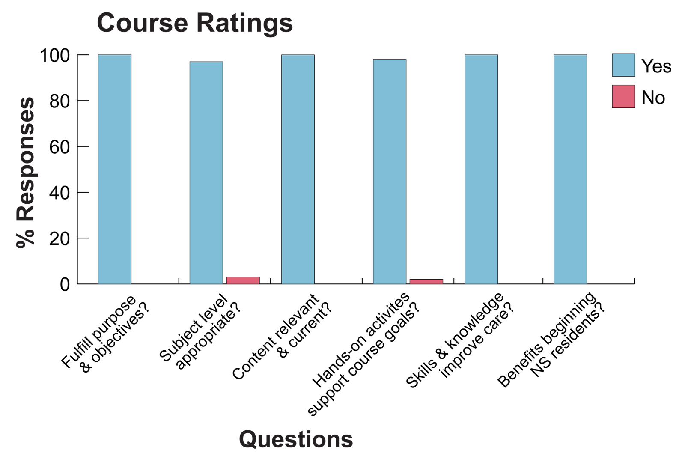

Slide 7
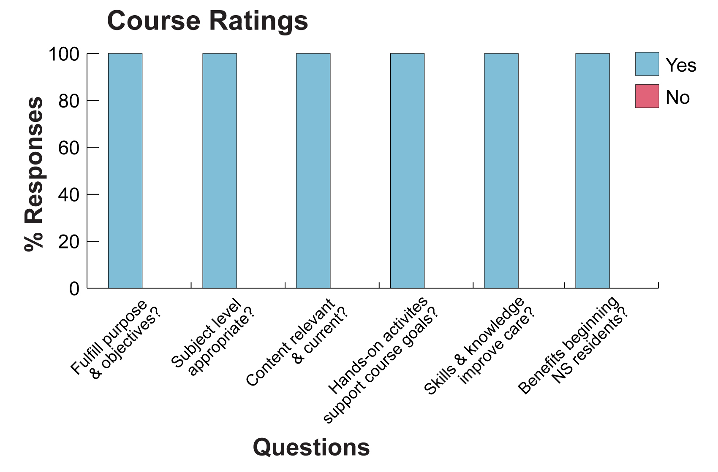

Slide 8
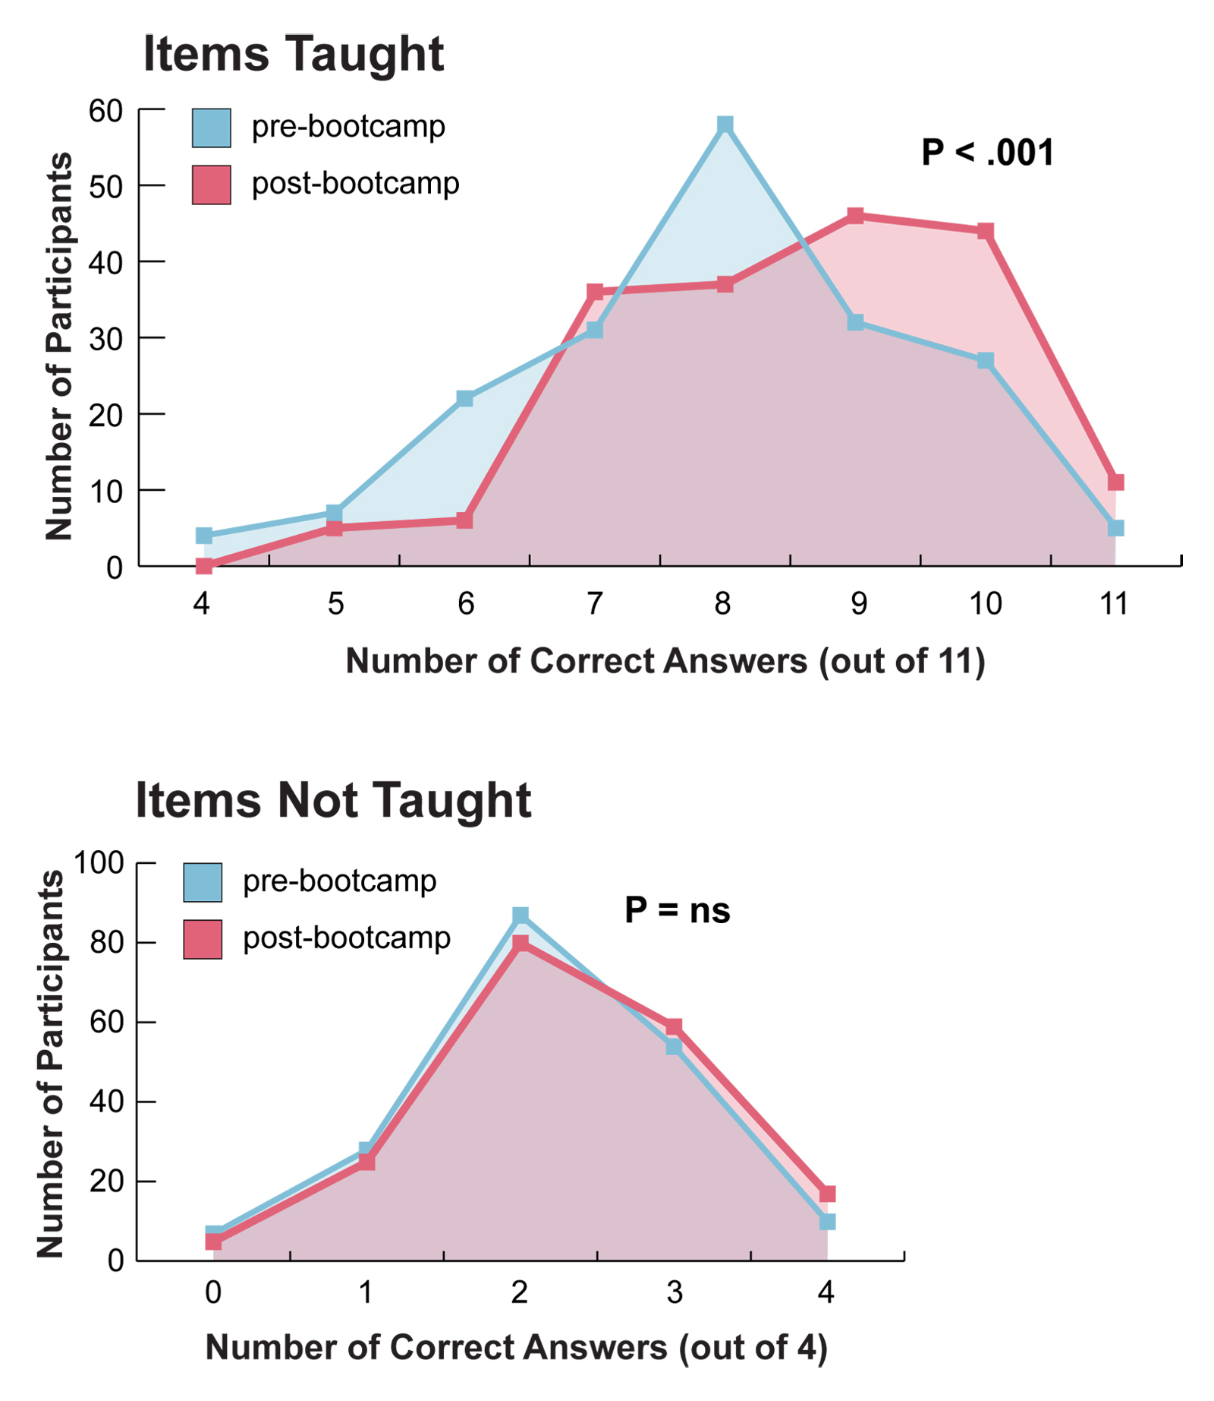

Slide 9
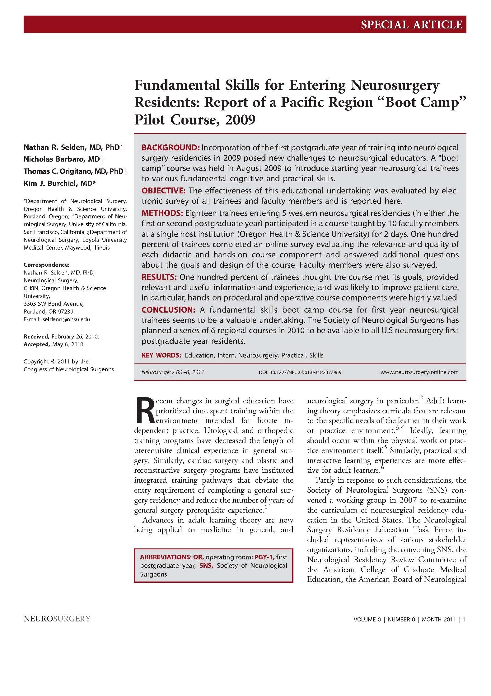

Slide 10
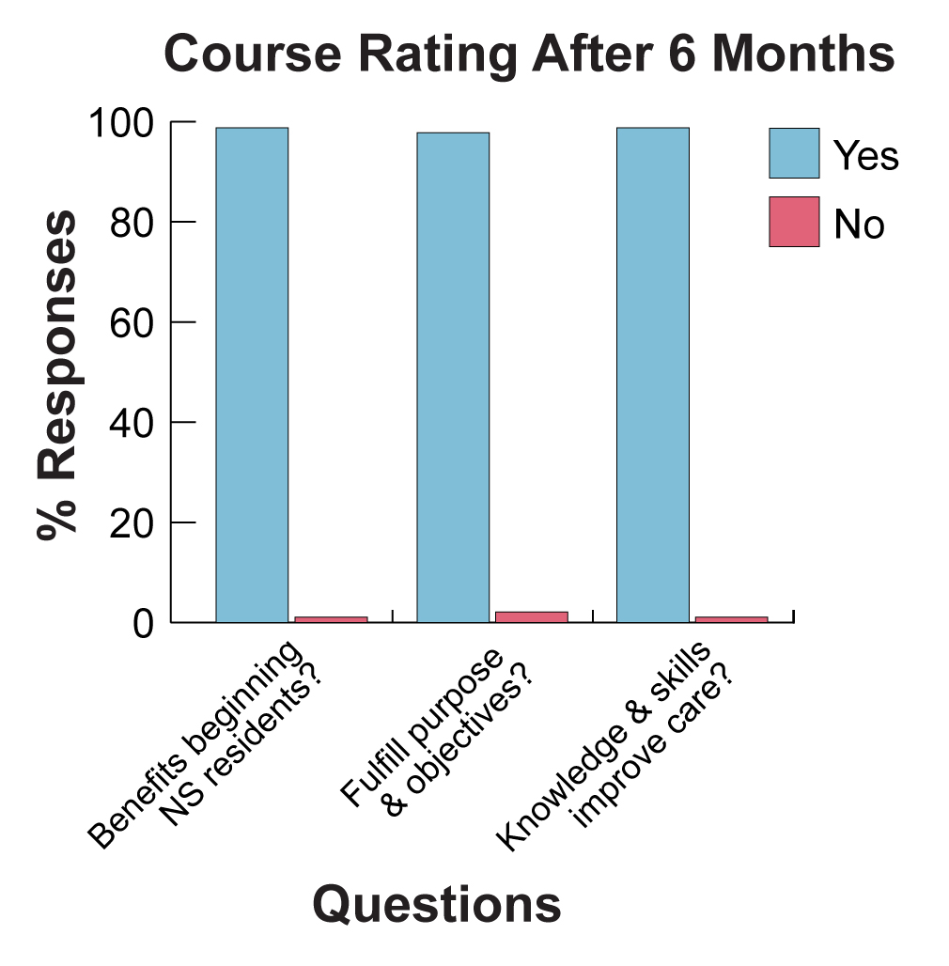

Slide 11
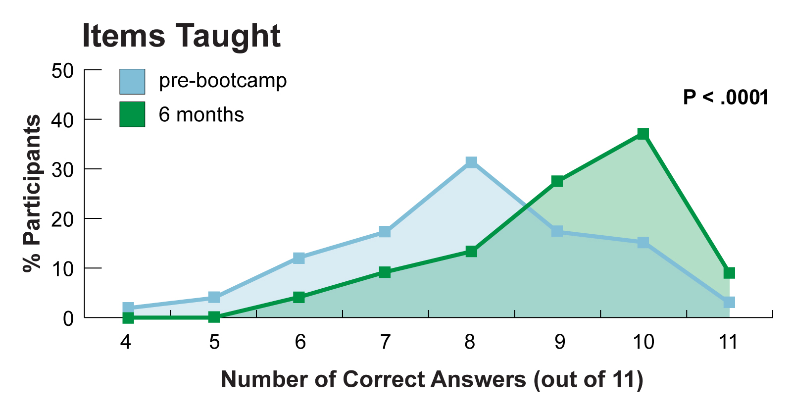

Slide 12
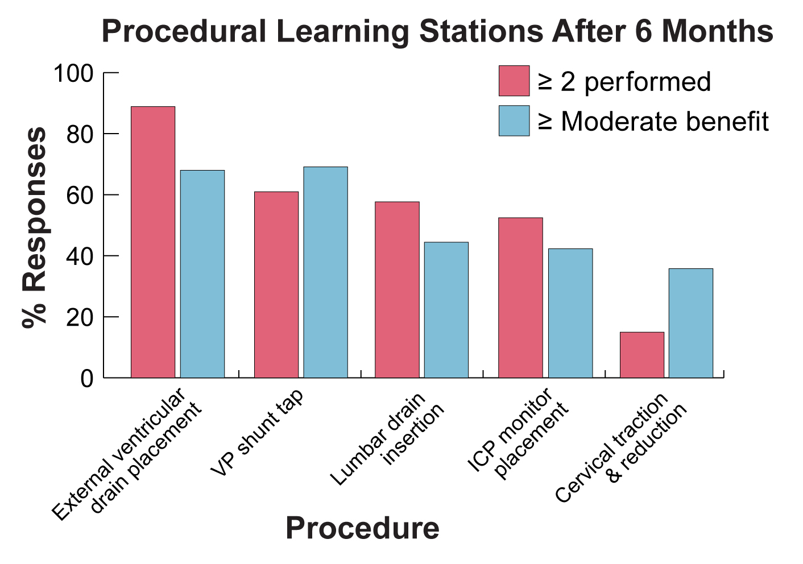
Notes:
Residents and faculty both valued hands on procedural simulation greatly.

Slide 14
Continued Acceptance
2011 Surveys: 92% completion (185/201)
Course beneficial 100% yes
Fulfilled purpose & objectives 99.5% yes
Knowledge & skill to improve 100% yes

Slide 15
Other Efforts
Neurosurgery Boot Camps have sparked a minor ‘movement’
  Canadian Neurosurgery Boot Camp
  Pakistani Neurosurgery Boot Camp
  American Board of Surgery Interest

Slide 16
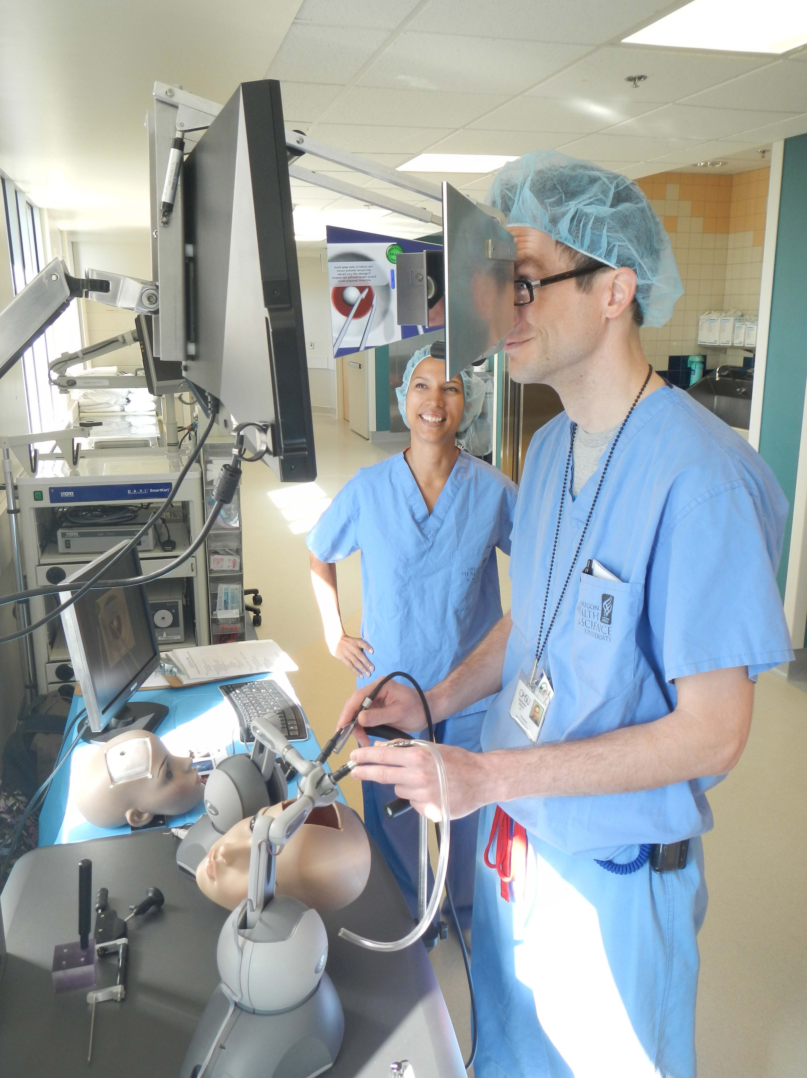
Innovations
Objective skills assessment
  Structured checklist
  Pilot 3 procedure stations
  National use 2013
Pilot of haptic surgical skills simulator
Housing of Boot Camp lecture material online for year-round learning

Slide 17
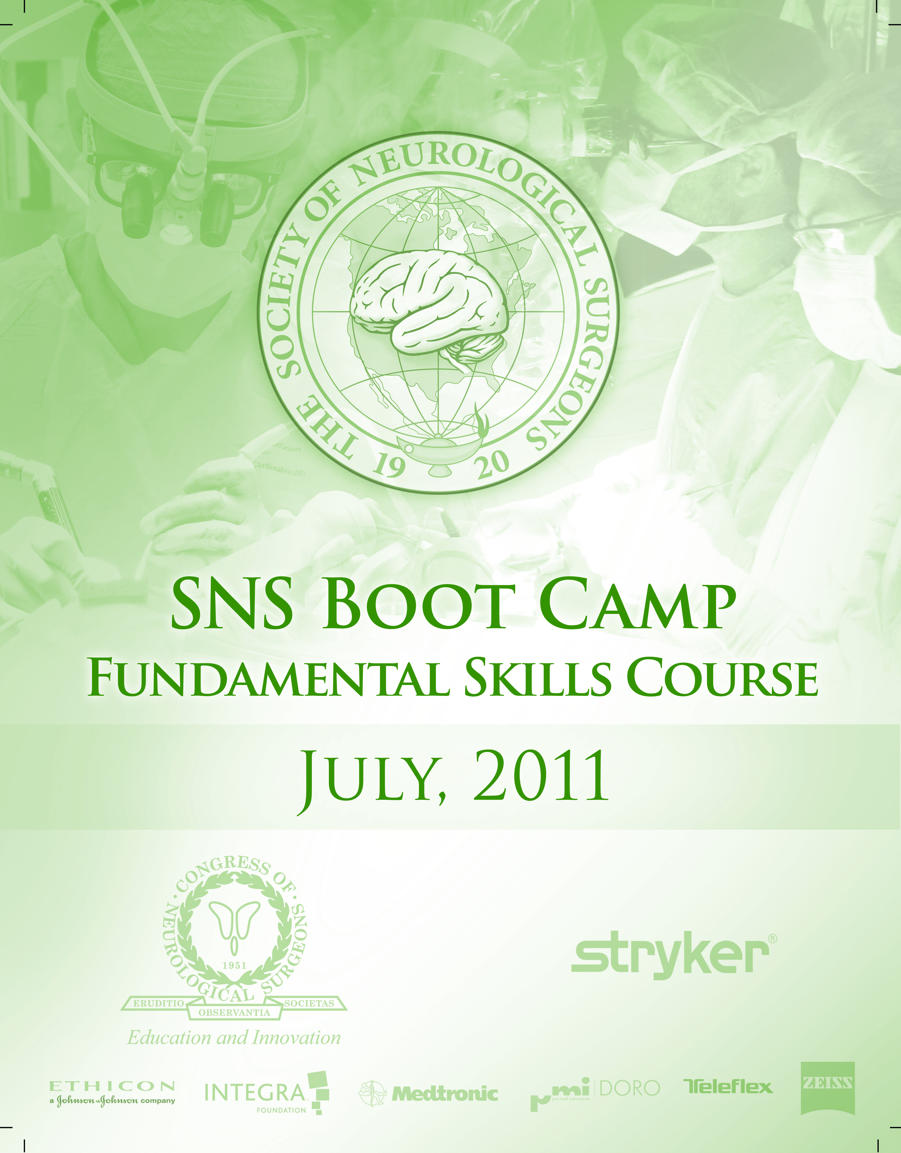
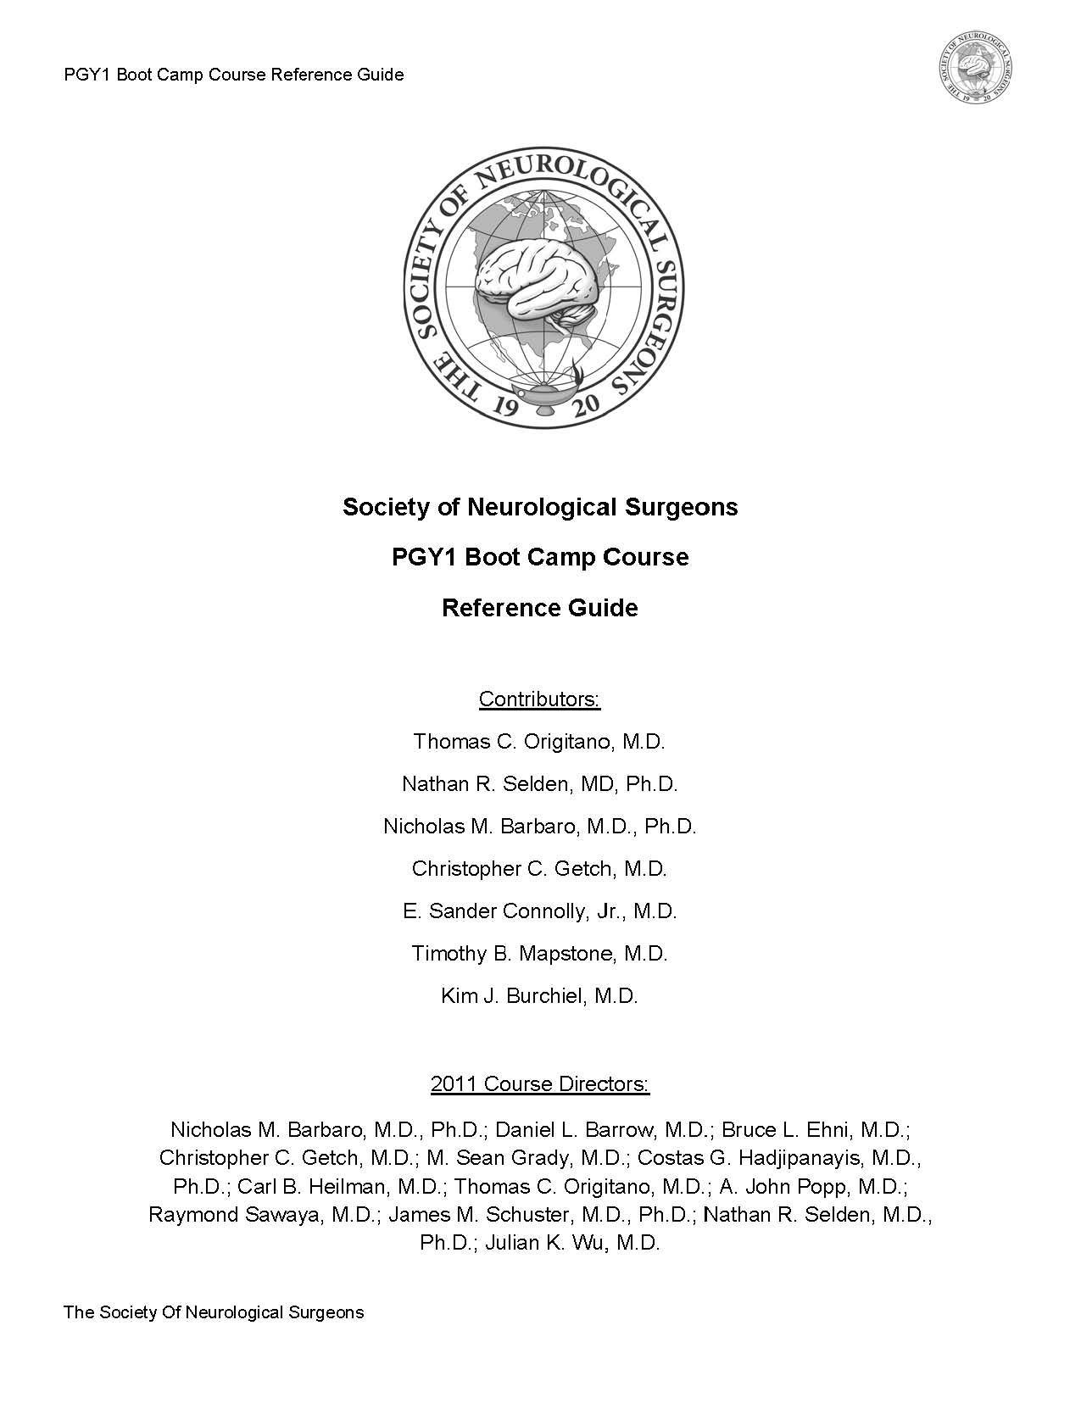

Slide 18
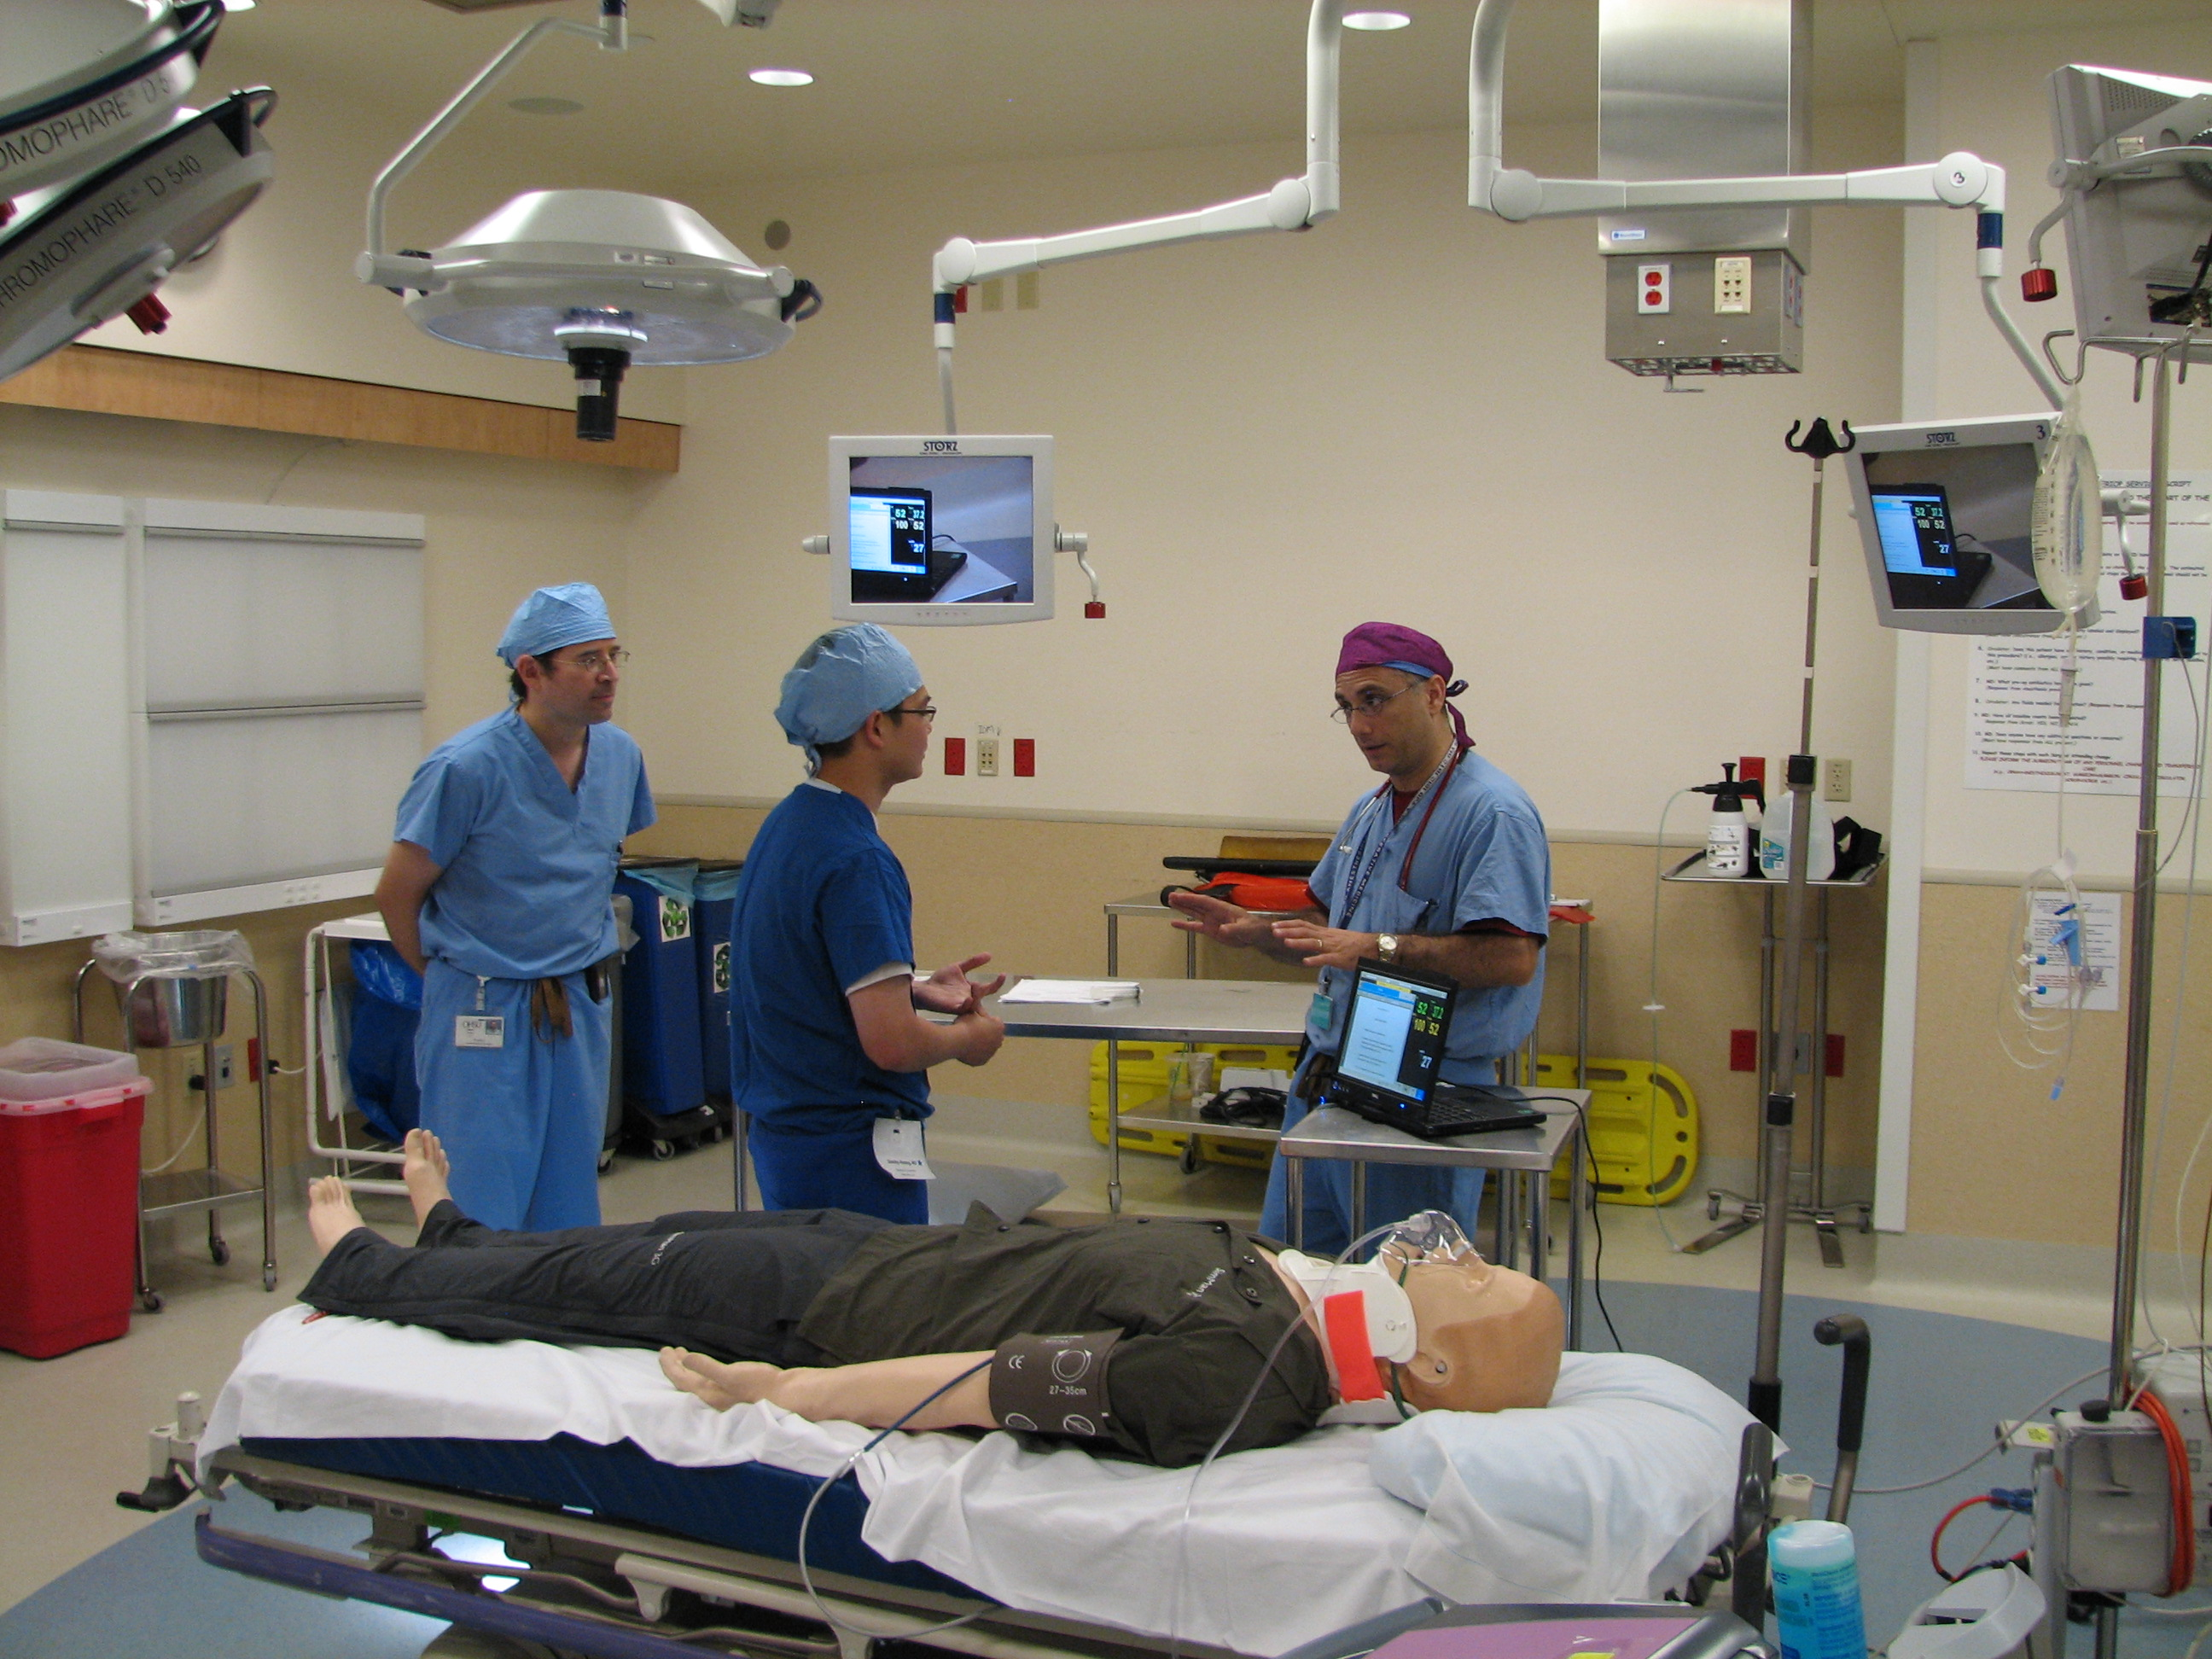
Decision Simulation
Clinical decision simulator
ED scenario: Neurological deterioration with expanding EDH
PGY1 is first neurosurgery team member to arrive
Assess, diagnose, stabilize, communicate

Slide 19
SNS Junior Resident Course
Curriculum focused on basic surgical approaches and professionalism/leadership
Based on national needs analysis
3 regional courses
Launched May 2013
  Rich Byrne will report on this effort in a moment

Slide 20
Model Based Simulation
Very effective modality for early learners
Technologically simple
Inexpensive
Avoid regulatory barriers and materials concerns with cadavers

Slide 21
Boot Camp Physical Models
Surgical
  Drilling
  Craniotomy
  Dural closure
  Cranial fixation
  Cranioplasty
  Scalp closure
Procedural
  ICP monitor
  EVD
  Lumbar drain
  Shunt tap
  Central line

Slide 22
Boot Camp Physical Models
Surgical
  Drilling
  Craniotomy
  Dural closure*
  Cranial fixation
  Cranioplasty
  Scalp closure*
Procedural
  ICP monitor
  EVD*
  Lumbar drain*
  Shunt tap*
  Central line
*Iterative physical model improvements

Slide 23
Boot Camp Physical Models
Surgical
  Drilling
  Craniotomy
  Dural closure*
  Cranial fixation
  Cranioplasty
  Scalp closure*
Procedural
  ICP monitor
  EVD*
  Lumbar drain*
  Shunt tap*
  Central line¶
¶Systematic introduction of valid model

Slide 24
Model based simulation
Example: Drilling
  Not updated after introduction (no need)

Slide 26
Iterative model improvement
Example: Dural closure

Slide 28
Iterative model improvement
Example: Lumbar drain

Slide 30
Iterative model improvement
Example: VP shunt tap

Slide 32
Iterative model improvement
Example: External ventricular drain

Slide 34
Systematic model introduction
Example: Central line

Slide 36
Iterative model improvement
Example: Spine surgery

Slide 37
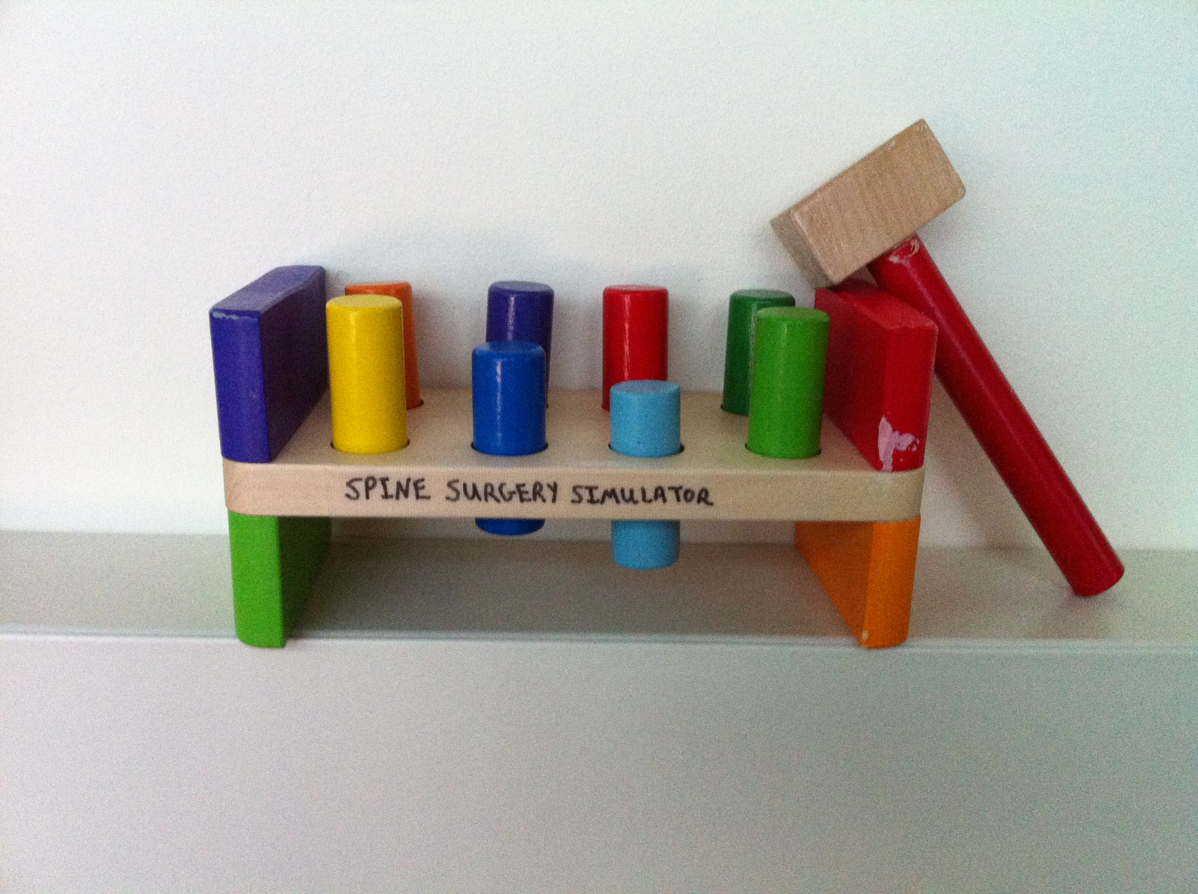

Slide 38
Percent
Hands on model based simulation not changed

Slide 39
P < .02
Percent
Hands on model based simulation improved

Slide 40
Model-based simulation for early learners
Selden, NR; Origitano, TC; Hadjipanayis, C.; & Byrne, R., (2013) NEUROSURGERY, in press

Slide 41
Coordination with ACGME
ACGME has adopted language recognizing the PGY1 Boot Camp courses “or equivalent” as part of appropriate experience before independent practice of procedures
Milestones incorporate Boot Camp experience into the PGY1 relevant goals

Slide 42
Notes:
Developmental progression of milestone elements across levels can be shown for either cognitive or technical skills. This example shows progression in technical skills across levels within the TBI PC milestone.

Slide 43
Boot Camp
Boot Camp
Notes:
Developmental progression of milestone elements across levels can be shown for either cognitive or technical skills. This example shows progression in technical skills across levels within the TBI PC milestone.

Slide 44
Notes:
Developmental progressions in a single skill area are important to evaluate and track. These 4 milestones can be captured in a single relevant evaluation question.

Slide 45
Boot Camp
JR Course
Notes:
Developmental progressions in a single skill area are important to evaluate and track. These 4 milestones can be captured in a single relevant evaluation question.

Slide 46
Financing and Administration
Boot Camps
  5 year agreement
    Administrative support from the CNS
    Educational grant from Stryker ($1.89 million)
  2013 is the 3rd year of the contract
Junior Resident Courses
  First year supported by Stryker, Integra, Depuy-Synthes, Zeiss
  Administrative support from the AANS

Slide 47
Lessons Learned
Curricula can be national and engage directly with outcomes based education imperatives
Industry is interested in arms length funding of real safety and skills training for residency
  Public mission
Model based simulation is very useful for early learners
Decision making simulation is critical
Notes:
Stryker: Beth Sizemore, Jason King, Ryan Emery
Medtronic: Kimberly Hill et al
Synthes: Peter Fehlman

Slide 48
Thanks
SNS Council
Subcommittee on Boot Camp Courses
  Steering Committee: Byrne (Chair), Barbaro, Burchiel, Origitano, Selden
Course Directors (12) and Faculty (89)
CNS, AANS
Corporate sponsors

