Slide 1
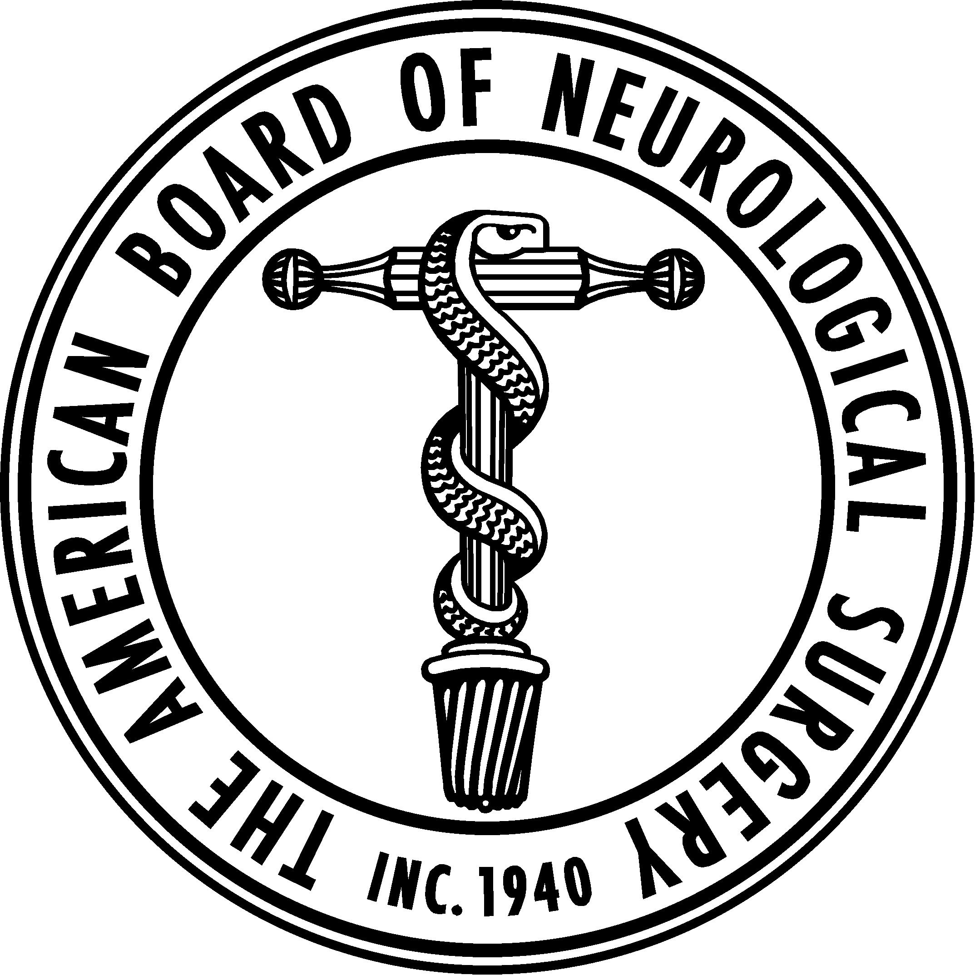
ABNS Update
Carl Heilman MD
Secretary ABNS

Slide 2
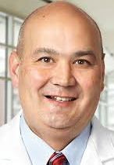
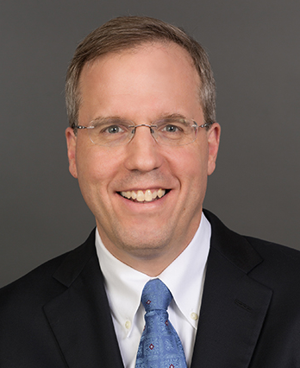
2019 ABNS Officers and New Directors
Chair: Linda Liau MD PhD
Vice Chair: Doug Kondziolka MD
Secretary: Carl Heilman MD
Treasurer: Kevin Cockroft MD
New Directors: Russ Lonser MD, Nate Selden MD, Paul Camarata MD
CNS
SNS
NSA

Slide 3
ABNS Numbers:
7,063 Total ABNS Diplomates
5,986 Active Diplomates: 3,191 lifetime
1,489 Neurosurgery residents in 115 ACGME training programs
16% of neurosurgery residents are women

Slide 4
Resident Case Minimums
In January 2019, the ABNS directors voted to require individual neurosurgery residents meet the case minimums during residency.
The required individual case minimums are identical to the ACGME residency program case minimums.

Slide 5
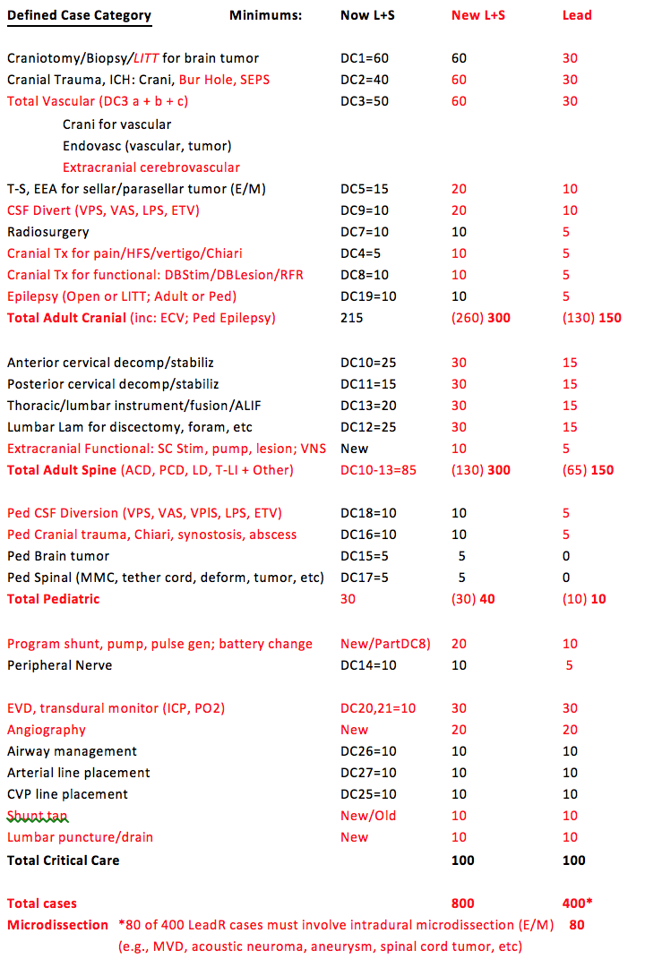

Slide 6
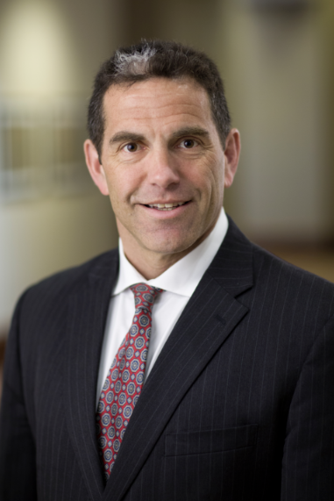
ABNS Primary Exam 2019
2019 Exam: Score of 335 to pass
61 % correct
1% (2 candidates) failed in 2019

Slide 7
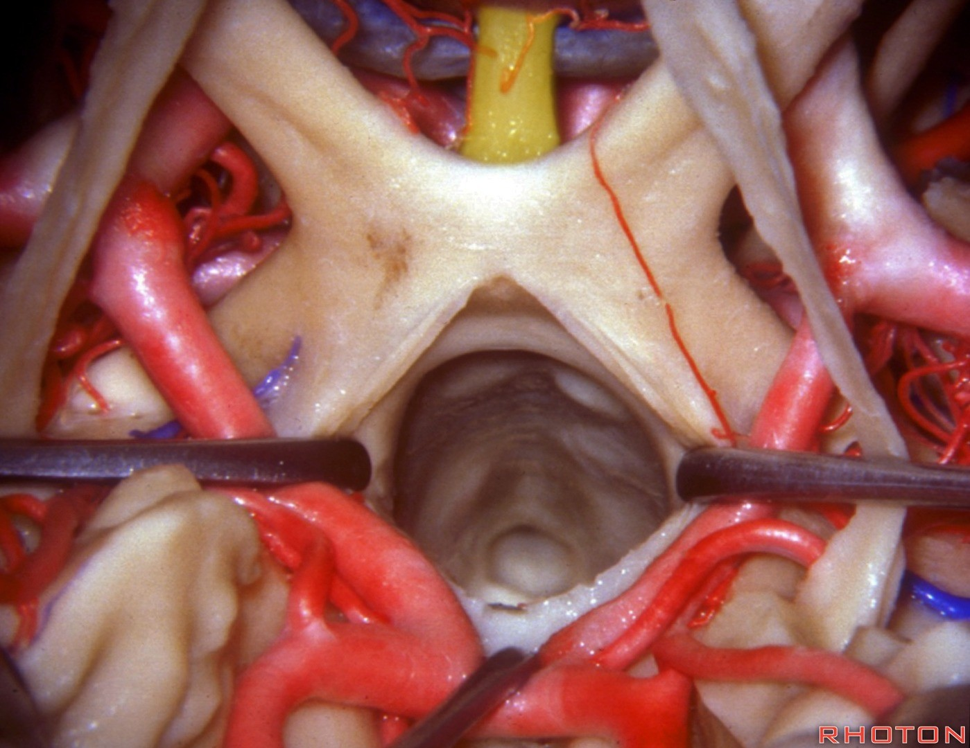
Neuroanatomy PGY2 Mastery Exam

Slide 8
Neuroanatomy Exam: July PGY2: 100 Questions
1. Rhoton Top 100: Surgical Anatomy + Vertebral Anatomy (60 questions)
2. Neuroanatomy Text and Atlas. John Martin, McGraw Hill 2012 (37 questions)
A. Text: 2 questions from each of the 16 chapters (32 questions)
B. Atlas (5 questions)
Atlas I: images 1 through 7 (Gyri, sulci, CN)
Atlas II: Images 1 through 14, and images 20, 23, 26, and 28. (Cross sections spinal cord, brain)
3. Aids to the Examination of the Peripheral Nervous System 5th Ed (3 questions)
Figure 3: Brachial Plexus
Figure 56: Lumbar Plexus
“Commonly Tested Movements” chart on last page of book. (Roots, nerves, muscles)

Slide 10
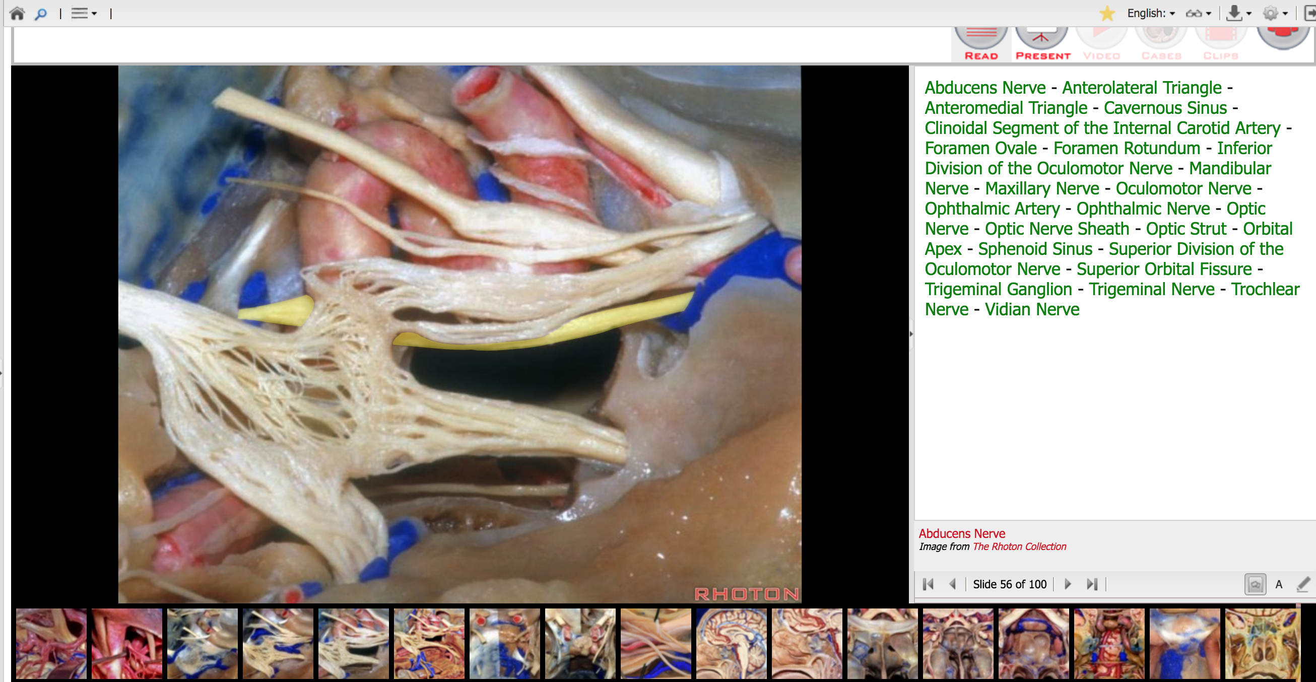
Each image has labeled structures. Any structure with a green anatomical term to the right might be on the test.

Slide 11
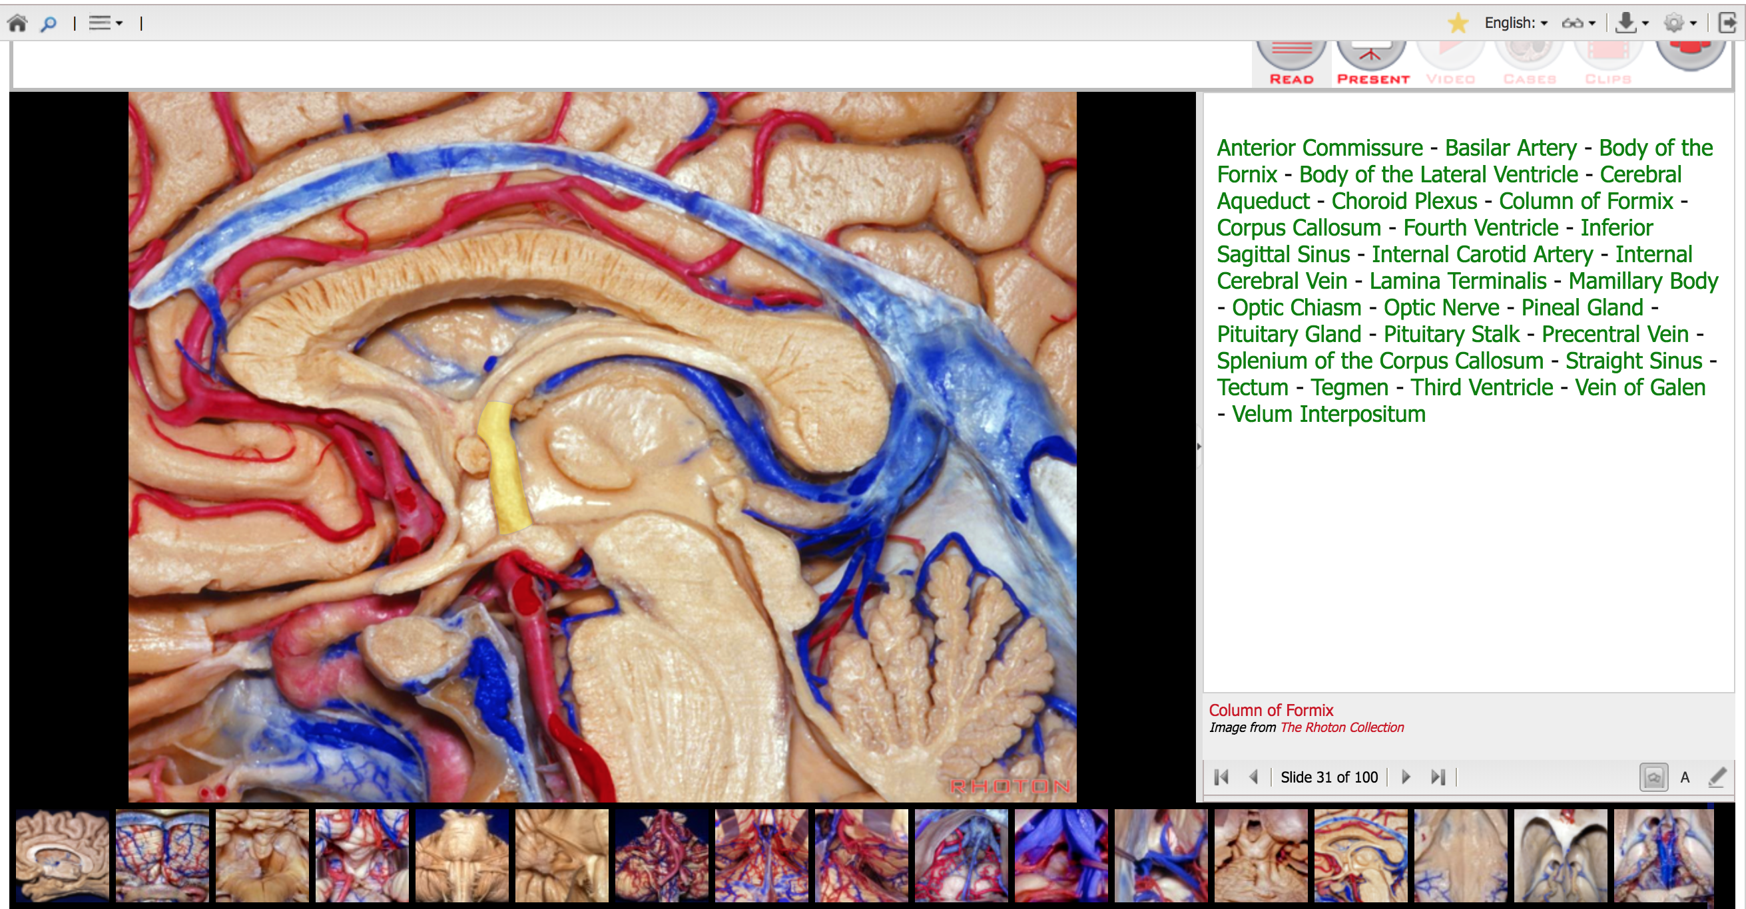

Slide 12
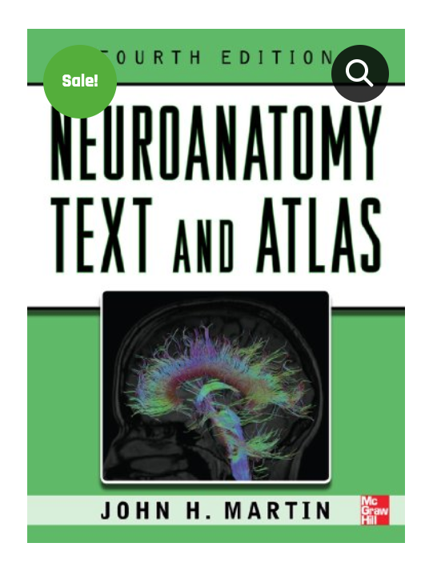
$75
$30

Slide 13
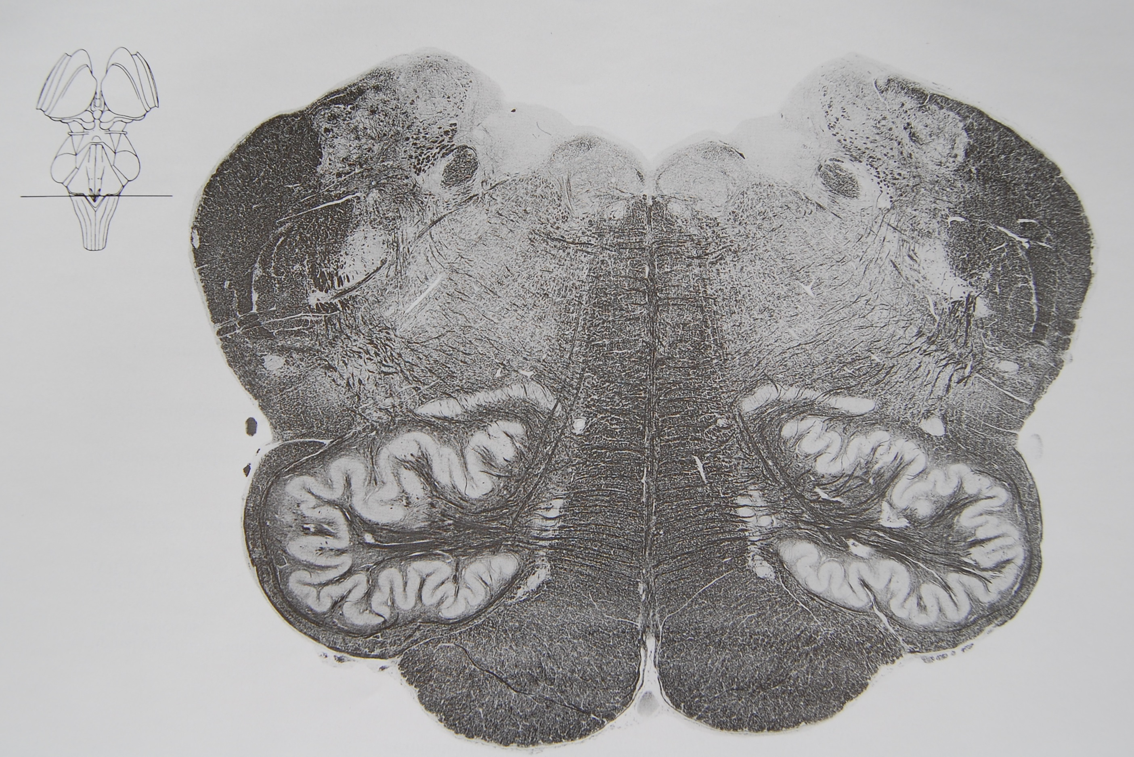
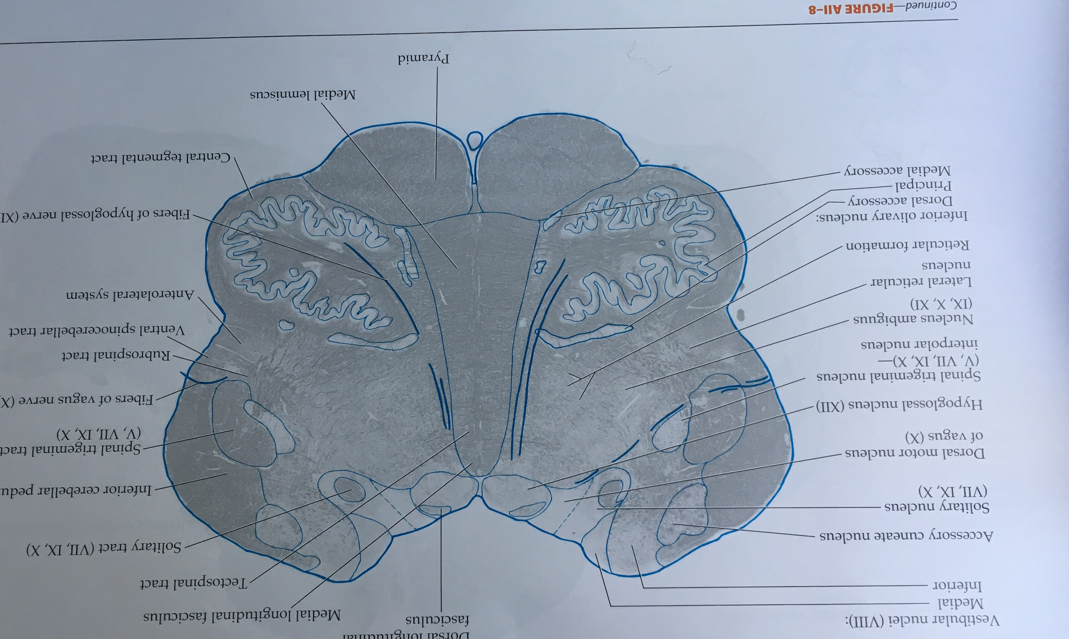
Example: Neuroanatomy Text and Atlas J Martin
There will be 5 questions from the Atlas Section

Slide 14
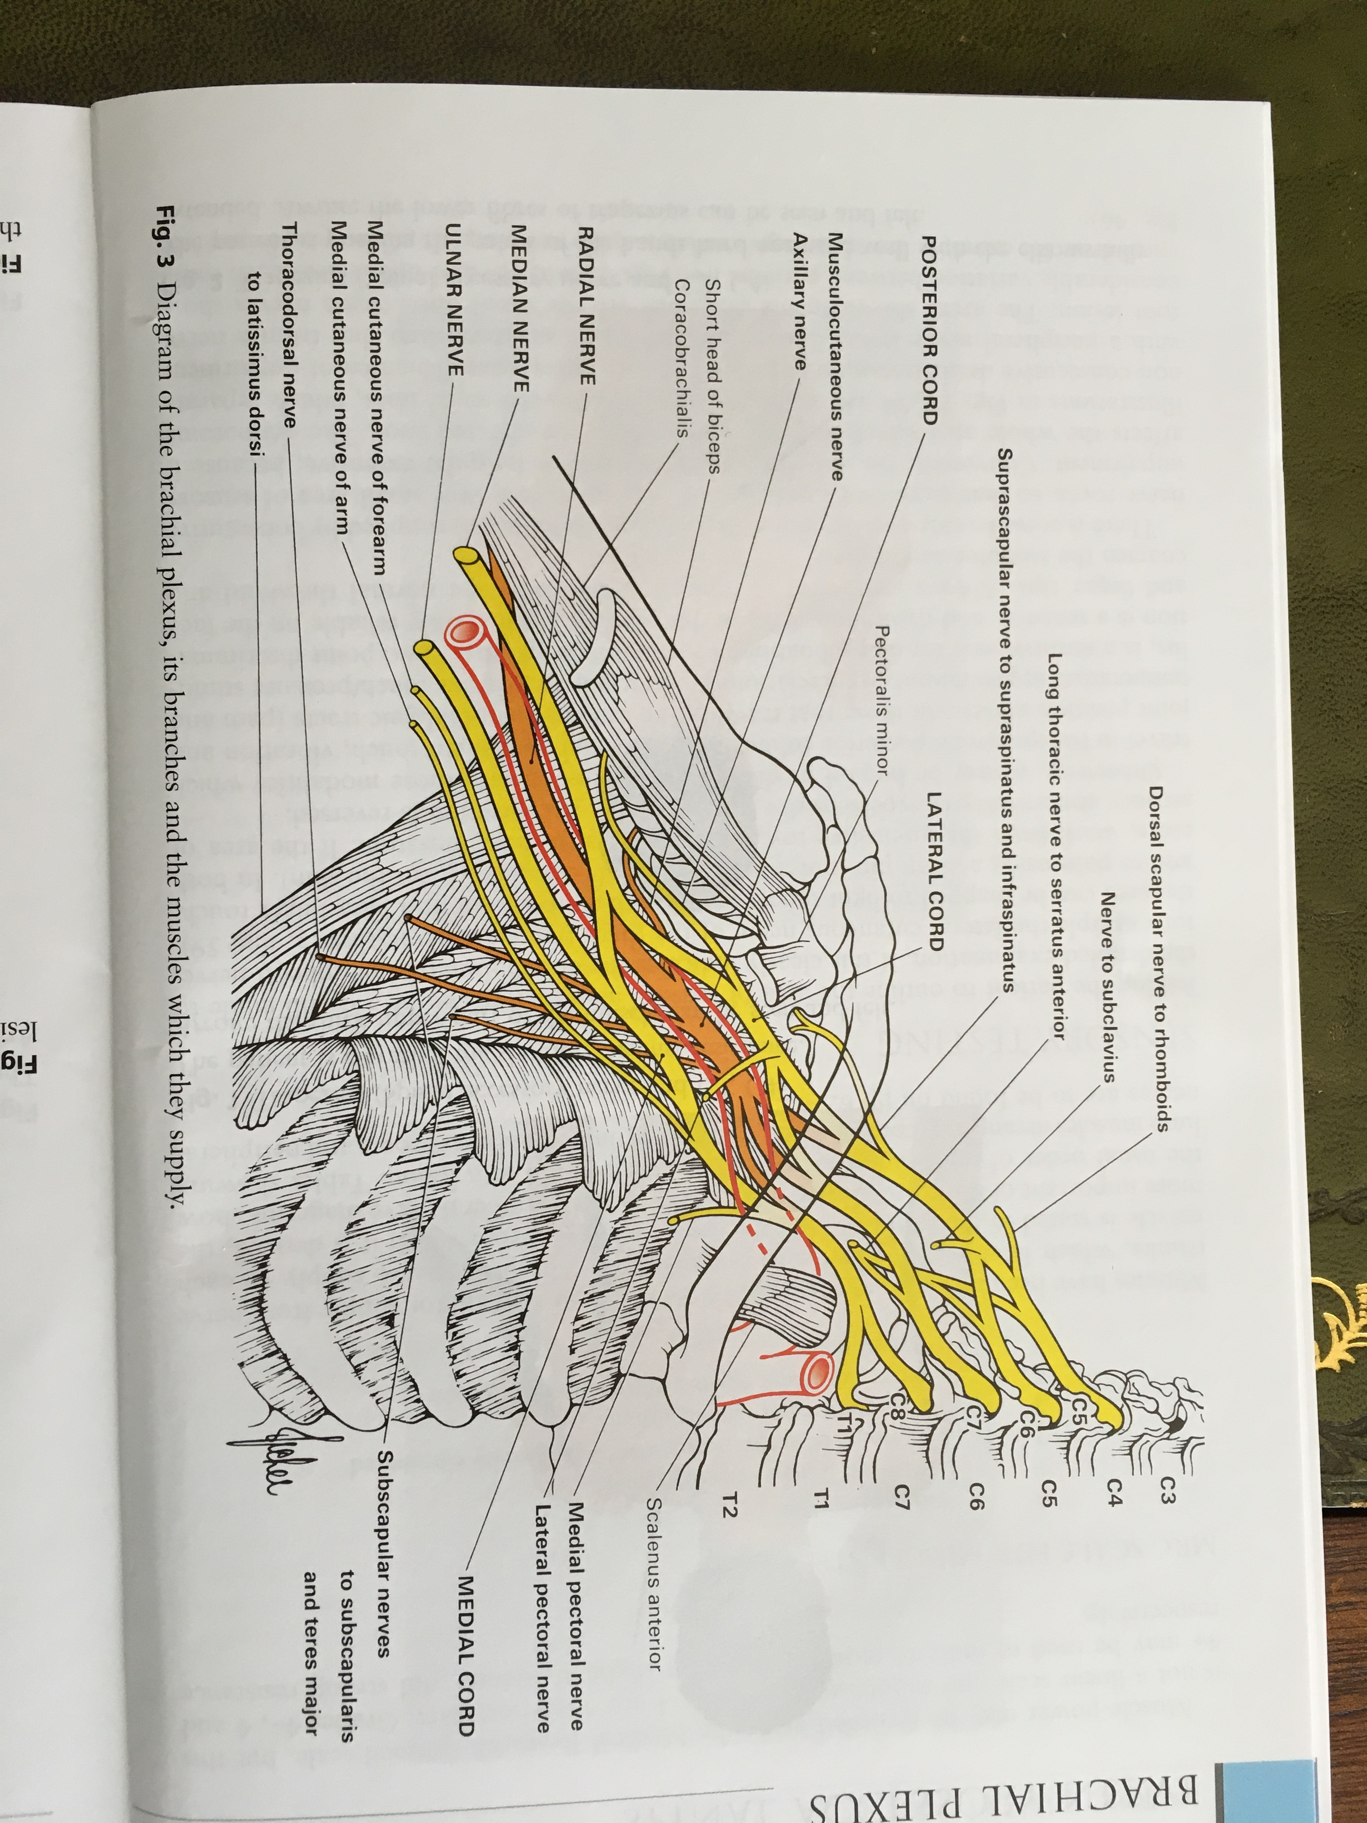
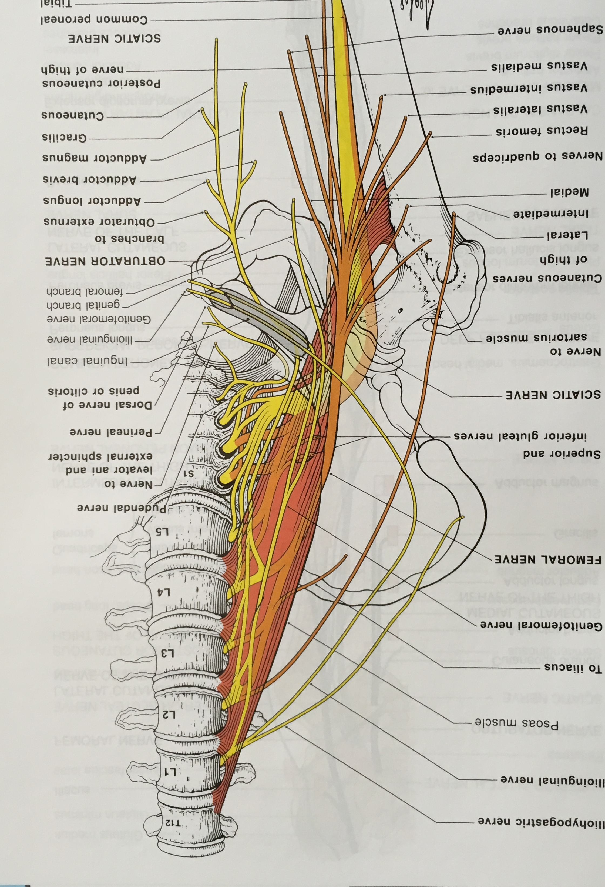
Aids to the Examination of the Peripheral Nervous System

Slide 15
Aids to the Examination of the Peripheral Nervous System: Last Page

Slide 16
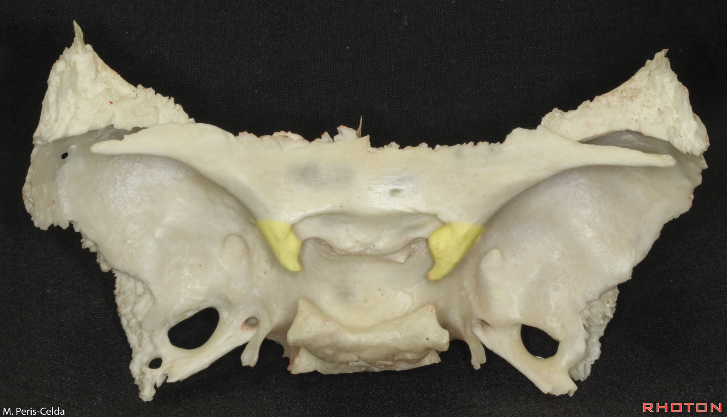

Slide 17
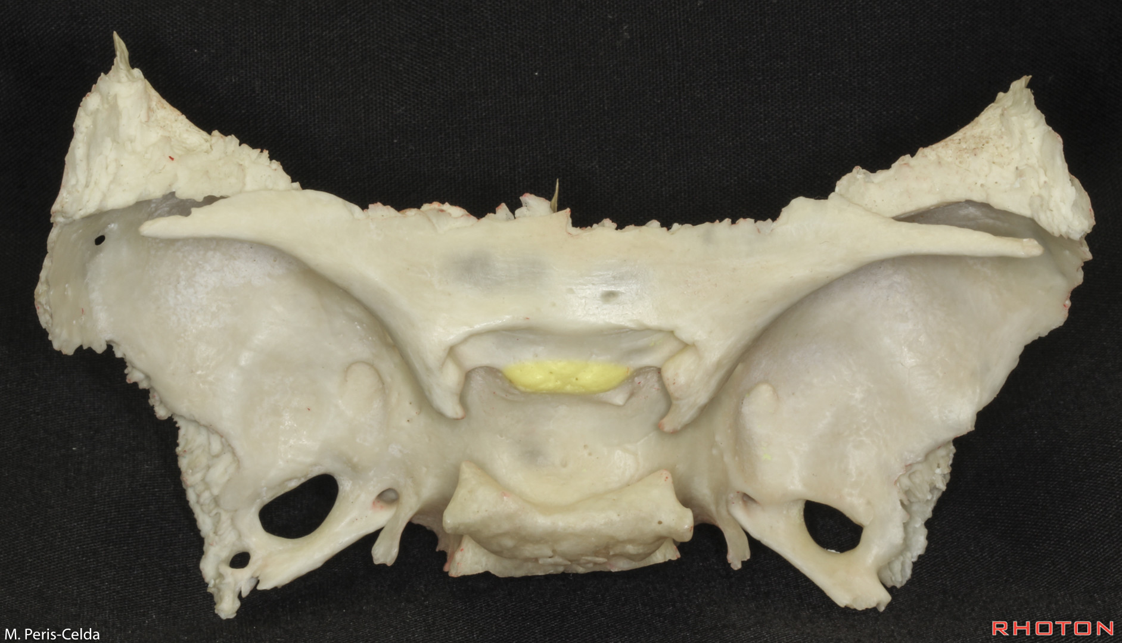

Slide 18
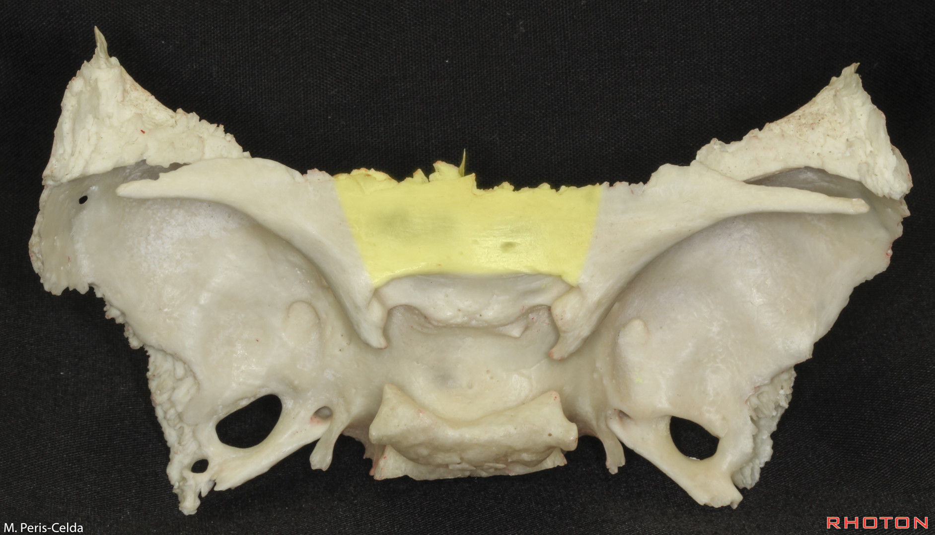

Slide 19
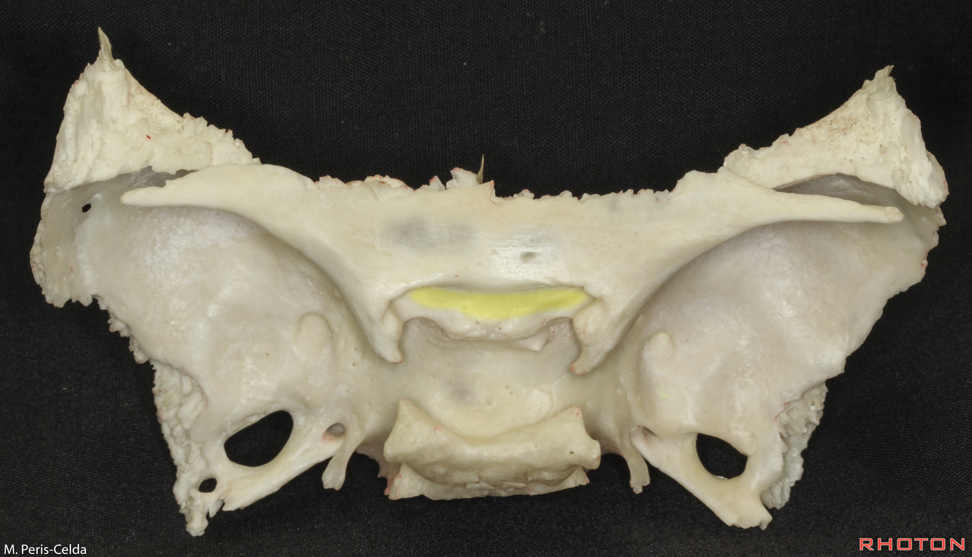

Slide 20
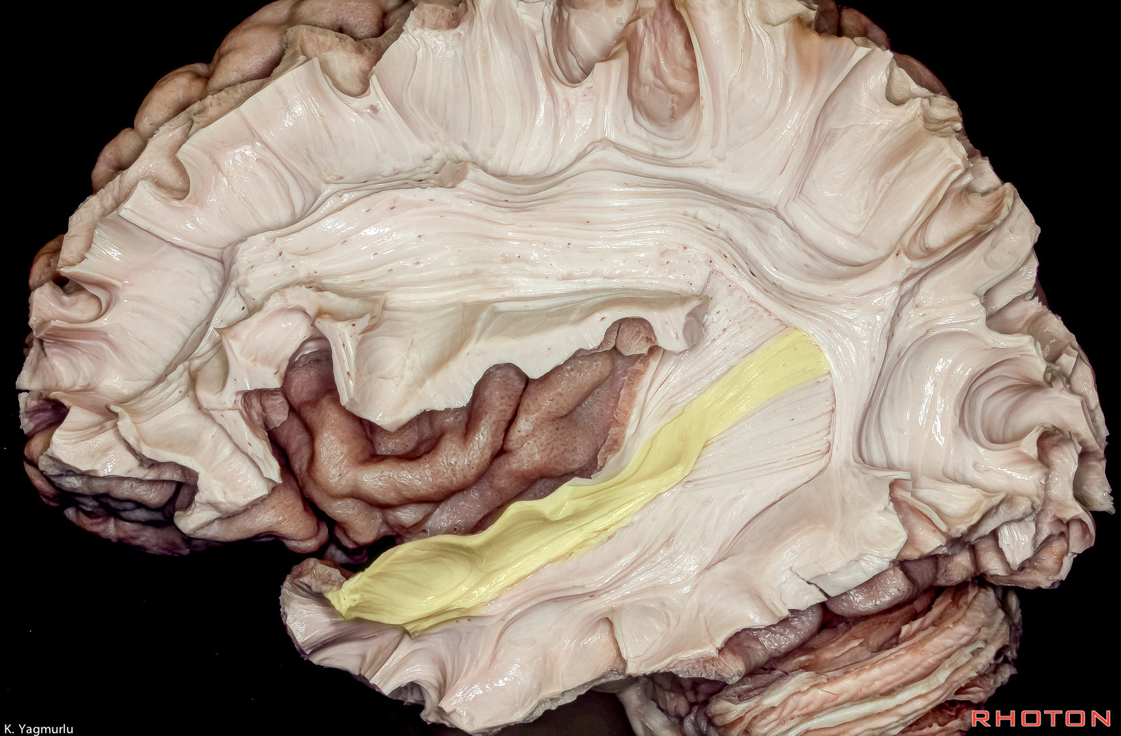

Slide 21
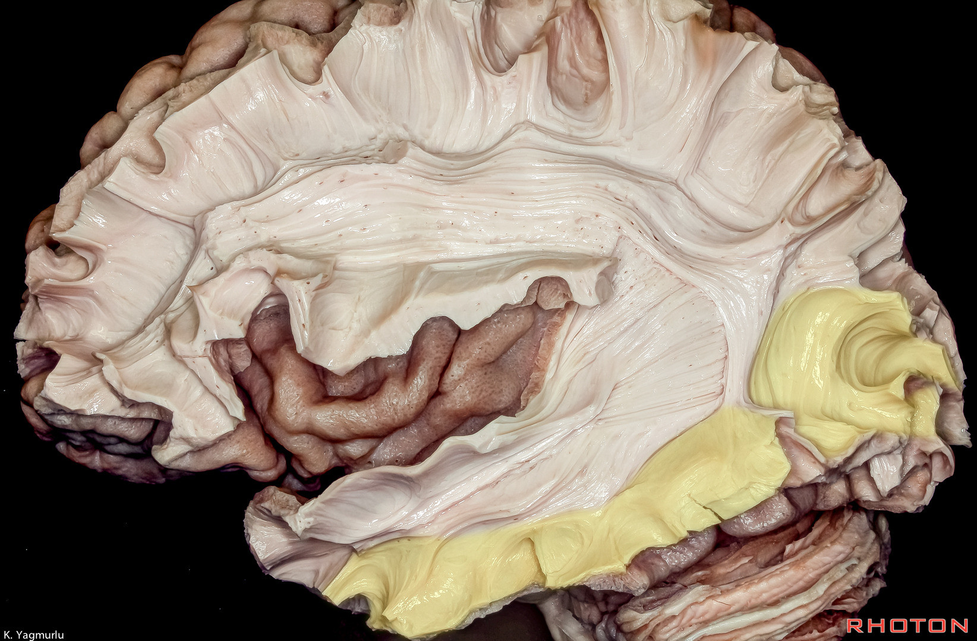

Slide 22
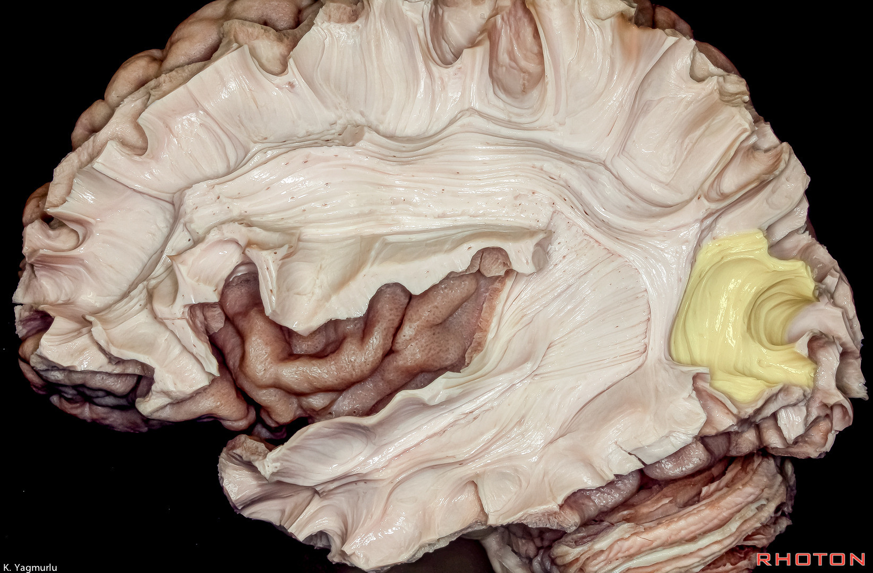

Slide 23
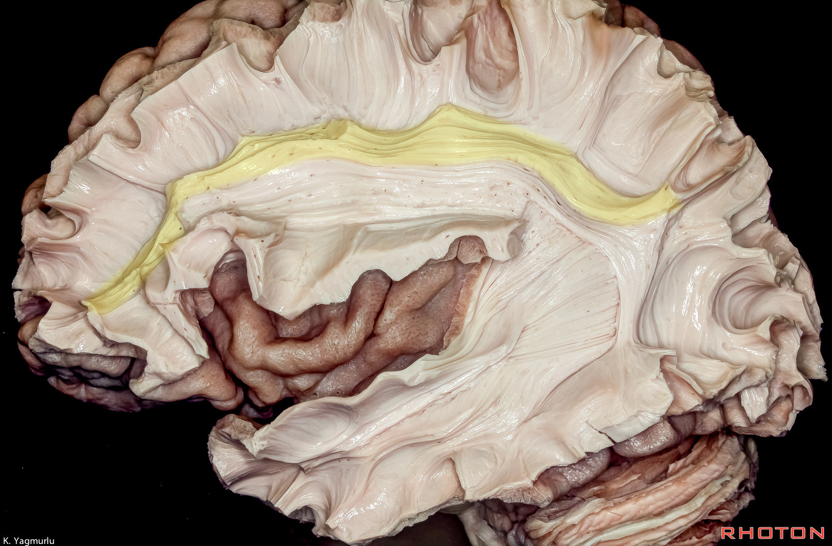

Slide 24
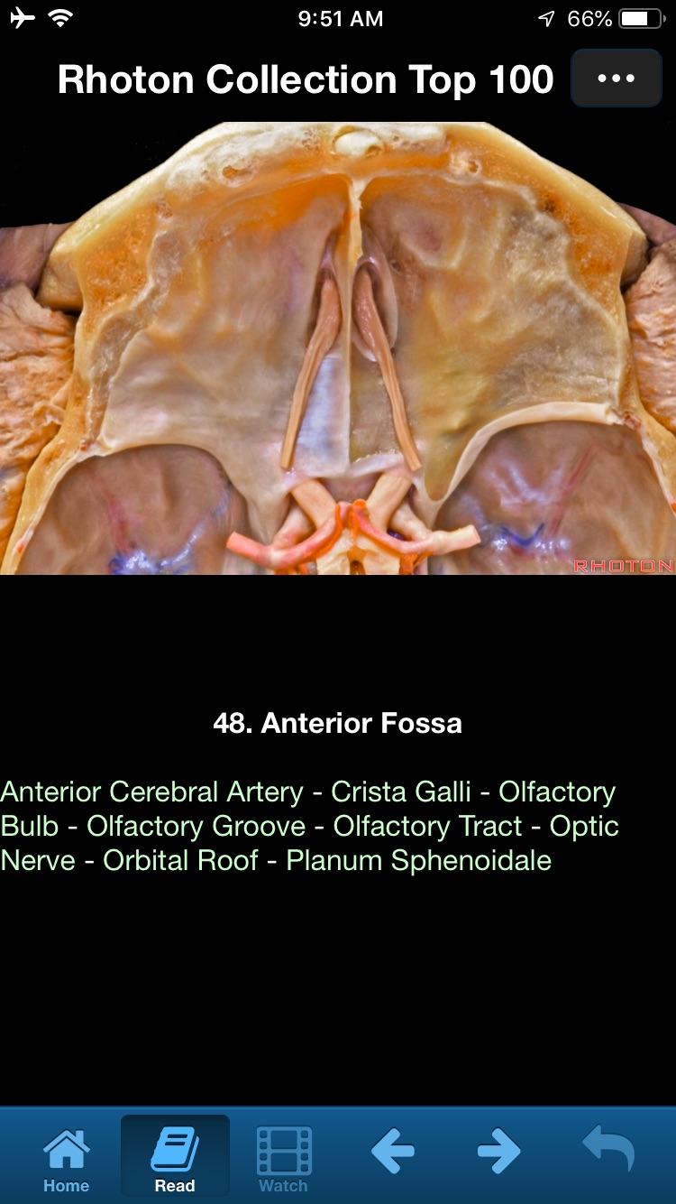

Slide 25
Statement on Fellowships in ABNS Bylaws
“4.3.5 Commencing on July 1, 2021, enfolded fellowships (i.e., fellowships taken concurrently with residency training) must be taken after the trainee’s chief resident year. As a practical matter, this means that an enfolded fellowship will be possible only in the PGY-7 year and then only if the trainee has been chief resident during his or her PGY-6 year. A focused training experience prior to the chief residency year is considered to be an elective and not a fellowship.
This restriction does not apply to enfolded fellowships in neurocritical care, which may be taken prior to the trainee’s chief resident year. In addition, CNS endovascular training requires an initial training experience in the performance of angiography. This training period may occur prior to the chief resident year. The second year of CNS endovascular interventional training, as of July 1, 2021, must occur after the chief resident year, thus PGY-7.
The ABNS does not require fellowships (enfolded or otherwise) as a requirement for initial ABNS certification. However, a fellowship may be required for neurosurgeons who wish to achieve an ABMS “Focused Practice Designation” in certain areas of neurological surgery practice.”

Slide 26
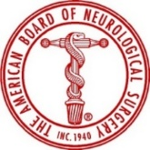
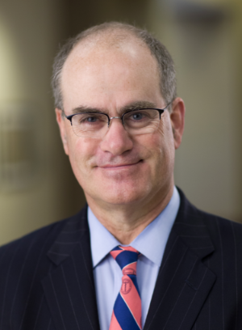
ABNS POST Case Log Practice and Outcomes of Surgical Therapies
Candidates must submit 125 consecutive cases with imaging
POST takes more time for the candidate to complete and more time for the directors to review.
Elad Levy
Jack Knightly

Slide 27
Update on ABNS POST: (Practice and Outcomes of Surgical Therapies)
POST has completely transformed candidate evaluations.
Version 1 has been in use for about 9 months
>30,000 cases logged into POST to date
141 candidates have completed a full case log of 125 cases
Automated PowerPoints created from POST are used on the “Cases” portion of the ABSN Oral Exam.

Slide 29
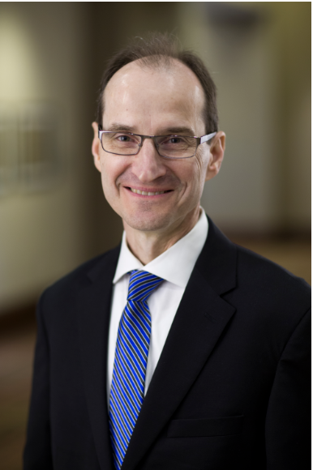
ABNS Credentials Chair
Second Review of POST Case Logs with Issues.
Approves candidates to take the Oral Exam
Works closely with attorney Jeffrey Schneider on any legal issues and manages ABNS hearings
Involved with any diplomate with a state action against medical license.

Slide 30
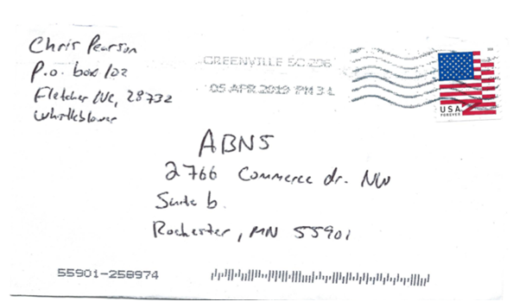
ABNS Credentials Committee

Slide 31
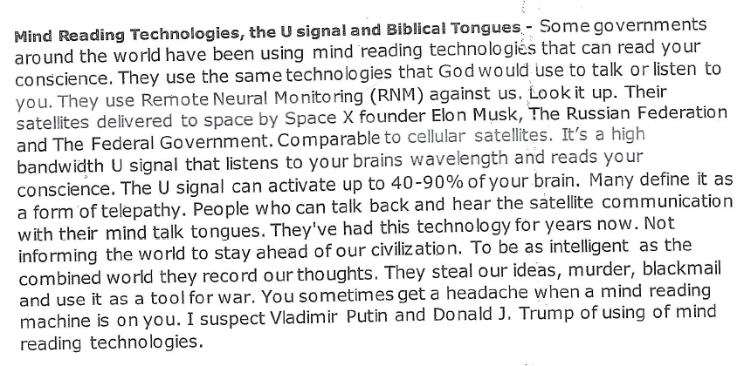

Slide 32
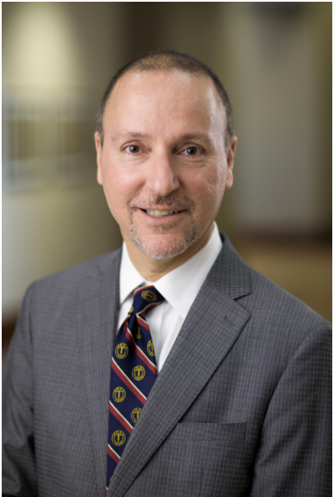
ABNS Oral Exam
122 candidates tested at the May 2019 exam.
Significant progress has been made on backlog
Spring 2018 - 112 examined
Fall 2018 - 154 examined
Spring 2019- 122 examined.
The goal is to examine everyone within 6 months of submission of their POST case log.

Slide 33
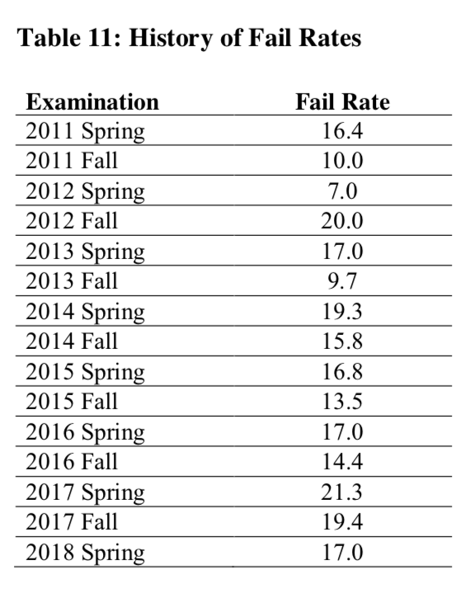
Oral Exam Fail Rates
First Exam with Candidate Cases
2018 Fall 14.9
Average of past 8 years 15%

Slide 34
Continuous Certification:
I. Professionalism and Professional Standing
Chief of Staff* Questionnaire: Unrestricted Privileges, Safety Module Participation, and M and M
II. Lifelong Learning and Self Assessment: 20 CMEs/yr
III. Assessment of Knowledge, Judgment and Skills:
Adaptive Learning Tool. On line, 24/7/365.
32 core neurosurgery principles.
8 Additional principles if Recognition of Focused Practice (RFP).
IV. Meaningful participation in an M and M Conference or Meeting
Participation must be at least quarterly
It must involve review of a diplomate’s own case or cases.
The meeting or conference may be local, regional or national

Slide 35
Continuous Certification
All 15 ABNS Directors are participating in Continuous Certification.
ABNS has led all ABMS boards in making CC less burdensome and hopefully useful.
No high stakes exam. No case log entry. Participation in CC satisfies CME requirement for ACS level I trauma call.
Lawsuits: ABIM, ABR, ABPN

Slide 36
Recognition of Focused Practice:
Neurocritical Care Medicine: collaboration with ACGME and SNS/CAST
Pediatric Neurological Surgery: collaboration with ABPNS
CNS Endovascular Surgery: collaboration with Radiology (ABR) and Neurology Boards (ABPN)

Slide 37
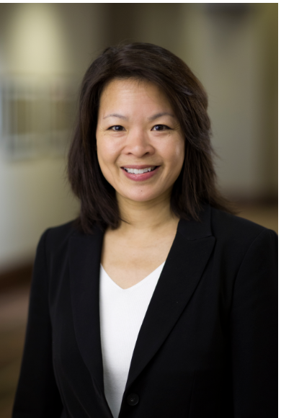
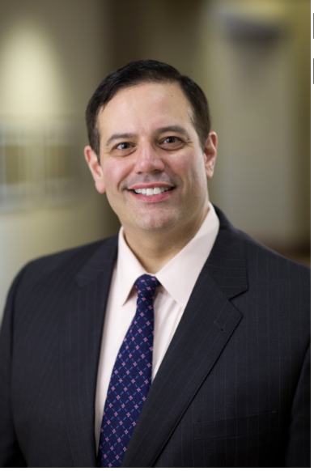
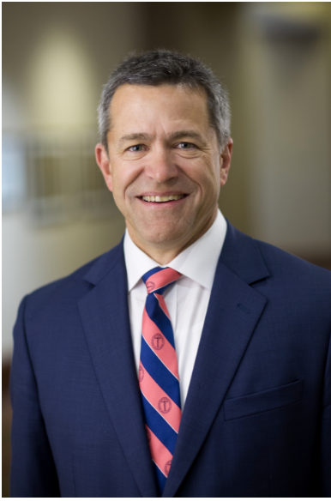
PGY1 to 2
Marjorie Wang Steve Kalkanis John Wilson

Slide 38
Thank you

