Slide 1
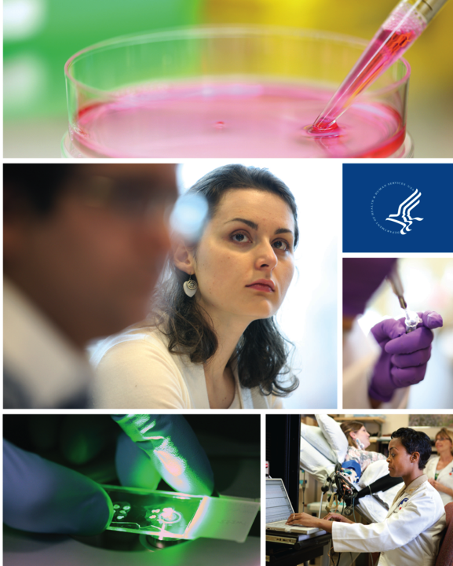
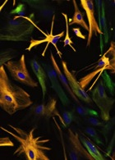
Update from NIH/NINDS
Society of Neurological Surgeons 109th Meeting
May 21, 2018
Walter J. Koroshetz, M.D.
Director, National Institute of Neurological Disorders and Stroke, NIH

Slide 2
NINDS and NIH Appropriations History
Dollars in Thousands
 | FY 2013 | FY2014 | FY 2015 | FY 2016 | FY 2017 | FY 2018 Omnibus | FY 2018 with Cures
NINDS | $1,533,795 | 1,588,904 | 1,604,607 | 1,692,833 | 1,778,688 | 2,145,149 | 2,188,149
NINDS % Change | -5.6% | 3.6% | 1.0% | 5.5% | 5.4% | 20.6%* | 23%
NIH | $29,151,462 | 30,150,853 | 30,311,349 | 32,345,549 | 34,161,349 | 36,738,000 | 37,234,000
NIH % Change | -5.5% | 3.4% | 0.5% | 6.7% | 5.6% | 7.5% | 9%
  NIH General Increase for all ICs is 5.4%
  BRAIN Initiative funding increased to approximately $400m for FY 2018
    NINDS received $20.5m in addition to $43m from the 21st Century Cures Act
  NIA received $414m in FY 2018 for AD/ADRD research
  *NIH received $500m for the Opioid Crisis (HEAL Initiative) for two years, will be redistributed across Institutes.
Notes:
Ryan: please update this slide in the core slides so we are consistently using the same and correct version. I grabbed this from the MDCC talk and revised the title.

Slide 3


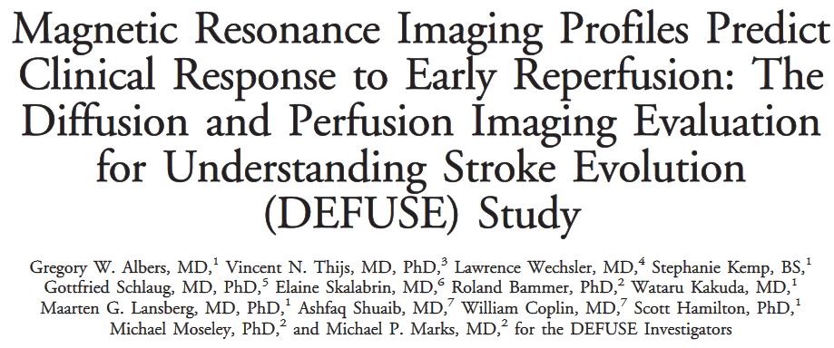
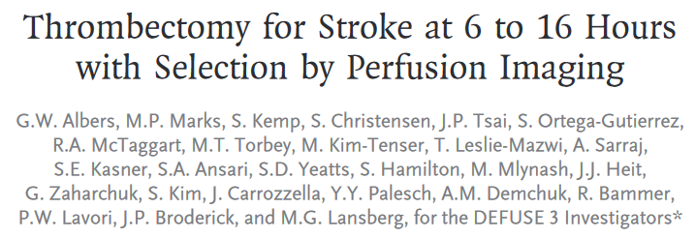
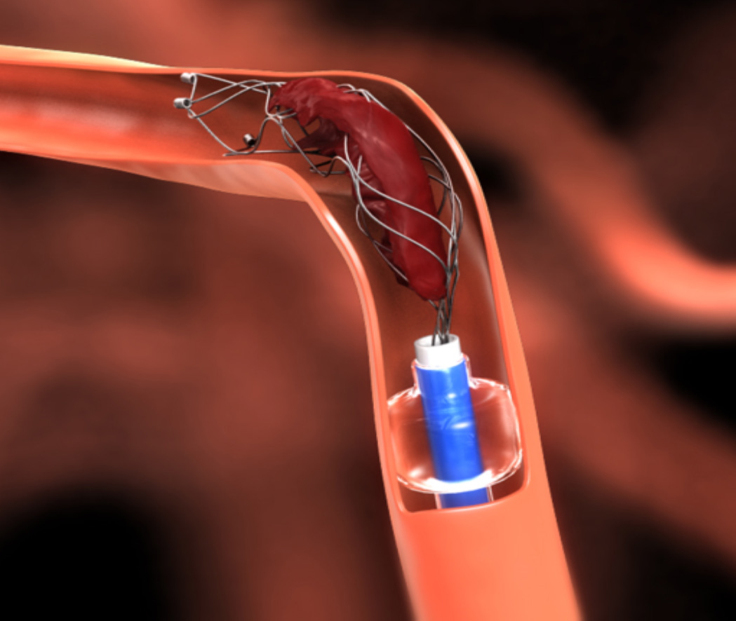
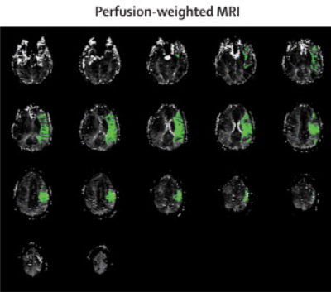
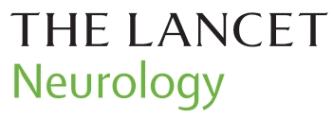
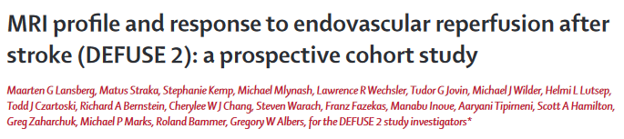

Endovascular Intervention in StrokeNet
2006
2012
2018
Illustration courtesy of Greg W. Albers, M.D., Stanford University Medical Center

Slide 4
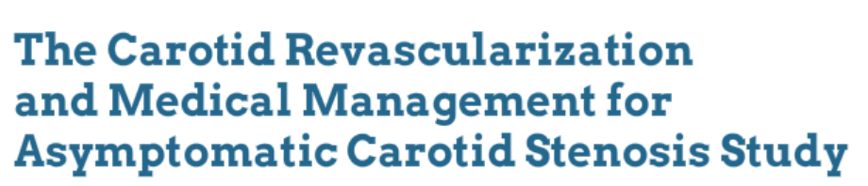
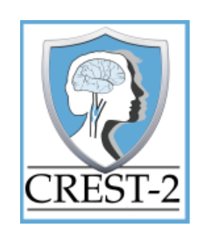

Ongoing clinical trials
Two parallel multi-center studies in asymptomatic patients with high-grade cervical carotid artery stenosis
  Intensive medical management (IMM) alone vs. IMM and endarterectomy
  IMM alone vs. IMM and carotid artery stenting
Outcome: composite of stroke plus death w/in 44 days and ipsilateral stroke up to 4 years
Minimally Invasive Surgery plus tPA
for ICH Evacuation
To determine whether minimally invasive surgery and injections of tPA improves recovery after intracerebral hemorrhage
Outcome: 12% increase in mRS score 0-3 compared to medically treated subjects assessed at 180 days
Notes:
StrokeNet
Carotid Revascularization and Medical Management for Asymptomatic Carotid Stenosis Study (CREST 2) - Most strokes are caused when blood flow to a portion of the brain is blocked; one place this often happens is in the carotid artery. The purpose of CREST 2 trial is to determine the best way to prevent strokes in people who have a high amount of blockage of their carotid artery but no stroke symptoms related to that blockage. Trial participants will receive intensive medical treatment and will be randomized to also receive either carotid stenting or carotid endarterectomy to restore blood flow through their blocked artery. (IMM: control of BP, LDL, smoking, & other vascular risk factors) For more information on the trial, see: http://www.crest2trial.org/.
Note recent discussion: https://www.ncbi.nlm.nih.gov/pubmed/28446652
MISTIE – enrollment now complete.

Slide 5
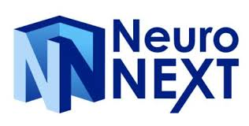
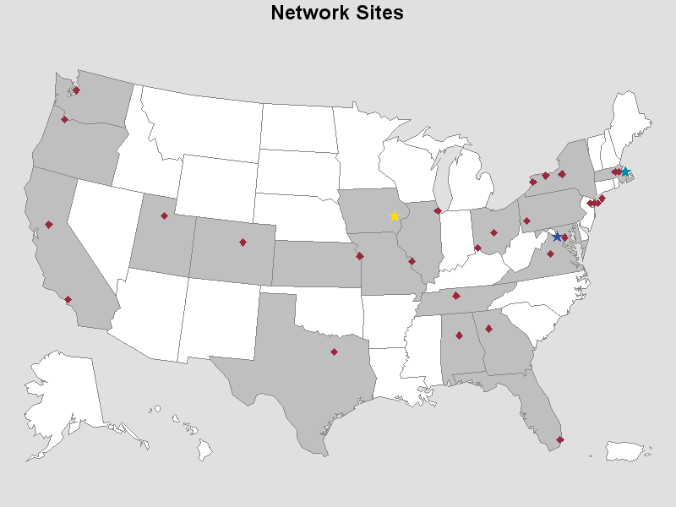
NINDS Supports Clinical Trials
The NeuroNEXT program aims to:
Provide a robust, standardized, and accessible infrastructure to conduct studies of treatments for neurological diseases
Create and leverage partnerships with academia, private foundations, and industry
Increase the efficiency of clinical trials
Support scientifically sound, possibly biomarker-informed, exploratory clinical trials that provide data for clear go/no-go decisions
Expand the pool of experienced clinical investigators and research staff

Slide 6

Network for Excellence in Neuroscience Clinical Trials
Cytochrome C Oxidase Activity in Newly Diagnosed Glioblastoma Multiforme
PI Corinne Griguer and James Markert UAB Neurosurgery
To prospectively evaluate the hypothesis that overall survival time for newly diagnosed GBM (with standard of care therapy) is a function of CcO enzymatic activity in the tumor
  Tumors with high CcO activity are associated with shorter time of overall survival when compared to tumors with low CcO activity
  Standard of care therapy: post-surgical radiation therapy with concurrent Temozolomide followed by up to 12 cycles of adjuvant Temozolomide
Notes:
CYTO-C (Cytochrome C Oxidase Activity in Newly Diagnosed GBM)
Glioblastoma multiforme is the most common malignant primary brain tumor. These tumors are often aggressive and infiltrate surrounding brain tissue. Signs and symptoms are initially non-specific. They may include headaches, personality changes, nausea, and symptoms similar to that of a stroke. Worsening of symptoms is often rapid and can progress to unconsciousness.
This research study is being conducted to prospectively evaluate the hypothesis that the overall survival time of a subject with newly diagnosed GBM tumors, treated with standard of care therapy, is a function of the CcO enzymatic activity in the tumor. In particular, tumors with high CcO activity, are associated with shorter time of overall survival when compared to tumors with low CcO activity. Standard of care therapy consists of post-surgical radiation therapy with concurrent Temozolomide followed by up to 12 cycles of adjuvant Temozolomide.
This study is being conducted through the NeuroNEXT Network under a Cooperative Agreement with the National Institute of Neurological Diseases and Stroke (NINDS).

Slide 7
Glioblastoma: from bench to CT.gov
U of Michigan-Combined Cytoxic and Immune-Stimulatory Therapy Trial Combining gene therapy with thymidine kinase to kill dividing cancerous cells and (Flt3L) to summon dendritic cells to the tumor. Translational grants to Maria Castro/Pedro Lowenstein.
Northwestern U- Neural Stem Cell Based Virotherapy of Newly Diagnosed Malignan Glioma- delivering a novel oncolytic adenovirus via a neural stem cell line in combination with radiation and chemotherapy, NINDS grants to Matt Lesniak.
Brigham and Women’s- Treatment of recurrent malignant glioma with rQNestin34.5v.2-oncolytic virus dubbed rQNestin34.5v.s. started out as herpes simplex virus type 1 (HSV1), but was genetically modified to only infect glioblastoma cells. NINDS grants to Nino Chiocca.
U of Florida- Toca 5 Clinical Trial- modified virus (Toca 511) delivers the gene for a yeast-derived enzyme to cancerous cells at the site of the glioblastoma. Then the enzyme converts 5- fluro cytonsine to 5 fluoro uracil – only expressed in the Toca 511-infected cancerous cells. NINDS grants to Noriyuki Kasahara

Slide 8
Launching Effectiveness Research to Guide Practice in Neurosurgery
NINDS workshop, February 5, 2015
Pros and Cons of Randomized Controlled Trials in Neurosurgery
Requirements for Rigorous Determination of Causality from Observational data
  Prospective specification of outcomes and analytic methods without resort to the actual outcome data, even if this is already available
  Prospective estimation of sample size
  Outcome measures that are clearly defined and captured in the study data
  Completeness of the data set for outcomes, that is, limiting missing data
  The ability to measure and record all of the important covariates that influence treatment assignment
Aviva Abosch MD, Anthony Asher MD, Fred G. Barker II MD; Zoher Ghogawala MD, Robert Harbaugh MD, Lara Jehi, MD; John Kestle, MD, Walter Koroshetz, MD, Roderick Little PhD, Donald Rubin, PhD; Alex Valadka, MD, Stephen Wisniewski PhD and , E Antonio Chiocca MD, PhD for the Workshop Participants*
Walicke P, et al. Neurosurgery. 2017 Apr 1
Notes:
Walicke P, et al. Launching Effectiveness Research to Guide Practice in Neurosurgery: A National Institute Neurological Disorders and Stroke Workshop Report. Neurosurgery. 2017 Apr 1;80(4):505-514. PMID: 28362926.
This workshop addressed challenges of clinical research in neurosurgery. Randomized controlled clinical trials (RCTs) have high internal validity, but often insufficiently generalize
to real-world practice. Observational studies are inclusive but often lack sufficient rigor. The workshop considered possible solutions, such as (1) statistical methods for demonstrating
causality using observational data; (2) characteristics required of a registry supporting effectiveness research; (3) trial designs combining advantages of observational studies and
RCTs; and (4) equipoise, an identified challenge for RCTs. In the future, advances in information technology potentially could lead to creation of a massive database where clinical
data from all neurosurgeons are integrated and analyzed, ending the separation of clinical research and practice and leading to a new “science of practice.”

Slide 9
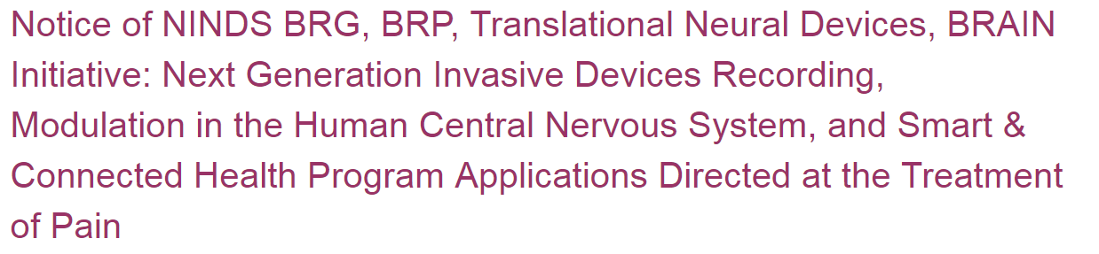
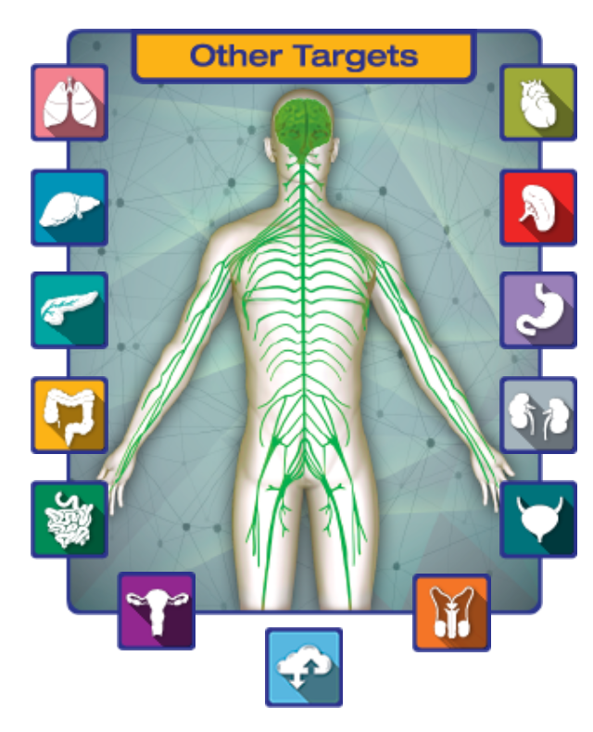


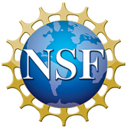
Devices for the Treatment of Pain
NOT-NS-18-052, release date: March 27, 2018
Bioengineering Research Grants
Bioengineering Research Partnerships
Translational Neural Devices
BRAIN Initiative
NIH/NSF Smart Connected Health Program
Stimulating Peripheral Activity to Relieve Conditions (SPARC)

Slide 10







Focus on Circuit Structure and Function
Goal: See the circuits in action to understand:
  How the brain controls our ability to move, plan, execute, and remember
  How to monitor/modulate circuits for improved function
  How disordered brain circuits cause neuro/mental/substance use disorders
FIRST FIVE YEARS
SECOND FIVE YEARS
Emphasize technology development
Emphasize discovery
driven science
Molecular/Structural
Pathology
Circuit
Dysfunction
Neuro/Mental/Substance Abuse
Functional Disability
Cell Types
Circuits
Monitor Neural Activity
Interventional Tools
Theory/Data Analysis
Human Neurosci
Integrative Approaches

Slide 11
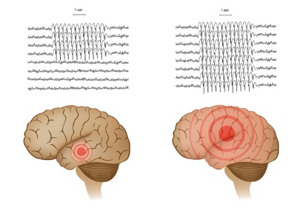
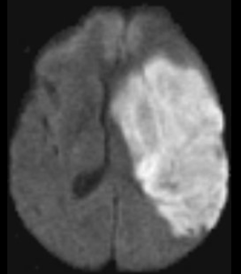
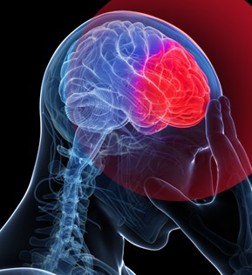
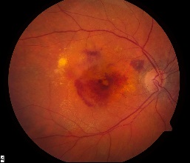
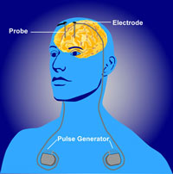
BRAIN Funds Tool Development to Improve Health
Epilepsy
Stroke
Of 345 BRAIN awards, 80 projects involve human subjects research
Therapeutic projects in BRAIN: 16 awards targeting nine distinct disorders
  Developing individualized algorithms in DBS devices for Parkinson’s disease management
  Using DBS stimulation to disrupt circuit dysfunction in OCD
  Building next-generation device therapy for cognitive impairment associated with TBI
In FY2017, four R01 grants awarded for neuroethics research
Traumatic Brain Injury
Blindness
Parkinson’s Disease
Obsessive Compulsive Disorder
Notes:
4 projects that involve neuroethics
40 projects that include patient involvement
48 projects that involve neural stimulation
69 projects that involve neural recording
33 projects that involve invasive neurotechnologies
53 projects that involve non-invasive neurotechnologies

Slide 12
Next Generation Human Invasive Devices
Funding Year | PIs | Title
2017 | Lee Fisher Douglas J Weber | Spinal root stimulation for restoration of function in lower-limb amputees
2017 | Helen Mayberg | Electrophysiological Biomarkers to Optimize DBS for Depression
2017 | Sameer Sheth, Jeffrey F Cohn Wayne K Goodman Nader Pouratian | Deep brain stimulation for depression using directional current steering an individualized network targeting
2017 | Dennis Turner | Scalar Closed-Loop STN/GPi DBS Based on Evoked and Spontaneous Potentials
2016 | Darin D Dougherty Emad Eskandar | Combined Cortical and Subcortical Recording and Stimulation as a Circuit-Oriented Treatment for Obsessive-Compulsive Disorder
2016 | Wayne K Goodman Brian Kopell | Adaptive DBS in Non-Motor Neuropsychiatric Disorders: Regulating Limbic Circuit Imbalance
2016 | Robert E Gross | Asynchronous distributed multielectrode neuromodulation for epilepsy
2016 | Aysegul Gunduz Kelly Foote | Closing the Loop on Tremor: A Responsive Deep Brain Stimulator for the Treatment of Essential Tremor
2016 | Andre Machado | Deep cerebellar electrical stimulation for post-stroke motor recovery
2016 | Philip Andrew Starr | Closed loop deep brain stimulation for Parkinson’s Disease
2016 | Philip R. Troyk David Frim, Ben Roitberg | Clinical Testing of an Intracortical Visual Prosthesis System
2016 | Harrison Walker Barton Guthrie | Noninvasive Biomarkers to Advance Emerging DBS Electrode Technologies in Parkinson’s Disease
2015 | Leigh R Hochberg Emad Eskandar | High-Bandwidth Wireless Interfaces for Continuous Human Intracortical Recording
2015 | Nicholas D Schiff Andre Machado | Central thalamic stimulation for traumatic brain injury
2015 | Gregory A Worrell Jamie Van Gompel | Neurophysiologically Based Brain State Tracking and Modulation in Focal Epilepsy
Notes:
Complete list, as of May 2018 (15 awards)

Slide 13
Adaptive deep brain stimulation
for Parkinson’s disease
First successful demonstration of adaptive deep brain stimulation in Parkinson’s disease using a fully implanted device and neural sensing
Dr. Philip Starr (UCSF) and team demonstrate real-time modification of deep brain stimulation to treat Parkinson’s disease (PD)
Fully implanted neural prosthesis is enabled to utilize brain sensing to control stimulation amplitude, adjusting stimulation based on cortical gamma oscillatory activity
In two patients, short-term clinical testing showed substantial energy savings and consistently maintained therapeutic efficacy
Adaptive DBS setup using activa PC+S
aDBS device response during dyskinesia
Swann et al., J Neural Engineering, 2018
Monitor Neural Activity
Interventional Tools
Human Neurosci
Notes:
Publication: http://iopscience.iop.org/article/10.1088/1741-2552/aabc9b/meta
Paper figure caption: Adaptive DBS utilizing activa PC + S under control of an external computer (Nexus D3), from patient 1. (A) Schematic
illustration of external control. (B) 3D reconstruction of patient’s brain and ECoG contacts used for sensing, derived from postoperative CT
images computationally fused to a preoperative brain MRI. (C) Neural data, classifier state, and stimulation state during adaptive DBS. Top
panel: spectrogram of time domain signal recorded from motor cortex for longest adaptive DBS session during which dyskinesia occurred.
Second panel: classifier state (gold), DBS voltage (blue), and gamma power used as the control signal (red). The y-axis is in arbitrary units.
Lower panels show a zoomed in view to demonstrate that classifier state transitions correspond appropriately to fluctuations in gamma band
power. Gamma signal is indicated with the black arrow.

Slide 14

Closed loop DBS for essential Tremor:
Kelly Foote, and Ayseul Gunduz-U of Fl
http://www.youtube.com/watch?v=xejclvwbwsk
http://www.youtube.com/watch?v=IOHtUzW02cg
Other videos
Notes:
Lab of Aysegul (“Eye-sha”) Gunduz, University of Florida
Has partnership with Medtronic to acquire devices
COMES WITH HAND-HELD DEMO – surface electrodes lie at surface of sensori-motor cortex to collect brain activity that signals intention to move. This information is sent to the pacemaker, which turns on to send stimulation to deep brain regions to stop the essential tremor

Slide 15
NINDS R25:
Research Support for Residents and Fellows
Neurology, Neurosurgery, Neuroradiology Neuropathology, Neuroanasthesia and Emergency Medicine
Institutional award started in 2009
PGY salary x percent effort and $3,000 for travel
    Funds 6-12 months during residency
    If completed appropriately, up to 2 more years in residency or fellowship
    80% effort required while supported in residency (surgeons can drop to 50% effort for subsequent years of support)
Mandatory attendance at workshop – career development, networking, one-on-one help with specific aims, poster session
Goal and metric of success: Get to a K award
Notes:
May 2017, S. Korn: We’re spending ~$700K per year supporting neurosurgery residents to do research (R25).
Currently support 7 neurosurgery programs and 8 combined neurology/neurosurgery programs
76 neurosurgeons supported 2009-2017, including 20 supported for multiple years
So far, program participants have shorter time from residency to K award, a promising indicator of success
22 programs currently supported
Neurology (7)
Neurosurgery (7)
Neurology and neurosurgery combined (8)
Residents and Fellows 2009-2018 (awardees/applicants)
Neurologists: 142/221 (64%)
Pediatric neurologists: 28/50 (56%)
Neurosurgeons: 83/173 (48%)
Neuropathologists: 7/10 (70%)

Slide 16
Neurosurgeon Research Career Development Program (NRCDP K12)
Goal: Obtain individual research funding by end of K12
(NIH career development award or research award)
12-member national advisory committee
Funds first-year neurosurgery faculty for 2 years
Institution must guarantee 50% protected time for research for 5 years, even though K12 funding may only last 2 years
Annual meeting for applicants, other neurosurgeon K awardees and K-level researchers, with leaders in neurosurgery research, several neurosurgery chairs
Started July 2012
~$1M per year, 13 awardees to date
NINDS/CNS Getch Scholar Award
Partnership with the Congress of Neurological Surgeons (CNS), through the Foundation for NIH (fNIH), as part of the K12 program
2018-2019 awardee: Babacar Cisse, MD, PhD (Weill Cornell)
K12 scholars already successful in securing additional funding
  Dana Foundation, DARPA, Gerstner Foundation, NSF, NIH, Sackler Foundation, and more
Notes:
UPDATES – 2017
May 2017, S. Korn: We’re spending approximately $1 million per year on the K12 (this includes the ~$100K yearly contribution from the CNS).
RFA reissued - RFA-NS-17-010 (so existing awardee will recompete with other potential applicants)
Intended to support 2-3 new scholars each year
Current awardee is http://neurocdp.org/ - based at MGH
K12 scholars already successful in securing additional funding: (Outcomes likely to be discussed by other panelists)
Dana Foundation, DARPA, Gerstner Foundation, NSF, NIH, Sackler Foundation, and more

Slide 17
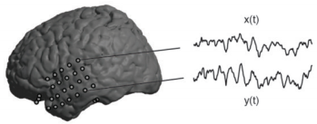
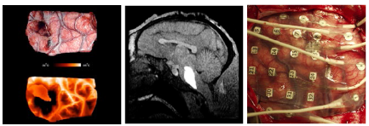
Neurosurgery at NINDS
Surgical Neurology Branch (SNB)
John Heiss, M.D., Chair and Residency Training Program Director
Functional and Restorative Neurosurgery Unit
Kareem Zaghloul, Ph.D., Chief
Research
Human intracranial recordings in epilepsy
Human intracranial recordings during deep brain stimulation surgery
Residency Program
7-year, ACGME-accredited program in collaboration with the University of Virginia
Experience in laboratory and clinical research, equipping participants to become leaders in neurosurgery research.
Fellowship
One- or two-year combined basic science and clinical fellowship
Fellows participate in laboratory, translational, and clinical phases of research projects
Notes:
The resources of the Surgical Neurology Branch are uniquely suited to advancing research from the laboratory to the clinic.
Other ongoing neurosurgical protocols include:

Slide 18

Questions?
Thank You!
Walter J. Koroshetz, M.D.
Director
National Institute of Neurological Disorders and Stroke
Email: koroshetzw@ninds.nih.gov
Website: http://www.ninds.nih.gov/
Follow me @NINDSdirector

Slide 19
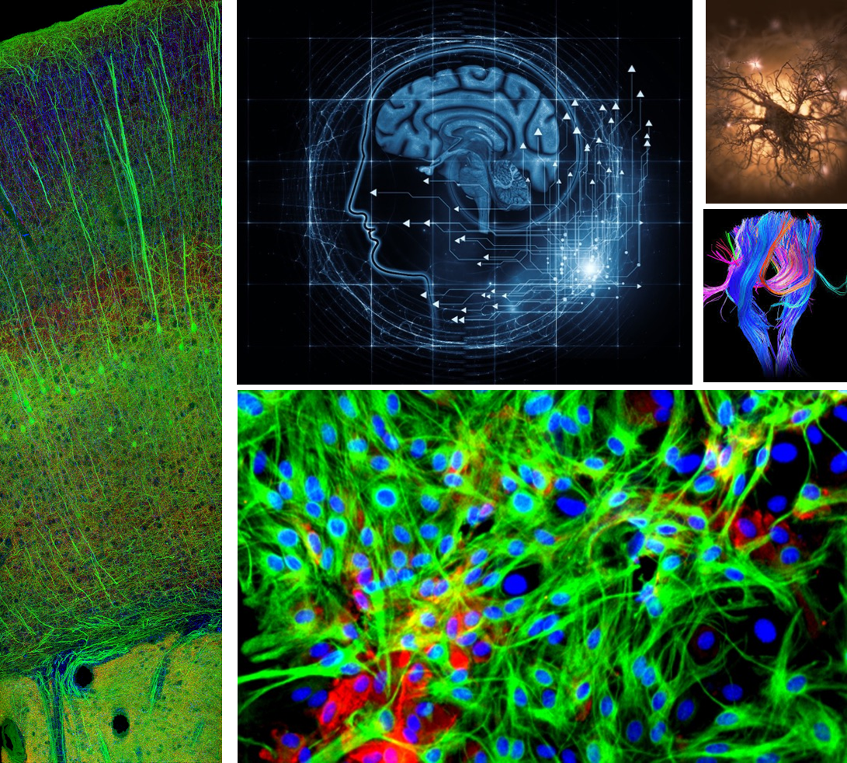
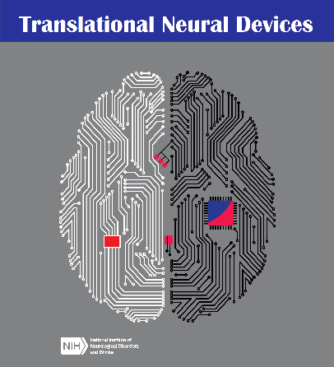
Translational Research Opportunities
NIH BRAIN Initiative
Next-Generation Invasive Devices for Recording and Modulation in the Human Central Nervous System
RFA-NS-18-021, RFA-NS-18-022 (SBIR), RFA-NS-18-023
Supports translational and clinical studies for invasive recording and/or stimulating devices to treat nervous system disorders and better understand the human brain
Use the NIH BRAIN Public-Private Partnership Program (not required)
NINDS Translational Neural Devices
RFA-NS-18-011, RFA-NS-18-012 (SBIR)
Cooperative agreement and SBIR Fast-Track award programs support development, validation and verification, and early clinical studies of therapeutic and diagnostic devices to treat neurological disorders.
Support for small clinical trial to collect safety and effectiveness data

Slide 20
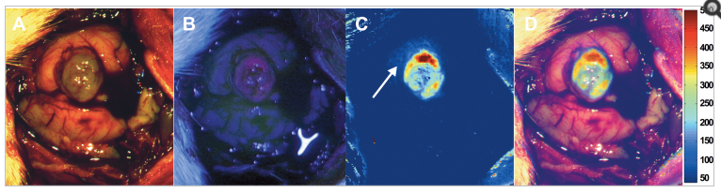
Neurosurgeons in brain tumor research
David W. Roberts, MD
Center for Surgical Innovation, Dartmouth-Hitchcock Medical Center
Coregistered Fluorescence-Enhanced Resection of Malignant Glioma
Improving fluorescence-guided surgery for glioma
  customized microscope modules for intraoperative use
  combining multiple contrast agents to enhance detection limits
In collaboration with engineer Keith D. Paulsen, PhD
Wide-field qFI estimates of CPpIX in a rodent model of glioma.
Figure 3, from: Valdés PA, et al. Sci Rep. 2012. PMID: 23152935
Notes:
From Jane Fountain, 5/2017: David Roberts’ R01 (R01-NS052274) activity is quite exciting. He’s a neurosurgeon developing a hand held device and using different tumor “paints” (fluorophores) to determine which are the best to use along with the device. His preclinical efforts were based on extending the depth and width by which a neurosurgeon could detect tumor cells to help with resections. Others are doing similar things, but not necessarily with a hand-held device. They’re now running pilot studies in patients with the device. He is paired with a talented bioengineer, Keith Paulsen. This R01 is my most complicated grant with device development, imaging biomarker development/validation, foreign collaboration, preclinical testing in rats and mice, and 4 pilot studies in HS. It goes to show that one can pack a lot of stuff into a single R01 and succeed. This might be an interesting human interest story to promote how much someone can contribute with just one R01 and inspire other neurosurgeons to consider getting involved in research.

Slide 21
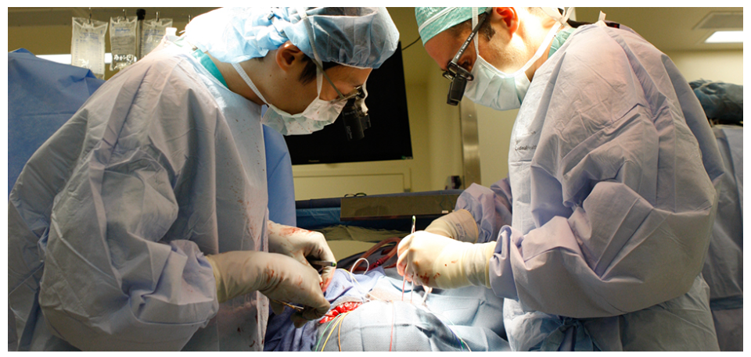
NINDS Investments in Neurosurgery Research
NINDS is committed to supporting excellent research and research training in neurosurgery
  Support for basic neuroscience research, clinical research, translational device and therapy development
  The NIH BRAIN Initiative especially invasive neuromodulation and neural recording
  Training programs tailored to support neurosurgeon-investigators
  NINDS Intramural Surgical Neurology Branch (research and training)
https://neuroscience.nih.gov/ninds/zaghloul/index.html
Notes:
Image source: https://neuroscience.nih.gov/ninds/zaghloul/index.html

Slide 22
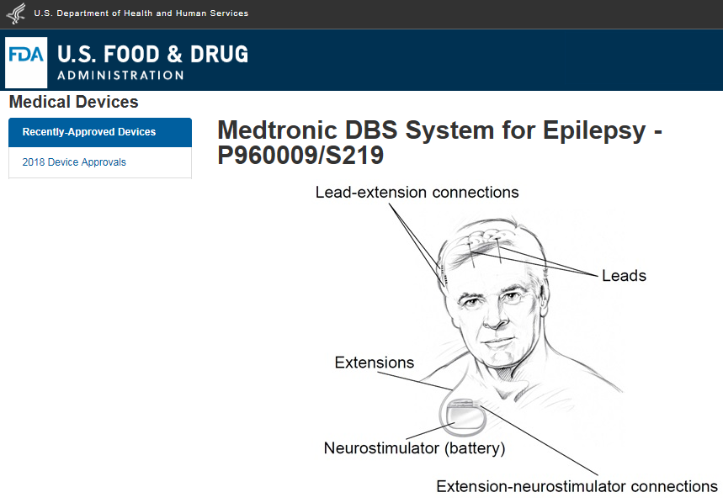
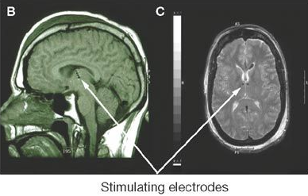
DBS for refractory partial onset seizures
Approved April 27, 2018
Image reprinted by permission from Springer Nature: Stacey WC, Litt B. Nat Clin Pract Neurol. 2008. doi: 10.1038/ncpneuro0750
Notes:
NINDS provided support for early development and pilot clinical trial for stimulation in the anterior nucleus of the thalamus (ANT) (NS041811 Dichter, Litt; NS044001 Fisher); see https://www.ncbi.nlm.nih.gov/pubmed/15030497
https://www.ncbi.nlm.nih.gov/pubmed/20331461; https://www.ncbi.nlm.nih.gov/pubmed/25663221
The Medtronic Deep Brain Stimulation (DBS) System for Epilepsy is a device that delivers controlled electrical pulses to a location inside the brain which is involved in seizures. The system consists of a pulse generator (IPG) implanted under the skin of the upper chest, and two leads implanted in the brain. The Medtronic DBS System for Epilepsy helps reduce the frequency of seizures in epilepsy patients who have frequent, disabling, partial-onset (focal) seizures and have not responded well to antiepileptic medications.
How does it work? A pulse generator implanted under the skin of the upper chest sends a constant stream of tiny electrical pulses through the leads (wires) to the electrodes in selected area of the brain. The electrical impulses block the seizures associated with epilepsy.
When is it used? The Medtronic DBS System for Epilepsy is used in conjunction with antiepileptic drugs in individuals 18 years of age or older with partial onset seizures, with or without secondary generalization, who have not responded to three or more antiepileptic medications. The Medtronic DBS System for Epilepsy is used in patients who average six or more seizures per month. It has not been evaluated in patients with less frequent seizures.
What will it accomplish? The Medtronic DBS System for Epilepsy is intended to reduce the frequency of seizures. The clinical study (SANTE trial) demonstrated that patients with the device turned on experienced a 17 percent greater reduction in the average number of seizures per month as compared to the percent reduction in patients who had the device turned off.

Slide 23
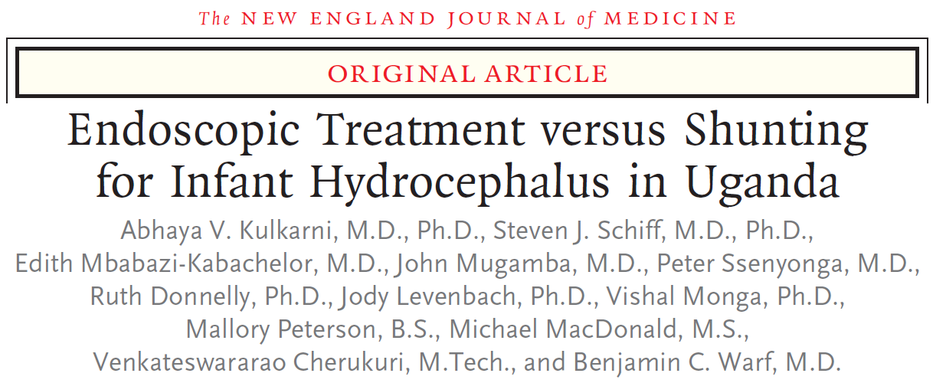


Comparing treatments for hydrocephalus in infants
No significant differences found between treatment groups at 12 month follow-up
cognitive score (primary outcome)
treatment failure, language and motor scores, brain volume (secondary outcomes)
More research needed to compare treatments
replicate in N. American population (major causes of hydrocephalus and other factors differ)
assess long-term outcomes
determine ideal age to treat
Notes:
https://www.ncbi.nlm.nih.gov/pubmed/29262276 (December 2017) - Discussed at April 2018 workshop (previous slide)
ABSTRACT:
BACKGROUND: Postinfectious hydrocephalus in infants is a major health problem in sub-Saharan Africa. The conventional treatment is ventriculoperitoneal shunting, but surgeons are usually not immediately available to revise shunts when they fail. Endoscopic third ventriculostomy with choroid plexus cauterization (ETV-CPC) is an alternative treatment that is less subject to late failure but is also less likely than shunting to result in a reduction in ventricular size that might facilitate better brain growth and cognitive outcomes. METHODS: We conducted a randomized trial to evaluate cognitive outcomes after ETV-CPC versus ventriculoperitoneal shunting in Ugandan infants with postinfectious hydrocephalus. The primary outcome was the Bayley Scales of Infant Development, Third Edition (BSID-3), cognitive scaled score 12 months after surgery (scores range from 1 to 19, with higher scores indicating better performance). The secondary outcomes were BSID-3 motor and language scores, treatment failure (defined as treatment-related death or the need for repeat surgery), and brain volume measured on computed tomography. RESULTS: A total of 100 infants were enrolled; 51 were randomly assigned to undergo ETV-CPC, and 49 were assigned to undergo ventriculoperitoneal shunting. The median BSID-3 cognitive scores at 12 months did not differ significantly between the treatment groups (a score of 4 for ETV-CPC and 2 for ventriculoperitoneal shunting; Hodges-Lehmann estimated difference, 0; 95% confidence interval [CI], -2 to 0; P=0.35). There was no significant difference between the ETV-CPC group and the ventriculoperitoneal-shunt group in BSID-3 motor or language scores, rates of treatment failure (35% and 24%, respectively; hazard ratio, 0.7; 95% CI, 0.3 to 1.5; P=0.24), or brain volume (z score, -2.4 and -2.1, respectively; estimated difference, 0.3; 95% CI, -0.3 to 1.0; P=0.12). CONCLUSIONS: This single-center study involving Ugandan infants with postinfectious hydrocephalus showed no significant difference between endoscopic ETV-CPC and ventriculoperitoneal shunting with regard to cognitive outcomes at 12 months. (Funded by the National Institutes of Health (Fogarty, NICHD, NINDS); ClinicalTrials.gov number, NCT01936272).
Limitations: single center, low baseline cognitive function, study may not be powered to detect small differences, longer follow up likely required to compare treatment success and outcomes
If successful, ETV+CPC could reduce shunt dependence, not just in regions with limited access to care for shunt maintenance, but potentially in developed countries as well. However, important questions remain regarding whether this approach may also work in other settings (where the predominant causes of hydrocephalus differ), and whether neurodevelopmental outcomes differ over longer follow up.

Slide 24
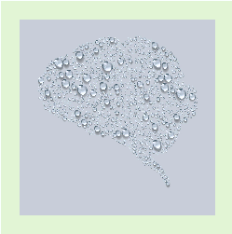
2018 NIH Hydrocephalus Workshop:
State of the Science and Future Directions
Genetics of hydrocephalus
most congenital hydrocephalus may be genetic, but known genes account for small fraction
genes may predispose to normal pressure hydrocephalus (NPH), combined with other stressors
Adult hydrocephalus
definition/diagnosis of idiopathic NPH and its relationship to neurodegenerative diseases
need for evidence on effectiveness of shunts for NPH
Preclinical research
immune and inflammatory processes
opportunities for basic/clinical research collaboration
Clinical research
how to assess and compare surgical approaches
identifying outcome measures
April 18-19, 2018
Sponsored by NINDS and the Hydrocephalus Association, in partnership with the Hydrocephalus Clinical Research Network (HCRN)
Notes:
Current initiatives for hydrocephalus research: originated from 2014 Midbrain/Hindbrain Malformations and Hydrocephalus Workshop
(PA-18-622)Disease Mechanisms of Prenatal and Pediatric Hydrocephalus (R01 Clinical Trial Not Allowed)
molecular, cellular and developmental mechanisms; genetic and acquired etiologies (incl. hemorrhage, infection)
(PA-18-623)Tools to Enhance the Study of Prenatal and Pediatric Hydrocephalus (R21 Clinical Trial Not Allowed)
to advance research on mechanisms and therapies (non-shunt); animal and cell models, novel methods/technologies
Standard dates, through May 8, 2021

Slide 25
Next Generation Human Invasive Devices
Funding Year | PIs | Title
2017 | Lee Fisher Douglas J Weber | Spinal root stimulation for restoration of function in lower-limb amputees
2017 | Helen Mayberg | Electrophysiological Biomarkers to Optimize DBS for Depression
2017 | Sameer Sheth Jeffrey F Cohn Wayne K Goodman Nader Pouratian | Deep brain stimulation for depression using directional current steering an individualized network targeting
2017 | Dennis Turner | Scalar Closed-Loop STN/GPi DBS Based on Evoked and Spontaneous Potentials
BRAIN Initiative Public-Private Partnership Program:
Industry Partnerships to Facilitate Early Access to Neuromodulation and Recording Devices for Human Clinical Studies
https://www.braininitiative.nih.gov/resources/brain_ppp/index.htm
Notes:
Most recent awards shown. (15 awards to date, as of May 2018)
RFAs reissued for FY2018 (see link).
Two advances from this program highlighted in the next 2 slides.

Slide 26
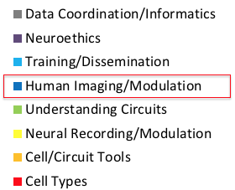
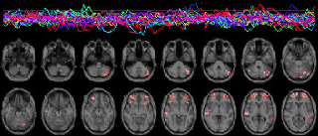
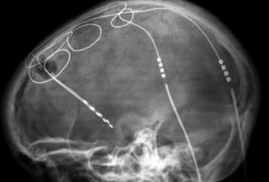
Discoveries from BRAIN Priority Areas
Next generation human imaging technologies (phase 2 awards)
Foundations of human imaging
Noninvasive neuromodulation
Next generation DBS devices for a range of disorders
Public Private Partnership Program
Researchers are improving on FDA-approved Deep Brain Stimulation to incorporate feedback from brain to automatically adjust brain stimulation from pacemaker
www.braininitiative.nih.gov/resources/BRAIN_PPP/index
Notes:
Video of human brain activity in real time
DBS VIDEO NEXT SLIDE: From Aysegul Gunduz, Kelly Foote: Closing the Loop on Tremor: A Responsive Deep Brain Stimulator for the Treatment of Essential Tremor
Public Private Partnerships: facilitate partnerships between clinical investigators and manufacturers of latest-generation stimulation and/or recording devices that are FDA-designated as Class 3 (invasive) to conduct clinical research in the CNS; NIH helps reduce barriers to negotiating the partnerships by signing an MOU with participating companies who are willing to share device information and provide support to researchers.; website
Development of Breakthrough Imaging Tools and Technologies
UGURBIL, KAMIL
MINNESOTA
Elementary Neuronal Ensembles to Whole Brain Networks: Ultrahigh Resolution Imaging of Function and Connectivity in Humans
$2,100,170
GARWOOD, MICHAEL
MINNESOTA
Imaging Human Brain Function with Minimal Mobility Restrictions
$2,607,806
FEINBERG, DAVID
UC BERKELEY
MRI CORTICOGRAPHY: DEVELOPING NEXT GENERATION MICROSCALE HUMAN CORTEX MRI SCANNER
$3,748,941
20% cut
WALD, LAWRENCE
MGH
A magnetic particle imager (MPI) for functional brain imaging in humans
$1,010,052

