Slide 1

ABNS Update
Steven Kalkanis MD
Director, ABNS

Slide 2
ABNS Bylaws
The broad aim of the ABNS is to encourage the study, improve the practice, elevate the standards, and advance the science of neurological surgery, and thereby to serve the cause of public health.

Slide 3
ABNS Mission
To improve public health care by developing and executing a sequence of certification activities to improve and maintain the educational and professional standards of neurological surgery.

Slide 4
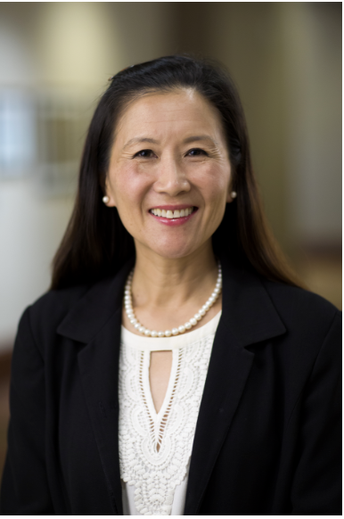
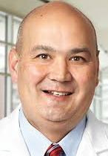
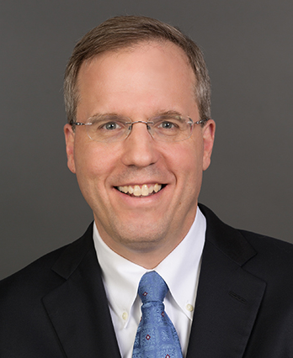
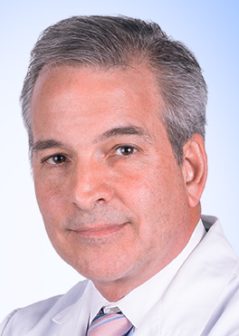
2019 ABNS Officers and New Directors
Chair: Linda Liau MD PhD
Vice Chair: Doug Kondziolka MD
Secretary: Carl Heilman MD
Treasurer: Kevin Cockroft MD
New Directors: Russ Lonser MD, Nate Selden MD, Paul Camarata MD
CNS
SNS
NSA

Slide 5
ABNS Numbers:
7,063 Total ABNS Diplomates
5,986 Active Diplomates: 3,191 lifetime
1,489 Neurosurgery residents in 115 ACGME training programs
16% of neurosurgery residents are women

Slide 6

Residency
PGY 1-7
Primary Exam
Take for self assessment
Fellowship
1-2 years; optional
Continuous Certification (MOC)
Oral Exam
Practice yrs.
Must pass once for credit
Application
Case log
Professionalism, professional standing
Lifelong learning and self assessment
Assessment of knowledge, skills judgement
Medical practice improvement
Board Certification pathway
Procedure Logs

Slide 7

The oral exam has evolved over the past 77 years…

Slide 8
Why this examination format?
Increasing relevance to actual practice.
Testing neurosurgeons on what they actually do.
Reduce failures based on cases candidates are unlikely to do.
Precedent in other specialties (orthopedic surgery only uses applicant cases)
Help to increase public safety by evaluating practice realities.
Will allow prospective data collection and outcomes to better understand the product of training and how neurosurgical practice actually exists.

Slide 9
Prior Exam Current Exam
3 x 60 minute sessions 3 x 45 minute sessions
Cranial – Spine – “Other” General – Focus Practice – Cases
6 questions per session 5 questions per session
50% standard questions All standard questions
2 examiners per session 2 examiners per session
Director/Former Director + Guest Director/Former Director/ABNS Examiner
plus Guest

Slide 10

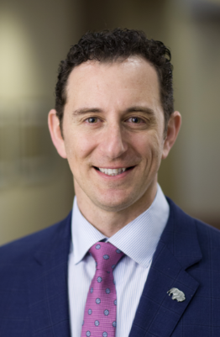
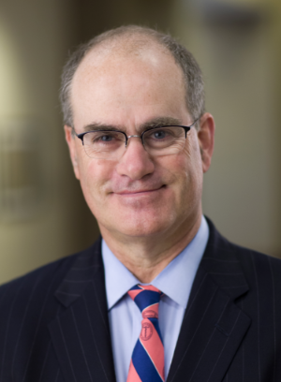
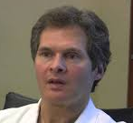
ABNS POST Case Log
Practice and Outcomes of Surgical Therapies
Candidates must submit 125 consecutive cases with imaging
POST takes more time for the candidate to complete and more time for the directors to review.
Elad Levy
Jack Knightly

Slide 11
Update on ABNS POST:
(Practice and Outcomes of Surgical Therapies)
POST has completely transformed candidate evaluations.
Version 1 has been in use for about 9 months
  >30,000 cases logged in POST to date
  141 candidates have completed a full case log -> 125 cases
  Automated PowerPoints of cases will be on this exam
Most of the initial computer issues have been resolved. We are about to begin work on Version 2 of POST.

Slide 12
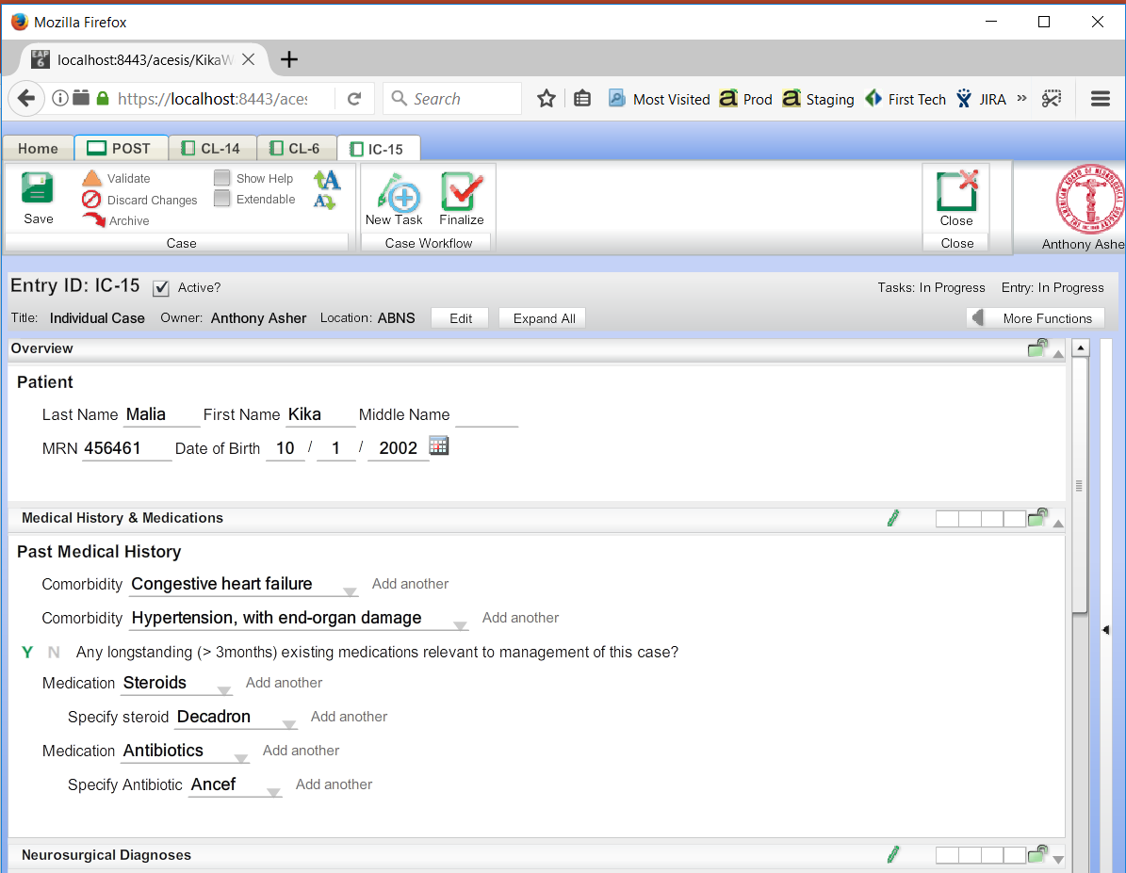
Individual Case - History
ABNS POST

Slide 13
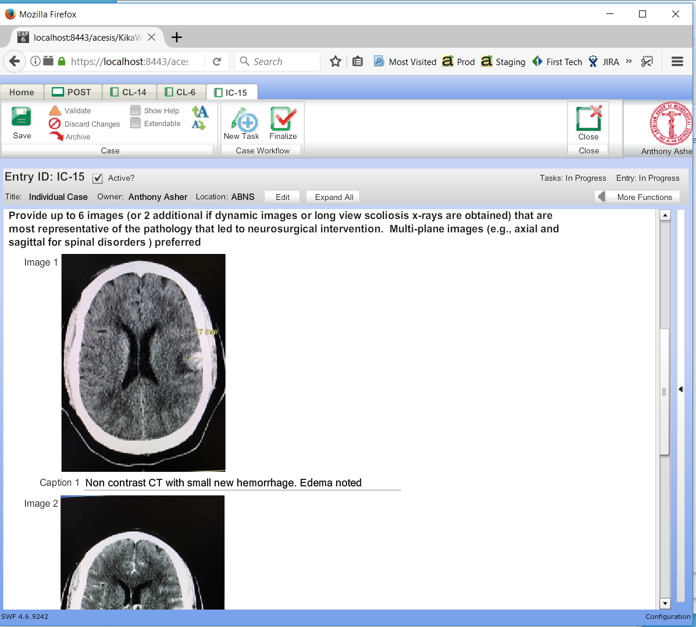
Individual Case – Preop Imaging
ABNS POST

Slide 14
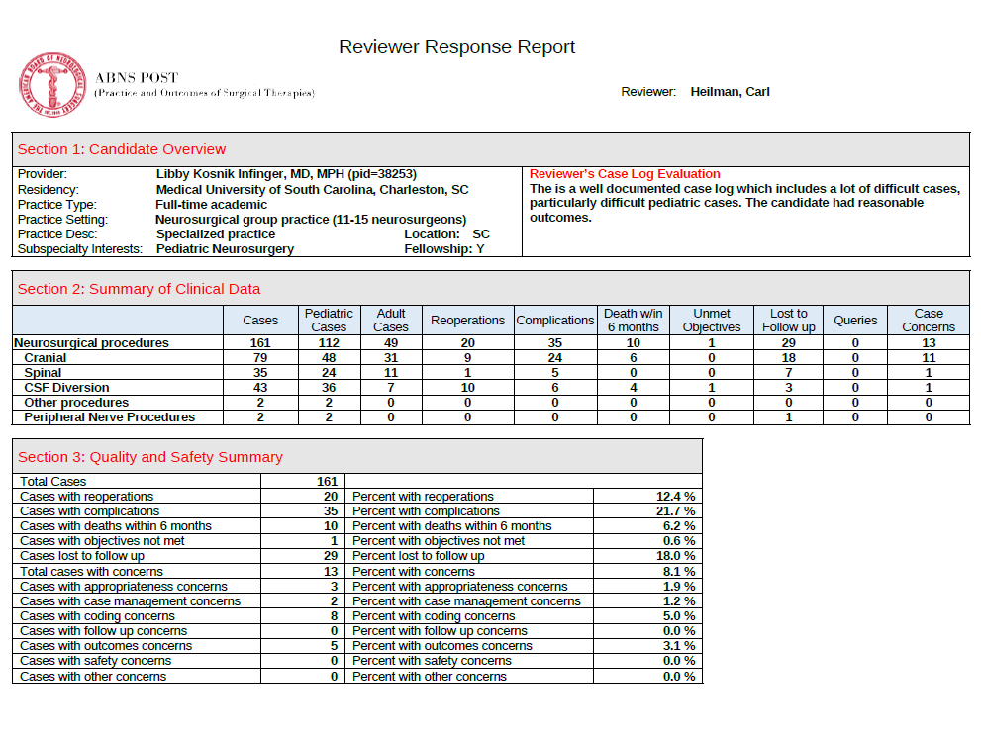

Slide 15
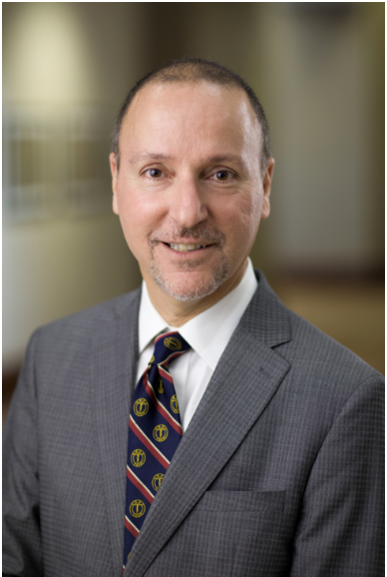
ABNS Oral Exam
122 candidates sat this exam cycle.
On this exam, candidate cases came from both Neurolog and POST.
Significant progress has been made on the candidate backlog
  Spring 2018 - 112 examined
  Fall 2018 - 154 examined
  Spring 2019- 122 examining.
The goal is to examine everyone within 6 months of submission of their POST case log.

Slide 16
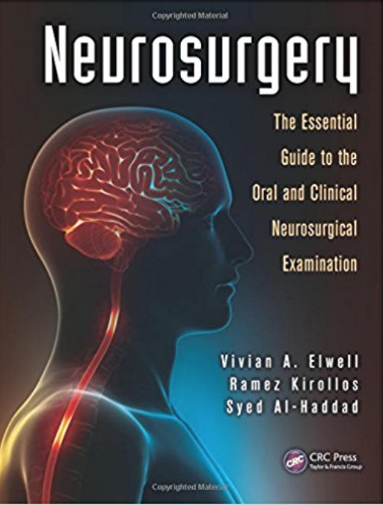
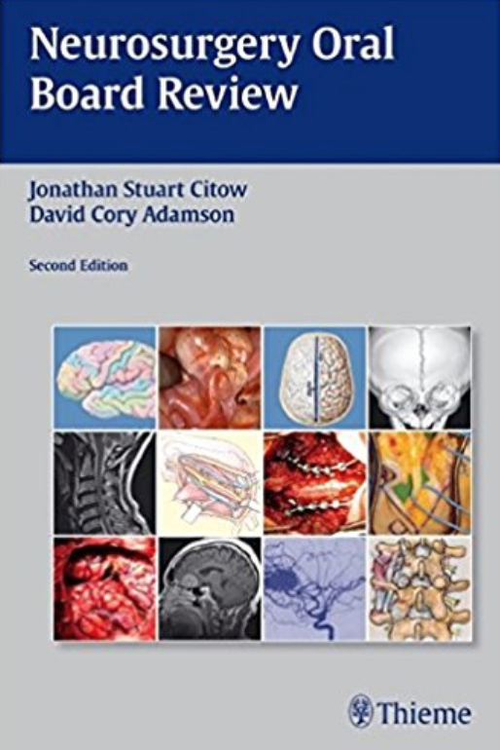
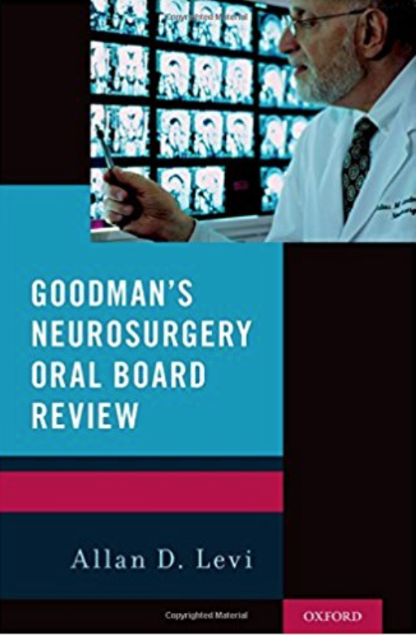
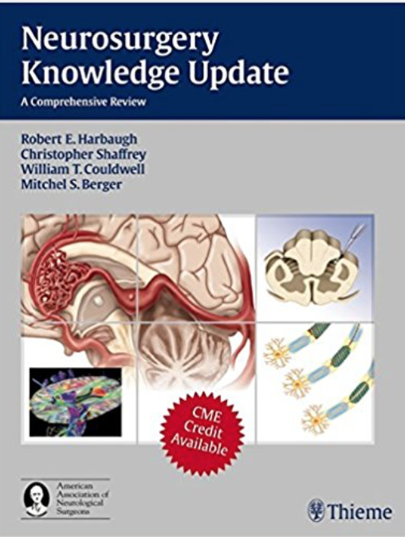

Slide 17
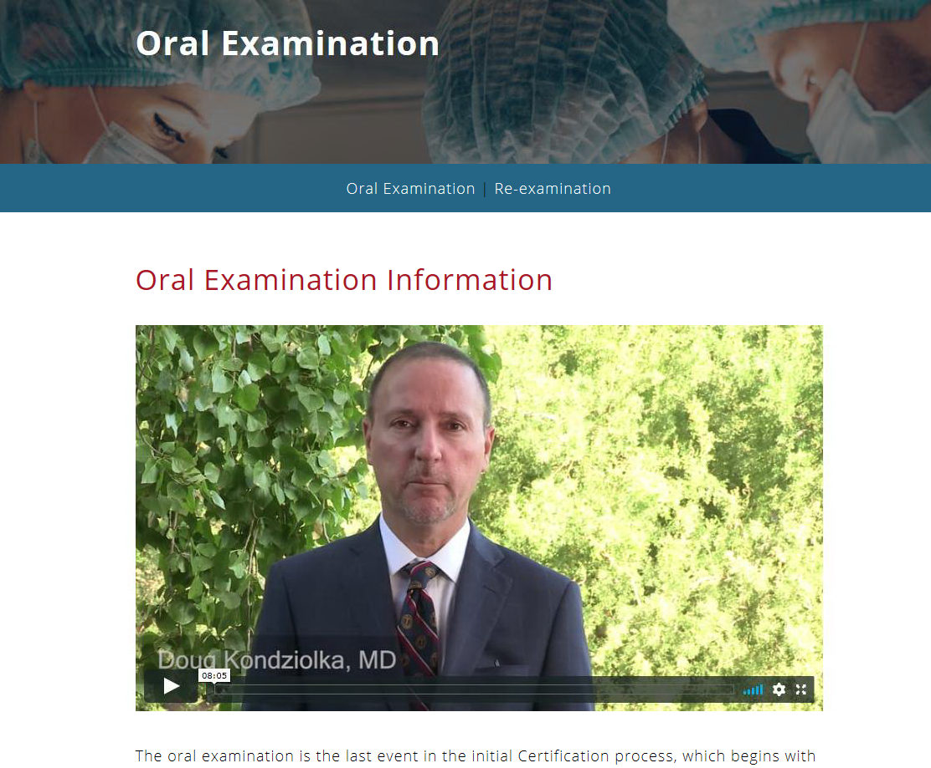
An 8 minute video primer

Slide 18
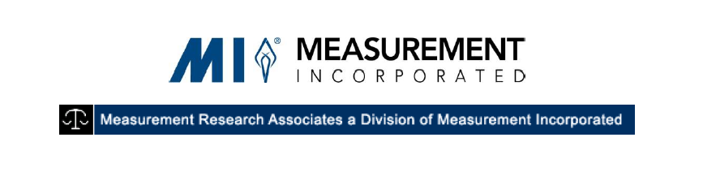

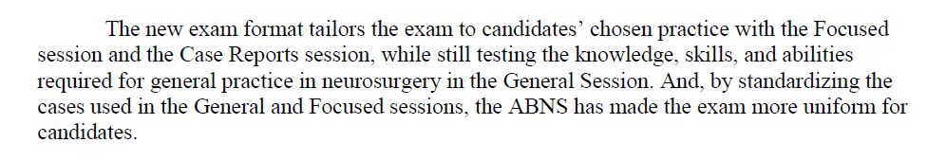
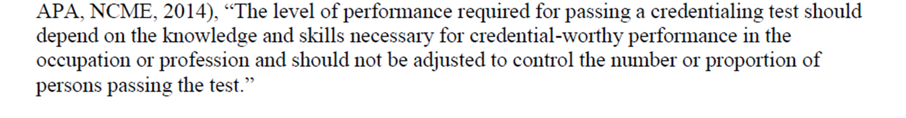

Slide 19


Slide 20
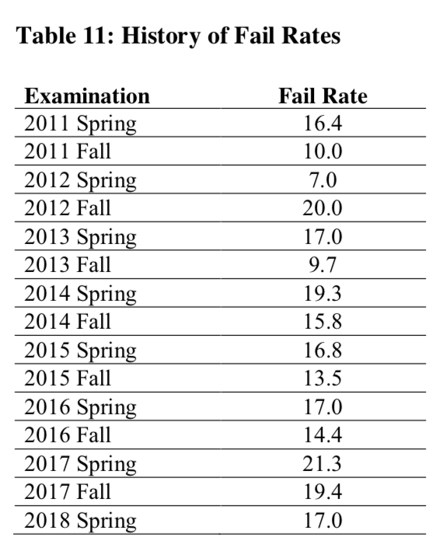
Oral Exam Fail Rates
First Exam with Candidate Cases
2018 Fall 14.9
Average of past 8 years 15%

Slide 21
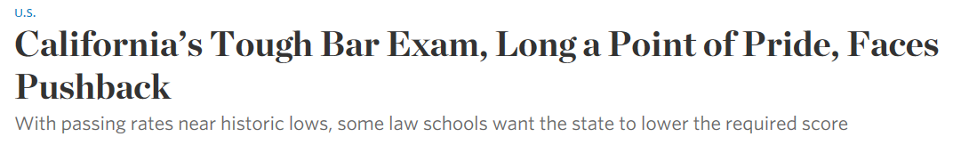
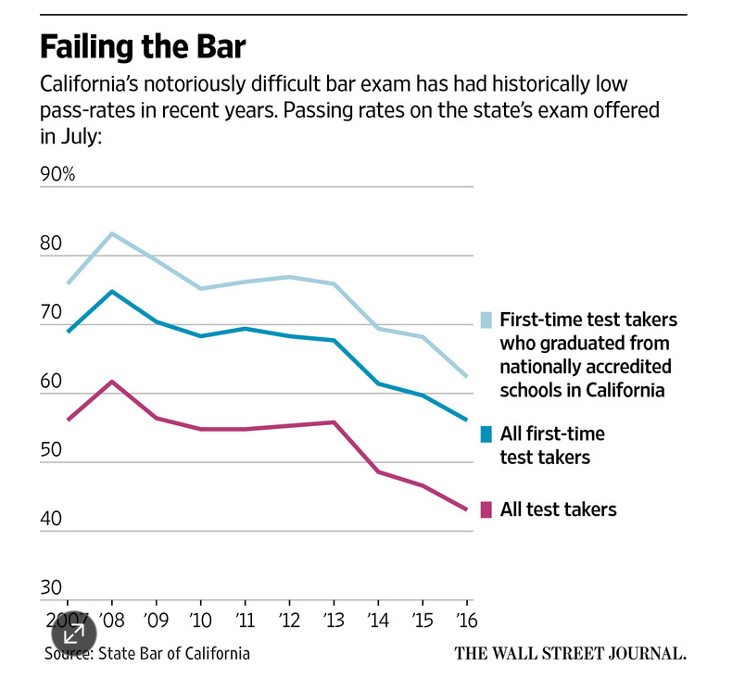
6/1/17

Slide 22
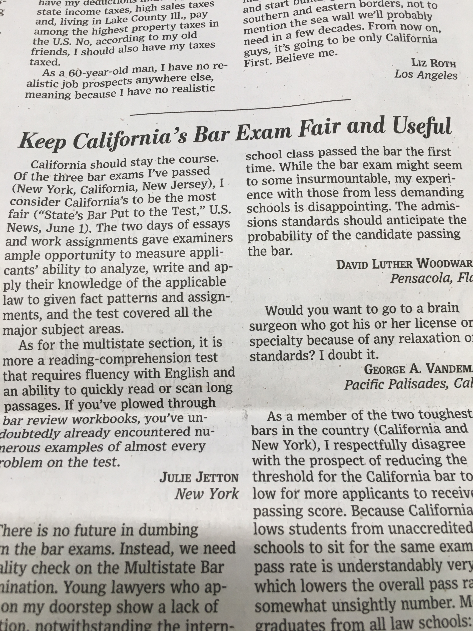
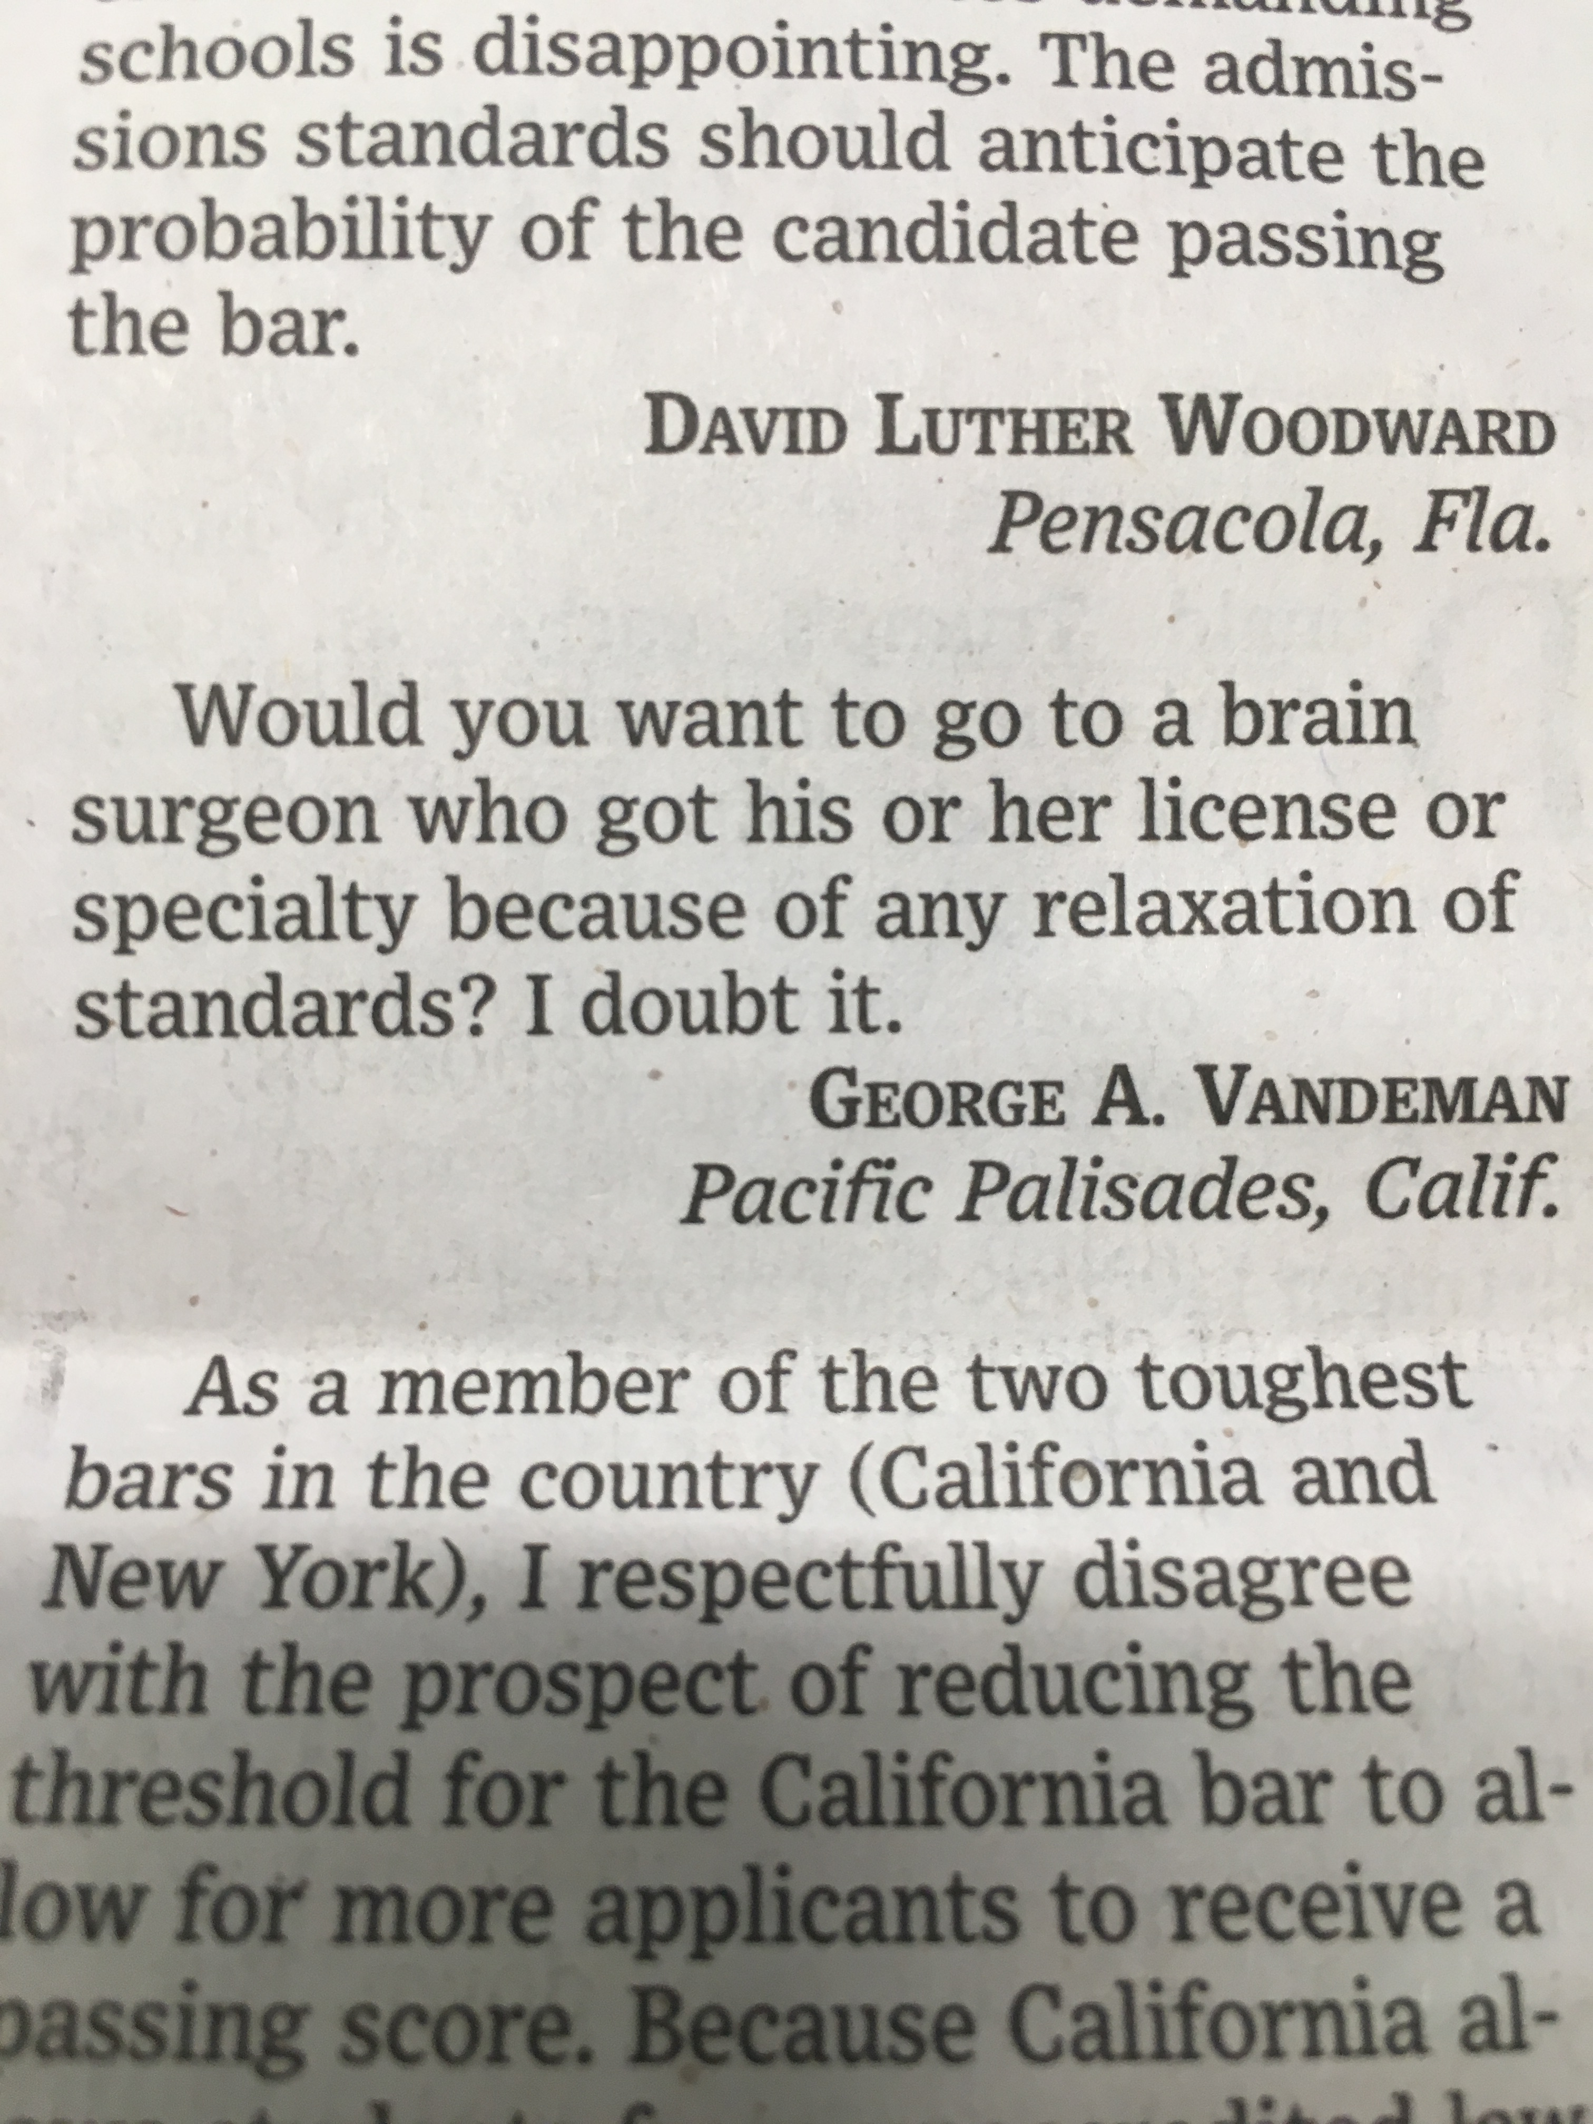
WSJ - June 8, 2017

Slide 23
More comments:
I will preface my comments by saying that I was absolutely terrified about the oral exam. Many colleagues (especially my fellow spine surgeons) made me extremely paranoid about the whole process ("they will fail you if they feel like it"; "if you don't mention [esoteric detail] they will fail you immediately"; "don't ever approach the neck anteriorly, they will give you an unfixable CSF leak", etc.). In hindsight I should have listened to the few colleagues who were actual past guest examiners. They had a much more realistic, calm approach to the exam. Another source of my anxiety was the fact that I have been in practice for 5 years, and if I fail the exam that means the ABNS feels that I am UNSAFE (have I been harming patients? should I continue to practice?) Needless to say, the actual exam was a complete shock to me.
With regards to the general and spine focused sections I will say this: If the ABNS asked me to write my own questions for the oral exam, they would have been nearly the same as the questions actually asked. I am a fellowship trained spine surgeon in an academic practice who sees spine and PNS in the clinic and general ER neurosurgery on call. I therefore would expect a relevant oral exam to hit spine very hard and sprinkle in emergency neurosurgery (head trauma/ICH, common brain tumors, etc). I feel that this is EXACTLY what I got--the exam stuck to the topics listed on the ABNS website. Furthermore, all four of my examiners were beyond cordial and fair. I really felt that I was talking to colleagues, not being tricked or made to look stupid (again contrary to what I had heard in preparation). The spine section in particular was a very positive experience, and while I know I didn't knock that section out of the park, I felt best about my performance on that section. The examiners could tell I was nervous and over-thinking at times and they did their best to put me at ease. They really just wanted to hear what I do in practice, not pre-prepared canned answers that are unrealistic. I think that is the essence of what an oral exam should be, and I will certainly pass this sentiment on to any future examinees I work with.
(continued…)

Slide 24
The Oral Exam
Session 1: General neurosurgery (5 cases)
Session 2: Focused Practice (General #2, Spine, Tumor, Vascular, Functional, Trauma/Critical care, Pediatric) (5 cases)
Session 3: Applicant Cases (10 submitted, 5 chosen)
Each session is 45 minutes. There is no set order for the sessions.

Slide 25
We have worked to match the candidate with examiners of the same specialty for the focused and case based sessions.
Also, examiner conflicts were taken into account. This is more challenging for the smaller specialties but it was achieved with attention to choosing guest examiners in certain disciplines.

Slide 26
Choosing the applicant cases for the oral examination…
Complications - common practice cases
Unusual Cases - interesting cases
Good outcomes - poor outcomes
Professionalism - coding
________________________________________________
The ABNS Certification Process remains unchanged:
Completion of accredited training
Application for ABNS certification
Licensing in good standing
Regional practice references
Hospital references
125 consecutive case submission reviewed by an ABNS Director
(Cases reviewed according to the above criteria. Information is by text alone, not with images.)
6. Entire file then reviewed by 3 directors prior to allowing the applicant to take the oral examination.

Slide 27
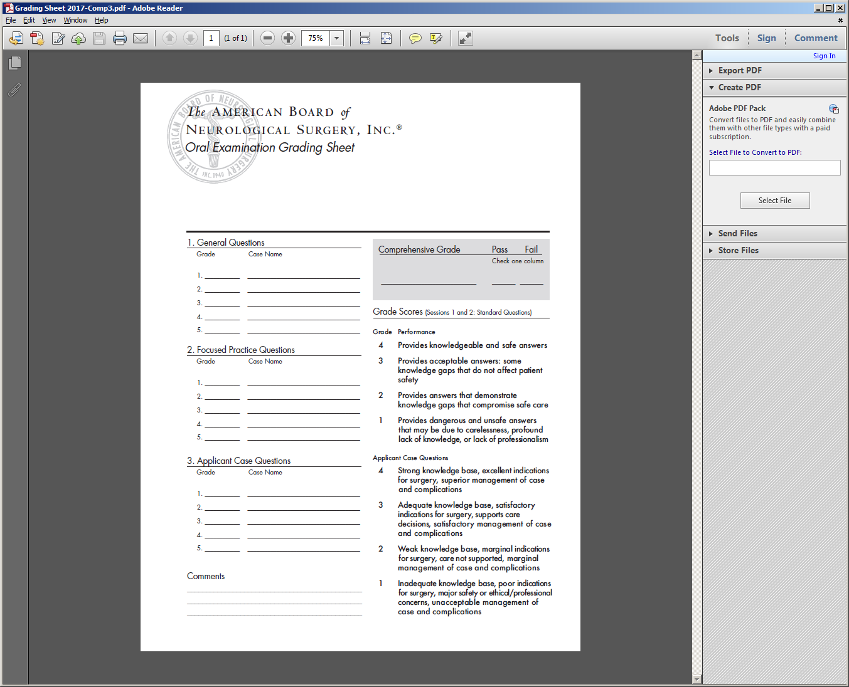
The Applicant Cases:
You may see a weak indication for surgery.
You may see a complication.
You may see management that you cannot understand.
You may see images that do not seem to justify surgery or care.
You may see “lost to follow-up”.
You may see coding concerns.
How are these scored? (4-3-2-1?)

Slide 28
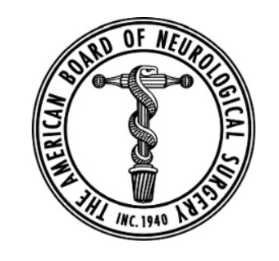
Components: Knowledge – Safety- Surgical Indications – Care Decisions Supported – Case Management

Slide 29
IF THE CANDIDATE FAILS ON THE GENERAL, FOCUS or CASE SESSIONS:
The candidate remains board eligible
The candidate can take the exam as early as 6 months later.
The candidate can use their previously submitted cases for the case review, or they can submit 75 new consecutive cases for review which can begin within the prior 12 months of the exam that they failed.

Slide 30
There are many elements to this ABNS Oral Examination
Efficiency
Grading
Relevance to the applicant, to us, and to the public
Software development continues for analytics
ABNS POST
Case submission
Imaging
Software for power point presentation
PLEASE DO WHAT THE ABNS REQUESTS!
They will support you fairly.

Slide 31
Thank you!

