Slide 1
Introduction to Neurosurgical Subspecialties: Vascular and Endovascular Neurosurgery
Brian L. Hoh, MD¹ and Gregory J. Zipfel, MD²
¹University of Florida, ²Washington University

Slide 2
Vascular Neurosurgery
Vascular neurosurgeons treat patients with:
Cerebral aneurysms
Brain and spinal AVMs
Dural AVFs
Cavernous malformations
Intracerebral hemorrhage
Ischemic stroke / Carotid stenosis

Slide 3
Vascular Neurosurgery
Fellowship not required, but some neurosurgeons opt for further specialized training in open vascular surgery via fellowship
Frequently combined with specialized training in endovascular neurosurgery
While neurosurgeons only can do open intracranial vascular surgery, radiologists and neurologists can also do fellowship training in endovascular treatment

Slide 4
Case Illustration #1
45 yo female with incidental MCA aneurysm

Slide 5
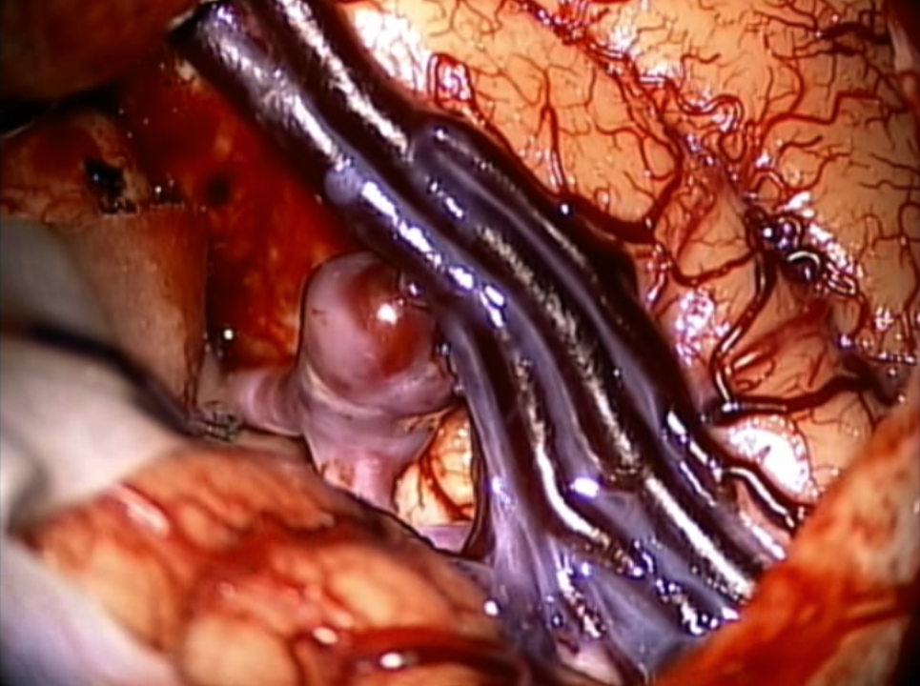
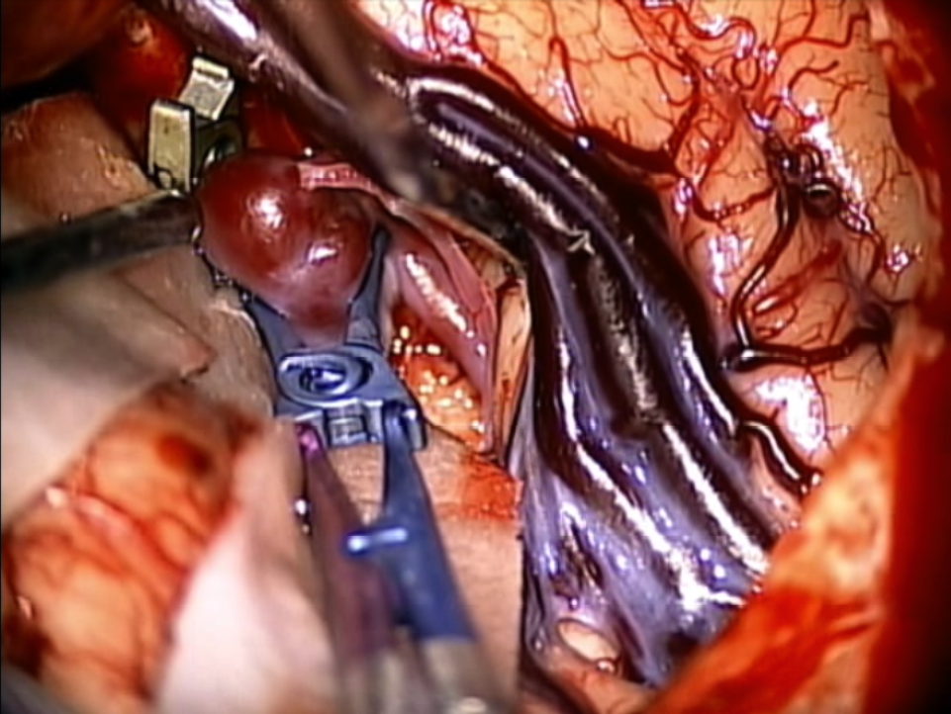
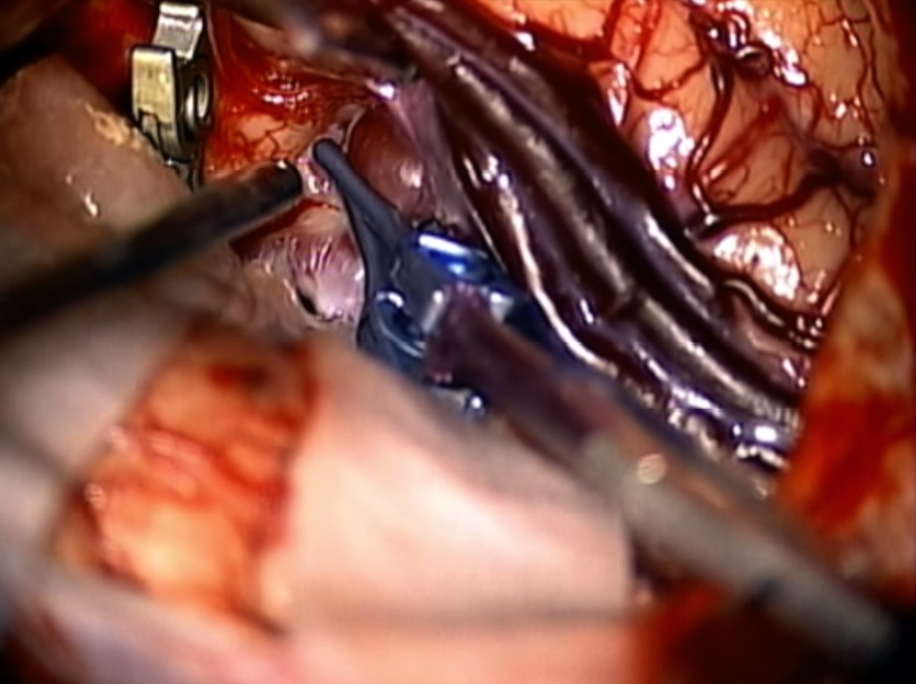
Case Illustration #1
Tandem clipping technique of MCA aneurysm

Slide 6
Case Illustration #2
15 yo male with seizure; left MCA aneurysm
Large fusiform left MCA aneurysm incorporating frontal M2 branch (arrow)
STA-MCA bypass (arrow) + aneurysm clipping

Slide 7
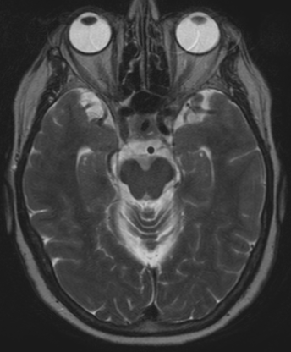
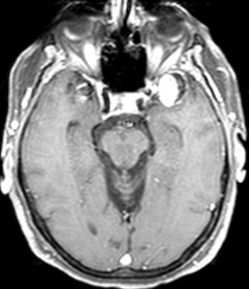
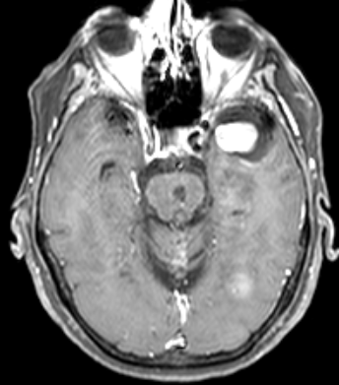
Case Illustration #3
70 yo female with enlarging giant left MCA aneurysm s/p previous coiling
8/13/2007
11/15/2007
7/30/2009
12/27/2011

Slide 8
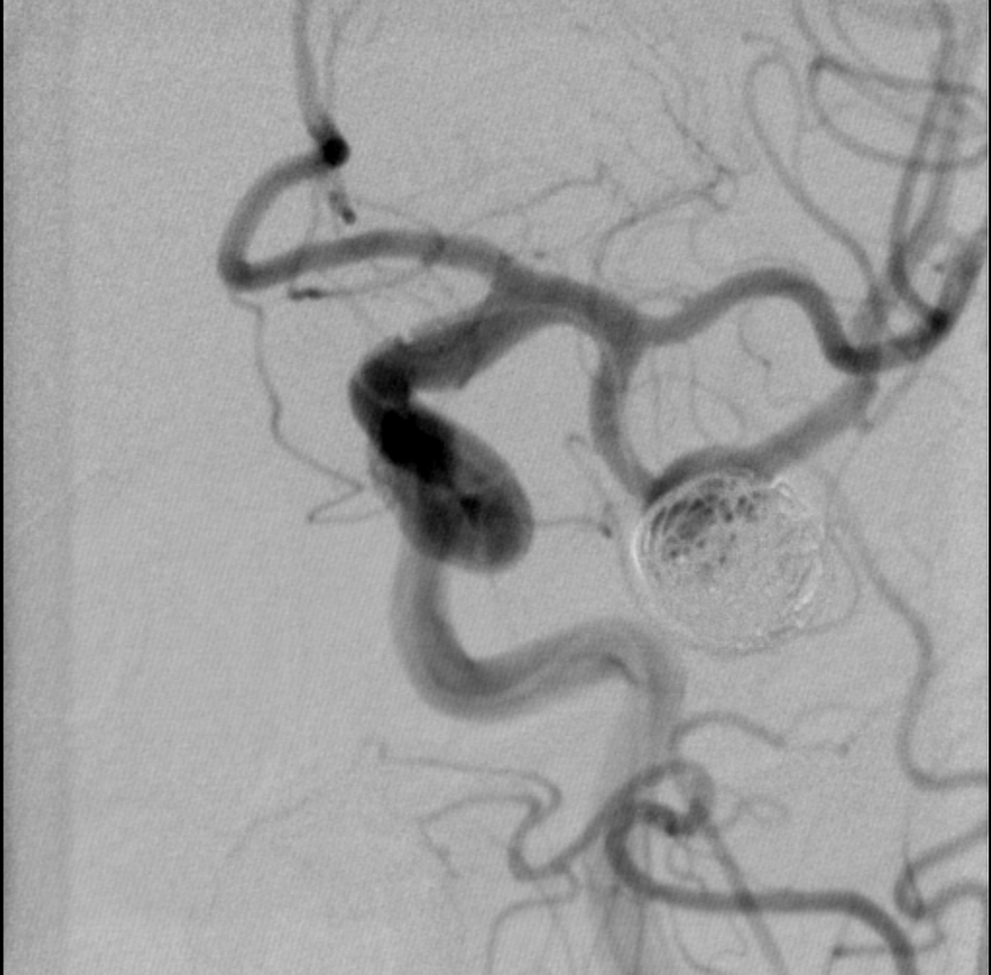
Case Illustration #3
2008
Radial artery high flow bypass (arrows) + aneurysm trapping
2012
Recurrent giant left MCA aneurysm s/p coiling

Slide 9
Case Illustration #4
12 yo girl presents with headache, nausea, vomiting, ataxia, lethargy, and right hemiparesis; Brainstem cavernous malformation on MRI

Slide 10
Case Illustration #4
Subtemporal craniotomy + petrosectomy for resection of brainstem cavernous malformation
Post-op MRI

Slide 11
Endovascular Neurosurgery
Endovascular neurosurgeons treat patients with:
Cerebral aneurysms
Vasospasm
Brain and spinal AVMs
Dural AVFs
Ischemic stroke
Carotid stenosis
Tumors
Head and neck bleeding

Slide 12
Endovascular Neurosurgery
Neurosurgeons, neurologists, and neuroradiologists can specialize in endovascular
Fellowship is typically required

Slide 13
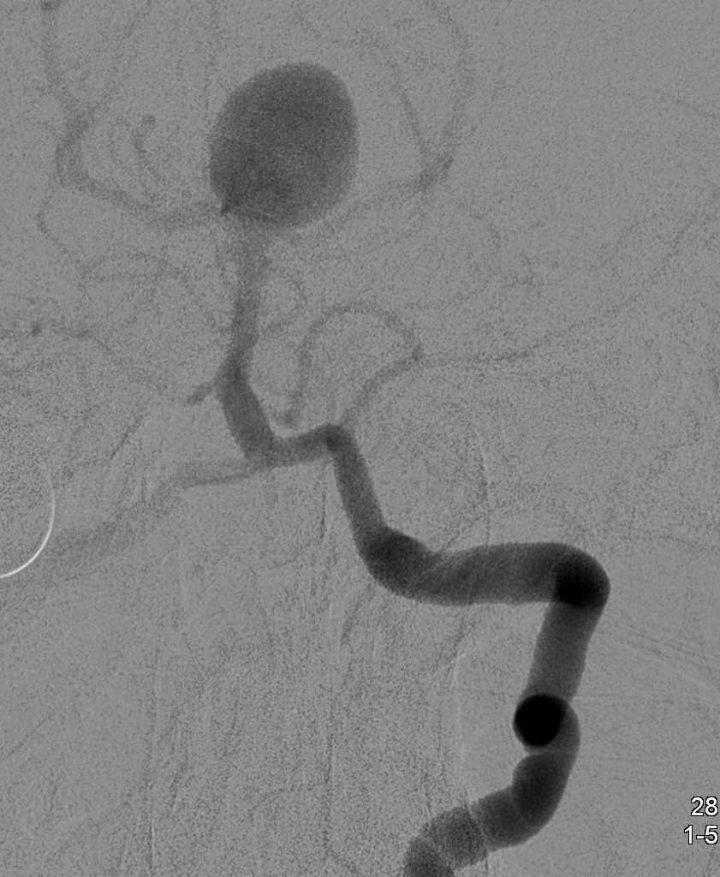
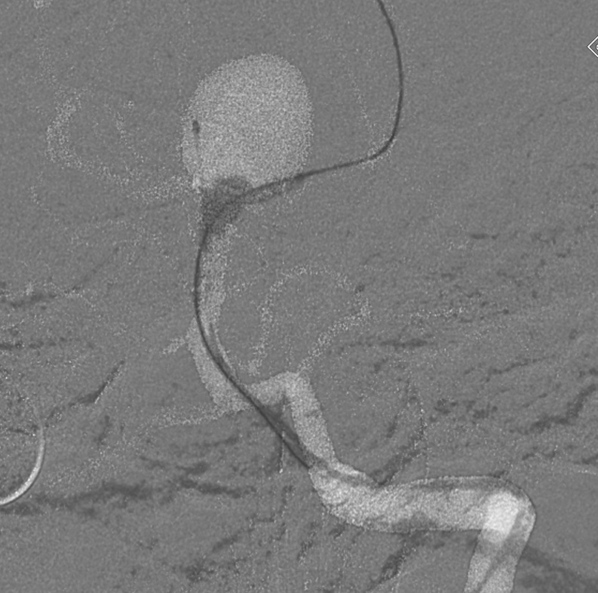
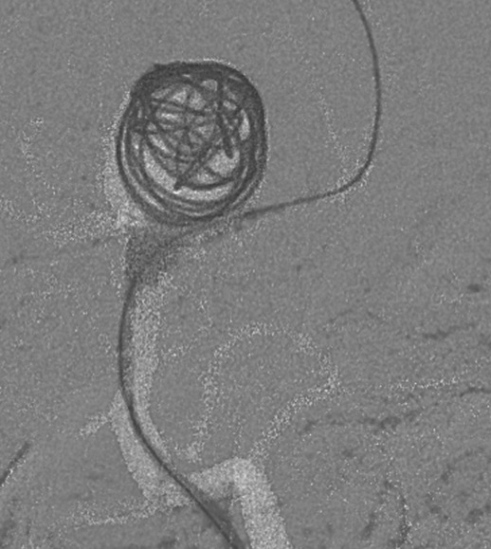
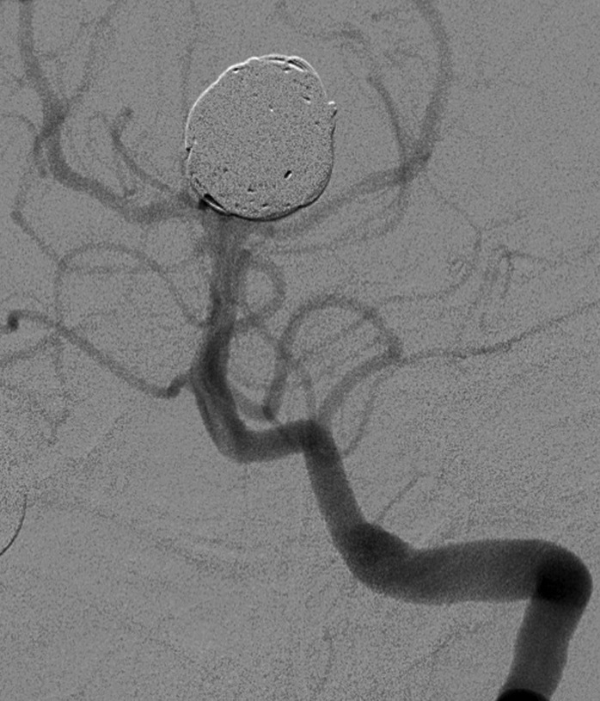
Endovascular Neurosurgery
Case Illustration #1
67 year old woman with SAH from ruptured basilar tip aneurysm

Slide 14
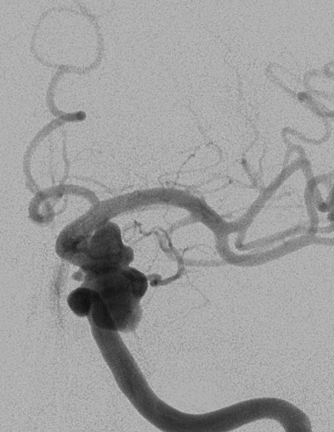
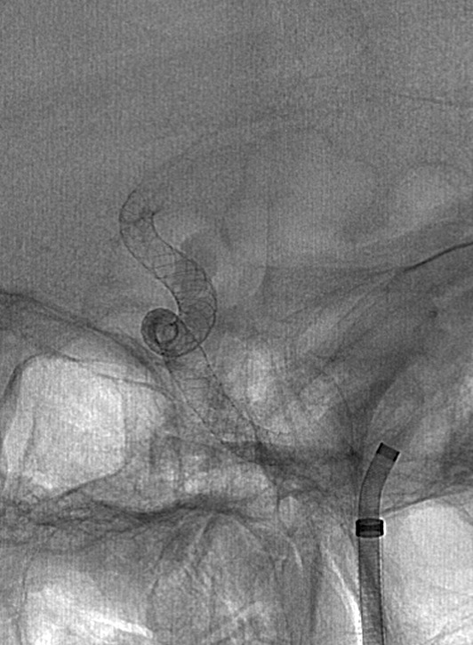
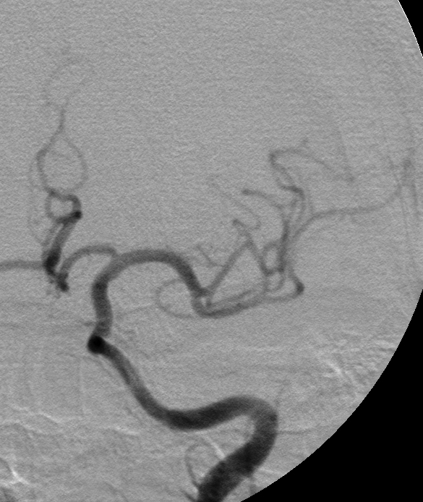
Endovascular Neurosurgery
Case Illustration #2
69 year old woman with left CN3 palsy
Treated with Pipeline stent, left CN3 palsy resolved

Slide 15
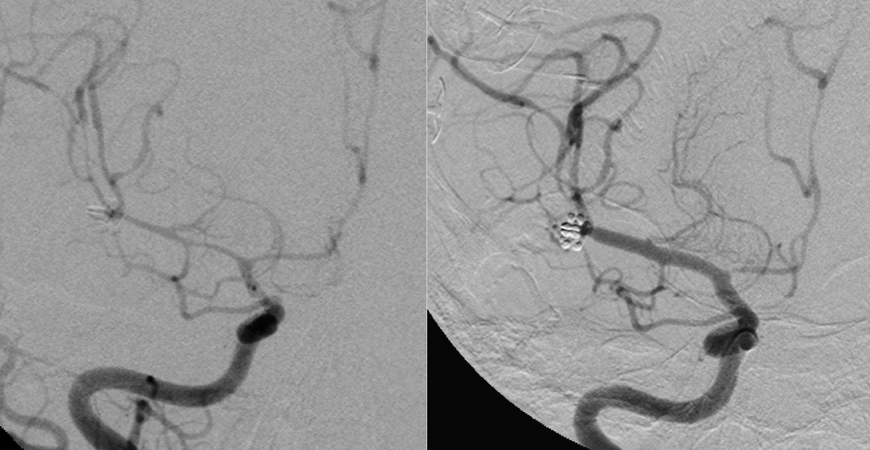
Endovascular Neurosurgery
Case Illustration #3
Patient POD#5 s/p clipping of ruptured right MCA aneurysm develops left hemiparesis
Balloon angioplasty

Slide 16
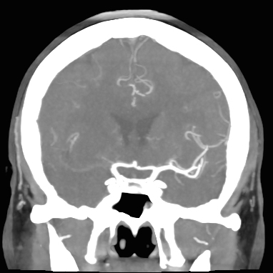
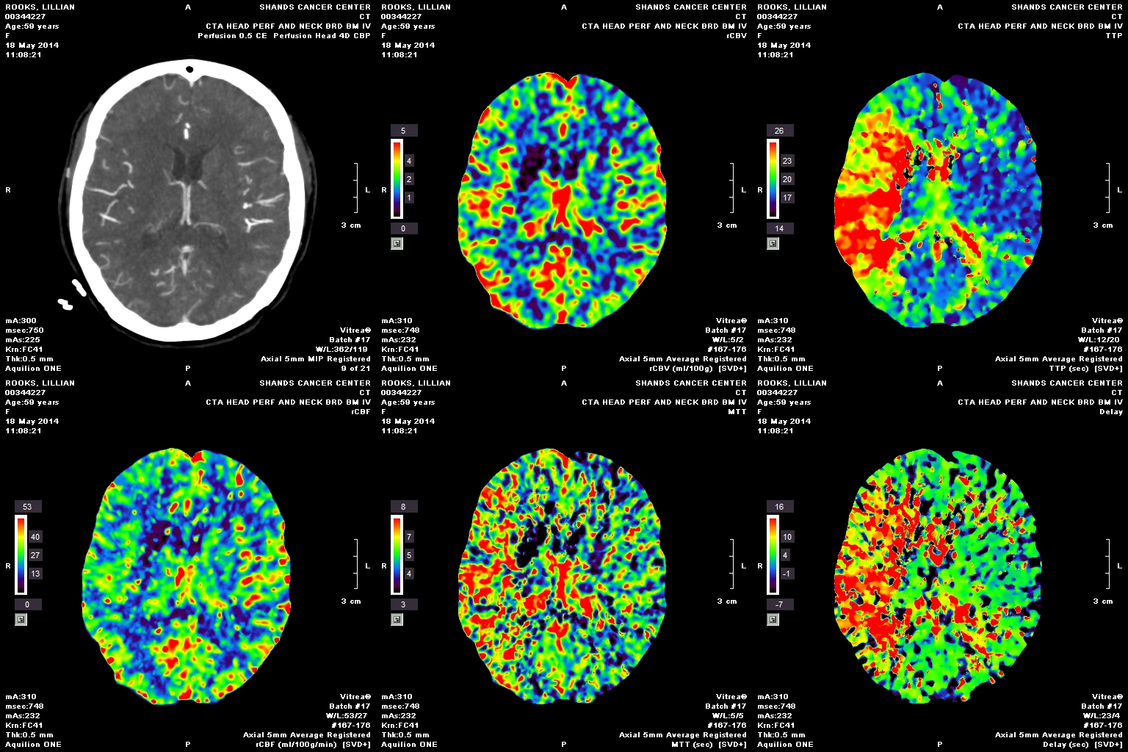
Endovascular Neurosurgery
Case Illustration #4
59 year old woman with ischemic stroke presenting with left facial droop, left hemiparesis, dysarthria

Slide 17
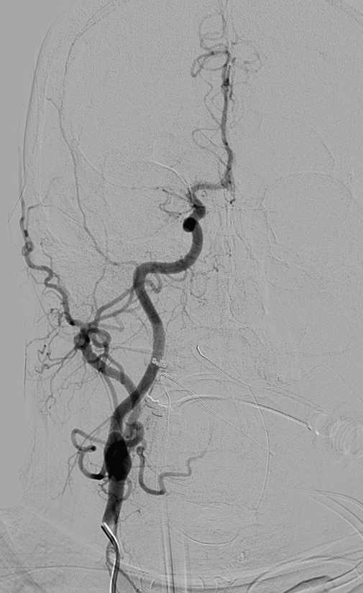
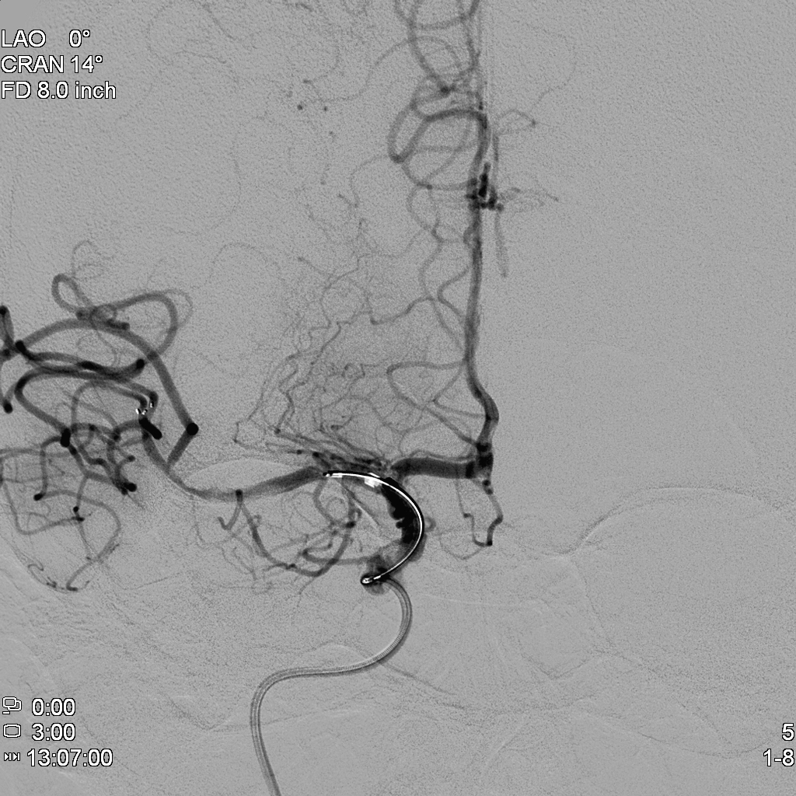
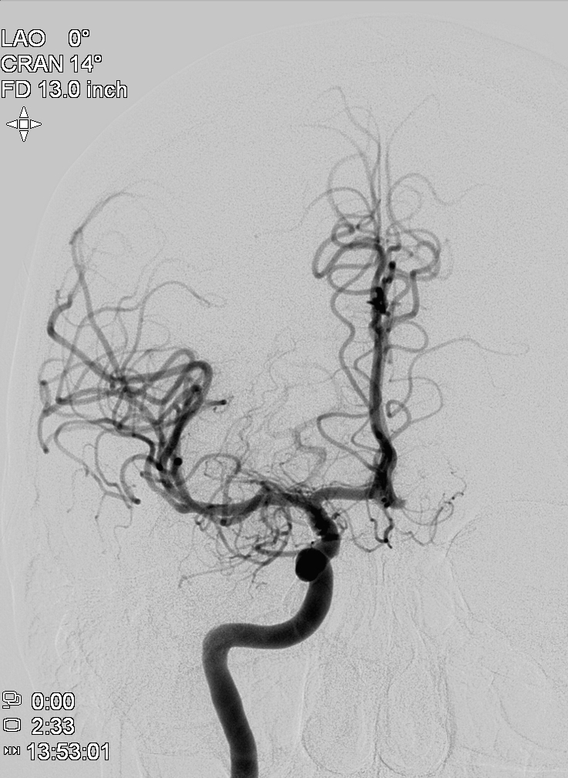
Endovascular Neurosurgery
Case Illustration #4
Endovascular embolectomy

Slide 18
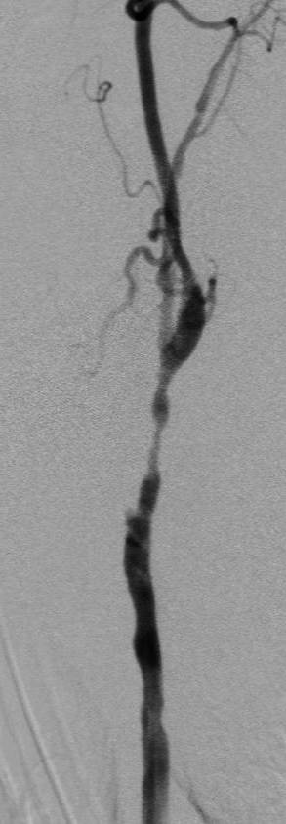
Endovascular Neurosurgery
Case Illustration #5
68 year old man s/p neck surgery and radiation therapy for neck cancer, now with TIAs of right hemiparesis
Angioplasty and stenting

Slide 19
Conclusions
Vascular neurosurgery is an large and intensive subspecialty of neurosurgery
Vascular patients can be extremely critically ill
Endovascular techniques are an indispensable part of vascular neurosurgery
Fellowship training is required for endovascular privileges.
While not required, many surgeons do opt for further fellowship training for open vascular surgery as well

