Slide 1
Neurosurgery Research Career Development Program
Emad Eskandar, MD, MBA
Jeffrey Bergstein Professor & Chair
Albert Einstein College of Medicine
Montefiore Health System
Hershey, PA, 2018

Slide 2
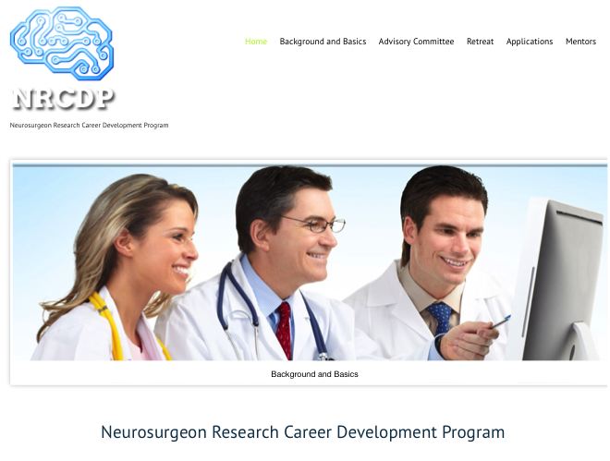
The K12 Program
An NIH Funded Program
Two Years of Support
Three awards per year
$85,000 for salary
$50,000 for supplies

Slide 3
Eligibility
Junior Faculty Members
Within one-two years of completing residency or fellowship
Any academic program in the United States
Established mentor with record of funded research
50% effort dedicated to research
Letter of Support from department chair

Slide 4
Difference from Individual K08’s
Parent K12 grant has already been awarded and mechanism is in place
Parent grant has been renewed and is now in its 6th year
National Advisory Committee (review panel) is made up primarily of neurosurgeon-scientists
Uniquely suited for neurosurgeon-scientists

Slide 5


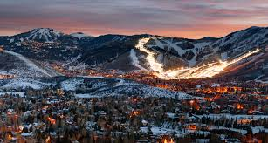
Annual Retreat
Three Day Event
K12 Trainees & Applicants
K08 Trainees & Applicants
Presentations
Grant Writing
Scientific Integrity
Personal Interviews
Review of Applications
New Hampshire
Massachusetts
Park City Utah

Slide 6
Annual Retreat Attendance
87 Applicants
50 Different Institutions
All Sub-specialties

Slide 7
Comments
Sameer Sheth, Columbia University: Awarded NRCDP 2012, subsequently awarded R01 among other awards: “Very helpful for several reasons: 1) connecting with other academic neurosurgeons who can provide advice, suggestions regarding specifics of the process for neurosurgery. 2) Establishing a relationship with NINDS in general, and Steve Korn in particular. Great to have someone at the NIH in your corner to ask questions. 3) Helping mentor neurosurgery residents/fellows/new attendings who are starting the process”
Tim Lucas, University of Pennsylvania, Awarded NRCDP in 2012, Subsequent R01 and DARPA Funding: “The program is indispensable and transformative. Junior investigators face a number of challenges establishing their research during formative years. This program provides a valuable bridge that protects investigator time while they prepare larger extramural grants.”
Andrew Grande, University of Minnesota, Applied in 2014, NRCDP not awarded. He has a K08 pending.
“I believe that this program is incredibly important and helpful. Perhaps the greatest value for me is bringing together other neurosurgeons who are in a similar situation as myself and enabling us to talk to more senior neurosurgeons who have navigated the challenging waters of physician science in neurosurgery.”

Slide 8
Trainees
16 Awardees to date
Most have obtained subsequent funding
All subspecialties are represented
Wide geographic distribution
Penn, Columbia, Maryland, Pitt, Cincinnati, OHSU, Iowa, Indiana, Stanford, BWH, Yale, Mayo, Wash U, Duke, Yale, BNI

Slide 9
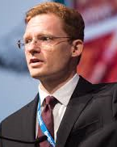
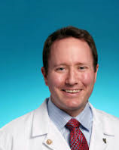
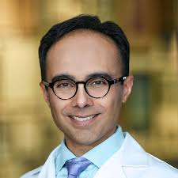
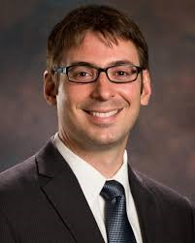
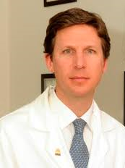
Trainees
2012: Timothy Lucas, MD PhD. U Penn
Brain Computer Interface for the Restoration of Grip.
Sameer Sheth, MD PhD: Columbia University:
The Human Cingulate in Cognitive Adaptation
Graeme Woodworth, MD: Maryland
Brain-Penetrating Nanoparticle Gene Therapy for Glioblastoma”
2013: Timothy Vogel, MD: Cincinnati Children’s:
Primary cilia progenitor cells in neonatal hydrocephalus
Andrew Ducruet, MD: Pittsburgh. “Complement Mediated Neurovascular Injury after tPA”
T Lucas
T Lucas
T Vogel
S Sheth
A Ducruet
G Woodworth

Slide 10
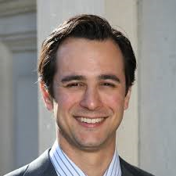
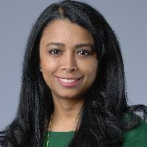
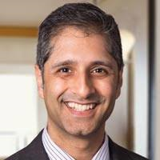
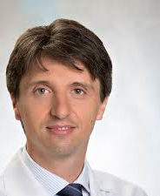
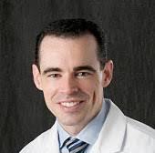
Prior Trainees
2014: Casey Halpern MD Stanford University:
NAcc DBS and binge eating
Shahid Nimjee, MD PhD; Ohio State University: Reversible Anti-Von Willebrand Factor Inhibitor and rTPA
2015. Brian Dlouhy, MD PhD: University of Iowa. “Amygdala Influence on Brainstem Control of Breathing.”
Mahua Dey, MD: University of Indiana.
Role of plasmacytoid dendritic cells in malignant glioma.
PierPaulo Perruzi MD, PhD: Brigham & Women’s. “miR-128 as a regulator of epigenetic complexes…in glioblastoma”
C Halpern
M Dey
S Nimjee
P Perruzi
B Dlouhy

Slide 11
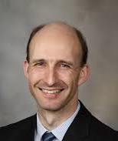
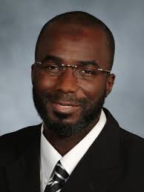
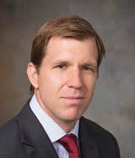
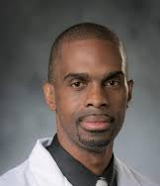
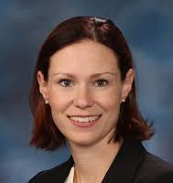
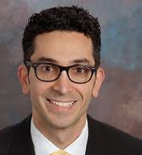
Prior Trainees
2016: Terry Burns, MD PhD: Mayo Clinic. “Microglia and Radiation-Induced Brain Injury.”
Kristopher Kahle, MD, PhD: Yale University. ”Genetic mechanisms of human hydrocephalus.”
Jennifer Strahle MD: Washington University. “Iron Mediated Cilia Dysfunction in IVH”
2017: Babacar Cisse, MD/PhD, Cornell. ” Regulation of Glioma-Associated Immune Cells”
Rory Goodwin MD PhD, Duke.
“SUMOylation of Pyk2 in breast cancer spinal metastases”
Zaman Mirzadeh, MD PhD: BNI “Arcuate nucleus circuits and glucose homeostasis”
T Burns
B Cisse
K Kahle
R Goodwin
J Strahle
Z Mirzadeh

Slide 13
National Advisory Committee
Aviva Abosch University of Colorado
Sepideh Amin Hanjani MD University of Illinois
Bob Carter, MD PhD MGH / Harvard
Clark Chen, MD, PhD University of Minnesota
Nino Chiocca, MD PhD BWH / Harvard
Mary Heinricher, PhD OHSU
Langston Holly, MD, PhD UCLA
Matt Howard, MD, PhD University of Iowa
Linda Liau, MD, PhD UCLA
Russel Lonser, MD PhD Ohio State University
William Mack, MD USC
Jeffrey Ojemann, MD, PhD University of Washington
Shenendoah Robinson Johns Hopkins
Alfredo Quinones, MD Mayo Clinic
Kareem Zaghloul, MD, PhD NIH
Greg Zipfel, MD Washington University

Slide 14
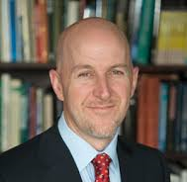
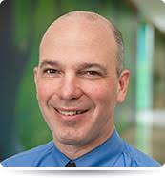
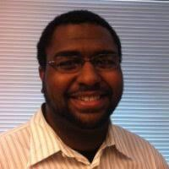
Personnel
Steve Korn – NIH Program Officer
Emad Eskandar, MD, PI
Greg Zipfel, MD, Co-Director
Jeffrey Ojemann, MD PhD, Co-Director
Matthew Thombs, Coordinator

Slide 15
Applications
Application deadline: October 1st, 2018
Retreat: November 2018, Park City Utah
Email: eeskanda@montefiore.org
Google: NRCDP
Website: http://www.neurocdp.org

Slide 16
Going Forward
Creation of a robust community
Inclusion of additional NS Scientists
Better outreach to societies and applicants
Enhanced support of emerging scientists
Enhanced Website
Development of successful neurosurgeon-scientists

Slide 17
Summary
K12 is unique funding mechanism dedicated to junior neurosurgeon scientists
K12 is an excellent way to start promising young neurosurgeons on their academic careers
Please consider graduating residents/fellows and junior faculty members

Slide 18
Applications
Application deadline: October 1st, 2018
Retreat: November 2018, Salt Lake City
Email: eeskanda@montefiore.org
Google: NRCDP
Website: http://www.neurocdp.org

Slide 19
Questions

