Slide 1
MICROVASCULAR ANASTOMOSIS
Michael L. Levy MD PhD
Professor and Division Head Pediatric Neurosurgery
UCSD – Rady Children’s Hospital of San Diego

Slide 2
Tubing Too Tight

Slide 3
Less Tension on Tubing – Or Free Up One Side
Yes

Slide 4
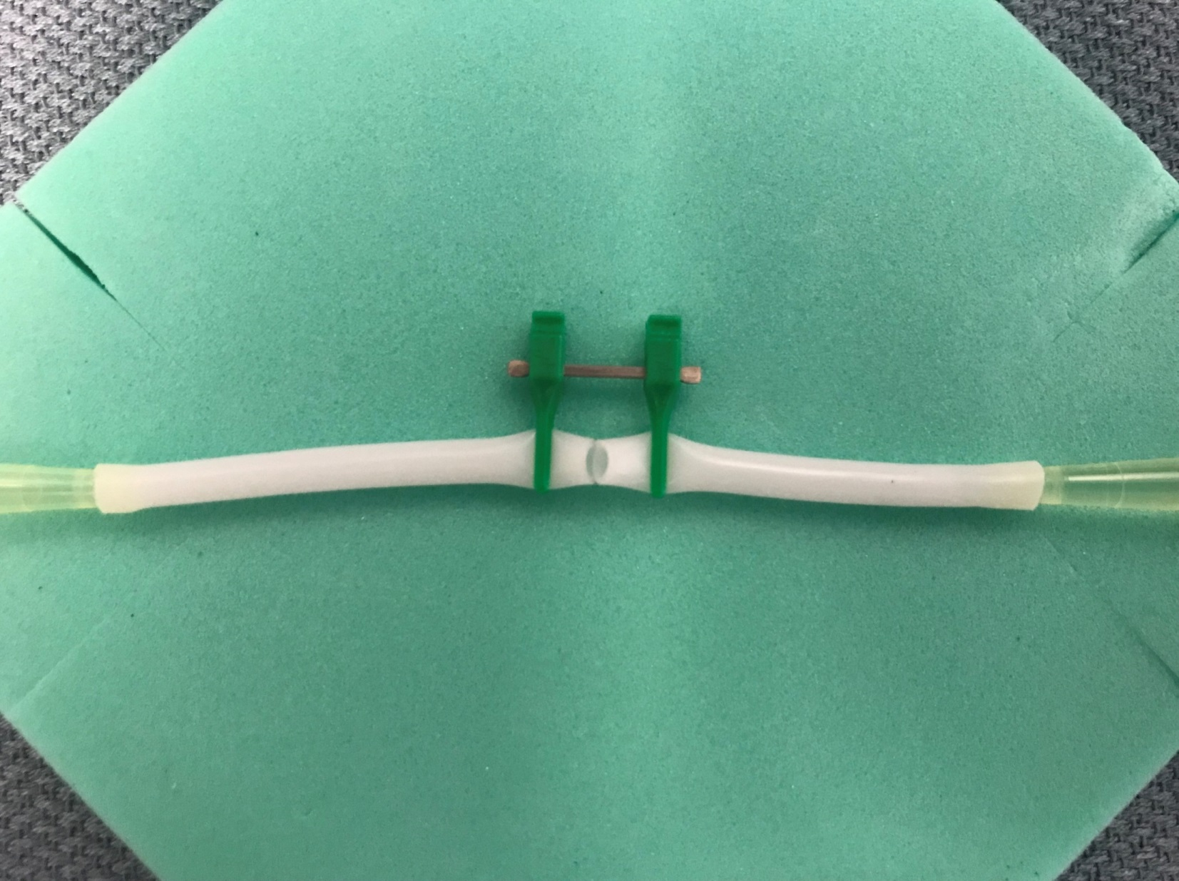
Less Tension on Tubing – Or Free Up One or Both Sides

Slide 5
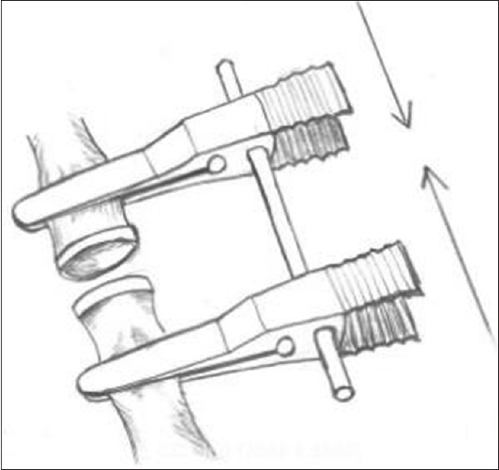
The Standard Use of the Microvascular Clips to Approximate the Vessel Edges Does Not Work Well in This Model.

Slide 6
Yes
Cut the Tubing Once Placed in the Clamps
No

Slide 7
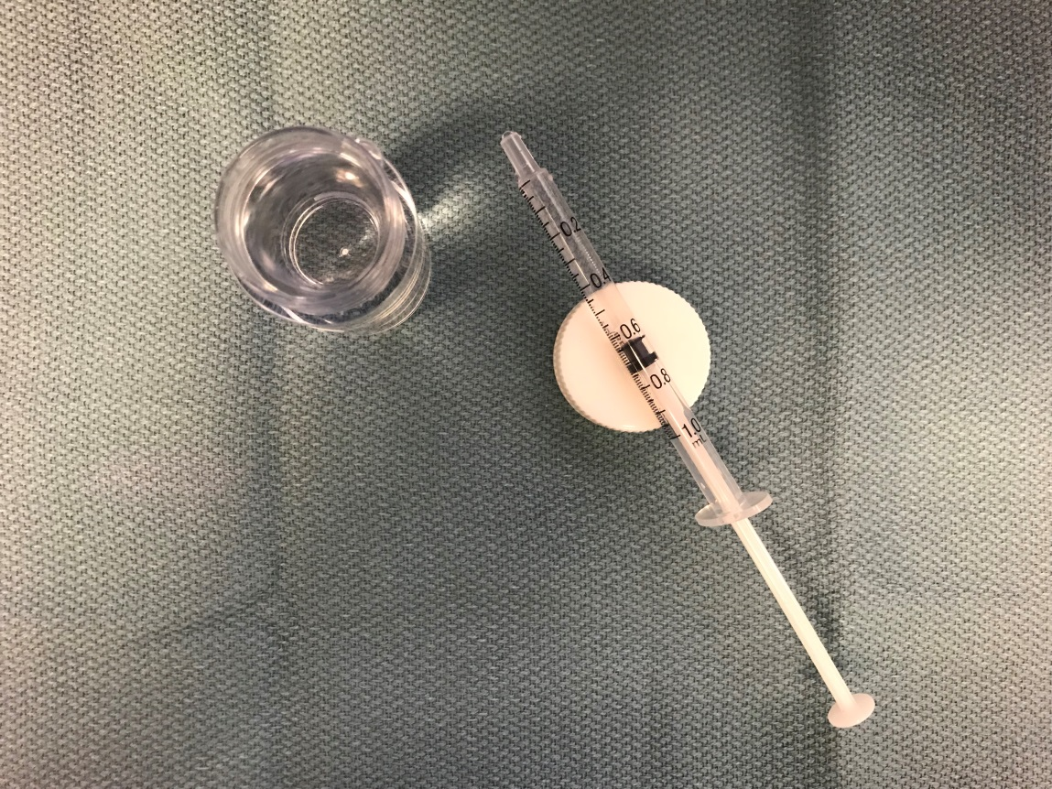
Keep Tubing Moist

Slide 8
There are numerous surgical techniques that surgeons utilize for end-to-end anastomosis. A simple method to start learning these techniques:
Start with two opposite and tied sutures at 0°and 180°.
Leave a tail on both sutures that can be used to turn the vessel for access to all sides.
Once the initial sutures are placed you can complete the anastomosis with running or simple sutures, depending on the diameters. Taha AY: Principles of vascular anastomosis

Slide 9
The Needle Should Be Directed 90° to the Vessel Wall. Always Include the Intima Especially on the Downstream Side to Avoid Dissection

Slide 10
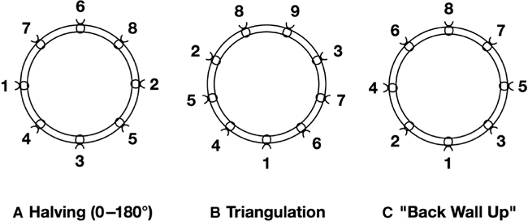
Other considerations for interrupted suture re-anastomosis

Slide 11
3 Suture Technique

