Slide 1
Shelly D. Timmons, MD, PhD, FACS, FAANS Leadership Development in Neurosurgery
Society of Neurological Surgeons
Hershey, PA
May 20, 2018

Slide 2
Leadership in Multiple Environments
1
2
3
Departmental and Institutional
Organized Neurosurgery
Community and Government
Developing Skill Sets for Various Scenarios

Slide 3
Leadership at the Departmental and Institutional Level
1
Faculty Development

Slide 4
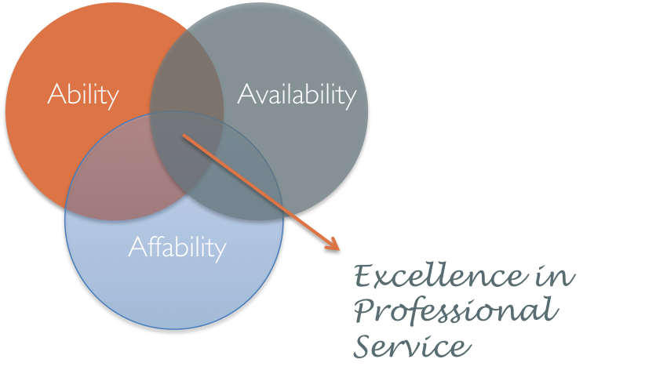
Apply Practice-Building Principles to Organizations
Ability—Most Important
Especially Early, Offer to Help Out in Areas of Strength
…But…Stretch Goals are OKAY!
Organizations and the People in Them Provide Infinite Learning Opportunities
Availability
Make Sure Faculty Can Follow Through on Their Commitments…
…while Not Turning Down Opportunities
Affability
It’s All About Relationships

Slide 5
Maturation in Practice
Activities don’t take place in a vacuum
Future leaders will be gaining skills over time in practice
Surgical
Educational
Administrative
Research
In parallel to gaining skills via organizational activities
Becoming an excellent physician and surgeon is the MOST important goal.

Slide 6
Committee Service
Being present on campus and involved in committees and other institutional initiatives cements not only the role of the individual but of the department
Reputation for being the “go-to” people to make a difference
Populate committees broadly with departmental representatives
Match up talent/interest with institutional needs

Slide 7
Align Departmental Goals with Institutional Goals
…However, department can lead institution when policies and procedures don’t make sense
Reputation of being team players will help with direction setting.

Slide 8
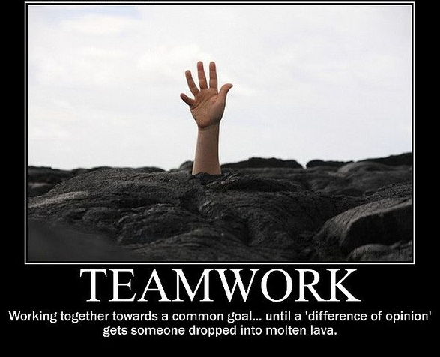
Sponsorship and Promotion of Camaraderie
Putting faculty forward for appropriate “jobs”
Strong faculty meetings
Relationships outside of work
Developing a shared culture / shared goals
Avoidance of territorialism
Organize with Sections
Makes professional life worthwhile on a different level

Slide 9
Leadership in Organized Neurosurgery
2
Volunteer Development

Slide 10
Watch & Listen Learn & Contribute
Volunteer is incorporated to organizational endeavors and starts to contribute
Ongoing learning through wide, keen attention
Contribution to events by volunteers with guidance from leadership
Coordination of volunteer and leadership activities through shared references to collective efforts
Appraisal of volunteers’ mastery and what supports are needed.
Leadership provides feedback about contributions
Volunteer participation is transformed to responsibility,
Sharing of acquired information & skills, thereby contributing to the organization
Collaborative social organization
Incorporation of flexible ensembles, blending ideas, agendas, and pace.
All are engaged, anyone may take the initiative
Volunteer is eager to contribute and belong
Leadership’s motives are to accomplish organizational goals and guide volunteers
Adapted from Theories of
“Learning by Observation and Pitching In”
Barbara Rogoff
Professor of Psychology
UC-Santa Cruz
Observational Learning Models in Children
Mayan Communities in Guatemala
Mirrors the Life-Cycle of a
Professional in an Organization

Slide 11
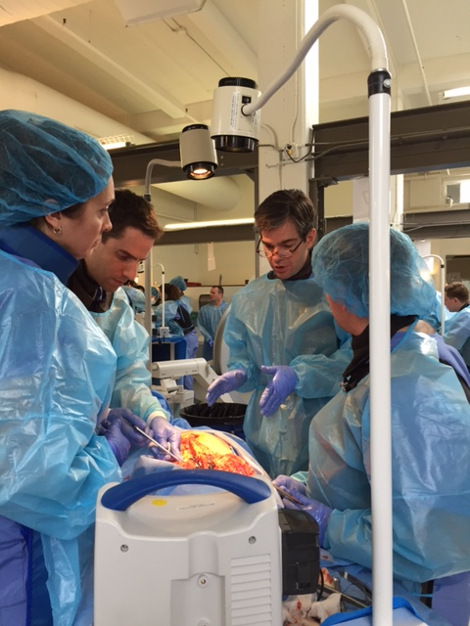
Aligning Organizational and Personal Values
Learn about the Mission, Character, and Make-Up of the Organization
Find Activities Within Organizations that Match
Passions and Intellectual Interests
Talents and Skill Sets
Willingness to Offer Time, Attention, and Even Money
Identify How Potential Leaders Can Make a Long-Lasting Contribution to the Profession of Neurosurgery

Slide 12
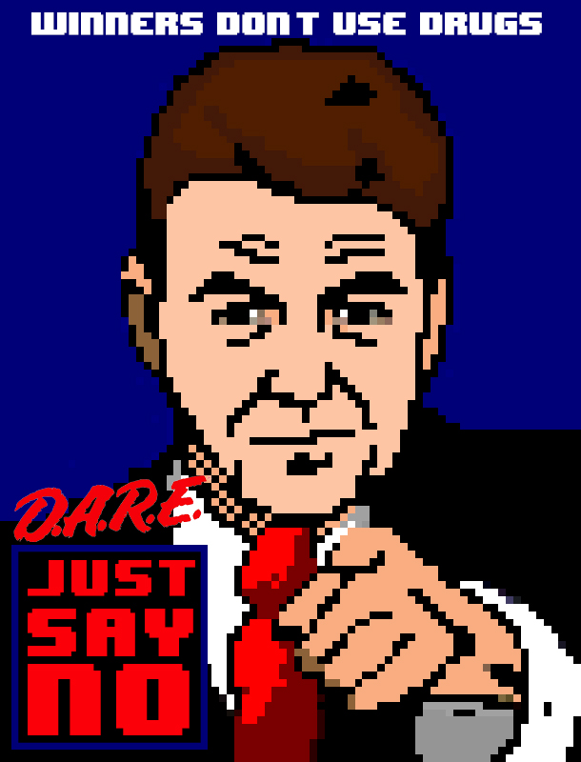
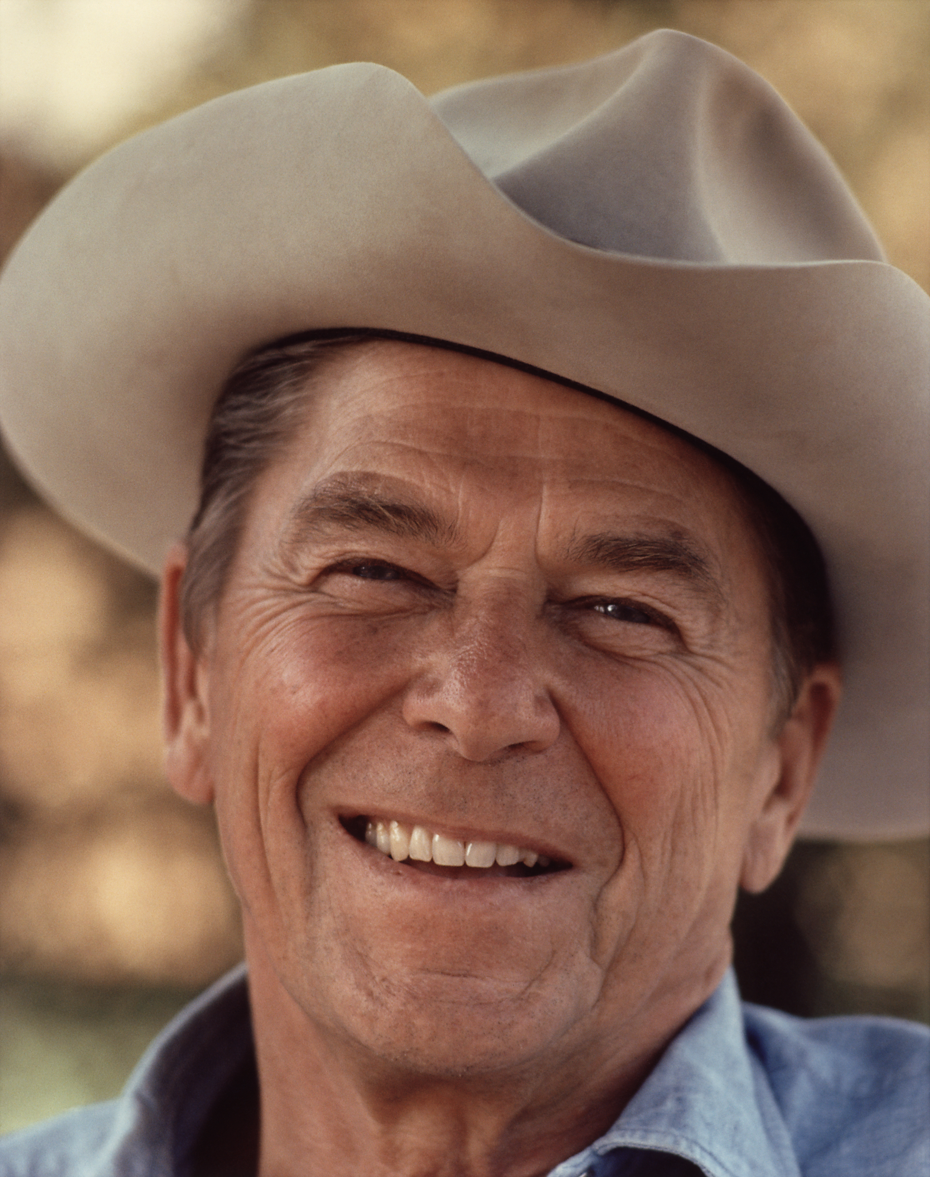
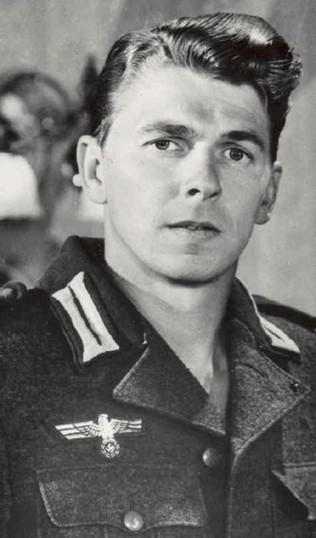
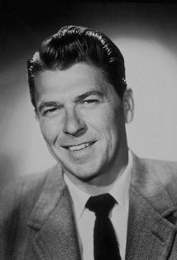
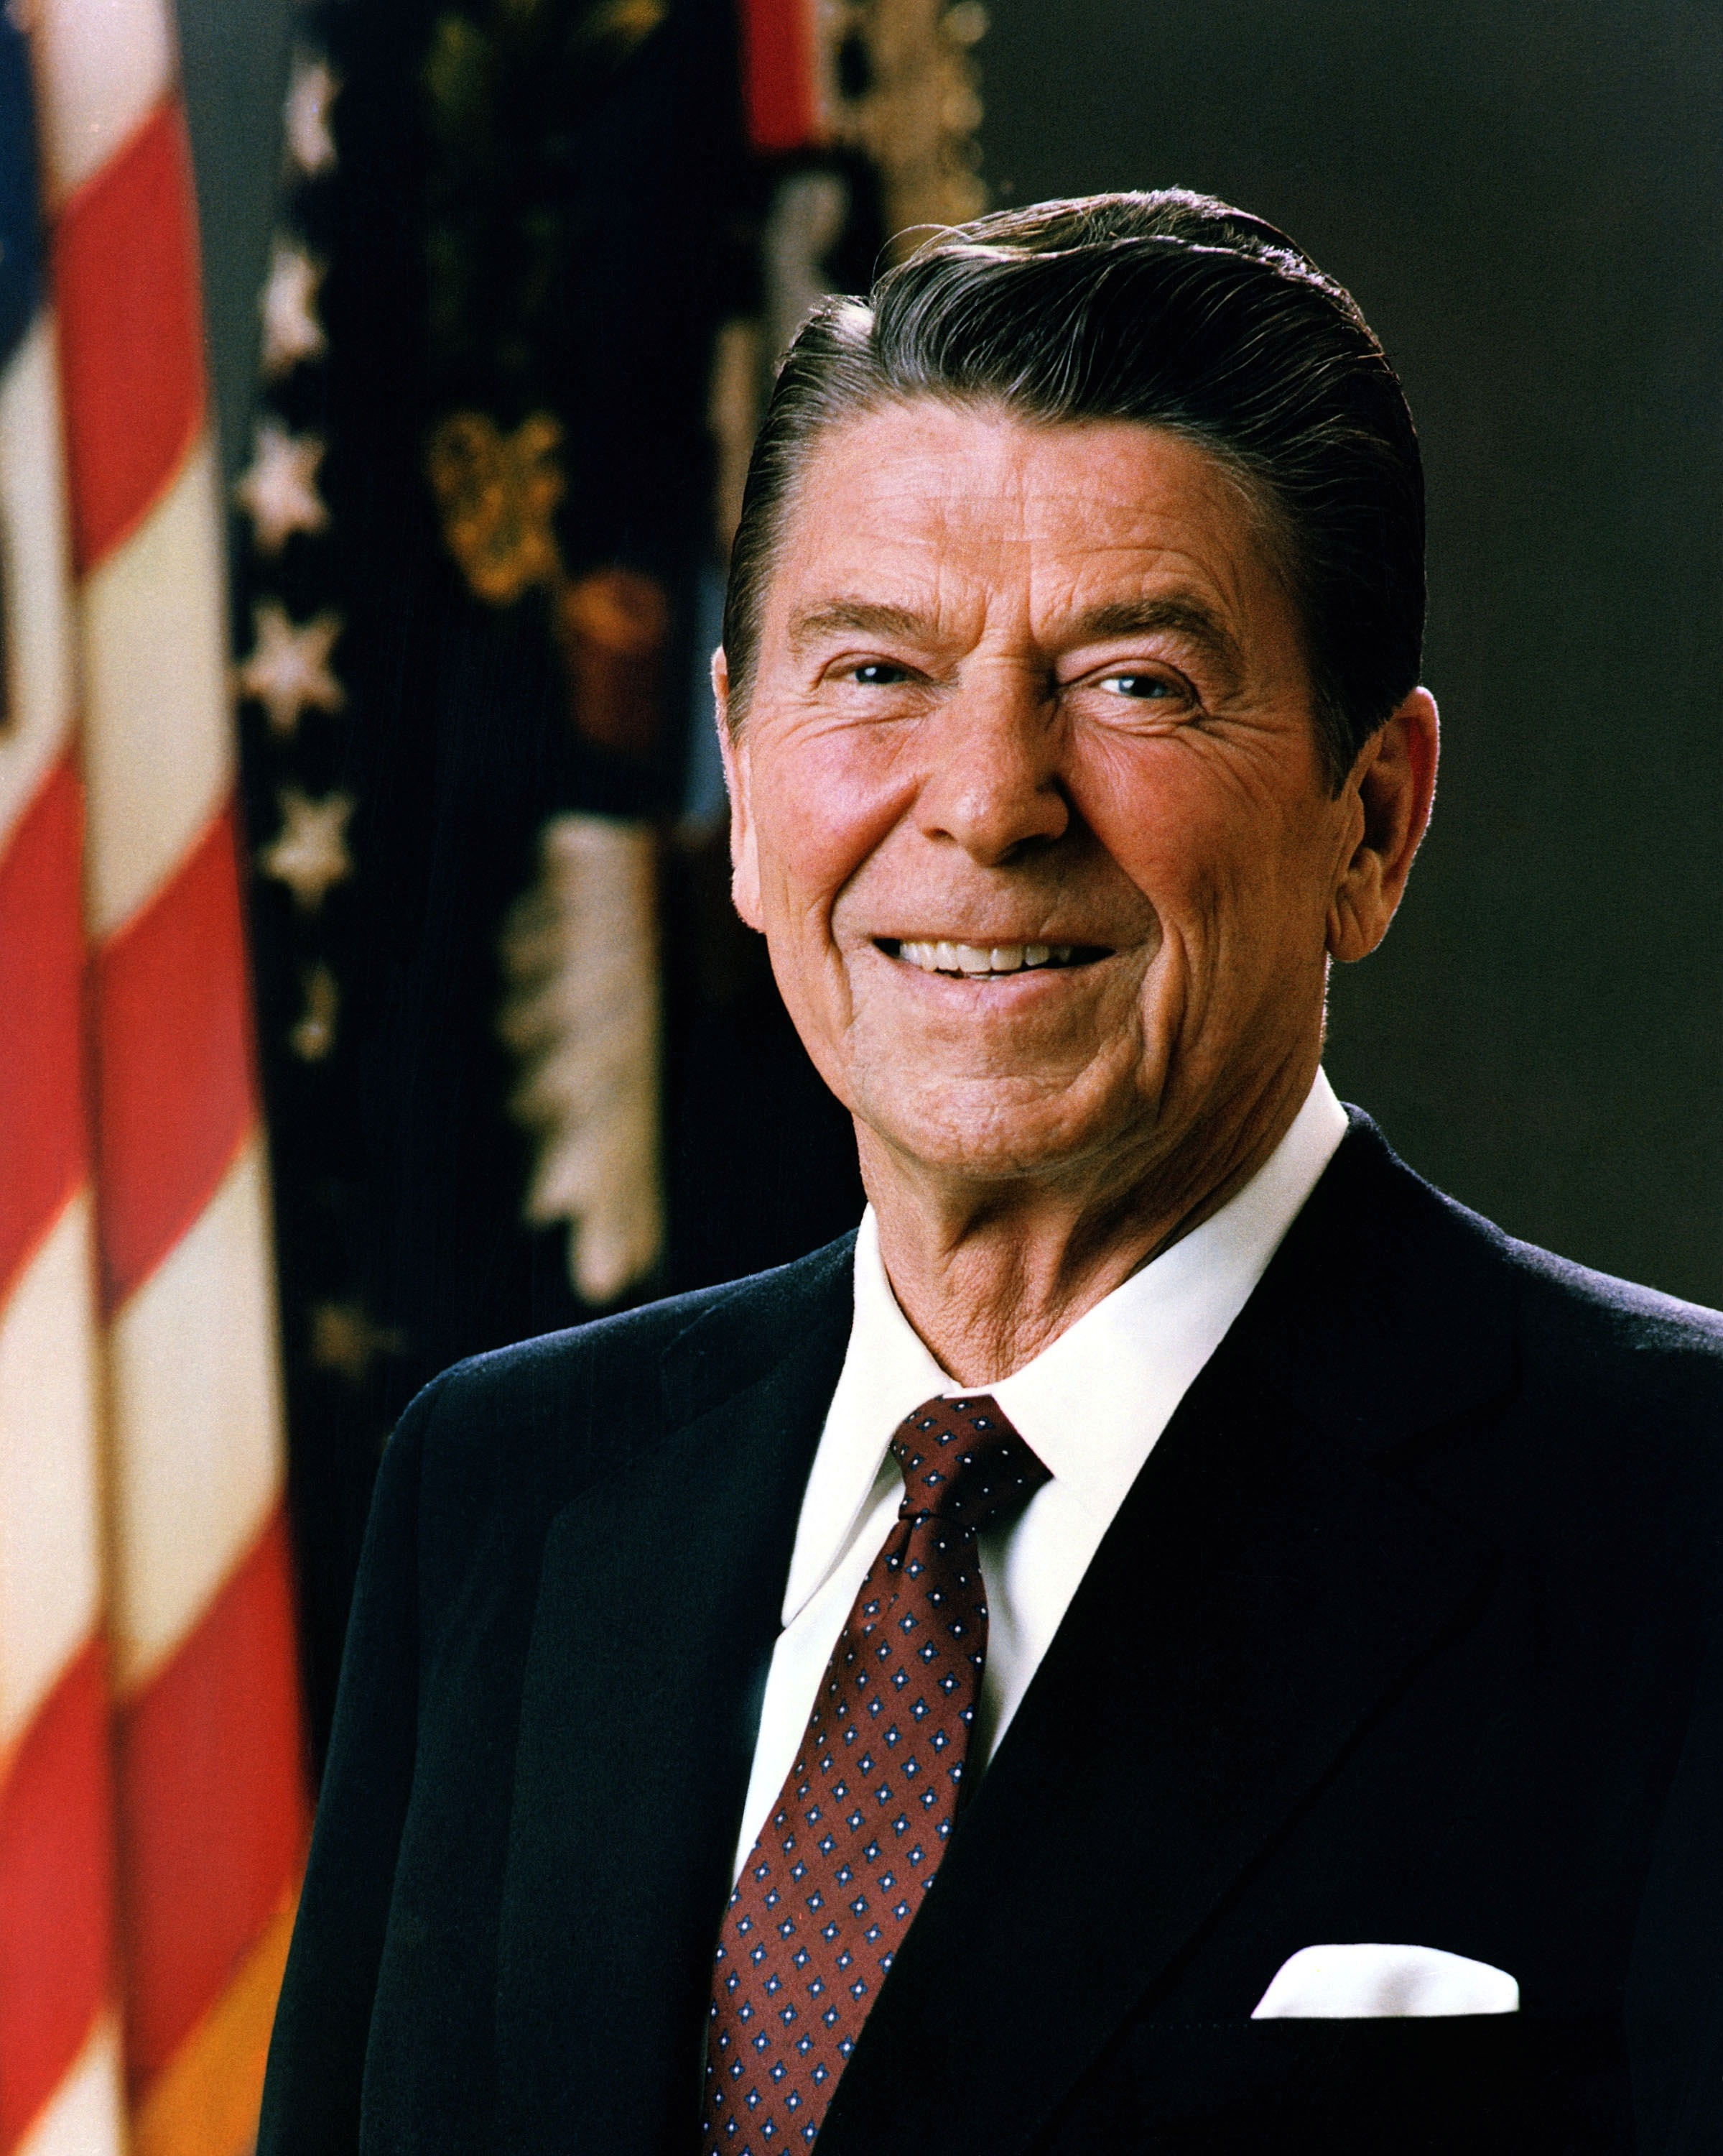
Things Change.
Adaptability and Flexibility are Important.

Slide 13
It’s About Service—Advice to Young Neurosurgeons
Volunteer if you
Are Dedicated to Advancing Neurosurgery
Have Energy and Time to Offer
Can Execute and Follow-Through
Don’t volunteer to
Get Ahead
Make a Name for Yourself
Earn Frequent Flyer miles

Slide 14
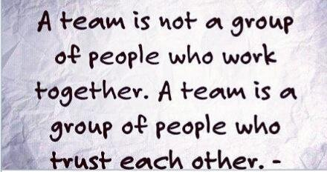
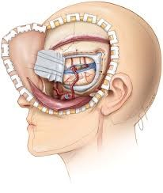
TRUST
TRUST is an essential component of
organizational relationships
just as it is in
developing the next generation of neurosurgeons

Slide 15
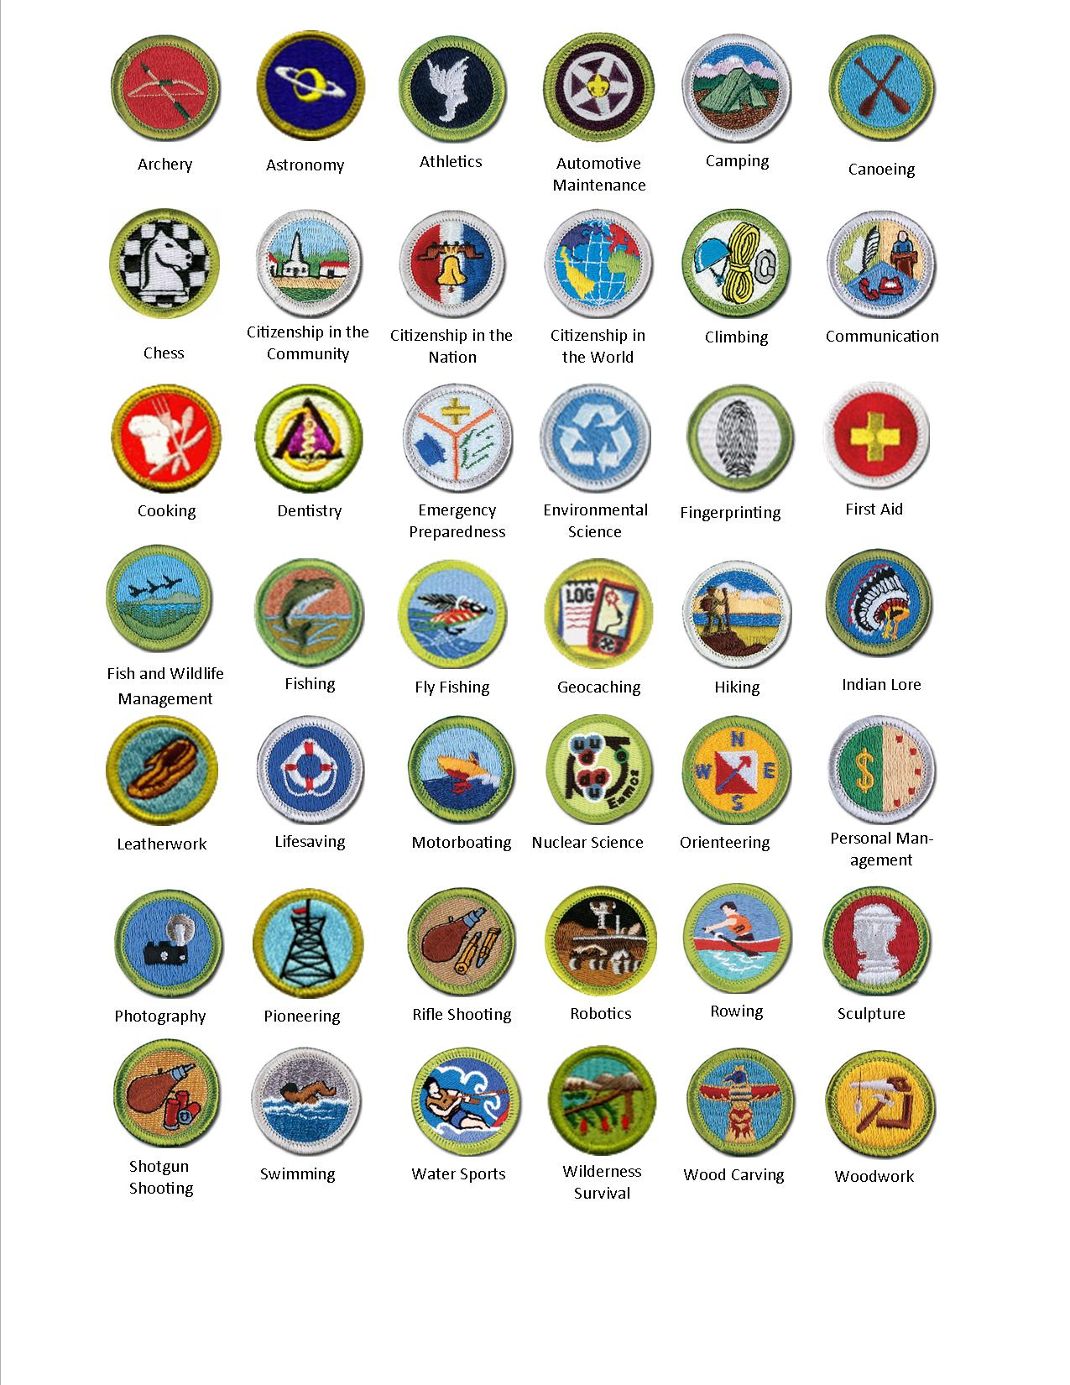
Organized Neurosurgery is a Meritocracy
Sponsorship is critically important, but…
The person has to show up and do the work.
Not This
Or This
Or This
Seeker
This

Slide 16
In other words…

Slide 17
Leadership in the Community and Government
3
Good Citizenship

Slide 18
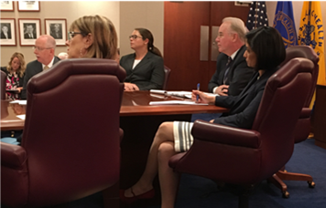
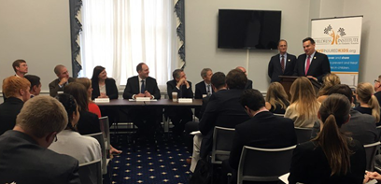
Leadership in the Community and Government
Voluntary help to advise leaders in areas of expertise is invaluable
Simultaneous Skills Acquisition
Perspective Setting and Contextualization
Articulating Shared Cultures vs. Competing Needs
Governmental and Regulatory Procedures
“Politics”

Slide 19
Feel compelled to be part of setting the agenda?
Exciting new transitions
Run for office.
…etc.

Slide 20
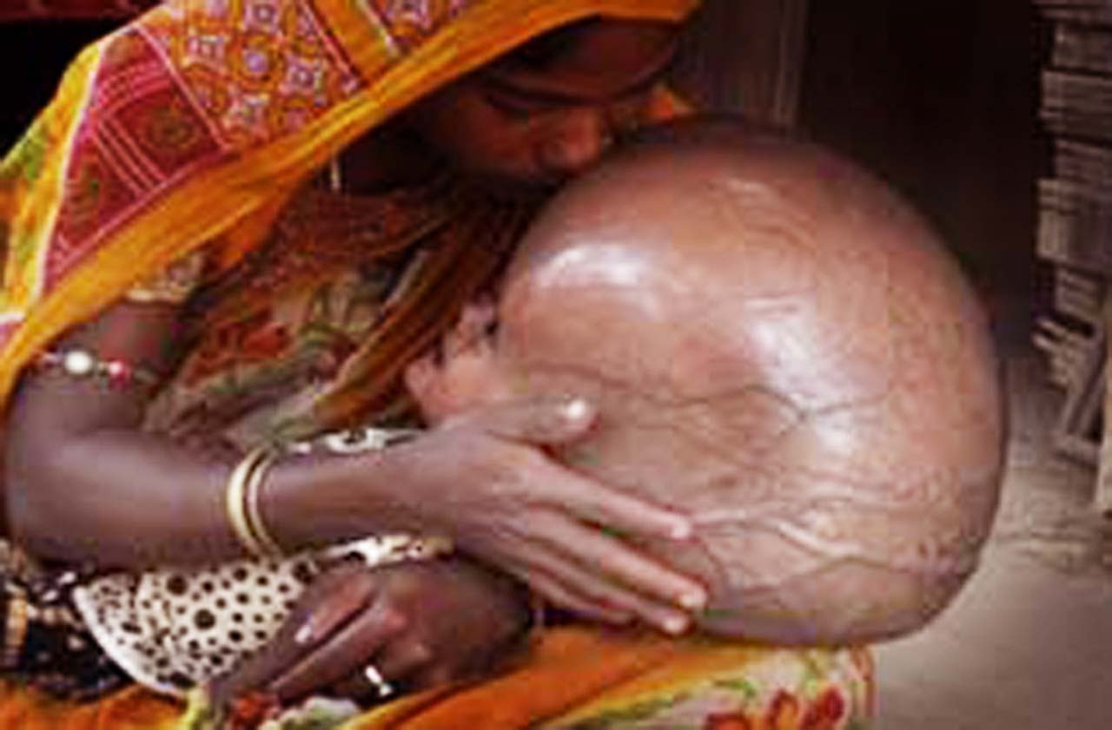
Collaboration
Regulatory Agencies
Expert Panels
Grant Reviews
Advisory Committees
Foundation and Charities
Mission Work
It’s about
team work,
developing future problem-solvers,
and volunteering.

Slide 21
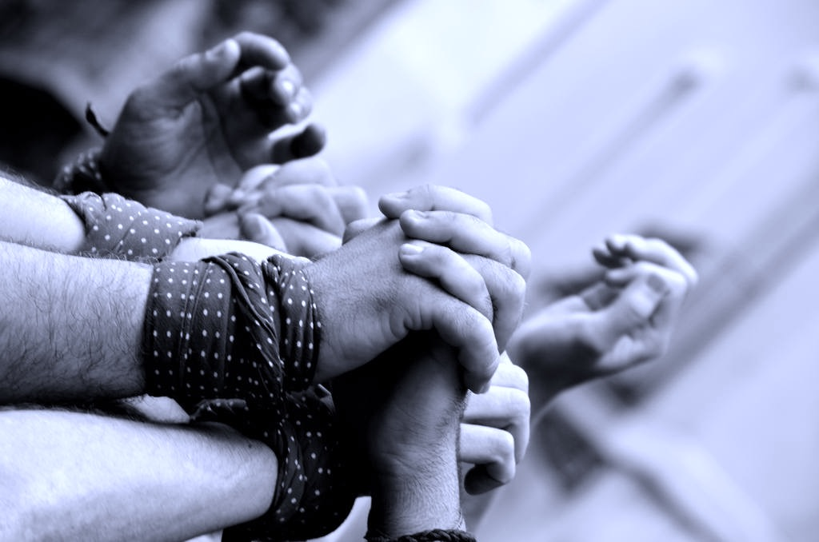
Service which is rendered without joy helps neither the servant nor the served. But all other pleasures and possessions pale into nothingness before service which is rendered in a spirit of joy.
Mahatma Gandhi

Slide 22
Thank You!
What’s Your Message?

