Slide 1
One Neurosurgery SNS Summit
Integration & Coordination of Leadership & Resources

Slide 2
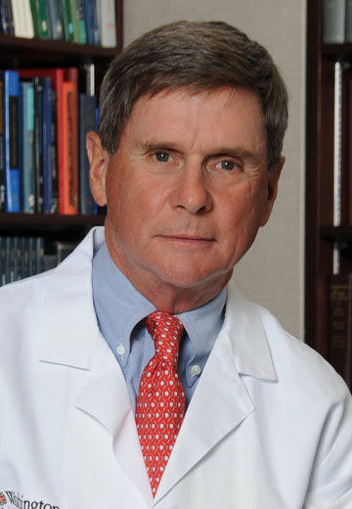
One Neurosurgery SNS Summit
Notes:
About 6 years ago, Past –President Ralph Dacey led an effort to develop a strategic plan which informed the priorities and decisions of the SNS leadership over the next 5 years. In retrospect, the Society followed that plan remarkable well and accomplished most of the priorities and goals established by Dr. Dacey’s plan. Among those goals was the One Neurosurgery Summit.

Slide 3
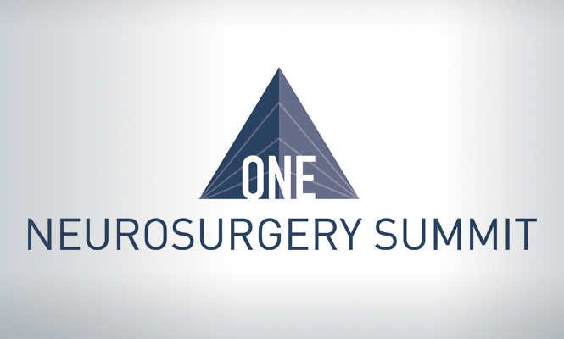
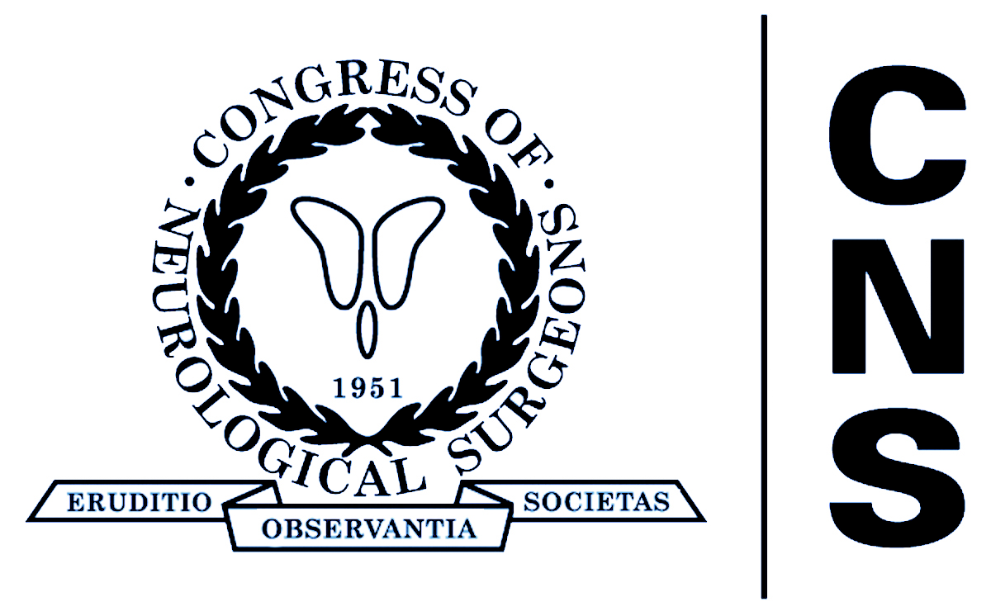
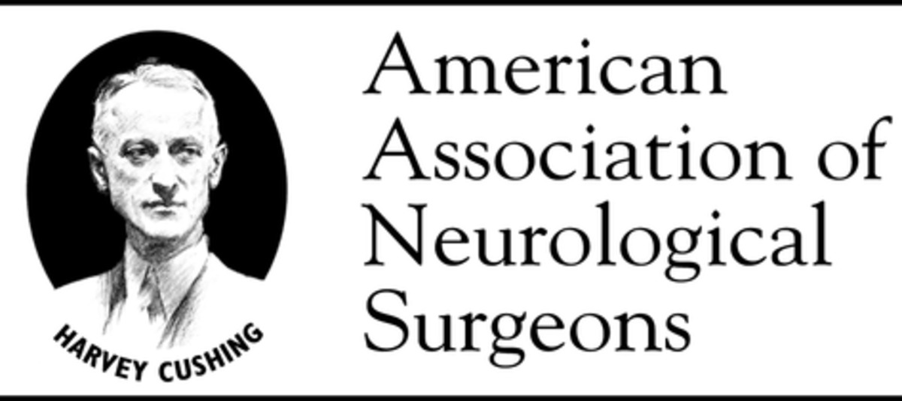
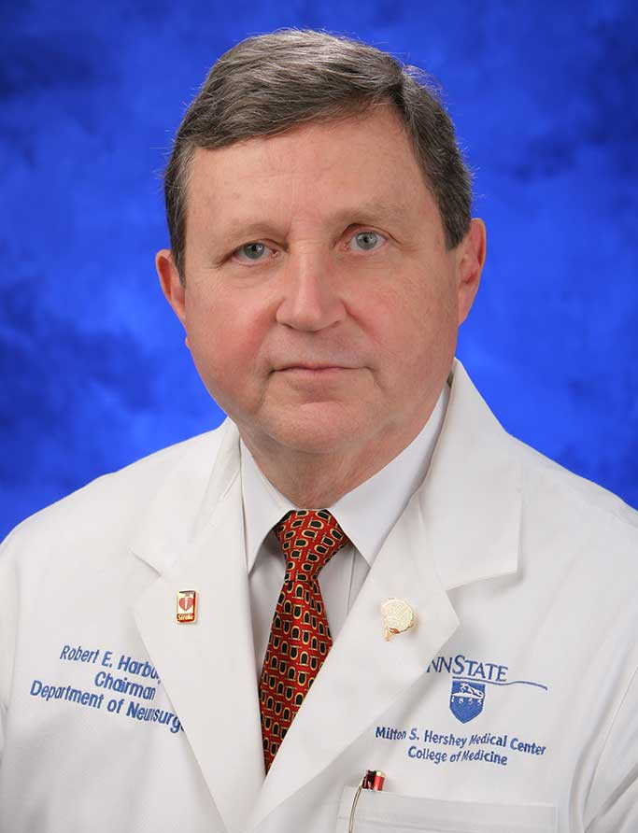
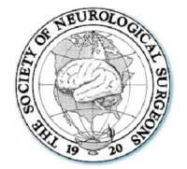
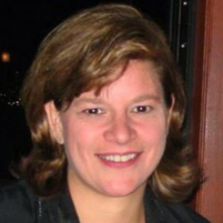
Notes:
Bob Harbaugh established the One Neurosurgery Summit in his SNS Presidential Address. Although neurosurgery is a small specialty, it is blessed with many organizations that bring unique perspectives, talents and resources to the table. The effective collaboration of these organizations is essential in making sure that neurosurgery continues to lead American medicine in patient care, education, research and public service. (*) One Neurosurgery — the seamless collaboration of the AANS, ABNS, CNS, RRC, SNS, Academy, and the Washington Committee to advance the specialty of neurosurgery — is the key to our continued success.

Slide 4
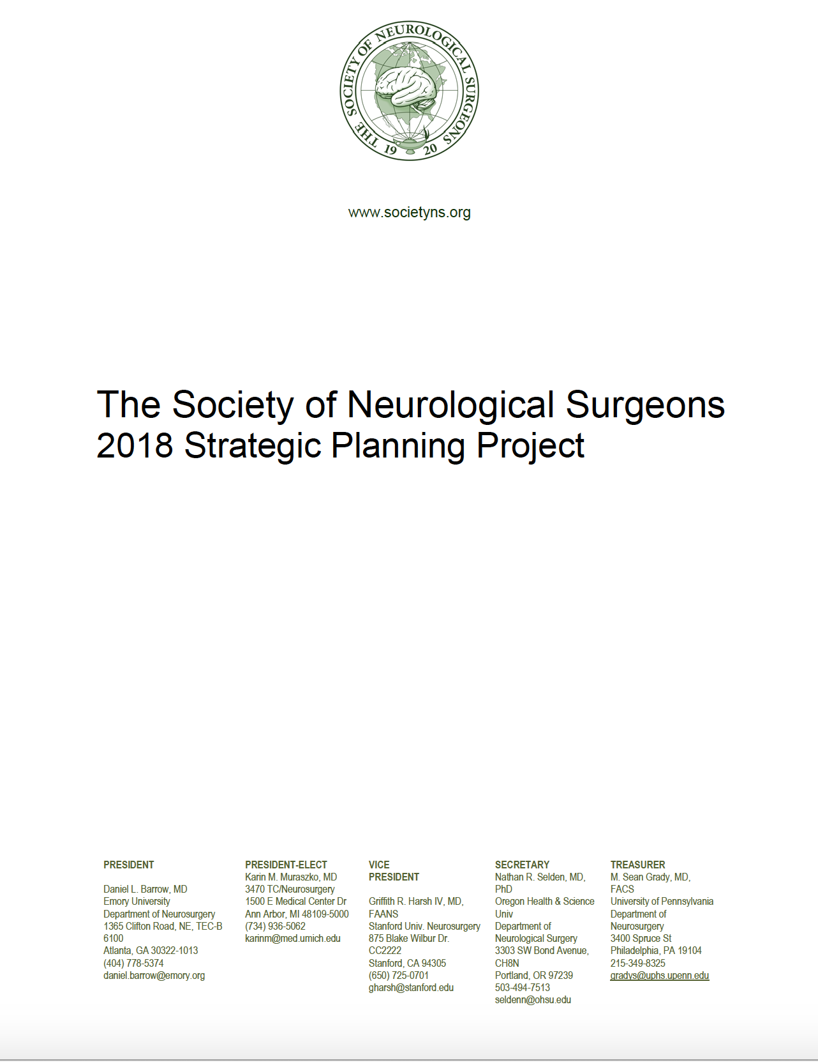
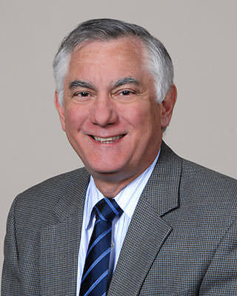
2018 Strategic Plan
Nick Barbaro
Mike Heaton
Notes:
This past year the Society engages in a new strategic planning effort which was led by Past-President, Nick Barbaro and Mike Heaton, partner in Katz, Sapper & Miller's Healthcare Resources Group, who has served as our consultant.

Slide 5
Notes:
All stakeholders that interact with the Society were engaged in the process with the opportunity to provide input into the strategic plan and all provided thoughtful responses to our request to help define the role of the Society in the world of organized neurosurgery.

Slide 6
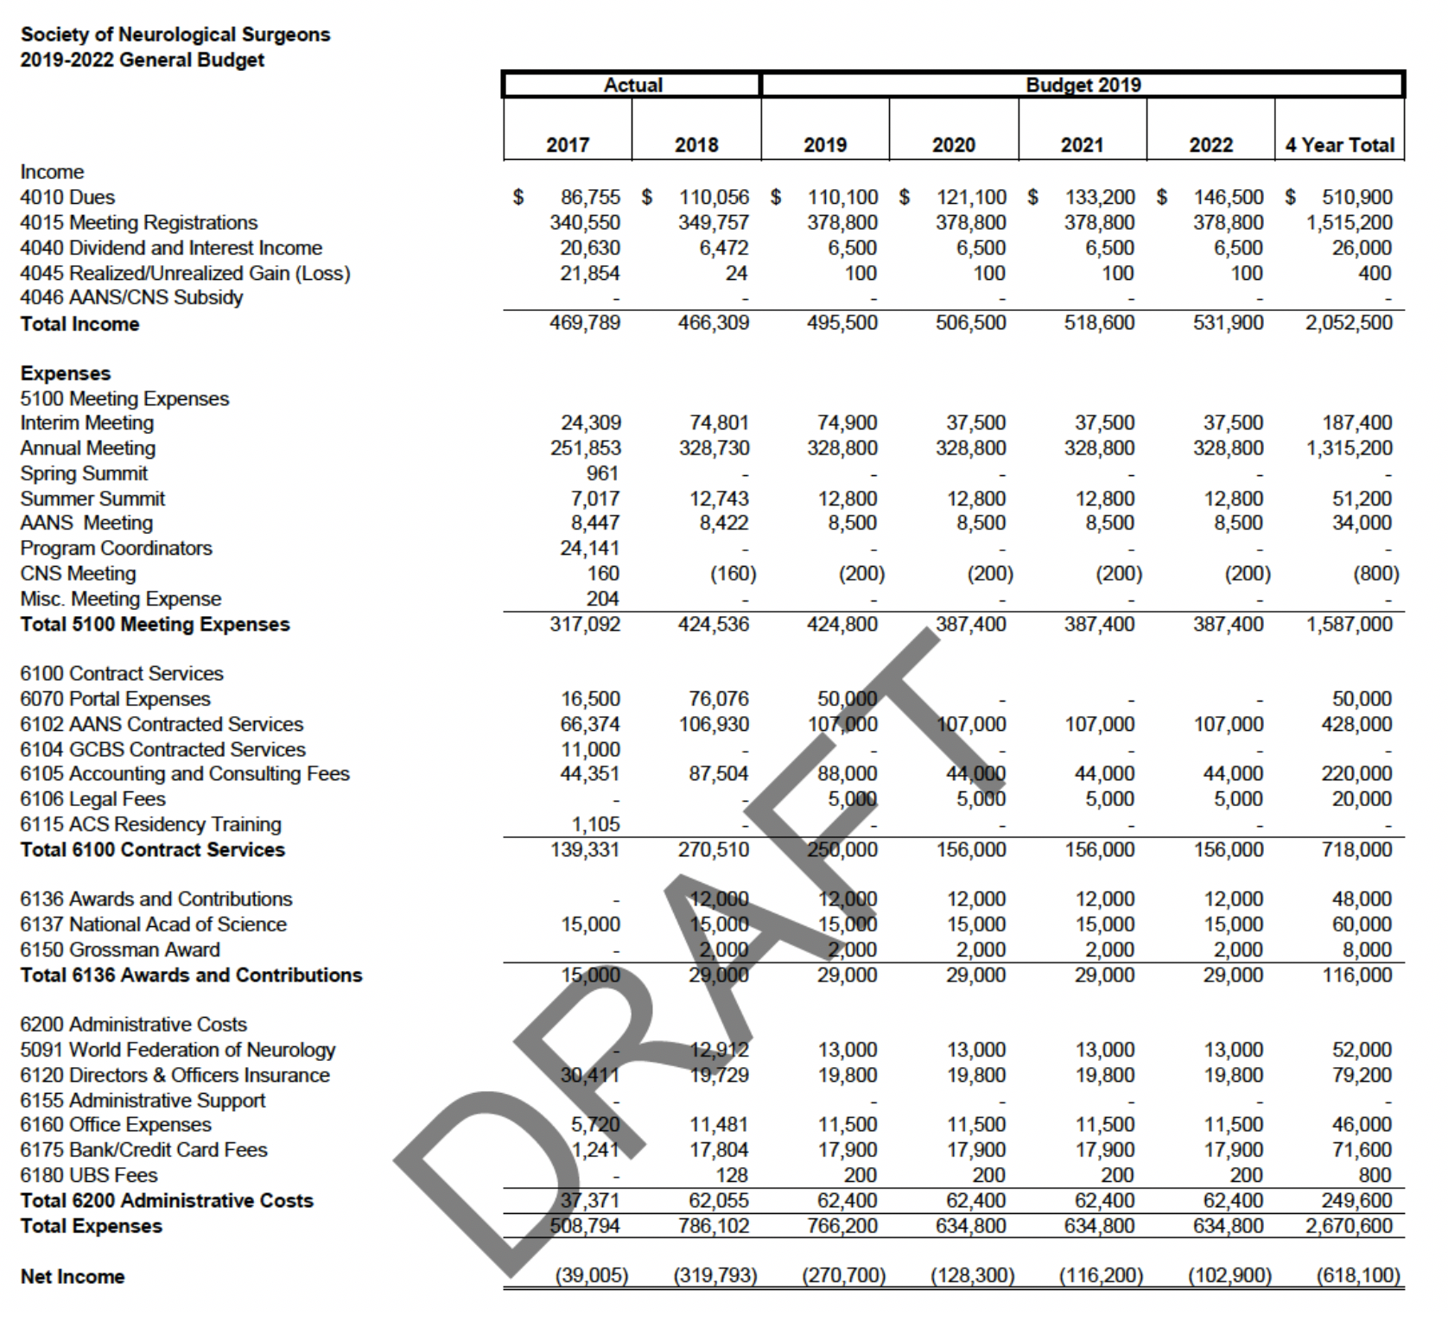
SNS Budget
Not strategic
Minimal sources of revenue
Increasing products requiring capitol investment
Notes:
The SNS can depend on about $200,000/year in revenue

Slide 7
The Society of Neurological Surgeons
The American society of leaders in neurosurgical residency education, and the oldest neurosurgical society in the world. Academic department chairman, residency program directors, and other key individuals comprise the active membership of the Society.
The purpose of the Society in carrying on the traditions of the founding members will be:
The continuing development of the field of neurological surgery including graduate and post-graduate education.
To encourage and support research in neurosciences.
to coordinate with other key organizations in Neurological Surgery that are involved in resident education. These organizations include the American Board of Neurological Surgery (ABNS), the Residency Review Committee (RRC) for Neurological Surgery, the American Association of Neurological Surgeons (AANS), and the Congress of Neurological Surgeons (CNS). In its role as the program directors' society for Neurological Surgery, the SNS plays a pivotal role in determining the content and format of residency education with regard to curriculum requirements and program design.
To help set the agendas for undergraduate education preparatory to neurosurgical residency, and for both basic and clinical neurosurgical research.
Notes:
The Society of Neurological Surgeons is the oldest neurosurgical society in the world and its mission is almost exclusively focused on education, and in particular, the education of trainees- medical students, residents and fellows.

Slide 8
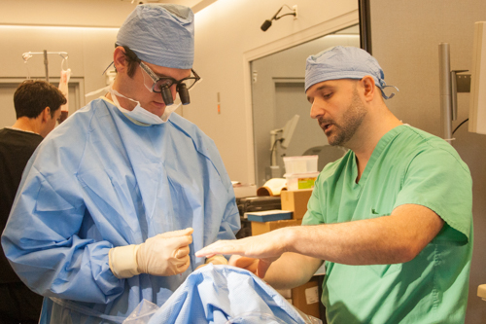
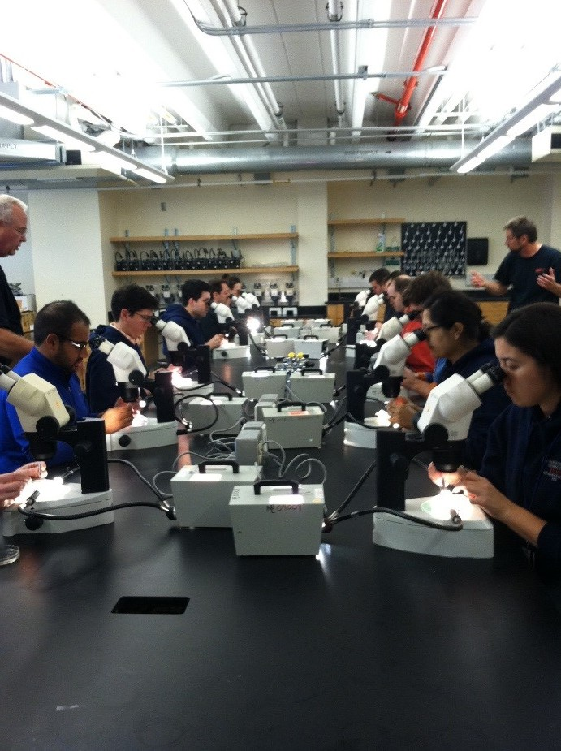
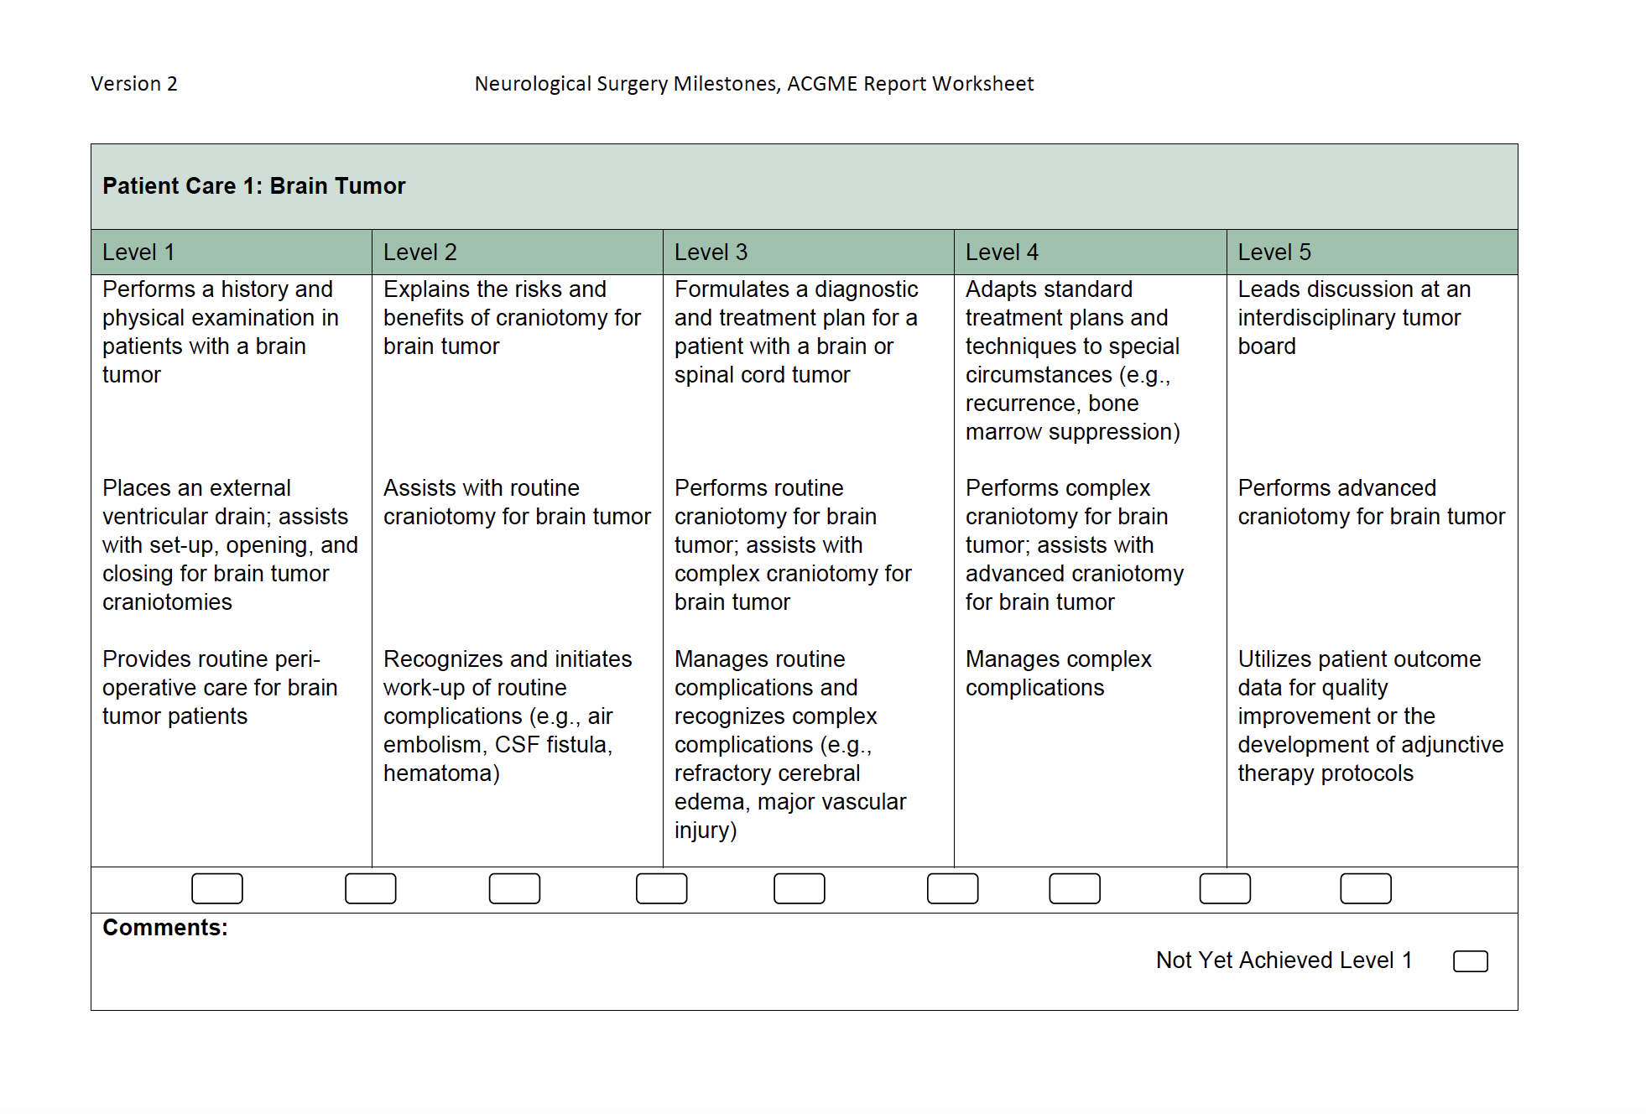
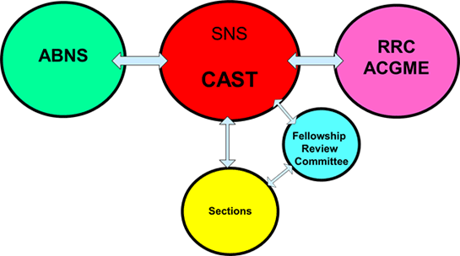
SNS Educational Products
Bootcamps
RUNN Course
Milestones
Matrix Curriculum
CAST
Neurosurgery Portal
One Neurosurgery Summit

Slide 9
SNS Options
Produce profitable products
Seek corporate support
Become a wholly-owned subsidiary
Change the mission-annual meeting only
Take on the responsibility of some of the educational mission of the AANS and/or CNS

Slide 10
AANS & CNS Missions
Education
Research
Spokesperson
Advocacy
Policy-Making
Socioeconomics
Lobbying

Slide 11
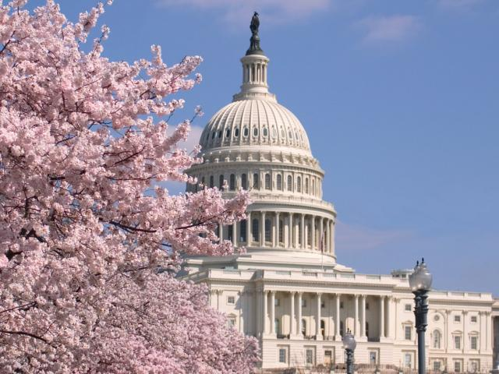
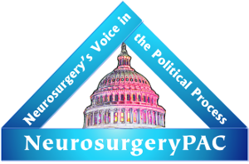
AANS & CNS Outsourcing
Washington Committee
Neurosurgery PAC
Notes:
These missions are not outsourced outside our specialty, but to members of the AANS and CNS who volunteer to complete those tasks more efficiently, more effectively, and more economically.
The Neurosurgery PACS allows us to lobby for legislation favorable to our patients and specialty yet maintain the 501c3 status of the AANS.

Slide 12
Benefits
SNS lives behind a firewall against industry
AANS and CNS have substantial retained earnings that should be put to good use
Avoids duplication of effort in one of our most sacred missions
Forces us to speak with one voice in education
Takes advantage of a unique Society

Slide 13
Proposal
Partner with the ABNS to reduce expenses and increase collaboration on CAST
CNS has offered to re-frame their strategic plan to support SNS mission
AANS Strongly supports SNS mission

Slide 14
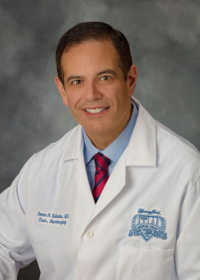
Steve Kalkanis

Slide 15
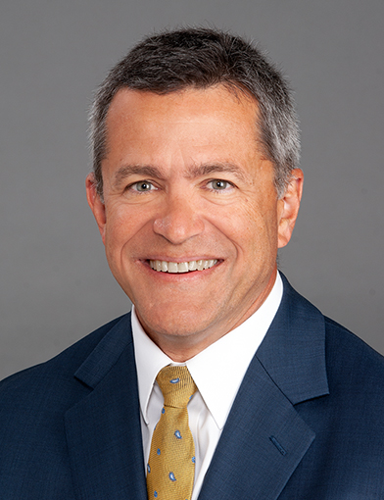
John Wilson

Slide 16
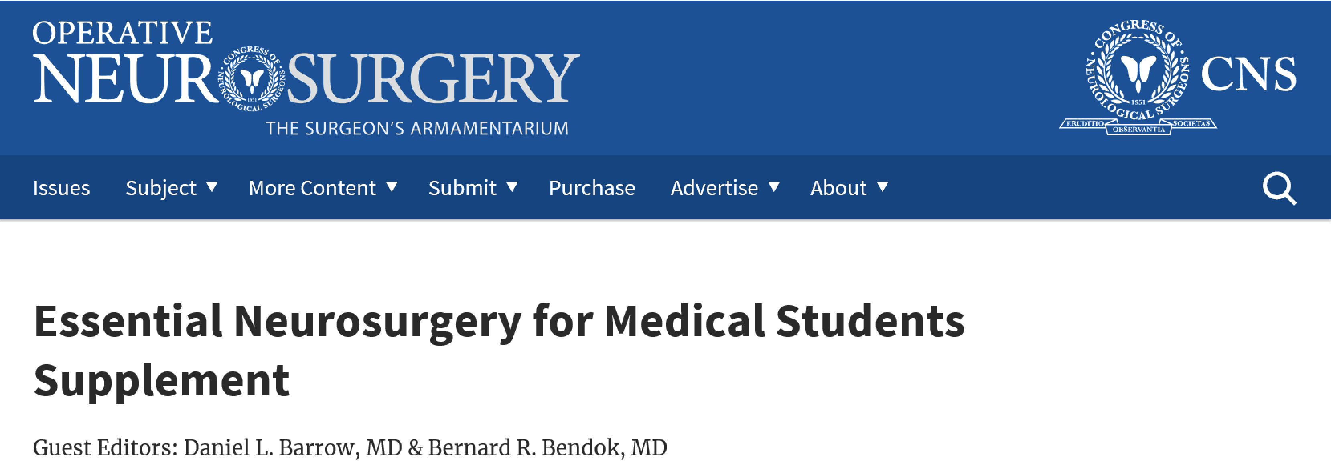
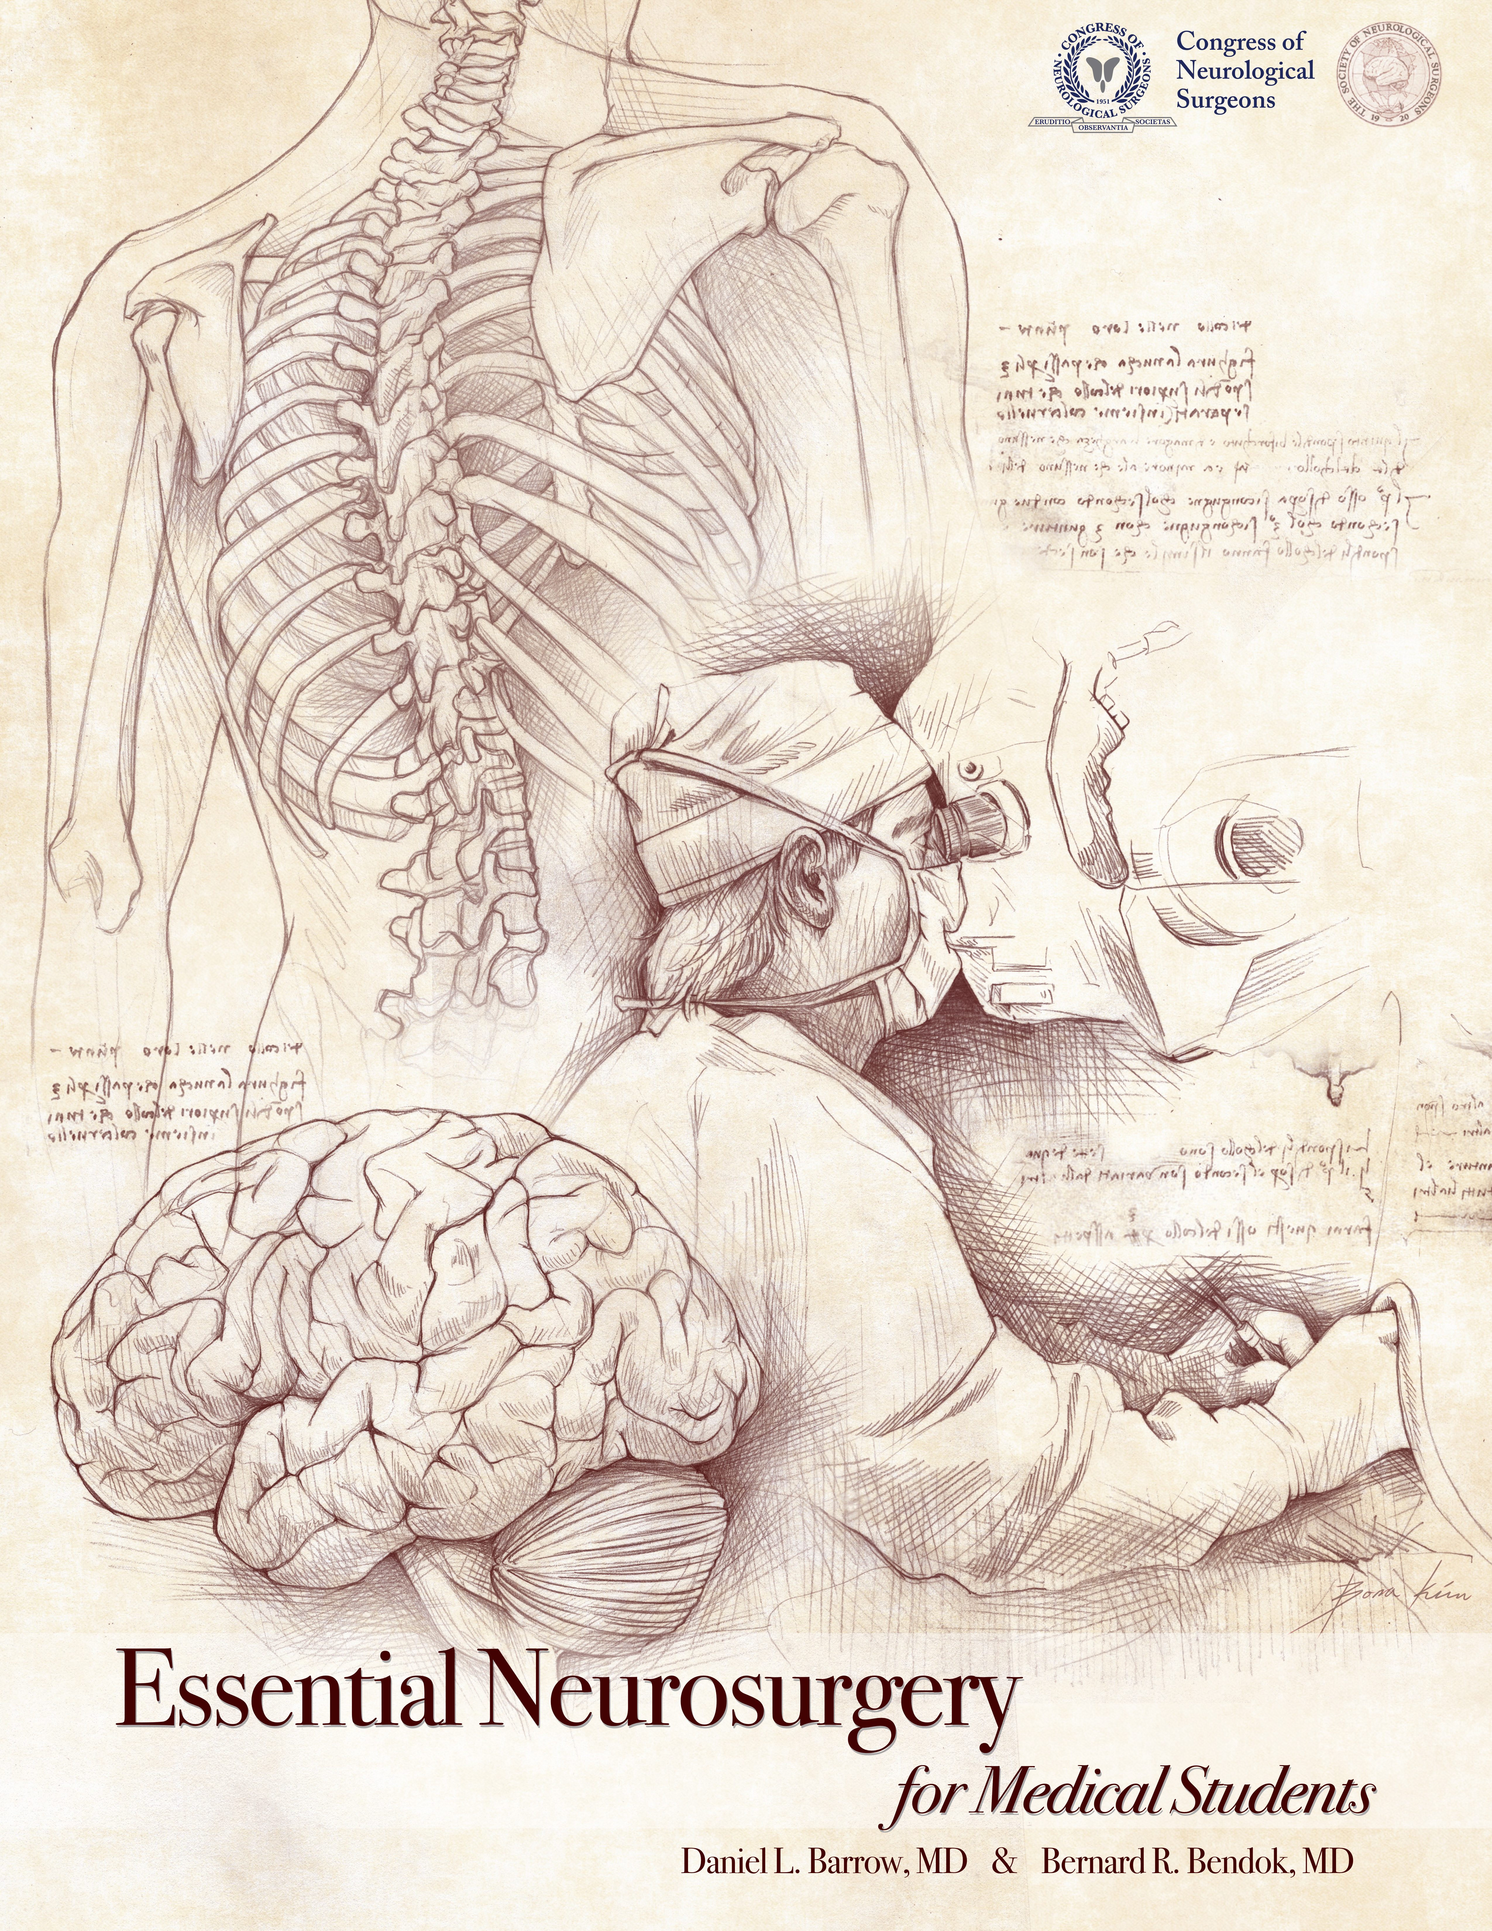
Notes:
I’m very proud to announce one of the most recent educational products of the Society.

Slide 17
END

