Slide 1
CAST SNS – Hershey PA 2018
Arthur L Day MD
Steven Giannotta MD
Charles Branch MD

Slide 2
CAST as of April 2018 AANS Meeting
Current CAST Members (3 yr term, renewable x 1 – total 6 yrs)
Cormac Maher 2017 pediatrics Charles Branch 2011 spine
Antonio E. Chiocca 2011 tumor
Arthur L. Day (Chair) 2013 CV
Steven Giannotta (Secretary) 2008 CV
Shelly Timmons 2014 trauma/NCC
Doug Kondziolka 2016 functional
ABNS ad hoc – Kevin Cockroft 2018 Ex-Officio ABNS Secretary – Carl Heilman 2018 Ex-Officio
RRC - Griff Harsh 2017 Ex-Officio

Slide 3
CAST Program Accreditations (AANS April 2018)

Slide 4
CAST: Program Accreditations (AANS April 2018)
Programs Approved: Previously April 2018 TOTAL
a. Cerebrovascular 9 0 9
b. Endovascular 27 5 32
c. Neuro Critical Care 21 2 23
d. Neurological Oncology 12 1 13
e. Peripheral Nerve 4 2 6 f. Pediatric 28 0 28
g. Stereotactic/Functional 23 1 24
h. Spine 39 1 40
TOTAL 175

Slide 5
basic CAST fellowship structure
oversight body
affiliations
ACGME-accredited
neurosurgery training program affiliation
ACGME
CAST accredited fellowship
- neurosurgery +/- other specialties
- infolded, post-graduate, FMGs
Sections
- ECs
- CAST representative
- FRCs
SNS via CAST
CAST diploma
recognizes successful completion
of subspecialty fellowship training

Slide 6
CAST subspecialty fellowships: accreditation and certification
_{FRC selection criteria/duties:}
three (3) members active in Section (and _{SNS)}
- potential candidates for CAST committee
_{- 3 yr appointment/1 renewal}
_{Responsibilities:}
- update Program Requirements for each subspecialty variation including duration, timing of training, enfolded, etc
- define subspecialty–specific institutional/individual case requirements
_{(forms 2 and 3)}
_{- milestone revisions}
_{SNS}
_{CAST}
_{CAST}
_{Sections}
_{FRCs}
_{Fellowship}
_{Review}
_{Committee}
_{Sections}

Slide 7
CAST fellowship accreditation: data/form requirements
Form A: application form – entered via SNS website
updated, portions transferred to ACGME (ADS)/NREF annually
Form 1: institutional case report – general
all cases done by sponsoring institution residency training program
Form 2: institutional case report – subspecialty
all pertinent subspecialty cases done by sponsoring institution residency training program
Form 3: individual case report form – training
validates the experience of the individual during the fellowship
updated, transferred to ACGME annually

Slide 8
CAST Timeline/milestones - new fellowship guidelines/forms
April 2018 AANS Discuss new guideline/Forms A,1,2,3 (& form 4 for NES, NCC), CAST Section representative, FRCs with each Section**
May 2018 SNS send official CAST request to Section FRCs for form 2 and 3, revised guidelines (including enfolded specifications, definition of “senior” resident).
Sept 15, 2018 Section FRCs new guidelines, Forms 2,3 due
Oct 2018 CNS 1st round of edits/reviews of guidelines/forms presented/discussed by CAST subspecialty member
Jan 1, 2019 Final Forms/Guidelines sent to Sections leaders/FRC for final review/edit
Mar 15, 2019 Final documents submitted to CAST.
April 2019 AANS Discussion/approval of final guidelines/Forms
May 2019 SNS Revised Guidelines and Forms completed/presented to SNS EC
July 1, 2019 New guidelines/forms enforced for all new applications and renewals
includes Forms A, 1-3 for everyone, plus Form 4 for NES/NCC.
All programs submit form A and 3 annually.
Fellow receives CAST fellowship completion certificate after Form 3 received (except NCC/NES)
**Peds use ACPNF equivalent forms

Slide 9
_{CAST contract with ACGME}
_{(revised)}
CAST will share data with the ACGME on a regular basis:
1. list of all CAST accredited programs for each institution
2. Form 3: graduate trainee reports
3) Integration into ADS system
Pam Derstine will come to the CAST meetings. Information to be transmitted from the ACGME could include previous citations of that residency training program as they relate to the fellowship under consideration for accreditation, especially in relation to conflict with other learners, as well as any inadequacy of specific index cases to maintain the good standing of the residency.
_{ACGME “recognition” – pending}
no forthcoming bills from the ACGME to participating fellowships
CAST - ACGME interactions
data sharing
RRC linkage
billing

Slide 10
CAST Program Accreditations: NES (AANS April 2018)
64
2023

Slide 11
CAST Program Accreditations: NCC (AANS April 2018)
45
2023

Slide 12
CAST Individual Certifications: NES
(AANS April 2018)
candidate subspecialty approved April 2018 subtotal previously
a. Neurosurgeons 63 14 77
b. Neurologists 41 5 46
c. Radiologists 43 11 54
TOTALS 147 30 177
300
2023

Slide 13
CAST Individual Certifications: NCC
(AANS April 2018)
candidate subspecialty approved: April subtotal
previously 2018
a. Neurosurgeons 39 2 41
b. Neurologists 39 5 44
c. Pulmonologist 19 19 d. Anesthesiologist 13 13
e. Neurointensivist – EmerMed 5 3 8
f. Pediatrician 1 1
TOTAL 116 10 126
200
2023

Slide 14
NESAC Membership
Neurosurgery JSCVS - Joint Section, Cerebrovascular Surgery (AANS/CNS)
Name | Institution | Term Start | Term End
Brian Hoh, MD** | University of Florida-Gainesville | 2015 | 2020
Adnan Siddiqui, MD | SUNY Buffalo | 2015 | 2019
Howard Riina, MD | New York University | 2015 | 2018
Neurology SVIN – Society of Vascular and Interventional Neurology
Name | Institution | Term Start | Term End
Tudor Jovin, MD** | University of Pittsburgh | 2015 | 2020
Sam Zaidat, MD | Medical College of Wisconsin | 2015 | 2019
Italo Linfante, MD | Miami, FL | 2015 | 2018
Radiology SNIS – Society of Neurointerventional Surgery
** denotes signing member of NESAC formation document, finalized Jan 2015
Name | Institution | Term Start | Term End
Philip Meyers, MD** | Columbia University | 2015 | 2020
Colin Derdeyn, MD | Washington University at St. Louis | 2015 | 2019
Aquilla Turk, MD | Medical University of South Carolina | 2015 | 2018

Slide 15
NCC/NT FRC Membership
NeuroCritical Care/NeuroTrauma
Name | Institution | Start Date | Term End
Shelly D. Timmons, MD | Penn State Hershey/Neurosurgery | Original
Robert E. Harbaugh, MD | Penn State Hershey/Neurosurgery | Original
Alex B. Valadka, MD | Virginia Commonwealth University | Original
Richard Rodgers, MD | Indiana University | New
Thomas Bleck , MD | Rush University Medical Center | New
Jaime Ullman, MD | Mount Sinai | New
Cheryl Chang – Advisor/Liaison | UCNS | New

Slide 16
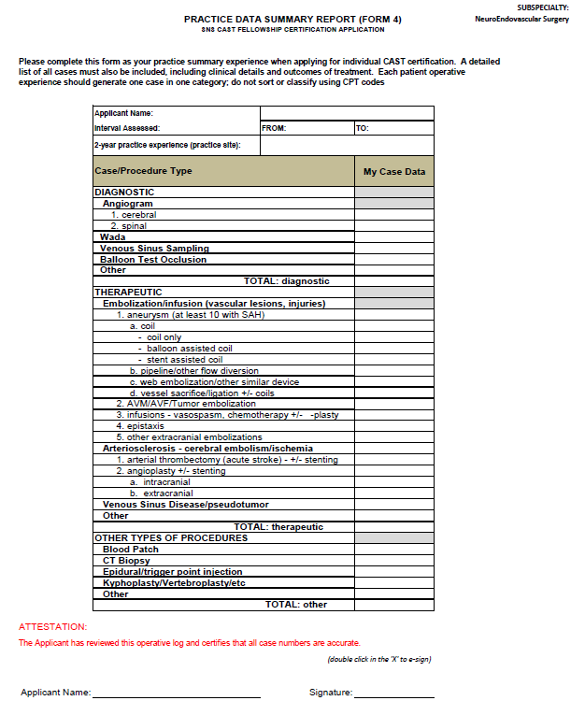
Form 4:
INDIVIDUAL
CASE REPORT
– PRACTICE EXPERIENCE
2 year case summary of all endovascular cases
done by practitioner after
completion of training
accompanied by detailed case log for review by NESAC
submitted as checklist requirement when applying
for CAST NES certification

Slide 17
CAST multi-disciplinary FRCs transition from individual “certification” to “focused practice”
Applicable only to NES and NCC
- pediatric neurosurgery has separate structure and processes
Establish mechanisms/processes for Joint Programs that are fair/uniform/standard among specialties and not liable to politically-motivated alterations or variances
Neurosurgery remains able to be its own determinant for the future (i.e. NCC)
- CAST remains the neurosurgical vehicle for maintaining that position

Slide 18
CAST multi-disciplinary FRCs transition from individual “certification” to “focused practice”
ABNS office interactions:
a. testing
b. reservoir for individual practice data
c. individual graduates of CAST-accredited training programs directed to ABNS for focused practice designation, including neurosurgeons and other specialties within those programs
d. transmits individual information to other ABMS specialty boards

Slide 19
oversight body
ACGME Residency
1. Neurosurgery (7 years)
2. Neurology (+ stroke/NCC fellowship
3. Radiology ((+ neuroradiology fellowship
NES
CAST fellowship
ACGME +/- other
organizations
CAST accredited
NES fellowship
CAST diploma
recognizes successful completion
of subspecialty fellowship training
SNS via CAST
ABMS directed
through ABNS
via NESAC 2
practice data
written exam
successful NESAC-2 candidate review
ABNS: data review/oral exam
focused practice recognition
ABNS board certification
ABPNS no data/oral exam
ABR: focused practice recognition
maintain continued 1º certification

