Slide 1
Developing a Clinical Trial:
Lessons Learned
Linda M. Liau, MD, PhD
Professor & Vice Chair of Academic Affairs
UCLA Department of Neurosurgery
Jonsson Comprehensive Cancer Center
David Geffen School of Medicine
Los Angeles, California

Slide 2
Disclosures
Research grants from:
  Northwest Biotherapeutics, Inc.

Slide 3
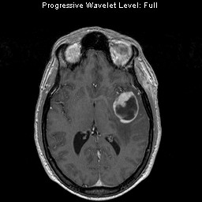
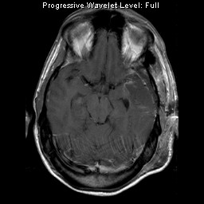
Define the Clinical Problem:
GBM always recurs despite standard therapy
Surgery
Radiation therapy
Chemotherapy
Immunotherapy

Slide 4

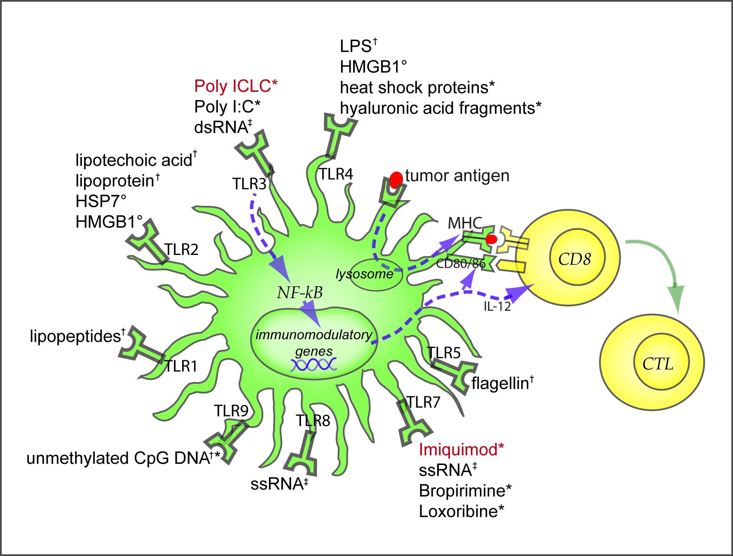
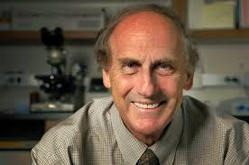
Get Ideas: Dendritic Cells (DC), master regulators of immunity
Ralph Steinman, M.D.
2011 Nobel Prize

Slide 5
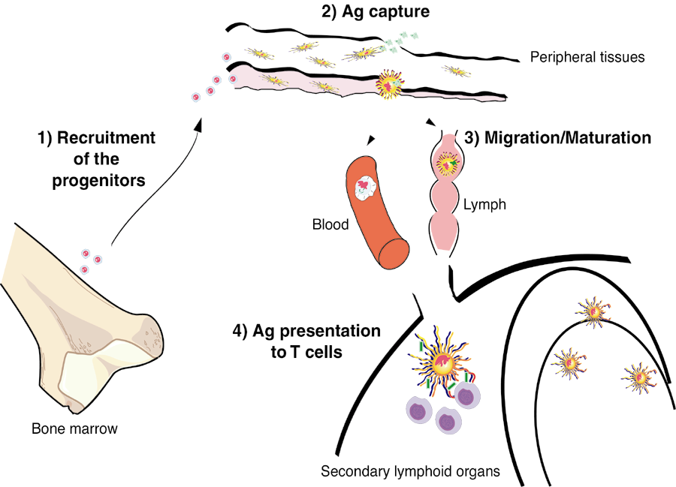
Dendritic Cells: “Professional” Antigen-presenting Cells (APC)
Liau LM et al., Brain Tumor Immunotherapy
(Humana Press, 2001)

Slide 6
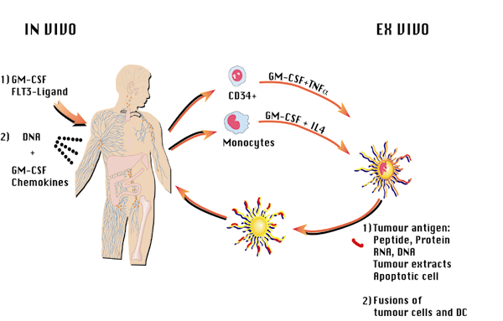
Develop Hypothesis: DC-based
Brain Tumor Vaccines
from Liau LM et al., Brain Tumor Immunotherapy
(Humana Press, 2001)

Slide 7

Get funding to test hypothesis:
K career development award
K-award application success rate (FY2000-FY2012)
 | All Applicants | Neurologists | Pediatric Neurologists | Neuro-surgeons | Other
K08 | 57% (254/443) | 65% (119/183) | 73% (30/41) | 49% (33/68) | 48% (72/51)
MD | 49% (87/178) | 55% (29/53) | 71% (10/14) | 41% (17/41) | 44% (31/70)
MD/PhD | 64% (163/254) | 69% (90/130) | 74% (20/27) | 59% (16/27) | 53% (37/70)
Other | 36% (4/11) |  |  |  | 36% (4/11)
K23 | 50% (170/340) | 52% (106/202) | 43% (12/28) | 60% (6/10) | 46% (46/100)
MD | 51% (118/232) | 53% (88/166) | 41% (9/22) | 63% (5/8) | 44% (16/36)
MD/PhD | 43% (25/58) | 50% (18/36) | 50% (3/6) | 50% (1/2) | 21% (3/14)
Other | 54% (27/50) |  |  |  | 54% (27/50)

Slide 8
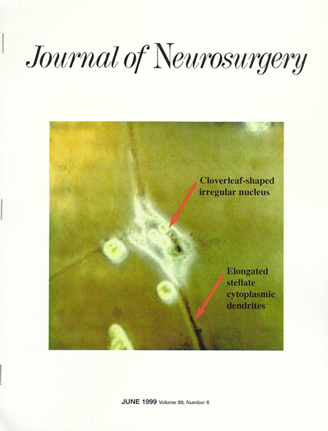
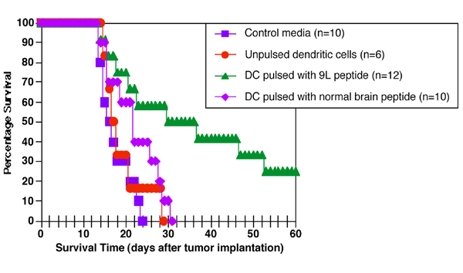
Test hypothesis in animal models: Treatment of intracranial gliomas with DCs + tumor antigens
Control
DC treated
CD8+ T cells
K08-CA82666
Liau LM et al, J Neurosurg, 1999

Slide 9
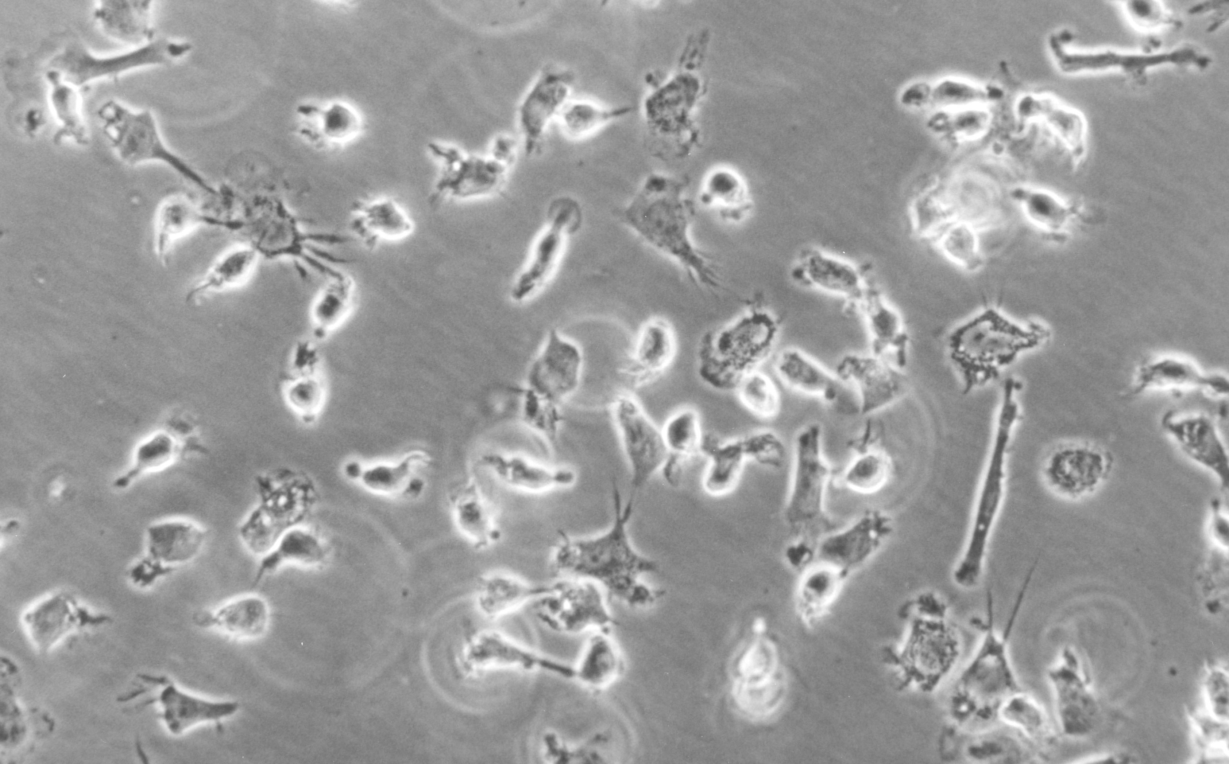
FDA IND #8434: Phase I Clinical Trial of DC Immunotherapy for Malignant Gliomas
Leukapheresis
(Day –7)
Monocyte
(DC precursor)
enrichment
DCs develop
in cell culture
3 bi-weekly
Injections
(Days
0, 14, 28) +
boosters
+ GM-CSF
+ IL-4
Antigens
(acid-eluted peptides,
synthetic tumor-associated antigens,
autologous tumor lysates)
Cultured
dendritic cells
R21-CA91545

Slide 10
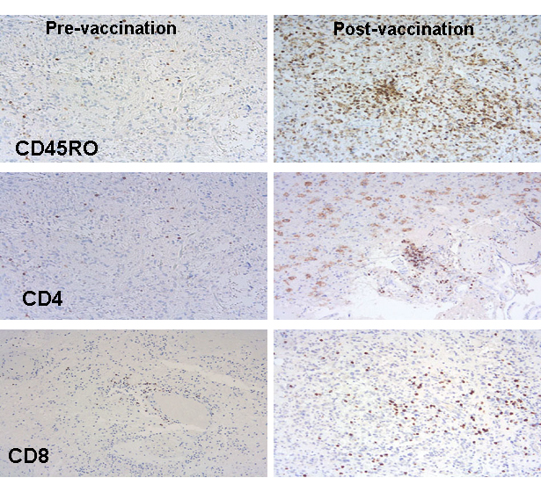
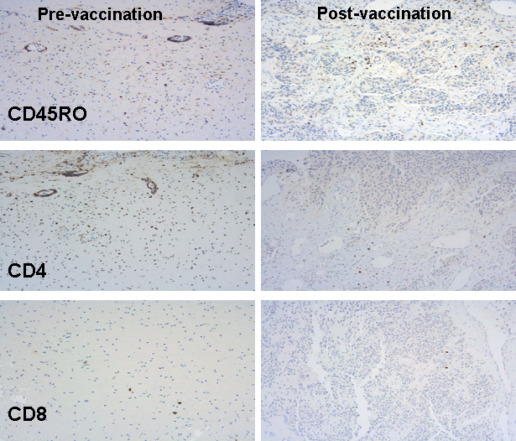
DC vaccination in glioblastoma patients induces systemic and intracranial T-cell responses modulated by the local CNS brain tumor microenvironment
Patient #1: OS = 30.2 mos
Patient #2: OS = 11.4 mos
Patient #12:
OS = 9.3 mos.
Patient #5:
OS > 120 mos.
Increased CD8⁺ T-cell infiltration
correlated with increased survival
Increased TGF-β expression
correlated with decreased survival
Liau LM et al., Clin Cancer Res, 2005.

Slide 11
FDA IND #11053: Phase I/II clinical trial of DC-tumor lysate vaccine
DAY
- 8 weeks
-7
0
10
20
28
q 2 mo.
+ adjuvant
Temodar
(5 days on/
23 days off)
Leuk-
apheresis
MRI
Surgery
DC injections
3 biweekly injections, then
1 booster injections q 2 mo in between TMZ cycles
Exam
XRT
+
Temodar
Immunologic
assays
R01-CA112358
R01-CA121131

Slide 12
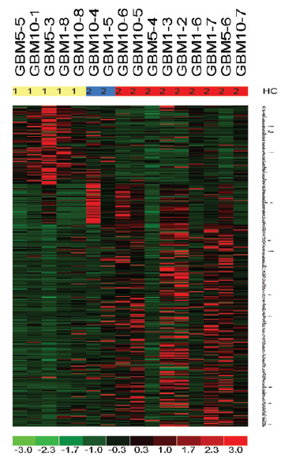
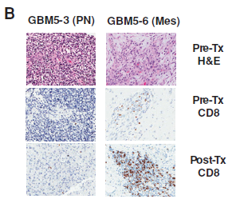
“Mesenchymal” gene expression signature associated with increased tumor-infiltrating lymphocytes
Prins RM et al., Clin Cancer Res, 2011

Slide 13
Phase I/II clinical trial of DC-tumor lysate vaccine:
Overall survival of patients from time of diagnosis
 | % alive at
Patient population | 1 year | 2 years | 3 years
DC vaccine treated (n=23) | 91 | 55 | 47
Institutional controls (n=119) | 69 (p<0.02) | 34 (p<0.05) | 21
Stupp et al. 2005 (n=287) | 61 | 26 (p<0.001) | 20
Mirimanoff et al. RPA III |  | 32
Mirimanoff et al. RPA IV |  | 19
Median survival = 31.4 mos.
31.4

Slide 14
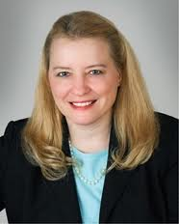

Collaboration with Industry:
Clinical Development of DCVax-L®
Linda Powers, CEO
Non-blinded,
randomized
Blinded, randomized,
controlled
Multi-center
Phase II
Trial
2007
Phase III
trial in GBM
2012—
Second Phase I/II trial in GBM at UCLA
2003-06¹
Phase II
trial in
GBM
2010-12
First Phase I trial in GBM at UCLA
2000-2002
1999 | 2000 | 01 | 02 | 03 | 04 | 05 | 06 | 07 | 08 | 09 | 10 | 11 | 12
FDA grants
first IND
Collaboration with
Northwest Biotherapeutics, Inc.
FDA approves
Phase III status

Slide 15
Phase III DCVax-L® Trial Design
Multi-center, double-blind, randomized, placebo controlled trial
311 newly diagnosed GBM patients, randomized 2:1 (treatment:placebo) with cross-over
DCVax-L adjuvant to standard of care (surgery, radiation, Temodar); injections interspersed with adjuvant Temodar
Centralized imaging review with reassessment of pseudo-progression
Primary endpoint: Progression-Free Survival
Secondary endpoints: Overall Survival, TTP, Immune Responses, Safety, Landmark analyses for survival

Slide 16
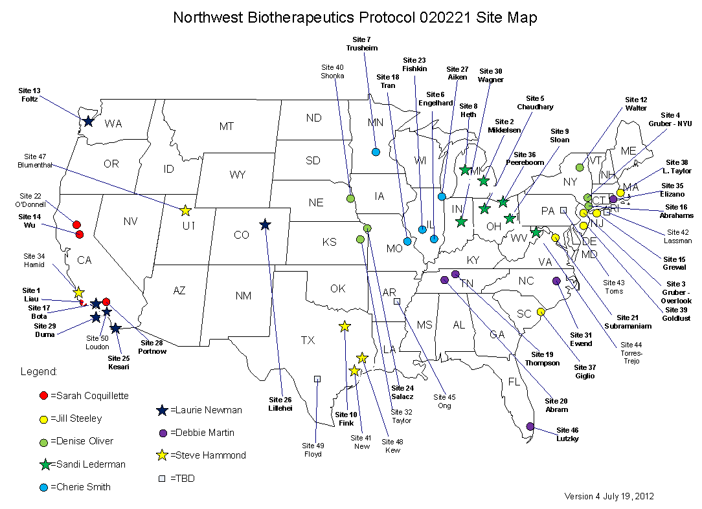
Phase III multi-center, randomized clinical trial of DCVax-Brain™ for newly diagnosed GBM (n=311)
$30 million
46 sites in U.S.

Slide 17
International Expansion of Phase III DCVax-L trial for GBM
Orphan drug status for DCVax-L in GBM granted in Europe
United Kingdom
  Phase III clinical trial is approved by MHRA (UK)
  King’s College Hospital, London, is now recruiting patients
  Additional site preparations are underway in the UK
Germany
  GermanyFraunhofer IZI has obtained manufacturing authorization for DCVax-L (a 2-year process)
  $5.5M grant was awarded to support the trial in Germany

Slide 18
DCVax-L Phase III Trial for GBM – Projections
Recruitment to continue through Q2 of 2014
Interim analyses (DSMB) in early 2014
Final analysis by end of 2014
Regardless of efficacy of DCVax-L® for GBM, there will be a wealth of clinical information, centralized imaging, and tumor/blood samples for genomic subgroup analysis, development of immunological biomarkers, and new avenues of clinical research

Slide 19
Conclusion:
Steps to heading a clinical trial
Define the clinical problem/need
Develop an idea/hypothesis
Get funding $$
Test hypothesis in relevant animal models
Talk to the FDA; get an IND
Get more funding $$$$
Develop effective collaborations with industry

Slide 20
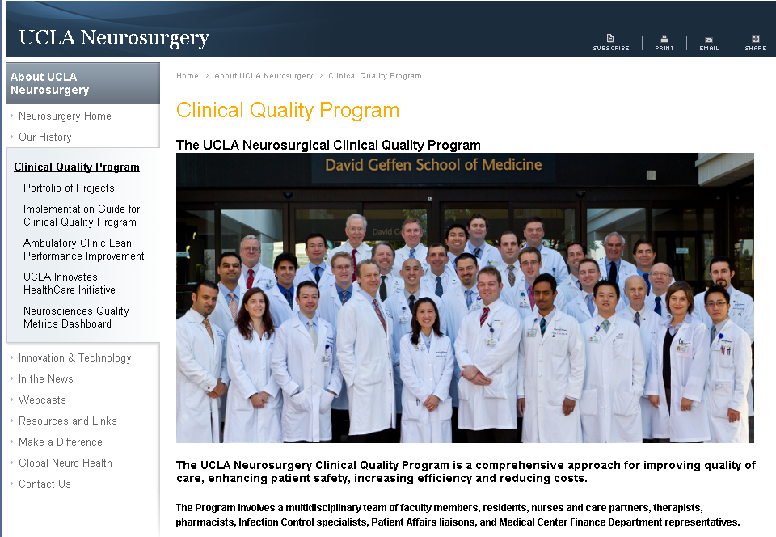
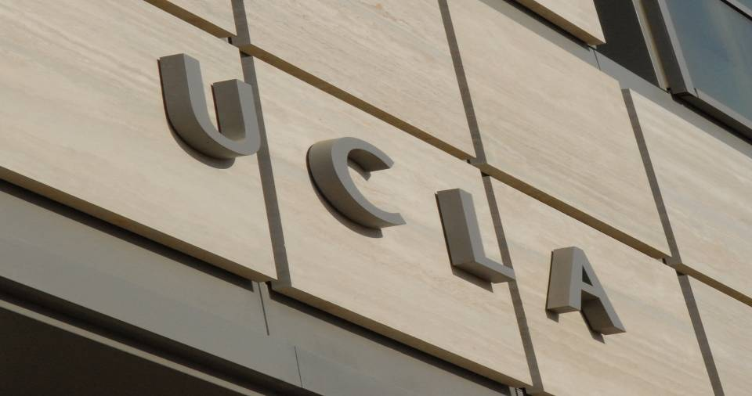

THANK YOU!
UCLA Department of Neurosurgery

