Slide 1
2012 RESEARCH UPDATE IN NEUROSCIENCE FOR NEUROSURGEONS (RUNN COURSE ) October 28 –November 4, 2012 SPONSORED BY THE SOCIETY OF NEUROLOGICAL SURGEONS
COURSE DIRECTORS
Allan H. Friedman, M.D. and
Robert H. Friedlander, M.D.
CO-DIRECTORS
Issam Awad
Bruce Anderson
Henry Brem
Antonio Chiocca
Robert Dempsey

Slide 3
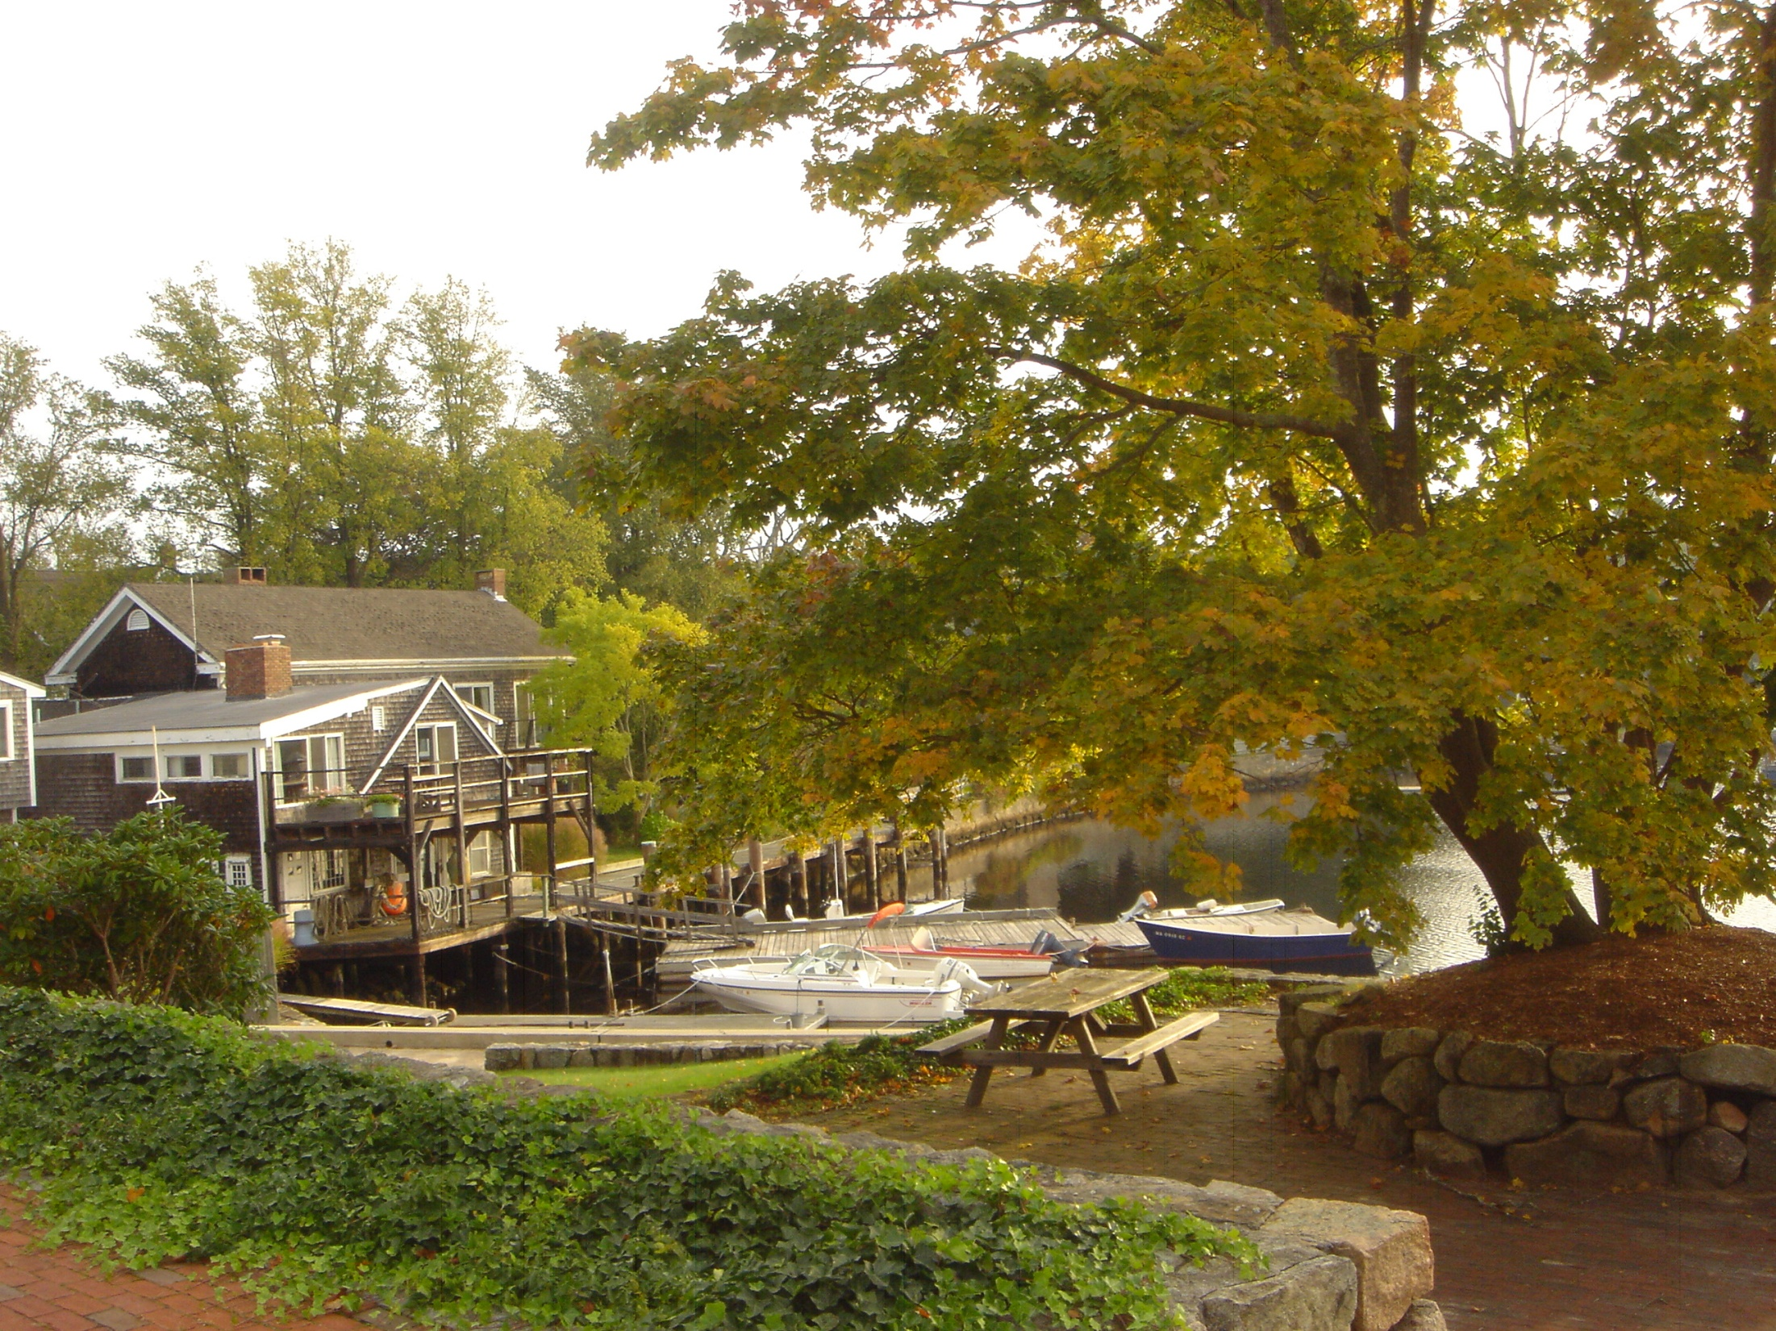

Slide 4
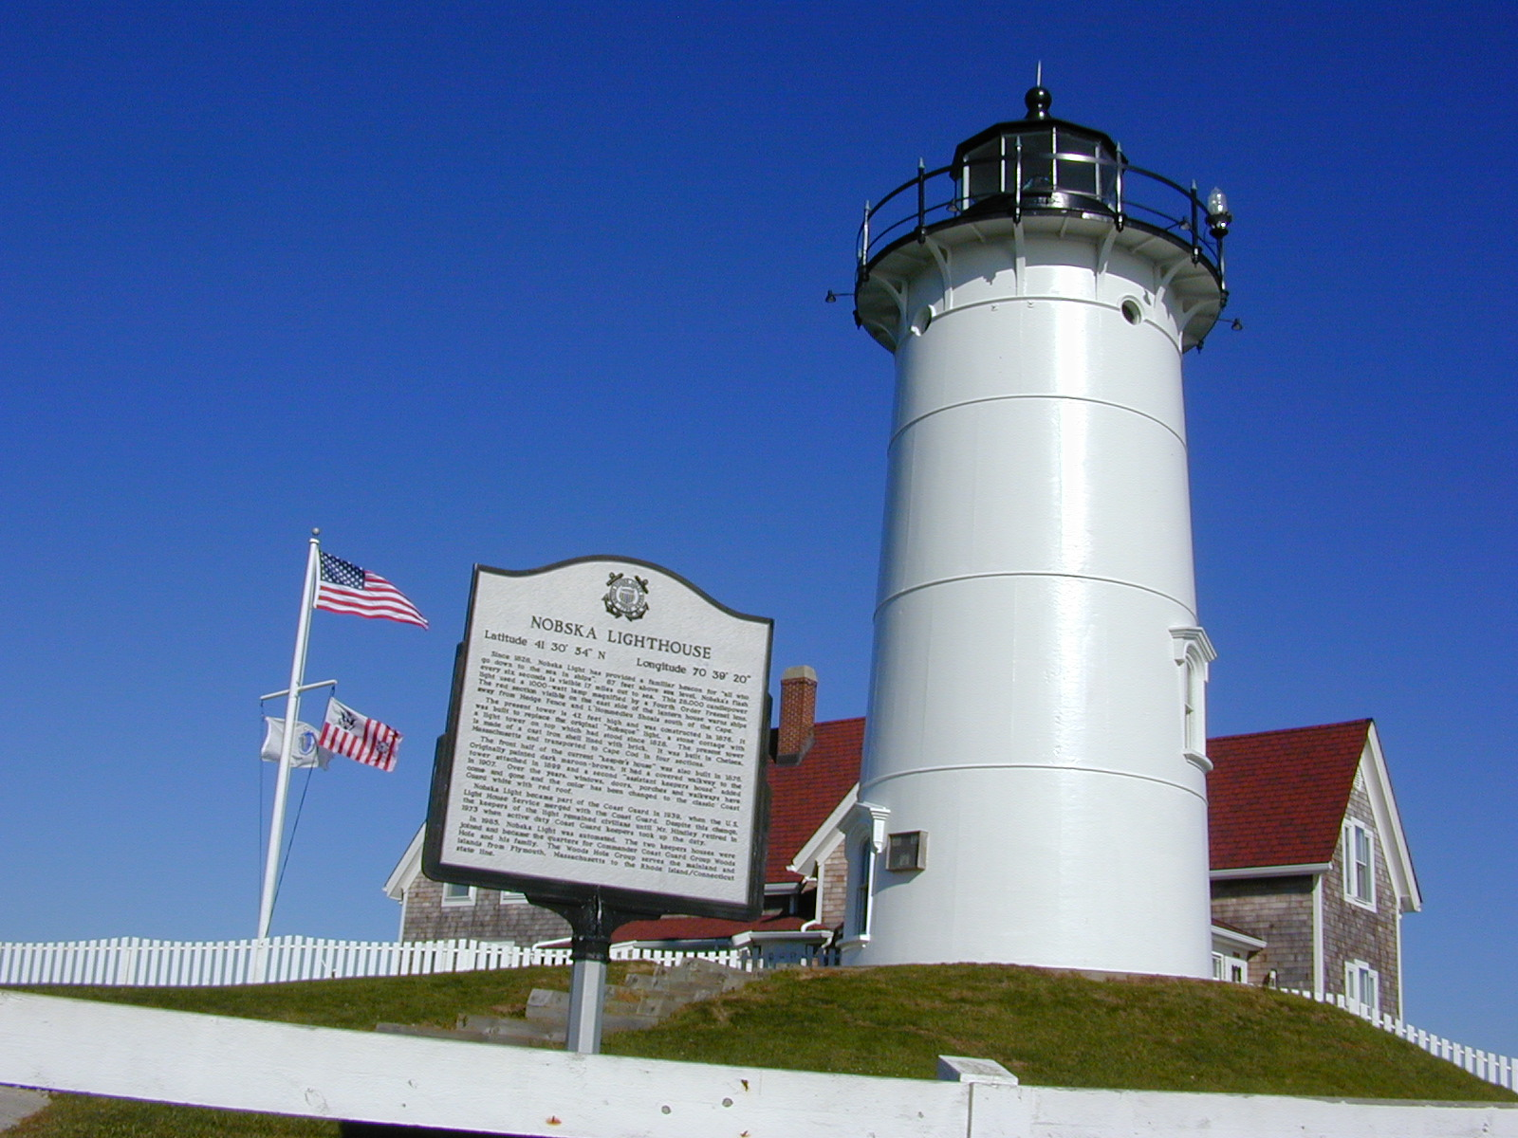

Slide 5
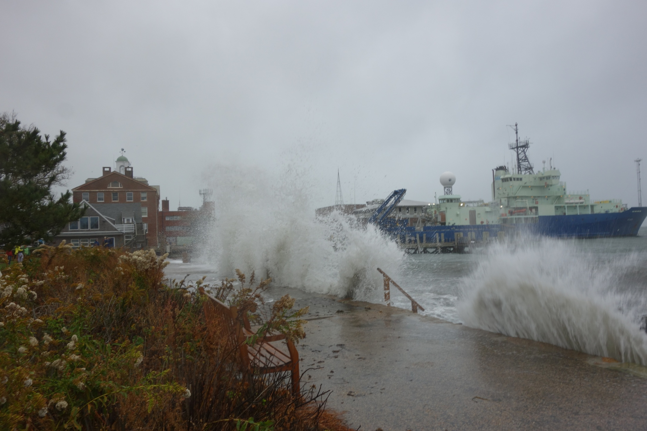

Slide 6
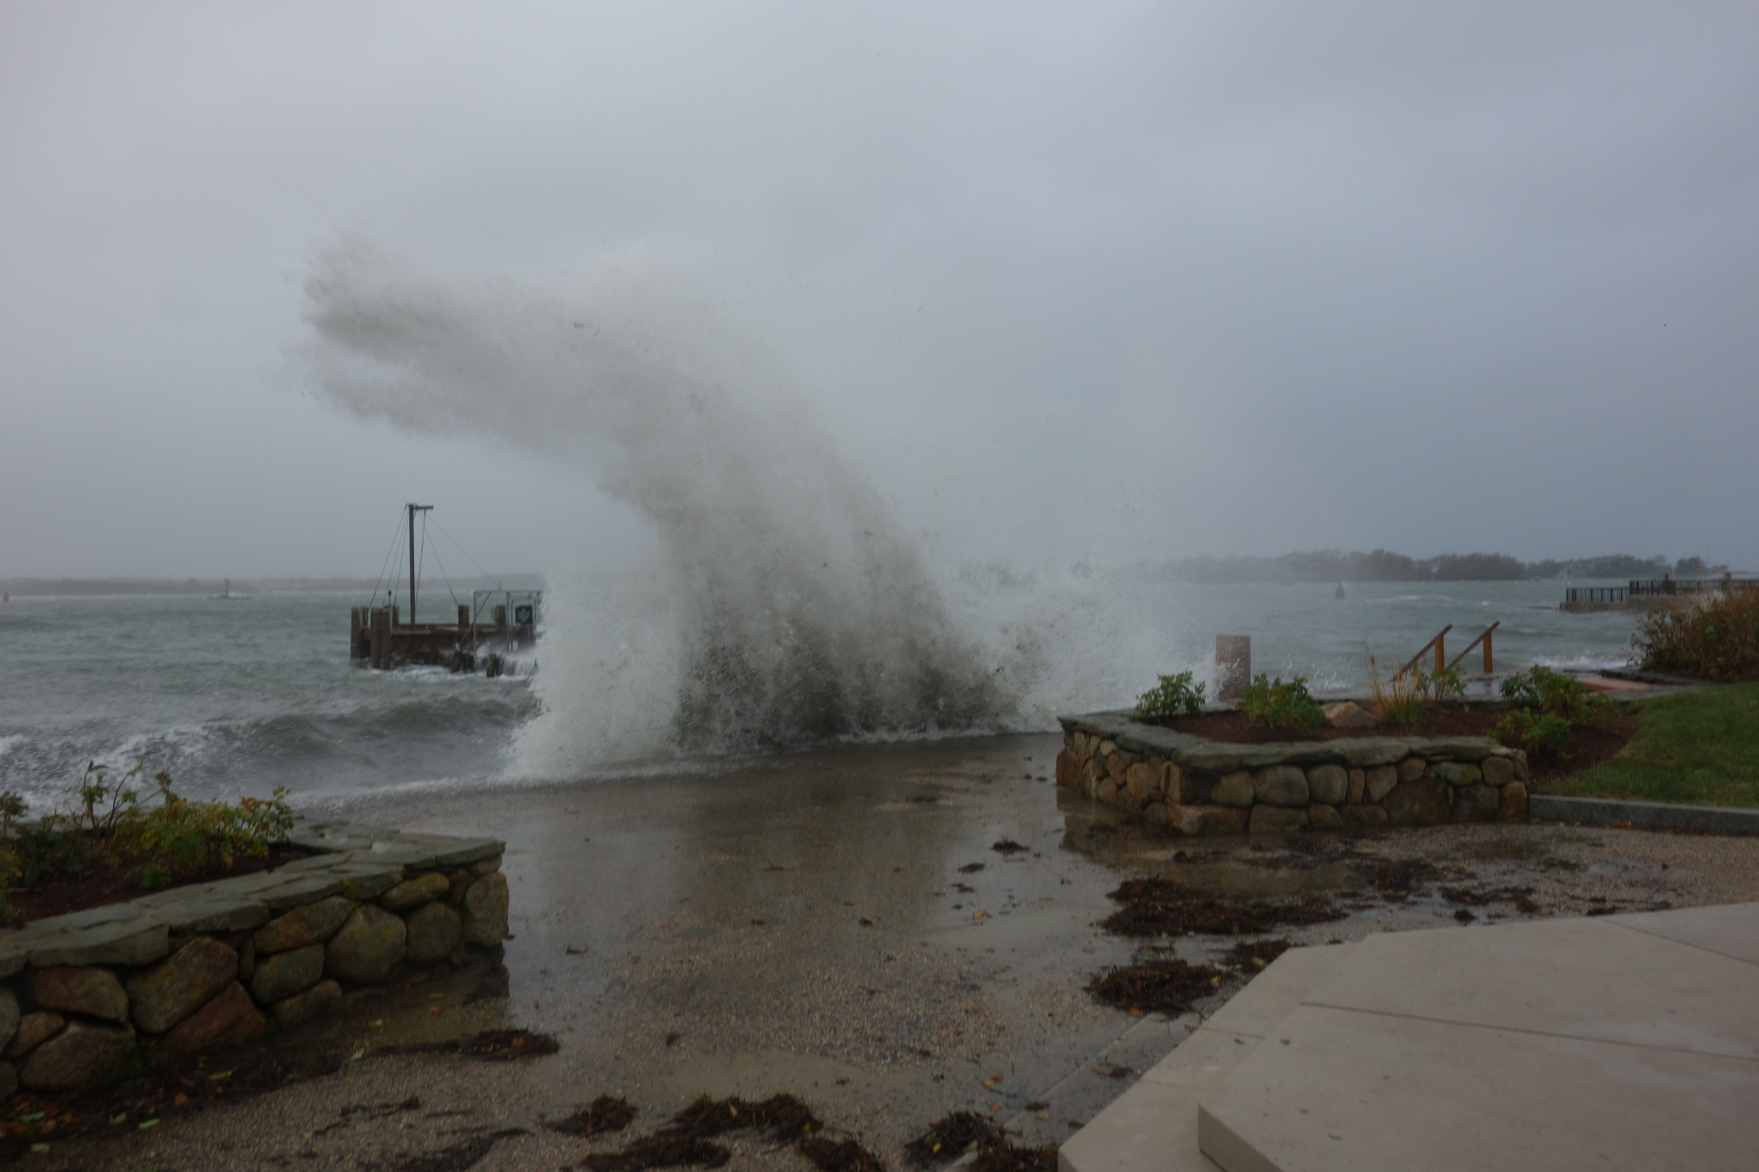

Slide 8
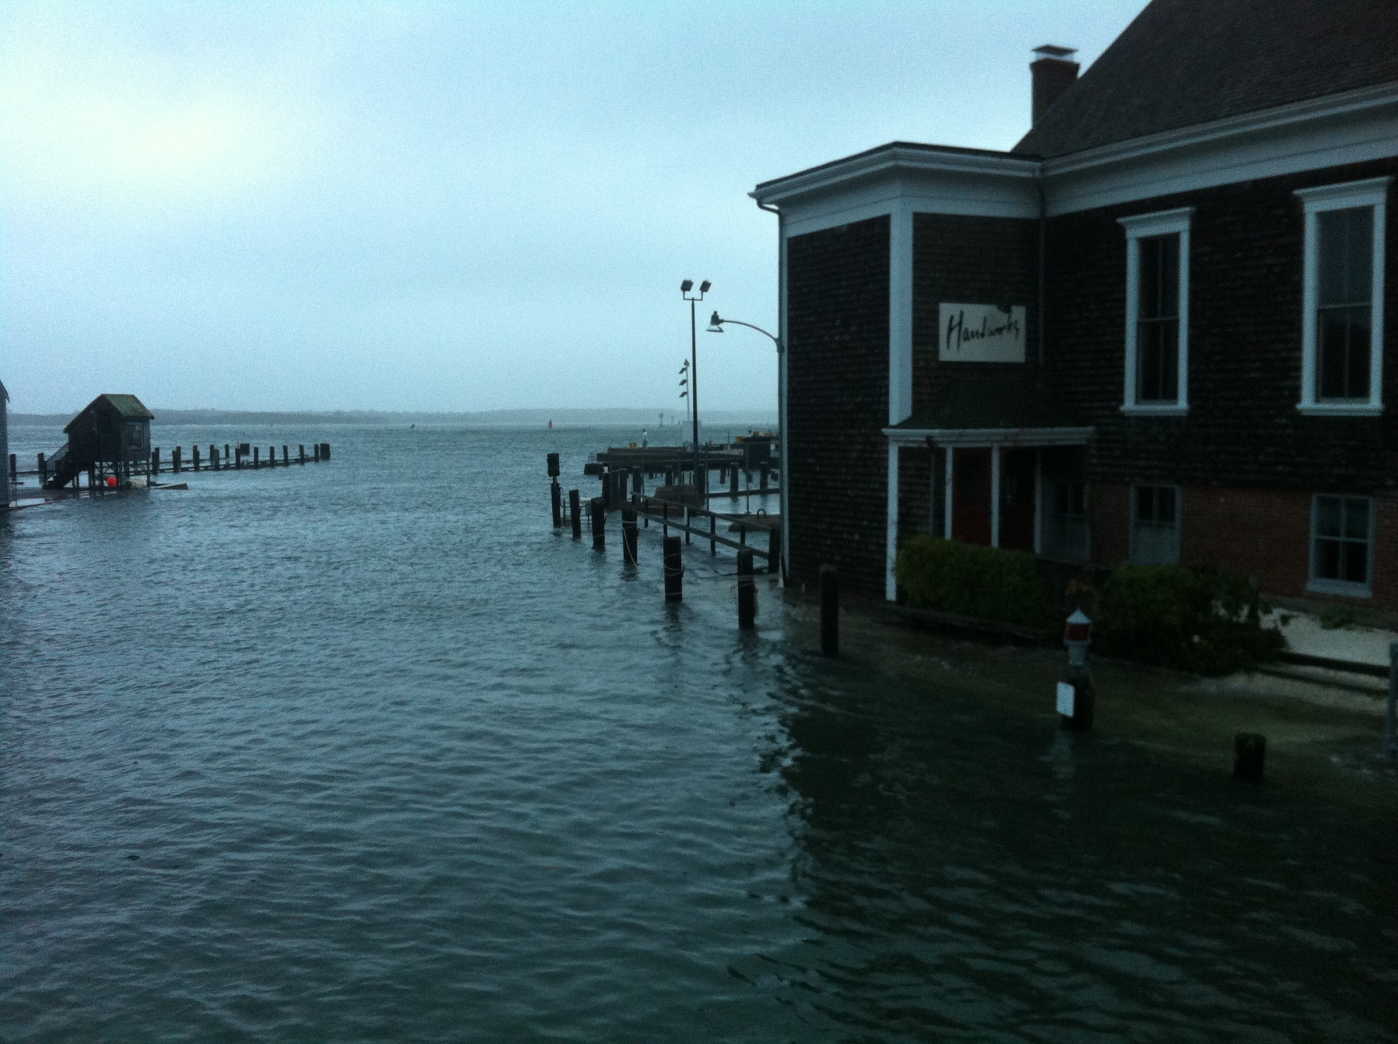

Slide 12
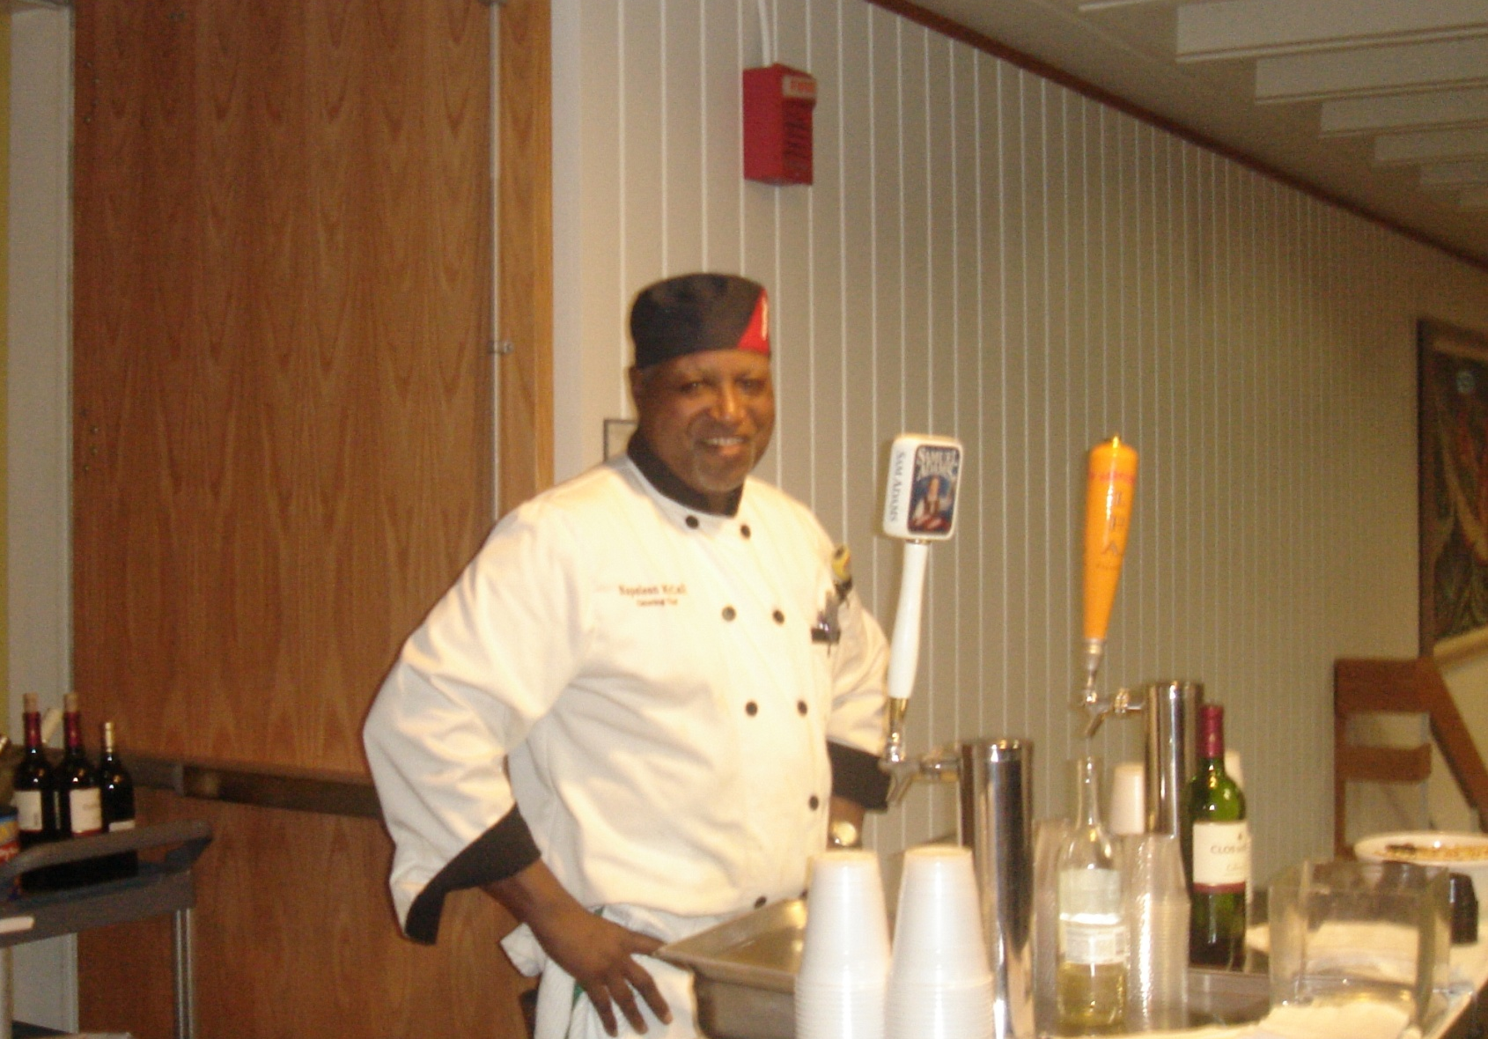

Slide 14
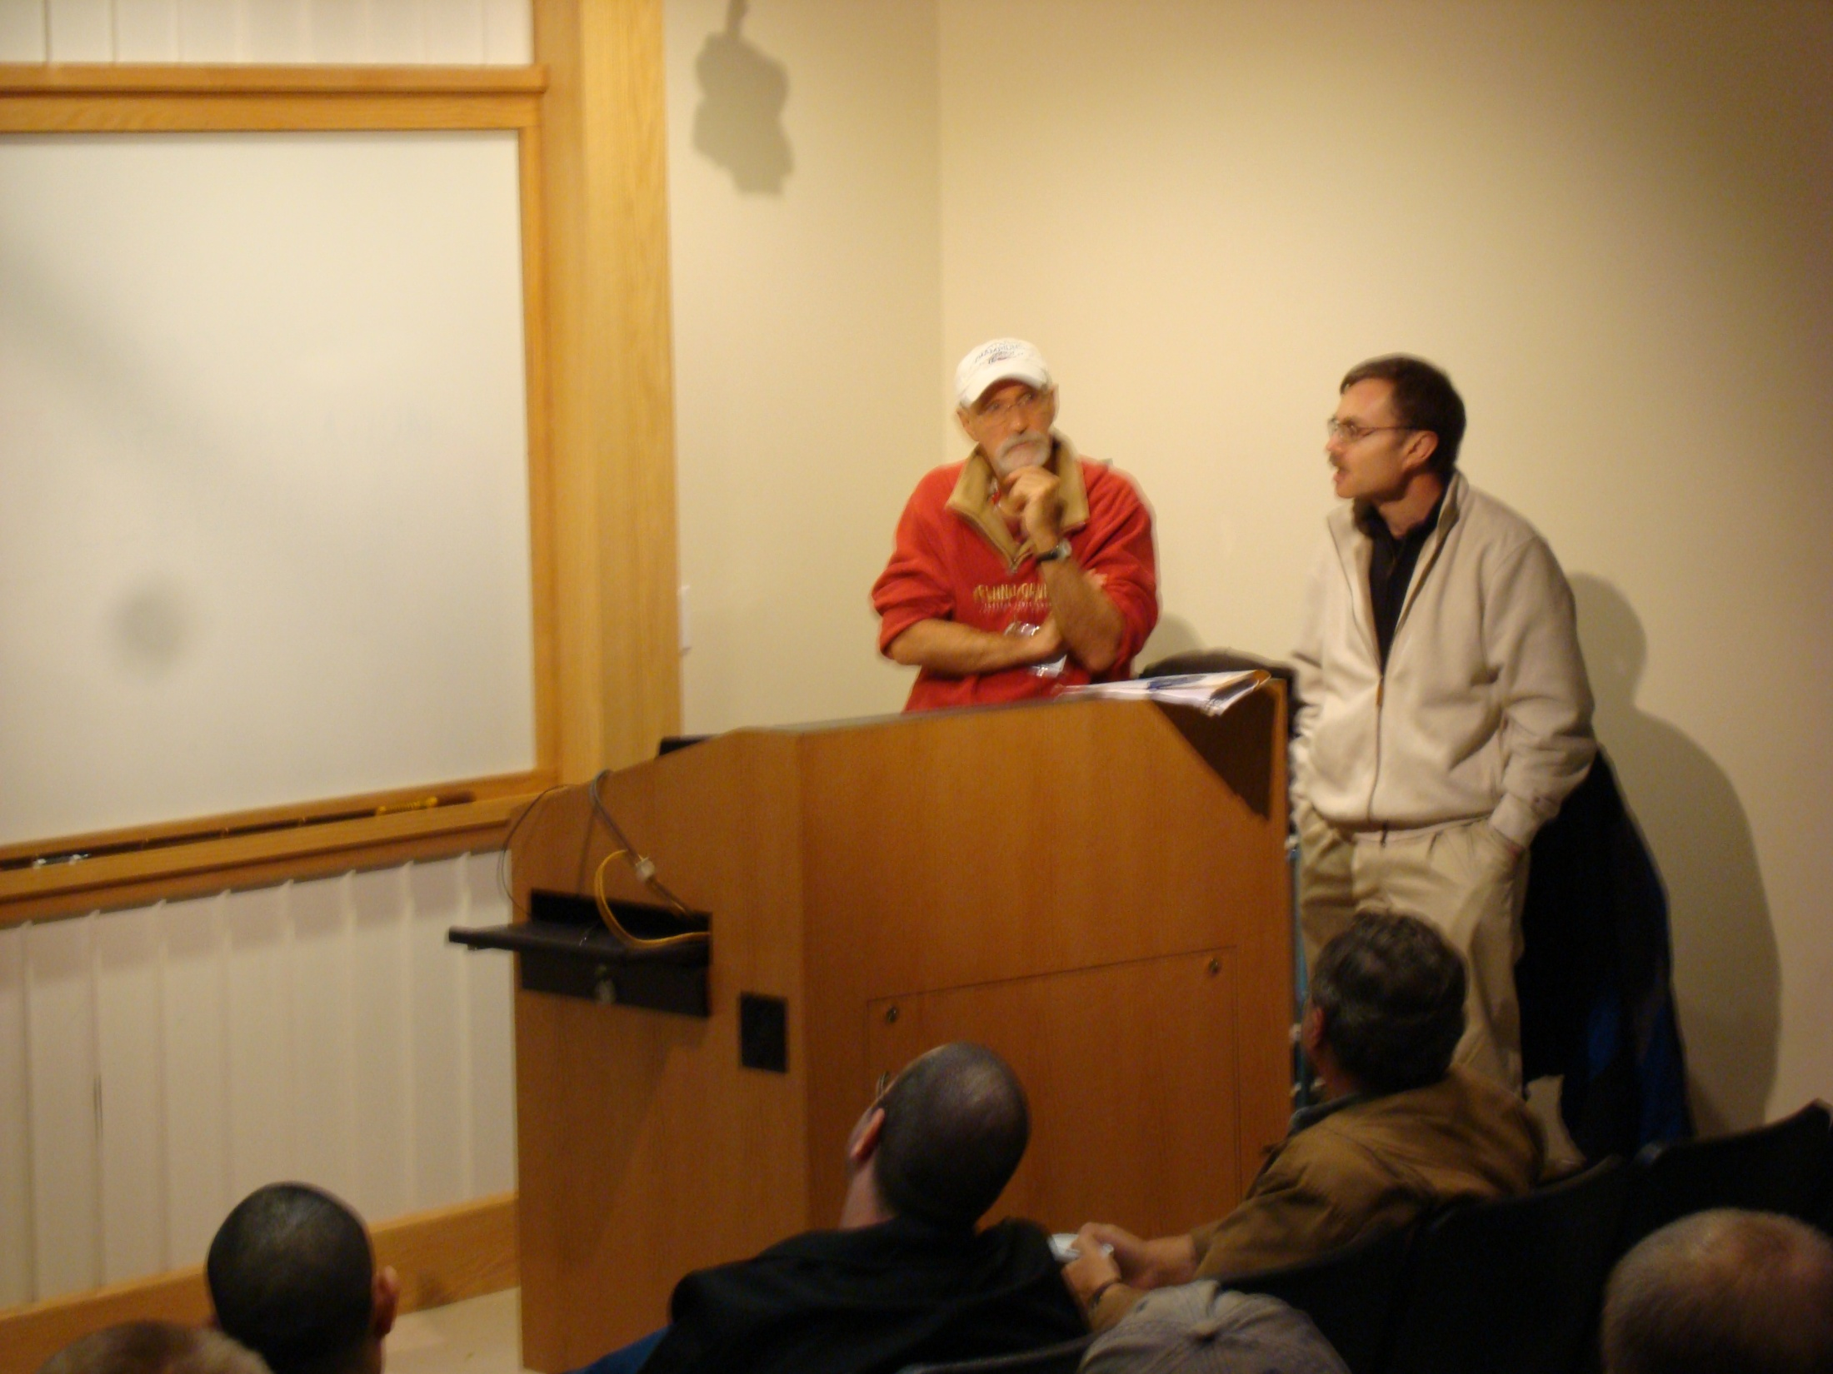

Slide 15
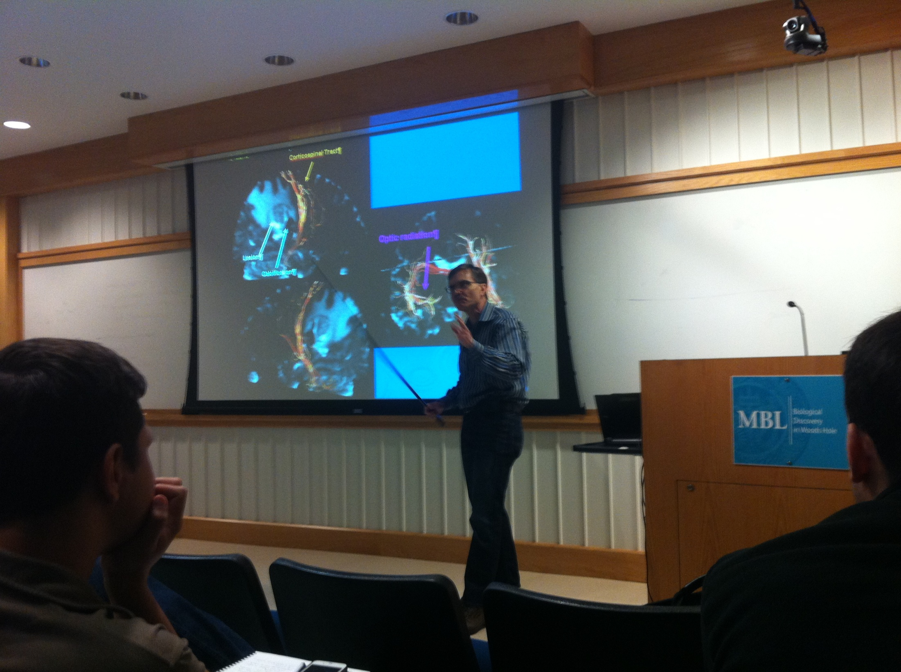

Slide 16
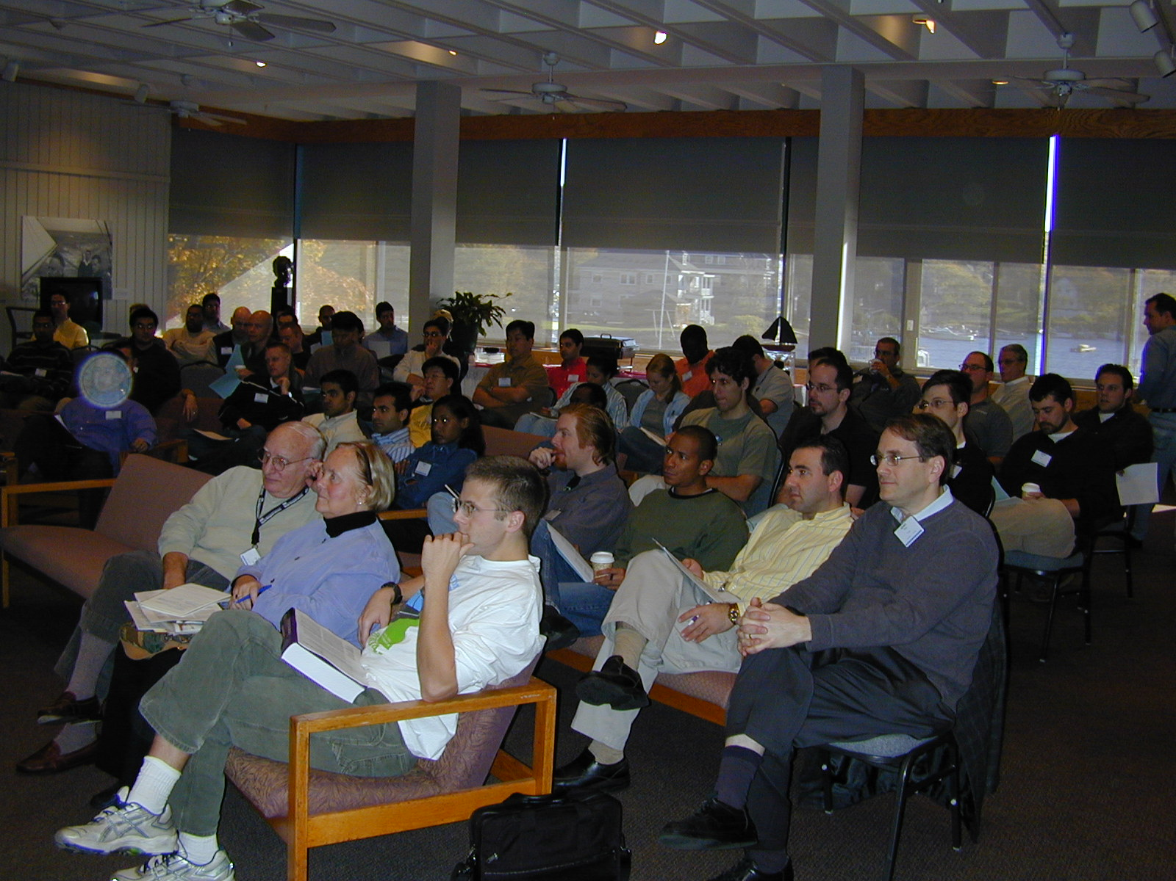

Slide 17
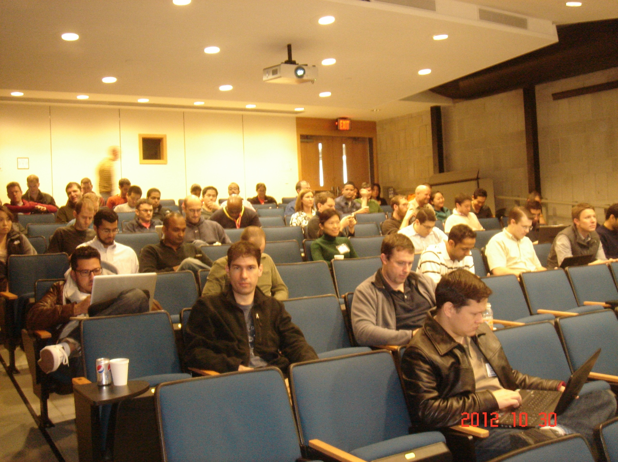

Slide 18
“I hesitate to say anything negative because I'm glad we were able to have those lectures in spite of the storm. However, when there is a choice I prefer live lectures. In my view it's challenging to communicate things like curiosity, dedication, passion over the phone. When a lecturer is present, it's easier for their enthusiasm to be contagious, the audience becomes more engaged, and they interact more.”
Ephraim W. Church MD
PGY2, Department of Neurosurgery
Pennsylvania State University

Slide 19
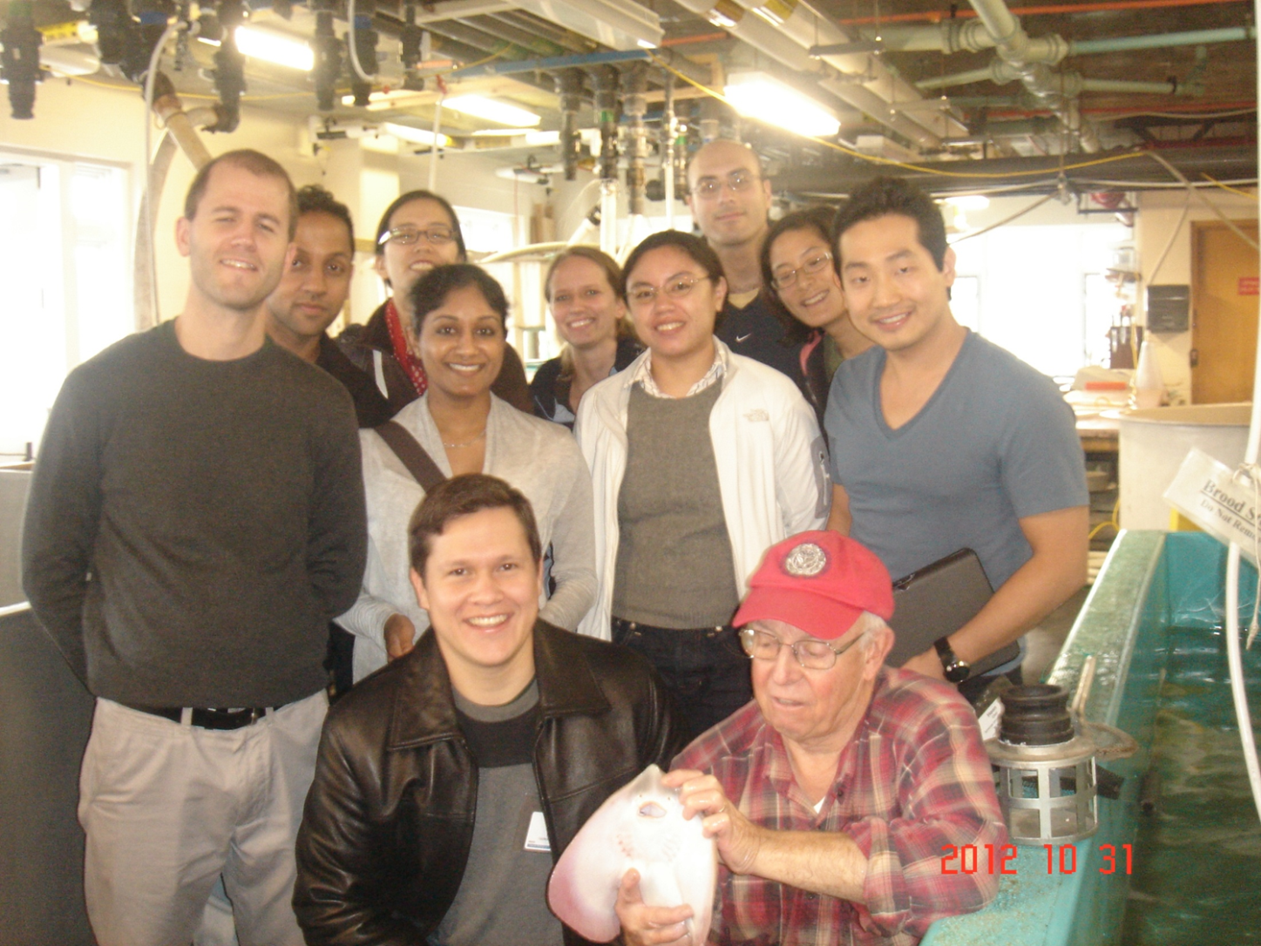
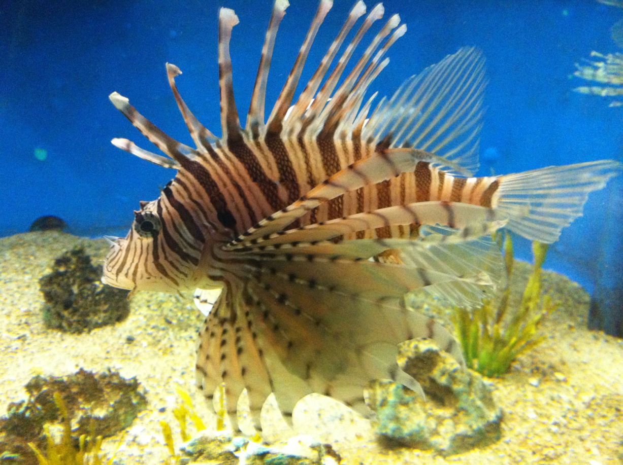

Slide 20
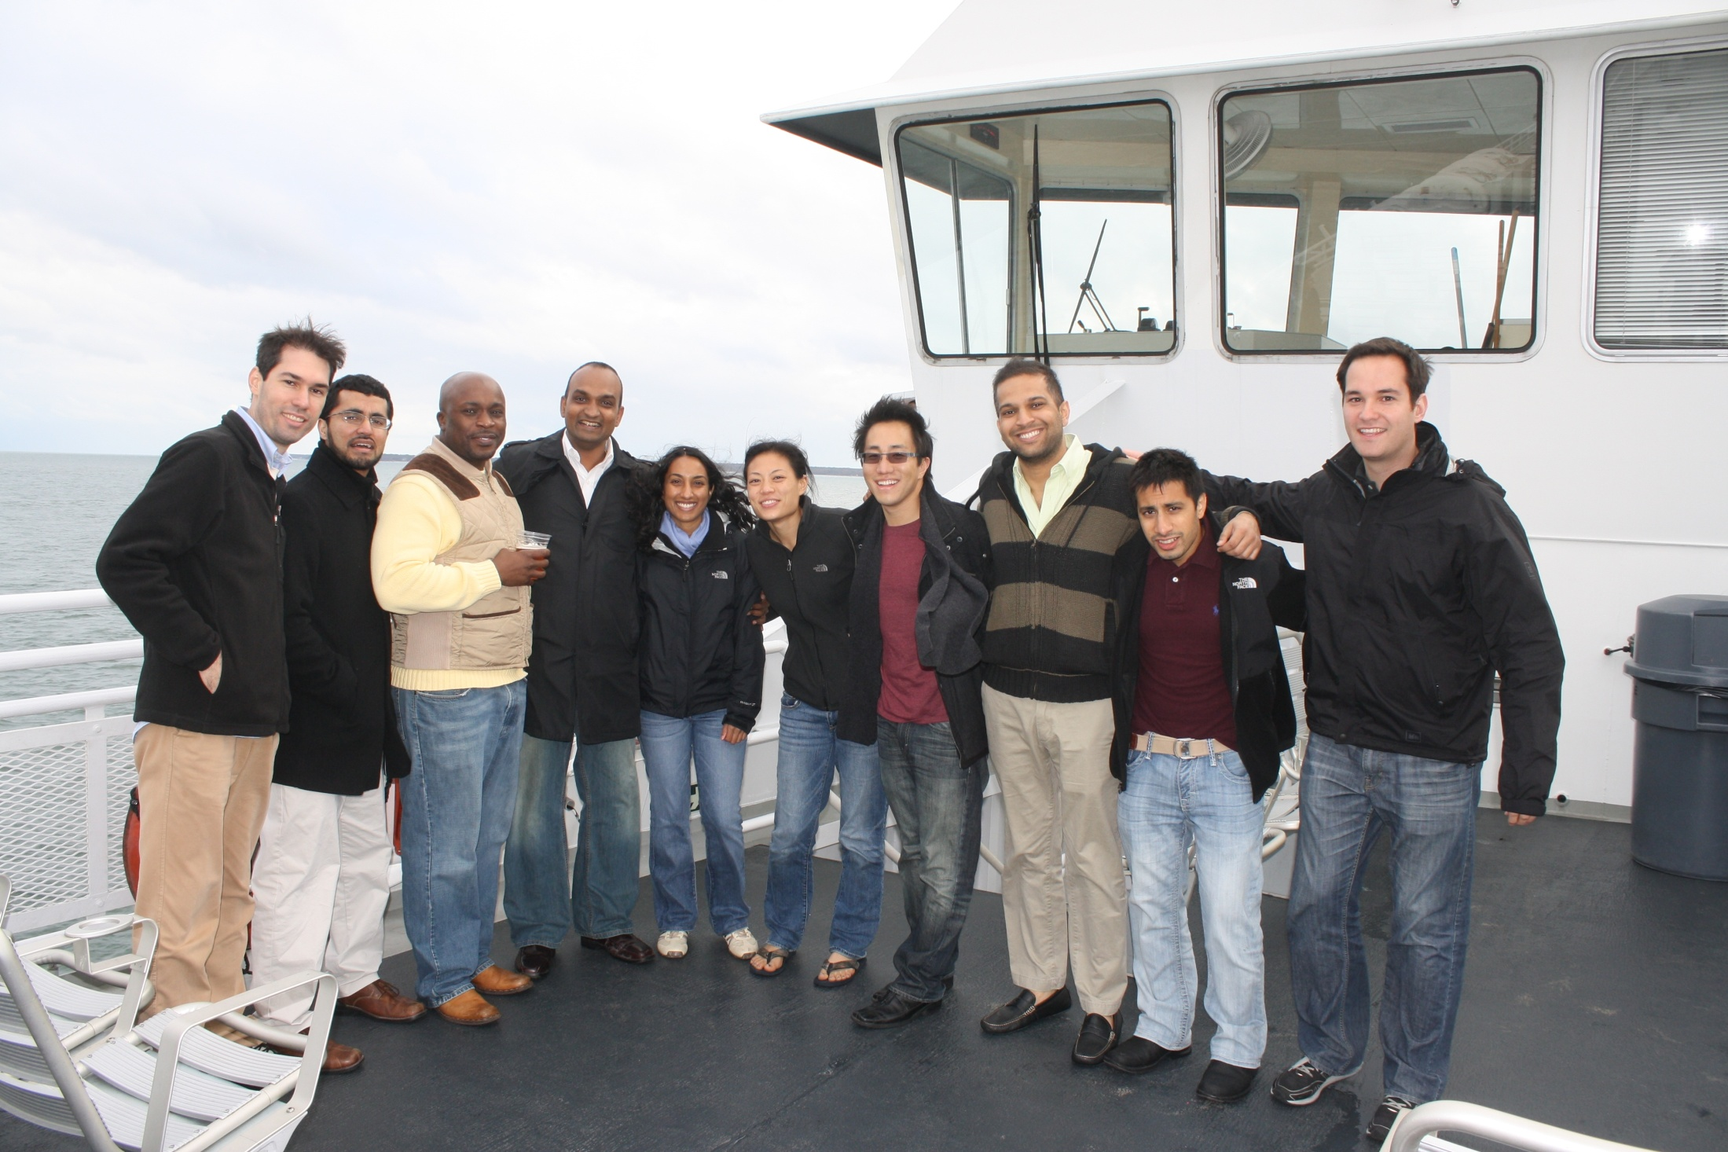

Slide 21
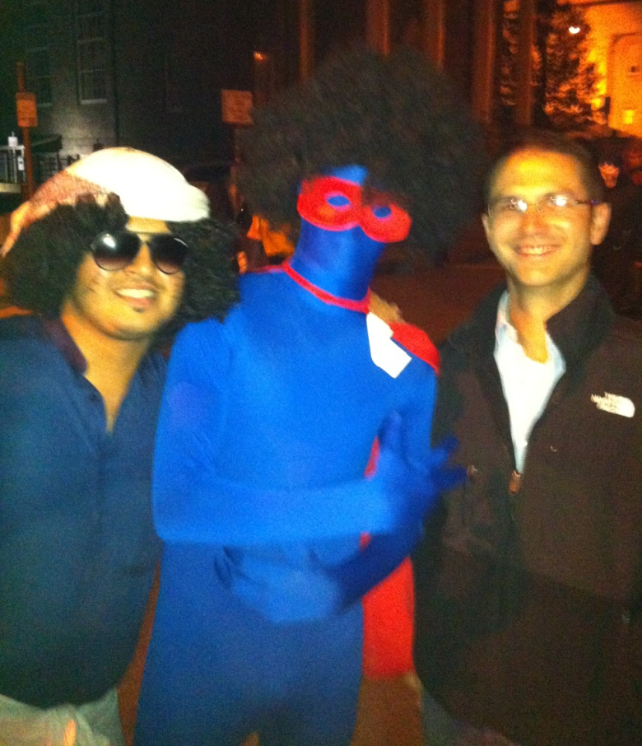
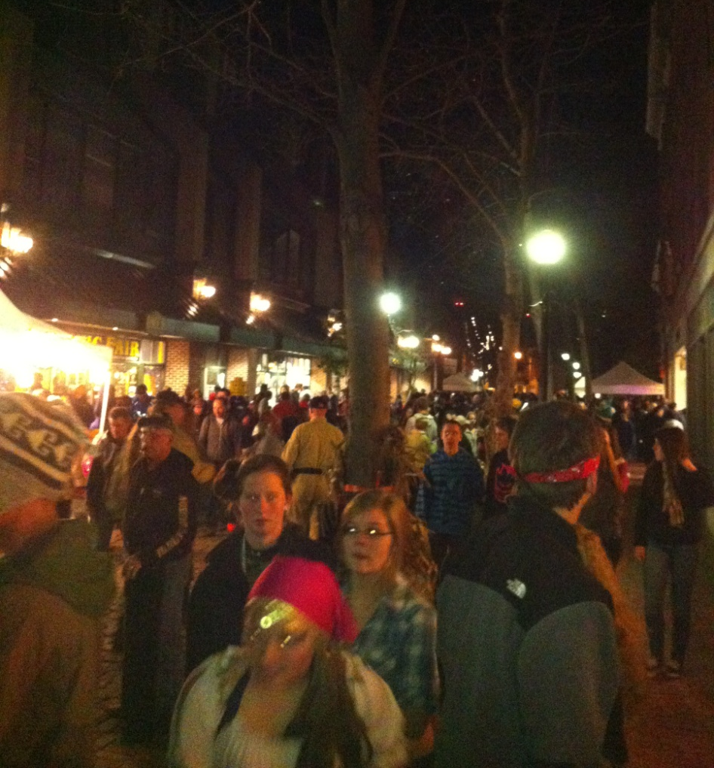
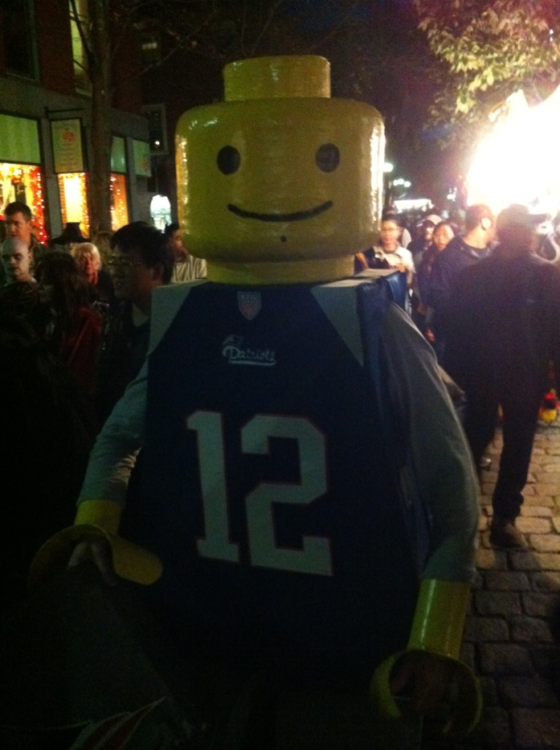

Slide 22
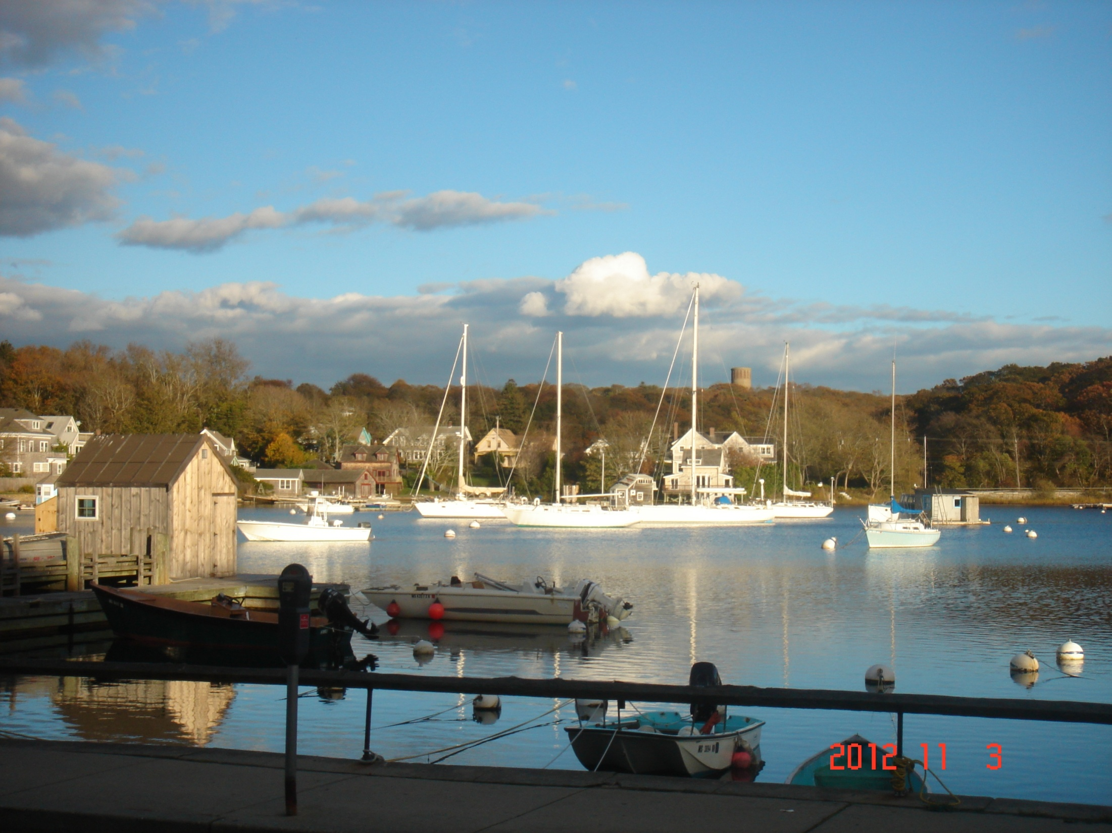

Slide 23
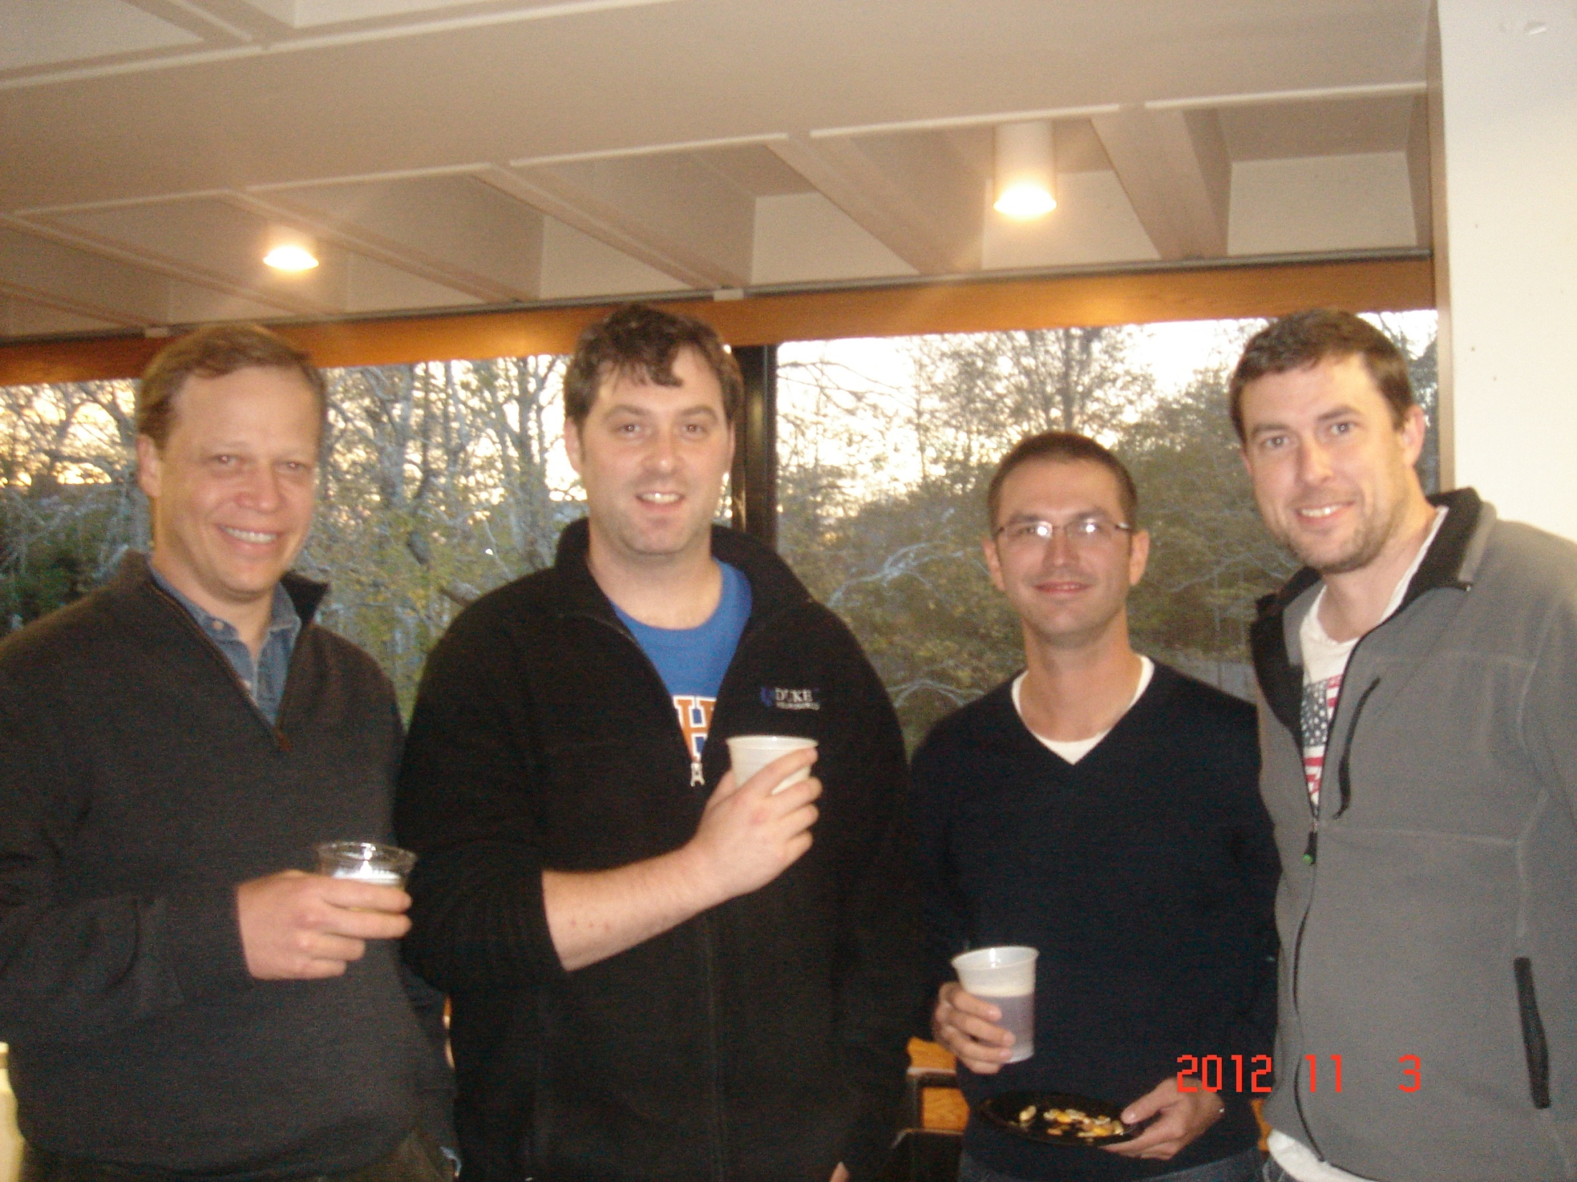

Slide 24
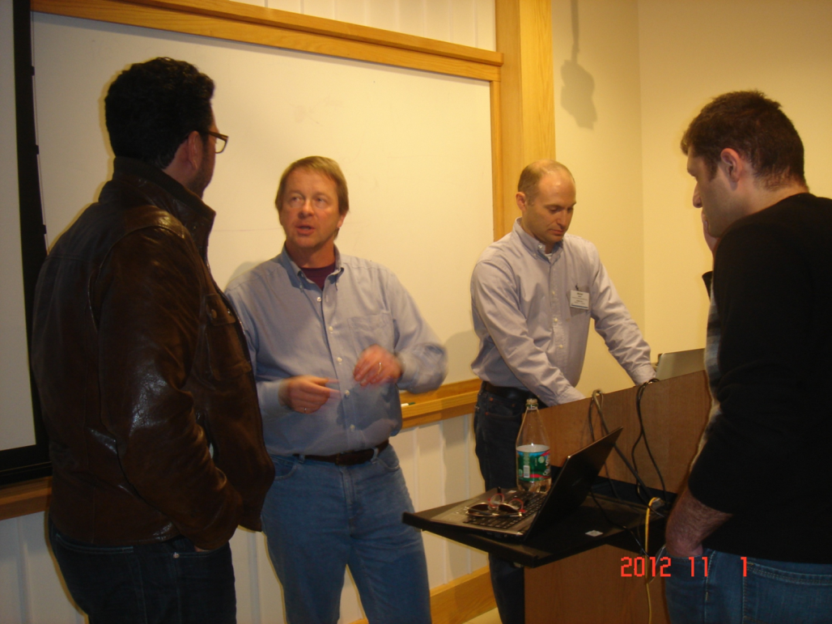
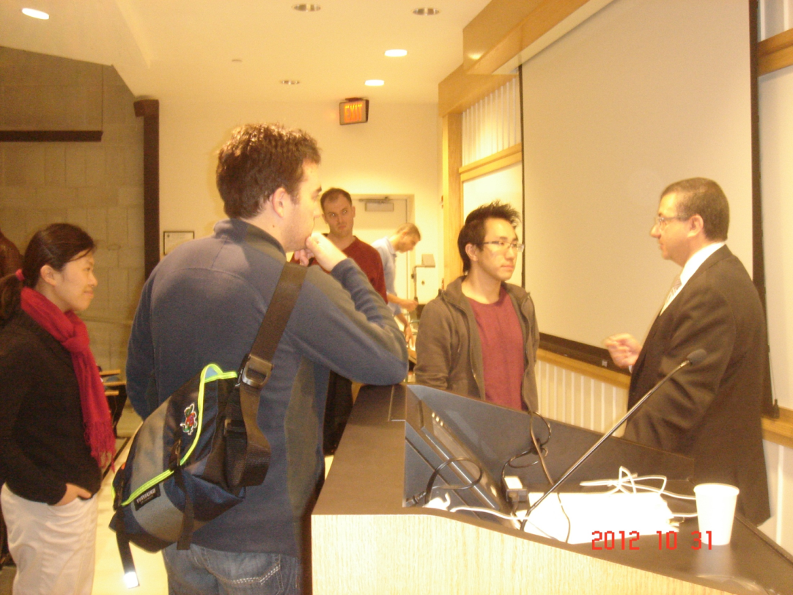
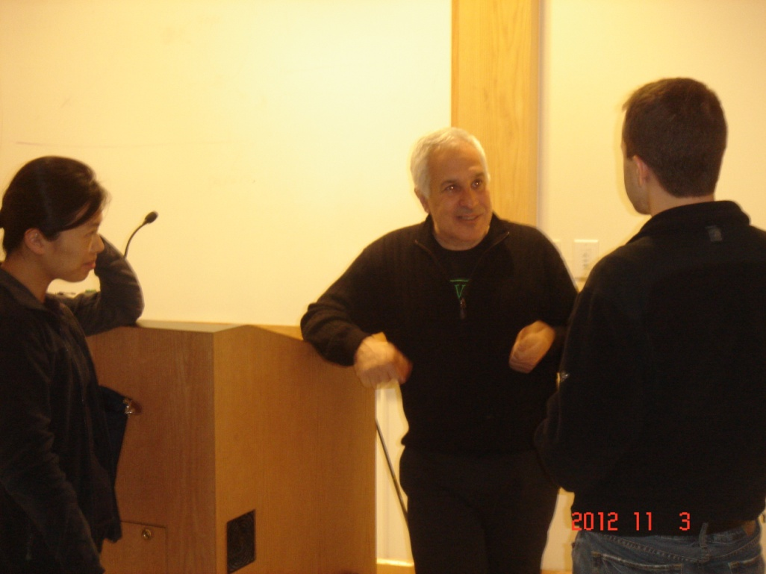

Slide 25
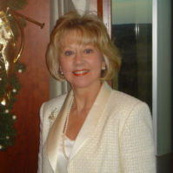

Slide 26
Runn Course 2012
Participants 93 residents, One practicing neurosurgeon
3 residents cancelled
Notes:
The shift in the faculty represents a shift inour philosophy and the addition of high quality neurosurgical researchers Ed olfield and andres lozano

Slide 27
Review of RUNN Speakers
20 Lecturers: 1-1.9
3 Lecturers: 2-2.6

Slide 28
RUNN 2012 FINANCIAL REPORT OCTOBER 28 - NOVEMBER 4, 2012
REVENUE
Registration Fees, Misc Income $148,266.00
Educational Grants $41,000.00
TOTAL REVENUE: $189,266.00
EXPENSES
MBL $116,437.00
MBL Deposit $1,000.00
Faculty Travel, Housing, Meals, Reg. $19,962.16
Faculty Honoraria $5,750.00
2012 Annual Report Design $630.00
Administration $8,000.00
Neuroscience Textbook $8,356.92
Miscellaneous Expenses $856.92
Registration Refunds $4,500.00
2011 Research Grant Awards $10,000.00
TOTAL EXPENSES $175,387.28
NET REVENUE $13,878.72

Slide 29
Education Grants 2012 RUNN Course
Synthes Spine $8,000.00
Integra Foundation $5,000.00
Stryker Spine $5,000.00
Biomet Microfixation / W. Lorenz $3,000.00
Baxter $2,500.00
Brainlab $2,500.00
Codman $2,500.00
Marathon Medical $2.500.00
Hitachi Aloka Medical, Ltd. $2,500.00
Anspach $2,000.00
Synthes, CMF $2,000.00
Mizuho America $1,000.00
Zeiss $2,500.00
TOTAL $41,000.00

Slide 30
RUNN Course Goals
Update in neuroscience for neurosurgeons
Tools to start independent research: lab, translational, or clinical

Slide 31
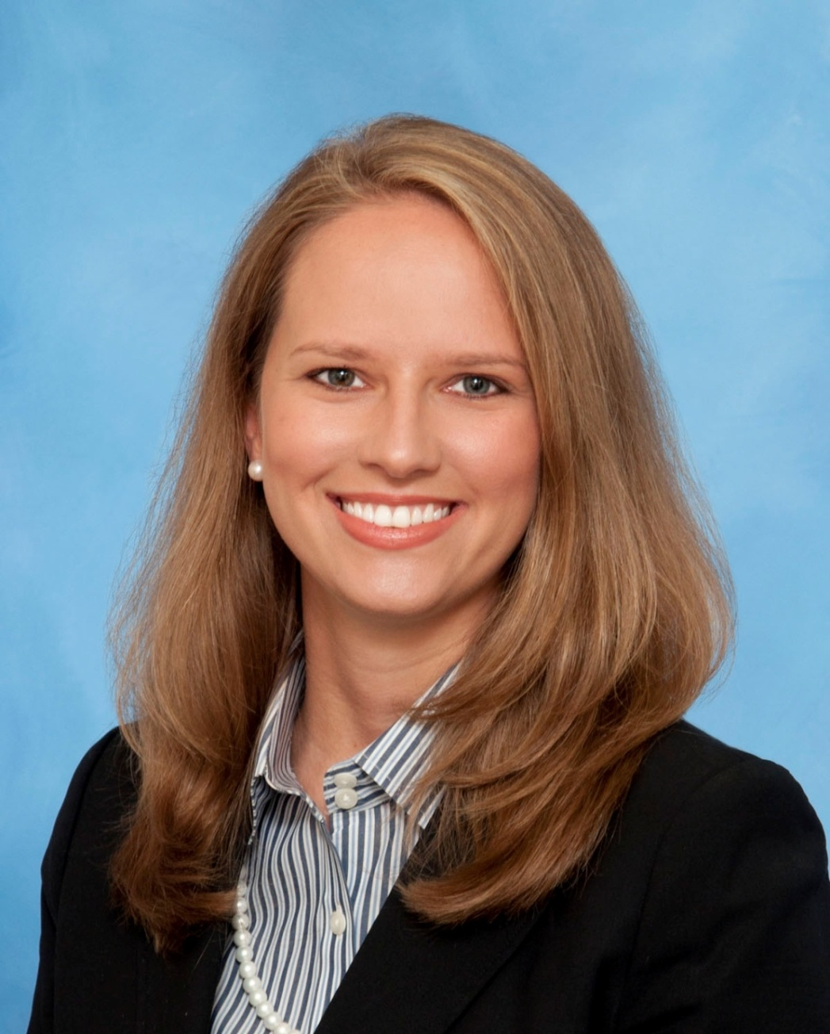
Nicole Bentley MD
University of Michigan
Opticogenetic Alteration of Proprioceptive inputs of Motor Cortex for the Development of Neuroprosthetic Devices

Slide 32
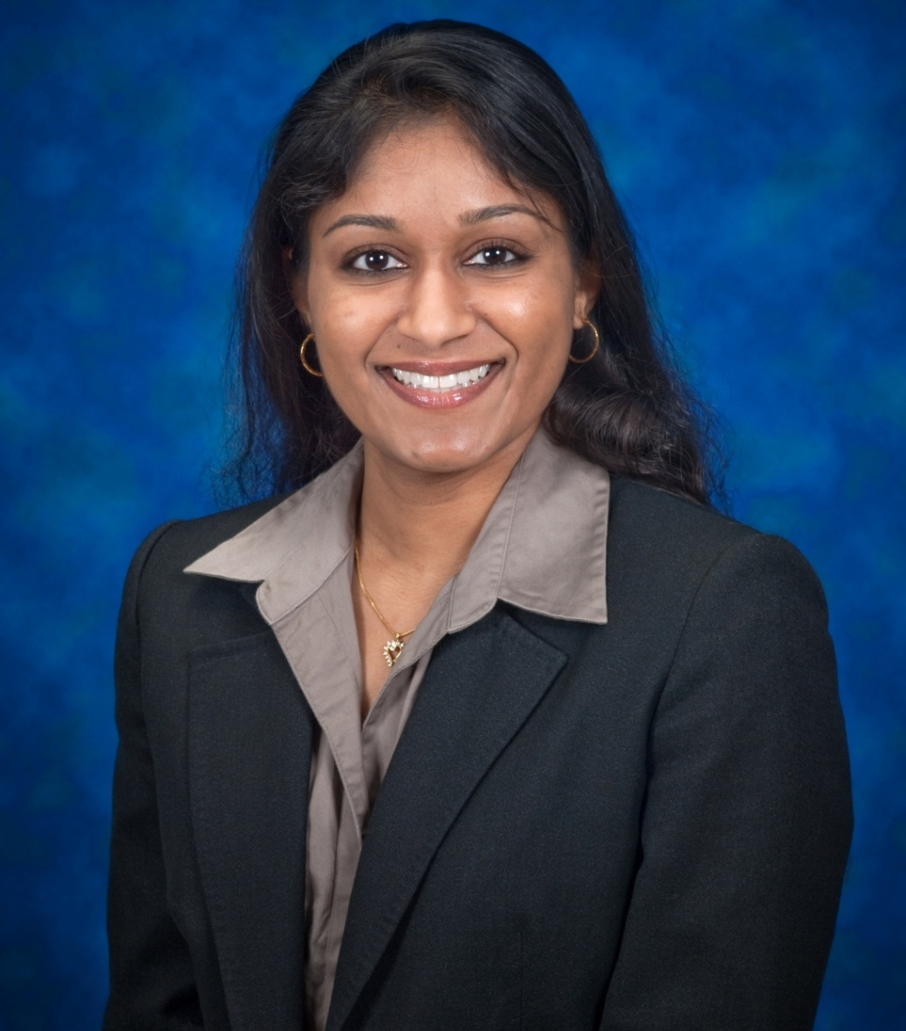
Neena Marupudi
Wayne State University
Utilization and Mechanism of Anti CD3 x Notch Bispecific Antibody-Armed Activated T-Cells to target GBM Stem Cells: A Novel Immunotherapy

Slide 33
2013 RESEARCH UPDATE IN NEUROSCIENCE FOR NEUROSURGEONS (RUNN COURSE ) October 26 –November 3, 2013

Slide 36
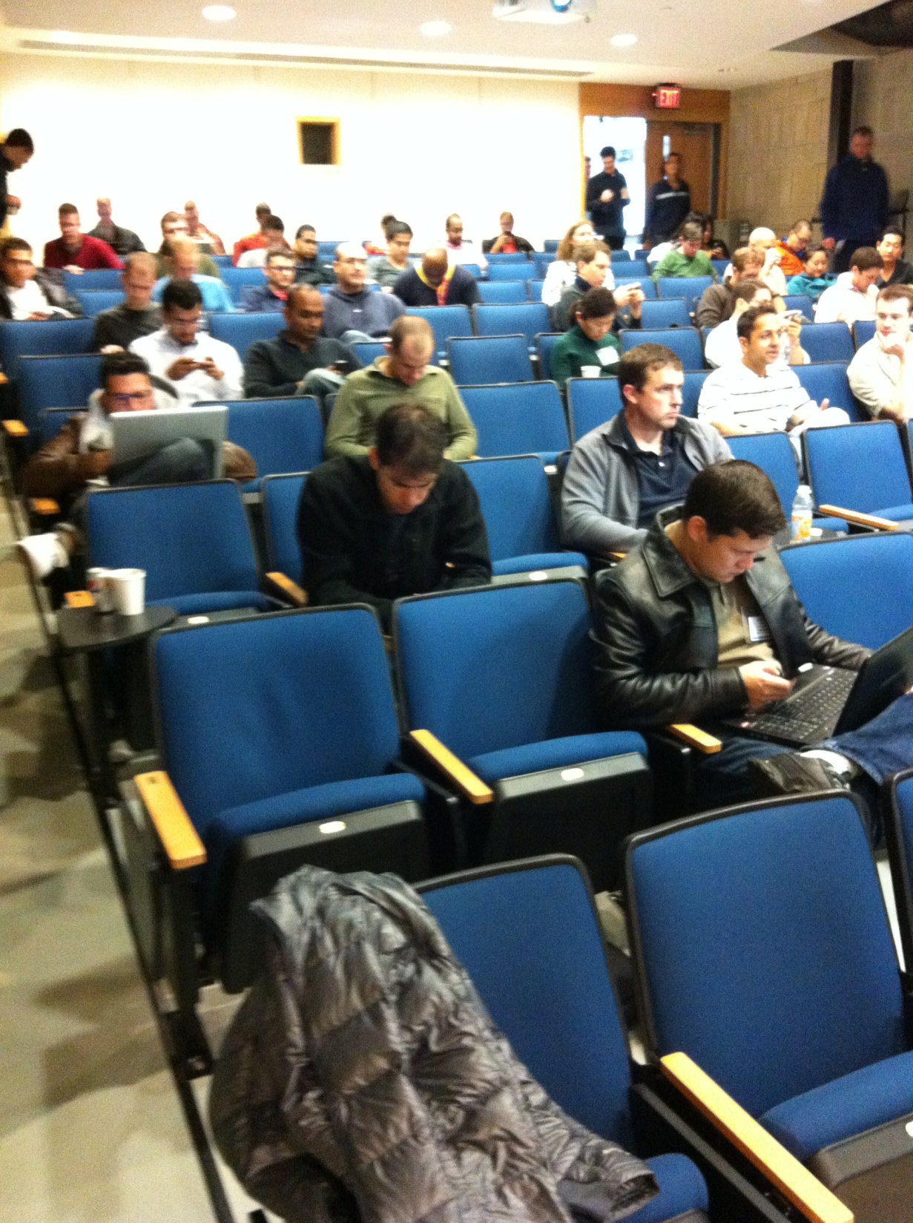

Slide 37
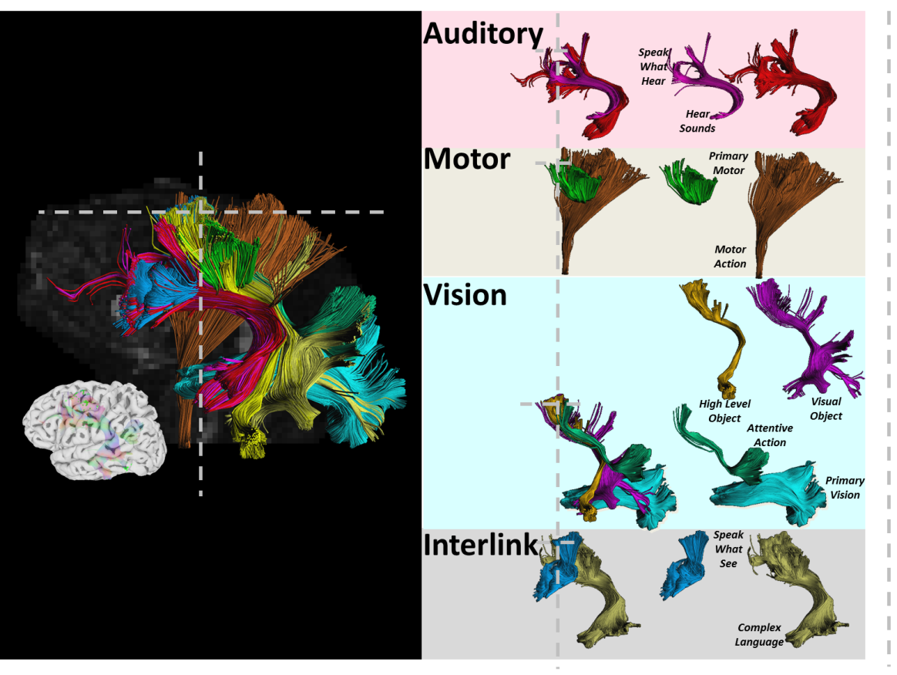
Creating a Personalized Circuit Diagram
Size of lines are scaled for the size of connection.
The Numbers are in thousands of 0.1mm streamline representing an estimated 4400 axons
Virtual Dissection
Circuit Diagram
Left Side
21
To Right IFG
11
Motor
Output
IFG
PMd
1
5
OP
IP
14
2
2
2
2
A1
SUPERIOR
MIDDLE
Audition
F2
INFERIOR
V4
V2
V1
Vision

Slide 39
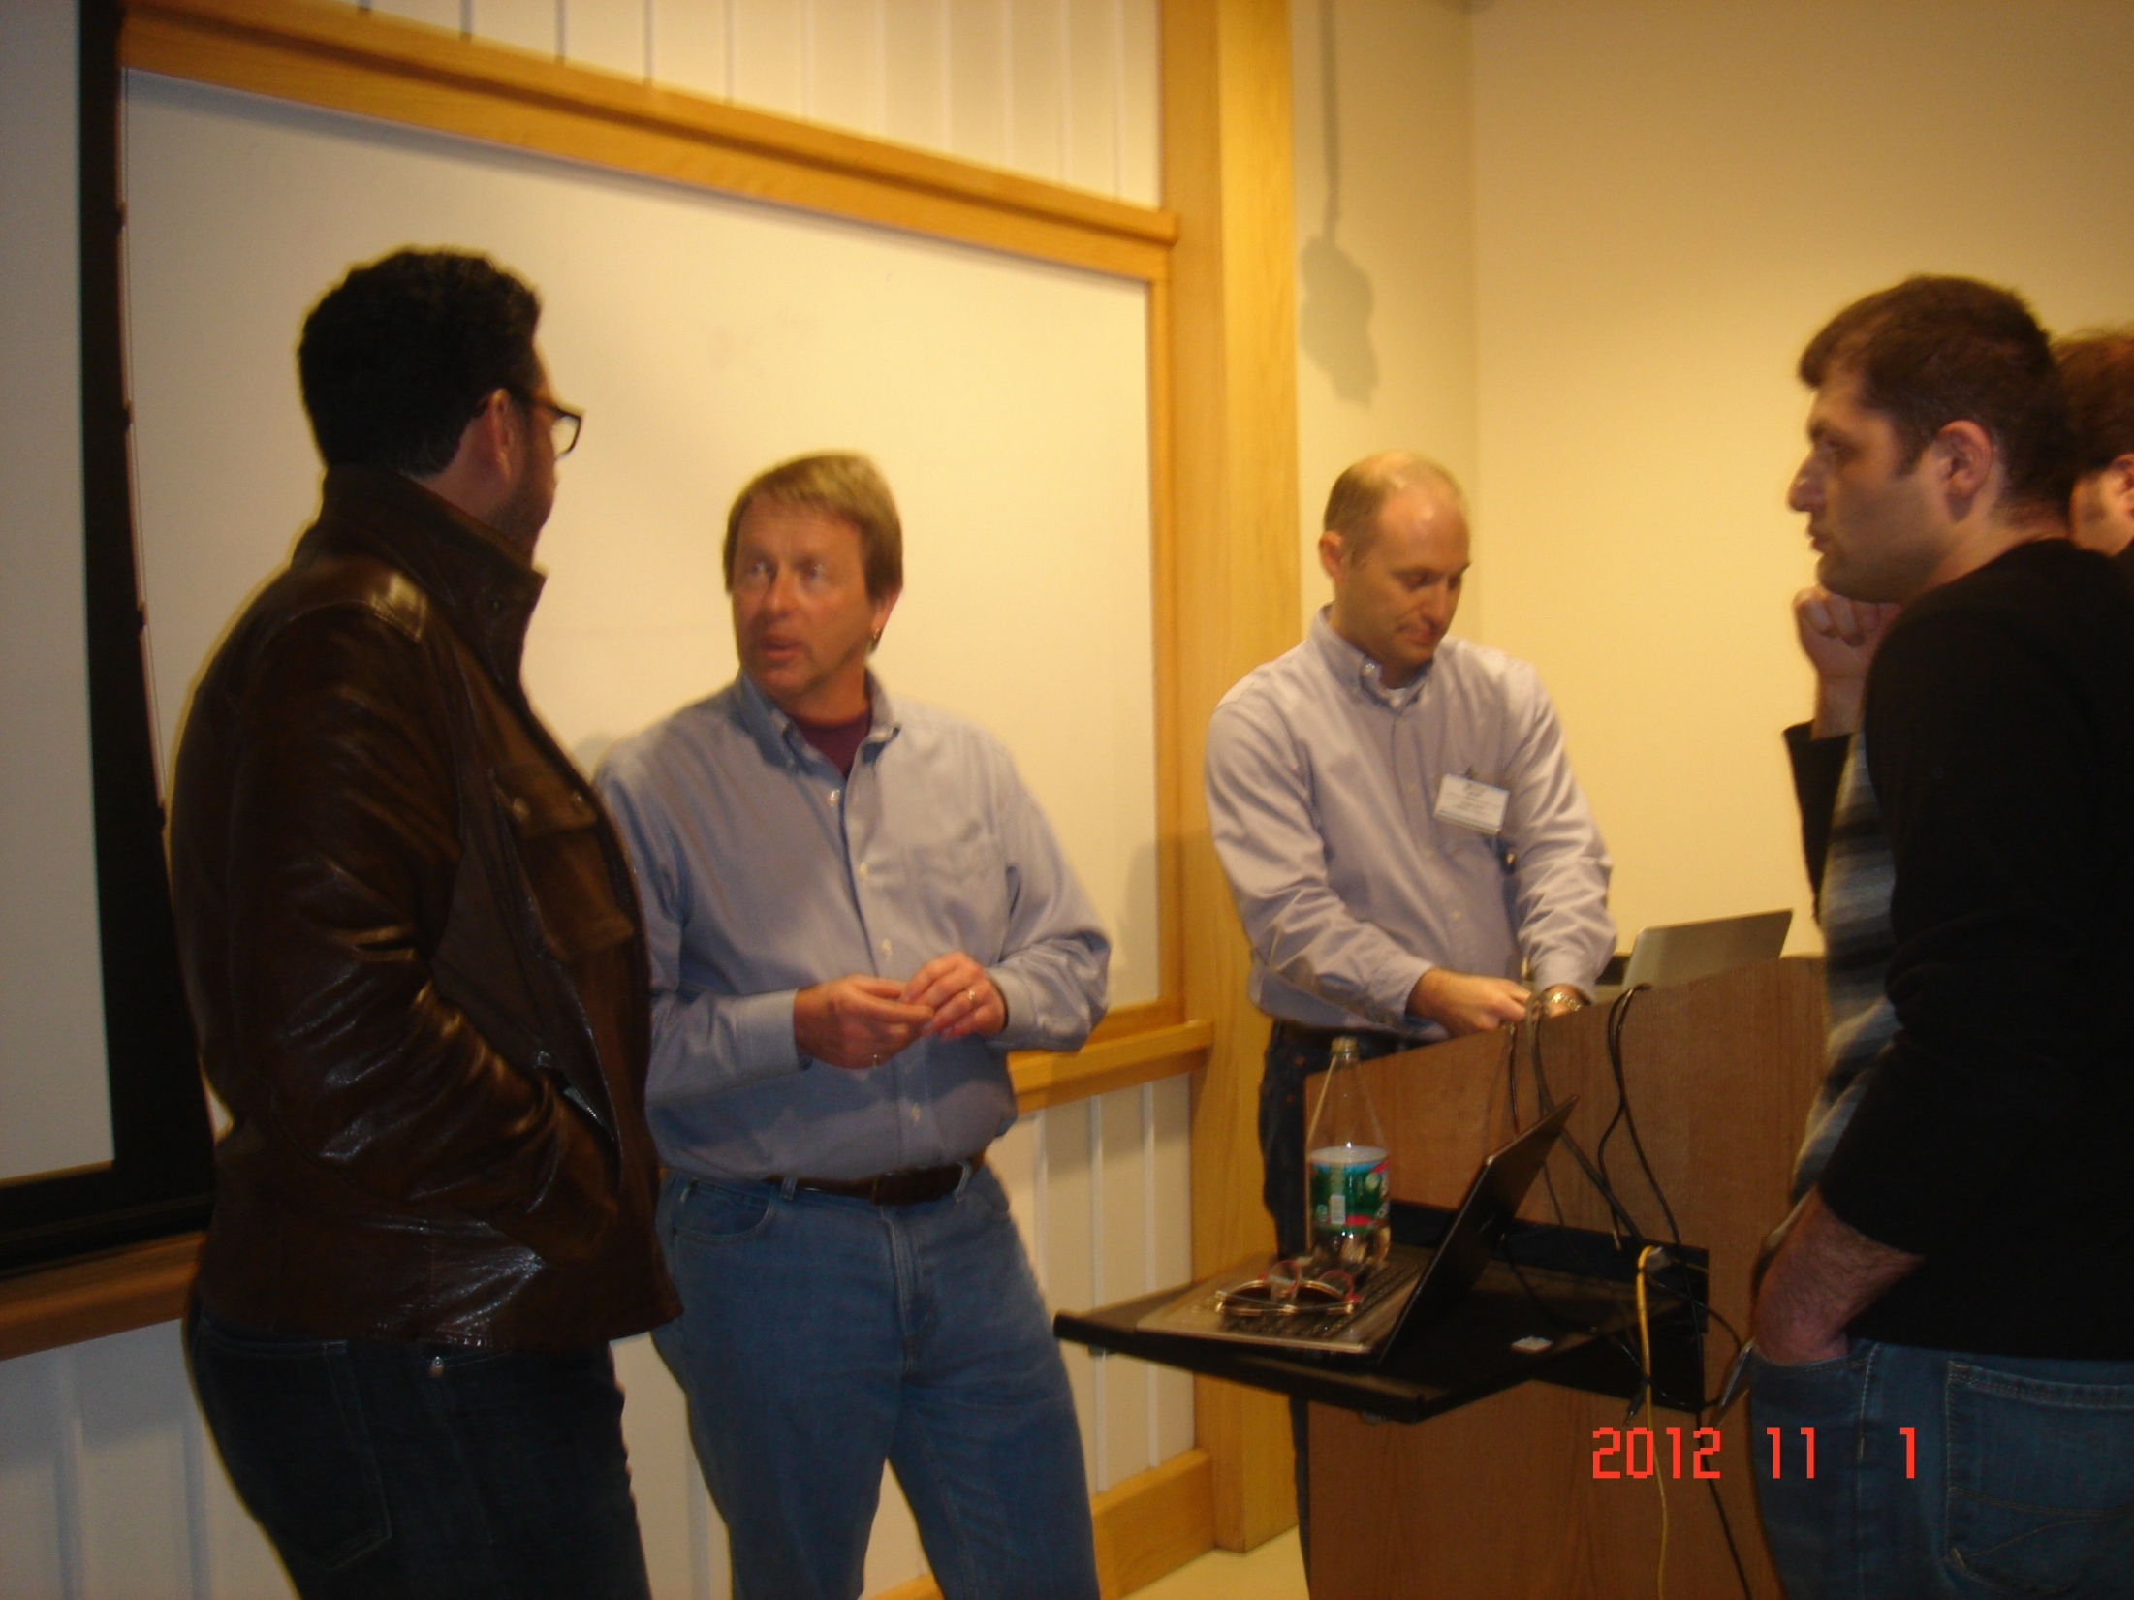

Slide 40
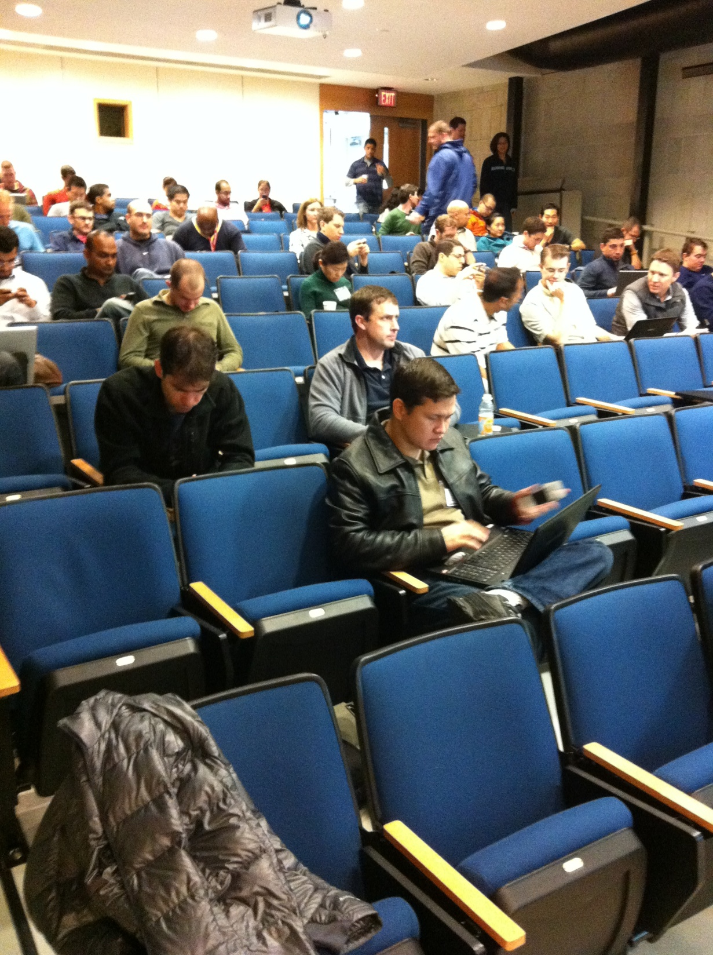

Slide 43
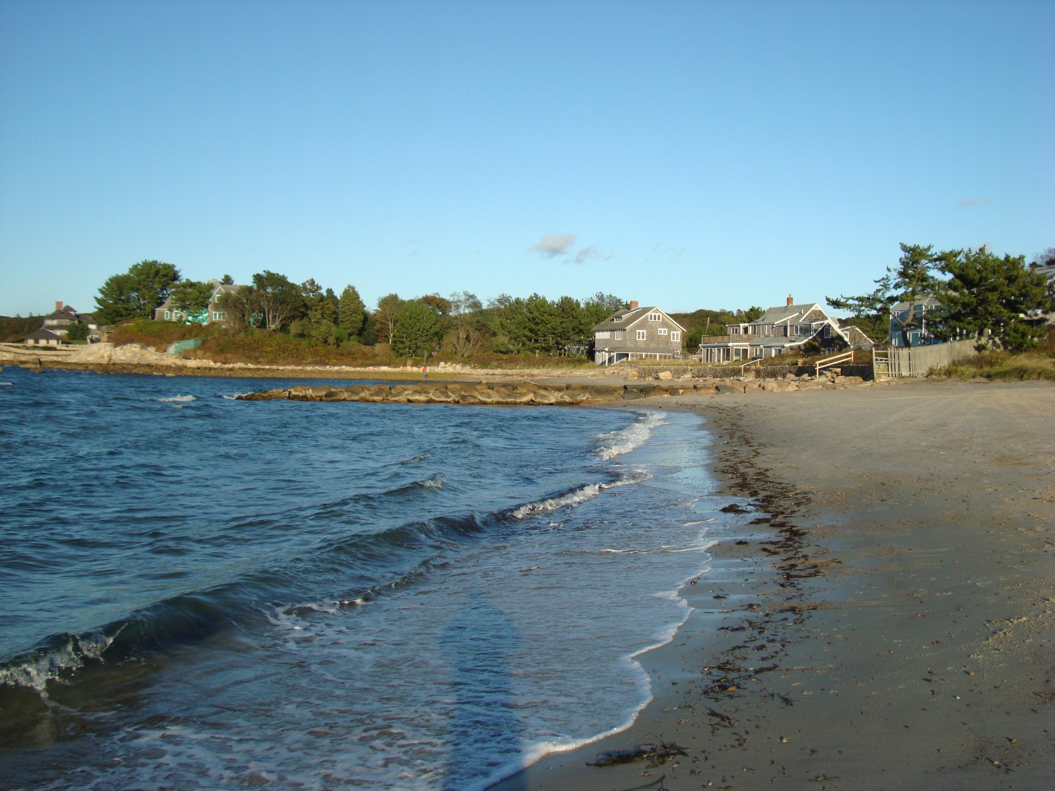

Slide 45
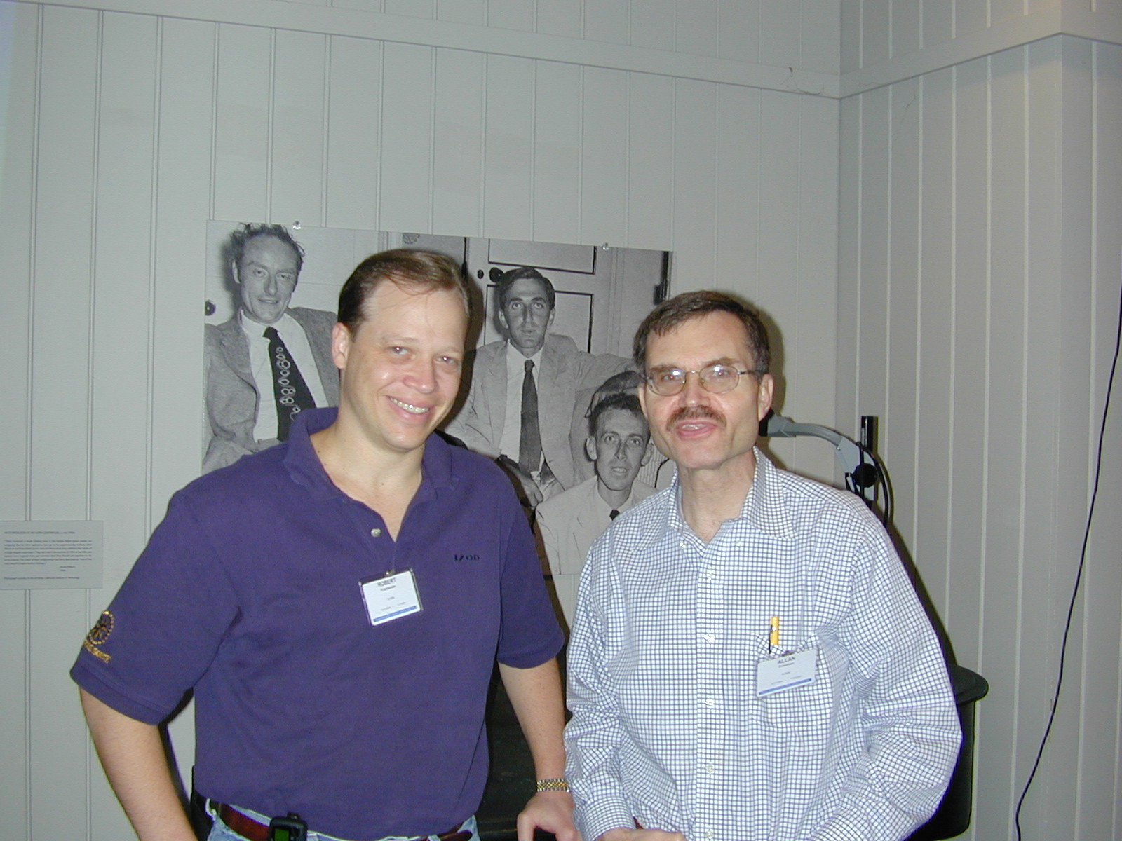

Slide 46
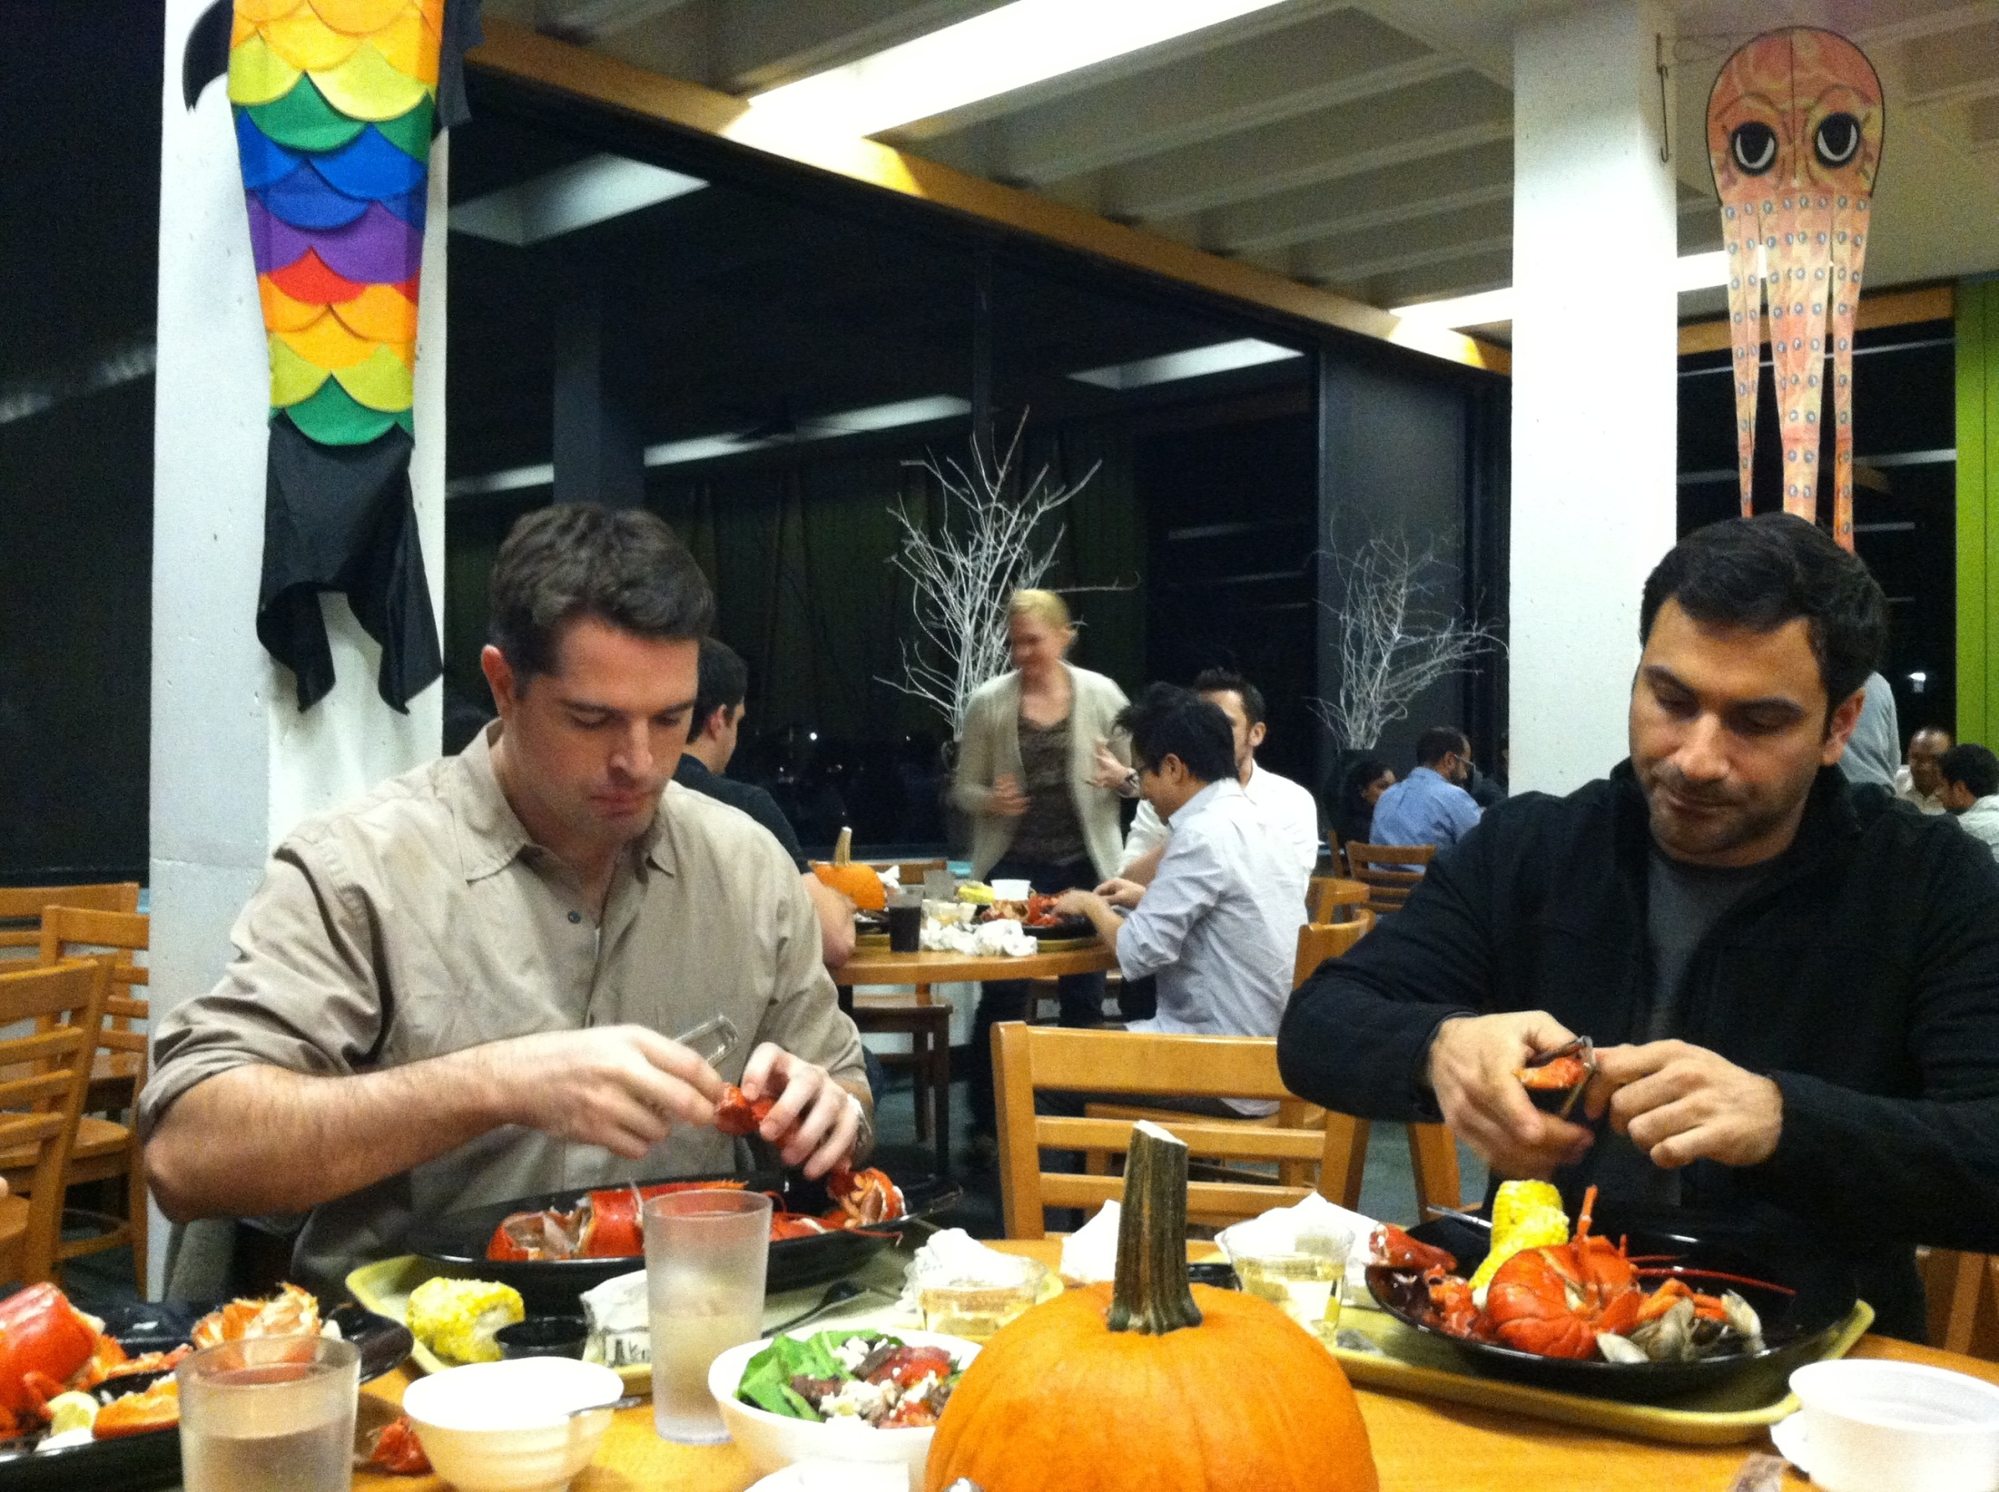

Slide 47
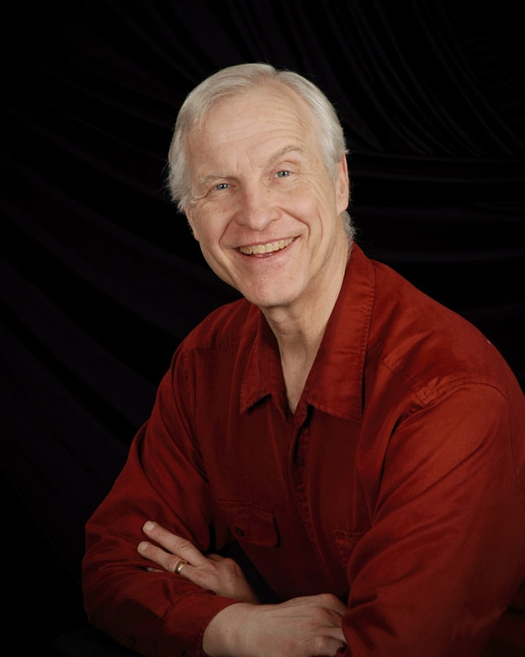

Slide 48
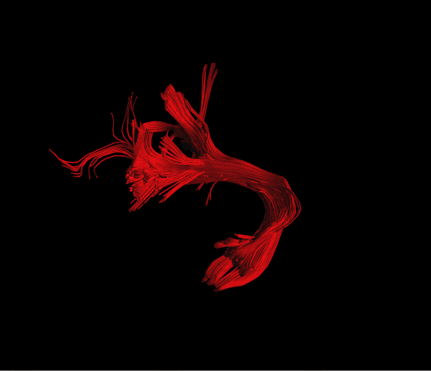
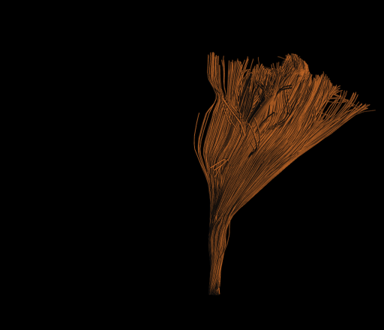
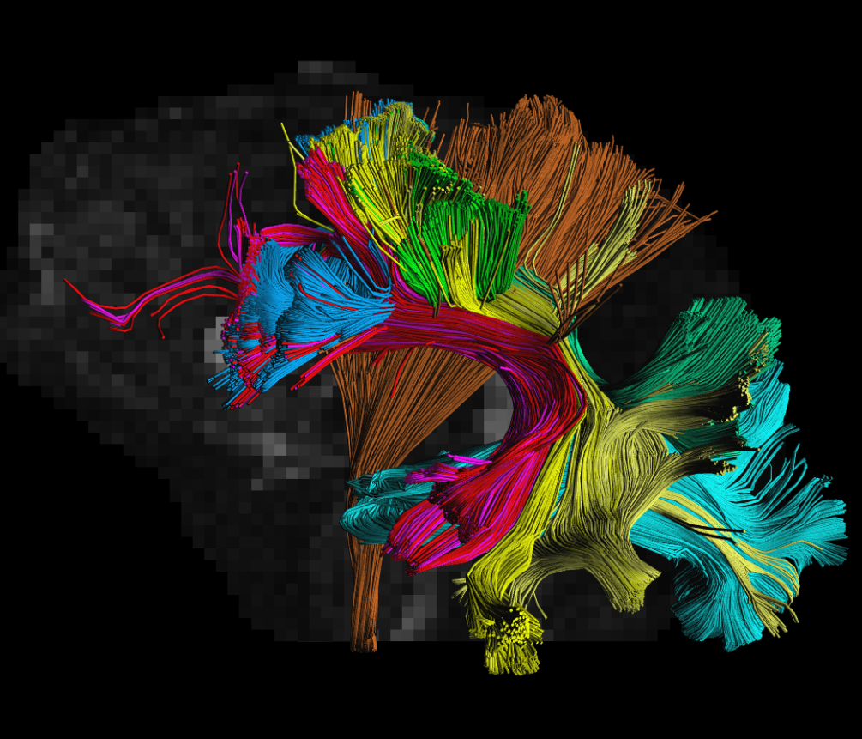
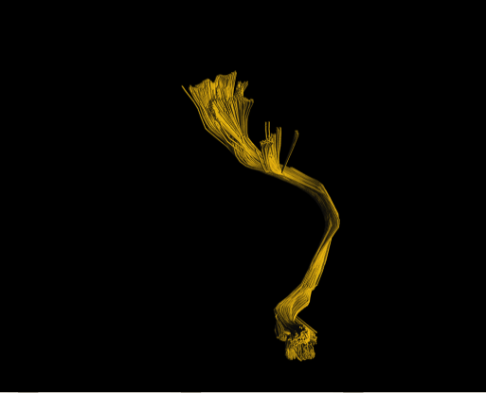
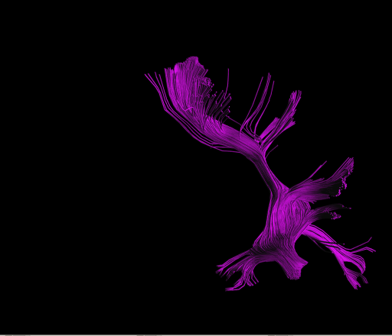
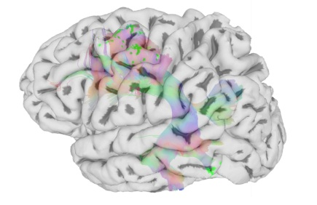
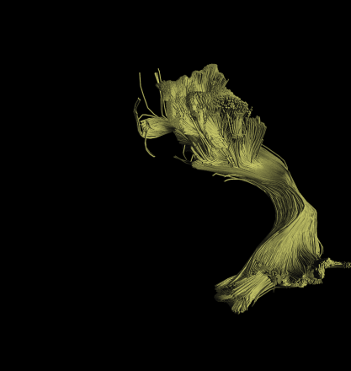
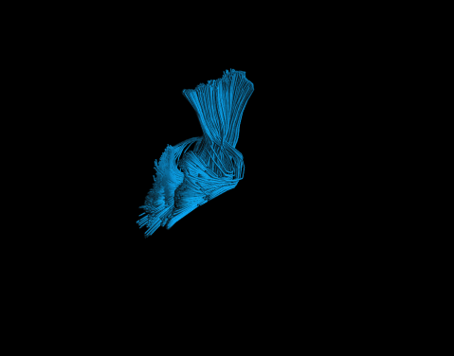
Virtual Dissection
Language Tract
Arcuate Fasciculus
Auditory
Speak What Hear
Hear
Sounds
Motor
Primary
Motor
Motor
Action
Vision
High Level
Object
Visual Object
Attentive
Action
Primary
Vision
HDFT virtual dissection of arcuate fasciculus (language tract)
Interlink
Speak
What See
Complex Language

Slide 49
Virtual Dissection
Language Tract
Arcuate Fasciculus
Auditory
Speak What Hear
Hear
Sounds
Motor
Primary
Motor
Motor
Action
Vision
High Level
Object
Visual Object
Attentive
Action
Primary
Vision
HDFT virtual dissection of arcuate fasciculus (language tract)
Interlink
Speak
What See
Complex Language

Slide 51
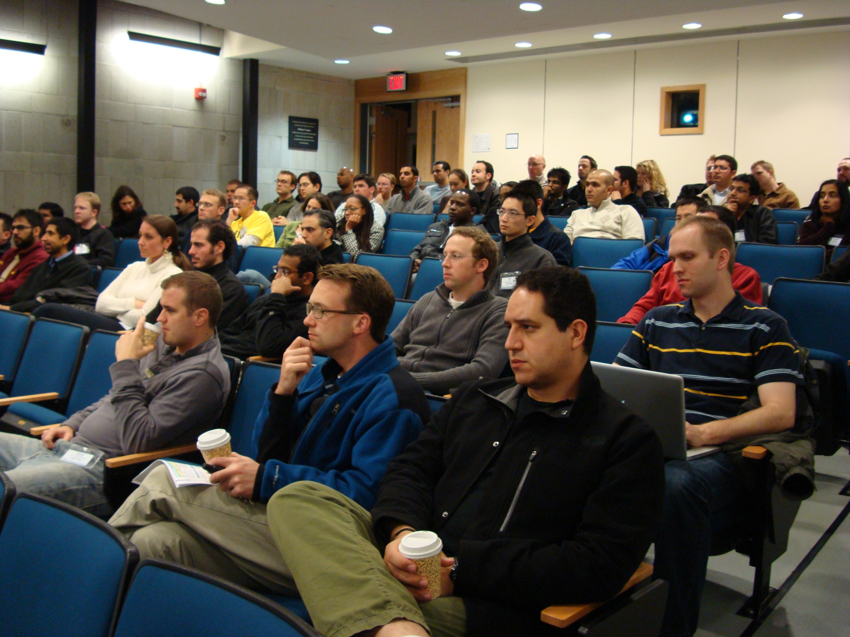

Slide 52
RUNN 2012 OCTOBER 28 - NOVEMBER 4, 2012 EDUCATIONAL EXPENSES
REVENUE
Educational Grants $41,000.00
Total Grant Revenue $41,000.00
EXPENSES
Faculty Travel, Housing, Meals $19,962.16
Faculty Honoraria $5,750.00
Faculty Recruitment, Arrangements,
Course Administration $4,000.00
A-V, Room Rental $4,018.78
Neuroscience Textbook $8,356.20
Resident Research Awards $10,000.00
Total Expenses $52,087.14

