Slide 1
Radiation Safety for Neurosurgeons
Society of Neurological Surgeons
Junior Resident Course

Slide 2
Wilhelm Conrad Roentgen (1845-1923)
Discovered X rays on November 8, 1895, at the University of Wurzburg
Named it X-ray because he did not know what it was when he discovered it
Roentgen received the first Nobel Prize in physics in 1901.
X rays since then have revolutionized physics and medicine.

Slide 3
Types of Radiation
Ionizing radiation
Radiation that carries enough energy to knock electrons off an atom
Can generate free radical particles
Can cause damage to DNA and lead to malignancy
No established safety dose threshold
Non-ionizing radiation
Does not carry enough energy to remove electrons
Generally not harmful to organisms

Slide 4
Ionizing radiation
Alpha rays
Consisted of helium particles with 2 protons and 2 neutrons
generally does not penetrate skin
Beta rays
Consisted of electrons (-) or positrons (+)
Penetrates further than alpha radiation, but is usually stopped by a few millimeters of metal

Slide 5
Ionizing radiation
Gamma rays
Electromagnetic waves (Photons) with freq greater than 1x10^19 Hz
Each photon carries about 4.14 keV of energy
X-rays
Electromagnetic waves with freq between 3x10^16 and 3x10^19Hz
carries about 1.24keV of energy
Ultraviolet rays
Electromagnetic waves with freq between 3x10^15 to 3X10^16 Hz
Upper frequency range can be ionizing; lower frequency range is generally not ionizing

Slide 6
Non-ionizing radiation
Soft UV light
Visible light
Infrared light
Microwaves
Radio waves
Long waves

Slide 7
Non-ionizing radiation
Soft UV light
Visible light
Infrared light
Microwaves
Radio waves
Long waves
Does not carry enough
energy to remove electrons
and generally not harmful
to humans

Slide 8
Units of Measurement
Gray (Gy)
Absorbed radiation dose
Defined as absorption of one joule of radiation energy by on Kg of mass
1 Gy= 100 cGy = 100 rads =1 Joule/Kg

Slide 9
Units of Measurement
Sievert (Sv)
a single unit which expresses the health effects associated with all possible exposure situations
"effective dose”; named after the Swedish physicist who was one of the pioneers in protection against ionizing radiation.
1 Sv = 100 rem* = 1 Joule/Kg
1 rem = 10mSv
*rem = The roentgen Equivalent in Man (older term)

Slide 10
Gray vs. Sievert

Slide 12
Radiation Effects
Deterministic effects:
The severity of the effects is a function of the dose
A threshold is generally present
Radiation dermatitis, epilation and radiation poisoning are some examples
Stochastic effects:
The probability of occurrence of the effect (not the severity) is a function of the dose.
no threshold of radiation dose for stochastic effects.
Malignancy induction and genetic hazards are two examples

Slide 13
Radiation exposure doses
Flight → 0.005 mSv per hour in air → Round trip NY to LA (0.06 mSv)
Chest X-ray → 0.1 mSv
CT head→ 2 mSv;
CTA head → 5mSv
CT chest → 7 mSv
CT abd/pel → 10 mSv
CT spine → 10mSv
Annual radiation dose limit → 20 mSv/year avg over 5 yrs
Maximum dose in any single year → 50 mSv
Radiation poisoning → 400 mSv if received in short period
Fatal → 4 to 8 Sv

Slide 15
Radiation exposure doses

Slide 16
Radiation exposure doses

Slide 17
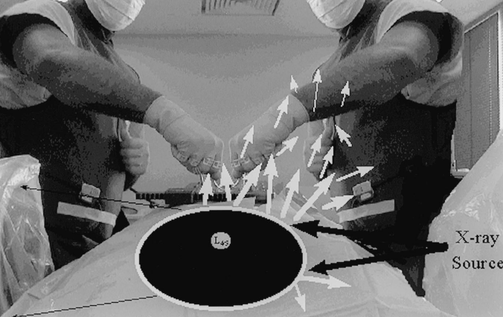
Radiation exposure with spine surgery
Continuous fluoroscopy
0.43 to 1.25 mSv for 1–3 min
Pulsed fluoroscopy
0.1 mSv for 1 min.

Slide 18
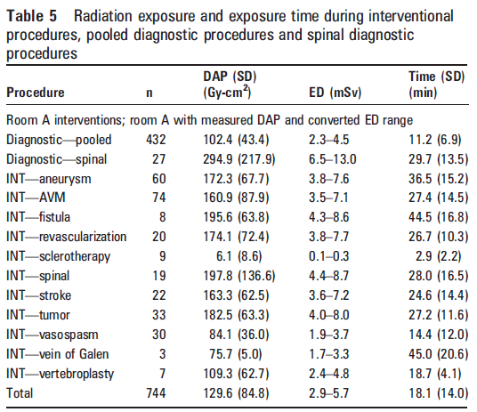
Radiation exposure with endovascular procedures

Slide 19
Strategies for reducing occupational radiation exposure
Minimizing radiation from source
Dose reduction
Reduce scattering
Imaging guidance with O-arm
Shielding
Lead gown, thyroid shield, lead goggles
Increase distance from radiation source
Inversed square law
Stand as far away as possible

Slide 20
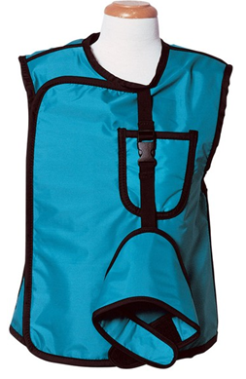
Lead Gown and Thyroid Shield
The typical thickness of a lead gown:
0.25 mm → 90% attenuation
0.35 mm → 95% attenuation
0.5 mm → 99% attenuation (twice as heavy as 0.25mm)
Areas not protected by the apron:
extremities, eyes, and thyroid
Pregnant women should monitor exposure
with a badge outside the lead apron and
should wear a second badge inside the apron
over the abdomen to monitor fetal exposure.

Slide 21
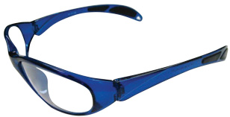
Lead goggles & gloves
Glasses can provide about 20% attenuation.
Leaded glasses attenuate x-rays 30% to 70%, depending on the amount of lead.
Lead or tungsten gloves can have exposure reduction of 7% to almost 50% → varies by manufacture, and can give surgeons false sense of security

Slide 22
Distance
Stay as far away from the source as you can
For example, standing 6 ft away vs 3 ft away has a huge difference in radiation dose
Staying 10ft away is recommended

Slide 23
Stay Safe!

