Slide 1
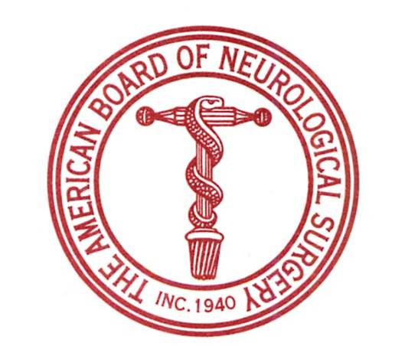
ABNS Changes: How Do They Affect Residency Curriculum and Requirements for Practice Data
Nelson M. Oyesiku, MD, PhD, FACS
Al Lerner Chair, Neurosurgery,
Professor, Neurosurgery & Medicine (Endocrinology)
Department of Neurosurgery
Emory University School of Medicine
Atlanta, GA,
Past Chair, ABNS

Slide 2
ACGME
ABMS
Residency Review Committee
for Neurological Surgery

Slide 3
Residency Review Committee
for Neurological Surgery
Certification,
MOC
Accreditation
Residents and fully-
trained Neurosurgeons

Slide 4
Maintenance of
Certification
Training
Requirements
Primary
Examination
Practice
Assessment
Credentials
Assessment
Oral
Examination
Issue
Certificates

Slide 5
What ABNS Changes?
Training Requirements
Elective – Core Rotations
Primary Certification requirements
ABNS-SNS (CAST)
Portal
Case Logs – Case Minimums
Milestones

Slide 6
Training Requirements (aligned with RRC)
6 to 7 yr residency length conversion
During the first 18 Mo of Education - 3 Mo of Clin Neuroscience + at least 3 Mo of Crit Care applicable to the Neurosurgical Patient + 6 Mo of Structured Education in Gen Patient Care
54 Mo of Clin NS Education. A minimum of 21 Months must occur at the Primary Clin Site
42 Mo of Operative Neurological Surgery of which 12 months as CR
The remaining months of the Program must be used for Elective Clin Educ and/or Research
Elimination of TTP year

Slide 7
ABNS PRIMARY CERTIFICATION REQUIREMENTS
150 Current, Sequential Major Operative Cases, minimum of 3 Mo followup
Logging should commence 3 Mo into Practice
Must Submit For Orals Within 4 Yrs and Take Part 2 Within7 Yrs of Graduation
Oral Exam - 5 Point Grading Scale
Cranial, Spinal, Other Distributed in Each Hour

Slide 8
Elective – Core Rotations
Previously training obtained at another program (including foreign program) could be only be recognized as elective credit.
The ABNS now recognizes this training as counting for up to 12 months of the core 54 month requirement as long as this education occurred at an ACGME approved neurosurgery program.

Slide 9
ABNS PRIMARY CERTIFICATION REQUIREMENTS
After Each Examination Minimum Passing Scores Are Established For Each Subject Domain
Must Pass All 3 – cranial/spinal and other
Approximately 50% Standardized Questions
May Fail 3 Times, NOT 2
All 3 Attempts Must Occur Within 7 Yrs of Graduation

Slide 10
ABNS-SNS (CAST)
The ABNS strongly supports the SNS proposal to recognize infolded fellowship training through the Society of Neurological Surgeons’ Committee on Accreditation of Subspecialty Training (CAST).

Slide 11
Portal
The ABNS strongly supports of the SNS proposal to recognize infolded fellowship training through the Society of Neurological Surgeons’ Committee on Accreditation of Subspecialty Training (CAST).
Resident case logging
Primary certification case logging
MOC practice data – outcomes/PFP/benchmarking/quality improvements/recognition of focused practice

Slide 12
Case Logs – Case Minimums
The ABNS has adopted a requirement for certification that graduating residents satisfy a minimum number of key cases similar to that adopted by the ACGME in order to provide an objective assessment of having achieved surgical competency during residency training. The details are being arranged.

Slide 13
Milestones
The ABNS is considering a requirement for certification that graduating residents satisfy level 4 milestones similar to that adopted by the ACGME in order to provide an objective assessment of having achieved surgical competency during residency training. The details are being arranged.

