Slide 1
The Value of Off-Site Resident Specialty Courses
Society of Neurological Surgeons
May 2008

Slide 2
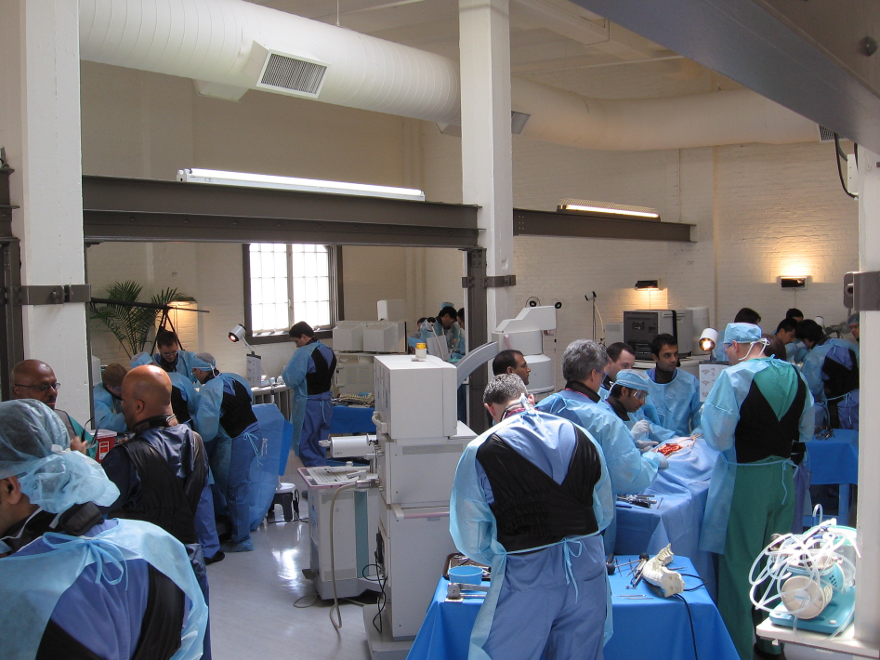
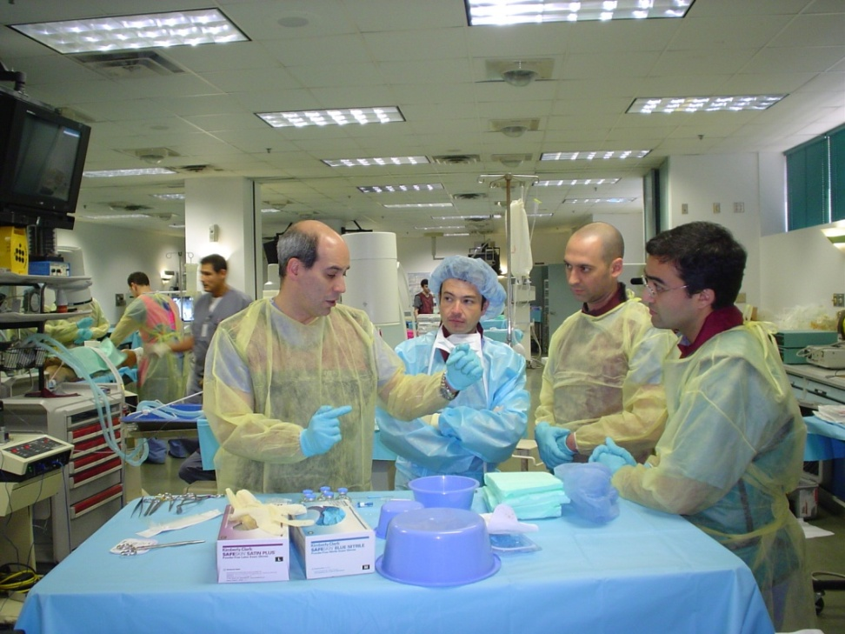
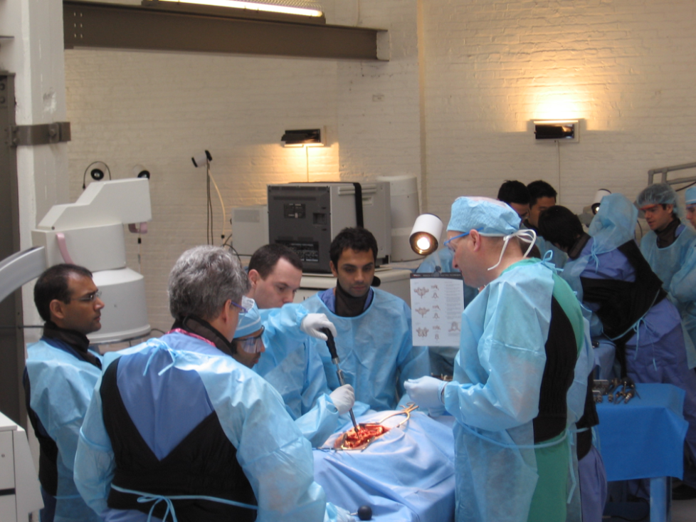
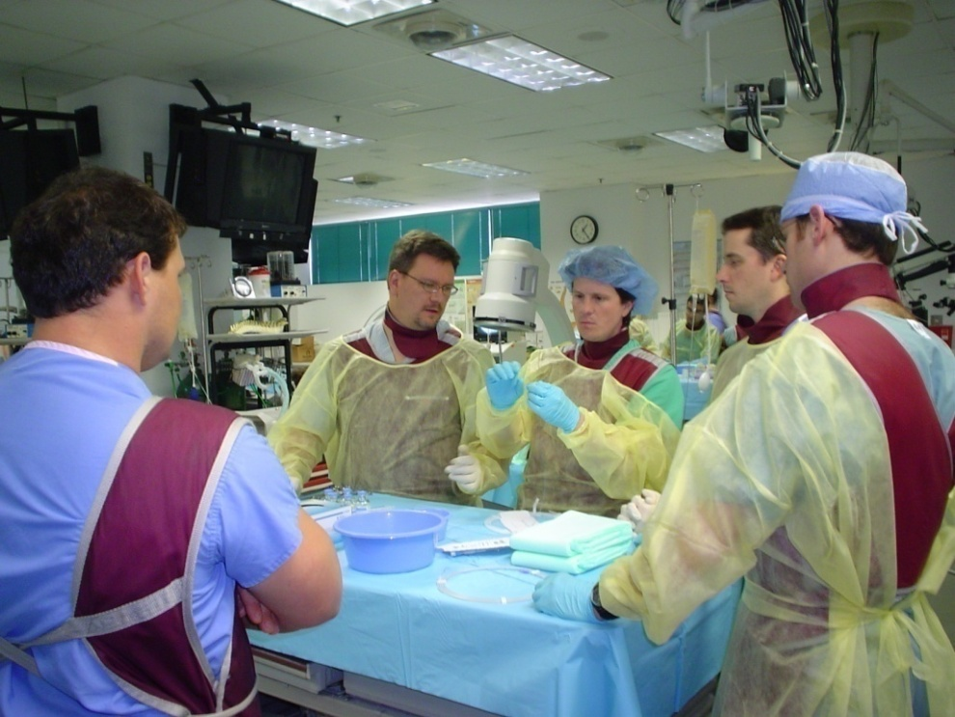
Education
Expert Faculty Exposure
Fellowship Opportunities

Slide 3
Strict Guidelines
Infrastructure
(finance, develop, implement, assess)
Dedicated Faculty
Facility

Slide 4

AANS Resident Education
  JNS, Neurosurgical Focus, AANS Bulletin, discounts on publications, complementary registration, etc
Educational opportunities coordinated with needs identified by SNS & ABNS
  NREF
  Pinnacle Partners Program
  AANS-SNS Online Training Modules
  Resident Mentoring Program
Member Benefits
Supportive Role

Slide 5
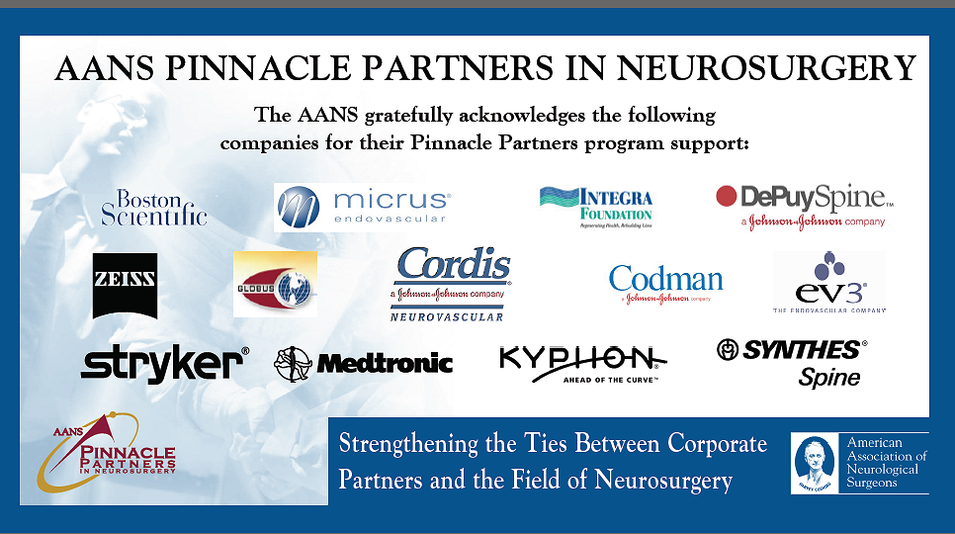

Slide 6

AANS Guidelines for Corporate Relationships
Approved December 2004
AANS has complete control of site selection, development of educational content, selection of faculty, implementation and assessment of all programs
In exchange for financial support, corporate sponsors will not influence or alter any educational event

Slide 7
AANS Development Committee
Chairman – Bill Couldwell
Members – Jon Robertson, John Popp, Carl Heilman, Anil Nanda,
Gail Rosseau, Paul McCormick, Reg Haid, Rick Fessler,
Bob Harbaugh, Bob Rosenwasser, Greg Thompson,
Michael Wang, Griff Harsh
*To support the coordinate fund raising efforts of the AANS Development Program
with individuals, groups, and corporations
*Balance ethical & legal concerns with the need for significant financial support from industry for AANS educational programs

Slide 8
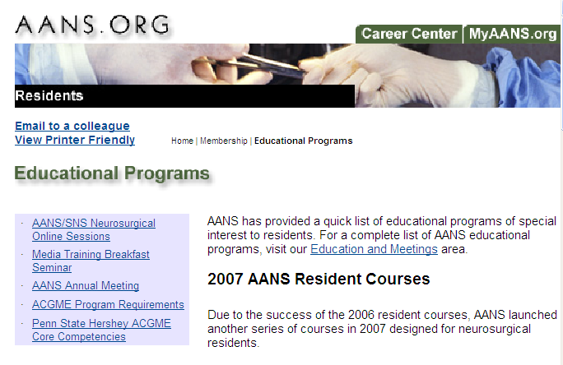
AANS Director of Development – Michele Gregory
AANS Associate Executive Director, Education & Meetings – Joni Shulman
AANS Director of Development – Michele Gregory
Associate Executive Director, Education & Meetings – Joni Shulman

Slide 9
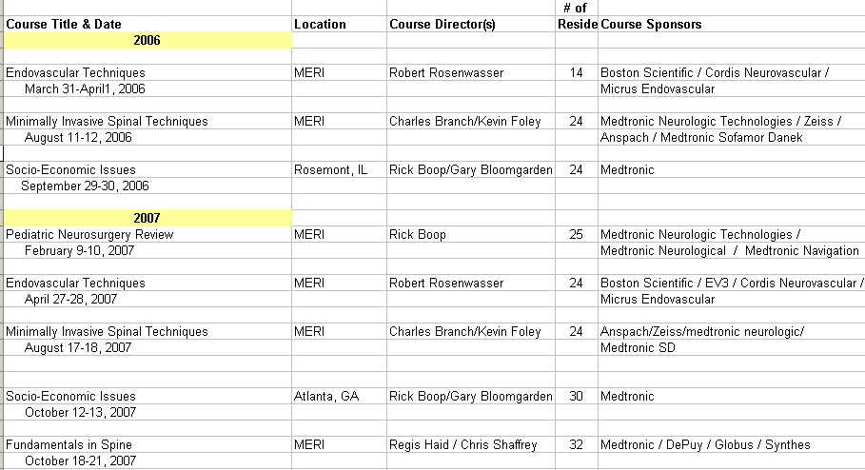
AANS Resident Educational Courses

Slide 10
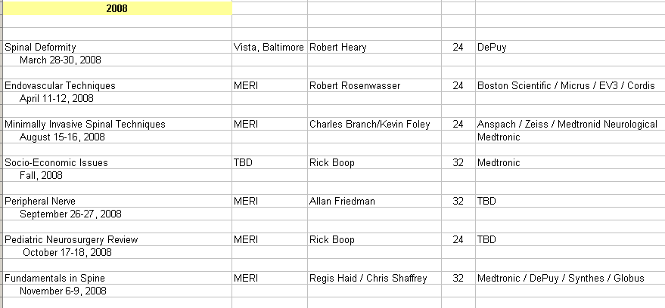
AANS Resident Educational Courses

Slide 11
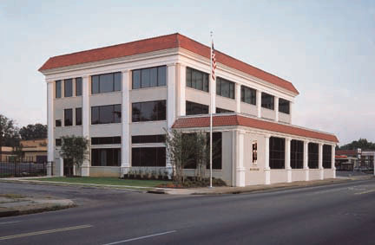

MERI is an independent not-for profit (501(c3)) education and research institute , opened in April 1995
27,000 sq ft 3 story facility with state-of the art surgical equipment and high quality anatomic material
Approved as AANS Anatomical Teaching Institute 2002

Slide 12
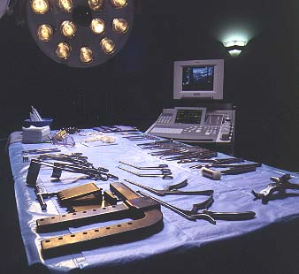
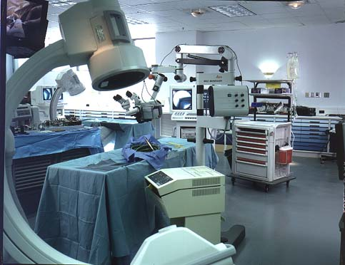
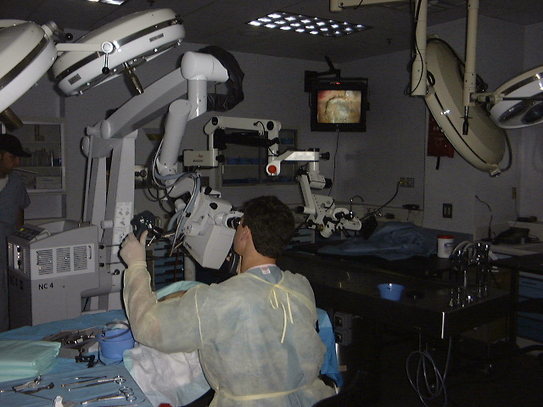

Slide 13

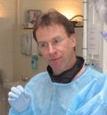

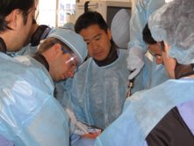
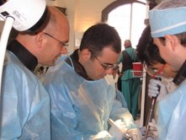
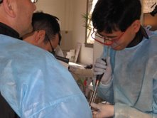
Spinal Deformity Course – March 2008

Slide 14
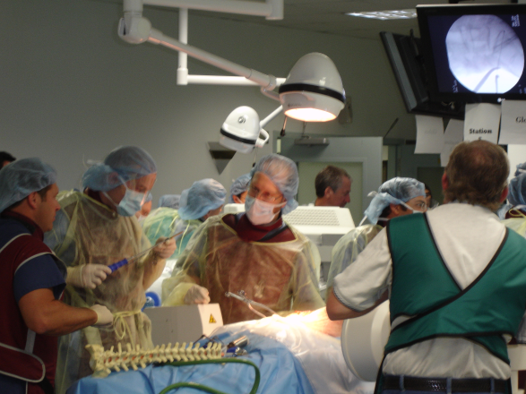
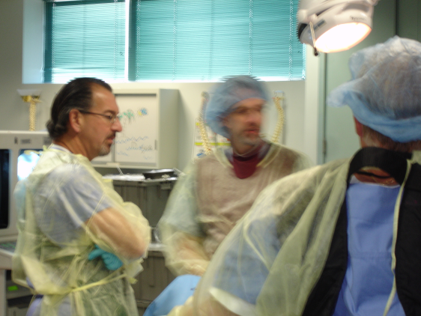
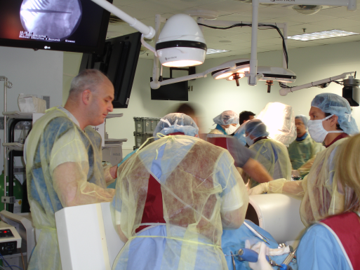
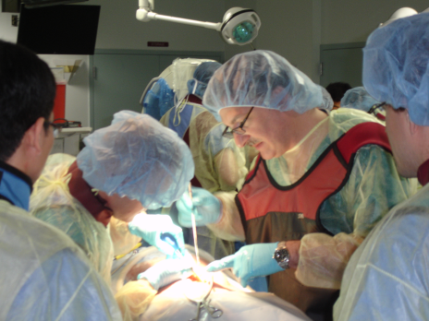
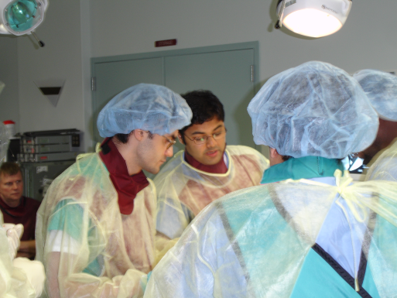
Fundamentals in Spine – October 2007

Slide 15
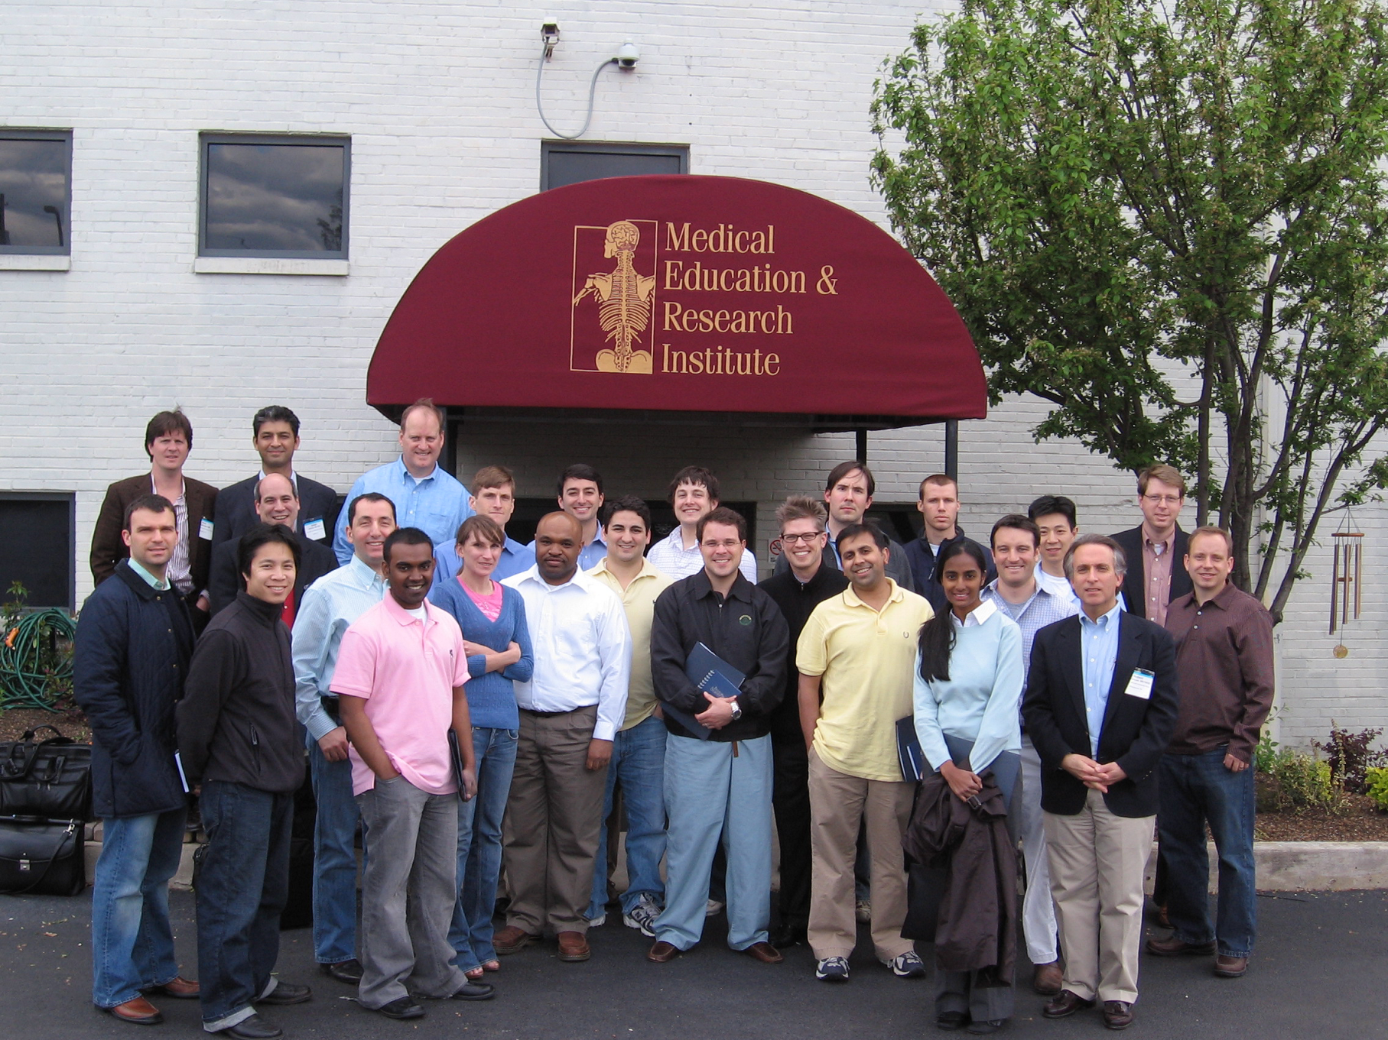
3rd AANS Endovascular Resident Course - April 2008

Slide 16

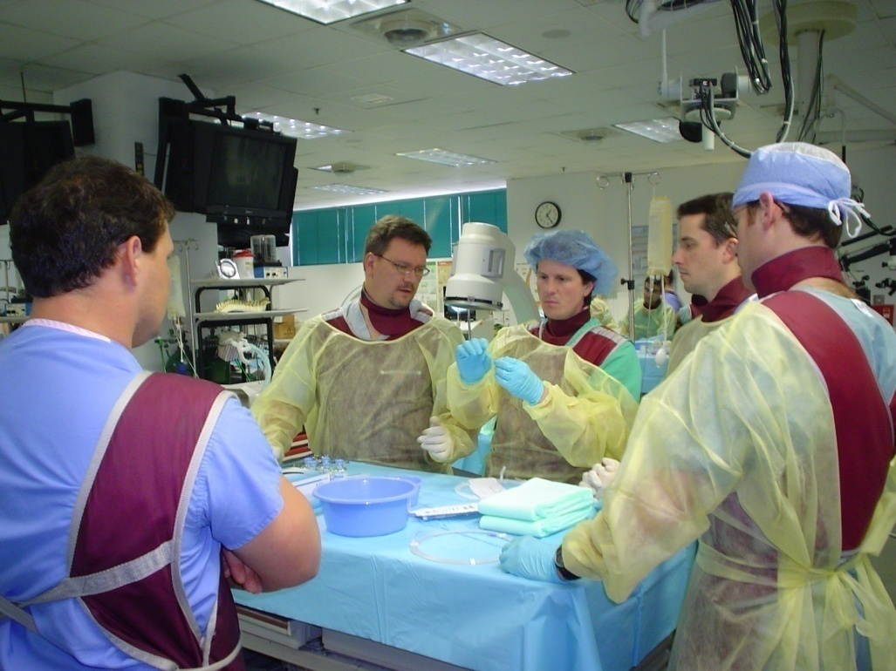
Residents perform
-angioplasty
-stenting
-coiling
-glue embolization

Slide 17
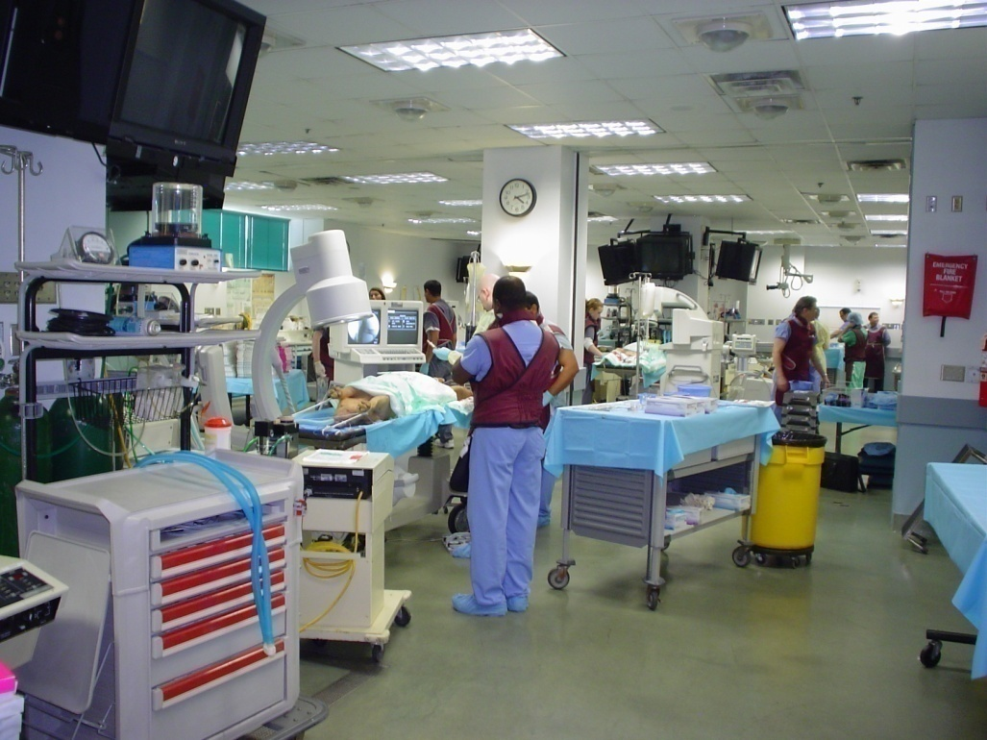
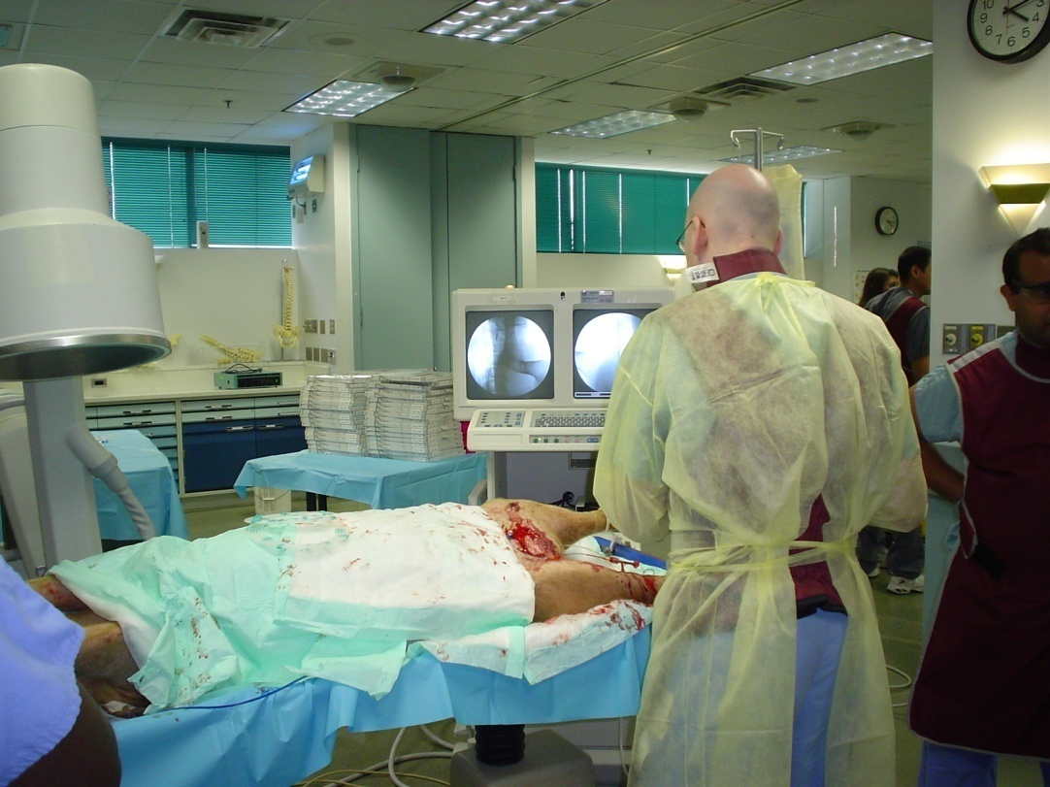
Residents perform
-femoral catherterization
-diagnostic angiography
-selective catherterization

Slide 18
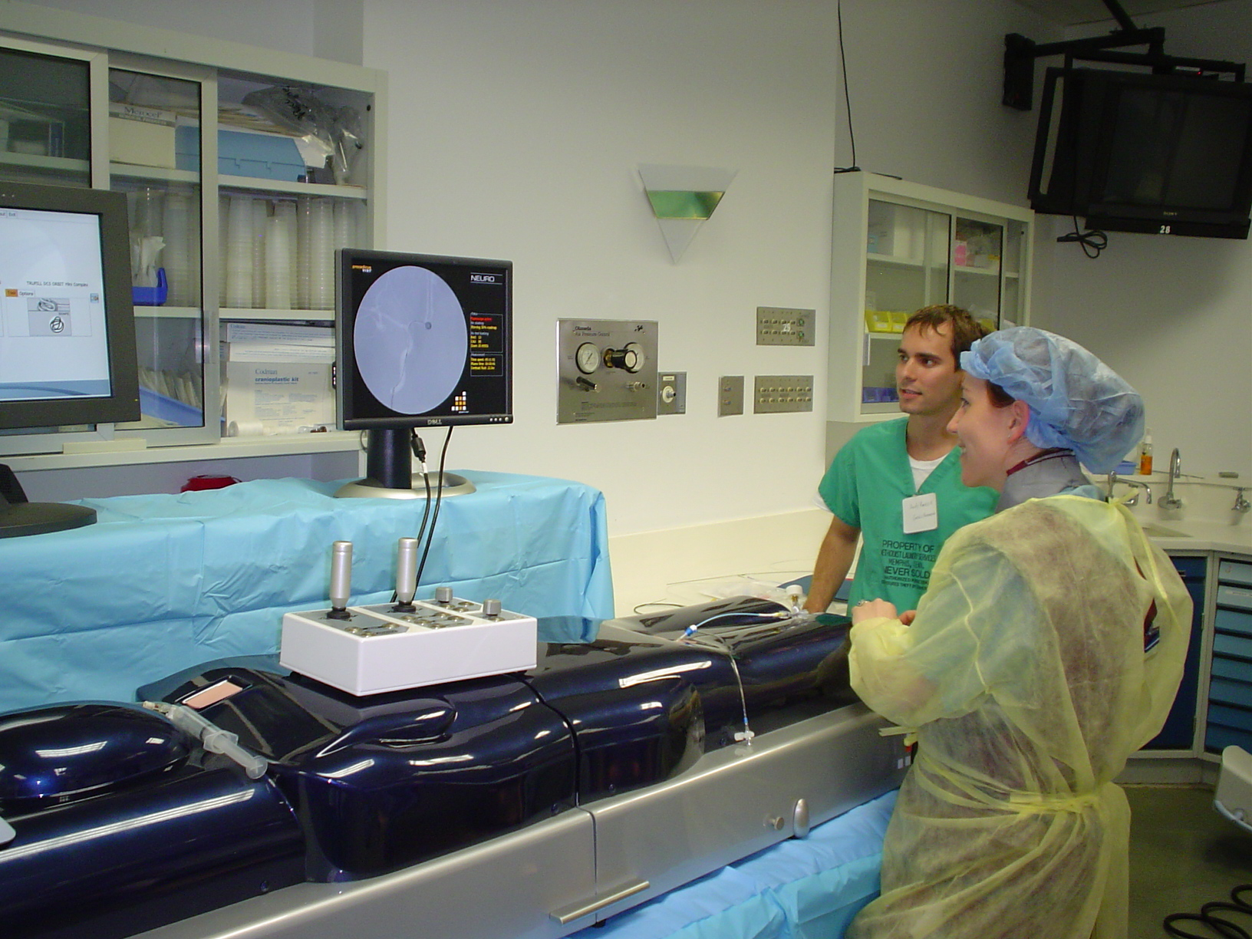
Simulator experience in guiding intra-arterial catheter

Slide 19
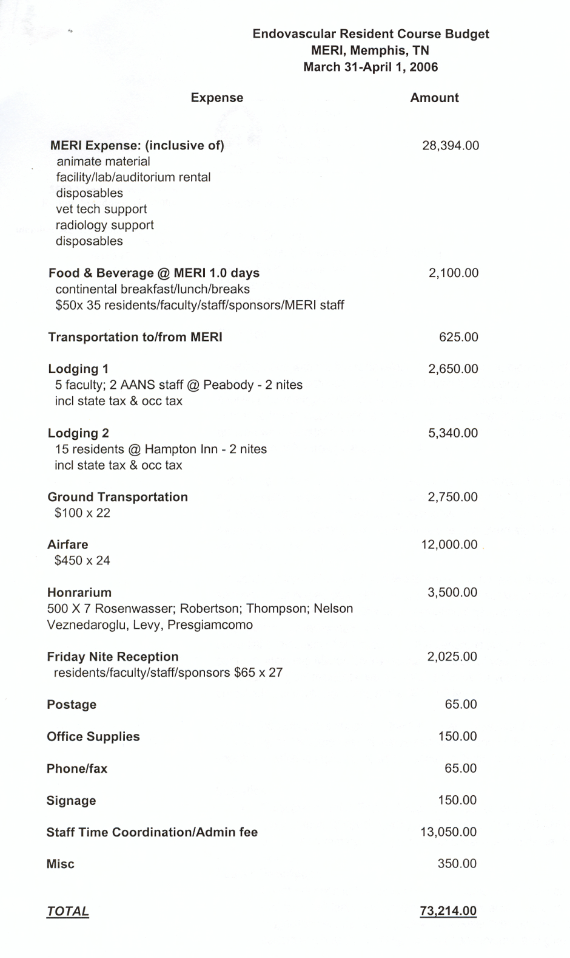
Cost - $73 K

Slide 20
AANS Resident Education Courses
2006 (3 courses) $220K 62 residents
2007 (5 courses) $465K 135 residents
2008 (7 courses) $650K 192 residents
18 courses $1.3 million 389 residents

