Slide 1
Presentation Title (Strategic Plan)
Health Care Reform, the MA Experience, and the Future of Academic Medicine
Elizabeth G. Nabel, M.D.
President, Brigham and Women’s Hospital
Professor of Medicine, Harvard Medical School
Society of Neurological Surgeons
Boston, MA
June 09, 2013

Slide 2
Change is Here and Now
Massachusetts
Increasing coverage Intense focus on costs
2006: Universal Coverage Bill
2008: Cost Containment Bill
2010: Small Business Premium Relief
2012: Cost Growth Benchmark/Payment Reform (Ch. 224)
Seeks to hold spending to MA GSP (3.6%)
Encourages movement toward new payment models
Notes:
2006: Addressed coverage & access. Reduced uninsured to <2%.
2012: focus on cost & payment
Reduce total medical expense with focus on utilization, population health and value
Movement away from transactional fee for service to new payment models
Risk sharing (ACOs, shared savings, global budgets, bundles)
MA: 5 Pioneer ACOs, Medicaid RFPs, 75% of MDs in Blue Cross Alternative Quality Contract
Moving to full risk

Slide 3
Rising health care costs have been squeezing employers and employees for years
Cumulative Increase in national Health Care Premiums, Wages and Inflation (1999 base)
Health Care Premiums
Workers’ Earnings
Inflation

Slide 4
There are three ways society is combating rising costs
Implement payment reform
Turn patients into consumers
Contain rates through regulation
Make physicians economically sensitive
Global payment (e.g. Medicare ACO, Blue Cross AQC,etc.)
Bundled payments for acute/chronic disease
Make consumer economically sensitive
Tiered provider networks
Differential co-pays and deductibles
Provide consumers with data on relative costs and quality
Slow or stop rate increases for Medicaid/ Medicare
Mandate lower commercial reimbursement rates
Notes:
There are three possible strategies private and public payers could use to moderate rising costs:
Increase physician economic sensitivity by using more global payments for care (e.g., Blue Cross AQC) or bundling payments for chronic/acute disease treatment
Make consumers more economically sensitive by raising deductibles or tiering providers
Reduce rates through regulation. We expect to see rate pressure from Medicaid/Medicare, but there is also the potential that commercial rates could be capped to grow at national medical CPI or set to community averages so Partners will no longer be able to charge for its research, teaching, and community activities

Slide 5
Leading Change
“ ... just as we showed the nation how to deliver universal health care, Massachusetts will be the place that cracks the code on cost containment.” -- Gov. Patrick

Slide 6
Full Spectrum of Care
Acute Care
2 Academic Medical Centers
3,450 Tertiary Specialists
6 Community Hospitals
Post Acute Care
4 Rehabilitation Hospitals
2 Skilled Nursing Facilities
Home Health Agency
Ambulatory Care
6 Multi-Specialty Ambulatory Care Centers
3,300 Community-Affiliated Physicians
6 Community Health Centers
Specialty Care
Psychiatric Hospital
4
Notes:
Foundation: Developed distributed network with full range of care providers
PHS is comprised of tertiary & quaternary academic teaching hospitals, community hospitals, non-acute services, ambulatory care, and perhaps most importantly, a robust primary care system that supports the system.

Slide 7
Strategic Vision
Preserve
Mission
To provide superior care, patient-family centered, accessible,
coordinated and affordable.
To lead in research that fosters collaboration and shares our
successes with the world.
To invest in education and training for the next generations of
leaders.
To touch the communities we serve, local or global with
sustainable improvements that focus on underserved
populations.
Notes:
Our mission is the most important thing in this organization. It is the “roof” under which all we do must reside.
I’d like to remind you of the principles we laid out at the beginning of this journey.
[Read bullet points]
Now, I’d like to walk you through a framework that will serve as our guiding structure for the strategic initiatives we will discuss today.
7

Slide 8
The Strategic Path
We need to control our destiny to make our institutions stronger and to preserve our mission
We must own financial responsibility for our patients
Price linked to Quality – in the marketplace
Right Care, Right Place, Coordination

Slide 9
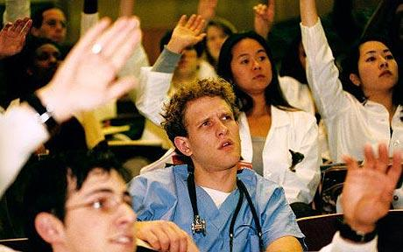
Academic Medical Centers: Facing Many Challenges
Volatile political climate
Depressed economic climate
Uncertainty of NIH funding
Skyrocketing drug discovery and development costs
Medical curriculum outdated for modern medicine
Exponential growth of knowledge
Changing disease burden and demographics

Slide 10
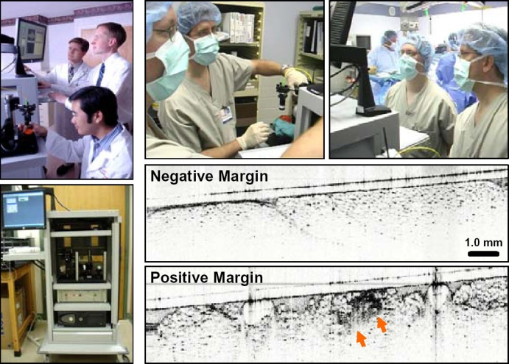
Making a Case for Change: Clinical Care
Seamless, high-quality patient and family-centered affordable care
Information integration
E-health records
Point-of-care imaging

Slide 11
Population Health Management
Deliver care in the Community and Develop ambulatory care delivery
Closer to home patient access
High quality, innovative practices with employed physicians
Support for Primary Care and Patient-Centered Medical Home
Support for our Community Hospitals
Appropriate complex referrals to BWH

Slide 12
Research: Do Our Methods Need to Change?
The R01.
The Lab.
Facts, requirements, courses.
In-patient visits.
Team science?
Interdisciplinary, inter-sector collaborations?
Competencies?
Flexible locus of care?

Slide 13
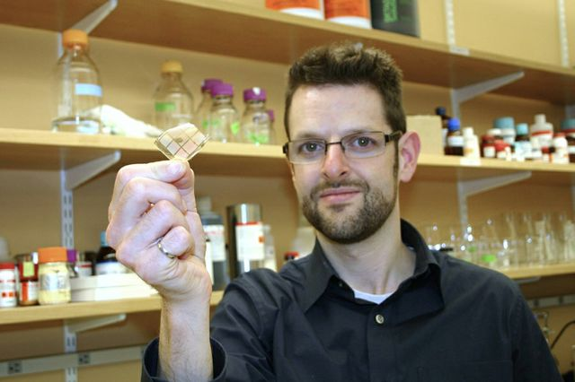
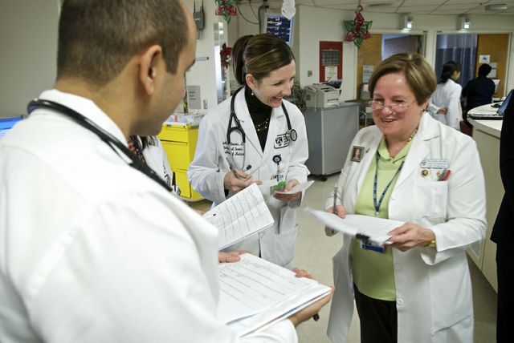
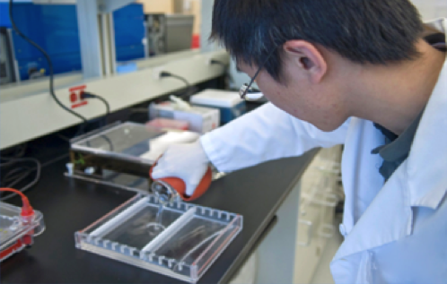
Making a Case for Change: New Directions in Research
New revenue sources
Partner with venture capital, biotech, pharma
Specific diseases instead of general alliances
Systems approach to research process; Cross-institutional research platforms
Secondary use of health care data
Focus beyond drug discovery including those in diagnostics, devices and emerging IT platforms

Slide 14
Partners Bench to Bedside Research Continuum
Clinical Research
Translational
Research
Technology
Development
Basic Research
Healthcare Delivery
2,200 P.I.s
6,600
Active MDs
CTSA
Harvard Catalyst
Basic/Clinical
Project Planning/management
Engineering/human studies
Business/market analysis
AMCs
Community Hospitals
Non-acute Care Centers
Community Health Centers
Discovery/Translational Research
- Academic medical centers/teaching hospitals and specialty care hospitals
Advanced Translation
- AMC/Industry/Venture partnerships
Product Introduction
- Primary care physicians
- Community health centers
Notes:
14

Slide 15
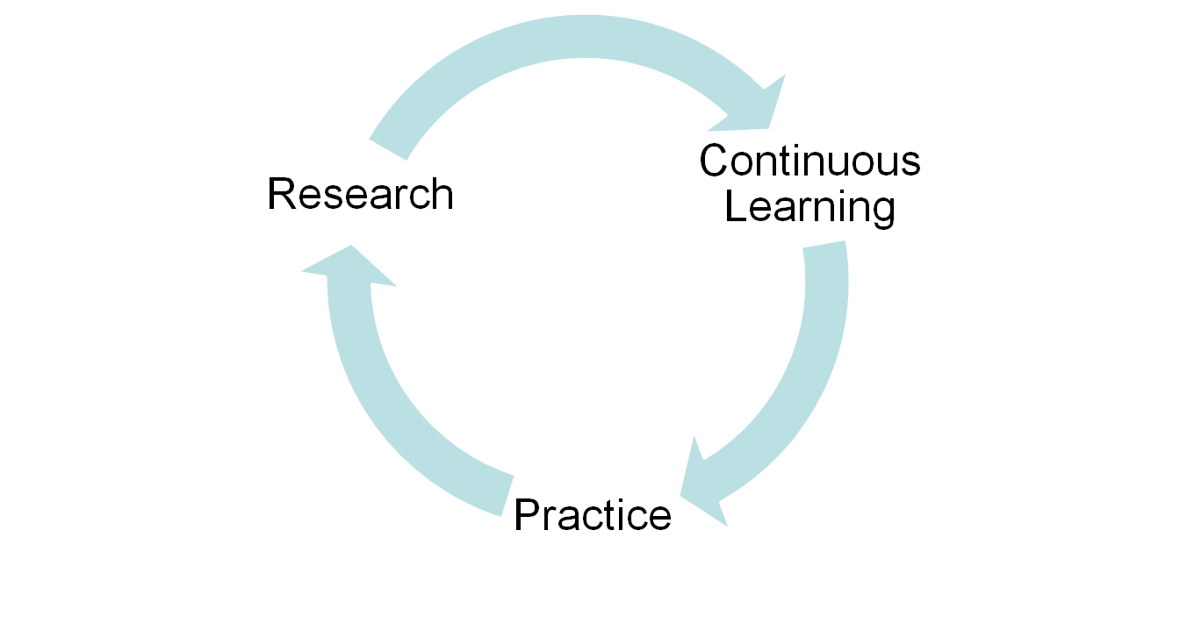
Integration is Necessary
New research models:
foster innovation in translational research
commercialization amid research funding cuts
Bridge research, clinical and community missions:
common clinical system is a catalyst for information integration
A new, integrated model of continuing professional development

Slide 16
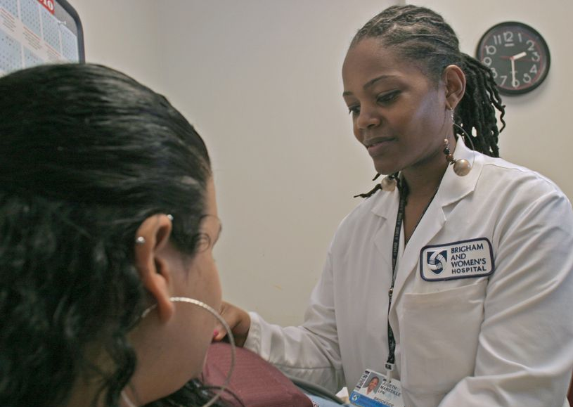
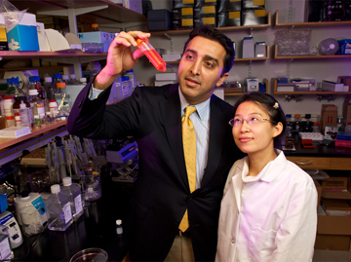
Making a Case for Change: New Models for Education
Competency-based accreditation
Cross-training for students, postdocs, housestaff
Authentic basic-clinical collaborations
Diversity in thinking, doing

Slide 17
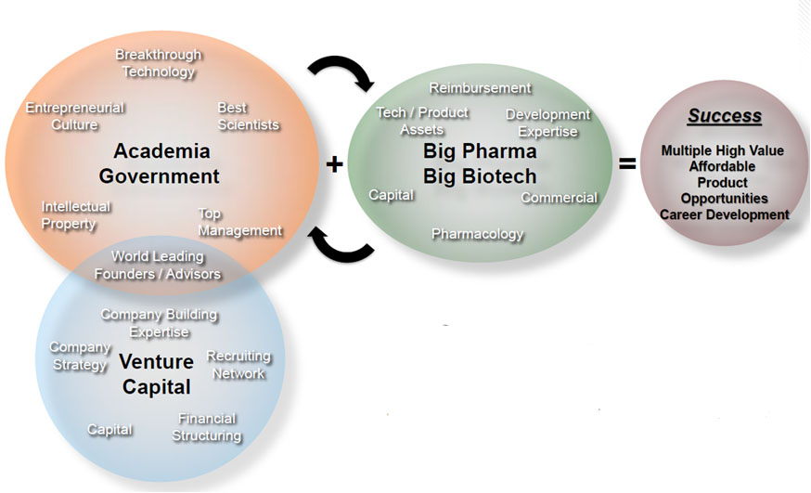
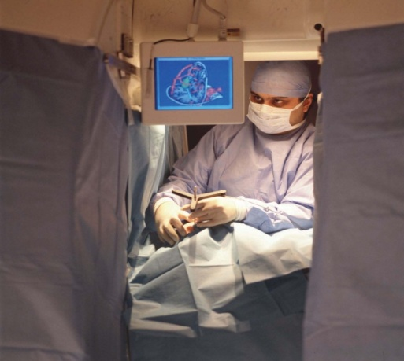
Future Strategic Partnerships
Third Rock Ventures, 2012

Slide 18
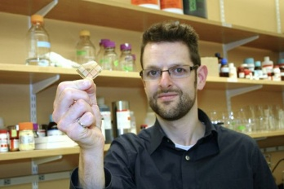
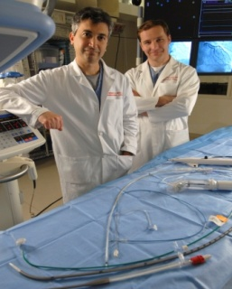
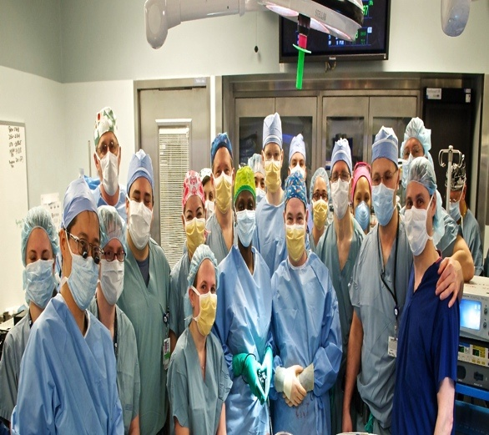
Academic Medical Centers: Our Vision is Clear
Seamless High Quality Patient and Family-Centered Care
Cutting-Edge Innovation and Discovery
Leadership in Education
Engaged Workforce
Health Equity
Affordable Care for Patients
Demonstrated Excellence

Slide 20
Change is Here and Now
Cannot sustain health care cost growth
Federal Deficit
State Budgets
Private Employers
Cost squeeze on municipal budgets
Political pressure to act

Slide 21
Chapter 224 – Health Care Cost Reform
“Payment Reform Mandate”
Chapter 224
“Rate Setting”
Global Cap w/o Rate Setting
State mandated capitation
ACO formation
Medicaid rates frozen
Significant Medicare cuts
Rate Setting
State rate setting
Medicaid rates frozen
Significant Medicare cuts
Caps on reimbursement rates for higher cost providers
Gross State
Product
Accountable
Care Organizations
State Attention to Marketplace
Transparency
PLUS
Medicare and Medicaid Cuts from Federal and State government
6/9/2013
Notes:
21
Given all of these pressures, the Operating Heads developed a set of potential future scenarios and modeled what they would mean for our margin. We believe that the Aggressive Market Forces or Rate Setting Scenarios are most likely to occur, and the implication of these is a $240M to $750M hit to our margin if we did nothing. And that is based on a one-year rate reduction, not year over year reductions.
The economics are sobering. In any of these scenarios, we will need to significantly change the way we operate if we want to continue to serve our mission.
[In response to questions: We are doing additional analysis to understand the financial implications of what we are already experiencing in the market.]

Slide 22
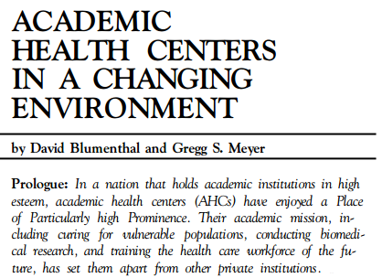
Academic Medical Centers: Bedrock of U.S. Biomedicine
Excellent clinical care
Innovative, high-impact research
High-quality education

Slide 23
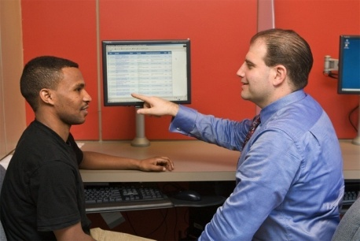
Academic Medical Centers: Our Vision is Clear
We aspire to transform healthcare through compassionate care, science, and education, locally and globally

Slide 24
New Research Models: Financial Drivers
Partners research funding nearly tripled, while NIH share of total down 10%

Slide 25
GeneInsight: Partners Research IT Enables Clinical Care
Enables management of patient genetic profiles
Delivers alerts to physicians as new variant information emerges
Real-time interpretation
Important advance for both research and clinical care

Slide 26
Massachusetts Leads the Way
Health reform beyond universal care
Improve patient care while containing costs
Enhance transparency
Oct. 1, 2013: Health care price comparisons online
Boston is an U.S. epicenter of knowledge and innovation economy
Role of Academic Medical Centers in health reform

Slide 27
Change is Necessary:
NIH Funding Uncertainty
NIH paylines in the single digits
NIH salary cap decreases
Review/ likely limitations on grant funding $ and/or
number of grants per investigator
Looming
Cuts to indirect rate

