Slide 1
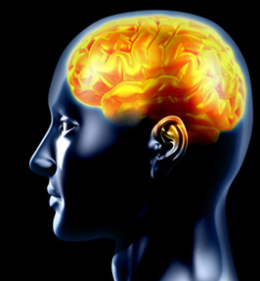
Sleep Deprivation & Fatigue Management
Mitchell C. Sokolosky, MD
Associate Dean, GME
Designated Institutional Official
Wake Forest Baptist Medical Center
Stacey Q. Wolfe, MD
Residency Program Director Department of Neurosurgery
Wake Forest Baptist Medical Center

Slide 2
Case 1
A nurse calls a second year resident to clarify an order for a patient
The resident angrily and loudly states “Why do you keep calling me and interrupting my work. Can’t you figure this out on your own!”

Slide 3
Case 2
A fourth year surgical resident is meeting with the department chairman to explain the recent inability to show up on time in the OR for morning scheduled cases
The resident admits to taking a sedative as a sleeping aid and drinking energy drinks to stay awake during afternoon conference

Slide 4
Case 3
A third year emergency medicine resident is transported to the ED by EMS following a motor vehicle collision on his way home after working the night shift
The resident states that he did not recall falling asleep while driving

Slide 5
What do these cases have in common?
Sleep Deprivation and Fatigue

Slide 6
Why learn about sleep deprivation & fatigue?
Affects every practicing physician
Many negative consequences
Simple countermeasures
Career satisfaction and longevity
Regulatory bodies

Slide 7
ACGME Requirement
The program must educate all faculty members and residents:
Recognize the signs of fatigue and sleep deprivation
Alertness management and fatigue mitigation processes
Adopt fatigue mitigation processes to manage the potential negative effects of fatigue on patient care and learning

Slide 8
Sleep Physiology
4-stages of sleep
Stages 1-3 and REM (rapid eye movement)
Each stage varies in length with distinct physiological functions
Requirements change throughout life
8-hours of sleep required to be restorative
Regulated by circadian rhythm
Notes:
Sleep proceeds in cycles of REM and NREM, the order normally being N1 → N2 → N3 → N2 → REM.
Each sleep cycle lasts from 90 to 110 minutes on average, and each stage may have a distinct physiological function.
NREM sleep: Little dreaming in NREM.
Stage N1: Somnolence or drowsy sleep. Loose some muscle tone and most conscious awareness of the external environment. Sudden twitches, myoclonus, and hypnagogic hallucinations.
Stage N2: Conscious awareness of the external environment disappears. 45 to 55% of total sleep in adults.
Stage N3: Parasomnias as night terrors, bedwetting, sleepwalking, and sleep-talking occur.
REM sleep: 20–25% of total sleep time, most dreaming, descending muscular atonia. Such paralysis may be necessary for protection from self-damage through physically acting out scenes from the often-vivid dreams that occur during this stage.

Slide 9
Sleep Stages
Sleep proceeds in cycles of REM and NREM, the order normally being N1 → N2 → N3 → N2 → REM.
Each sleep cycle lasts from 90 to 110 minutes on average, and each stage may have a distinct physiological function.
NREM sleep: Little dreaming in NREM.
Stage N1: Somnolence or drowsy sleep. Loose some muscle tone and most conscious awareness of the external environment. Sudden twitches, myoclonus, and hypnagogic hallucinations.
Stage N2: Conscious awareness of the external environment disappears. 45 to 55% of total sleep in adults.
Stage N3: Parasomnias as night terrors, bedwetting, sleepwalking, and sleep-talking occur.
REM sleep: 20–25% of total sleep time, most dreaming, descending muscular atonia. Such paralysis may be necessary for protection from self-damage through physically acting out scenes from the often-vivid dreams during this stage.

Slide 10
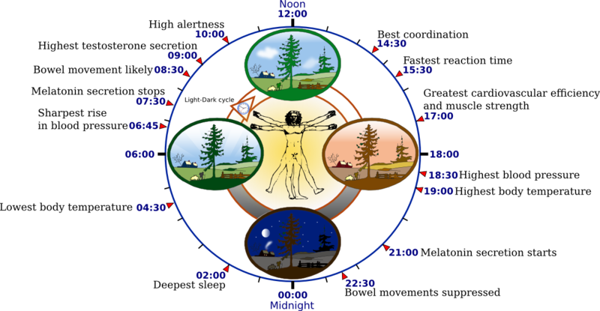
Notes:
The circadian clock—an inner timekeeping, temperature-fluctuating, enzyme-controlling device

Slide 11
Are you sleep deprived?
<5-minutes to fall asleep = sleep deprivation
Optimal cognitive performance
Requires adequate sleep
Declines with sleep deprivation
Notes:
Rocking chair marathon – hallucinations, paranoia, blurred vision

Slide 12
Consequences of Fatigue
Medical errors
Majority are cognitive
Motor vehicle crashes*
Fatigue involved in one in 6 fatal road accidents
Slowed thought process
Emotional and Somatic changes
Job burnout
*NEJM. 2005;352:125-134
Notes:
Majority of medical errors are cognitive errors.
Fatigue involved in one in 6 fatal road accidents. - NRMA

Slide 13
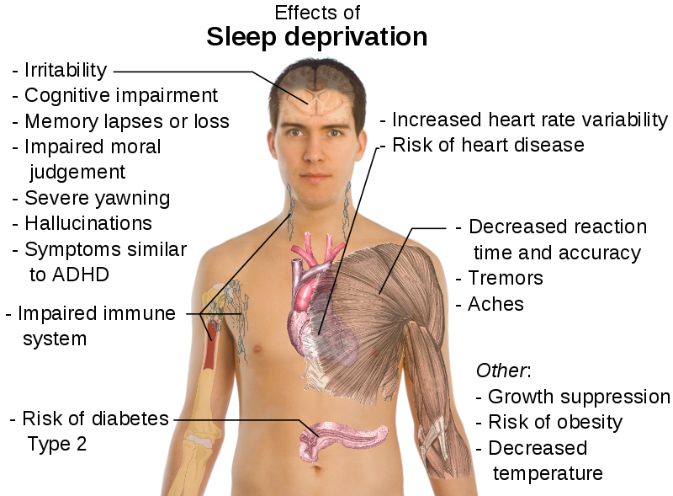

Slide 14
Two Types of Sleep Loss
Acute, total sleep loss
Recent 24-hour sleep loss
Chronic, partial sleep loss
<6-hours of sleep per night on average for at least one week

Slide 15
Chronic Partial Sleep Loss
Often goes unrecognized
Effects are cumulative
Sleep debt must be paid back at some point
Similar effects to alcohol intoxication
Cognitive impairment is similar for acute and chronic sleep loss

Slide 16
The effect of one night without sleep on problem solving and immediate recall.
“Performance testing of vigilance (responsiveness to simple repeated tasks) and serial mathematical calculations were equally affected by 24-hours of total sleep loss and one week of sleep restriction to 5-hours of sleep per night”
Psychol Res. 1992;54:127-136

Slide 17
Effects of sleep deprivation on performance: a meta-analysis
“Mean cognitive performances of young healthy adults who are sleep deprived (both short-term and chronic) are 1.3 standard deviations below the mean”
“Verbal processing and complex problem solving is impaired with both acute and chronic sleep deprivation”
Sleep. 1996;19:318-326
Sleep. 1998;11:528-536

Slide 18
Impact on Patient Care
Interns working extended duty periods:
36% more serious medical errors
21% more serious medication errors
6-times as likely to make serious diagnostic errors
NEJM. 2004;351:1838-1848

Slide 19
Night Shift Workers
Simulated intubation task and clinical accuracy in a triage task were worse for night shift emergency physicians
Performance deteriorated across night shifts but not across day shifts
Ann Emerg Med. 1994;24:928-34

Slide 20
Countermeasures
Sleep
Scheduling recommendations
Alertness promoting agents
Sleep promoting agents
Exercise and diet
Bright lights

Slide 21
Sleep
Most effective counter-measure against fatigue
Essential to healthy living…and being an effective physician
Many people don’t sleep well simply because they practice poor sleep habits

Slide 22
Sleep Tips
Maintain a regular bed and wake time schedule including weekends
Establish a regular, relaxing bedtime routine
Create a sleep-conducive environment that is dark, quiet, comfortable and cool
Sleep on a comfortable mattress and pillows
Use your bedroom only for sleep and sex
Finish eating at least 2-3 hours before bedtime
Restrict fluid intake close to bedtime
Avoid caffeine within 4-hours to bedtime
Avoid nicotine and alcohol close to bedtime
Exercise regularly
Don’t oversleep
National Sleep Foundation
Notes:
Reading or listening to soothing music
Most mattresses have a 10-year life expectancy
Complete workout at least a few hours before bedtime to allow body to cool down
Drugs such as sleeping pills and alcoholic beverages can suppress certain stages of sleep, leading to sleep deprivation. This can result in sleep that exhibits loss of consciousness but does not fulfill its physiological functions (i.e., one may still feel tired after otherwise sufficient sleep).

Slide 23
Napping
Several positive effects
“Power naps”
No sleep inertia or affect circadian rhythm
Long nap or nap taken too late in day may affect nighttime sleep
Reduce the chances of an accident*
IOM recommendations – “strategic napping”
*Sleep. 2004:27:1446-1448
Notes:
Why nap? Increase alertness, boost creativity, reduce stress and improve perception, stamina, motor skills & accuracy.
Power Naps: 20-30 minutes
Sleep inertia: Period of drowsiness upon awakening. Tends to be more severe and last longer in people who are sleep deprived or nap for longer periods.

Slide 24
NASA on Napping
“A nap as short as 26-minutes can boost performance by 34%”

Slide 25
Famous Nappers
Albert Einstein
JFK
Thomas Edison
Ronald Reagan

Slide 26
Shift Workers
Sleep disturbances and associated excessive sleepiness
Increased risk for chronic illnesses
Cardiovascular and gastrointestinal diseases, obesity, diabetes, hypertension
Circadian misalignment
Shift work sleep disorder
Notes:
Shift work sleep disorder is a circadian rhythm sleep disorder according to the International Classifications of Sleep Disorders
The researchers found that circadian misalignment, resulted in hormonal and metabolic changes that, if chronically maintained, could explain the increased risk for obesity, high blood pressure, diabetes and cardiovascular disease frequently found among shift workers.

Slide 27
Sleeping After Night Shifts
Sleeping as soon as possible after a night shift is desirable
Don’t sleep beyond 4-hours following single night shift
Splitting the sleep cycle for short stretches (few days)
Sleep for 4-hours after and before each shift
Anchor sleep for long stretches (weeks)
Sleeping during the same period each day
Notes:
Sleeping as soon as possible following a night shift allows for some sleep to occur during the normal sleep period.
Sleeping beyond 4-hours following a single night shift may retard the next night’s sleep.

Slide 28
Anchor Sleep
Isolation unit study
Individuals slept either as a single random 8-hour period or two randomly arranged 4-hour sleep periods
“Circadian rhythms were stabilized in the 4-hour group if anchor sleep was taken at the same time each day regardless of the timing of the second half of sleep”
Int J Chronobiol. 1981;7(3):65-88
Notes:
Consider anchor sleep if working long stretches or exclusive night shifts.

Slide 29
Exercise and Diet
Healthy physical tiredness is a natural sedative
Exercise combats sleep inertia
Timing of exercise is important
Sleep is associated with cooling body temperatures
Healthy diet + regular exercise = health benefits

Slide 30
Bright Lights
Suppress release of melatonin
Prevent sleepiness in overnight workers*
NEJM. 1990:322:1253-1259

Slide 31
Fatigue Management Options
Immediately notify your supervising physician if you cannot safely perform your duties due to fatigue
Too tired to drive home safely?
Nap in a Call rooms
Obtain ride home from co-worker, family or friend
Call taxi/UBER/Lyft and bring receipt afterwards to GME office for reimbursement

Slide 32
Take Home Points
Sleep at least 8-hours each night
Chronic partial sleep loss is a common cause of fatigue and cognitive impairment
Pay back sleep debt by sleeping in on weekends and taking naps

