Slide 1

Developing and Promoting Resilience in a Neurosurgical Program
Theresa Williamson, MD
PGY5 Duke Neurosurgery
(Jacquelyn Corley MD, Michael Haglund MD PhD, John Sampson MD PhD)
SNS Annual Meeting 2019
Seattle, Washington

Slide 2
Disclosures
None

Slide 3
Outline
Burnout Stats: Argument for resilience programming
Developing a Resilience Program: Literature Search, Psychology, Focus Groups
WellSpentMD: a mobile application aimed at improving positive news
Early Results
Future Directions

Slide 4
Burnout: The Stats
Notes:
Where is the Depersonalization data from? 2016 our residents

Slide 5
Developing a Resiliency Program: Tipping the scales towards positivity
Physicians have more prevalent burnout symptoms than other occupations
Work-life integration satisfaction has gone down in neurosurgeons between 2011-2017 (Shanafelt et al 2018)
Neurosurgeons are no exception (about 40% report burnout symptoms)
Individual and organizational interventions can result in meaningful reductions in physician burnout
Motivation and wellness come from meaning, rewarding the process not the outcome and appreciation (Ariely 2017)
Prior programs, for example, Stanford’s time-banking System promote flexibility, wellness, and work-life integration (Fassiotto 2018)
Successful programs understand the drivers of professional fulfillment, use specific approaches to fix flaws in organizational culture, and measure their success (Shanafelt 2019)
Notes:
Sotille – positive vs. negative interactions (70 – 2 or 3 neg to pos)

Slide 6


Developing a Resiliency Program: Focus Groups
Results of Stakeholder interviews led to consistent themes:
  Lack of recognition for the things that mattered to them
  Poor control of time
  Lack of work-life integration
  Less programming that was unique to physicians
  “Perks help with employees morale to some extent, but people are looking for meaning. They want to feel commitment, appreciation and a sense of progress.” ~ Dan Ariely
Notes:
Add pics here – next JUMP, duke I&E, duke neurosurgery logos

Slide 7

Positivity Lack of Feedback
Radical Candor – Care personally & Challenge directly
“In an effort to create a positive, stress-free environment, I sidestepped the difficult but necessary part of being a boss: telling people clearly directly when their work wasn’t good enough. I failed to create a climate in which people who weren’t getting the job done were told so in time to fix it.”
~ Kim Scott
Notes:
Goes on to say… 1. culture of guidance, 2. understand what motivates people, 3. drive results collaboratively

Slide 8
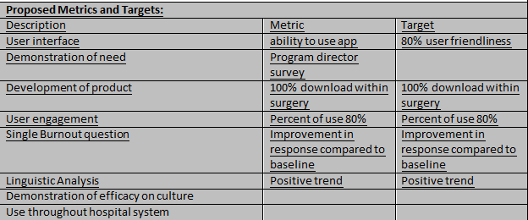
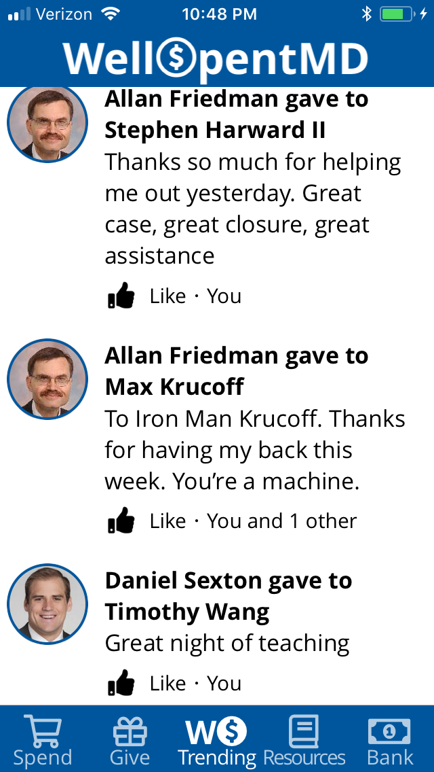
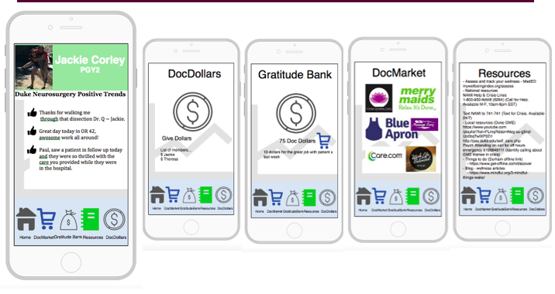
Creating WellSpentMD
Goal: To design a simple, mobile device program that generates positive feelings throughout the program to enhance physician wellness and resilience.
Decision to create mobile application
Feedback from Strategy Committee
Development of idea of Positive Feedback and Wellness rewards
Departmental Funding
Feedback and Survey
4/2016
GME Innovation Grant
Development Process
Launch
5/2019
Early Focus Group to identify needs
Wireframes and Focus Groups

Slide 9
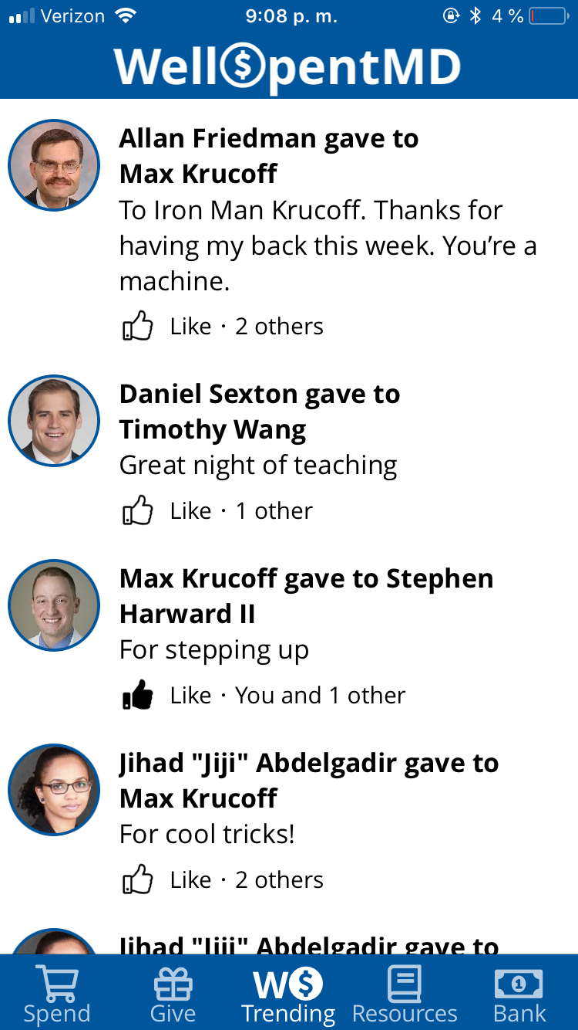
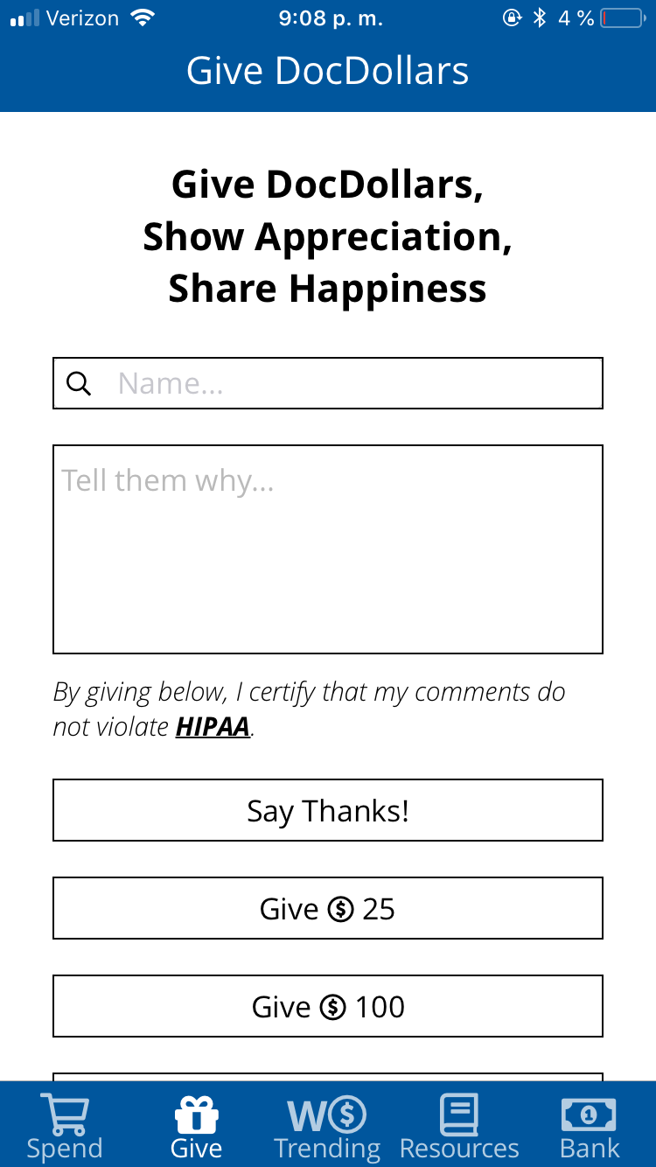
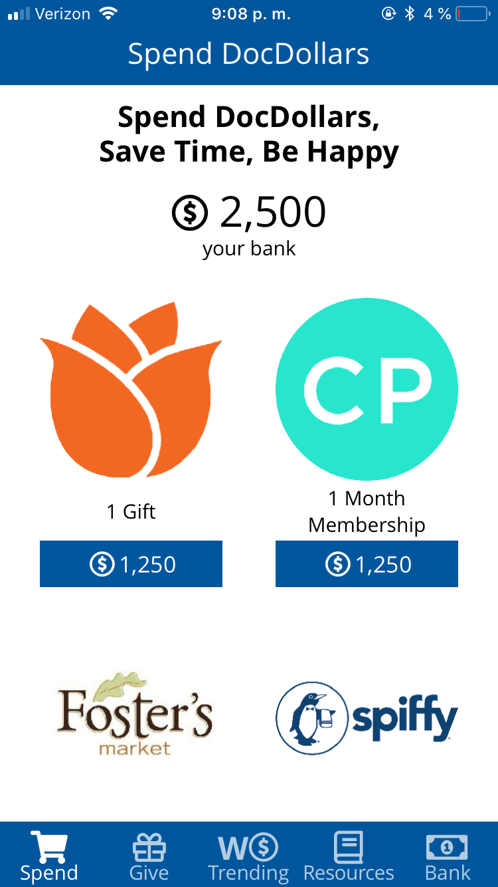
Components of WellSpentMD
Newsfeed of compliments
Giving $ and Compliments
Marketplace

Slide 10
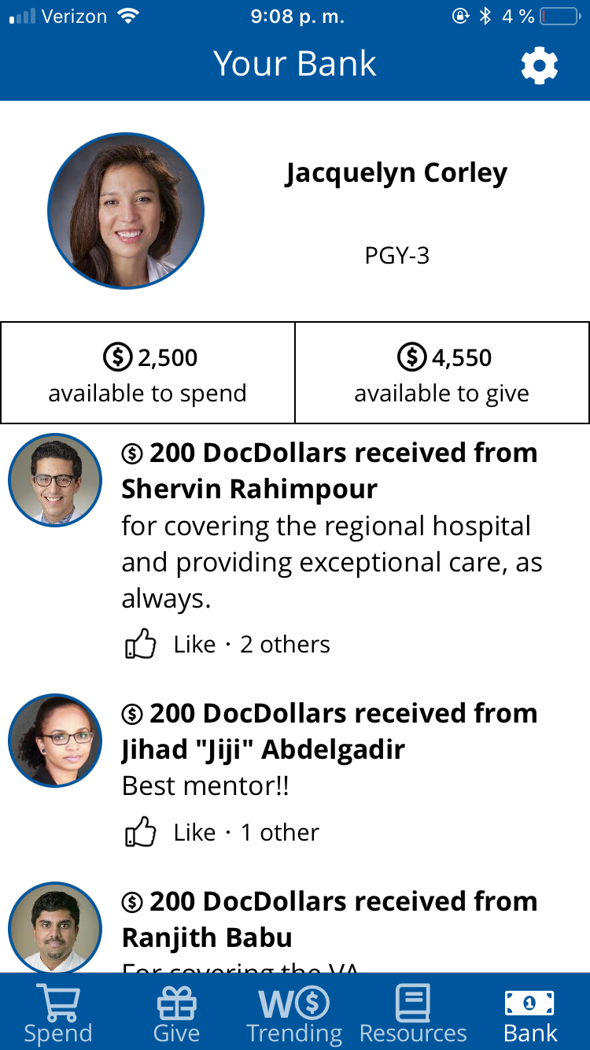
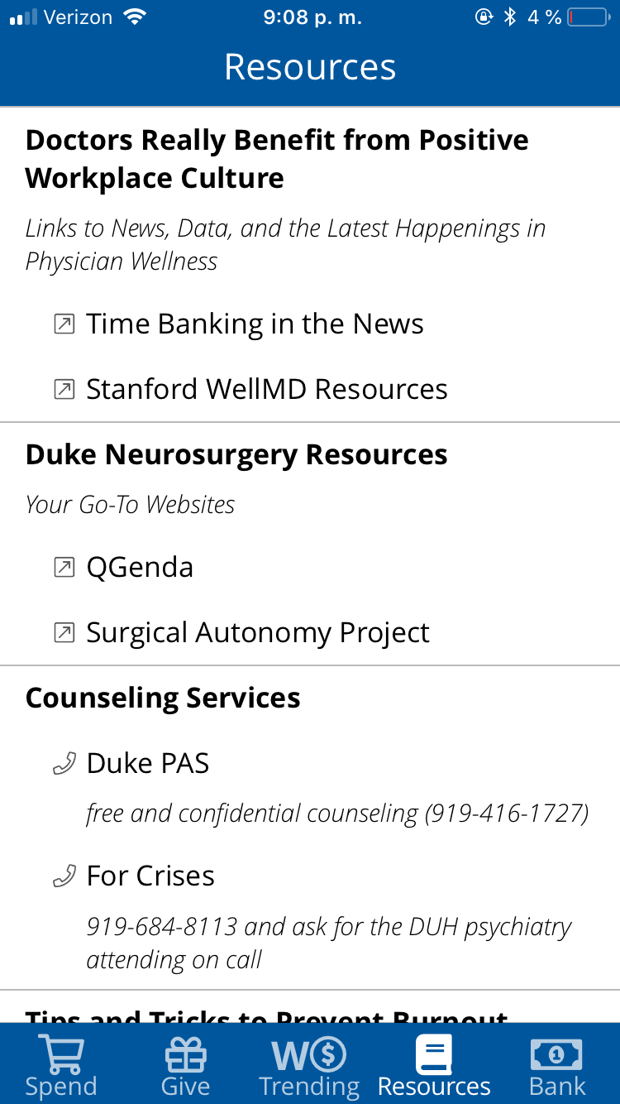
Components of WellSpentMD
Wellness Resources
Personal Profile

Slide 11
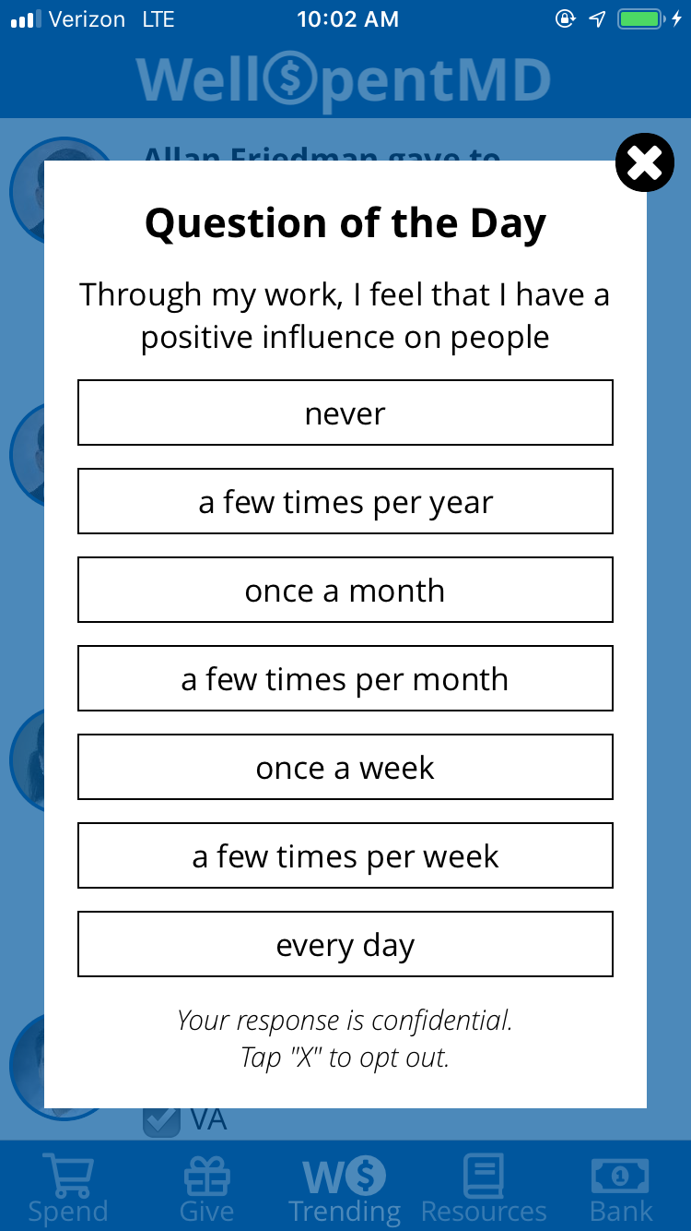
Components of WellSpentMD: Feedback
- Mixpanel analytics usage data
- Application prompts members to answer four key pulse questions from the Masloch Burnout Inventory (MBI) twice weekly.
- The results of the MBI questions were recorded and de-identified by the program.

Slide 12
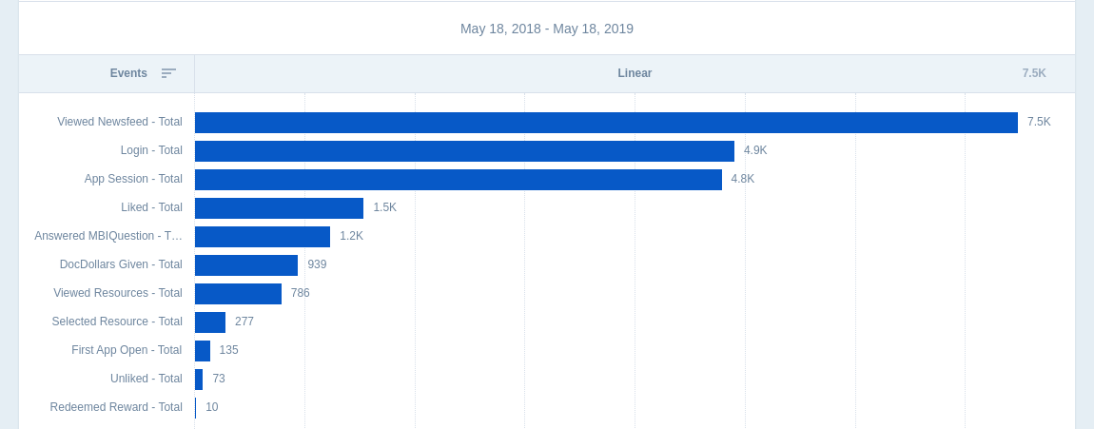
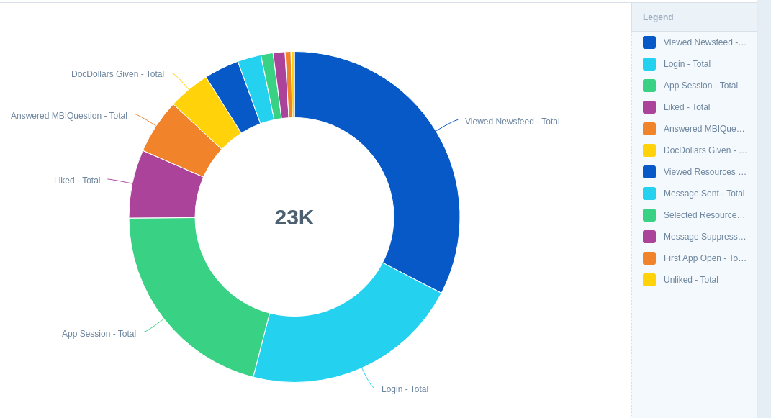
What We’ve Seen: Total Usage
Summary of 11 month trial period
74 % of faculty and residents invited to the pilot used the application.
Though 77% of users reached the docdollar threshold to redeem a reward only 13% have done so.
Notes:
What time period is this over,

Slide 13
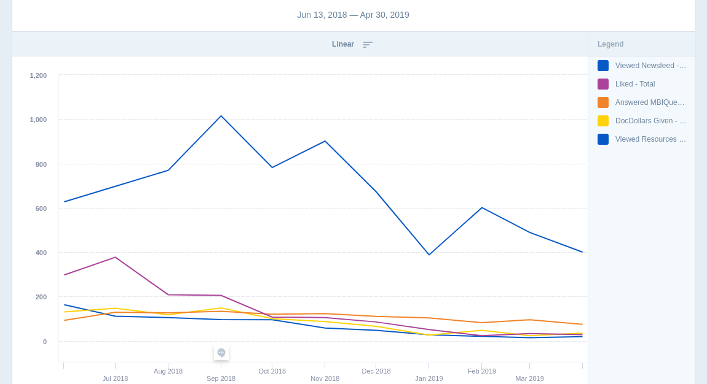
Trends in Views of the Newfeed, Likes, and DocDollars Shared
Newsfeed is the most popular feature
Usage varies daily
Identifying Trends points out needs for intervention
Notes:
Again realize weekly but do you have more recent data, is it different since this is pretty old data, do you have something from Jan 2019 to maybe April 2019?

Slide 14
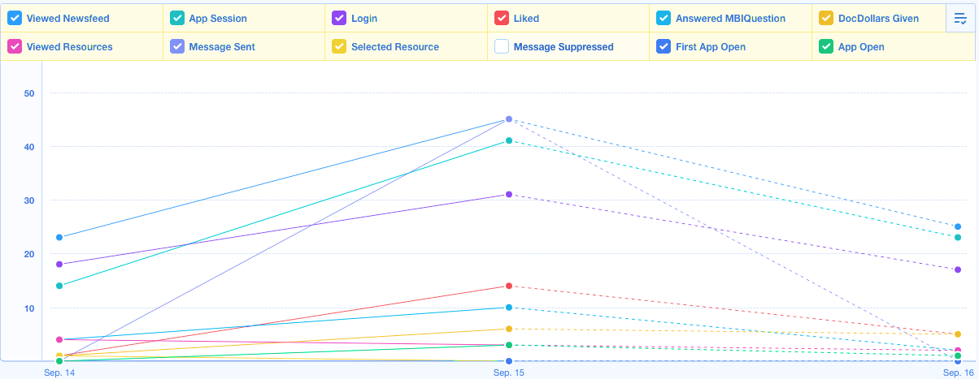
What We’ve Seen: Responsiveness to Notifications
Notification
Notes:
Not sure I understand this one

Slide 15
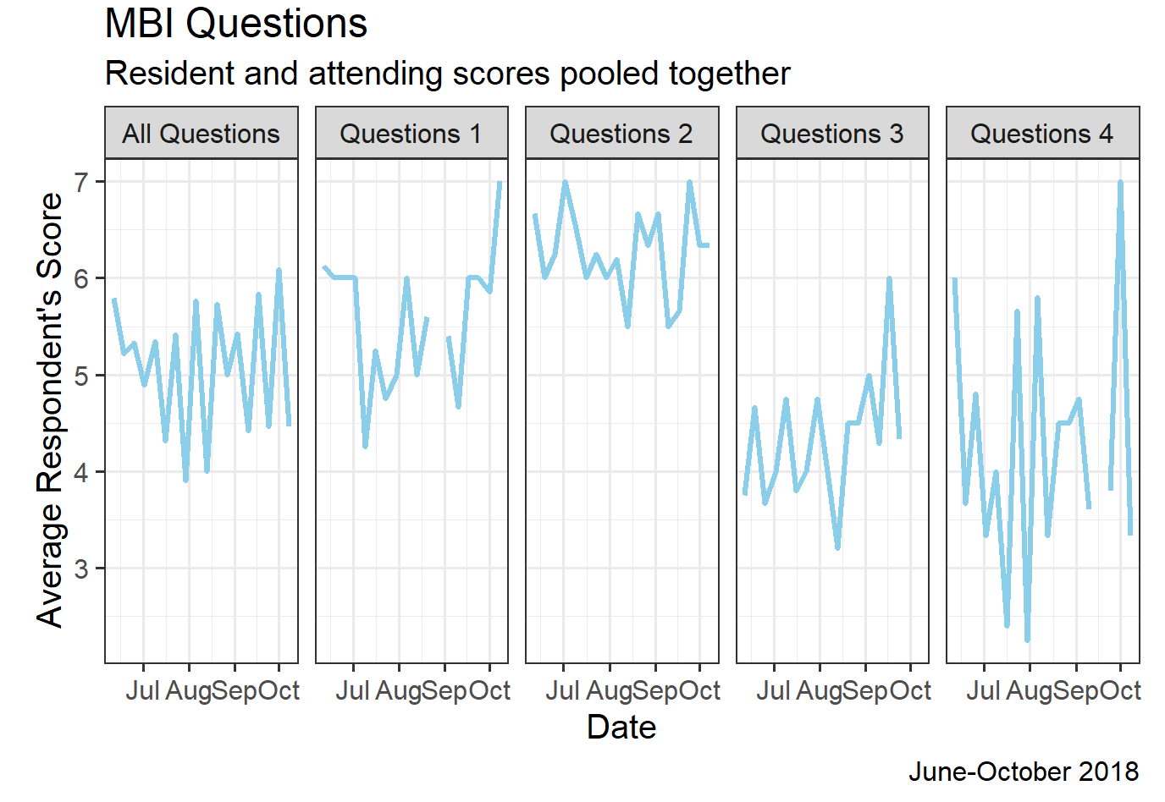
Trends in Wellness Scores
31 users over the study period
19 were residents and 12 attendings
Questions four was skipped 48% of the time, followed by question three (47%), question two (42%), question one (41%).
Trend towards improvement in pulse MBI questions amongst residents (0.24 points over the course of the study for all questions averaged).
id | question
1 | Through my work, I feel that I have a positive influence on people
2 | I accomplish many worthwhile things in this job
3 | I have become more insensitive to people since I’ve been working
4 | Working with people all day long requires a great deal of effort
Notes:
60% consented, In particular, the first question, “through my work, I feel that I have a positive influence on others” raised from an average of 5 (a few times a week) to 6 (every day) during the pilot period. Line where it isn’t positive
Can you compare last Jul through Oct 2018 to Jan through April 2019 to show improvement or use a bar graph approach since I don’t really see much of a difference, or you could put a linear regression line shoing it going up
Answer Value -1 Question skipped, unanswered 0 never 1 a few times per year 2 once a month 3 a few times per month 4 once a week 5 a few times per year 6 every day

Slide 16
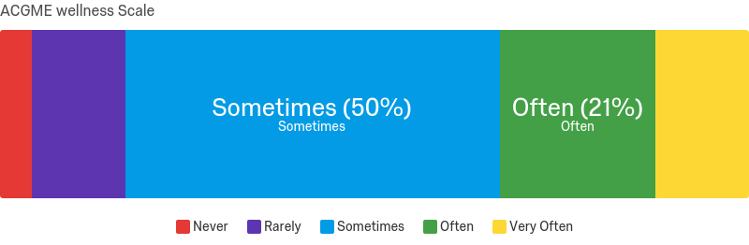
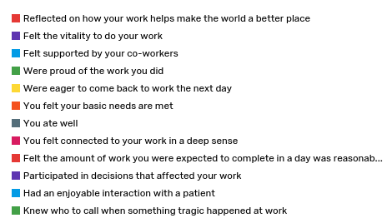
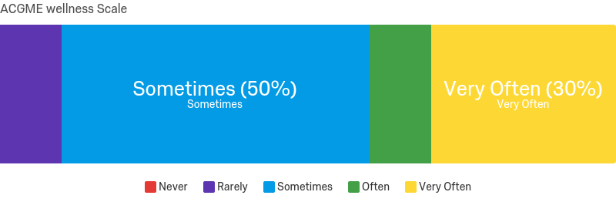
12 month follow-up Wellness Scores
N= 27
N=10

Slide 17
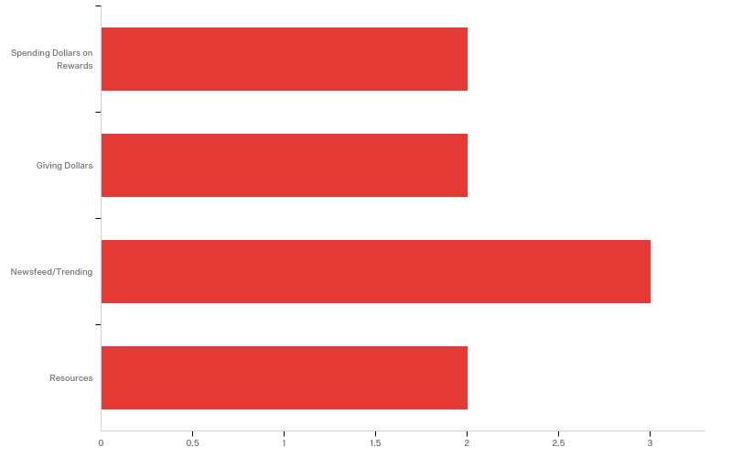
Comments about the app…
My favorite feature of WellSpentMD is...
If you use the mobile application, please tell us why.
satisfaction of keeping up with what is going on with the residents (like instagram)
easy to use. good support for coresidents.
If you don't use the mobile application, please tell us why.
think it encourages people to expect recognition for work they should be doing anyways. It is biased twoards people who seek out and/or need external reinforcement for their work
No notifications to remind me to check it

Slide 18
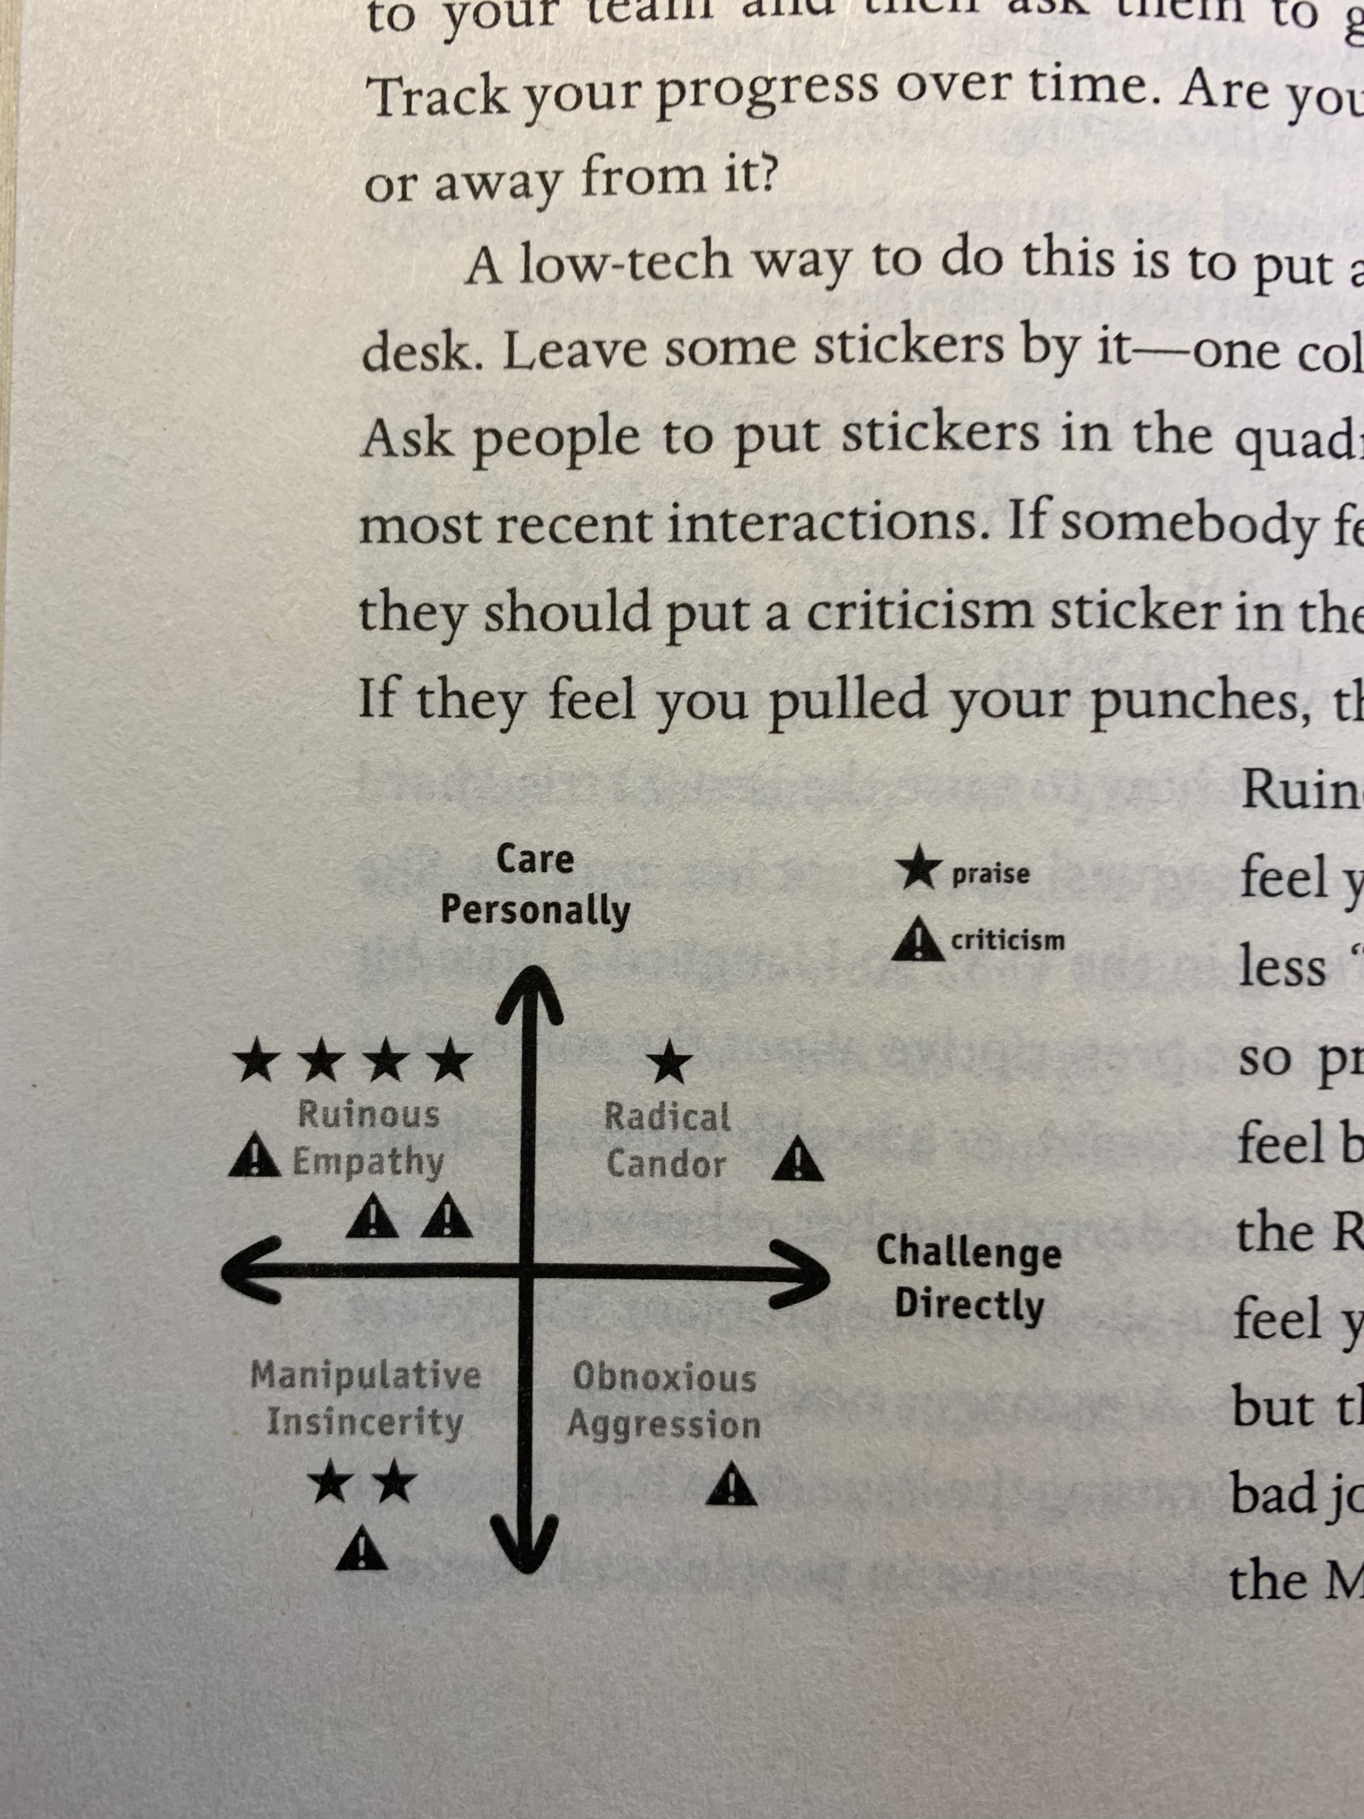
Application Succeeds
- Application addresses dimensions key to stakeholders (gratitude)
- Application has very low organizational burden
- Could achieve longitudinal use
- Proved broadly applicable
Learning Points
- Important to address and re-address stakeholders
- Having a plan and team for continued engagement
- Acknowledge that workplace culture is dynamic and fragile

Slide 19
Coming Soon…
Version 2 of application
  Enhancing utility
  Optimizing data collected in a proactive way
Expansion to other departments - efficacy across domains and achieve more robust data

Slide 20
Acknowledgements
Duke Department of Neurosurgery
Duke Innovation & Entrepreneurship Center
ACGME Back to Bedside Initiative
Duke Graduate Medical Education Innovation Grant

Slide 21
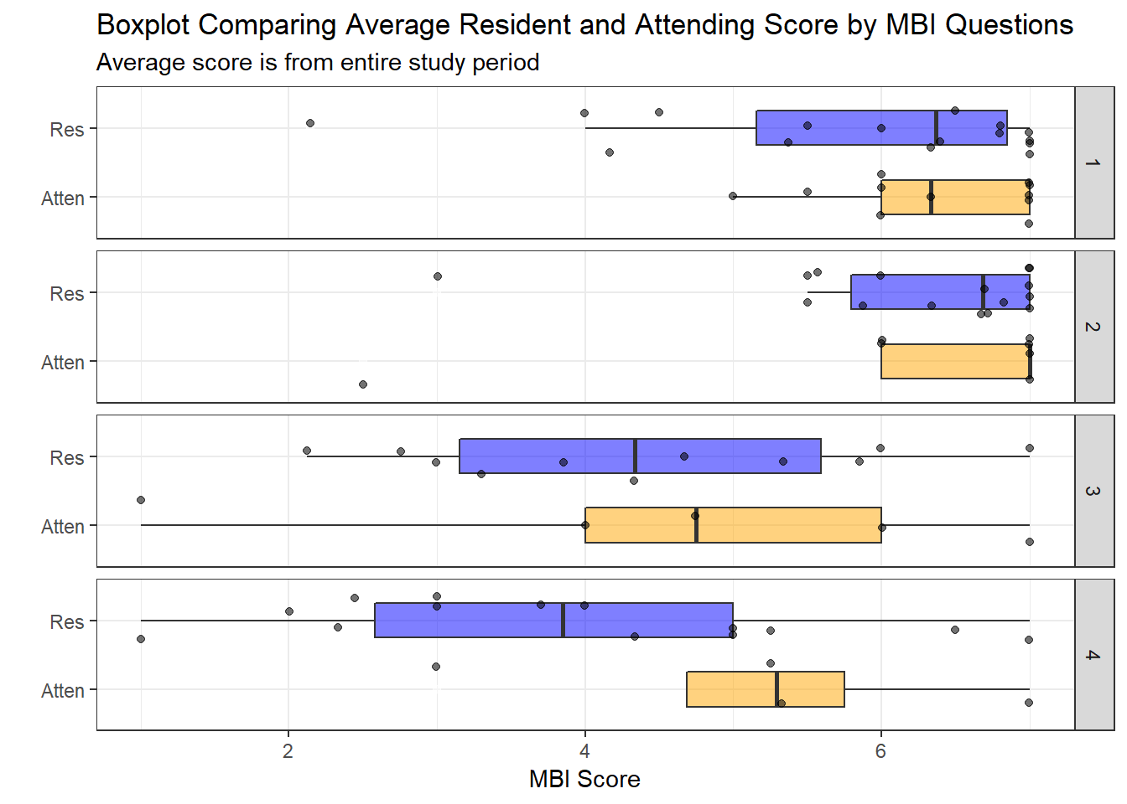
Trends in Wellness Scores
Responses from residents vs. attendings
Mostly positive responses
Attending’s scoring significantly higher than residents (p=0.034).
Notes:
60% consented any data on average from before we started that could be on graph? Nice to know what the question is?

