Slide 1
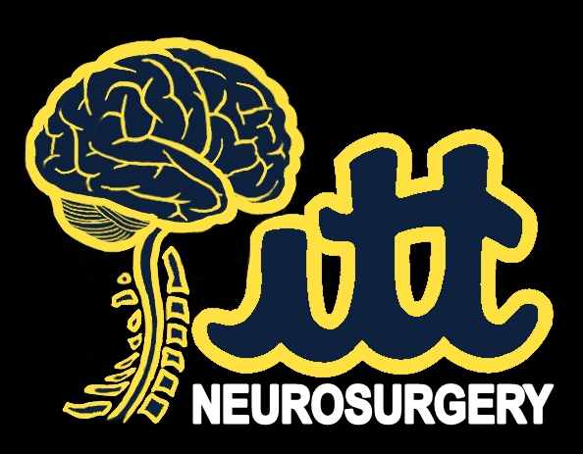
Early Medical School Engagement and Neurosurgical Interest Groups
Michael M. McDowell, MD
L. Dade Lunsford, MD
Robert M. Friedlander, MD, MA
Raymond F. Sekula, MD, MBA
University of Pittsburgh Medical Center
Notes:
Good afternoon, my name is Michael McDowell. I am a PGY5 resident at the university of Pittsburgh. Thank you for the opportunity to speak about our experience with medical student engagement

Slide 2
Conflicts of Interest
Demonstration products loaned by Stryker, Karl Storz, and Zimmer Biomet were used for teaching purposes without financial transaction.
Notes:
We have no direct financial disclosures to report related this topic, but we did receive free equipment from these companies for certain modules, which we did return afterwards.

Slide 3
Introduction
Challenge: Recruitment and visibility
Challenge: Training educators
Solution: Pre-clinical courses
Solution: Interest groups
Notes:
Today I would like to speak about two major challenges that we face as a field. First, how can we recruit the best possible students and second, how can we ensure that they go on to be the best possible teacher. I will then speak on how both of these can be addressed to the benefit of residents and medical students in the form of pre-clinical courses and interest groups

Slide 4
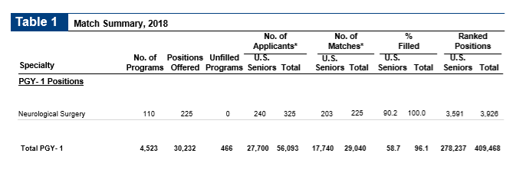
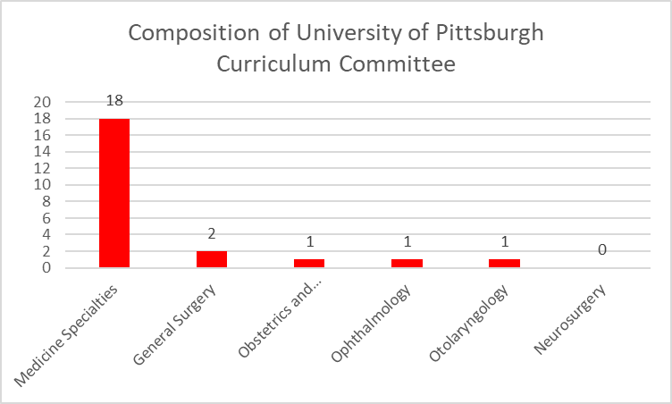
Recruitment and Visibility
Notes:
According to match statistics, neurosurgery positions make up less than one percent, but we remain committed to recruiting the best students to our field. Due to the demands and schedules of surgical fields, we are heavily underrepresented in many cases in the role of medical educators early in medical curricula as well as in the leadership positions related to medical education. For example, at UPMC, the vast majority of the curriculum committee is made up of physicians from medical specialties and only 20% is made up of surgical specialists. None are neurosurgeons. This is a critical committee and it is being run by physicians who do not necessarily value the same things we do in terms of educational goals.

Slide 5
Anatomy Education at University of Pittsburgh
1990s
2010s
2019
Full semester
1/3 Semester
18 full days
Removal of
Neuroanatomy
Partial Prosection
Notes:
Antomy has long been a course that served as a foundation for students but also as a recruitment tool for by providing time for surgeons to demonstrate clinical correlation in the form of surgical procedures performed on cadavers. However, increasing cuts to anatomy has made this less feasible. At UPMC in the 1990s anatomy consisted of approximately 100 days of dissections and lectures. By 2010 it had been reduced to 40 days by relying on prosections more heavily and as of this year the anatomy course has been reduced to 18 full days of lecture and dissection spread out over about 2 months. Neuroanatomy was completely removed from the first year curriculum and it now consists 5 2 hour prosection reviews and 7 one hour lectures at the end of the second year of medical school. These are not likely decisions that we would have made and they are not malicious in nature, but we do not have a seat at the table currently.

Slide 6
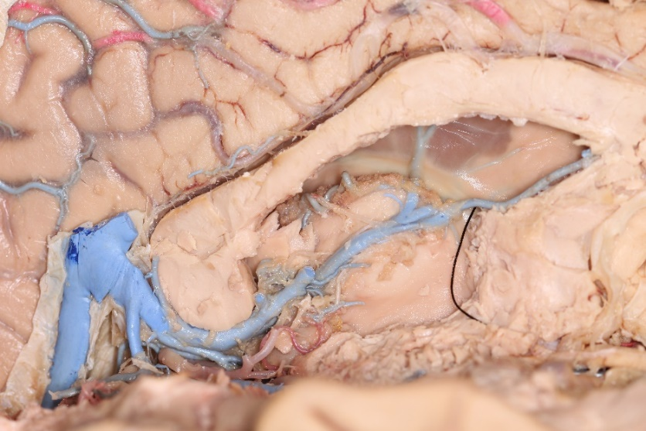
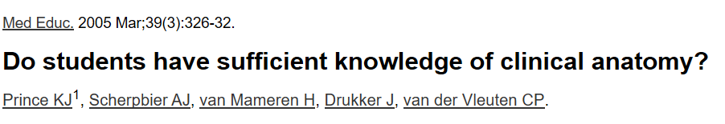
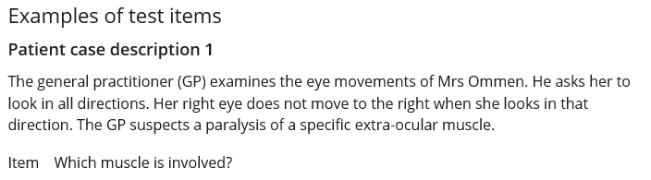
Notes:
While anatomy is not necessarily the only meaningful pre-clinical course for future surgeons, learning anatomy and , more importantly, learning how to learn from anatomy is critical to surgical specialties training. I have had the privilege of spending a significant amount of time performing dissections as part of my training, and each dissection that I do only reinforces to me its value to myself, but also to all physicians. There is a growing body of literature that suggests that medical students are not learning sufficient anatomy due to similar trends at many schools. In a study of approximately 350 pre-clinical students having completed anatomy after a transition away from dissections, almost 40 percent were found to have failed a test of general clinically applicable anatomy based on the scoring by their own anatomy teachers and nearly 60% failed to reach the level expected of students by teaching physicians. Here is an example of one question from the test.

Slide 7
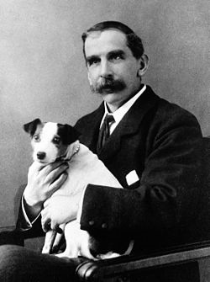
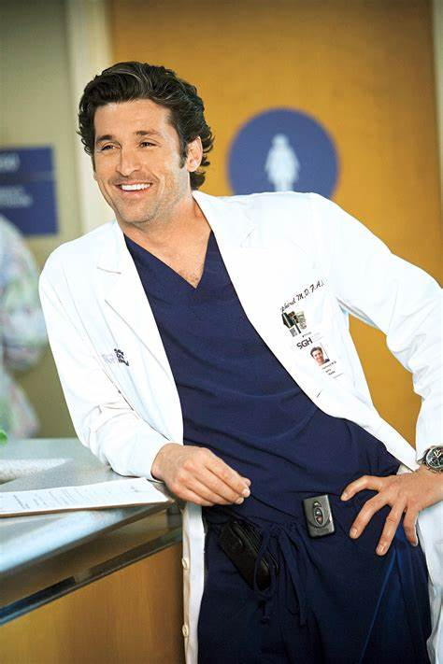
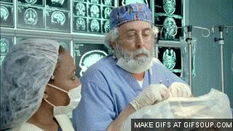
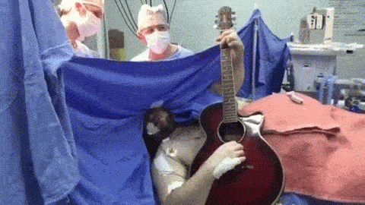
Reputation and Representation
Notes:
So what happens when we no longer get to meet students when they at the beginning of their journey? Neurosurgery, as a small but extraordinary field, relies more heavily on general knowledge of the field rather than direct exposure of pre-medical student compared to more accessible fields such as emergency medicine and general suregery. Unfortunately, that also means that the perception of the kind of person that makes the best neurosurgeon is heavily biased by media portrayals and the understanding of what it is we do and why is frequently misrepresented. Without aggressive direct interaction with medical students, those who we attract may not actually be the ones most suited or prepared to pursue a neurosurgical residency and career

Slide 8
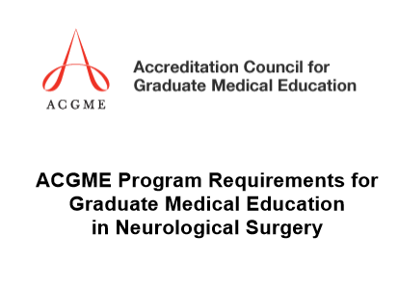
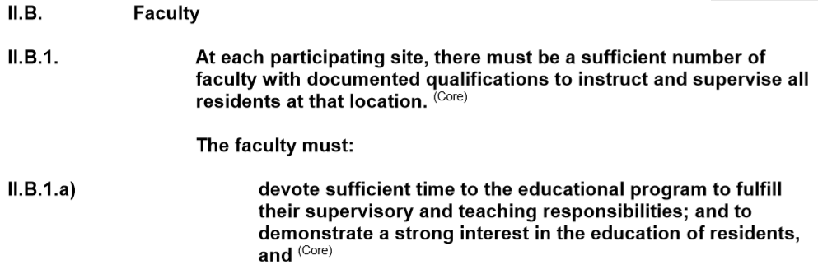
Challenge: Training Educators
Notes:
The second challenge that I want to address is that of teaching teachers. The ACGME definition of core faculty for a neurosurgery residency program in the very first bylaw emphasizes that these individuals should be qualified instructors with an interest in resident education.

Slide 9
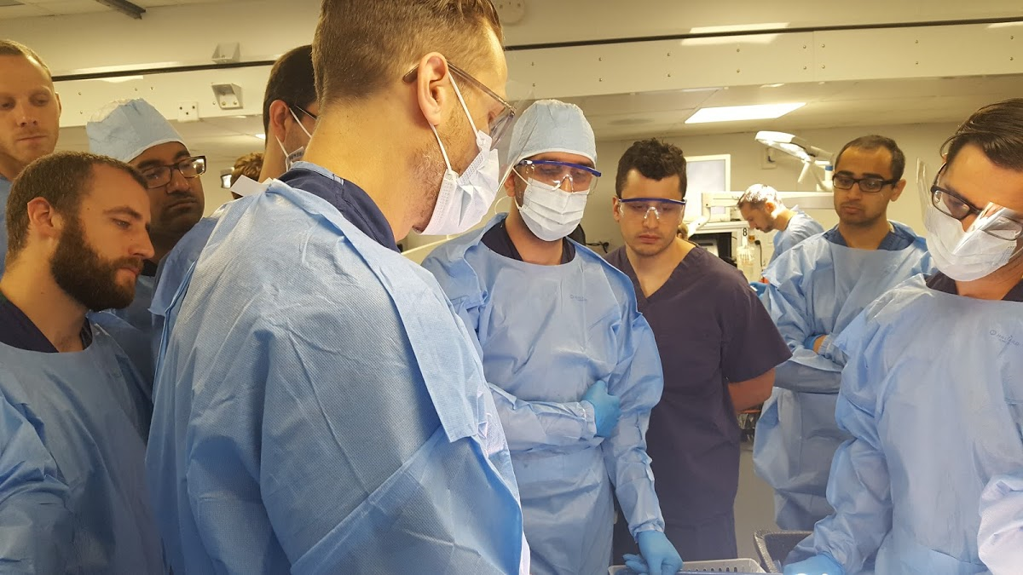
Challenge: Training Educators
Notes:
But how do we ensure that the residents benefitting from this education go forward with the skills to become educators themselves. I have been very fortunate to have had many great educators sas part of my training, but at no point has there been any formalized time to prepare residents for how best to become educators. Often the time constraints within and without of the operating room are major barriers to residents who desire to teach and developing teaching skills.

Slide 10
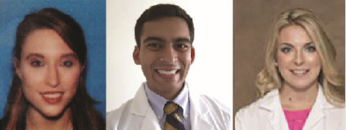
Transitioning Absence to Asset: Pre-Clinical Courses
Notes:
So how can use the increasing dissue of cadavers to address both of these topics? We approached the anatomy department to see if we could potentially make use of the cadavers after the anatomy course was over in order to provide interested students with exposure to the anatomy of our profession while also providing an opportunity for residents to reinforce their own surgical skills through teaching students. We worked very carefully to make it as conflict free as possibly, choosing Monday nights in order to avoid class conflicts and test days. This course was aggressively advocated for by three students who helped me tremendously along the way: Alexandra Sansosti, Ronak Jani, and Rachel Jacobs, who will be applying in one year The first course reached its cap in under a day after the opening of registration, and every year third and fourth year students petition for exemptions in order to be allowed to participate despite schedule conflicts.

Slide 11
Transitioning Absence to Asset: Pre-Clinical Courses
Cadavers through collaboration with anatomy division
Utilizing disposable or older surgical instruments from the operating room
Use of neurosurgery controlled educational space
Collaboration with industry to utilize demonstration equipment
Notes:
Having acquired the cadavers through collaboration with the anatomy department, we obtained disposable or older versions of surgical instruments from the operating room. To ensure guaranteed teaching space, we made use of our department’s lecture halls when needed. Lastly, we reached out to industry venders in order to borrow demonstration equipment such as drills and spinal instrumentation.

Slide 12
Modules
Introduction to Neurosurgery (Lumbar Punctures)
Stereotactic Radiosurgery (Gamma Knife Planning)
Emergent Procedures (Hemicraniectomy and EVDs)
Pediatric (Chiari Decompression)
Tumor (Endoport)
Endoscopic Endonasal Approach (Sellar Approach)
Peripheral (Carpal and Cubital Tunnel Decompression)
Spine (ACDF and Posterior Lumbar Fusion)
Vascular (Carotid Endarterectomy)
Notes:
We sought to expose students to as many parts of neurosurgery as possible in the form of individual modules using representative procedures that were feasible to demonstrate in a cadaver model. The modules taught in the course include an introduction to neurosurgery, stereotactic radiosurgery, emergent procedures, pediatric neurosurgery, tumor surgery, endoscopic endonasal approaches, peripheral nerve surgery, spine surgery, and open vascular surgery

Slide 13
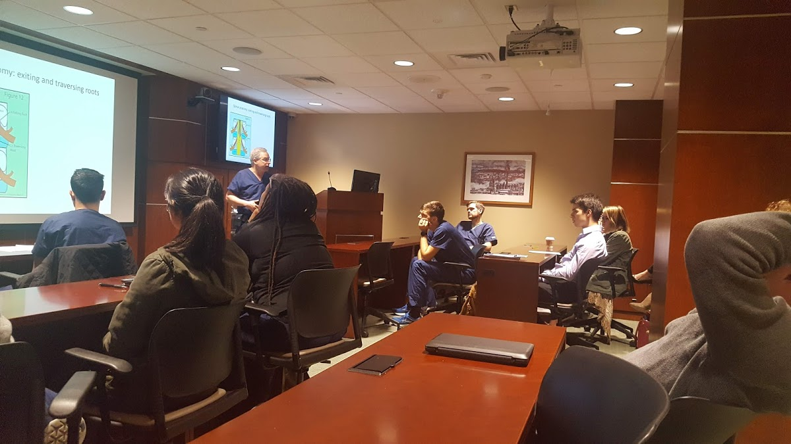
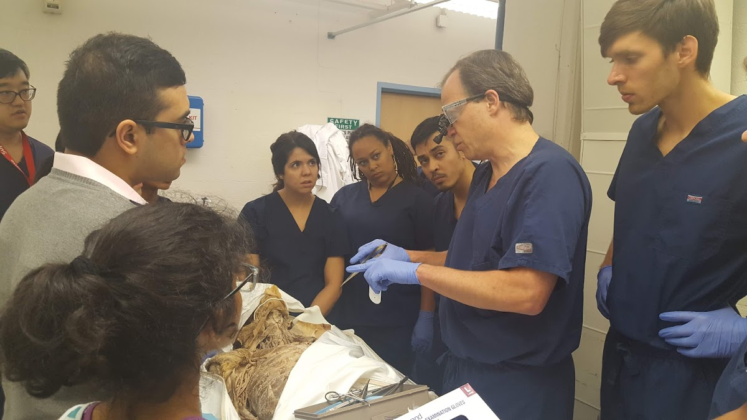
Two Hour Format
Notes:
Each module consisted of one hour of didactics and one hour of procedural skills. The didactic section consisted of a lecture followed as well as time to discuss the background and practice of the specific surgeon involved. We worked to ensure a wide range of surgical careers were represented ranging from those in private practice to those with basic science labs.

Slide 14
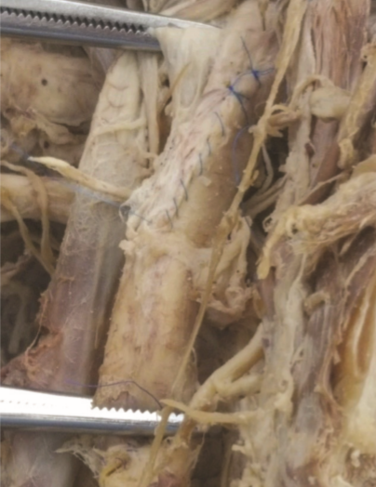
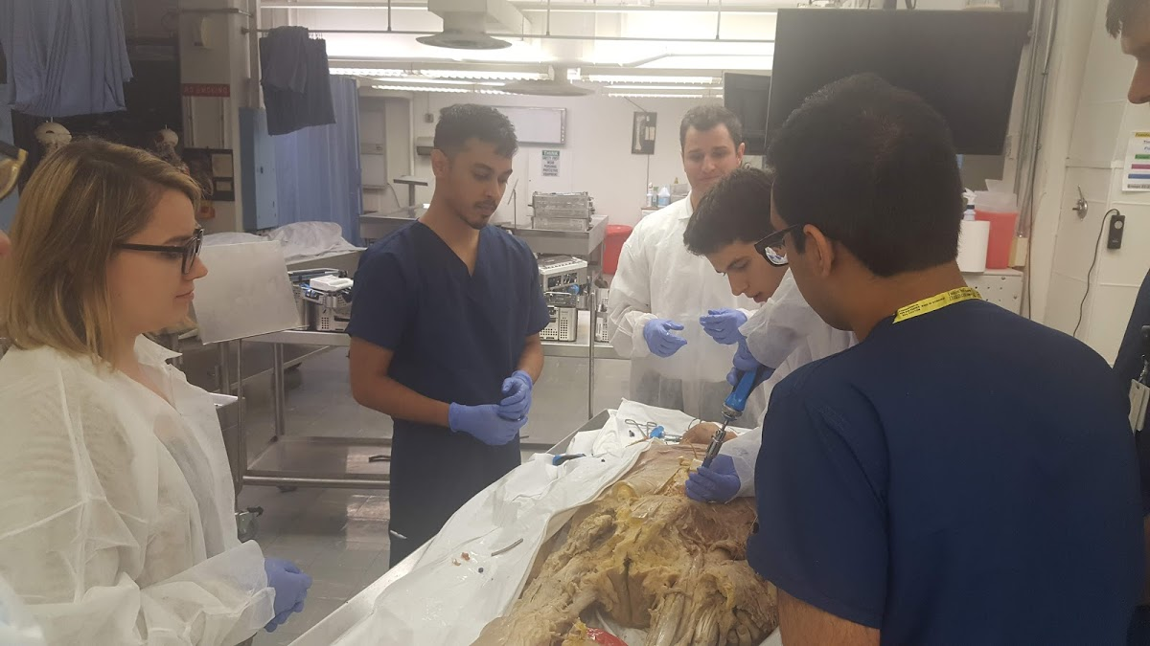
Breadth not Depth
Notes:
Here are some examples of vascular and spine modules. They were by no means perfect, but we sought to focus the most critical portions. Often the cadavers were partially dissected in the case of the non-cranial modules, so we focused on the critical portions of the cases such as instrumentation for spine surgery.

Slide 15
Total Monetary Cost
$0.00
Notes:
So what was the total cost of this course over the last three years? There were no expenditures except the effort and time of those involved.

Slide 16
Demonstrating Effectiveness
Cap of 16 pre-clinical students per year
Pre-course and post-course digital surveys
Likert Scale: 1 (low) to 10 (high)
Compared results of first and third years for quality purposes
Notes:
In order to ensure the highest quality education for students enrolled we capped the number at 16 students per year. A pre-course and post-course survey were conducted examining the impressions of students on a variety of topics related to neurosurgery and a neurosurgical career. These were scaled from 1 to 10. For quality purposes we performed these surveys during the first and third years of the course in order to gauge our progress.

Slide 17
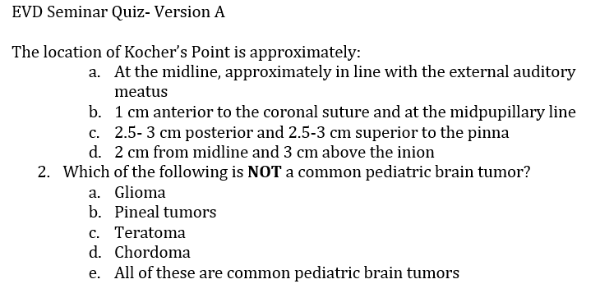
Demonstrating Effectiveness
Notes:
Every module began with a 10 question quiz and ended with a separate quiz. Half of questions were relevant and the other were irrelevant to the topic at had to serve as a negative control. The first question is an example of a relevant question for the emergent procedules module. The second question is irrelevant. We avoided irrelevant topics taught in previous modules.

Slide 18
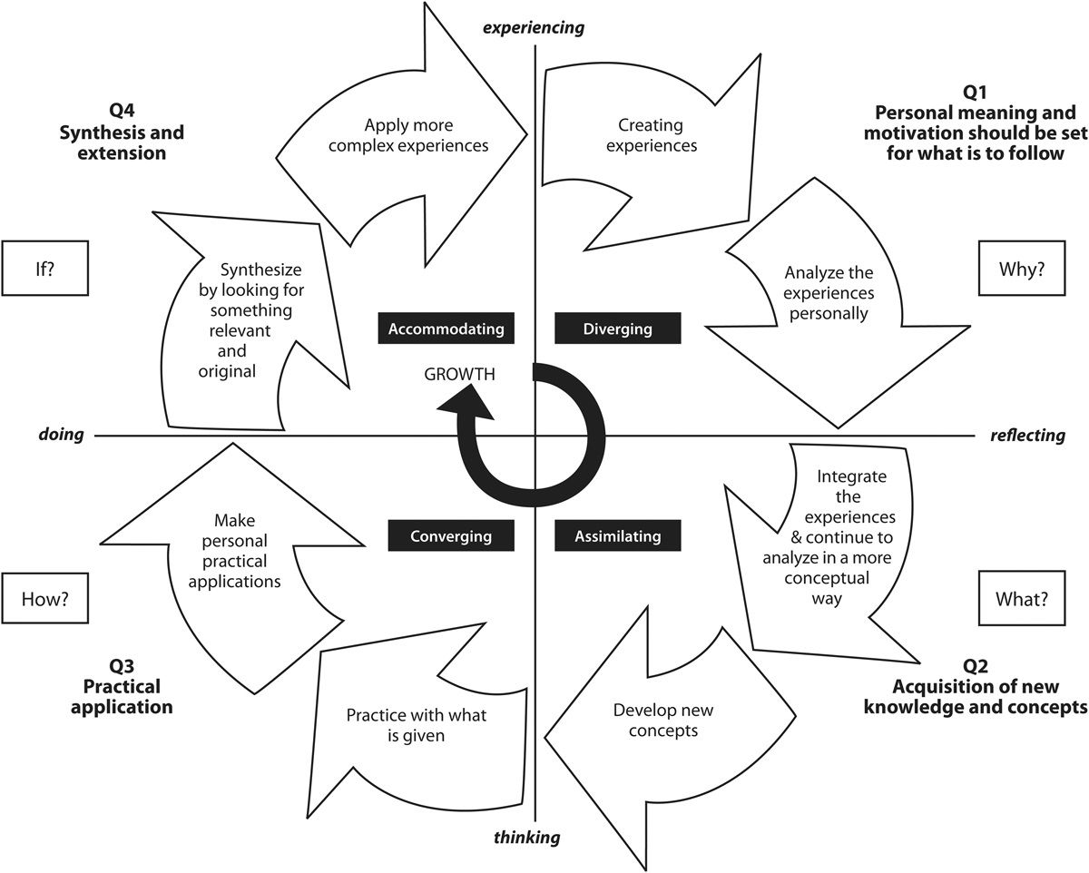
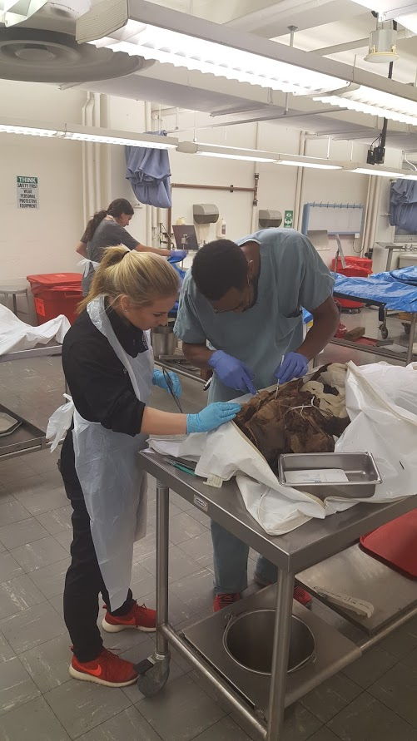
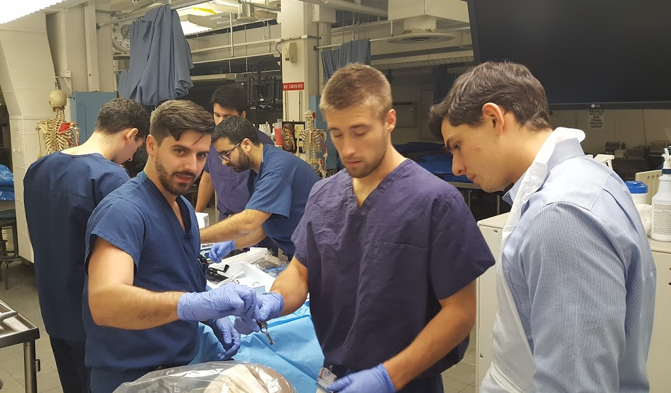
Teaching is Learning
Notes:
Both attendings and residents served as proctors for sessions. The different modules naturally provided an array of opportunities for residents of different levels. For example junior residents frequently teach procedures such as EVDs whereas senior level residents focus on more complex topics such as carotid endarterectomies. Both also receives reinforcement of their knowledge and skills in a no risk environment. This is in line with the Kolb adult learning inventory. Most of pre-clinical education focuses on the first two quadrants, where information is acquired and assimilated into past knowledge. Practical courses push students into the third quadrant of practical application. By teaching known skills, residents push themselves into the fourth quadrant and open themselves up to a more complex understanding and opportunity to learn

Slide 19
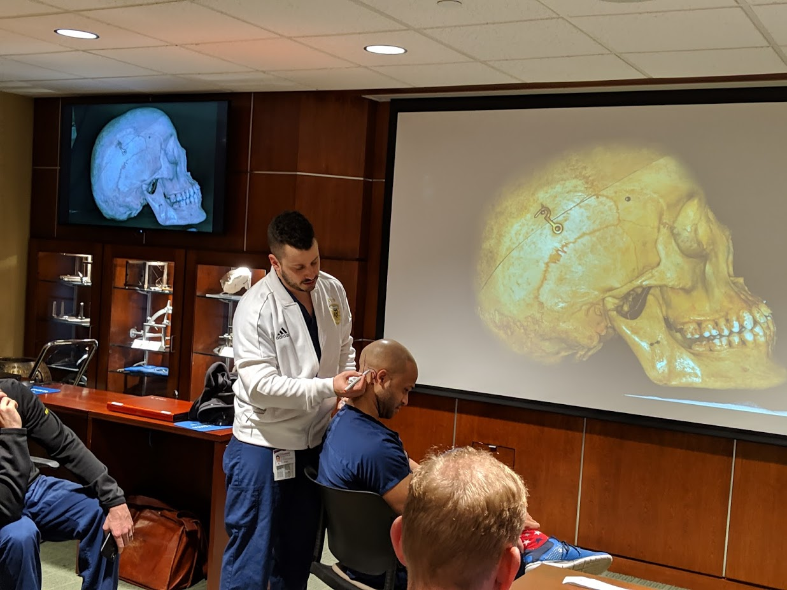
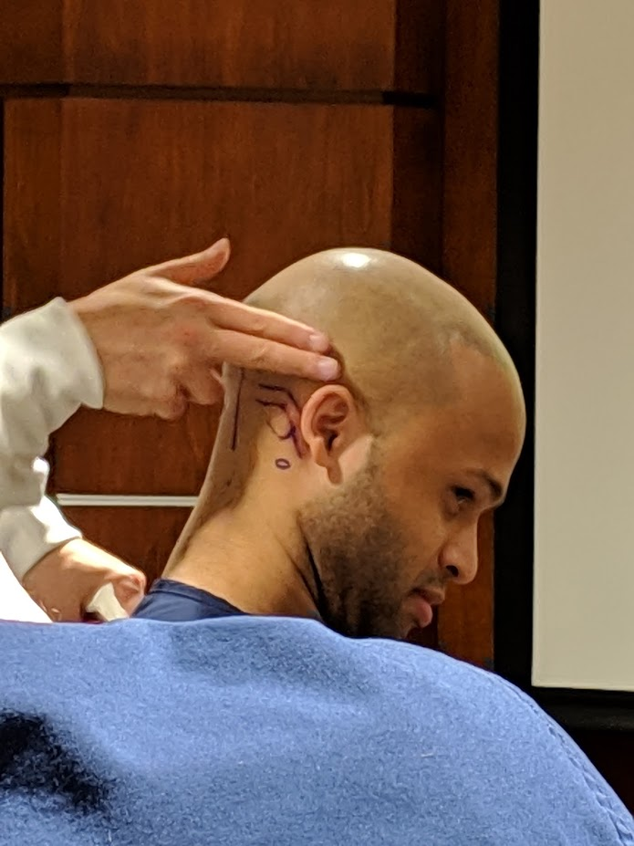
Teaching is Learning
Notes:
Even interns such as Dr. Fields here found unique ways to contribute to a discussion of cranial anatomy

Slide 20
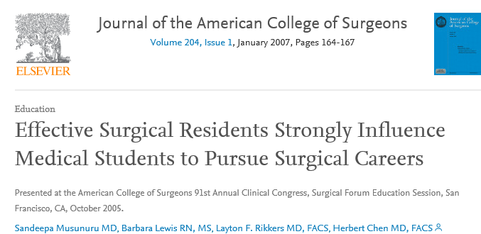
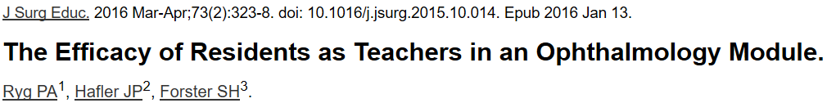
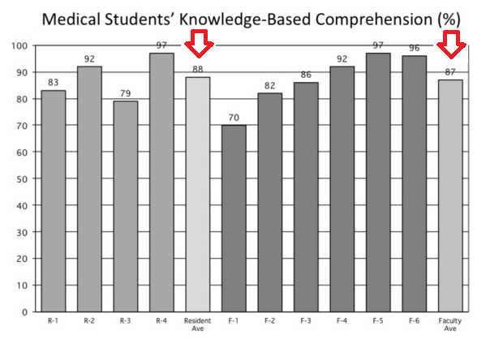
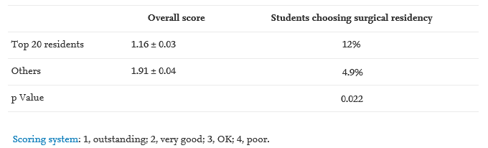
“Near-Peer Learning”
Notes:
The inclusion of effective resident teachers into medical education has repeatedly demonstrated benefit. In a study of approximately 120 residents and 2600 students rotating through general surgery as a third year student over a five year period, students exposed to the best rated resident teachers were more than twice as likely to enter a surgical residency. In terms of making resident effective teachers, it has been show that even a single day of organized teaching workshops can make residents effective lecturers and group leaders.

Slide 21
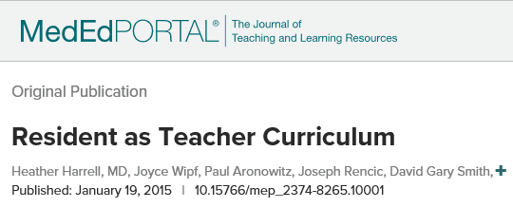
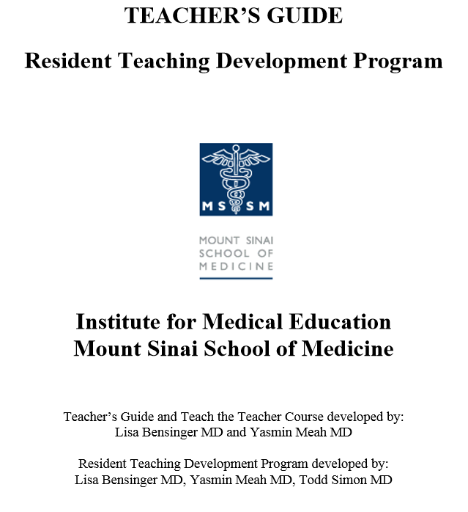
Notes:
There are a number of these courses and modules available for free online that are designed to be about one day in length. Unfortunately, the vast majority of them focus heavily on the education of medical residents as teachers, though the mount sinai program does have some modules for general surgery and OBGN.
Reporter educator manager educator

Slide 22
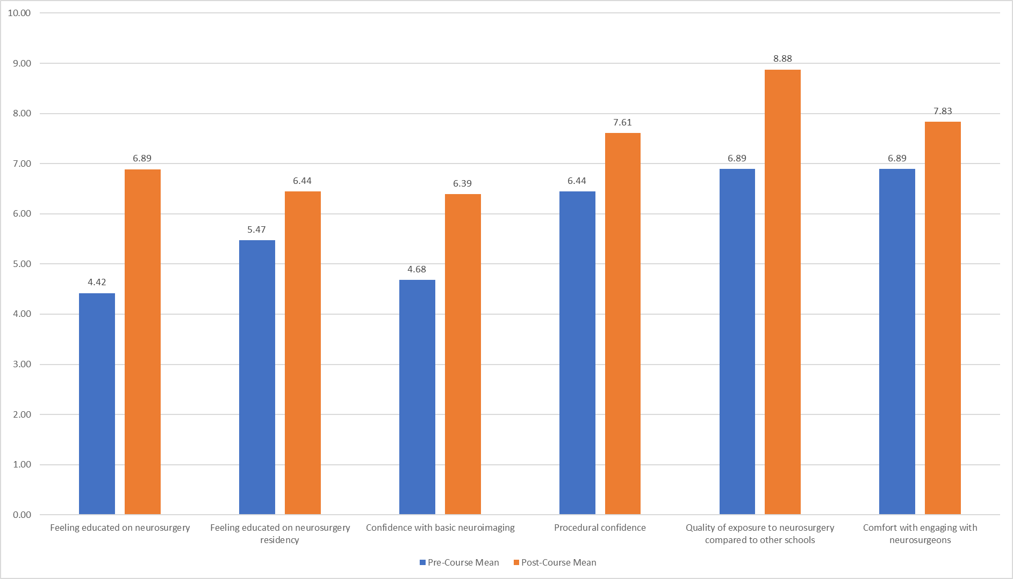
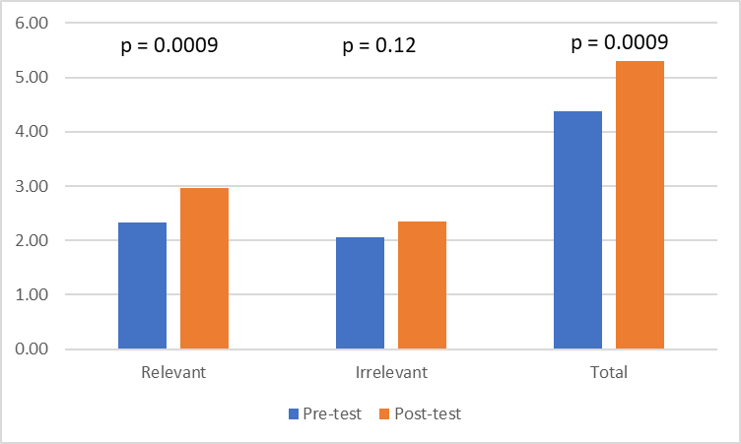
Results
Notes:
As one would expect, students performed significantly better on relevant post-course questions compared to irrelevant questions. When reviewing the pre and post survey opinions survey, we found that the course had a positive effect on the opinion students had regarding their level of education of neurosurgery and residency, their confidence with imaging and procedures, and their comfort with engaging with neurosurgeons. Students felt particularly strongly that their level of exposure to neurosurgery was far greater than average compared to other medical schools, which I am particularly proud of. These are the composite scores of the first and third courses, which were very similar when compared separately

Slide 23
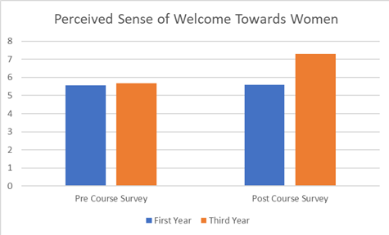
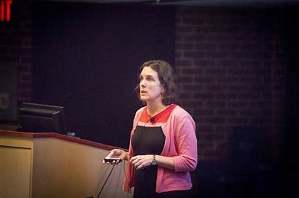

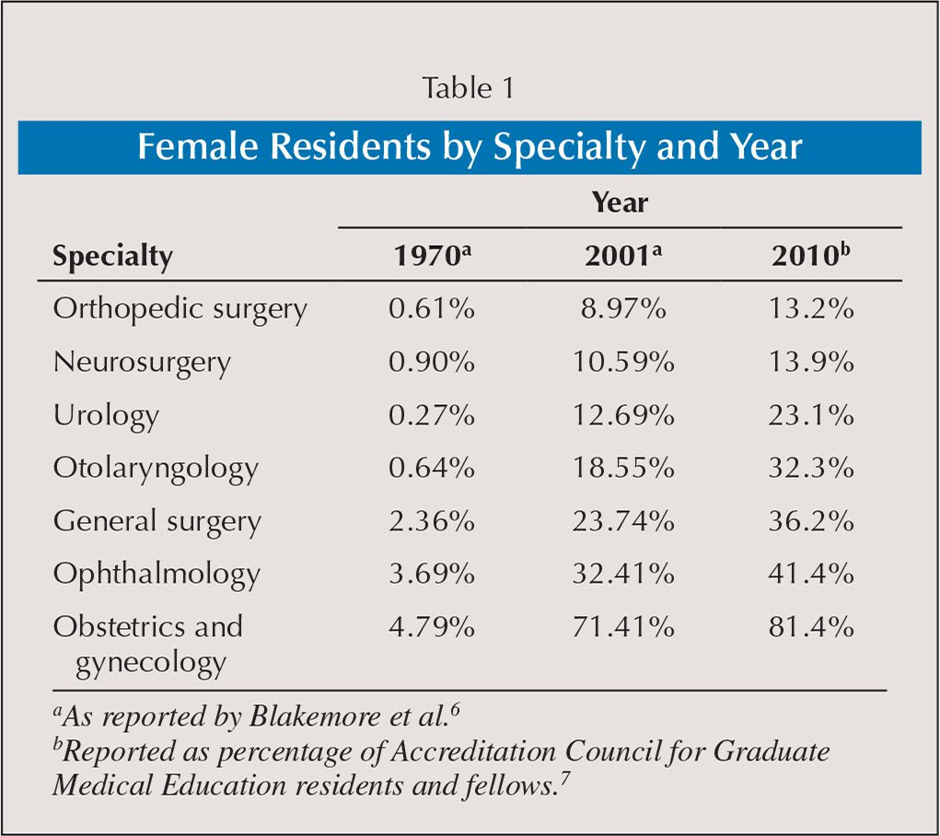
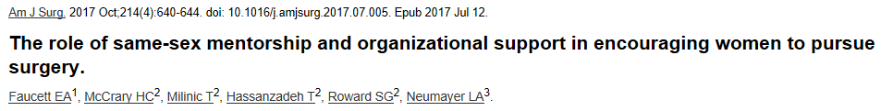
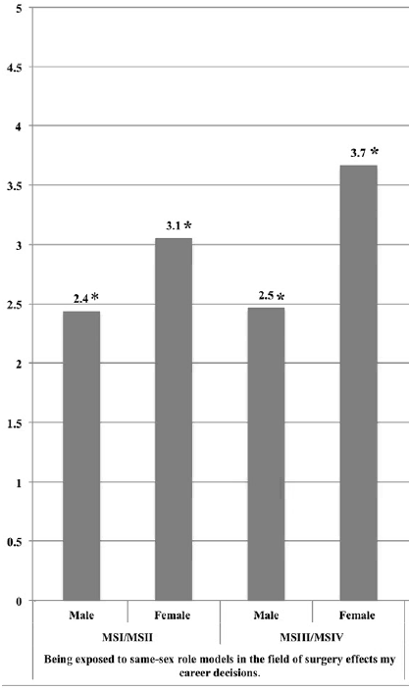
Notes:
What was not similar between the first and third course was student opinion on how welcome women are in neurosurgery. One of the major changes that occurred from the first to third year of the course was the involvement of Dr. Tyler-Kabara as well as the recruitment of two female residents to our residency. While the perception of the welcome of women in neurosurgery remained static before and after the course the first year, there was a dramatically more positive perception after the third course. Finding mentors cans be challenging as women have traditionally made up less than 15% of all residents, but the acquisition of female role models in surgical fields has been strongly associated with student career decisions for women considering surgical careers.

Slide 24
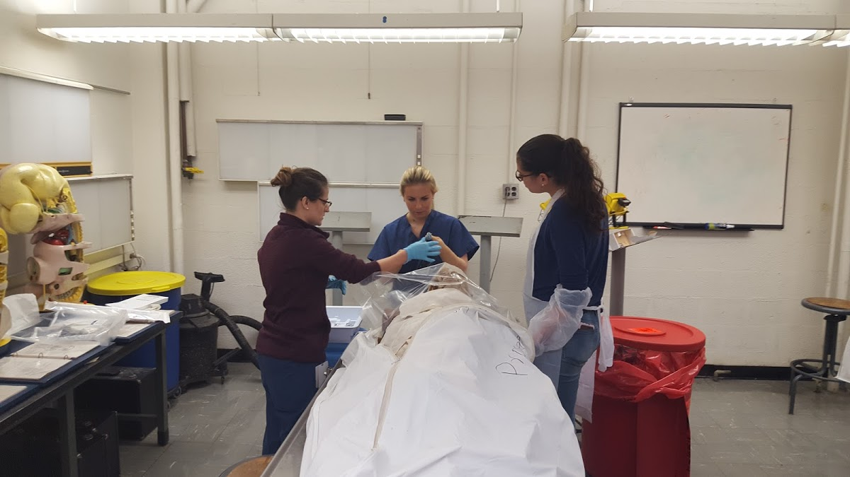
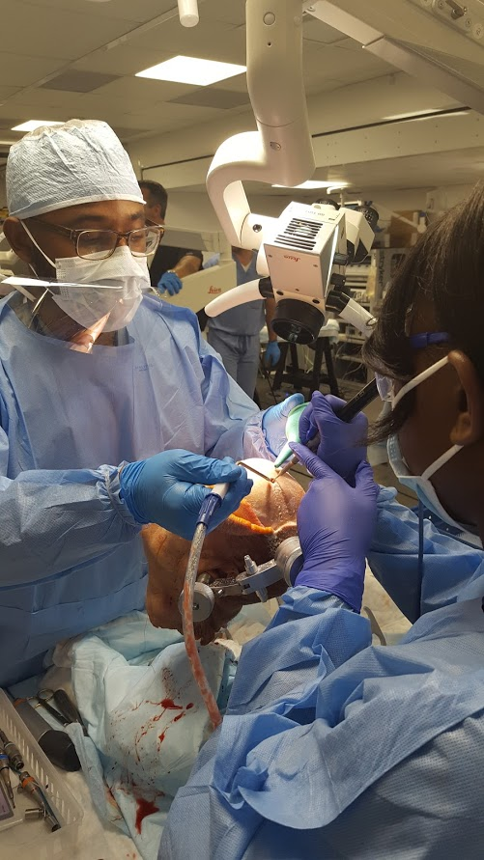
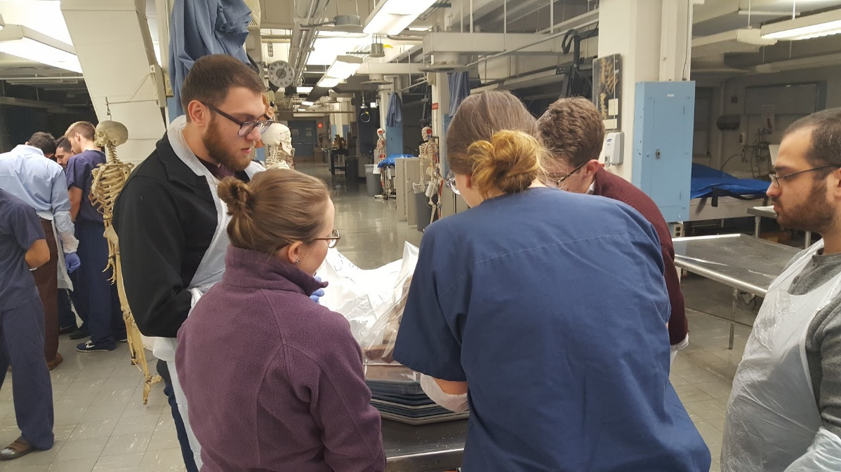
Notes:
Mentors can come from all backgrounds, but one of the primary values of early student exposure is to provide students with contact with residents and attendings who can provide frank, relatable, and shared experiences in a nonthreatening environment. Providing as diverse a group of mentors as possible allows us to reach the greatest diversity of students

Slide 25
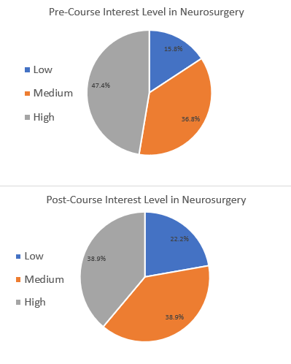
Neurosurgery as a Career
Notes:
The overall rating for neurosurgery interest remained stable at 6.7 before and after the course, but the number of students rating their interest from 8-10 decreased. While the absolute number number decreased, those within the high group went from a mean of 8 to a mean on 9, with a greater number of students reporting a 10/10 likelihood of pursuing neurosurgery as a career

Slide 26
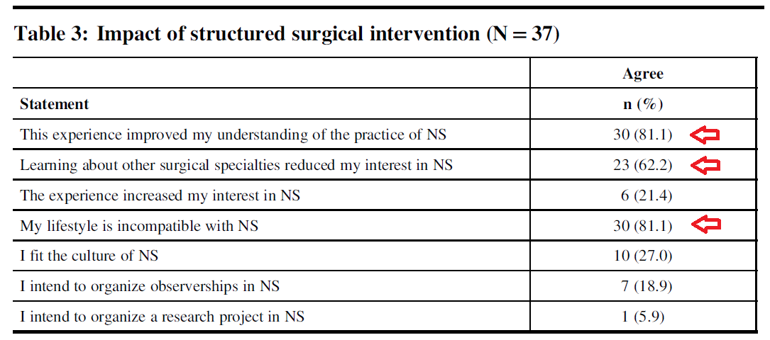
“Neurosurgery is a lifestyle specialty. The lifestyle is neurosurgery.” -Anonymous
Notes:
Other centers have reported similar results when students are exposed to neurosurgery early in their medical career. At Toronto, the school holds an optional two week surgical skills course covering multiple specialities. They also found that the overall perception interest of students decreased when given real exposure to neurosurgery, with the primary factors cited being interest in other surgical specialties and incompatible lifestyle. While on some level it would be in our interest for every student to apply to neurosurgery, the reality is that many students may not be able to “go the distance’ as it were, and helping them realize this early allows us to more effectively recruit and retain those who have the qualities necessary to thrive in our field.
In contrast to our results, Vanderbilt has published on slight increases in interest in neurosurgery after their course, but this consisted of classroom based experiences only and the overall percentage of students leaving with a high interest in a neurosurgical career was similar to our own.

Slide 27
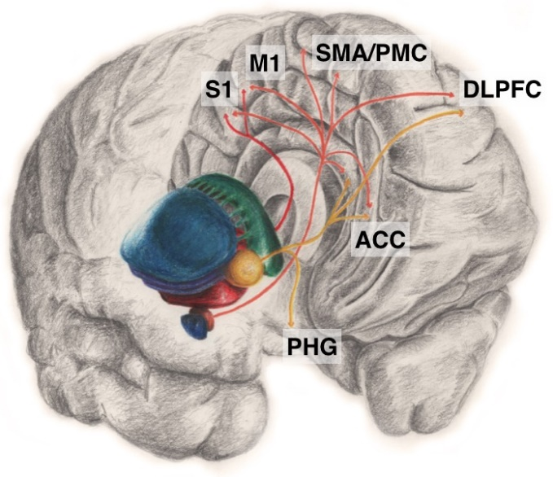
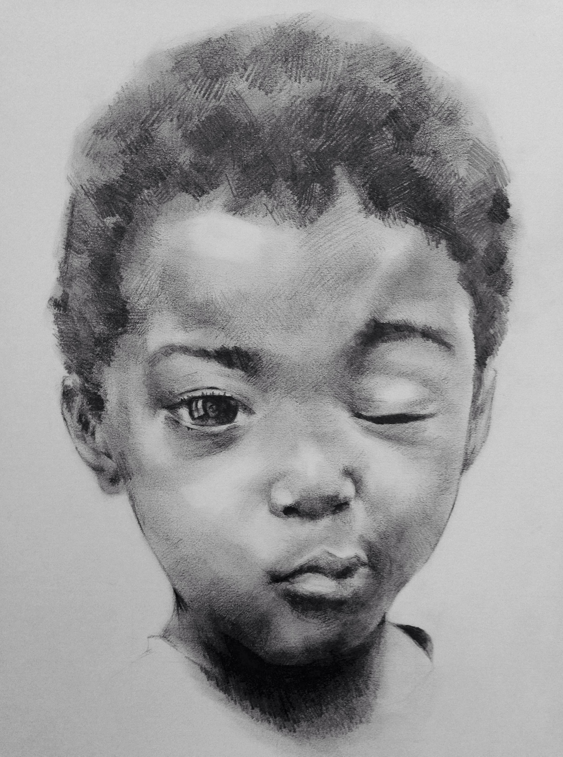
Interest Groups
Paired mentorships
Suture skills and OR etiquette workshops
Medical illustration, statistical knowledge and other skills
Notes:
I will briefly touch on interest groups, which have become increasingly organized under the AANS purvue of the young neurosurgery committee. They serve as a good pool of potential students for shadowing and research but tend to be relative unstructured. We have worked to better engage them through unique opportunities such as paried mentorships for first year medical students with junior residents for longitudinal exposure during medical school. We also run very popular OR ettiquite and suturing skills workshops. I have found that medical students tend to have a lot of valuable talents. Mnay of them have proven themselves to be fantastic artists, as demonstrated here. They also may be skilled at statistics or at other things that make them especially valuable for publications.

Slide 28
Future Directions
Develop a one day neurosurgical resident as teacher module
Track the rate of former students matching into neurosurgery and other surgical fields
Produce formalized materials for distribution to other programs
Functional module: stereotactic biopsy, temporal lobectomy
Notes:
Now that our course has become well established, it is my hope to further expand into related areas. We hope to develop a one day teaching module specific to neurosurgical residents . We also plan to track the long term match rates of past students into neurosurgery and other surgical fields. We would like to start seeking funding for the prepation of formalized materials that can be distributed to other training programs similar to the lectures already available on the Senior Society webpage but with additional teacher’s manual materials for residents. Until this happens, I would Happy to share our existing materials with any program interested in this type of course. Lastly, we are still working out the details on how we could best represent functional neurosurgery given the limitations of cadaver course.

Slide 29
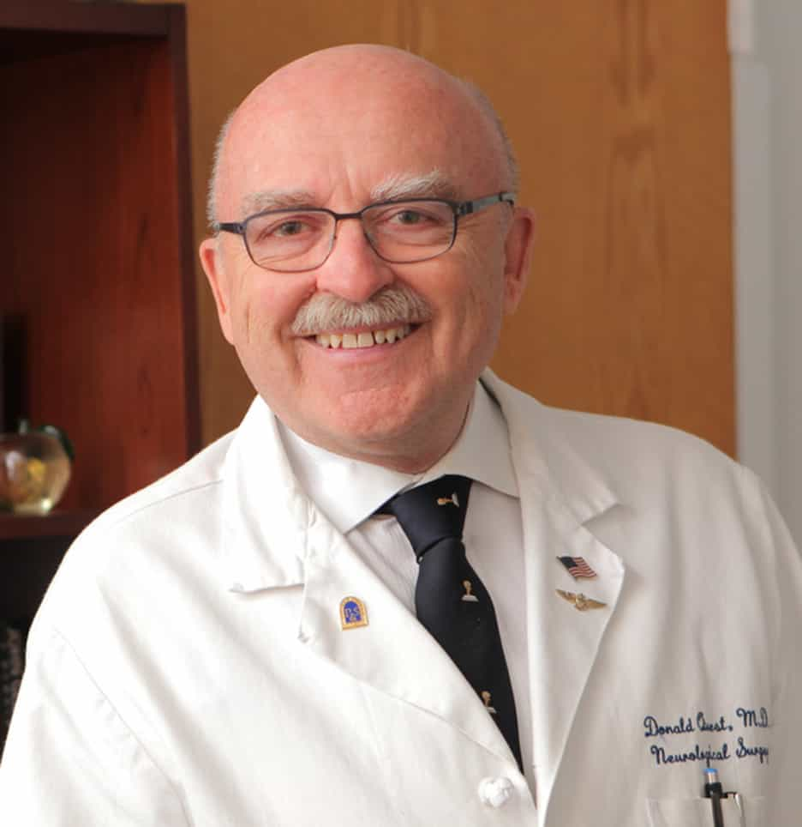
Early Influences
Notes:
I would like first like to acknowledge Dr. Quest, who’s medical student course was a major inspiration to the beginnings of my interest in organized medical education when I was at Columbia

Slide 30
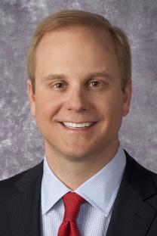
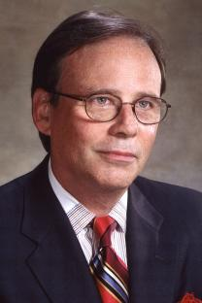
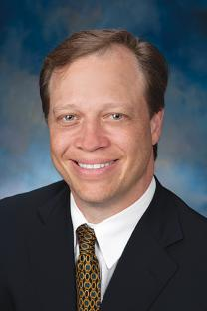
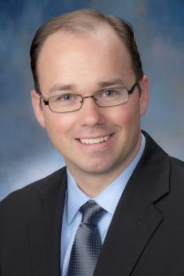
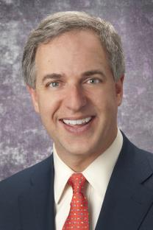





Thank You!
Dr. Raymond Sekula Dr. L Dade Lunsford Dr. Robert Friedlander Dr. Johnathan Engh Dr. Peter Gerszten
Dr. Bradley Gross Dr. Elizabeth Tyler-Kabara Dr. Daniel Wecht Dr. Nduka Amankulor Dr. Brian Jankowitz
Notes:
Next I would like to thank all of the faculty that have given their time to teaching and proctoring this course over the years

Slide 31














Thank You!
Notes:
I would also like to thank all of the residents who have been involved over the years.

Slide 32
Notes:
And lastly thank you for this opportunity to present today.

