Slide 1
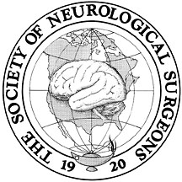
SNS Match Committee Report for SNS Meeting June 2013
SNS Match Committee: Oyesiku, Nelson M; Kathryn Holloway; David Roberts; Richard Fessler ; Johnny Delashaw; Phil Weinstein

Slide 2
All Data are from NRMP

Slide 3
SNS 2013 Match Committee Report
Based on fall 2012 data, there are 1,406 residents in training in 101 training programs. Approximately 15.7% are women.
146 residents completed training in 2012 and 214 are tracking towards completion in Spring 2013.
For the 2012 Residency Match there were 318 applications and 196 positions were filled. 87% of those matched were from U.S. Medical Schools.
Neurosurgery is the 3rd most competitive after plastic surgery and dermatology.
The average USMLE score for applicants was approximately USMLE 1 - 239 and USMLE-2 - 237 in 2009, the most recent available data.
Approximately 12% of applicants had a Ph.D. degree, and 28% were AOA.

Slide 4
Match Summary, 2013
ERAS 2013 applicants Neurological Surgery: USMGs
IMGs
No of Programs: 99
Positions offered: 204
No of Matches (US Seniors): 241 (% filled = 93.1)
No of Matches (Total) : 314 (% filled = 99.5)
Unfilled Programs: 1

Slide 5
Match Summary 2013: Advanced Data Table
 | No. of Programs | Positions Offered | Unfilled Programs | No. of Applicants US Seniors / Total | No. of Matches US Seniors / Total | % Filled US Seniors / Total | Ranked Positions US Seniors / Total
PGY-1 | 99 | 204 | 1 | 241 / 314 | 190 / 203 | 93.1 / 99.5 | 3207 / 3499

Slide 6
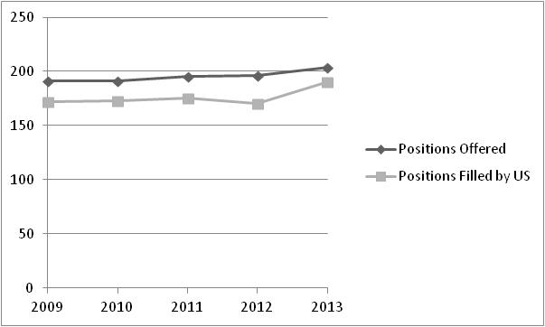
Total Positions Offered / Positions Filled by US Seniors

Slide 7
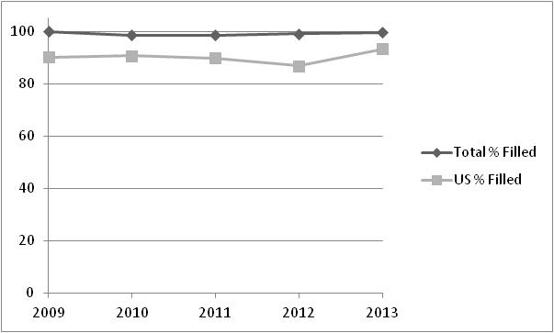
% Positions Filled / % Positions Filled by US Seniors

