Slide 1

Ventricular Anatomy

Slide 2
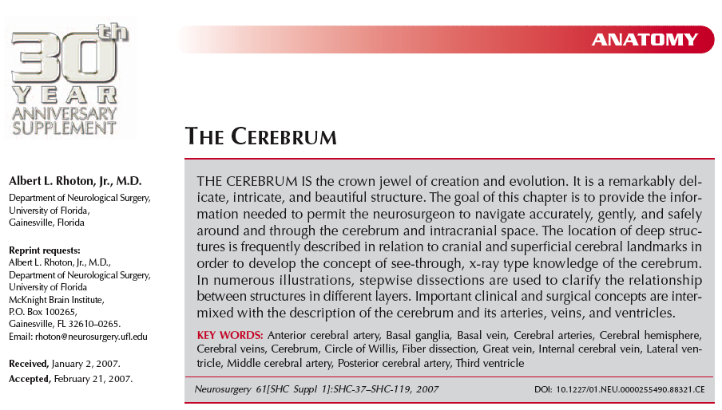

Slide 3
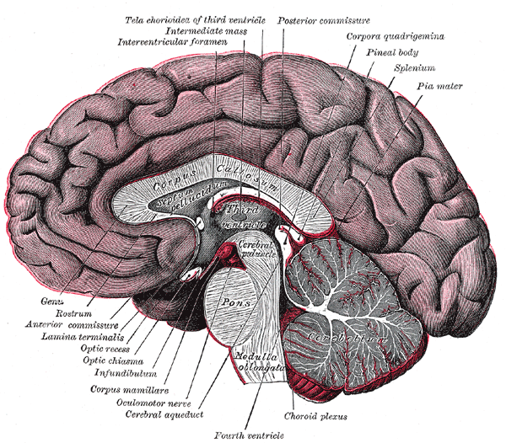

Slide 4
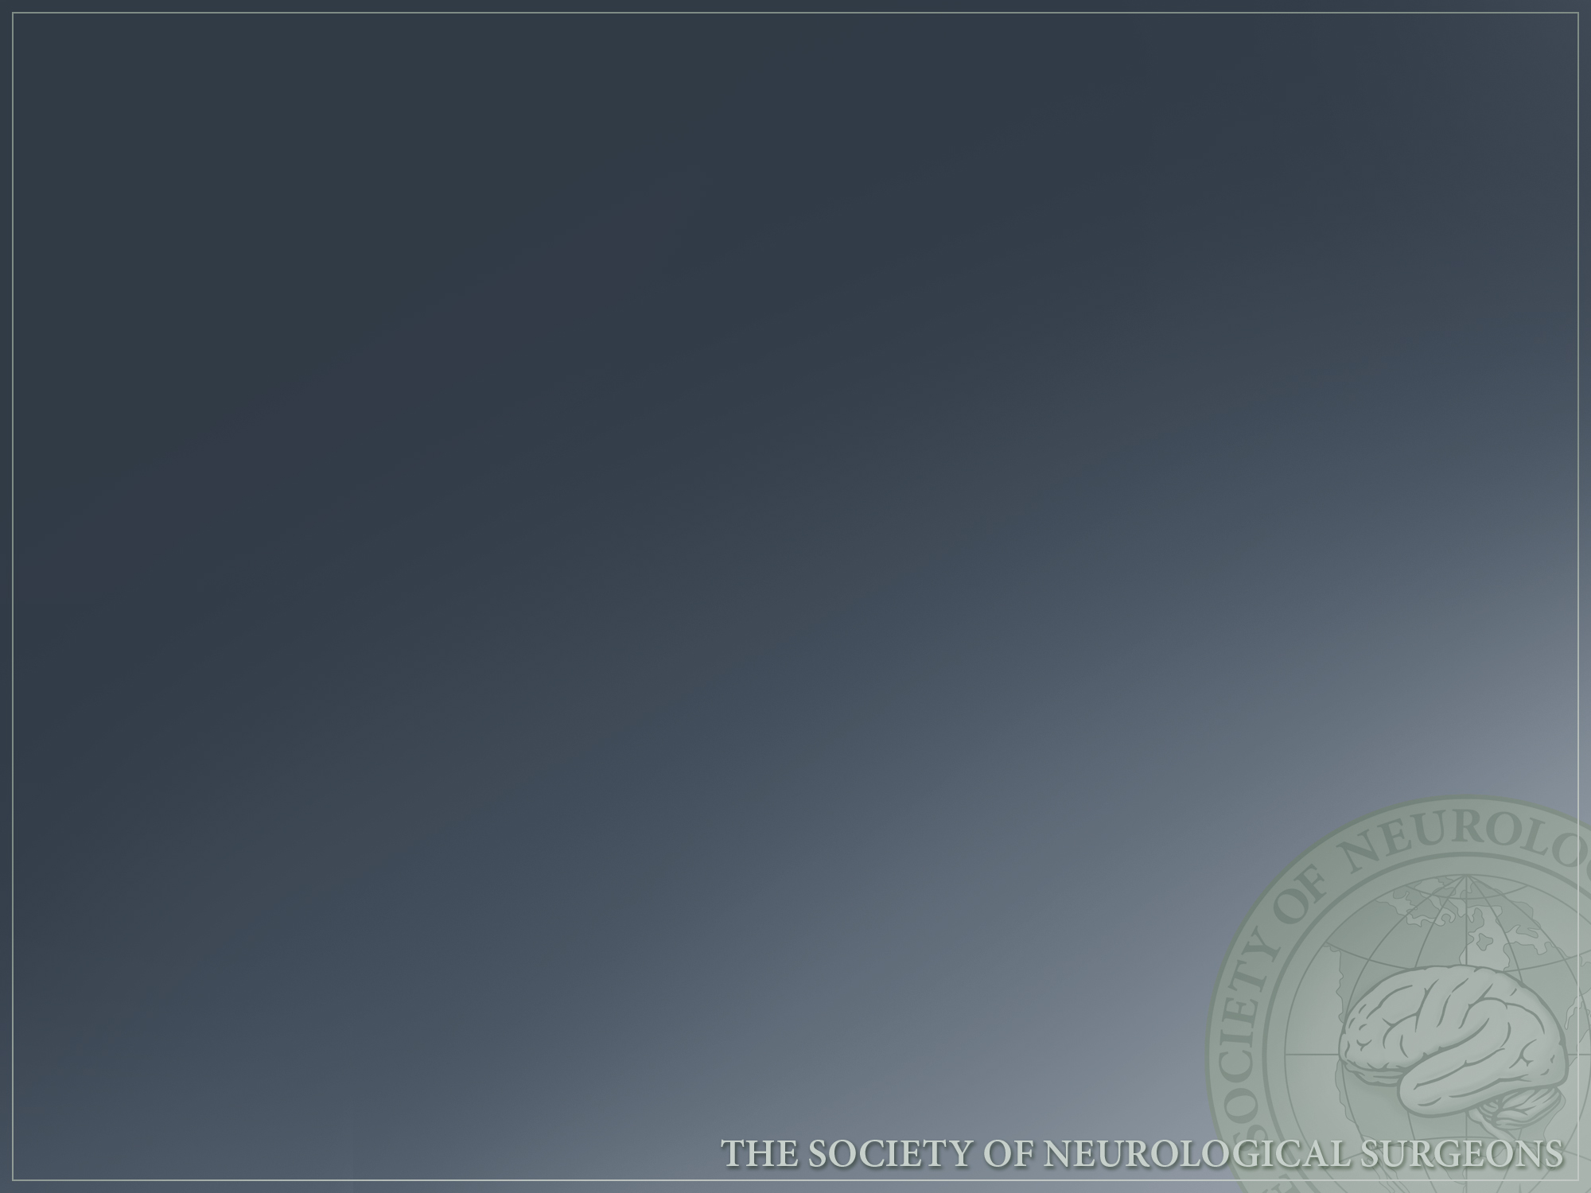
General Ventricular Anatomy
The two lateral ventricles communicate with the third ventricle through the foramen of Monro.
The third ventricle communicates with 4th ventricle through the cerebral aqueduct.
Lesions can involve the ventricular system and cause CSF communication pathway obstruction and hydrocephalus.

Slide 5
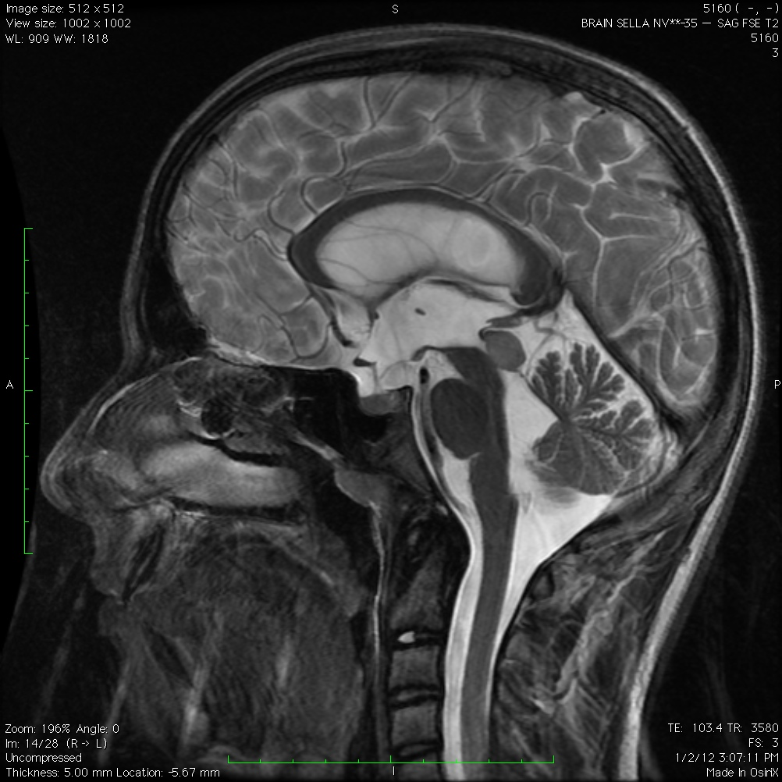
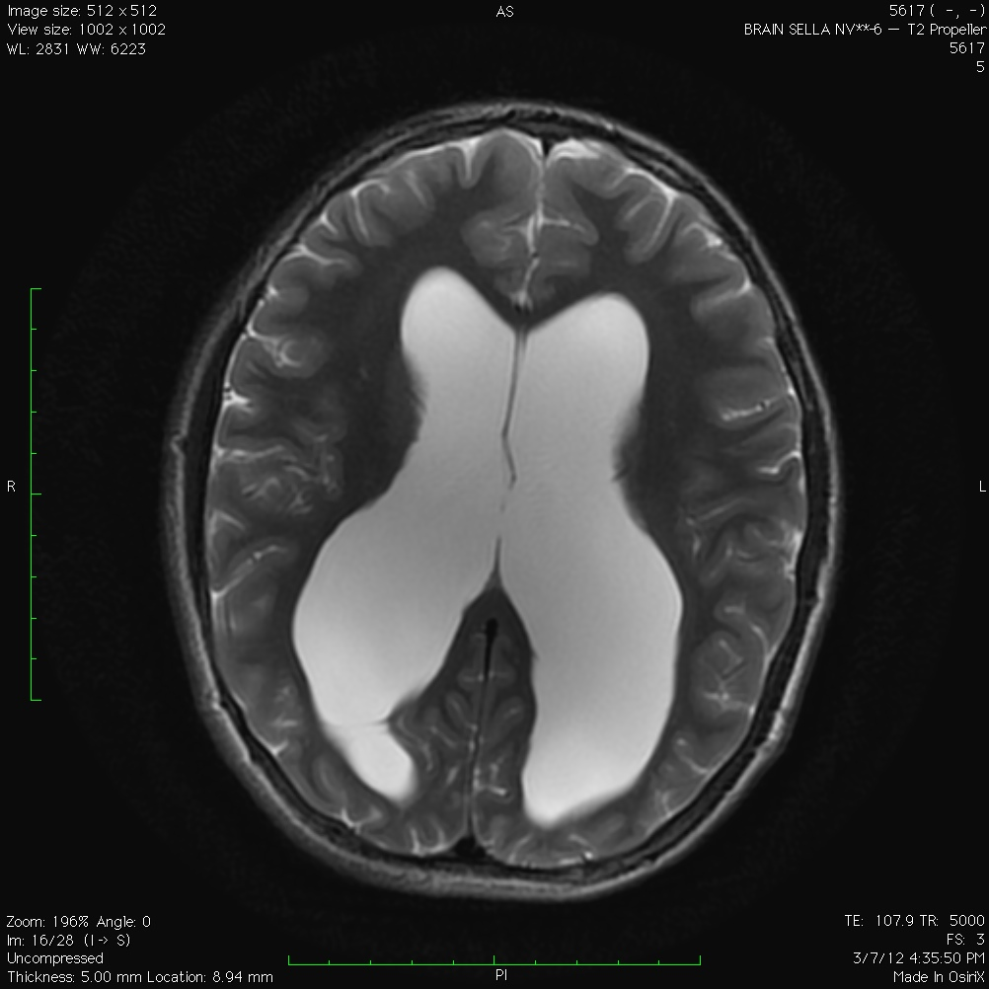
Obstructive Hydrocephalus

Slide 6
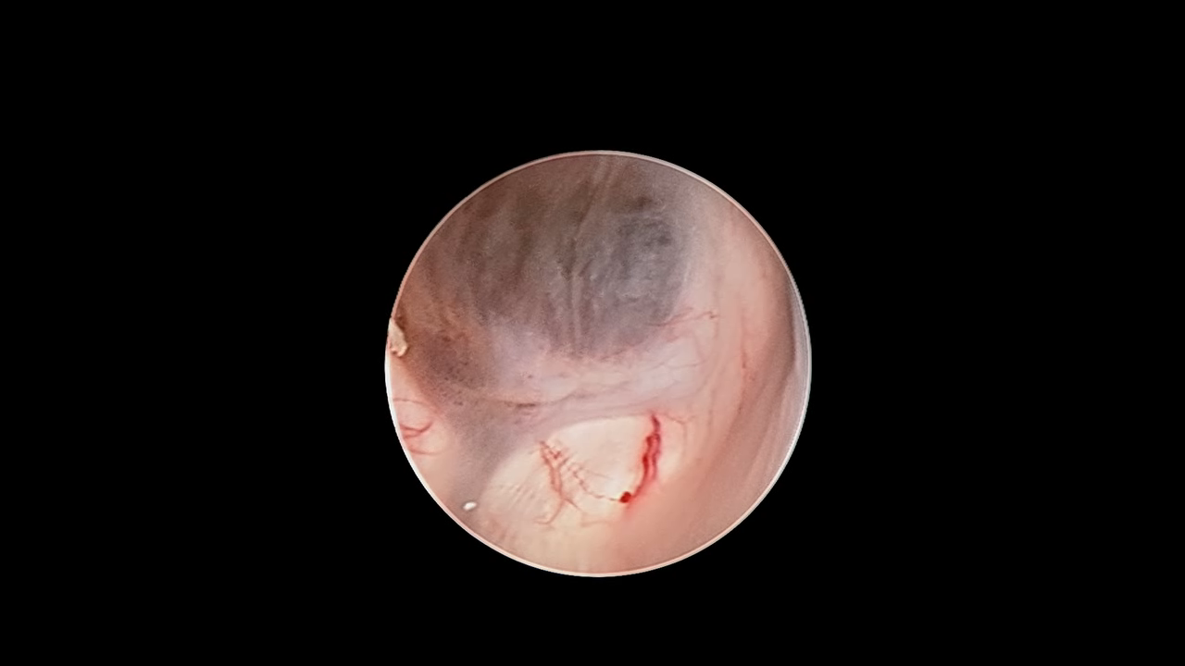
Intraventricular Anatomy

Slide 7
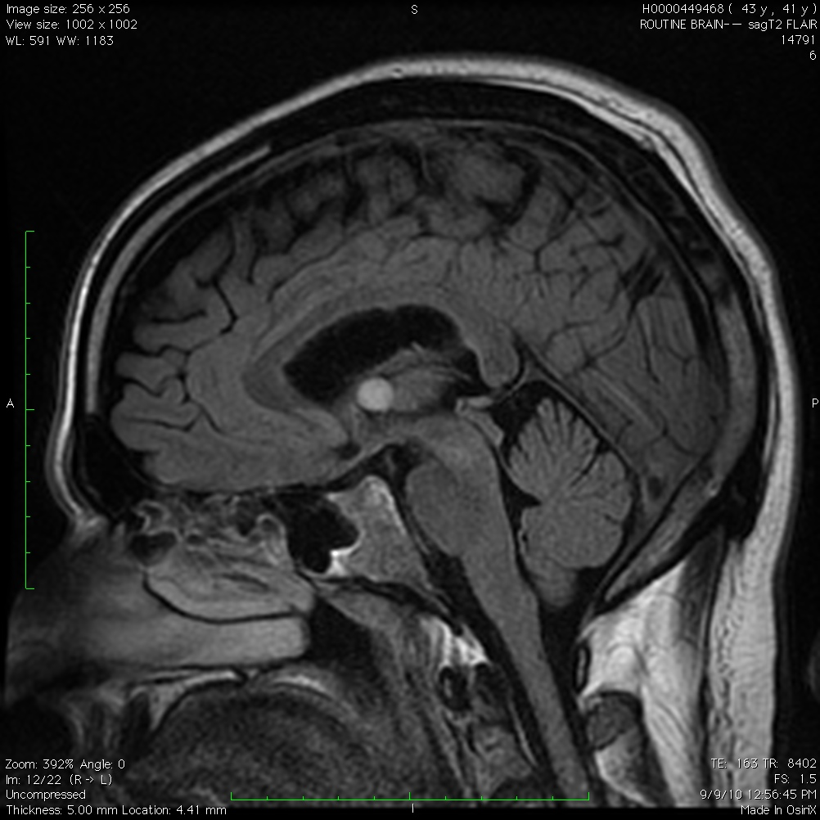
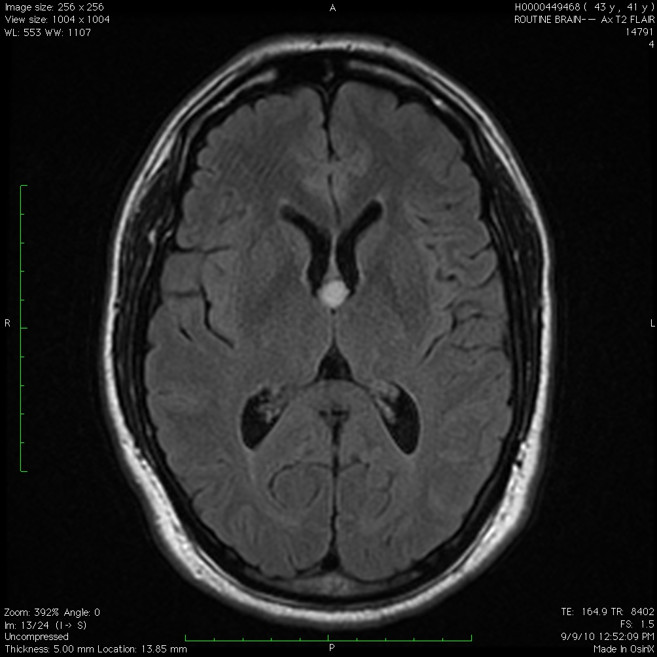
Colloid Cyst

Slide 8
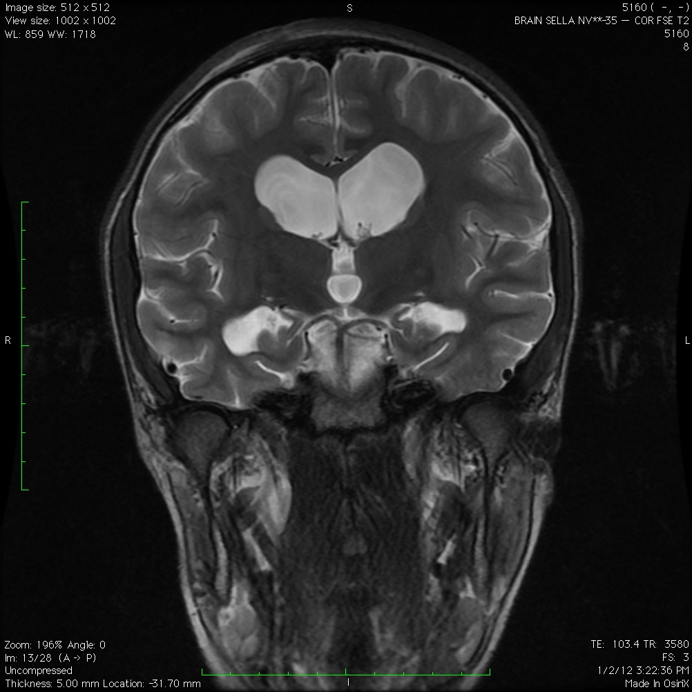
Lateral Ventricles
Each lateral ventricle is c-shaped that wraps around the thalamus
5 parts
  Frontal, temporal, and occipital horns, the body, and the atrium
Walls are formed by the:
  Thalamus, septum pellucidum, deep cerebral white matter, corpus callosum, caudate nucleus, and the fornix

Slide 9
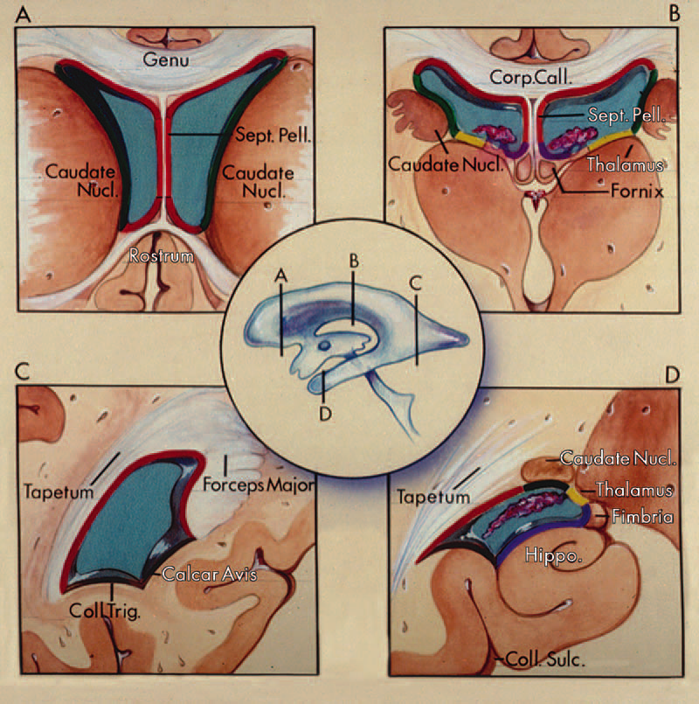

Slide 10
Fornix
C-shaped structure that wraps around thalamus in wall of ventricle.
Consists of hippocampomamillary tract fibers
  Originate from hippocampus, subiculum, and dentate gyrus of temporal lobe
Fimbria arises in floor of temporal horn and passes posteriorly to become crus of fornix
Paired crura meet to form body of fornix
  Separates roof of third ventricle from the floor of the lateral ventricles
Body of fornix separates into 2 columns that arch along the superior and anterior margins of the foramen of Monro in their course toward the mamillary bodies.

Slide 11
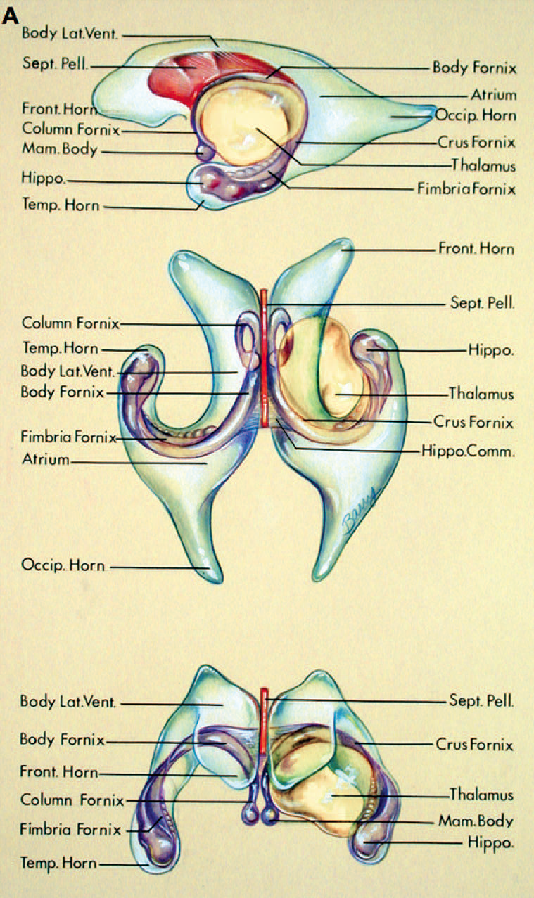
Lateral Ventricle
Frontal horn is anterior to the thalamus
Body is above the thalamus
The atrium and occipital horn are behind the thalamus
Septum pellucidum is the medial wall of the frontal horn and body
Hippocampal formation in floor of temporal horn
Fornix arises in hippocampal formation and wraps around thalamus

Slide 12
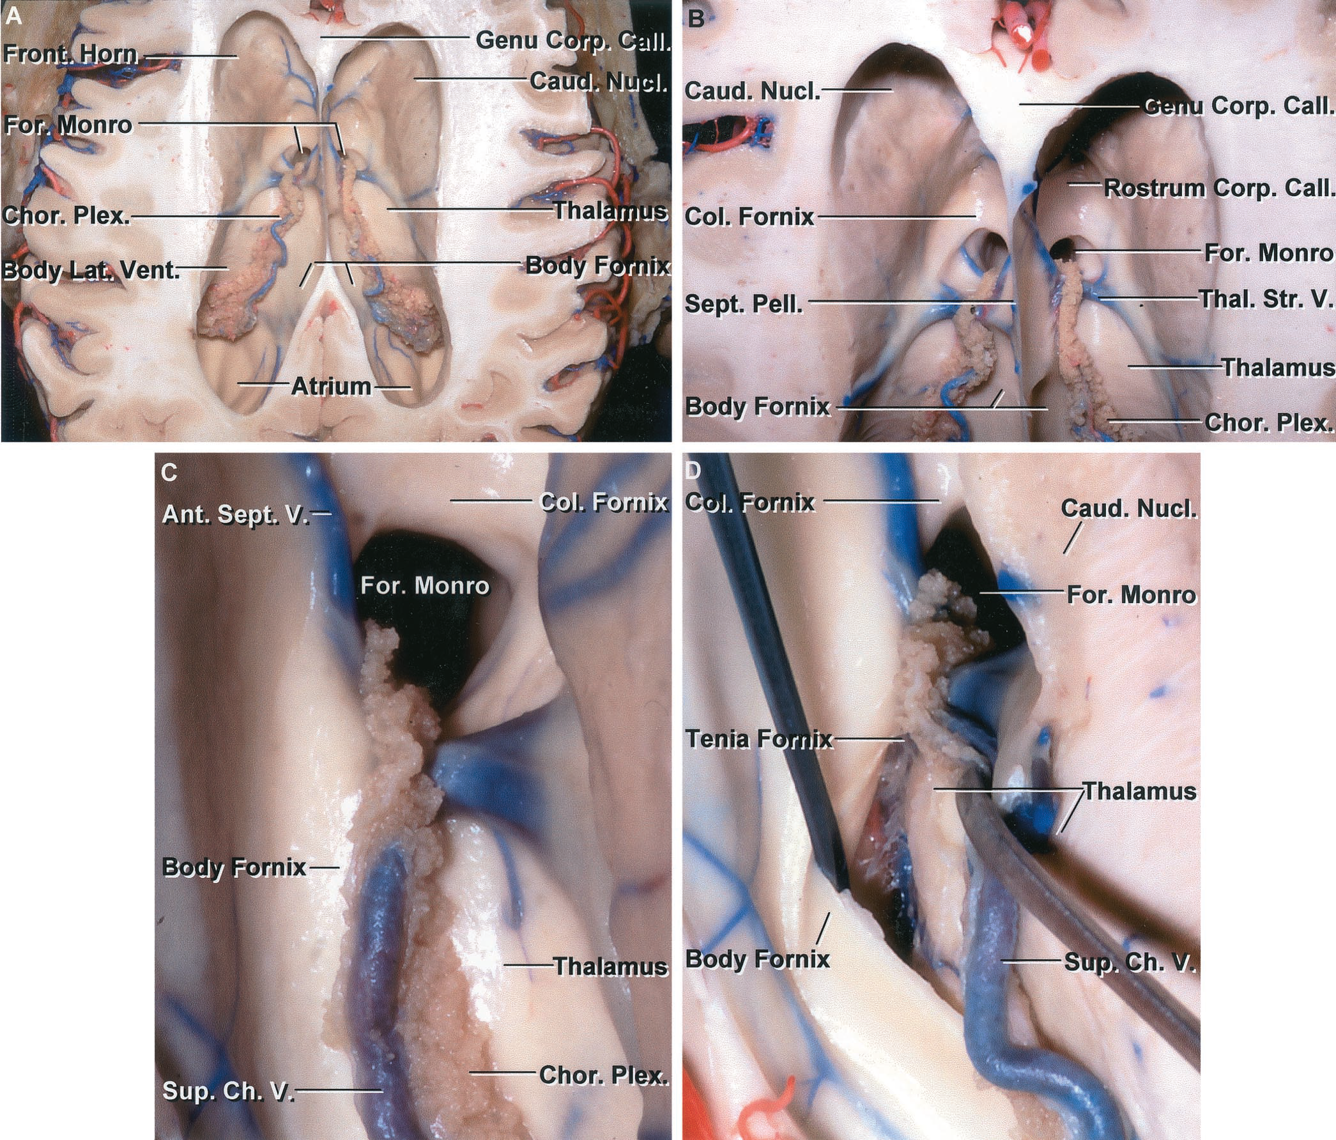
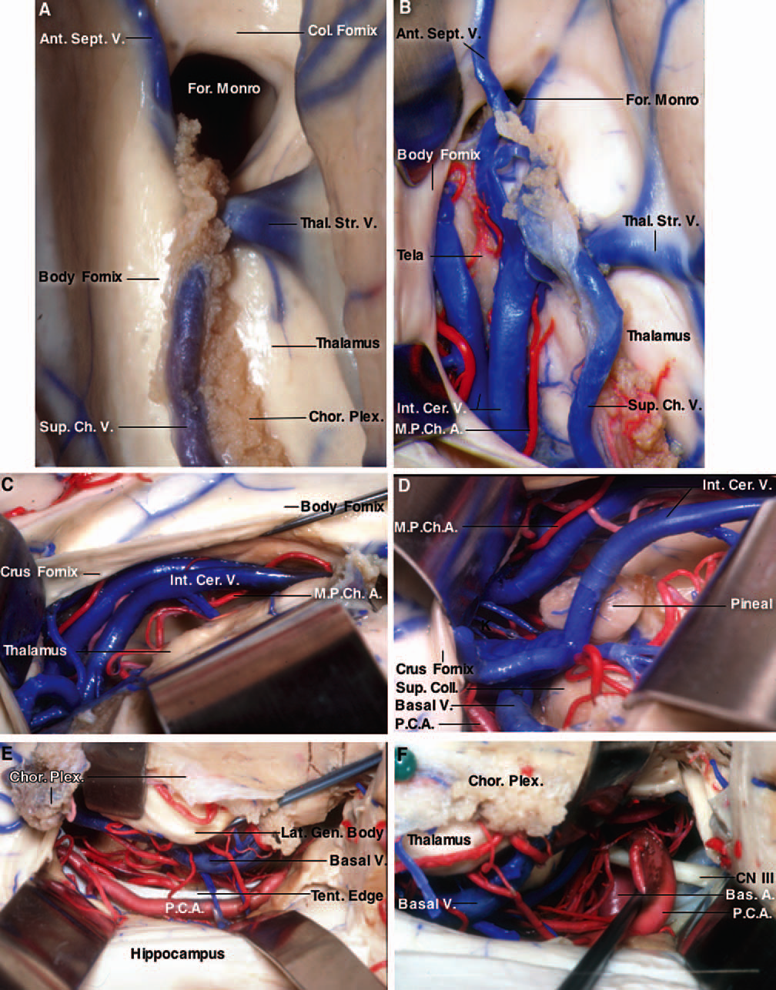
Foramen of Monro
Frontal horn of lateral ventricle is anterior and body behind the foramen of Monro.
The columns of the fornix form the anterior and superior margins of foramen.
Choroidal fissue is cleft between fornix and the thalamus along which the choroid plexus is attached.
  Superior choroidal vein

Slide 13
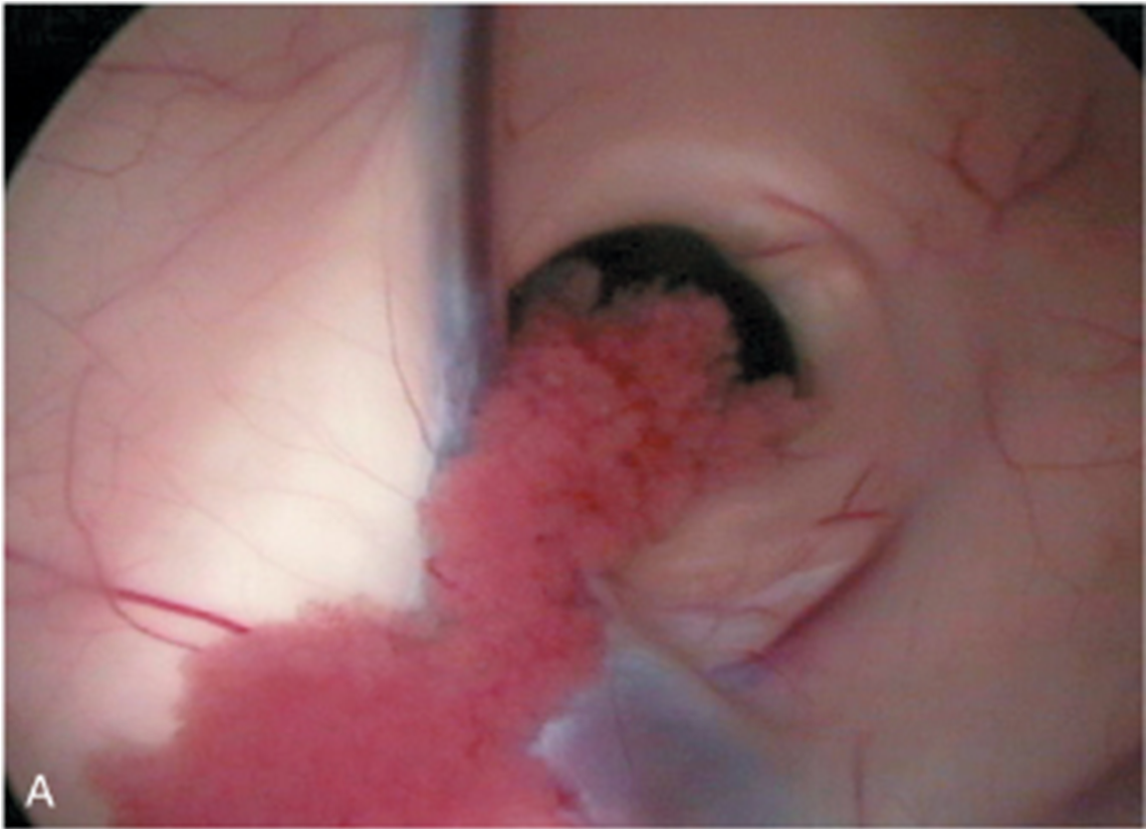
Foramen of Monro Anatomy
Foramen of Monro
Fornix
Septal Vein
Choroid Plexus
Thalamostriate Vein

Slide 14
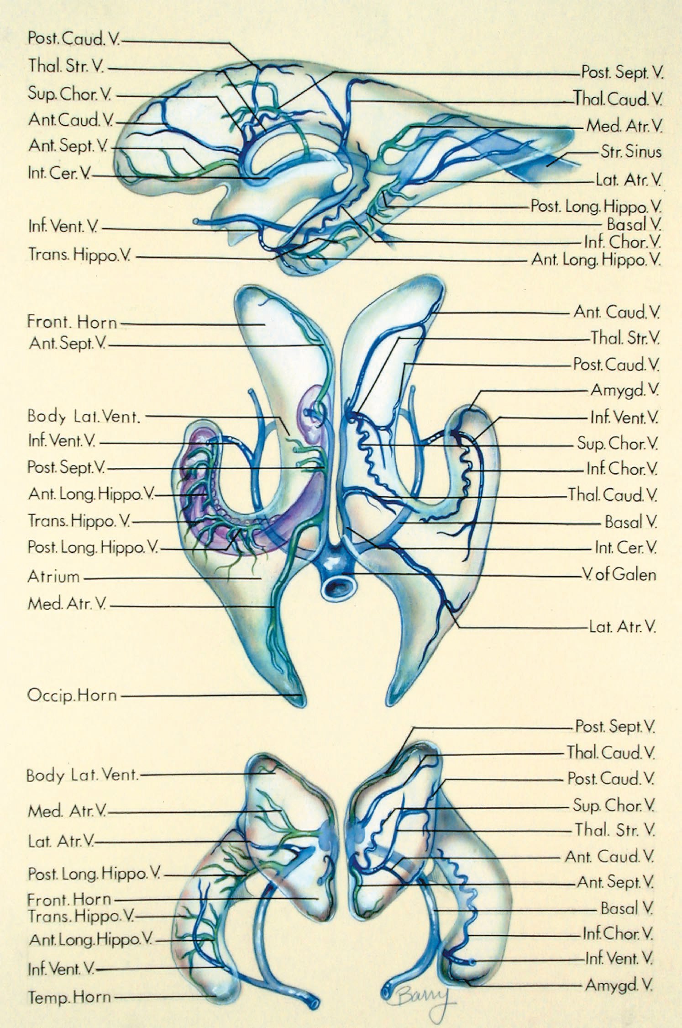
Venous Anatomy
Veins from frontal horn and body of lateral ventricle drain into the internal cerebral vein.
  Thalamostriate and septal veins
  Thalamostriate v. lies between caudate nucleus and thalamus
Veins from temporal horn drain into the basal vein of Rosenthal.
Veins draining atrium drain into basal, internal cerebral, or great vein of Galen
2 internal cerebral veins and 2 basal veins drain into the vein of Galen

Slide 15
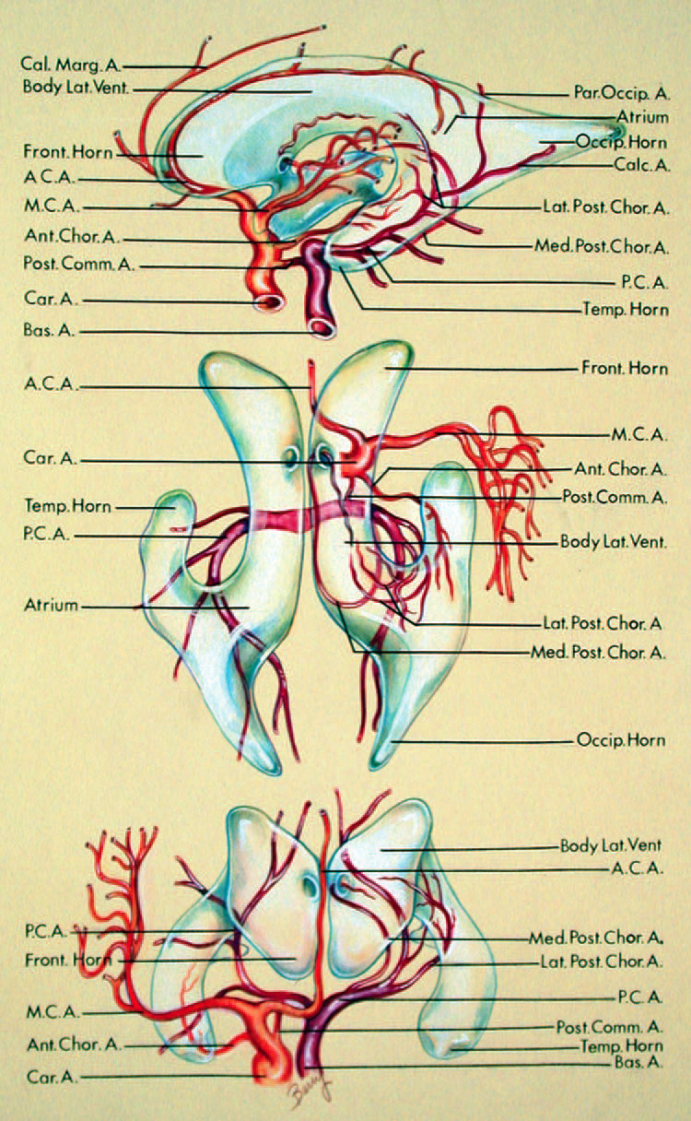
Arterial Anatomy
Anterior choroidal arteries send branches to choroidal fissures to choroid plexus
Anterior cerebral arteries pass around the anterior wall of the third ventricle and anterior wall of frontal horns to roof of lateral ventricles.
Posterior cerebral arteries pass medial to temporal horns and atria and give rise to posterior choroidal arteries
  Posterior choroidal arteries pass through choroidal fissure to supply choroid plexus

Slide 16
Third Ventricle
Midline cavity which connects each lateral ventricle through the foramen of Monro anterosuperiorly and posteriorly with the 4th ventricle through the aqueduct of sylvius.
Roof has 4 layers
  Fornix, 2 thin membranous layers of the tela choroidea, and a layer of blood vessels between the sheets of the tela choroidea
  Tela choroidea forms 2 of the layers in the roof
    2 thin semiopaque membranes derived from the pia mater.
    Velum interpositum is space between 2 layers of tela choroidea
  Vascular layer consists of medial posterior choroidal arteries, internal cerebral veins and their tributaries.
Choroidal fissure is located in the lateral margin of the roof.

Slide 17
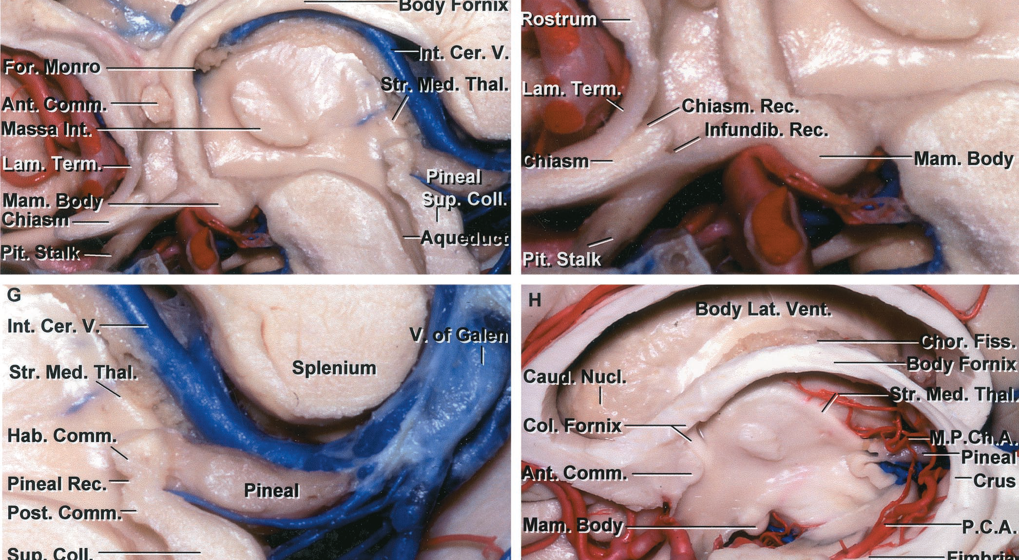
Third Ventricle

Slide 18
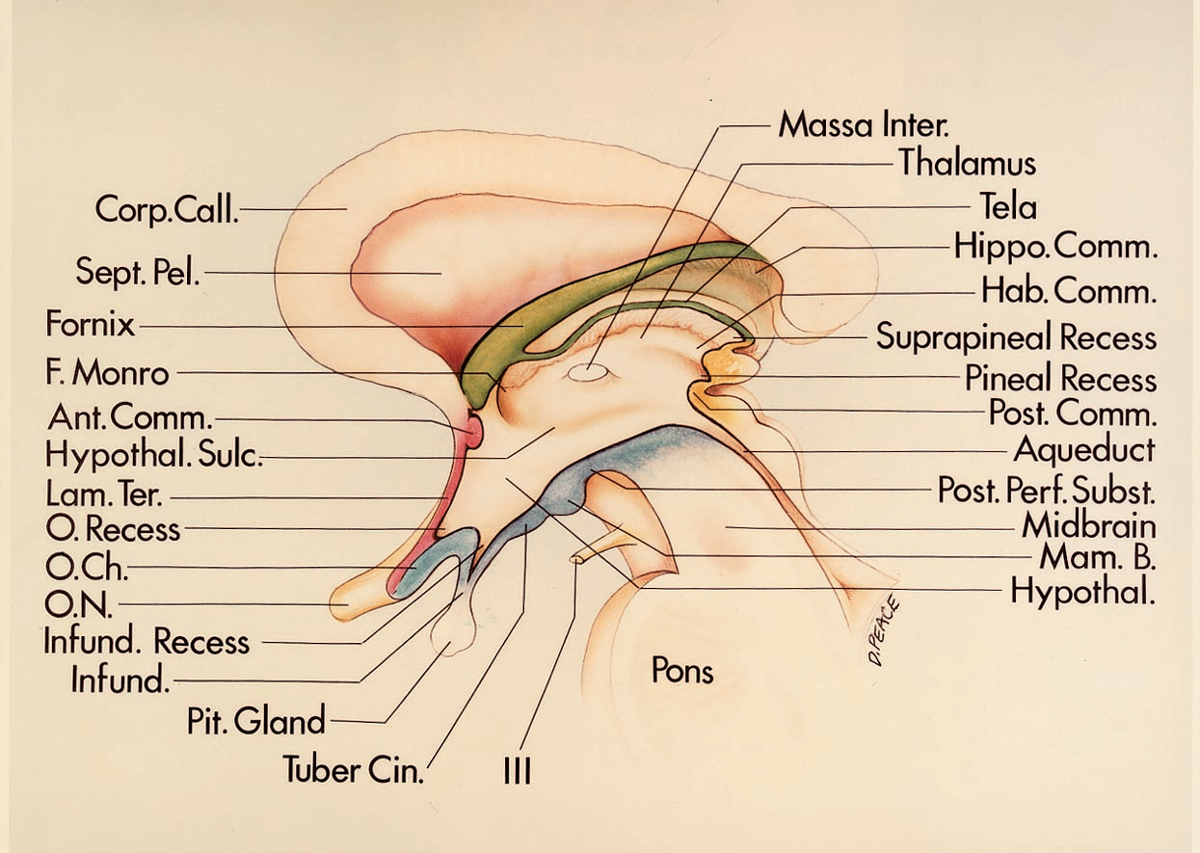
Third Ventricle

Slide 19
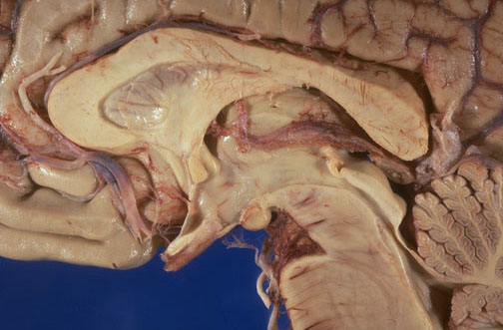

Slide 20
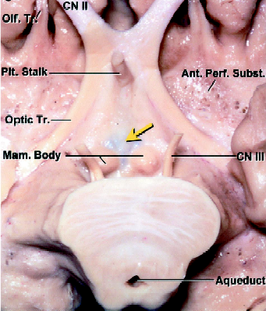

Slide 21
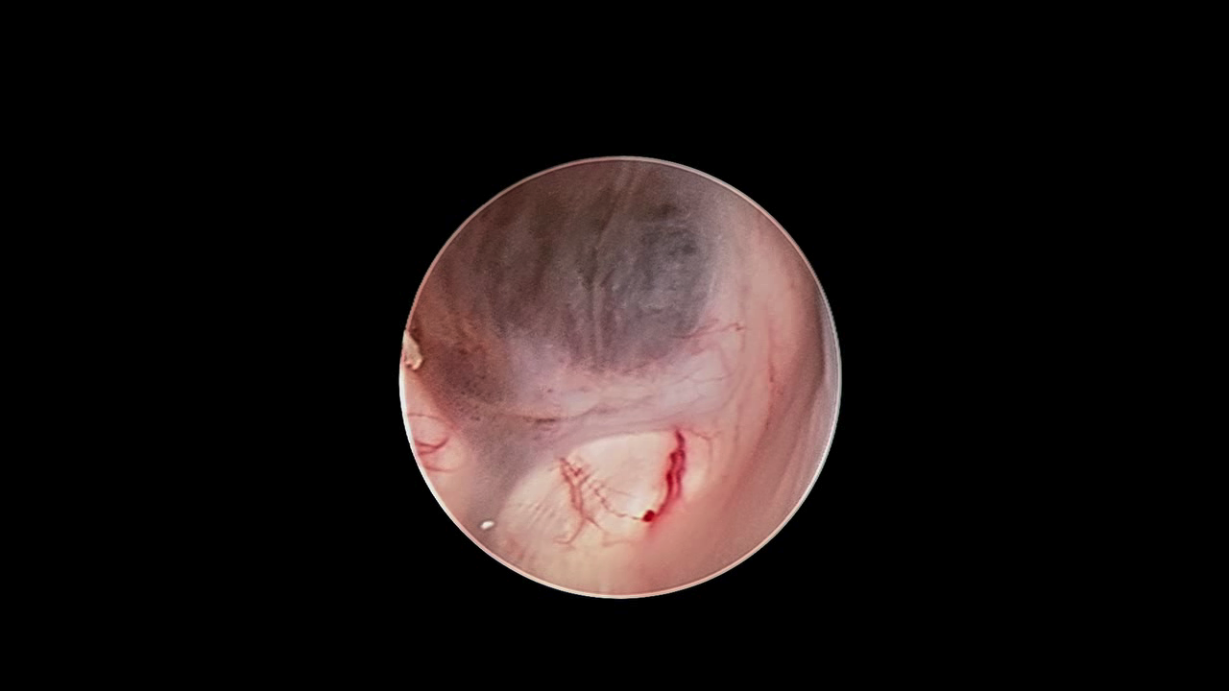
ETV

Slide 22
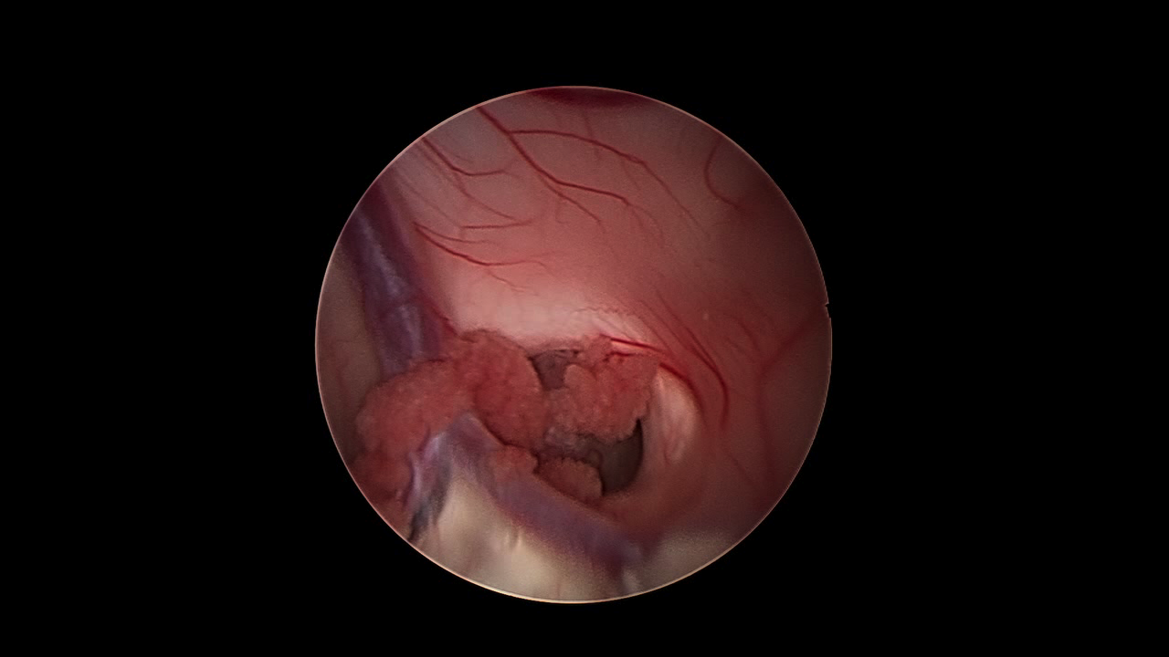
Colloid Cyst: Neuroendoscopic Approach

Slide 23
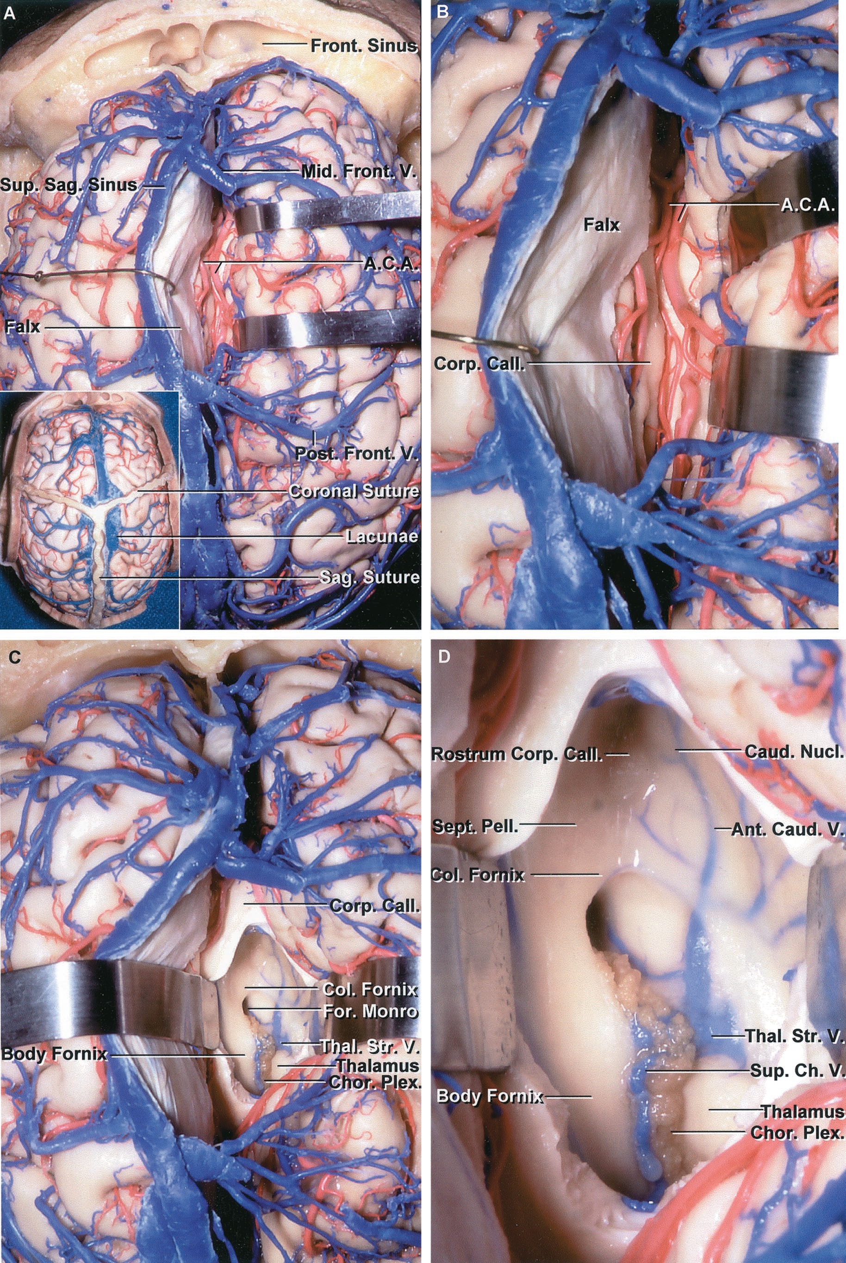
Interhemispheric Transcallosal Approach to the Lateral and Third Ventricles

